Slide 1
Occupational dyskinesia. Diseases of the peripheral nervous system. Diseases of the musculoskeletal system and connective tissue
Odessa National Medical University
Department of Occupational Pathology, Clinical Laboratory and Functional Diagnostics

Slide 2
Long-term overload of extremities by physical work
Working with vibrating tools

Slide 3
Long-term overload of extremities by physical work
  Heavy physical work
  Highly repetitive movements

Slide 4
The pathology, which is referred to diseases of locomotor apparatus, takes a rather considerable place among occupational diseases. First of all these conditions are connected with functional overstrains and microtraumatism.
They are met among blacksmiths, loaders, operatives of rolling patients, mine workers, typists, line-operators, pianists, insulation workers,etc.

Slide 5
Thus, the basic unfavorable factors in genesis of these diseases are both a high-gravity manual labor and a local loading and considerable static strain owing to motions of extremities that are multiply repeated, as well as
continuous stay in an enforced pose

Slide 6
Majority of this pathology syndromes are localized in the upper extremities, what is explained with large local loadings, significant amount of small stereotyped motions of hands and fingers of arms (in some trades they reach several tens thousand motions).
So, gravers of crystal only during one shift do up to 40 thousand press efforts in various positions of hands with considerable pressure of hands and forearms muscles.

Slide 7
Milkmaid fulf patients about 2500 compressions with fingers when milking only one cow during a day. Typist does above 60 thousand strokes on keys of type machine by fingers per one shift, and operators of accounting machines fulfill from 100 up to 200-250 thousand strokes with an effort at each stroke from 0.5 up to 1

Slide 8
These unfavorable factors are strengthened by enforced working
positions, continuous static strain of back and extremities muscles, nonobservance of operation and rest mode, irrational working methods (incorrect bearing of hands at musicians), microtraumatism of skin and its receptors, temperature drops, constant humidifying of hands by water, oils, emulsions and so on

Slide 9
Estimation of gravity and strain of labor process is carried out in accordance with «Labor hygienic classification». The І and II classes (they eliminate threat of development of occupational diseases) are considered as optimum and permissible.

Slide 10
Thus, such characteristics are standardized:
• power of dynamic work (W) at loading of muscles of the upper extremities should not exceed 45 W for men and 30.5 W for women, and at load of muscles of the lower extremities and trunk 90 and 63 W accordingly;
• weight of load that is lifted should not exceed 30 kg for men and 10 kg for women;
• quantity of hand and finger motions per one shift should not exceed 40000 small stereotype motions;

Slide 11
Classification.
The following occupational diseases conditioned by a functional overstress are marked.
1. Occupational dyskinesia (coordinator neurosis).
2. Diseases of peripheral nervous system: neuropathy, cervical shoulder plexopathy, cervical and lumbar-sacral radiculopathy, and lumbalgia.
3. Diseases of apparatus of resistance and motion:
а) illnesses of muscles (myalgia, myositis, myofascitis);
b) illnesses of fibrous-tissue and synovial formations (shoulder scapula periarthritis, epicondylitis,tendovaginitis, stenosing ligamentitis, contraction of palmar aponeurosis, and bursitis);
c) osteochondropathy (deforming arthrosis, spondylarthrosis, and bone aseptic necrosis);
d) combined syndromes.

Slide 12
Pathogenesis.
Mechanism of development of diseases conditioned by a functional overstrain is very complex and is not yet clarified to the end. If a pathogenesis of occupational dyskinesia is evaluated, it is considered that a continuous work, which demands doing of considerable amount of small motions of high coordination with a very fast speed, can cause an overstrain of nervous processes, lesion of cortex neurodynamics with formation of an isolated “ill nucleus” in certain department of motion analyzer

Slide 13
It results in lesion of complex motion stereotype, which is situated in foundation of strictly differentiated motions.
Besides, such factors, as emotional overload, dissatisfaction with job, often conflict situations at work and in a household provoke the development
of occupational dyskinesia.

Slide 14
High-gravity physical work, fulfillment of a great number of uniform motions is accompanied with traumatisation of peripheral receptors of a nervous pipe. Thus, lesions of blood circulation and metabolism, which lead to degenerative changes in peripheral nerves, arise.
Such factors as strains,compressions, infringement of nervous pipes in marrow or in muscle-binding channels, in particular in a working time that is carried out with permanently bent extremities also assist to development of these processes.

Slide 15
Lesion of blood circulation and metabolism develops also owing to accumulation in muscles of under oxidized products of exchange, changes of inflammatory nature in interstitial tissue and as a result of secondary degenerative lesions
of muscle fibers, which develops later.
The indicated processes as well as aseptic inflammation, which accompany them, can be developed in tendons, serous bags, periosteum, and cartilages of joints.
It results in development of such pathologic conditions, as periarthritis, tendovaginitis, bursitis, arthrosis and so on.

Slide 16
OCCUPATIONAL DYSKINESIA
Occupational dyskinesia takes a special place among all diseases conditioned by functional overstrain, as it is a functional disease of thecentral nervous system. For the first time, this disease was described as “writing spasm” in the middle of XIX century. The cause of its originating was connected with an intensive written work, as the disease was fixed at office employees and copyists. Later it turned out, that these phenomena of discoordination arise not only during writing, but also at many other kinds of job, which demand fulfillment of hard coordinated motions with fast speed.
Today occupational dyskinesia is described for gravers, knitters, graphic artists, draftsmen, fitters, milkers and milkmaids, musicians playing keyboard and string instruments

Slide 17
Clinic.
The disease arises gradually and develops slowly. Such clinical forms of this pathology are marked out: convulsive, paretic, atactic, shivering, neuralgic, and mixed. Increase of tone of hand small-sized muscles during occupational work is characteristic for the convulsive form.
So, persons, whose occupation involves writing, experience discomfort when writing of separate characters or digits, their handwriting becomes worse, and then cramps appear in one or several fingers during writing.

Slide 18
Sudden weakness in hands comes up at patients with paretic form of dyskinesia in time of working; fingers are relaxed involuntarily owing to what a worker can not hold in hands a pen, a pencil or other tool
A version of the paretic form is so-called atactic form of dyskinesia, which develops predominantly during work on a keyboard (typists, linooperators and pianists). Characteristic symptom of such disease is that an ill cannot touch the key, which is necessary to him/her.

Slide 19
At the shivering form of dyskinesia a tremor comes up predominantly in that hand, which is more loaded during fulfillment of this or that activity.
For the neuralgic form an occurrence of intensive pain is characteristic in muscles of hand, forearm or all arm during work-time.
Talk about the mixed form of occupational dyskinesia takes place in the event of presence of combination of several forms.

Slide 20
Diagnosis.
It is necessary to remember that the most typical symptoms of the occupational dyskinesia are selectivity with lesion only one function, which makes a basement of this or that occupational work: writing, typing on
a printing machine, playing on a musical instrument and so on.
Other motion functions of working hand can also suffer in the course of time.

Slide 21
Differential diagnostics.
The differential diagnosis of occupational
dyskinesia is carried out with hysterical paresis of hand, organic diseases of central nervous system, in particular with those that are accompanied by extrapyramidal and cerebellar lesions. Paresis of hand at hysteria develops usually quickly and is spread to all its functions.
The organic diseases of central nervous system are accompanied with intermediate symptoms and never are limited only with lesions of occupational functions of arm.

Slide 22
DISEASES OF PERIPHERAL NERVOUS SYSTEM
The given group of diseases includes lesions of separate nerves of spinal cord (ulnar, middle, small shank), polyneuropathy of the upper extremities, cervical - shoulder (plexalgy and plexopathy, lumbalgy, neck also lumbosacral radiculopathy).
A special place is taken by the so-called
tunnel syndromes (compressive neuropathy), which are developed owing to squeezing of ulnar, radial and other nerves with tissues, which surround them, and which have changed pathologically.

Slide 23
Neuropathy of an ulnar nerve is met most often owing to traumatism of the nerve during fulfillment of work, which demands supporting of elbow with table (carver, graver, engraver, and glassblower).
Patients complain of pain and paresthesia in a region of the fourth - fifth fingers. Strength and endurance of hand muscles are reduced owing to what they cannot hold in hands tool or detail that should be processed continuous time.
Hypesthesia is met on the fourth - fifth fingers and on ulnar edge of hand; hypotrophy of the fifth finger’s muscles arises. Patients cannot bring the fifth finger together with the fourth one.

Slide 24
Lesion of the middle nerve is characterized by that at patients early occurs paresthesia and pain in the second - third or in all fingers, in hand and forearm.
The pain is considerably strengthened at night, during cooling, at change of atmospheric pressure. Hands are cyanotic, wet.
Hypostasis of fingers, hyposthesia on palms, in particular on the first - third fingers and on back side of distal and middle phalanxes of the second - fourth fingers can be observed. In the course of time atrophy of muscles of the first finger’s rise develops, strength of hand’s compression is reduced.

Slide 25
The neuropathy of nerve of small shank develops at workers, which stand on knees or squat down during continuous time (parquet floor layers, roofers, workers of agriculture).

Slide 26
Vegetative-sensory polyneuropathy. Complains appear on an incipient stage of the disease: ache in bones and forearms, paresthesia in them (feeling of numbness, “crawling of insects”).
These feelings are strengthened during a change of atmospheric pressure, at cooling.
In the course of time pain and paresthesias strengthen, become constants, disturb patiend after work, at night, upsetting sleep.

Slide 27
Peripheral vegetative - vascular lesions
come up: hyperhidrosis, puffiness of distal phalanxes, change of skin coloration and hands temperature. Cyanotic color and invariable or heightened temperature, and paleness or marmoreal skin and hypothermia of hands at predominance of spastic phenomena are marked in case of paretic phenomena predominance in capillary tubes and vessels of small caliber.
Sensory lesions at vegetative
polyneuropathy decrease or hypesthesia takes place.

Slide 28
Surface sensitivity in process of development of a vegetative – sensory polyneuropathy is reduced according to polyneuritic type.
Expressiveness of peripheral vegetative - vascular lesions increases: edemas and hard movable properties of fingers, which are over or considerably decrease after beginning of work come up in the mornings.

Slide 29
Trophic lesions are often observed: hyperkeratosis of palms, change of form and frailness of nails, deformation of interphalanx joints.
Complain on weakness, fatigability, decrease of force in the upper extremities are joined in case of motive fibres retraction in pathological process.
Decrease of hands pressure force, hypotrophy of separate muscle groups of the upper extremities, decrease of tendon jerks are determined objectively

Slide 30
Lumbosacral radiculopathy is met at persons, whose work is connected which a considerable static-dynamic loading on lumbosacral area of vertebral column owing to frequent fulfillments, in particular to forced tilts
and trunk turns (operatives of rolling-mill, and lumberers), systematic lifting and transportation of hard loads (loaders, dockers, and carvers), continuous maintenance of forced pose (drifters, fettlers, miners), influence of general jerk similar vibrations (drivers of large trucks, tractor and combine operators). Overfreezing and temperature differences strengthen an effect of these factors

Slide 31
Steady pain in transversal - sacral region, in particular during trunk tilts and turns is marked at patients.
Decreasing of reflex of Achilles' tendon develops.
Weakness and hypotrophy of muscles of the front regions of shank develops gradually, in particular in a long extensor of large finger.
Knee reflex is reduced or disappears quite often.

Slide 32
DISEASES OF MUSCLES
These diseases are ones of the most widespread forms of occupational pathology conditioned with the functional overstrain.
They include two clinical syndromes: myalgia and myositis. These conditions are met at workers of the most different trades, whose jobs are connected with considered static-dynamic loading. First of all, builders, workers of brickworks and bread-baking plants, milkmaids, typist, pianists are among them.
Muscles of forearms are subjected to the affliction most often, muscle of shoulder less often.

Slide 33
Myalgia starts from sensation of discomfort, gravity, and strain in the according muscles. Speed of work is reduced, mechanical excitement of muscles and their bioelectric activity is increased. Strength and, in
particular, their endurance to static loads is reduced.
Myalgia is a functional stage of the disease. Condition normalization is already marked in some days of rest. At the same time a relapse of the disease with tendency to further progress down to development of degenerative – dystrophic also of secondary inflammatory changes in muscles is observed rather often at resumption of work.

Slide 34
Myositis is characterized with strengthening of pain and paresthesia in hands that cause patients to complain not only in working time, but also in periods of rest, especially at night.
The pain strengthens sharply during active motions. Speed of motions, productivity of work is reduced. The affected muscles become hard elastic, flabby, and atrophic. Very painful dense knots from 3-4 mm up to 2-3 cm are palpated in thickness of a muscle tissue.

Slide 35
DISEASES OF FIBROUS AND SYNOVIAL FORMATIONS
Such diseases as periarthritis, ligamentitis, epicondylitis, tendovaginitis, bursitis belong to diseases of peripheral ligaments or muscle fastenings.
Humeroscapular periarthritis as an occupational disease develops during fulfillment of work, which demands repetition of motions in a shoulder joint, in particular on a background of a considerable static-dynamic loading (bricklayers, plasterers, painters). The disease starts with pain in joints of shoulder at motion, raise, and rotation of shoulder.

Slide 36
With the course of time, the pain strengthens, becomes constant, crunching appears in joints at motion.
Limitation of motion in the joint increases gradually, especially at rotation and taking the shoulder aside. Taking an arm behind own back is considerably limited, and often it is impossible. Development of small mobility in the shoulder joint is possible later on. Pain comes up at palpation of a large knob of a shoulder bone, deltoid muscle less often, in particular in a place of its fixation to the shoulder bone.

Slide 37
X-ray research at periarthritis of shoulder joint demonstrates sclerotic change of a knob surface of a shoulder bone and availability of shades of calcareous deposits of different sizes, forms and density.
Multiple edge resorptions, which are surrounded by sclerotic process, and destruction of a large knob of a shoulder bone, saline deposits in a synovial bag are observed on a roentgenogram at this pathology most often.

Slide 38
Epicondylitis.
This disease is diagnosed at localization of an aseptic chronic inflammation and degenerative-dystrophic changes in a region of place of a node fixation of tendon of protractor-arch supporter group of muscles of forearms (lateral epicondylitis) or in a region of a medial node of fixation place of tendon of flexors of hand and fingers (medial epicondylitis).
The disease develops predominantly at persons occupied with high-gravity physical activity, and in case of fulfillment by them often protractor-bending and rotating motions in an ulnar joint (workers of agriculture, construction, blacksmiths)

Slide 39
Literal epicondylitis is characterized by appearance of ache in the region of a lateral node of shoulder bone during forced motions of a forearm and strained extension of a hand. In the course of time, the pain strengthens
and arises at any motions in an ulnar joint.
Soreness at palpation of the lateral node is a constant symptom.
A small swell occurs sometimes in this region. Unbending of forearm up to 160-170° for majority of patients is limited. Decrease of hand pressure strength is marked at all patients

Slide 40
Tendovaginitis.
This disease is characterized by lesion of a synovial membrane of tendinous vaginas of concomitant an aseptic (serose-haemorrhagic) inflammation. Tendovaginitis as an occupational disease develops mainly on the upper extremities, in particular as a result of fulfillment of a great number of motions with fingers,hands (insulator workers, bricklayers, winders, typist, and tailors).
A tendon of flexors and extensors of hand fingers are usually struck, tendon of a long head of shoulder biceps muscle, heel tendon is struck much less often.

Slide 41
Acute and chronic forms of the disease are marked according to their clinical developments.
Aseptic inflammatory process at acute tendovaginitis is accompanied by a fibrin deposit on a tendon surface and can be spread on cellular tissues around the tendon.
The process, which flows chronically, is
characterized by accumulation of exudation in synovial room. The exudation contains a lot of fibrin. At first from it the so-called rice corpuscles are formed, and then fibrinous adnations between parietal and visceral leaves of incrassate and loosened synovial membrane come in

Slide 42
Pathological process in case of chronic flow of the disease is developed most often in region of fingers flexors synovial vagina, which is arranged in a wrist canal.
The corresponding tendons are painful during a palpation, incrassated.
Swelling can be determined on a palmar surface of a radial carpal joint and distal part of the forearm. Pain and fluctuation takes place during its palpation. Force of this hand soon decreases.

Slide 43
Chronic tendovaginitis also develops gradually or is a consequent of a relapse of the crepitating tendovaginitis. Inflammatory reaction at this version of clinical flow of tendovaginitis is not expressed sharply, though it is
necessary to have in view that increasing phenomena of sclerotic process are resulted in a thickening of a synovial membrane, narrowing synovial room and lesion of tendons motions (so-called a stenosis form of tendovaginitis).

Slide 44
Occupational bursitis is a chronic inflammation synovial vaginas, which develops as a result of systematic pressure, overstrain and traumatism at mine workers, roofers, bricklayers, pavers, parquet floor layers, branchers, who are representatives of those trades, where continuous leaning on an elbow or a knee takes place with development of vagina aseptic inflammation and formation of serose-haemorrhagic exudation in it.
An inconvenient position, roughness of ground, imperfection of protective clothing, continuous cooling, abrupt change of ambient temperature, and vibrations assist the development of the disease.

Slide 45
Pathogenesis. Dystrophic changes in hollow of affected synovial bags with formation of numerous free bodies, which have chondroid density, arise under influence of prolonged pressure and rubbing near working surfaces of joints.
Sites affected with a sclerotic process, as well as liquid contents of the bags also experience a calcification. Loss of elasticity and thickening of the bags, fibrosis in the hypodermic basis, hyperplasia of walls of the synovial bags is an outcome of these processes.

Slide 46
Clinic. Bursitis acute (serous and purulent) and chronic (serous and proliferative) is distinguished. The acute bursitis is diagnosis less often, thanchronic.
At acute serous bursitis patients complain of morbidity in a joint, availability of intumescences of soft consistence and spherical shape. The skin has signs of hyperemia, local rise of skin temperature in this area is determined at contact, and limitation of mobility in the joint takes place. Content of the bag has serous nature. Body temperature at the purulent bursitis increases up to 39-40 °С.
Punctata of the bursa is purulent with large contents of leucocytes.

Slide 47
Chronic serous bursitis is met seldom. It is characterized by duration of flow, moderately expressed morbidity. Proliferate form is a widespread form of the chronic bursitis. Flow of the chronic bursitis of such form is lingering with periods of remissions and exacerbations; an infection contamination can be affixed often.
A fluctuation is determined locally, walls of the bags are incrassate, and an articular slot is reduced.
The Dupuitren’s syndrome is a fibrosis-degeneration of aponevrosis with formation of tendogenous contraction of the third - fifth
fingers in a site of the finger – phalange and proximal interphalangeal joints.

Slide 48
OSTEOCHONDROPATHIES
The types of osteochondropathies are arthrosis, spondylosis arthrosis, as well as aseptic neurosis of a bone.
Arthrosis. The occupational deforming arthrosis is developed at considerable dynamic and static loading on a joint. Concomitant vibration,
and also a plenty of motions, jerks make assistance to this pathology development. Representatives of such trades as bricklayers, loaders, blacksmiths, plasterers, painters, typists, pavers, parquet floor layers and so on are affected more often.
An elbow joint on the upper extremities is struck more often, a knee-joint on the lower extremities.

Slide 49
Aseptic necrosis of a bone.
It is an occupational disease, which is characterized by development of degenerative–dystrophic changes in supporting bones of a hand and foot, and also in bones of large joints of extremities, of the elbow one first of all.
A cause of their originating is an occupational chronic overload and micro traumatism of osteal structures during hard physical work, and influence of intensive local vibrations, in which spectrum a low- and mid-frequency vibration prevails. The pathological process develops more often in a fortnightly bone, which experiences the greatest loading from all bones of a radiocarpal joint

Slide 50
Treatment.
Main medical practice at the diseases caused by functional overstrains should include medicine drugs, physical and reflex methods.
Sedative drugs, tranquilizers, method of autogenic training, psychotherapy, electrosleep and balneotherapy are applied in the treatment. Drugs of antispasmodic effect and those influencing on condition of microcirculation. Vitamins B group (bromine thiamine, hydrochloride pyrodoxine, cobalamin cyanide), cocarboxylase, adenosine triphosphate, and biostimulants (aloe) are prescribed with the purpose of metabolic process normalization.

Slide 51
Ganglionic blockers: benzohexonium, Pachykarpin, spasmolytin (0.05-0.1 g three times a day), intravenous injections of 5 ml of 0.5 % Novocain solutions (10 injections per a course) are applied at presence of more expressed and steady changes.

Slide 52
Method of reflexotherapy and physiotherapy - electrophoresis 5 % of Novocain solution on hands, and ultrasound provides positive results.
Massage of a cervical - collar region, balneotherapy-radon and hydrosulphuric baths are recommended.
Treatment of the occupational radiculopathy is carried out with analgesics, non-steroid antiphlogistic drugs (Analginum 0.5 g, Butadion 0.25 g, Indomethacine 0.25 mg), neuroleptic drugs (Haloperidolum 1.5 mg triply per day), myorelaxants (Mydocalm 0.05 g, and Sibazone 0.5 mg during a day), injections of vitamins B group, biostimulants. Ultra-violete xposure, diathermy, radon and hydrosulphuric baths, massage used.

Slide 53
The treatment of diseases of muscles is the most effective in the incipient stage.
Application of ultrasonic sound, short-wave diathermy gives a positive result.
Medical gymnastics and massage have large value in treatment of myofascites. Intramuscular introducing of 5ml of 2 % Novocain solution per day during 10 days, vitamin В1 (30 mg per day during 15 days intramuscular) is recommended at presence of muscles sharp morbidity.
Warm baths with a subsequent massage of arms and shoulder girdle muscles are prescribed also.

Slide 54
Therapeutic measures at a periarthritis of the shoulder joint consist of mobilization, novocainic anesthesia, physiotherapy, including roentgenotherapy and treatment by ultrasound, punctures and washing of a
subacromial bag.
Analgin with Amidopyrin, electrophoresis
with Novocain are applied in the period of worsening.
Continuous immobilization of the shoulder joint is not recommended, as it can result indevelopment of hard mobility of the joint.

Slide 55
Treatment of epicondylitis of a shoulder in an incipient stage starts from immobilization of hand and forearm with a plaster bandage.
Hidrocortizon (from 5 up to 25 mg) every other day during 6 - 8 days inject in a region of the node. The novocainic blockade of the region of the node gives positive results. The course of the treatment consists of 3 to 4 blockades with
an interval of 5 days with a simultaneous immobilization of an extremity.
Dyadynamic therapy and paraffin applications on the region of the elbow joint (in 3-4 weeks after the immobilization) are effective physiotherapeutic procedures.

Slide 56
Treatment of tendovaginitis foresees a dismissal of the ill from work, a prescription of Novocain blockades in the forearm region (8-10 ml of 0.5 % solution) and imposing of a plaster bandage.
Warm, UHF therapy, paraffinic applications (4-6 performances) are prescribed from the 3 - 4-th day.
The plaster bandage is removed on the 7 - 8-th day, the volume of motions with the hand and fingers is increased.

Slide 57
Verification of the ability to work.
It is possible to conduct the treatment of the ill with presence of a myalgia, vegetative polyneuropathy,serous bursitis ambulantly with a shift of the patient on an easier work for the period of two weeks according to a medical board recommendation.
It is necessary to dismiss the patient from work at other forms of the pathology:
for 5-6 days at myalgia with a pain syndrome and lumbalgia, for 2-3 weeks if there is polyneuropathy, myositis, tendovaginitis with crepitation,epicondylitis, for 3-4 weeks at a humeroscapular periarthritis, arthrosis, aseptic necrosis of a bone

Slide 58
Patients are transferred to easy work under conditions, which eliminate traumatic effect, for the term from 10 till 14 days at myalgia,tendovaginitis, and from 4 till 6 weeks at other conditions of this pathology for strengthening of the treatment results. After that a sanatorium treatment is recommended.
Development of dystrophic changes, often relapses, development of a course of pathological process, presence of the steady pain syndrome, steady
lesion of the function are a basis for a training for a new profession of ill and its rational job placement that is not connected with effect of the functional overstrain. Patients are sent to medical board for a solution of the problem of the degree of disablement (1-2 years) in case of proficiency lowering due to change of the working place. And the group of physical inability can be
established at a steady decrease of functional capacities of ill (aseptic necrosis of wrist bones).

Slide 59
Preventive measures. Complex mechanization of the most hard works and those operations, which demand fulfillment of a huge number of stereotyped motions with hands and fingers, is the most effective mean
among preventive measures for warning of unfavorable effect of functional overstrain. Correctly organized operating mode and rest, gymnastics on a
working place, massage and warm baths for hands, prophylactic vitaminization and general ultra-violet lighting, which are carried out in autumn and spring, have also important value.
Particular value in preventive measures of these diseases alongside with occupational selection is given to periodic medical examinations, which are
carried out once every two years with participation of a doctorneuropathologist, surgeon, gynecologist, and therapeutist.

Slide 60
Occupation-Related
Compressive Neuropathies

Slide 61
Upper extremities
  Median nerve
    Pronator teres syndrome
    Carpal tunnel syndrome

Slide 62
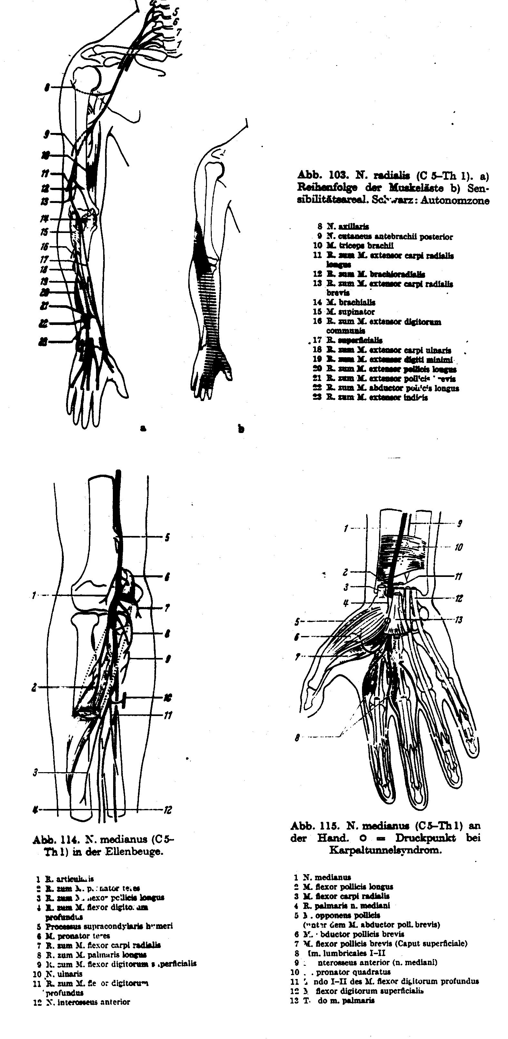

Slide 64
Upper extremities
  Median nerve
    Pronator teres syndrome
    Carpal tunnel syndrome
  Ulnar nerve
    Cubital tunnel syndrome
    Canalis Guyoni syndrome

Slide 65
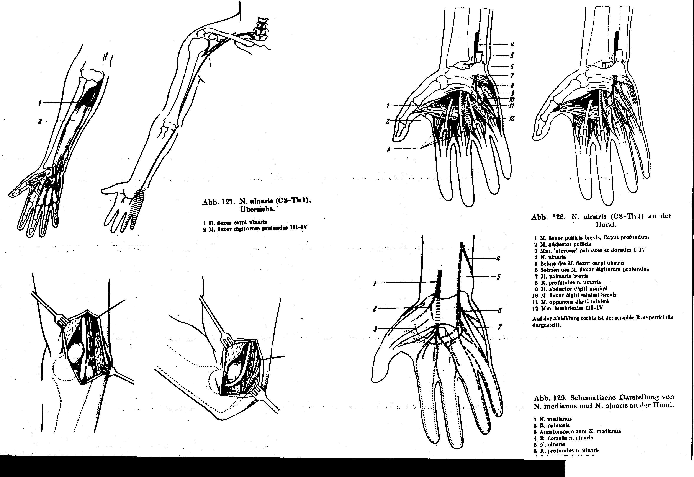

Slide 67
Upper extremities
  Median nerve
    Pronator teres syndrome
    Carpal tunnel syndrome
  Ulnar nerve
    Cubital tunnel syndrome
    Canalis Guyoni syndrome
  Radial nerve
    Supinator syndrome

Slide 69
Upper extremities
  Median nerve
    Pronator teres syndrome
    Carpal tunnel syndrome
  Ulnar nerve
    Cubital tunnel syndrome
    Canalis Guyoni syndrome
  Radial nerve
    Supinator syndrome
Lower extremities
  Fibular nerve

Slide 70
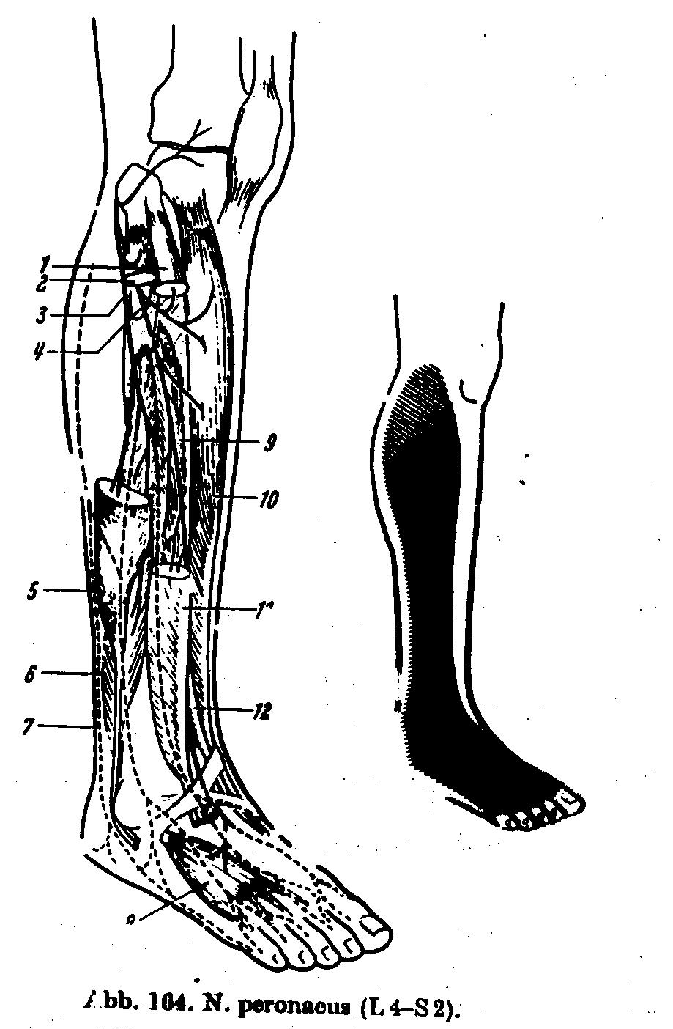

Slide 71
Upper extremities
  Median nerve
    Pronator teres syndrome
    Carpal tunnel syndrome
  Ulnar nerve
    Cubital tunnel syndrome
    Canalis Guyoni syndrome
  Radial nerve
    Supinator syndrome
Lower extremities
  Fibular nerve
  Tibial nerve
    Tarsal tunnel syndrome

Slide 72
Carpal Tunnel Syndrome

Slide 73
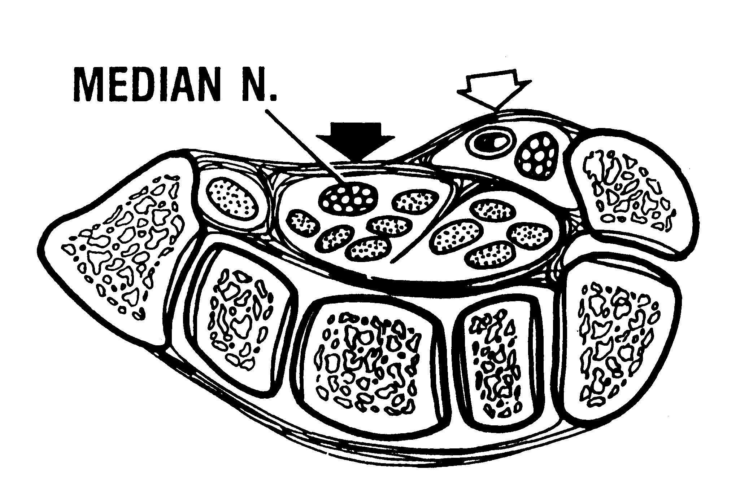

Slide 74
Etiology of Carpal Tunel Syndrome
Endogenous factors
  Inflammation
    Tendinitis
    Dermatomyositis
  Endocrinological changes
    Pregnancy
    Birth control pills
    Ovarial hypofunction
    Hypothyroidism
  Metabolic changes
    Diabetes mellitus
    Gout
Exogenous factors
  Post-traumatic changes
  Manual work

Slide 75
Types of Occupational Activities
Related to CTS
Static overload due to forceful and repetitive contraction of flexor muscles in the forearm
  Examples: working with a hammer or grinder, manipulating heavy loads
Stereotyped repetitive flexion-extension of fingers
  Examples: manual cow-milking, typing, playing musical instruments
Activities involving pinching, screwing etc.
  Examples: clockmakers, minute work
Direct pressure on the wrist
  Examples: dentists, bikers, working with scissors

Slide 76
Subjective Symptoms of CTS
Numbness upon awaking
Nocturnal paresthesiae (“Brachialgia paresthetica nocturna”)
Daily paresthesiae
Clumsy hand movements

Slide 77
Objective Signs of CTS
Hypesthesia in the distal median area

Slide 78
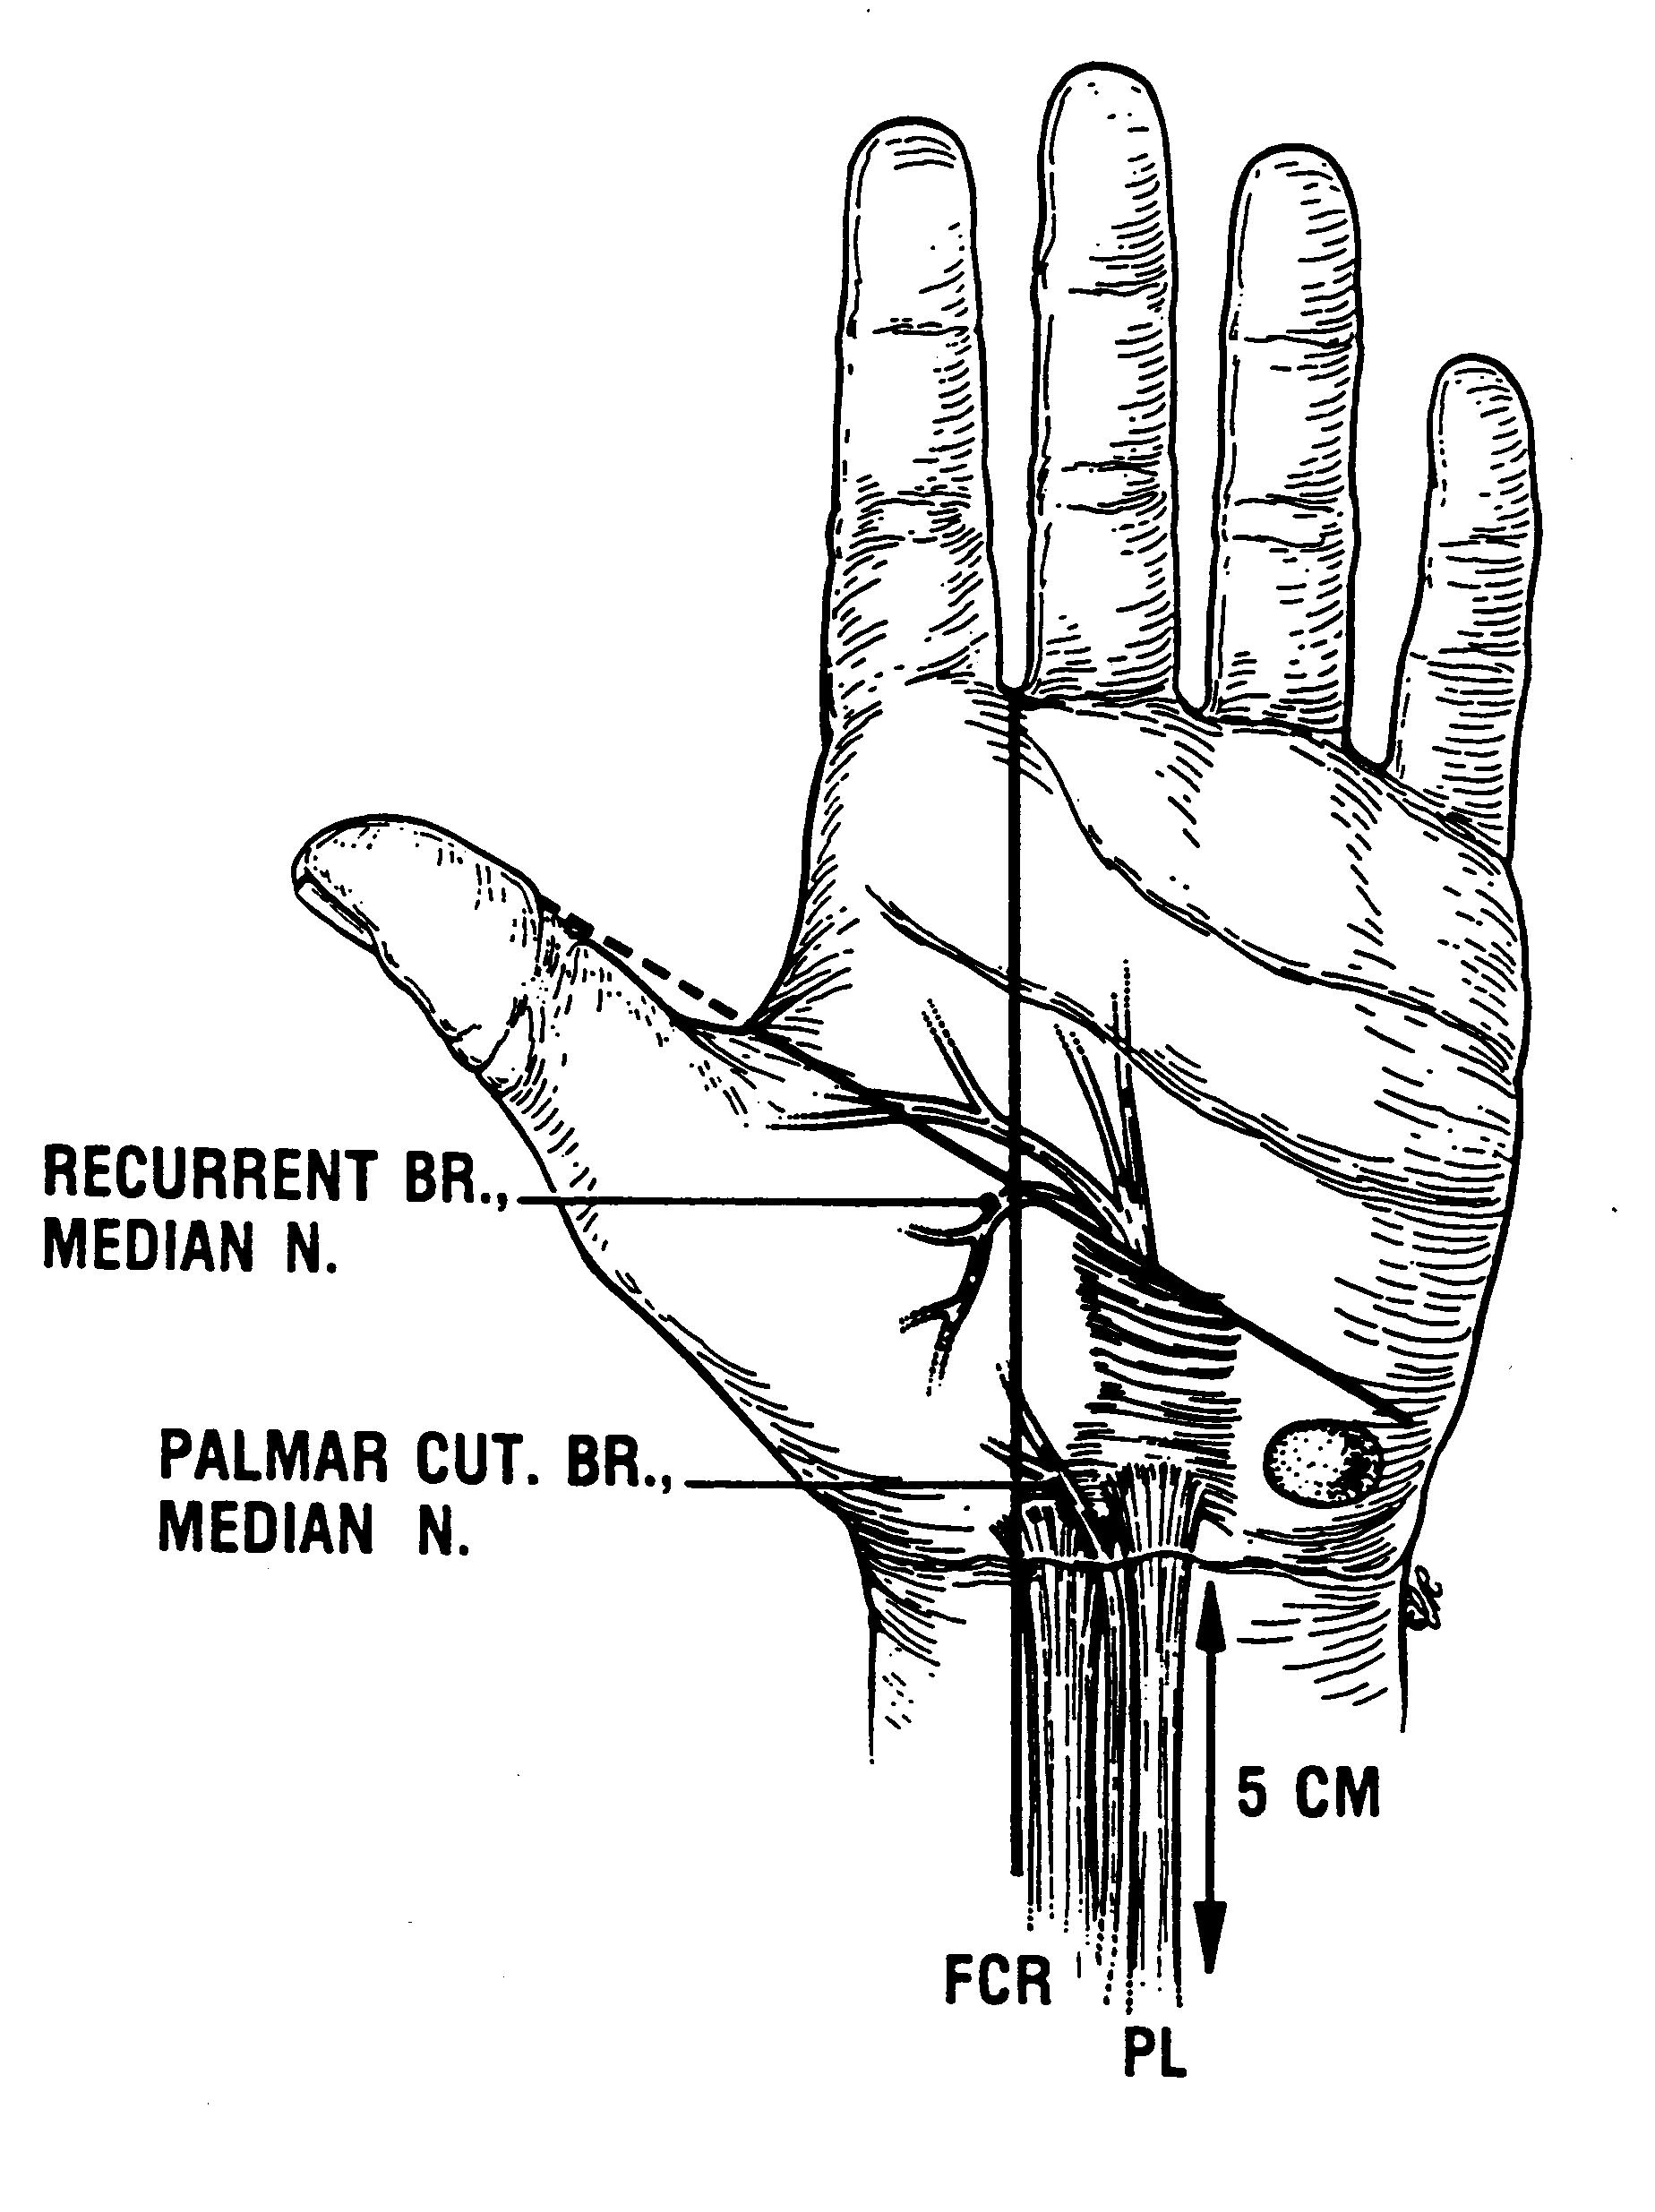

Slide 79
Objective Signs of CTS
Hypesthesia in the distal median area
Weakness of the abductor pollicis brevis muscle
Muscle and skin trophic changes
Local findings
  Punctum dolorosum
  Pseudoneuroma

Slide 80
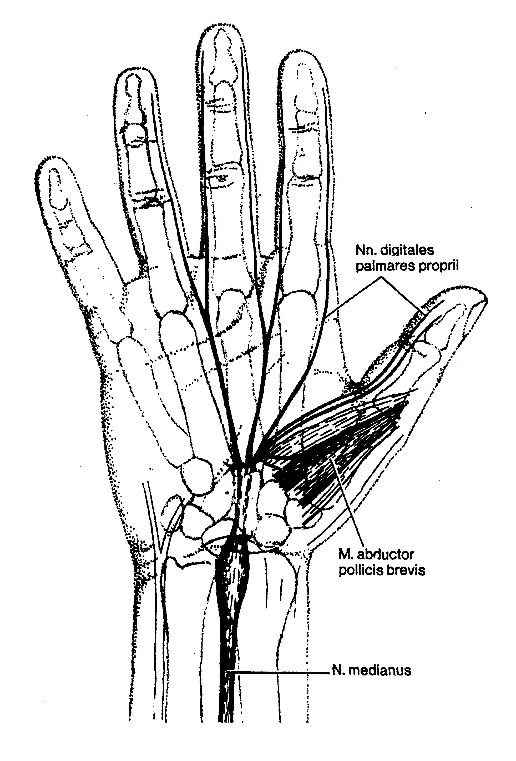

Slide 81
Objective Signs of CTS
Hypesthesia in the distal median area
Weakness of the abductor pollicis brevis muscle
Muscle and skin trophic changes
Local findings
  Punctum dolorosum
  Pseudoneuroma
Provocative tests
  Tinel’s sign
  Phalen’s sign (Flexion test)
  Extension test
  Elevation test
  Digital compression test

Slide 82
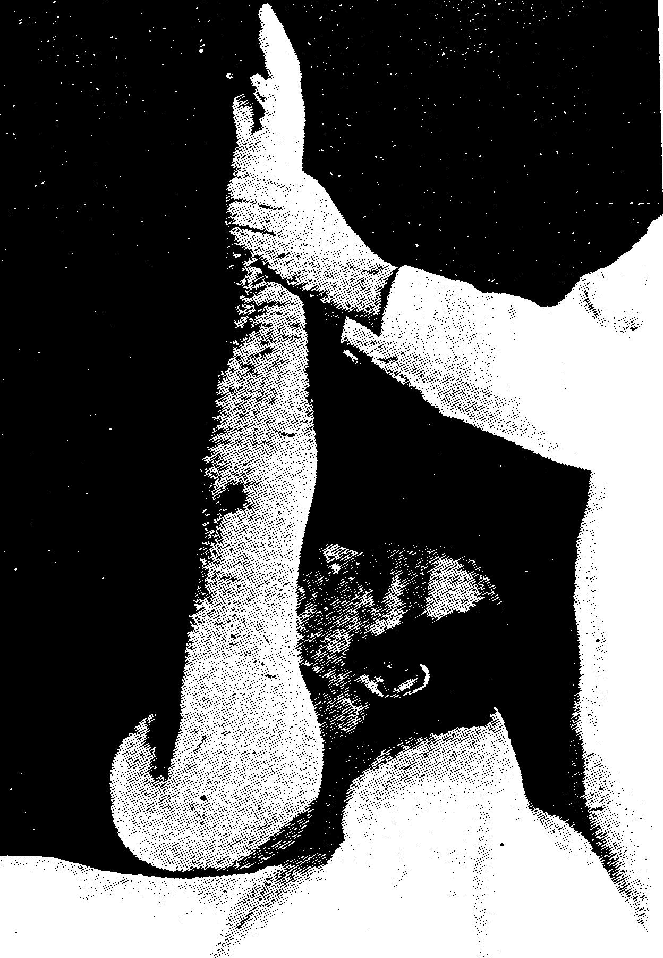

Slide 83
Laboratory Diagnostic Tests for CTS
X-ray examination
CT, NMR
Quantitative sensory testing
Nerve conduction studies
Needle electromyography

Slide 84
Electrophysiological Criteria for “Medium Severe” CTS
(1) Median sensory nerve conduction from the wrist to digit II or III ≤ 38 m/s or absent SNAP.
(2) Normal ulnar distal motor latency and sensory conduction velocity to digit V.
(3) Median distal motor latency ≥ 5.3 ms or absent CMAP.
(4) Persistently abnormal spontaneous activity on the needle EMG of the abductor pollicis muscle.
Conditions (1) and (2), and (3) or (4) must be met. (1 & 2) & (3 or 4)

Slide 85
Differential Diagnosis of CTS
Proximal median neuropathy (pronator teres syndrome)
Brachial plexopathy (upper trunk)
Thoracic outlet syndrome
Cervical radiculopathy (especially C6)
Polyneuropathy

Slide 86
Treatment of CTS
Removal from exposure
Splinting of the wrist
Vasoactive drugs
Nonsteroidal anti-inflammatory drugs
Local application of corticosteroids
Surgery

Slide 87
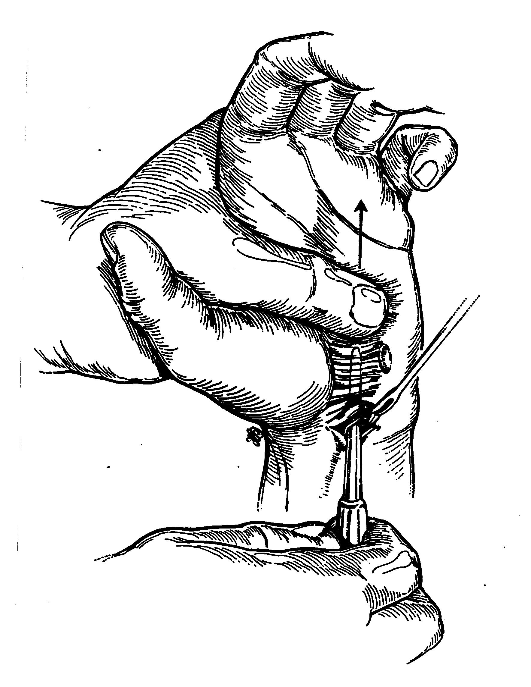

Slide 88
Occupational Compressive Neuropathies in the Lower Extremities
Compression of the Fibular nerve
  Examples: potato-lifters, miners, pavers, carpetlayers
Tarsal tunnel syndrome (Tibial nerve)
  Examples: ballet dancers, jockeys, long-distance runners

Slide 89
PNS Damage Caused by
Working with Vibrating Tools
Mononeural lesion
  Pathophysiological mechanism: compressive neuropathy
  Most frequently - CTS
Bineural lesion
  Pathophysiological mechanism: ischemic neuropathy
  Both the median and ulnar nerves damaged
  Frequent association with vibration white fingers

Slide 90
Occupational Cramps
Synonyms
  Occupational spasms
  Occupational neuroses
Examples
  Graphospasm
  Telegraphist’s cramp
  Trumpeter’s mouth
  Horn player’s torticollis
Pathopysiology
  Focal dystonia?
  Psychogenic origin?
Treatment
  Behavioral techniques
  Botulinum toxin injections

