Slide 1
BASIC PRINCIPLES AND MODERN METHODS TREATMENT OF
PATIENTS
WITH TUBERCULOSIS

Slide 2
BASIC PRINCIPLES OF TREATMENT PATIENTS WITH TUBERCULOSIS
1. Early or, as a minimum , timely Treatment – treatment should begin immediately after the patient is diagnosed with tuberculosis.
2. Long-term treatment – treatment until the cessation of bacterial excretion, healing of cavities, resorption of infiltrates and densification of foci.

Slide 3
3. Continuous treatment – regular intake of drugs according to the prescribed chemotherapy regimen. Continuous treatment reduces the frequency of development of MBT resistance to drugs.
4. Consistency and continuity in treatment at different stages – using a specific initially prescribed therapy regimen at all stages – inpatient, sanatorium, outpatient.
5. Comprehensive treatment – involves the use of various means and methods: etiotropic, pathogenetic and symptomatic therapy, surgical and collapsotherapeutic methods, physiotherapy, hygiene and dietary regimen.

Slide 4
6. Combination treatment – the use of at least 4 drugs at the beginning of treatment of all patients.
Combination therapy prevents the development of MBT resistance to anti-tuberculosis drugs, enhances the antimycobacterial effect, i.e. different drugs act on different structures of the mycobacterial cell, and contributes to a longer preservation of high concentrations of drugs in the blood and tissues.

Slide 5
7. Individual approach before treatment – treatment is based on taking into account the sensitivity of MBT to anti-tuberculosis drugs, the tolerability of drugs by the patient, and the presence of concomitant diseases. An individual approach involves making changes to the chemotherapy regimen drawn up at the beginning of treatment in the event of the development of MBT resistance to a particular antimycobacterial drug or the development of toxic or allergic complications of chemotherapy.

Slide 6
8. Two-phase treatment ensures a significant reduction in the MBT population in the intensive phase of treatment and clinical cure of the patient in the maintenance phase.
9. Controlled chemotherapy – taking drugs in the presence of medical workers, social workers, volunteers. The purpose of controlled chemotherapy is to ensure regular intake of drugs.
10. Treatment of tuberculosis patients must be free , accessible and safe .

Slide 7
The basis for the treatment of tuberculosis patients is the use of drugs with antimycobacterial action - ANTI-TUBERCULOSIS DRUGS .
Currently, about two dozen anti-TB drugs are used in Ukraine.
The most common classification of anti-TB drugs is the International Union against
Tuberculosis and Lung Diseases.
According to this classification,
5 groups of drugs are distinguished.

Slide 8
Group 1
First-line oral anti-tuberculosis drugs
Group 2
injectable anti-tuberculosis drugs
Isoniazid ( H),
Rifampicin ( R),
Ethambutol ( E),
Pyrazinamide ( Z) –
active in relation to the Office of the Ombudsman,
which are localized extracellularly and intracellularly,
well tolerated, used for the treatment of chemotherapy-sensitive tuberculosis
Streptomycin ( S) ,
Kanamycin ( Km) ,
Amikacin ( Am) ,
Capreomycin ( Cm) –
active in relation to the Office of the Ombudsman,
which multiply rapidly and are localized extracellularly,
have a bacteriostatic effect

Slide 9
Group 3
fluoroquinolones
Group 4
oral second-line anti-tuberculosis drugs with
bacteriostatic effect
Ofloxacin ( Ofx),
Levofloxacin ( Lfx),
Moxifloxacin ( Mfx),
Gatifloxacin ( Gfx)
have a strong bacteriostatic and slightly pronounced bactericidal effect,
Cross-resistance between different fluoroquinolones develops much less frequently than with aminoglycosides
Ethionamide ( Et),
Prothionamide ( Pt),
Cycloserine ( Cs),
Terizidone ( Trz),
Para-aminosalicylic acid
( PAS)
have a bacteriostatic effect, less effective than drugs of groups 1 and 3

Slide 10
Group 5
anti-tuberculosis drugs of uncertain efficacy
Clofazimine ( Cfz) ,
Amoxicillin clavulanic acid ( Amx/Clv) ,
Clarithromycin ( Clr) ,
Linezolid ( Lzd)
enhance the effectiveness of other PTPs,
good in vitro activity has been established
(but little evidence of a distinct effect in vivo)
Depending on the stage of use in treatment regimens, anti-tuberculosis drugs are divided into 2 groups:
First-line (main) – isoniazid, rifampicin, ethambutol, pyrazinamide;
Second-line (reserve) – ethionamide, kanamycin, amikacin, capreomycin, PASK, fluoroquinolones and all others.

Slide 11
When prescribing anti-tuberculosis drugs, it is necessary to take into account their antimycobacterial activity and ability to diffuse into various organs and tissues of a person.
Isoniazid, rifampicin, rifabutin act on MBT bactericidally , other drugs - bacteriostatically .
Rifampicin, rifabutin, isoniazid, pyrazinamide, prothionamide, ethambutol penetrate well into the lung tissue, tuberculous foci, caverns, tuberculomas, caseous lymph nodes; streptomycin, kanamycin, florimycin, PASK, thioacetazone - weakly.

Slide 12

The MBT population in the patient's body exists in several states
( Mitchison D. A. , 1985 ) :
1) extracellularly located active mycobacteria, which are affected by all anti-tuberculosis drugs;
2) intracellular mycobacteria, which are divided into:
- actively spreading MBT (they are affected by
isoniazid, rifampicin, ethambutol, ethionamide,
prothionamide, fluoroquinolones);
- MBTs that persist and periodically intensify their
metabolism (their growth is inhibited by isoniazid, ethambutol,
rifampicin, ethionamide, prothionamide, fluoroquinolones);
- persistent MBT (they are affected by pyrazinamide
ethionamide, prothionamide, fluoroquinolones);
- inactive MBT (drugs do not act on them).

Slide 13
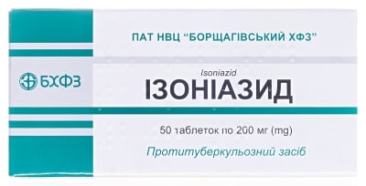
Pharmacological characteristics of antimycobacterial drugs
Isoniazid (N) is nicotinic acid hydrazide (NICA).
of drugs also includes flurenizide, metazide, ftivazide, saluzide .
Isoniazid is the most active bactericidal drug, acts on MBT, which multiply fast and slow , localized extracellularly and intracellularly .
In the Office of its 50 times concentration higher ,
than in the surrounding The drug reduces the synthesis of
endogenous MBT
catalase , which leads to termination their growth and reproduction , loss virulence .

Slide 14
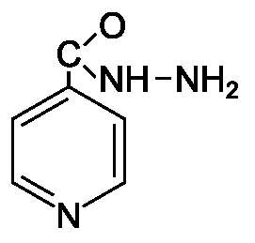
Isoniazid is well absorbed, penetrates well into tissues and caseous foci.
Release forms. Tablets of 0.1, 0.2 and 0.3 g,
10% solution for intravenous and intramuscular administration in ampoules of 5 ml.
Application. It is more often taken daily, and also in intermittent mode – every other day.
Daily dose 5-15 mg/kg (0.3 mg for adults ).
Side effects: Paresthesia, peripheral neuritis , psychosis, dizziness, euphoria, palpitations , liver dysfunction , hepatitis, blood microcirculation disorders, toxic-allergic reactions.
If adverse reactions occur, a course of vitamin B6 _{and} hepatoprotectors are prescribed.

Slide 15
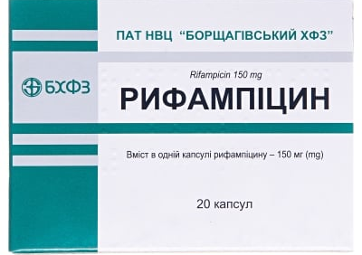
Rifampicin ( R) – semi-synthetic broad- spectrum antibiotic .
Inhibits activity of DNA- dependent RNA polymerase in susceptible MBT . They act on microorganisms ,
What placed extracellularly and intracellularly .
In the fires damage forms concentration ,
that 100 times exceeds minimal inhibitory concentration for the Office.
Quickly and completely absorbed into the blood, then enters the liver and along with bile is secreted into the intestines and reabsorbed into the blood.
In the liver is happening biotransformation with the formation of metabolites that​ keep antimycobacterial activity .

Slide 16
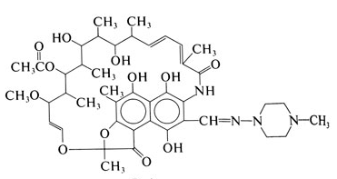
Rifampicin is able to accumulate in lung tissue and maintain a concentration in the cavities for a long time.
Release forms: 150 and 300 mg capsules,
wafer tablets of 450 and 600 mg.
Dosage: 450-600 mg/day once in the morning after
30-60 minutes before breakfast daily or 3 times a week;
fatty meals reduce blood levels of rifampicin. Daily dose 10 mg/kg (0.6 mg/day for adults)
The duration of treatment is not limited.
Adverse reactions : Toxic hepatitis, thrombocytopenia, anaphylactoid and allergic reactions, leukopenia, deep vein thrombosis, myalgia, arthralgia, dyspeptic phenomena. It is a potentially nephrotoxic antibiotic .

Slide 17
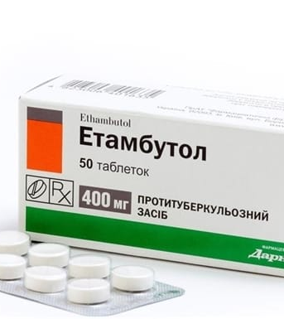
Ethambutol (E) is a synthetic drug, active in relation to the Office, which located extracellularly and intracellularly and multiply .
Brakes development resistance to others drugs . Depresses reproduction of MBT, disrupting RNA synthesis, structure ribosome and biosynthesis protein .
Ethambutol quickly absorbed mycobacteria ,
its intracellular concentration is 2 times higher concentration in the environment .
Quickly absorbed from the gastrointestinal tract, long circulates in the blood due to deposition in erythrocytes . Excreted kidneys in unchanged form in the form and in the form metabolites .

Slide 18
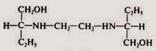
Release form: Tablets of 100, 200, 400, 600 and 800 mg.
Application. Before prescribing, it is necessary to check visual acuity, visual fields and color perception.
Prescribe at the rate of 15-25 mg/kg, for adults -
1.2 g once daily, in the morning after breakfast.
Food intake does not significantly alter the absorption of the drug.
Adverse reactions. May cause visual field restriction, scotoma formation, red and green color blindness, retrobulbar neuritis with vision loss. Possible neurological disorders - headache, paresthesia, increased number of epileptic seizures, peripheral neuritis.

Slide 19
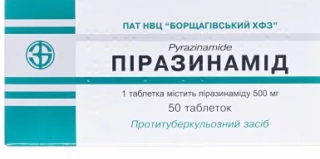
Pyrazinamide ( Z) – synthetic antimycobacterial drug, effective of intracellular and extracellular MBT. Active in acidic environment caseous masses and foci sharp inflammation .
Inhibits the synthesis of short -chain fatty acids , which are precursors of lipids cellular walls of the office.
Especially effective in the first 2 months treatment .
Quickly absorbed from the gastrointestinal tract
and penetrates everything​ tissues and fluids organism .
The metabolism of the drug occurs mainly in the liver .
About 70% of products metabolism are excreted in the urine.

Slide 20
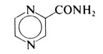
Release form: Tablets of 400, 500 and 750 mg.
Usage: The daily dose for adults is
1.5-2.0 g, daily in the morning, after meals.
It is possible to take 2 times a day.
Side effects: Causes hyperuricemia (accumulation of uric acid in the blood), accompanied by arthralgia and myalgia.
Hepatotoxic and toxic-allergic reactions are possible.

Slide 21
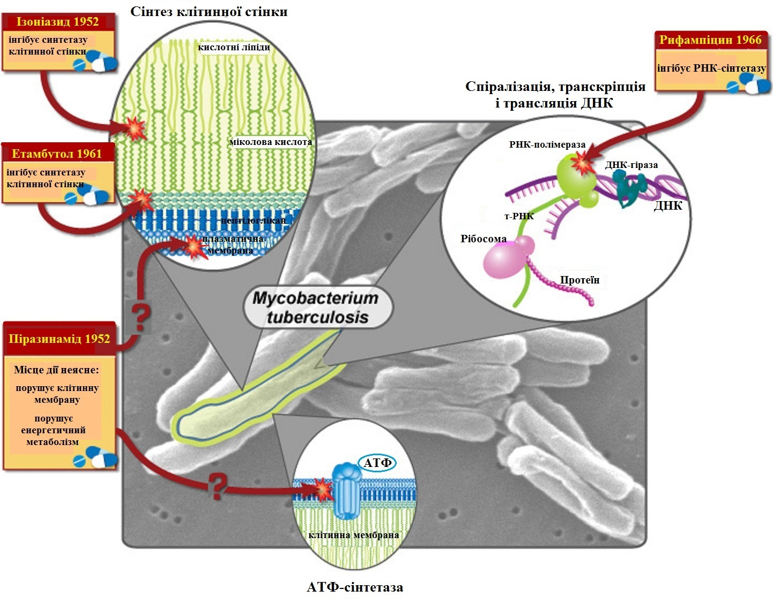
Mechanisms of action of first-line drugs
First-line drugs have different mechanisms of action,
that when used simultaneously
increases the effectiveness of therapy.

Slide 22
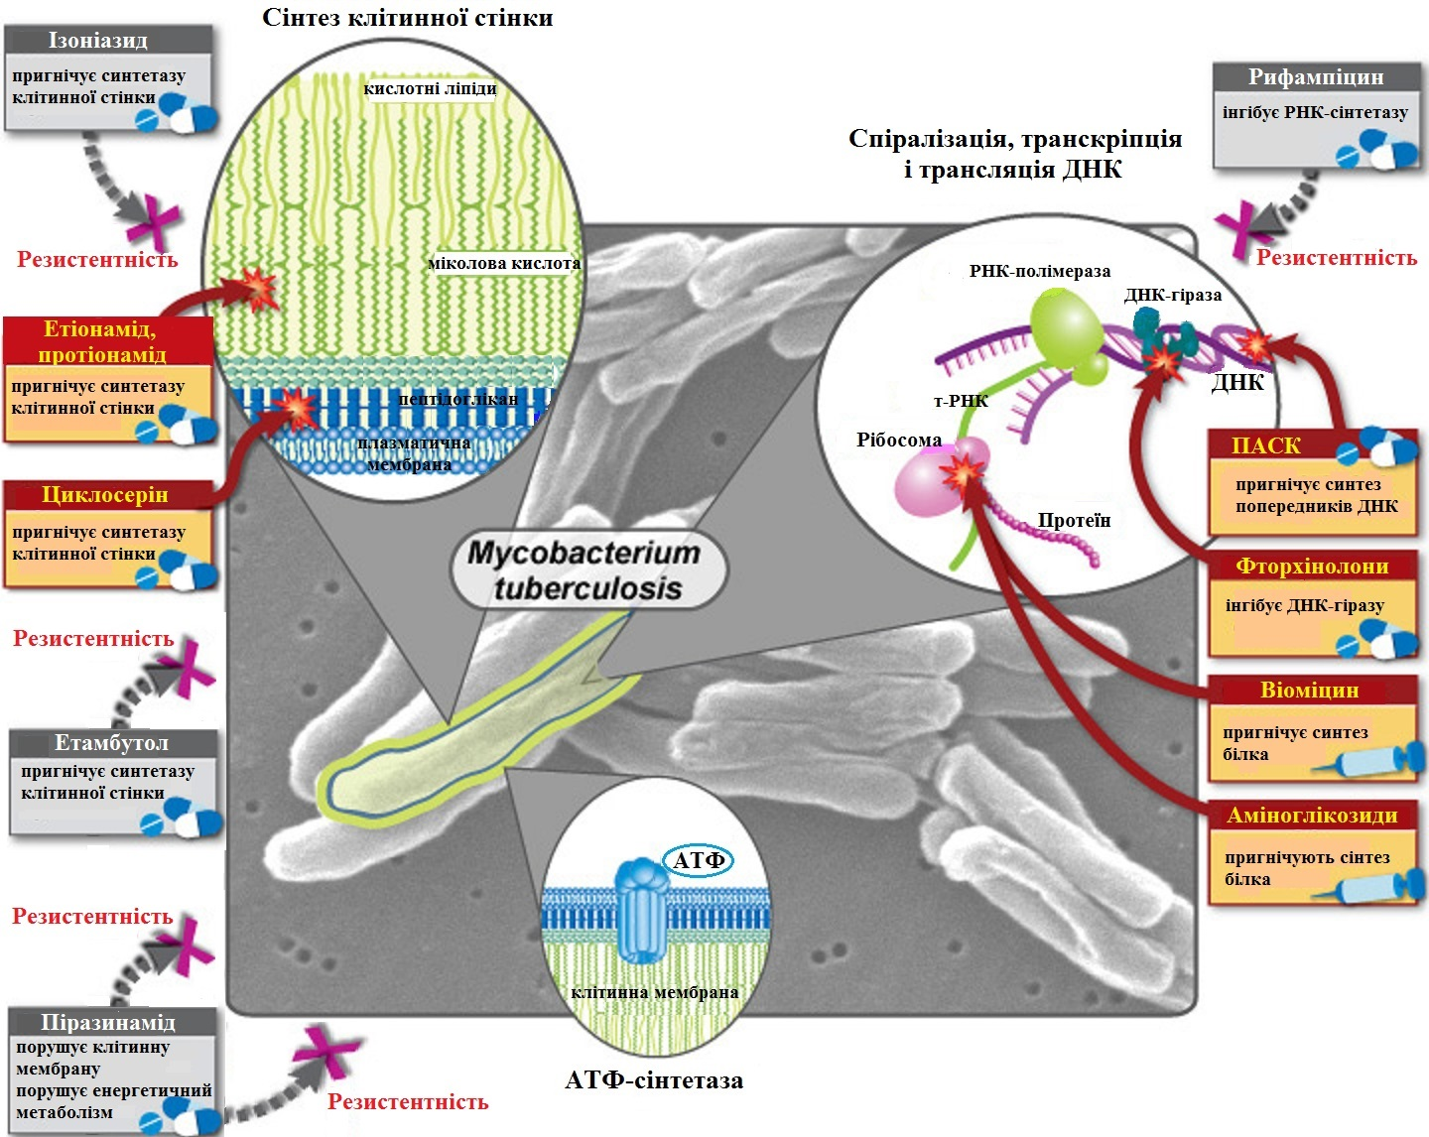
Mechanisms of action of second-line drugs
When resistance to first-line drugs develops, reserve drugs are used,
which have slightly different mechanisms of action.

Slide 23
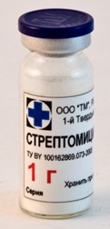
Streptomycin sulfate ( S) is a broad-spectrum antibiotic , an aminoglycoside that interferes with the processes of protein synthesis in bacterial cells. It is most effective in cases of severe exudation.
Not indicated for encapsulated processes, stimulates the development of connective tissue in the lungs. Unable to penetrate through the cell wall, through the meninges and pleura, provided that there are no inflammatory changes in the tissue.
Active against MBT, which multiply rapidly and are localized extracellularly, reaching bactericidal concentrations in tuberculous cavities.
not absorbed from the gastrointestinal tract, it is administered intramuscularly.
Up to 50% of streptomycin is protein bound. The drug-protein complex is inactive.

Slide 24
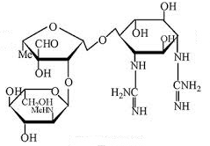
Microbiologically significant concentrations of the drug are created almost everywhere, except in the brain. A significant amount of streptomycin enters the pleural fluid and
cavities in the lungs. Penetration into caseous foci and areas with pronounced fibrosis is insignificant.
Release form. Dry substance for injection in vials
of 0.5 and 1 g for intramuscular administration.
Application. 1 g intramuscularly (in sodium chloride solution or novocaine) 1 time per day.
Before prescribing, audiometry and assessment of glomerular filtration rate are mandatory.
administered by inhalation and endotracheally.
The permissible duration of use is up to 2 months.

Slide 25
Side effects. May affect V and III pairs of cranial nerves (otovestibulotoksichny – decreased hearing acuity, unsteady gait, instability in Romberg’s posture), often causes allergic reactions, with prolonged use – reduces immunity .
Has hepatotoxic and nephrotoxic effects, causes coronary artery spasm, increased blood pressure.
With prolonged use, may cause reticular fibrosis of the lungs, suppression of immunity.
Not indicated in the treatment of tuberculosis in pregnant women.

Slide 26
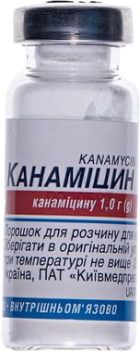
Kanamycin sulfate ( K) is a broad-spectrum aminoglycoside antibiotic . It causes disruption of MBT protein synthesis .
In an acidic environment its activity insignificant . Effective regarding the Offices located extracellularly
and what quickly multiply .
Penetrates into the lungs , pleural liquid .
Release form . Vials with dry substance for injection of 0.5 and 1 g, tablets of 0.125 and 0.25 g.
and capsules of 0.5 g .
Application . Kanamycin sulfate for intramuscular injection administration of 1 g once/day daily .
Side effects reactions . Ototoxic , nephrotoxic actions , causes allergy , microhematuria , albuminuria .
The drug is contraindicated pregnant women .

Slide 27
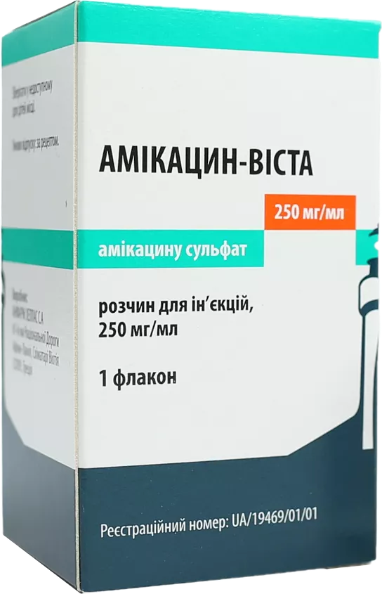
Amikacin ( Am) is an aminoglycoside . It actively penetrates the cell membrane and is irreversibly binds to receptor proteins on the ribosomal subunit .
Active relatively M. tuberculosis and some​ atypical mycobacteria ; detects bacteriostatic action on
M. tuberculosis resistant to streptomycin and other antibiotics .
Release form : Solution in 2 ml ampoules, which contain 100 mg or 500 mg of amikacin sulfate.
Application . Daily dose 1.0 g intramuscularly / intravenously (15-20 mg/kg).
Side effects reactions : Paresthesia , convulsions , tremor , neuromuscular disorders transmission , psychosis, otovestibulotoxicity , arterial hypotension , leukopenia , thrombocytopenia , nausea , diarrhea , dysbacteriosis , increased activities hepatic transaminases , hyperbilirubinemia , renal deficiency , allergic reactions .

Slide 28

Capreomycin ( Cm) – in iberkovo active of M. tuberculosis , which localized outside and inside cells .
Inhibits protein synthesis in bacteria cell , has bacteriostatic action . In monotherapy quickly causes appearance resistant strains ; noted cross resistance to kanamycin , viomycin , in some in cases to amikacin and neomycin .
Release form : Dry substance for intramuscular injections in vials of 1 g of capreomycin sulfate.
Application . Assigned only parenterally 1 g of the drug daily (maximum daily dose - no more than 20 mg/kg) for 60-120 days , then 1 g intramuscularly 2 or 3 times a week .
Treatment tuberculosis spend 12-24 months .

Slide 29
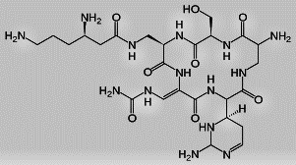
Adverse reactions: Nephrotoxicity, renal failure, unusual fatigue or weakness, neuromuscular blockade , difficulty breathing due to decreased respiratory muscle tone, otovestibulotoxicity, nausea, anorexia, thirst, hepatotoxicity, allergic reactions, arrhythmia, leukocytosis, leukopenia, eosinophilia, thrombocytopenia.

Slide 30
Ofloxacin (O f) is a synthetic antibiotic of the fluoroquinolone group .
It has a bactericidal effect on
due to inhibition of DNA gyrase, changing the spatial position of DNA in the bacterial cell.
Antibacterial activity is lower in an acidic environment.
Release form. Tablets of 100 and 200 mg. Solution for infusions of 100 ml in vials (0.2 g of active drug).
Application. Not less than 600 mg per day in 2 doses.
Adverse reactions. Dyspeptic phenomena, CNS disorders, allergic reactions, kidney damage, tachycardia, joint damage, photodermatitis. During treatment, monitoring of liver, kidney and hematopoiesis function is necessary.

Slide 31
Levofloxacin ( Lfx ) – an antibiotic of the fluoroquinolone group.
Blocks DNA gyrase and topoisomerase I and V, disrupts supercoiling and crosslinking
DNA breaks, inhibits DNA synthesis. Stops bacterial cell division, causes profound morphological changes in the cytoplasm, cell wall and membranes.
It has a wide spectrum of action.
It is widely distributed in the organs and tissues of the body, penetrates well into the lungs (concentration in the lungs is 2-3 times higher than in plasma), the mucous membrane of the bronchi and sputum, organs of the genitourinary system, and cerebrospinal fluid.
Release form: 250 mg and 500 mg tablets.

Slide 32
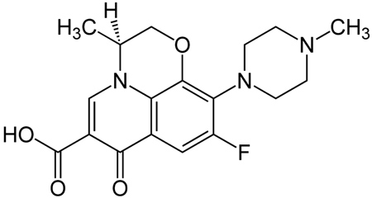
Application. The dose of the drug is determined individually, depending on the severity of the disease.
Take orally , regardless of meals, without chewing, with sufficient liquid; 250-500 mg, 1-2 times a day.
Adverse reactions: Allergic reactions , allergic pneumonitis, vasculitis, nausea , loss of appetite, pain in stomach , indigestion, diarrhea, headache, dizziness, impaired consciousness, increased excitability, depression, insomnia, ototoxicity, increased serum creatinine , eosinophilia , leukopenia, neutropenia, thrombocytopenia , agranulocytosis , hemolytic anemia.

Slide 33
Moxifloxacin (Mfx) is a fourth-generation fluoroquinolone.
Inhibits DNA gyrase and topoisomerase IV - enzymes necessary for replication, transcription and recombination of bacterial DNA. Disrupts the synthesis of DNA of the microbial cell, has a bactericidal effect.
Release form. Tablets of 400 mg, 1 ml of solution for infusions of which contains 1.6 mg of moxifloxacin hydrochloride.
Application. Oral, intravenous (infusion over 60 minutes), 400 mg once daily. The duration of therapy depends on the indications for use.
Adverse reactions: Same as for Levofloxacin.

Slide 34
Gatifloxacin ( Gfx ) - antimycobacterial action is provided by inhibition of DNA gyrase and topoisomerase IV. DNA gyrase is an important enzyme involved in the DNA replication of pathogens.
Topoisomerase IV is an enzyme that plays a leading role in the division of bacterial cell DNA chromosomes .
Forms: Solution for infusion , 1 ml of which contains 2 mg of gatifloxacin.
Application: Daily dose 400 mg.
Adverse reactions: Allergic reactions, asthenia, chills, hypertension, palpitations, anorexia, hyperglycemia, arthralgia, agitation, nervousness, paresthesia, visual abnormalities, taste perversion, tinnitus, dysuria.

Slide 35
Ethionamide (E t), Prothionamide (P t) – antimycobacterial synthetic homologues.
Effective in acidic environments, inhibit development of resistance to other drugs. Sufficiently active against MBT, which multiply slowly and rapidly , are located outside and inside the cell.
Able to penetrate into cavities and encapsulated foci.
Release form. Dragees and tablets of 0.25 g.
Application. Before prescribing, it is necessary to monitor liver function and the condition of the gastrointestinal tract. Prescribe 0.25 g 3 times a day after meals.
Side effects: Dyspeptic phenomena, exacerbation of gastritis, gastric ulcer and duodenal ulcer, hepatitis , nephritis, allergic reactions, less often - peripheral neuritis, PP hypovitaminosis.

Slide 36
Sodium para-aminosalicylate
(PAS - Pa s) is the sodium salt of para-aminosalicylic acid.
It acts mainly on MBTs located in extracellularly, it has a weak effect on intracellularly located MBT. The mechanism of action is associated with inhibition of folic acid synthesis and formation mycobactin – a component of the mycobacterial wall.
Inhibits the development of resistance to isoniazid and streptomycin. Currently , the drug is used in cases of intolerance or resistance to other drugs.
Release form. Available in powders, granules, tablets (0.5 g), 3% aqueous solution of PASK-Na for intravenous injections.

Slide 37
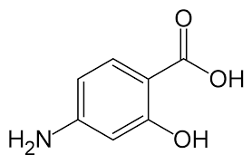
Application: prescribed at the rate of 2 g per 10 kg of body weight in 3 doses. Be sure to take with milk, alkaline mineral water.
Side effects Reactions. Irritates the gastrointestinal tract, causes loss of appetite, nausea, dyspepsia, abdominal pain, contributes to exacerbation of gastritis, gastric ulcer and duodenal ulcer, may cause allergic reactions, agranulocytosis, decrease in potassium concentration and pH in plasma.

Slide 38
Clofazimine ( Cfz ) - has antimycobacterial activity; inhibits energy production reactions in mycobacteria; the drug binds to nucleic acids, but it is unknown whether this affectson its antimycobacterial activity.
It has anti-inflammatory properties in infectious diseases characterized by the formation of granulomas. It is used to treat infections, that are caused by M. and vium-intracellulare, M.leprosy .
It has bacteriostatic activity against M. tuberculosis in vitro, it is included in the treatment regimens for tuberculosis with extended resistance, acts on extracellular MBT.
Application: orally , necessarily together with other anti-tuberculosis drugs in doses of 100 mg/day.

Slide 39
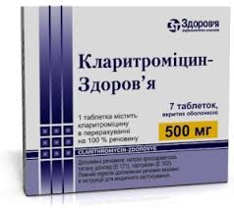
Clarithromycin ( Clr ) - an antibacterial agent of the macrolide group, a synthetic derivative of erythromycin.
in vitro efficacy against M. a vium. It is used in HIV-infected patients with lesions
M. avium ( with CD4 + lymphocyte count ≤100/ ^{mm3} ) .
For infections caused by mycobacteria, it is recommended to use Clarithromycin.
500 mg 2 times a day in combination with other antimycobacterial agents.

Slide 40
After the WHO recognized tuberculosis as a global threat in 1993 , the development of new methods of treating this disease began.
In 2000, the Global Alliance for Drug Development was created .
The mission of the TB Alliance is to ensure access to effective treatment for tuberculosis in countries with a significant prevalence of tuberculosis.
To date, clinical trials of
3 new anti-TB drugs have been completed - bedaquiline, delamanid and pretomanid .
Bedaquiline is the first new anti-TB drug in 40 years.
These drugs have high activity against MBT and a mechanism of action different from known drugs.

Slide 41
NEW ANTI-TUBERCULOSIS DRUGS
Potential new drug | Mechanism of action | Impact on the MBT population
Bedaquiline | Disrupts protein synthesis by inhibiting the proton pump ATP synthase MBT | Bactericidal. High activity against MBT at different stages of the life cycle.
Delamanid | Disrupts the synthesis of mycolic acids | Bactericidal. High activity against intracellular MBT in macrophages.
Pretomanid | Disrupts the synthesis of mycolic acids and MBT protein | Bactericidal, sterilizing Active against all subpopulations of MBT, including persistent ones, that do not reproduce.
New anti-tuberculosis drugs in Ukraine
not yet registered.

Slide 42
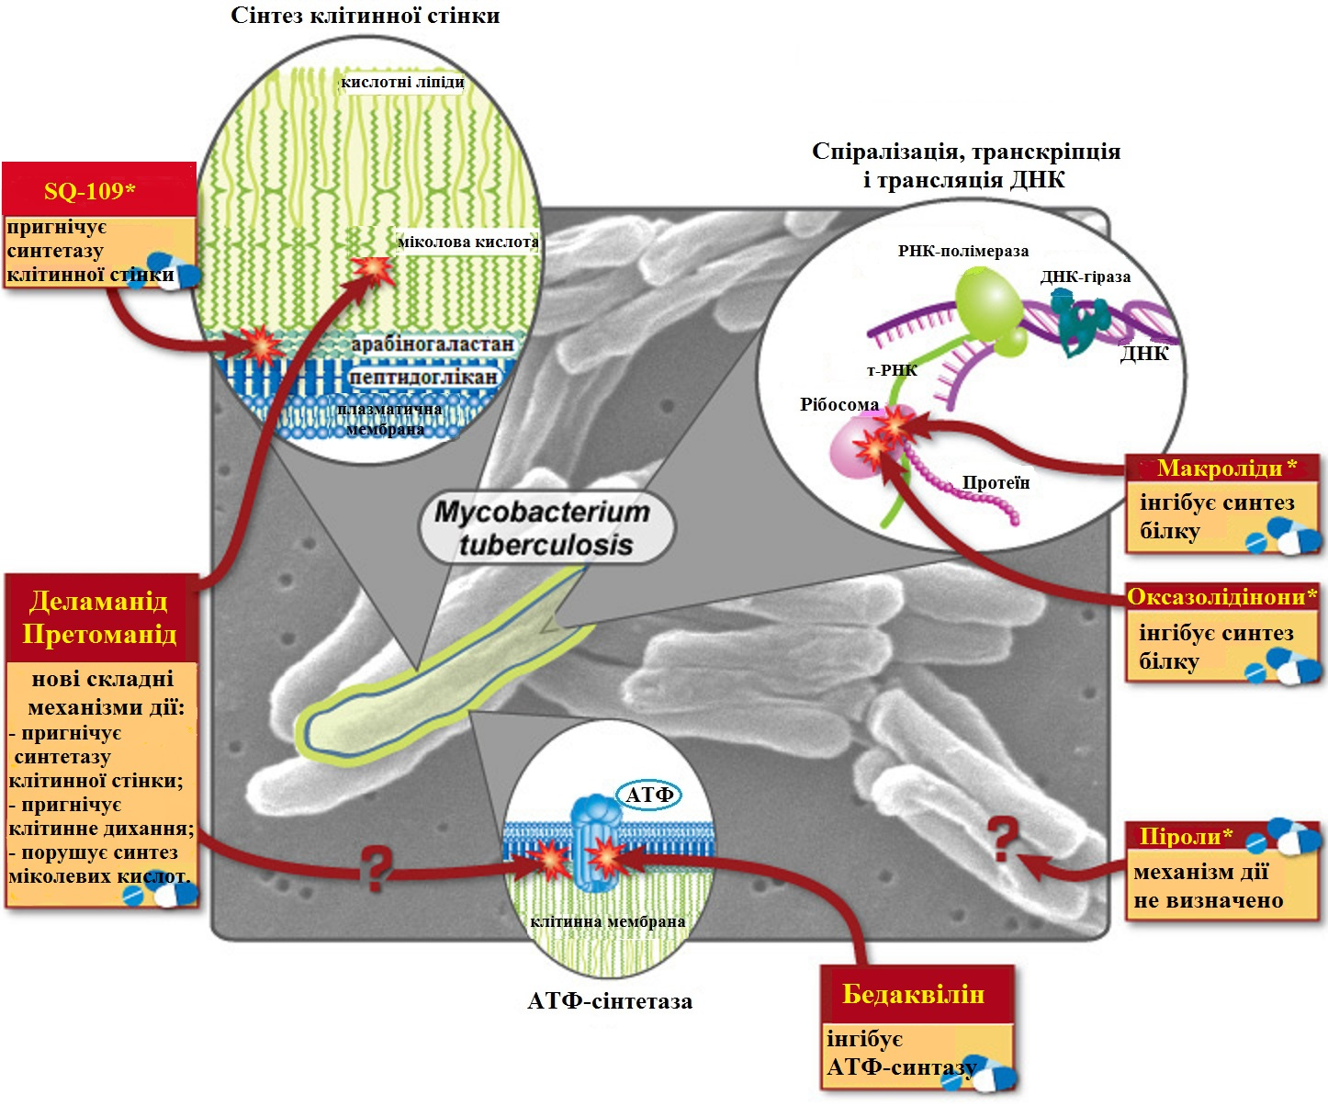
Mechanisms of action of new anti-tuberculosis drugs and drugs* undergoing development and clinical trials.

Slide 43
MAIN STAGES OF ANTI-TUBERCULOSIS THERAPY
Standardized therapy for tuberculosis patients consists of two phases: intensive (IF) and supportive (PF).
The intensive phase is aimed at stopping the reproduction of MBT and significantly reducing their population in the patient's body.
Such therapy eliminates acute manifestations of the disease, stops bacterial excretion, leads to the resorption of infiltrates and densification of foci, and in most patients - to the healing of cavities in the lungs.
The maintenance phase is carried out to consolidate the achieved results, ensure a stable clinical effect, and prevent exacerbation of the process.

Slide 44
According to WHO recommendations, the contingent of tuberculosis patients is divided into 4 categories.
The 1st category includes patients with newly diagnosed tuberculosis (TB) of various localizations with bacterial excretion (VDTB MBT+), as well as patients with other (severe) forms of the disease of various localizations without bacterial excretion (VDTB MBT–): miliary, disseminated, destructive pulmonary TB
(with single cavities over 3 cm or with the presence of more than than 3 cavities of smaller size); meningitis, caseous pneumonia, tuberculous pericarditis, peritonitis, intestinal TB, spinal TB with neurological complications, urogenital TB;
TB of intrathoracic lymph nodes with damage to more than 2 groups on one side or 2-sided process, primary tuberculosis complex .

Slide 45
Category 2 includes any cases of previously treated pulmonary and extrapulmonary TB registered for re-treatment:
- relapse of TB of any localization (RTB+/-);
- patients treated after unsuccessful previous treatment (NLTB with MBT+);
- patients who resumed treatment after they were considered to have dropped out of surveillance - interrupted treatment (LPP with MBT+),
- patients with other cases who were previously treated for TB (ITB with MBT+/–), but the result of the last course of treatment is unknown or not documented.

Slide 46
Category 3 includes patients with new cases (NDTB) of pulmonary and extrapulmonary tuberculosis without bacterial excretion (NDTB MBT–), who are not classified in category 1, as well as children with tuberculosis of unknown localization, children with tuberculosis of intrathoracic lymph nodes or primary tuberculosis complex in the calcification phase in case of preserved activity of the process.

Slide 47
The 4th category includes patients with
- multidrug-resistant TB (MDR-TB),
- extensively drug-resistant TB (EXT-TB),
- rifampicin-resistant tuberculosis (Rif-TB),
- with confirmed cases of chemoresistant TB (XDR-TB), who, according to the resistance profile, require treatment lasting more than 12 months.

Slide 48
Supervised treatment of all tuberculosis patients is carried out with the informed consent of the patient in compliance with infection control requirements in order to prevent the further spread of tuberculosis and prevent the development of multidrug-resistant tuberculosis.

Slide 49
In inpatient conditions, the intensive phase of treatment for patients of categories 1 and 2 is carried out strictly according to indications.
Indications for hospitalization are:
- pulmonary tuberculosis with a positive result of a sputum smear examination by bacterioscopy;
- severe clinical condition of the patient (hectic fever, respiratory and cardiac failure, cachexia);
- complications of tuberculosis before their cessation (pulmonary hemorrhage, hemoptysis, spontaneous pneumothorax, pleural empyema);
- adaptation of the chemotherapy regimen in patients with concomitant diseases;
- diagnosis and treatment of severe adverse reactions;
- surgical treatment in case of ineffectiveness of antibacterial therapy.

Slide 50
For patients of category 3, the intensive phase of treatment in inpatient conditions is possible only if there are medical indications
(severe concomitant diseases, intolerance to PTP).
In other cases, the treatment of patients of categories 1, 2, 3 is carried out in outpatient conditions, because such patients do not pose an epidemiological threat to those around them.
Treatment of patients of category 4 is carried out in specialized inpatient departments.
Treatment of patients in the maintenance phase is carried out in outpatient and / or sanatorium conditions.

Slide 51
Treatment of patients of categories 1, 2, 3 in the intensive phase is carried out according to the scheme: isoniazid + rifampicin + pyrazinamide + ethambutol -
2–3 months (not less than 60 doses and not more than 90).
The drugs are taken in one dose orally
, calculated according to body weight.
In the maintenance phase of treatment, the following isoniazid + rifampicin - 4 months daily or every other day.
Anti-tuberculosis drugs are taken under the direct supervision of medical workers.

Slide 52
Treatment of patients of category 4 in the intensive phase is carried out: with 5–6 anti-tuberculosis drugs according to drug sensitivity data for 8 months, with the mandatory use of injectable drugs of the second line and fluoroquinolones.
In the absence of drugs of the second line, the possibility of using palliative therapy is considered.
The maintenance phase is carried out taking into account drug sensitivity data for 12 months with the use of at least
4 anti-tuberculosis drugs
(of which at least 3 drugs of the second line).

Slide 53
The criteria for the effectiveness of treatment of patients with tuberculosis are:
- disappearance of clinical and laboratory signs of tuberculous inflammation;
- stable cessation of bacterial excretion, confirmed by microscopic and cultural studies;
- regression of pathological tuberculous changes in organs (focal, infiltrative, destructive, etc.), assessed by a complex of radiation and special instrumental (hardware) research methods specific to a particular affected organ (system);
- restoration of functional capabilities and working capacity.

Slide 54
Assessment of treatment outcomes in patients of clinical categories 1,2,3
( with TB drugs sensitive to MBT) is carried out after the completion of the intensive (preliminary) and maintenance (final) phases of treatment.
The following criteria for the effectiveness of treatment of patients of categories I, II, III are distinguished:
- cure;
- completed treatment;
- ineffective (failure) treatment;
- interrupted treatment;
- dropped out;
- fatal outcome.

Slide 55
Cured - a patient with pulmonary tuberculosis confirmed by bacteriological analysis at the start of treatment, for whom cultures and sputum analysis were negative in the last month of treatment and at least once before.
Completed treatment - a patient with tuberculosis who has completed treatment without obvious signs of treatment failure, but without data on negative cultures and sputum analysis in the last month of treatment and at least once before.
The reason may be that the necessary tests were not performed, or that their results are not available.

Slide 56
Ineffective (failure) treatment :
- according to smear and/or culture, when the patient remains with a positive result of microscopy and/or culture after taking 90 doses;
- according to the clinical and radiological picture, in patients who have a negative clinical and radiological picture of the pathological process and at the same time the results of microscopy and/or culture or other examination of the pathological material to detect the TB pathogen are negative;
- in patients in whom the result of the bacterioscopic examination at the beginning of treatment was negative, but became positive at the 2nd month of treatment;
- patients in whom MDR-TB was established according to the results of temporary drug sensitivity (TDS) at any time during the course of chemotherapy for categories 1, 2, 3, regardless of the presence of positive or negative microscopy results at the time of obtaining the TDS.

Slide 57
Interrupted treatment – a TB patient who did not start treatment, or whose treatment was interrupted for 2 or more months after receiving more than 30 doses of drugs.
Dropped out – a patient who was transferred to another region and the results of his treatment are unknown.
Fatal outcome – a patient who died during treatment, regardless of the cause of death.
Separately noted:
- from tuberculosis, patients whose main cause of death was tuberculosis;
- from other causes.

Slide 58
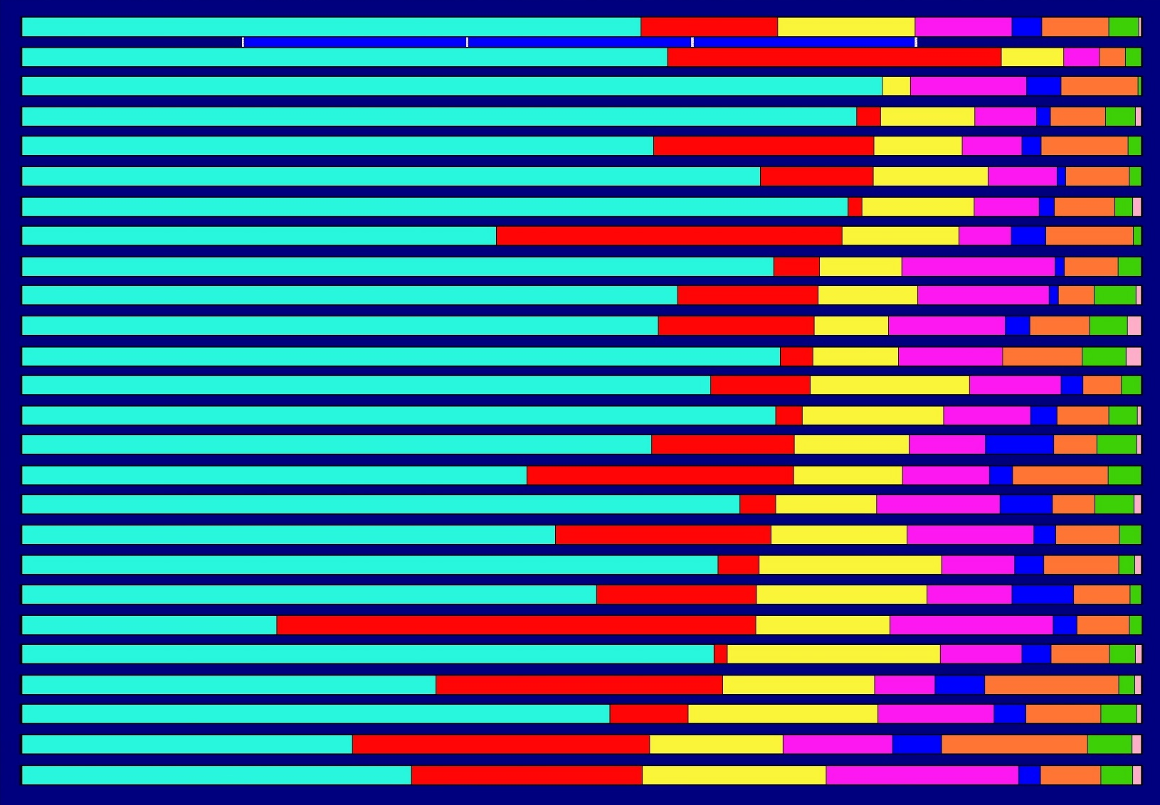
Effectiveness of treatment of patients with newly diagnosed pulmonary tuberculosis with bacterial excretion, detected in 2013.
Ukraine
Ternopil
Transcarpathian
Rivne
Lvivska
Vinnytsia
Chernihiv
Volynska
Zhytomyrska
Zaporozhye
Sumy
Chernivtsi
Poltava
Ivano-Frankivsk
Kherson
Khmelnytskyi
Kharkiv
Odesa
Mykolaivska
Kirovohradska
Donetsk
Kyiv
Dnipropetrovsk
Kyiv
Luhansk
%
0.0 20.0 40.0 60.0 80.0 100.0
Cured
Treatment completed
Patients died
Unsuccessful treatment M+
Unsuccessful treatment of Cl R
Interrupted treatment
Retired or transferred
Tuberculosis diagnosis removed

Slide 59
In case of ineffective therapeutic treatment of tuberculosis patients of all categories, surgical intervention is possible.

Slide 60
NON-SPECIFIC TREATMENT
OF PATIENTS WITH TUBERCULOSIS consists in carrying out a hygienic and dietary regimen, pathogenetic and symptomatic therapy.
The use of pathogenetic agents increases the effectiveness of antimycobacterial therapy. Pathogenetic therapy is aimed at the mechanisms that determine the development of the disease, their appointment mobilizes the body's protective reactions, helps reduce the degree of inflammatory reaction and accelerate its resorption, healing of the cavity, stimulation of regeneration processes, reducing the possibility of the development of fibrous changes, normalization of impaired body functions.

Slide 61
To the HYGIENE-DIETARY REGIME include: rational nutrition, aerotherapy, heliotherapy, hydrotherapy, moderate work.
The need for proper nutrition is due to significantly impaired metabolic processes in tuberculosis patients, the causes of which are tuberculosis intoxication and hypoxia.
Diet No. 11 is used in tuberculosis patients.
The diet should contain at least 100-110 g of easily digestible (milk, meat , fish, etc.) protein, and during the recovery period
- 120-140 g (60% - of animal origin).
Carbohydrates are given in physiological quantities (400-500 g).
Food should be rich in vitamins, especially ascorbic acid, thiamine and pyridoxine.
Sunlight is used mostly for the treatment of patients with extrapulmonary forms of tuberculosis, and for pulmonary tuberculosis, insolation should be used moderately, since hyperinsolation contributes to the exacerbation of the tuberculosis process. Air rich in oxygen reduces hypoxia and normalizes metabolic processes.

Slide 62
To PATHOGENETIC RESOURCES include those that affect the mechanisms of pathogenesis of tuberculous inflammation.
The use of pathogenetic therapy without effective antimycobacterial therapy is prohibited.
In the initial stages of tuberculosis development , when exudation and alteration processes prevail, pathogenetic agents are used in the treatment, which suppress various links in the development of inflammation.
With the productive nature of tuberculous inflammation, at the stages of reverse development of tuberculous inflammation (after 1-2 months of treatment), pathogenetic drugs are used, which stimulate the processes of repair and regeneration.

Slide 63
All pathogenetic therapy agents can be divided into:
1) glucocorticoids, their synthetic analogues;
2) non-hormonal anti-inflammatory agents;
3) immunocorrecting drugs: specific (tuberculin therapy, BCG vaccine therapy) and non-specific;
4) antioxidants;
5) antihypoxants;
6) antikinin drugs;
7) prokinin drugs;
8) eicosanoid system correctors;
9) proteinase inhibitors;
10) biologically active drugs and biogenic stimulants;
11) drugs of anabolic action;
12) reticuloendothelial system stimulants;
13) energy metabolism stimulants;
14) vitamins;
15) physiotherapeutic methods.

Slide 64
Pathogenetic therapy in the intensive phase
Glucocorticosteroids
Nonsteroidal anti-inflammatory drugs
drugs
Antioxidants
Antikinin drugs
INFLAMMATION
alteration
and exudation
Nonspecific
immunomodulators
Proteinase inhibitors
Correctors of the system
eicosanoids
Anticoagulants
indirect action

Slide 65
Group of drugs | Mechanisms of action
Glucocorticosteroids | Anti-inflammatory effect. Antitoxic effect. Desensitizing action . Antioxidant effect. Antifibroplastic action (delay development of connective tissue) . Immunoregulatory action. Blocking enzymes that destroy fabrics. Increased permeability of cellular and vascular membranes for drugs.
Nonsteroidal anti-inflammatory drugs | Anti-inflammatory effect. Antiallergic effect. Antipyretic, analgesic action. Reduction of exudation. Detoxifying effect. Acceleration of the resolution of edema and perifocal inflammation. Reducing hyperreactivity organism.

Slide 66
Group of drugs | Mechanisms of action
Antioxidants | Anti-inflammatory effect. Detoxifying effect. Desensitizing action. Antioxidant effect. Prevent destructive action underoxidized peroxide products oxidation of lipids, proteins and activated oxygen species on membrane and tissue structures. Reduce the exudative component inflammatory response and development destruction in tissues. Prevents the development of fibrosis.
Antikinin drugs | Anti-inflammatory effect. Reduction of exudation. Detoxifying effect. Acceleration of resorption infiltrates and perifocal inflammation. Reduction of vascular permeability.

Slide 67
Group of drugs | Mechanisms of action
Correctors of the eicosanoid system | Anti-inflammatory effect. Acceleration of the resolution of edema and perifocal inflammation. Accelerates the healing of destructions. Detoxifying effect.
Proteinase inhibitors | Inhibit endogenous proteases . Inhibit fibrinolysis, suppress thrombin system. Accelerates the elimination of excess some proteinases. Improves microcirculation and tissue respiration. Accelerates the healing of destructions.
Nonspecific immunomodulators | Assigned differentially according to the state of the cell and humoral immunity.
Indirect anticoagulants | Anti-inflammatory effect. Antihistamine action. Improves the penetration of drugs into fireplace

Slide 68
Pathogenetic therapy in the maintenance phase
Anabolic drugs
Tuberculin therapy,
BCG vaccine therapy
Energy boosters
exchange
Antihypoxants
INFLAMMATION
proliferation
Prokinin drugs
Biologically active drugs and biogenic stimulants
Stimulants
reticuloendothelial
systems

Slide 69
Group of drugs | Mechanisms of action
Anabolic hormonal drugs | Stimulate the synthesis of structural and enzyme proteins. Activate respiratory tissue enzymes. Reduce catabolic activity. glucocorticosteroids. Stimulates reparative processes. Improves tolerance tuberculosis drugs.
Tuberculin therapy, BCG vaccine therapy | Aimed at exacerbation specific inflammation - expansion blood and lymphatic vessels, increased permeability of the vascular wall, improving the permeability of the PTP into the zone damage. Stimulation of immunity, processes repair and reactivity of the body. Antiallergic effect.
Energy metabolism stimulants | Enhances metabolic processes and stimulate enzyme activity breath.

Slide 70
Group of drugs | Mechanisms of action
Antihypoxants | Anti-inflammatory effect. Reduction of tissue hypoxia in the area damage, increased efficiency tissue respiration, reduction tissue acidosis and the amount underoxidized products. Stimulation of immunocompetent cells and reparative processes. Reducing system activity blood clotting
Anabolic drugs | Affect all types of metabolism. Activate protein synthesis, normalize exchange of nucleotides and electrolytes. Antitoxic effect. Enhances regeneration processes and reparations. Enhance capillary blood circulation and permeability of histohematological barriers. Increase the penetration of PTP into focus of specific inflammation.

Slide 71
Group of drugs | Mechanisms of action
Prokinin drugs | Helps cleanse the walls of the cavities caseous masses. Enhances healing processes. Increase blood circulation in the affected area. Improve the penetration of PTP into the area damage.
Biologically active drugs and biogenic stimulants | Improves microcirculation processes. Increases permeability histohematological barriers, penetration PTP to the affected area. Stimulating factors of specific and nonspecific protection. Inhibits exudation processes and stimulate regeneration. Inhibits the development of scar tissue.
Stimulants of the reticuloendothelial system | Accelerates cell growth and reproduction, Enhance reparative processes. Stimulate leukopoiesis, phagocytosis. Anti-inflammatory effect. They enhance the body's nonspecific resistance and resistance to hypoxia.

Slide 72
Symptomatic therapy – this is the prescription of antipyretics, antitussives and expectorants, analgesics, and drugs that reduce other clinical manifestations of the disease to patients when necessary.

Slide 73
COLLAPSOTHERAPEUTIC TREATMENT METHODS
Collapsotherapeutic treatment methods for patients with pulmonary tuberculosis occupy an intermediate position between conservative and surgical treatment.
Collapsotherapeutic treatment methods for patients with pulmonary tuberculosis include artificial pneumothorax and pneumoperitoneum.

Slide 74
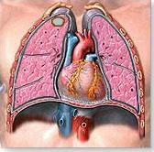
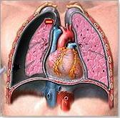
Artificial pneumothorax is the introduction of air into the pleural cavity for therapeutic purposes.
The positive effect of artificial pneumothorax on the course of the tuberculosis process is explained by the subsidence of the affected lung and the creation of its functional rest.
At the same time, conditions are created for the healing of the cavity, partial resorption and compaction of foci and infiltrates, and the development of scars.

Slide 75
Indications for artificial pneumothorax There are limited forms of pulmonary tuberculosis in the decay phase :
1) infiltrative pulmonary tuberculosis;
2) focal pulmonary tuberculosis;
3) limited disseminated pulmonary tuberculosis;
4) newly diagnosed pulmonary tuberculosis with the decay cavity size not exceeding 2-3 cm and located between the subpleural and basal zones of the lungs.
Artificial pneumothorax should be short-term and last no more than 3-6 months.

Slide 76
In the presence of the indicated indications, treatment with artificial pneumothorax is carried out:
1) when it is impossible to conduct rational antimycobacterial therapy in the presence of poly-, multi- or broad-resistance of MBT or intolerance to antituberculosis drugs;
2) in patients with alcoholism, drug addiction, patients who evade systematic treatment;
3) when the patient refuses surgical intervention;
4) under unfavorable epidemiological conditions, contact with children;
5) with bleeding from fresh cavities of decay, when hemostatic therapy has exhausted itself and it is impossible to perform surgical intervention;
6) in the case of a combination of tuberculosis with pregnancy, diabetes mellitus.
In the indicated cases, artificial pneumothorax is advisable when it is impossible to perform surgical treatment of the patient.

Slide 77
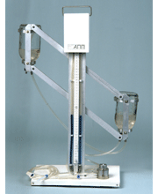
Method.
The puncture site is determined physically and radiographically. Following the rules of asepsis and antiseptics, a needle is inserted into the pleural cavity in the selected intercostal space along the upper edge of the rib, using 0.5% novocaine solution for anesthesia, and connected to a pneumothorax apparatus.
Air is introduced into the pleural cavity in small portions of 50-100 cm ³ .
pneumothorax device

Slide 78
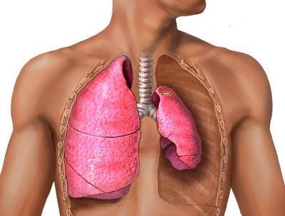
During the initial application of artificial pneumothorax, approximately 250-350 cm ³ of air is injected. During the first 10 days, air insufflation is carried out at intervals of 2-3 days under constant radiological control.
After the formation of a gas bubble, which compresses the lung by at least one third, the intervals between insufflations are increased to 5-7 days, and the volume of air injected is up to 400 cm ³ .
1
2
1- cavity in the lung
2- gas bubble

Slide 79
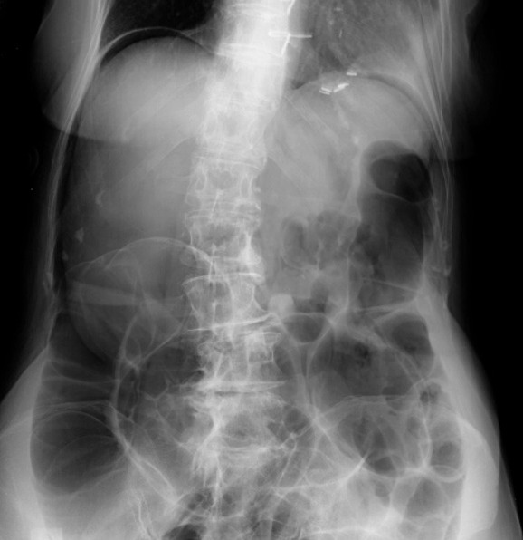
Pneumoperitoneum is the introduction of air into the abdominal cavity, particularly into the subdiaphragmatic space, for therapeutic purposes, in order to elevate the diaphragm and limit its excursion, compress and immobilize the affected lung, and cause blockage of the draining lymphatic vessels, which contributes to fibrosis.
Elevation of the diaphragm limits respiratory oscillations, mainly in the lower parts of the lungs.

Slide 80
Indications for the use of pneumoperitoneum :
- bilateral or unilateral infiltrates in the decay phase, especially with a tendency to bleeding, and in the elderly;
- subacute disseminated processes with phenomena of perifocal inflammation and decay;
- bilateral or unilateral infiltrates in the decay phase, subacute disseminated processes in the decay phase in women immediately after childbirth;
- delayed lung expansion and residual pleural cavity after phthisiosurgical interventions;
- primary or acquired resistance of tuberculosis mycobacteria;
- intolerance to antituberculosis drugs.
Treatment with pneumoperitoneum should be continued for 8 months.

Slide 81
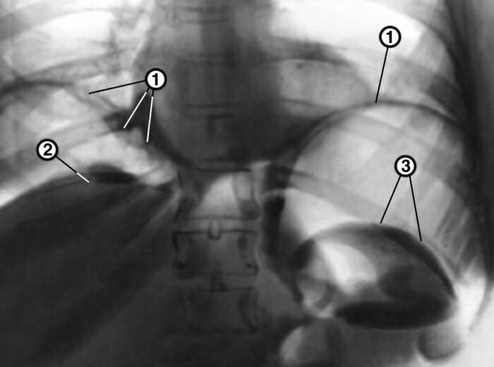
Methodology .
Preferably along the left edge of the rectus abdominis muscle , retreating
2-3 cm below the navel, the abdominal cavity is punctured with a platinum needle, observing all the rules of asepsis and antiseptics. A pneumothorax device is connected to the needle and approximately
500-600 cm ^{3 of air} is injected
.
During subsequent punctures, 800-1000 cm ³ of air and more are injected.
4
Abdominal radiograph after pneumoperitoneum is normal:
1 - right and left domes of the diaphragm,
2 - upper surface of the liver,
3 - upper outer contour of the spleen,
4 – gas bubble.

Slide 82
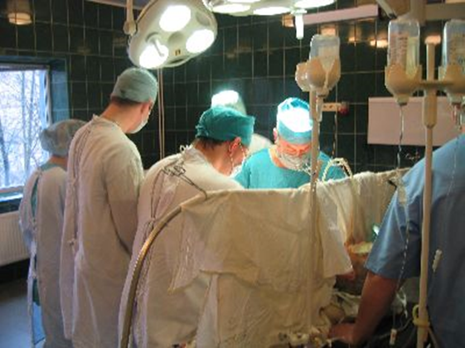
SURGICAL TREATMENT OF PATIENTS WITH PULMONARY TUBERCULOSIS
Surgical treatment of patients with pulmonary tuberculosis is a component of comprehensive treatment.
In the current conditions of the tuberculosis epidemic, the role of surgical treatment is increasing.
Surgical treatment in combination with antibacterial therapy provides a cure for 85-90% of patients with severe forms of tuberculosis.
Surgical methods of treating patients with pulmonary tuberculosis are aimed at eliminating the main source of intoxication and preventing further progression of the disease.

Slide 83
Surgical interventions are recommended:
- when bacterial excretion persists after taking
90 doses of drugs in the intensive phase, despite adequately conducted chemotherapy;
- in chemoresistant forms of tuberculosis
(after 4 months of the intensive phase, a phthisio-surgeon is consulted to resolve the issue of the possibility and necessity of surgical treatment);
- in hemoptysis that occurs periodically from the cavity or bronchiectasis after curing tuberculosis; - in mediastinal lymph node compression syndrome ; - in tuberculous empyema that has not resolved during chemotherapy;
- in round formations in the lungs.

Slide 84
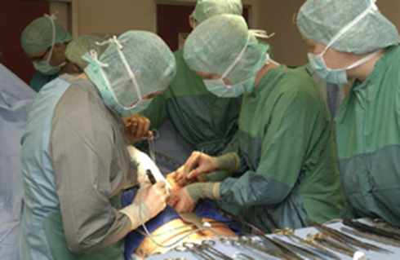
Indications for surgical intervention in pulmonary tuberculosis
According to vital indications:
- profuse pulmonary bleeding (surgeon consultation);
- tension valvular pneumothorax.

Slide 85
Absolute indications
(with operability, determined by the degree of respiratory function impairment and ECG changes):
- multidrug-resistant and extended-resistance tuberculosis with bacterial excretion after receiving 180 doses;
- infiltrative destructive tuberculosis with bacterial excretion (unilateral) after receiving 90 doses in the absence of positive dynamics;
- fibro-cavernous tuberculosis - unilateral or bilateral (no more than 2 lobes);
- cirrhotic pulmonary tuberculosis with bacterial excretion;
- chronic pleural empyema, cartilaginous pleurisy;
- recurrent pneumothorax.
- recurrent hemoptysis;
- mediastinal compression syndromes in primary tuberculosis.

Slide 86
Direct indications:
- large tuberculomas with decay or bacterial excretion (over 3 cm);
- incurable residual changes in the lungs - bronchiectasis, destroyed lung lobe (lung), pronounced bronchial stenosis;
- sanitized cavities without bacterial excretion for epidemiological reasons
(children's institution workers).

Slide 87
Individual surgical interventions
Resection interventions: segmental, lobe and pulmonectomy – this is the separation (resection) of a segment, lobe of the lung or the entire lung.
Cavernotomy – opening and subsequent open treatment of the cavity.
Cavernoplasty – elimination of the intrapulmonary cavity by filling it with a muscle, skin-muscle or fibrous flap on the pedicle. Thoracoplasty – decollation and partial resection of several or most ribs to lower the chest.
Extrapleural pneumothorax – formation of an extrapleural cavity above the affected lung. Pleurectomy and lung decortication – separation of the visceral pleura.

Slide 88
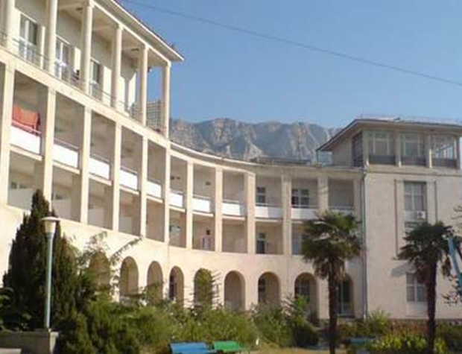
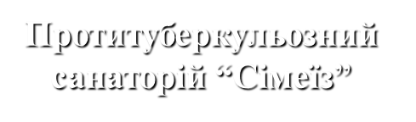
SANATORIUM AND RESORT TREATMENT OF PATIENTS
WITH TUBERCULOSIS
Sanatorium and resort treatment of patients with tuberculosis makes it possible to increase the effectiveness of treatment: clinical cure - up to 75-80%,
improvement of functional indicators – up to 95-98%.
Sanatorium-resort treatment is an important stage in the complex therapy of tuberculosis patients and in the prevention of tuberculosis among people from risk groups.

Slide 89
In children, especially with extrapulmonary forms of tuberculosis, as well as in adults with newly detected small and limited forms of pulmonary tuberculosis without bacterial excretion, the entire period of treatment can take place in a sanatorium, bypassing the inpatient stage.
In other cases, the sanatorium stage includes follow-up treatment and rehabilitation after an intensive phase of treatment or surgery.
An important point of sanatorium-resort treatment of tuberculosis is the combination of courses of specific chemoprophylaxis and chemotherapy with the use of natural-climatic, preformed physical and other sanatorium-resort factors.

Slide 90
CAPACITY EXAMINATION
OF TUBERCULOSIS PATIENTS
Impairment of work capacity occurs when a person cannot perform their professional duties with the average productivity typical of most people in a given profession. Impairment of work capacity in tuberculosis is caused by medical and social factors.
The medical factor begins with the establishment of a clinical diagnosis, which determines the clinical prognosis and a substantiated expert opinion. The clinical prognosis depends on the clinical manifestations of the disease, the prevalence of the process, the characteristics of the course, the degree of functional disorders, the effectiveness of treatment, the dynamics of the reverse process, the patient's age, and the presence of aggravating factors .

Slide 91
Social factors are the profession, nature and conditions of work and life, the patient's attitude to returning to work, the degree of epidemiological danger of the patient to others.
Sometimes, in dismissal from work, only medical factors are the main ones (pronounced intoxication, progression of the process, development of complications, etc.) and less often - only social ones (epidemiological contraindications to work in this profession).

Slide 92
In practice, two main types of disability are established - temporary and permanent .
Temporary disability is established with a favorable clinical and labor prognosis.
A favorable prognosis means the possibility of the patient's return to his previous professional activity, which is determined on the basis of an assessment of the nature of the tuberculosis process, its activity and the possibility of eliminating disorders in the body. Temporary disability is established in cases of detection of initial tuberculosis foci, exacerbation of the disease and relapses requiring long-term treatment. In most cases, the prognosis of the initial forms of tuberculosis is favorable and the ability to work is fully restored. Patients who recover after surgical treatment and fully or partially restore their ability to work are also considered temporarily disabled .

Slide 93
Temporary disability is assessed by medical advisory committees (MACs).
After temporary disability is established, the patient receives a disability certificate – a document for receiving financial assistance under state social insurance.
Patients with VDTB tuberculosis are issued a certificate of incapacity for work if necessary for a period of up to 10 months.
During the period of exemption from work, a patient with tuberculosis retains his place of work for a period of 12 months.
Patients with chronic forms of tuberculosis have the right to receive a certificate of incapacity for work for a period of up to 4 months continuously (in total, no more than 5 months per calendar year).
If the clinical cure of VDTB patients is delayed and clinical and radiological stabilization of the process does not occur, the doctor draws up the appropriate documentation and no later than 10 months from the date of the onset of incapacity for work refers the patient to the MSEK.
If necessary, the MSEK may extend the terms of the certificate of incapacity for work or determine the disability group.

Slide 94
Permanent disability is established when, despite treatment, anatomical and functional disorders have become persistent, which prevents the performance of professional work.
Permanent disability is established:
- for patients with various types of chemoresistant tuberculosis,
- for patients who are not amenable to surgical treatment,
- for patients with tuberculosis in combination with diseases that limit the clinical and labor prognosis
(for example, pulmonary tuberculosis and pulmonary heart failure of the III degree).
Permanent disability can be partial and complete.

Slide 95
Partial disability is established in cases where the patient is temporarily unable to work in his specialty, but can perform other work without harm to health.
Complete disability is determined if the patient requires a permanent special regime and treatment.
When establishing disability, the following are taken into account: the nature of the disease, the degree of impairment of body functions, the effectiveness of treatment and rehabilitation measures, the state of compensatory mechanisms, clinical and labor prognosis, the possibility of social adaptation, the need for various types of social assistance, specific conditions and content of work, professional training, age, etc. Depending on the degree of disability, the MSEK determines the III , II or I group of disability. All disabled people are provided with social assistance in the types provided for by law. Disability pensions are assigned in the event of complete or partial disability.

Slide 96
REHABILITATION
OF PATIENTS WITH TUBERCULOSIS
Rehabilitation in medicine is a complex of medical, professional and legal measures aimed at restoring impaired body functions and the working capacity of patients and disabled people.
The purpose of rehabilitation is to improve the health of the patient and provide him with assistance in restoring or developing professional skills, taking into account the specifics of the injury or illness he has suffered.
The main types of rehabilitation assistance are medical, psychological, professional, social, labor, etc.

Slide 97
Medical rehabilitation – this is the first stage of complete rehabilitation of tuberculosis patients, which consists in restoring lost or weakened body functions after treatment. For this purpose, drug, surgical, sanatorium-resort treatment is used, physiotherapy.
Medical rehabilitation of tuberculosis patients occurs with clinical cure, which is characterized by the absence of process activity, stabilization of residual changes. During cure, significant attention is paid to functional rehabilitation of tuberculosis patients. Modern methods of complex treatment of tuberculosis patients allow achieving medical rehabilitation in most cases.

Slide 98
Psychological rehabilitation – is closely related to medical rehabilitation, because even during the treatment period it contributes to the psychological preparation of the patient for proper adaptation or retraining in the event of incomplete restoration of his professional skills.
Social and labor , including professional, rehabilitation of tuberculosis patients is their return to work. The quality of professional rehabilitation largely depends on medical rehabilitation.
However, there is no complete correspondence between them, due to the fact that not all people clinically cured of tuberculosis regain their working capacity.
Some of them are diagnosed with disability .
Social rehabilitation - restoration of normal relations in society, primarily in the workplace and in the immediate environment.

Slide 99
Thank you for your attention !

