Slide 1
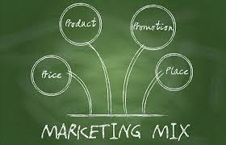
Odesa National Medical University
International Faculty
Department Organization and Economics of Pharmacy with postdiploma specialization
Pharmaceutical management and marketing
Lecture 10-11
Basic provisions of pharmaceutical marketing. Pharmaceutical marketing management process.
Odesa 2025

Slide 2

Lecture plan
1
Pharmaceutical market. Subjects, functions, classification.
2
Definition of terms Pharmaceutical marketing, Need, Demand. Concepts of pharmaceutical marketing.
3
Complex of pharmaceutical marketing
4
Management of pharmaceutical marketing and its planning
5
Development of a business plan for a pharmaceutical enterprise
6
Marketing environment of a pharmaceutical enterprise

Slide 3
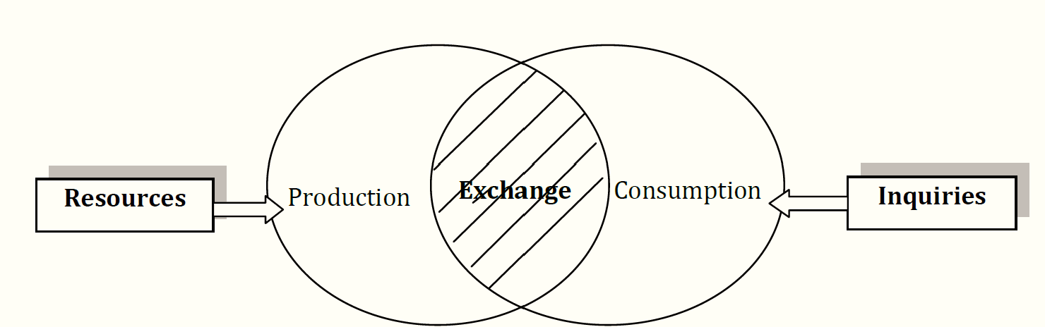
Pharmaceutical market. Subjects, functions
Pharmaceutical market − a system of buying and selling relations between economically free sellers and buyers of medicines and medical devices

Slide 4
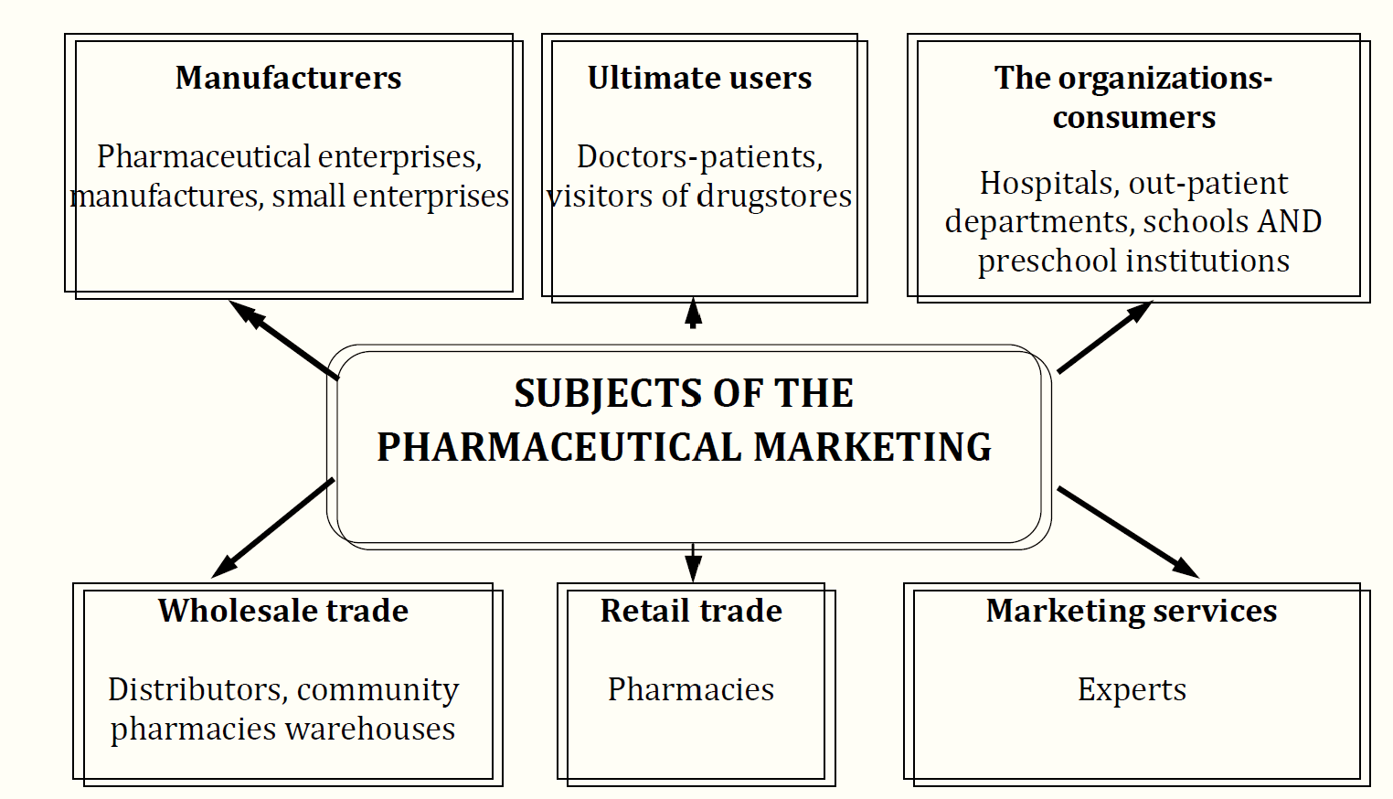
Pharmaceutical market. Subjects, functions
Subjects of the pharmaceutical market are manufacturers of medical products, wholesale intermediaries, retail intermediaries, organizations – consumers (treatment-and-prophylactic institutions), and users, and ex-perts in marketing

Slide 5
Functions of the pharmaceutical market
Economical
bringing the seller closer to the buyer, implementing the sale of drugs, balancing demand and supply, distributing drugs by region, reducing consumer costs for buying drugs and eliminating the disparity between demand and the population's income
Informational
objective information about the assortment and quality of those drugs that are supplied to the market
Intermediary
between subjects of the pharmaceutical market
establishment of an active relationship between cost and price, which responds sensitively to changes in production, consumption and conjuncture
the return of pharmaceutical production to the needs of consumers, the interest of all participants in the competitive process in meeting these needs
Price-forming
Stimulating
due to intra-industry competition and the ratio of supply and demand
Regulatory

Slide 6
Classification of the pharmaceutical market
By geographical location
internal
external
local
Regional
National
World
By saturation level
Balanced
Deficient
Redundant
the demand for medicines is comparable to their supply
demand is higher than supply
demand is lower than supply

Slide 7
Classification of the pharmaceutical market
In accordance with the current legislation
legal
Illegal
By nature of sales
Retail
Wholesale

Slide 8
Classification of the pharmaceutical market
By the degree of restriction of competition
Free
Monopolistic
Oligopolistic
free sale and purchase of drugs
one seller affects the total volume of offers and the price of drugs; there are no analogues; high barriers to entry exist
several firms sell a standardized or differentiated product, while the share of each of them in total sales is so large that changes in the quantity offered by one of the firms leads to a change in price.

Slide 9
Classification of the pharmaceutical market
By subject of pharm. market
Sellers' market
Buyers' market
Due to the shortage of medical supplies, sellers have more power, and buyers are forced to be the most active "market players"
there is plenty of goods, and therefore buyers have the opportunity to choose, and the most active "market players" are forced to be sellers

Slide 10
Pharmaceutical marketing, Need, Demand.
Pharmaceutical marketing − this is a management activity aimed at creating demand and achieving the goals of a pharmaceutical enterprise through maximum satisfaction of consumer needs for medicines and medical products.
Need
Demand
the feeling of a lack of a quality standard of living due to pathological changes in the state or functions of the human body, which took a specific form in accordance with the cultural level and personality of the individual
need supported by purchasing power, that is, these are the drugs that consumers are willing and able to buy at a certain price during a certain period of time.

Slide 11
Marketing principles
The manufacturers should take into account some principles:
to study a condition and changes of a consumer’s demand;
to search for a market niche, to carry out segmentation of the market and to let out production in view of features of separate segments;
to improve the goods constantly and to improve its quality;
it is necessary to influence the market using the system of promotion: selling, advertising, service;
to improve the marketing constantly.

Slide 12
Functions of marketing
The research function includes the research of market, consumer, product, and forming a structure.
The production function includes organizing the production of new products, working out new technologies, and management of quality and products competitiveness.
The sale market function includes organizing the distribution, service, promotion, carrying out a purposeful commodity and the price policy.
The management and control function includes strategic planning, control of marketing, promotion system, marketing management.

Slide 13
Complex of pharmaceutical marketing
The marketing mix (marketing mix, 4P) is a set of marketing tools, a combination of which the company uses to influence the target market, with the aim of achieving the desired response from it.
Product ( product ) is an assortment of medicines that a pharmaceutical company specially develops for its target consumers.
Price ( price ) is the monetary value of a unit of medicinal product.
Marketing or distribution methods ( place ) – activities that make the medicinal product available to target consumers.
Methods of promotion or marketing communications ( promotion ) are activities aimed at spreading information about the drug by the company and convincing target consumers of the feasibility of its purchase.

Slide 14
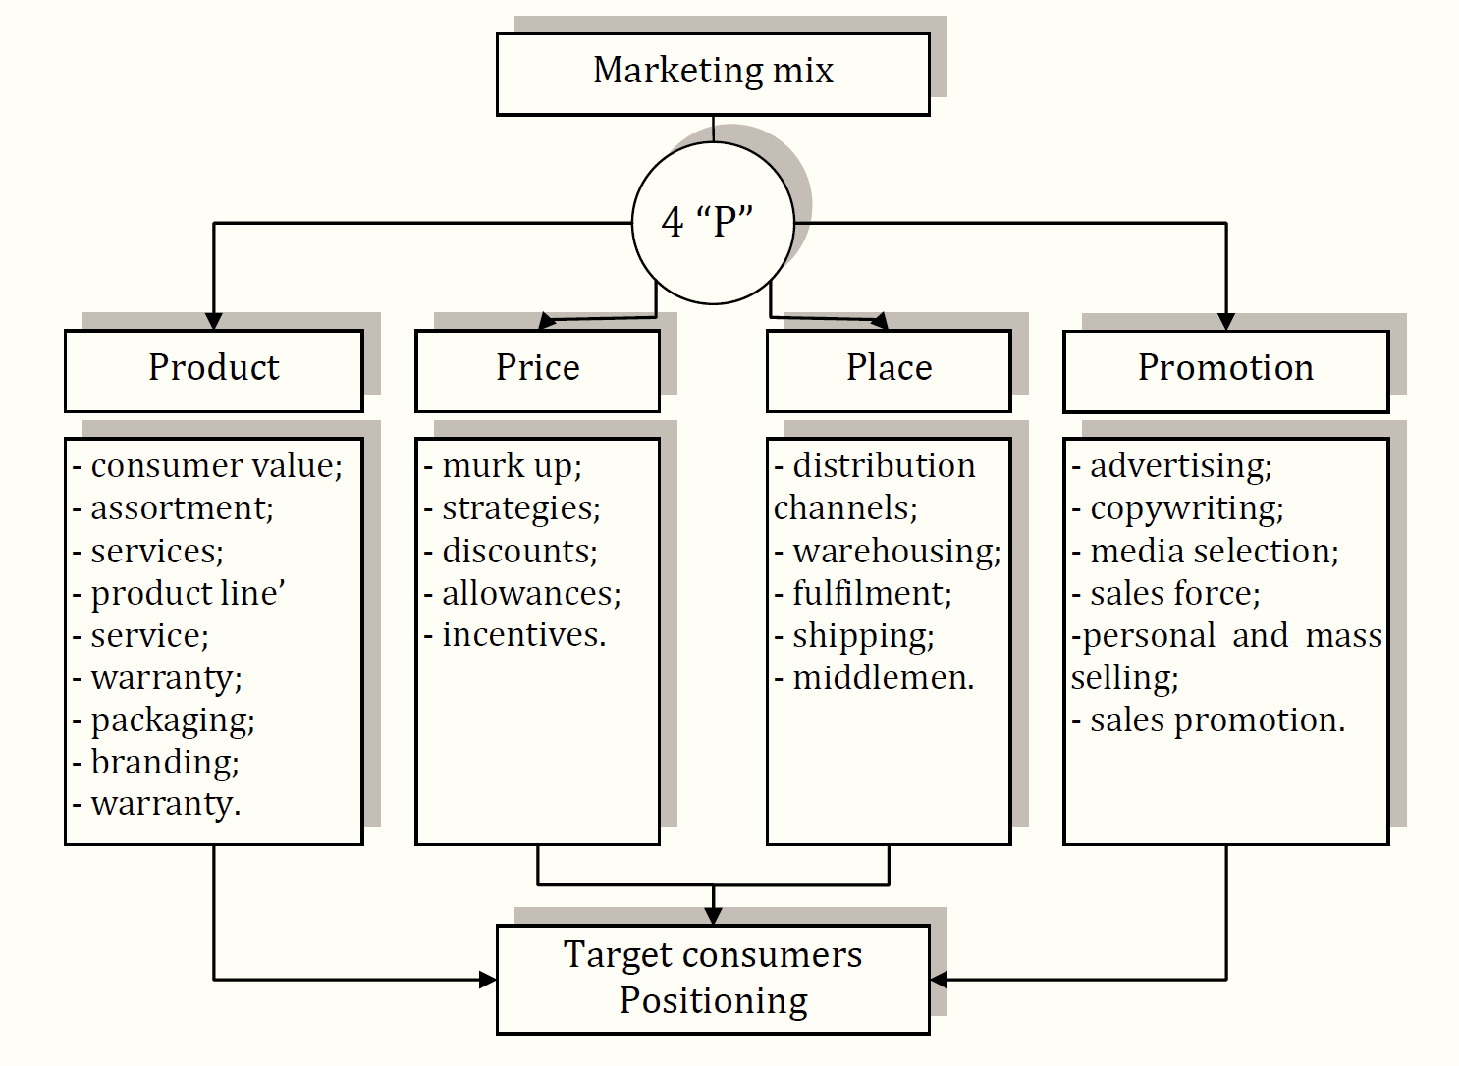
Complex of pharmaceutical marketing

Slide 15
FUNCTIONAL ENSURING THE MARKETING ACTIVITIES OF PHARMACEUTICAL FIRMS
Marketing management is the process of analyzing market opportunities, selecting target markets, developing a marketing mix, and implementing marketing measures in order to achieve the goals of a pharmaceutical enterprise.
The main functions of marketing management
Pharmaceutical market research
Planning of marketing activities
(includes the pre-planned analysis function)
Implementation of marketing plans
(includes the general management functions of "organization" and "motivation")
Marketing control

Slide 16
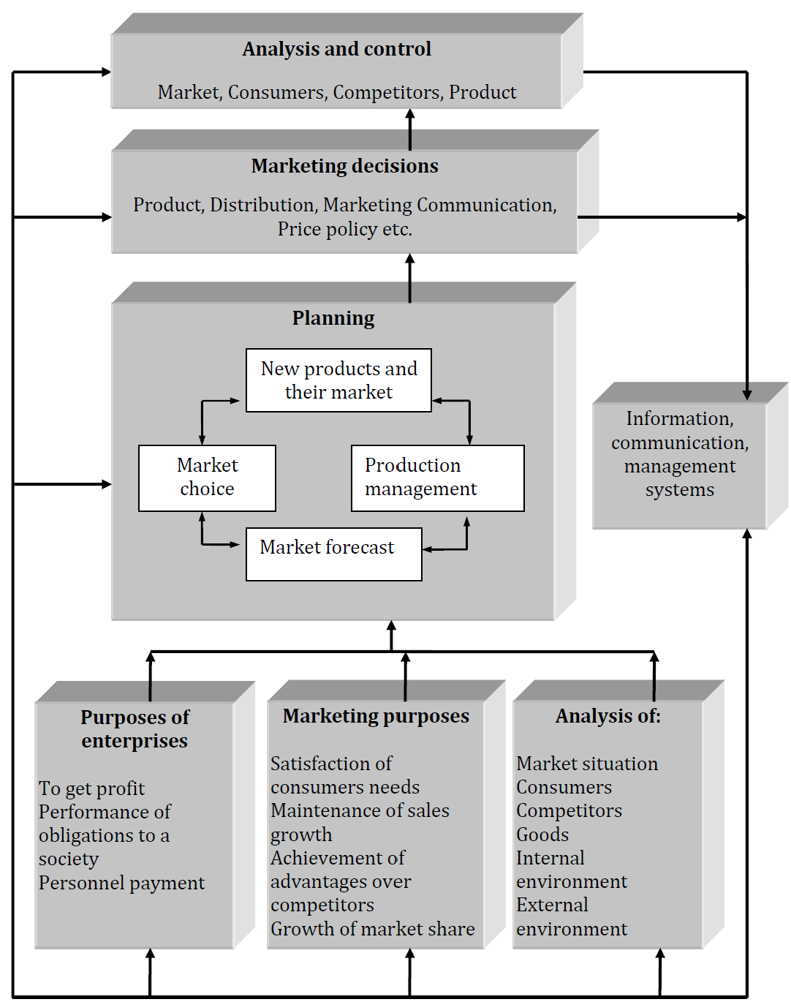
Planning of enterprises’ marketing activity

