Slide 1
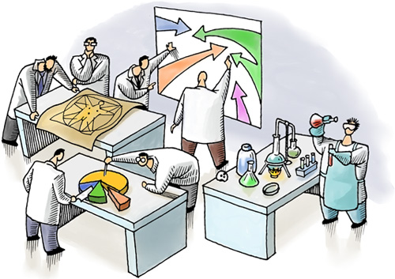
Ministry of Health of Ukraine
Odesa National Medical University
International faculty
LECTURE №12
“Marketing research and information. Marketing information systems”
Odessa – 2025

Slide 2

MARKETING RESEARCH are the scientific researches directed on regular gathering, reflexion and the analysis of the information concerning needs, opinions, motivations, relations, behaviour of separate persons and the organization's (subjects of economic activities, official bodies, etc.) for the purpose of proved marketing decisions’ acceptance.

Slide 3
Directions of marketing research
research of macro environment
research of the internal environment of the enterprise.
research of microenvironment
allow to define its strategy, to allocate perspective directions for work on the market.
study the market, competitors, consumers, goods, prices, distribution systems.
Manufacture, sale, management, marketing, the finance are analyzed
Concrete result of marketing research take place at a choice of strategy and tactics of enterprise’s marketing activity.

Slide 4
Directions of marketing research
Type | Goal | Results
Market research | research are tendencies and processes on the market which include the economic changes analysis, scientific and technical, demographic, ecological, legislative and other factors. | forecasts of its development, an estimation of conjecture tendencies, definition of key success factors. The market segmentation, choice of the target markets and market niches is carried out.
Research of consumers | define factors of consumers choice of goods (incomes, a social status, an age, sex, education). | consumer demand tendencies are investigated
Research of competitors | reception of necessary data for maintenance of competitive advantages on the market and also to find co-operation possibilities | The choice of ways and possibilities of achievement of the most convenient position in the market concerning competitors becomes result of such research.

Slide 5
Directions of marketing research
Type | Goal | Results
Goods research | is determine of conformity of technical and economic indicators and quality of goods which are present on the market, to requirements of buyers, and also their competitiveness analysis. | Results of research give the chance to the enterprise to develop own assortment of goods according to consumers needs, to raise their competitiveness,
Price research | directed on definition of such level and a parity of the prices which give the maximum profit with minimum expenses. | As a result of the spent research optimum parities "expense-price" and "price-profit" are selected.
Research of distribution and sales | provides determining of the most effective ways and means of the fastest selling of goods to the consumer. | Such data allow to define possibilities of increase in goods turnover, to optimise commodity stocks, to develop criteria of a of effective distribution channels choice and techniques of sale to end users.

Slide 6
Directions of marketing research
Type | Goal | Results
Research of marketing communications system | To optimize marketing communications system | develop a public relations policy and to create the favourable relation to the enterprise, its goods; to define methods of consumer demand formation, influence on suppliers and intermediaries; to raise efficiency of communicative connections, including advertising.
Research of the internal environment of the enterprise | define real competitiveness level of the enterprise as a result of comparison of corresponding factors of the external and internal environment. | This information is used for strategic and tactical decision making on a complex of marketing in a company.

Slide 7
The objectives of marketing research may be:
Object of research are the most significant sides of object which are subject to direct studying in applied research. Applied research are directed on studying of social factors: behaviour of individuals, social groups, collectives; products of human activity – goods and services; judgments, opinions, sights of people. A subject of marketing research of theoretical (fundamental) character are the various markets, types of consumers, their motivations, etc
search, i.e. providing for the collection of certain preliminary data on the basis of which a hypothesis can be developed;
descriptive, i.e. providing a description of a specific problem (phenomenon);
experimental, i.e. providing for the verification of the hypothesis of a certain causal relationship between the investigated phenomena.

Slide 8
PROCESS MODEL OF THE
MARKETING RESEARCH
The formulation of the research subject
Identification and study of the problem
Alignment of research objectives
Collection and analysis of secondary information
(“Desk” studies)
Internal sources of information
External sources of information
Collection of primary information
("field studies)
Analysis of primary information data by methods of statistics, logic, sociology
Preparation and submission of report
Development of a package of documents for improving the marketing activities of a pharmaceutical company

Slide 9


DESK research official sources of the information are used: the reporting, directories, the statistical data (secondary data).
Field research is used, as a rule, with the purpose of studying the reaction of consumers on a product (primary data). The main widespread methods are interrogation, supervision, experiment and panel.

Slide 10

Interrogation. It is necessary to understand finding-out of people’ positions or reception from them references on any question. Interrogation can be spent in the oral or written form. For working out of questions it is necessary to start from an information need and possibilities interrogated to give a right answer. If researcher wants to know agreement or disagreement, sufficient the type of questions «Yes − no». If it is necessary to draw a conclusion on opinions of interrogated might to use scale questions.

Slide 11
The types of Interrogation (surveys) are:
in-depth interview – an informal personal conversation to reveal the hidden, true attitude of respondents to the selected topic (to study consumer behavior, their reaction to the design or advertising of the product through the consumer's answers to a series of questions on the topic under study);
- focus group method – a one-time survey of several experts to discuss a certain problem;
- Delphi method – a group expert assessment, carried out in several stages. Sometimes it is not enough to conduct a market study once.
Omnibus" – a regular study of the opinions of a large number of respondents, which is usually carried out once a month (sometimes less often);
- "Panel" – repeated collection of data from one group of respondents at regular intervals.

Slide 12
The panel. The necessary information can be received as a result of numerous interrogation of group of the interested buyers at regular intervals or by supervision over sale development in certain group of pharmacies.
The panel has such signs:
the subject and a research topic are constant;
data gathering repeats at regular intervals;
a constant (with certain conditionality) set of objects of research − trading enterprises, consumers.
Distinguish three kinds of the panel: trading, consumer, special forms.

Slide 13
Supervision − is used as a way of information’s reception in market research much less often, than interrogation.
- independence of object desire to cooperation;
possibility to provide higher objectivity;
possibility of perception of not realized behavior (a choice of goods in pharmacy);
possibility of surrounding situation count, especially at supervision by means of devices.
it is difficult to provide representatively, because supervision has need, as a rule, special conditions (for example, behavior of visitors in pharmacy:
subjectivity of perception observing, selective supervision;
the behavior of objects can differ from natural if supervision is opened (effect of supervision).

Slide 14
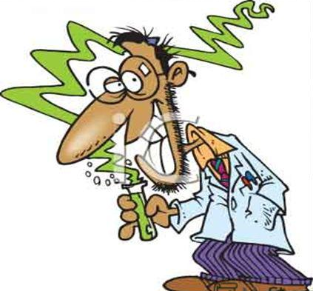
Experiment is research, at which should be established as change of one or several independent variables influences one or several dependent variables.
Essential signs of experiment:
the isolated changes (separate sizes vary the researcher, others should be, as far as possible, constants);
- the researcher actively interferes with process of data occurrence;
- the interconnection of cause and effect (for example, influence of color of packing on sales volume) is checked.

Slide 15
THE VALUE OF THE PHARMACEUTICAL INFORMATION
The information represents a set of the ordered document files and information technologies which provide information processes on the ba-sis of standardized forms of submission and data transmission, forms and methods of rendering of information services of different type.
Urgency, that is real timely display of the marketing environment condition (in the best commercial databases the information is updated daily);
Reliability − provides an exact reconstruction of a condition and development of manufacture, the market, an environment. In connection with necessity of preservation by the enterprise of competitive positions various sources of the information should be used, and the obtained data should be analyzed on absence of contradictions;
Relevance of data − information formation according to certain requirements;
Completeness of display − is necessary for the objective account of all factors forming or influencing of condition and development of the market-ing environment;
Purposefulness of data − focuses on specific goals and tasks;
The coordination and information unity – require such system of indi-cators’ working out which contradictions in conclusions would not be sup-posed, inconsistency of the primary and received data.

Slide 16
CHARACTERISTIC OF
SECONDARY AND PRIMARY INFORMATION
Type of information | Advantages | Disadvantages
Secondary - information that is the result of other studies or collected for the implementation of some other tasks | ✓ low price; ✓ availability; ✓ promptness of receipt; ✓ the ability to compare data with data sources; ✓ availability of data that sometimes cannot be obtained independently. | ✓ incomplete data; ✓ unwarranted reliability of information from some sources; ✓ possible availability of outdated data; ✓ possible inconsistency of data from different sources; ✓ The methodology for collecting and processing data is often unknown.

Slide 17
CHARACTERISTIC OF
SECONDARY AND PRIMARY INFORMATION
Type of information | Advantages | Disadvantages
Primary - going specifically to achieve the specific objectives of the study | ✓ is collected for the specific purposes of this study; ✓ data is not outdated; ✓ the methodology of data collection is controlled by a pharmaceutical company; ✓ access to research results for competitors is limited. | ✓ data collection takes a lot of time; ✓ needs significant costs; ✓ not all information can be collected in this way; ✓ In case of insufficient qualification of researchers, the information may be inaccurate.

Slide 18
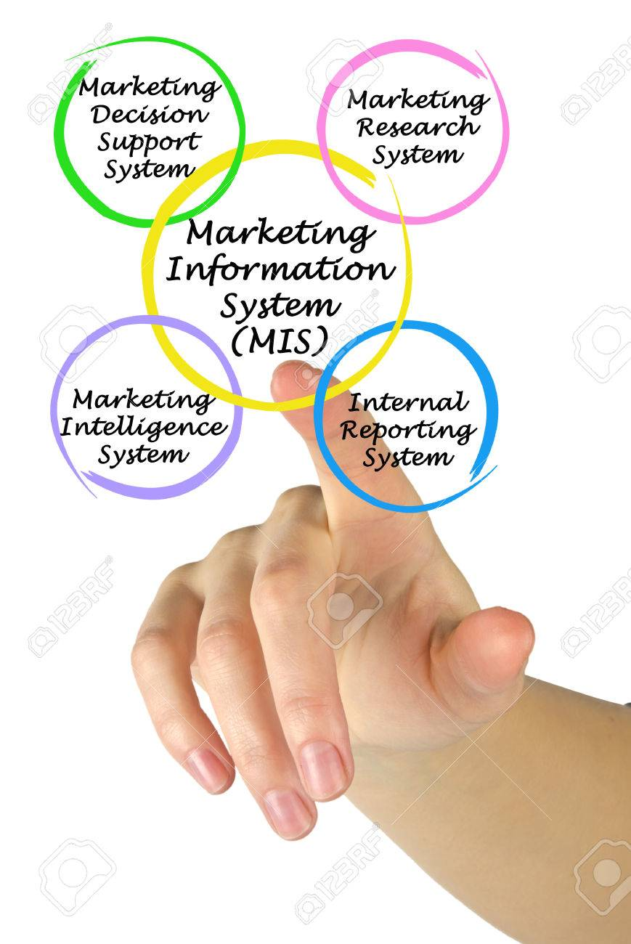
Marketing information system (MIS) is a set of procedures and methods designed to generate, analyze, disseminate, and store anticipated marketing decision information on a regular, continuous basis.

Slide 19
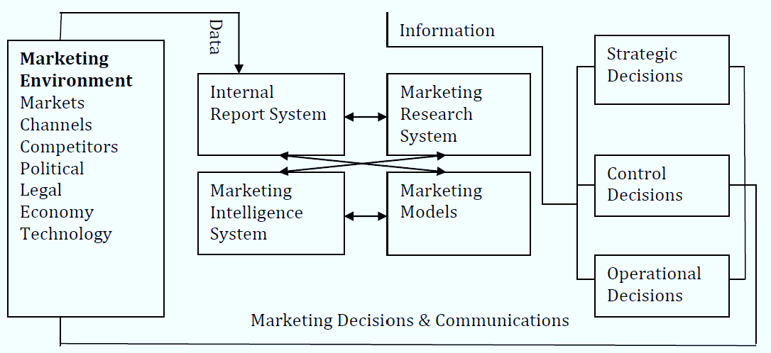
Structure of marketing information system
An Marketing Information System offers many advantages:
1. Organized data collection.
2. A broad perspective.
3. The storage of important data.
4. An avoidance of crises.
5. Coordinated marketing plans.
6. Speed in obtaining sufficient information to make decisions.
7. Data amassed and kept over several time periods.
8. The ability to do a cost-benefit analysis.
The disadvantages of a Marketing information system are high initial time and labour costs and the complexity of setting up an information sys-tem. Marketers often complain that they lack enough marketing information or the right kind, or have too much of the wrong kind.

Slide 20

for attention!

