Slide 1

Odesa National Medical University
International Faculty
Department of Organization and Economics of Pharmacy with postdiploma specialization
Pharmaceutical management and marketing
Lecture 13
Product in a marketing system
Odesa 2025

Slide 2

Lecture plan
1
CONSUMER PROPERTIES OF PHARMACEUTICAL GOODS
2
THE PRODUCT’S LIFE CYCLE
3
POSITIONING OF PHARMACEUTICAL GOODS
4
COMPETITIVENESS OF PHARMACEUTICAL PRODUCTS AND MANAGEMENT OF QUALITY
5
MARKETING STRATEGIES OF PHARMACEUTICAL ENTERPRISES

Slide 3
CONSUMER PROPERTIES OF PHARMACEUTICAL GOODS
A goods are the product of work made for realization at the market to satisfy certain need. Thus, the goods − are not only the physical things, but comprises also all necessary for satisfaction of inquiries and consumer wishes.
in marketing goods are considered first of all as "means", set of material and non-material characteristics with which help it is possible to satisfy certain need, and then already − as the product of work made for sale.
Medicines- any substance or a combination of substances (in the certain medicinal form), intended for treatment or preventive maintenance of diseases at the person, for diagnostics or for resto-ration, correction or changes of its physiological functions, placed in packing and placed at the market.

Slide 4
Classifications of medicines
Lists of medical products operating in Ukraine are made on the basis of Anatomo-therapeutic chemical classification (ATC-classification), which is based on distribution of medical products to groups depending on their action on certain anatomic body or system according to therapeutic indicators and chemical characteristics of a preparation.
Medical products classify also by:
- toxicological groups;
- anatomical-nozological principles (preparations operating on respiratory system, cardiovascular system, on digestive system, etc.);
- therapeutic application (analgetics, antibiotics, hypotensiv means, etc.);
- pharmacological action (diuretics, anticoagulants, neuroleptics etc.);
- chemical structure (alkaloids, cardiac glycoside, hormonal means etc.);
- kinds of the control and a turn order (narcotics, psychotropic sub-stances);
- prescribe and non prescribe drugs;
- direction of use (internal, external);
- physical and chemical properties and influence of environment factors (photosensitive, thermolabile, dyes, etc.);
- modular condition (firm, liquid, soft, gaseous);
- kind of the medicinal form (solutions, suspensions, tablets, ointments, etc.);
- readymade drugs (industrial production) and a medicine of individual manufacturing;
- working lives;

Slide 5
Basic characteristics of goods
functionality
reliability
duration
Consumer value − is set of consumer properties of goods.
quality; including reliability, suitability term, design
conformity to functional purpose
conformity of the price to quality and the consumer value
the presence of the accompanying documentation
quality after sales service
a variety of assortment; opportunity of choice

Slide 6
«key factors of market success»
individualization of goods
manufacture directed on small groups of homogeneous consumers
“critical weight of goods”
necessary set of technical novelties which consumer imagine high-quality and progressive goods associates
to satisfy certain needs not by group of goods, and one, secondly, to make it whenever possible more cheaply. The primary goal of the marketer in forma-tion of this factor − to take part in search and processing of idea of a multi-purpose choice
multifunctionality of goods
complex of the additional goods and services which allows the consumer: with maximum conveniences to use the bought goods under any conditions; it is convenient to keep and if necessary to serve goods; to use goods with any other goods for performance of the general functions
technical package

Slide 7
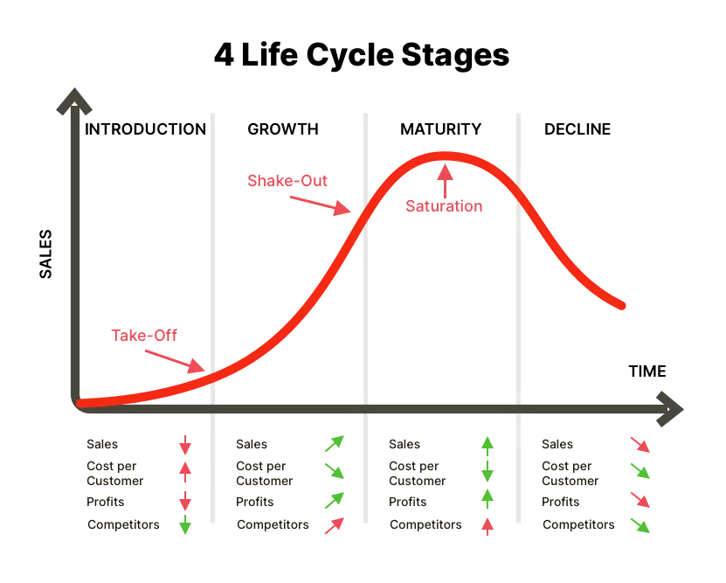
THE PRODUCT’S LIFE CYCLE
Related to the status of a product in the company portfolio is that product's place in the “product life cycle”.

Slide 8
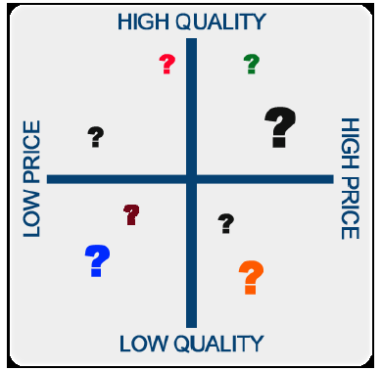

POSITIONING OF PHARMACEUTICAL GOODS
Opportunities for positioning of medical product:
1. On the basis of specific properties (force of action, by-effects, bear-ableness, etc.).
2. On the basis of a way of application (once a day, as primary therapy, in the second or in the third turn).
3. In relation to the end user or the patient.
4. In relation to a medical product to the competitor.
5. In relation to a therapeutic class of medical products (for example, new in an existing therapeutic class or the representative of a new therapeutic class).
6. In relation to elements of a marketing complex (for example, de-sign of packing, the size of packing, etc.).

Slide 9
COMPETITIVENESS OF PHARMACEUTICAL PRODUCTS AND MANAGEMENT OF QUALITY
Competitiveness of goods implies any relative integral characteristic, which displays its difference from goods of a competitor and, accordingly, determines its attractiveness to the consumer.
The main component of the competitiveness:
quality
Marketing component
Commercial component
economic component
image and prestigeimage and prestige
the price of consumption

