Slide 1
Ministry of Health of Ukraine
Odesa National Medical University
International Faculty
LECTURE №16:
“ Assortment policy of pharmaceutical enterprises.”
Odessa – 2025

Slide 2
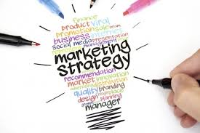
«Marketing strategy» (strategy of coverage of the market): this is formation and realization of purposes and problems of the enterprise-manufacturer and the exporter on each separate market (a market segment) and each goods for the certain period of time (long-term, intermediate term) for realization of industrial and commercial activity in full conformity of a market situation and opportunities of the enterprise (firm).
Realization of marketing strategy is carried out in the conditions of quickly changing environment of the firm which account is possible only in short-term plans, i.e. in frameworks of «marketing tactics».

Slide 3
Basic models of strategic decision-making
Ansoff's Product/Market Matrix
Porter’s generic strategies
Boston Consulting Group Matrix – BCG
Model “attractiveness – competitiveness”

Slide 4
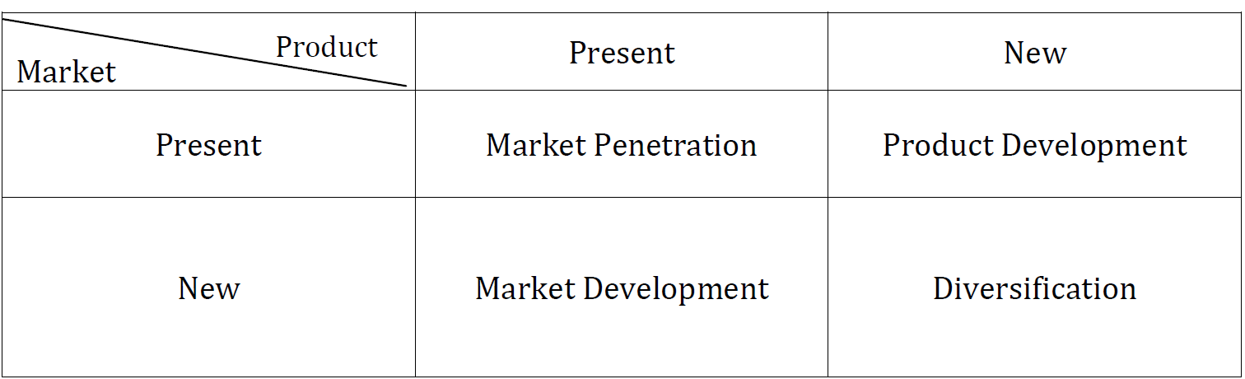
Ansoff's Product/Market Matrix
Market Penetration
Means increasing of revenue by, for example, promoting the product, repositioning the brand, and so on.
Market Development
Here we market our existing product range in a new market. This means that the product remains the same, but it is marketed to a new audience.
Product Development
This is a new product to be marketed to our existing customers. Here we develop and innovate new product offerings to replace existing ones.
Diversification
This is where we market completely new products to new customers. There are two types of diversification, namely related and unrelated diversification.

Slide 5
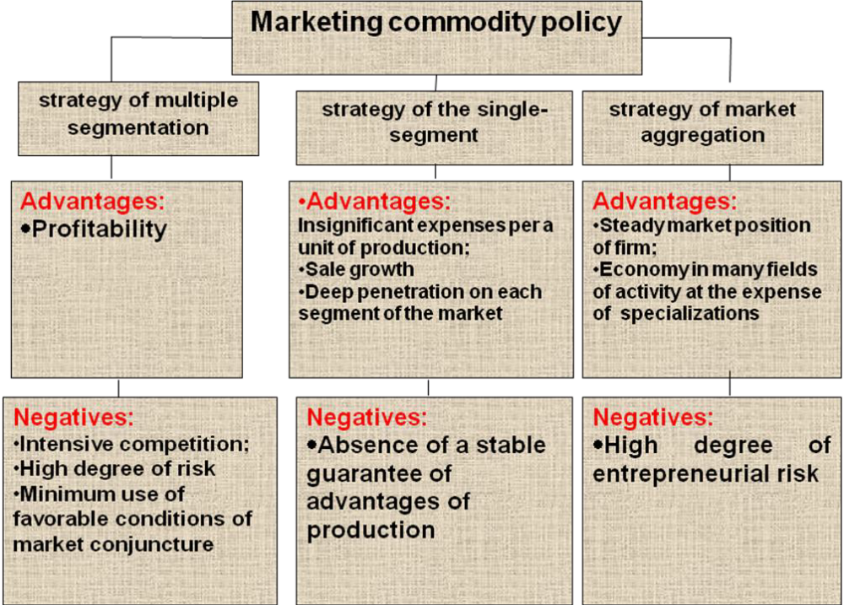
Strategic Porter’s model

Slide 6
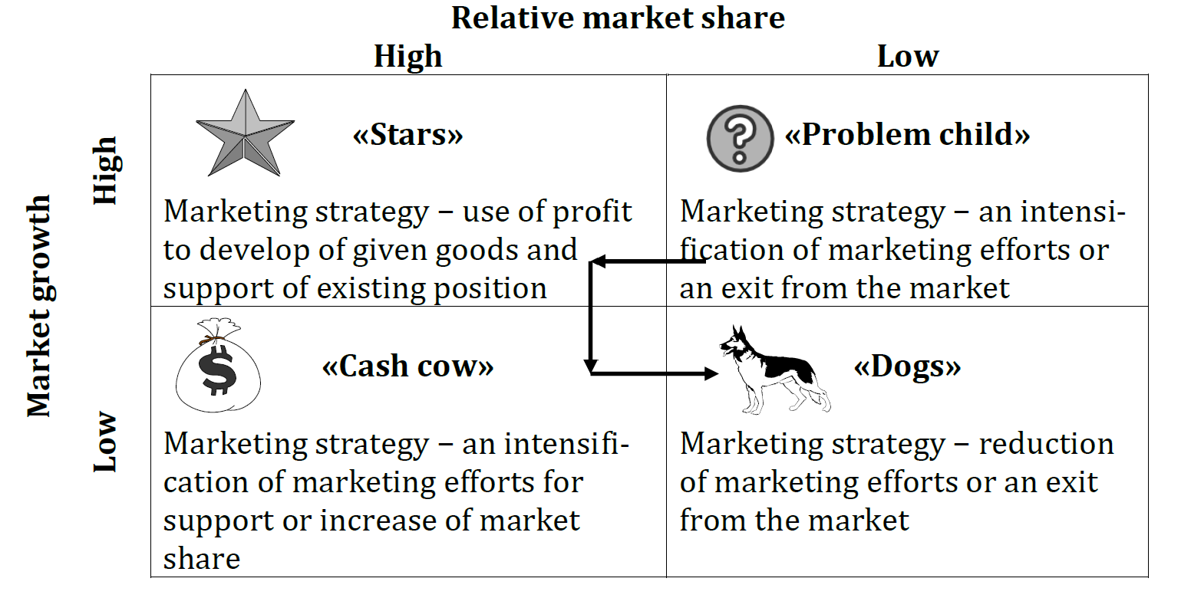
BCG Matrix

Slide 7
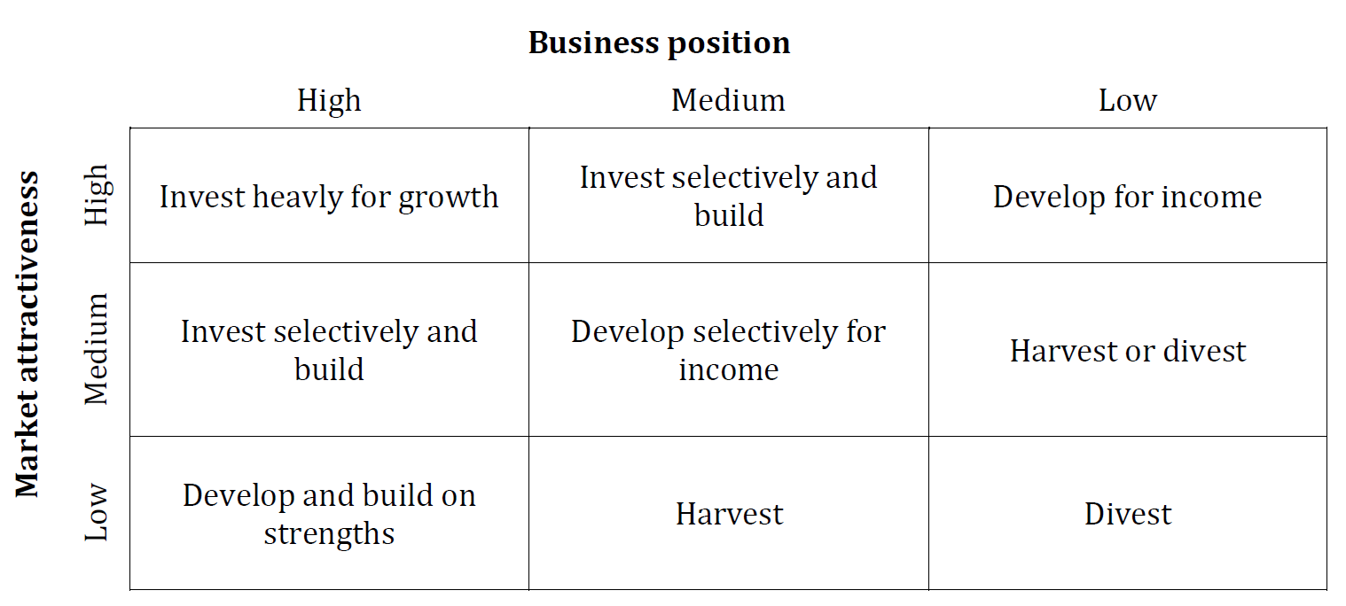
Model “attractiveness – competitiveness”
In construction process of a matrix for each of indicators weightiness is defined, the rank on the selected scale then the weighed estimation of an indicator taking into account the received estimation and factor of weightiness of an indicator is defined is appropriated.

Slide 8
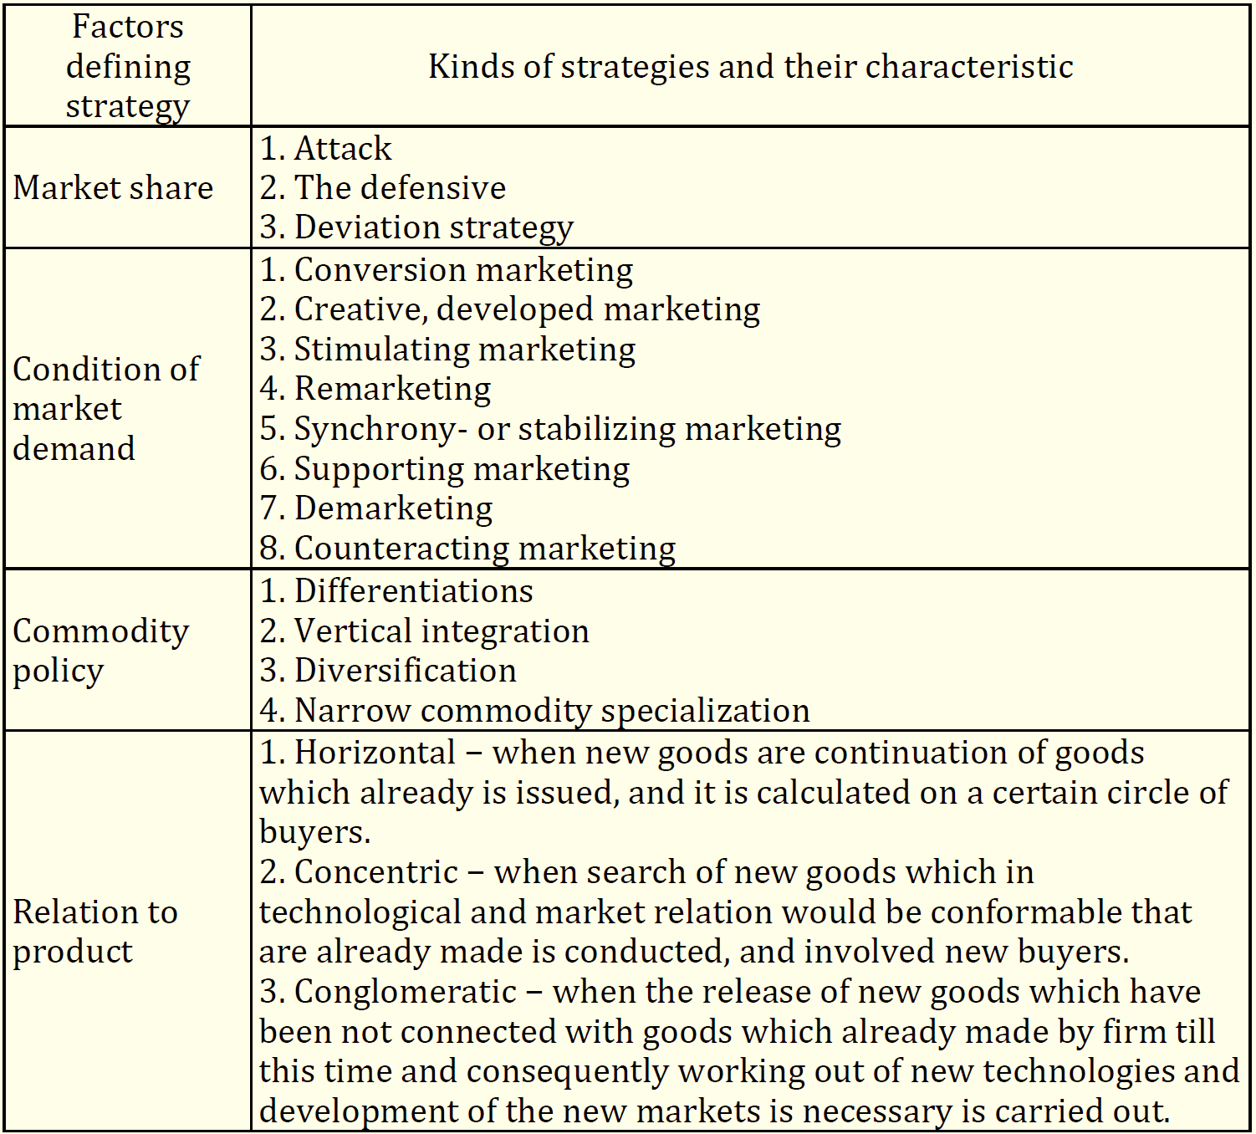
Classification of marketing strategies

Slide 9

Pharmaceutical innovations are new drugs and new processes, as well as their significant technological changes. Pharmaceutical innovations are classified into two types: product (grocery) and process.

Slide 10
Pharmaceutical innovations
Products (Grocery) include:
creation and release of original drugs;
development and production of generic drugs;
introduction of new forms of drugs;
Improvement of the quality of already produced drugs;
identify new areas of application of known drugs.

Slide 11
Pharmaceutical innovations
Process are divided into:
technological (introduction of new or improvement of existing technologies);
organizational and managerial (development of new markets, use of new channels of promotion of medicines and forms of sales promotion, use of new economic, managerial, organizational mechanisms);
social (improving the quality of drugs already being produced; improving working conditions and improving the qualification and professional level of staff);
information (implementation of information technologies in management, streamlining of information flows).

Slide 12

LEVELS OF NOVELTY OF MEDICINES
An original drug is a product that is owned only by the company that developed it or the company that holds the first license to sell it. The active substance of OD has a patent, until the expiration of which no other pharmaceutical company has the right to synthesize and use this active substance for commercial and non-commercial needs.
generic drug - a drug whose term of patent protection for an active substance has expired.
new
pharmacological group
existing pharmacological group

Slide 13
THE MAIN STAGES OF DRUG DEVELOPMENT
Stage | The name of the stage and its relevance for:
 | of the original medication | generic medication
I | Scientific idea and its rationale | Not done
II | Directed synthesis or screening of biologically active substances | Not done
III | Development of control technology and methods ; biopharmaceutical, preclinical and clinical studies | Development of technology and methods of control; biopharmaceutical simplified preclinical studies and limited clinical trials or demonstration of bioequivalence of medicinal products
IV | Commercial production, marketing and marketing

Slide 14
COMPETITIVENESS OF A MEDICINAL PRODUCT
is a set of consumer properties of a medicinal product provided during development and production, which contributes to its fastest realization on a specific market in a certain period of time in the case of differences from analogues:
by the degree of satisfaction of the needs of the consumer organization or the individual consumer and the level of costs for its purchase and use;
by the degree of awareness, accessibility and convenience of the consumer in making the purchase and use, provided with marketing and logistical measures.

Slide 15
A trademark is a name, a name, a symbol, a picture, or a combination thereof, intended to identify the products or services of a particular seller and differentiate them from the products of competitors.
Pharmaceutical companies manufacturing generic drugs often release them under an international, non-proprietary name or under a specially crafted name that must be different from the original drug's name.

Slide 16
Function of Trademark
- establishment of direct connections with consumers;
- determination and representation of goods’ features in comparison with analogues;
- description of relationship of different goods of the same kind by certain criteria (quality, price line);
- symbolical instructions on consumer properties and utility of goods for the consumer;
- protection against fakes and probability to mix with the similar goods of other manufacturers.

Slide 17
Types of trade marks
- manufacturer mark (brand) – the mark created by the manufacturer;
- own-label mark (brand) which is created and appropriated by trading and marketing intermediaries;
- license mark – the branded name of goods or the service, offered the licensee the proprietor of trade mark;
- joint mark – provides use for one goods of branded names of two different enterprises (firms);
- group marks – use by firm of one name for all goods (for example, production of known manufacturer of medical equipment “Siemens”);
- marks-fighters – cheap variants of marks which are supervised by manufacturers and provide small expenses for trade mark advancement.

Slide 18
Brand
A brand is a strong perception of the consumer about the brand, its image in the minds of consumers. In other words, a brand is called a well-known brand with a defined, formed position. A brand is a broad concept that, in addition to the brand, covers: the drug itself, its characteristics, expectations, consumer perceptions, consumer information and promises of certain benefits that the brand owner guarantees to consumers.

Slide 19
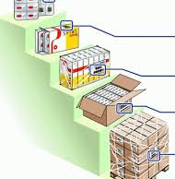
Packaging of medicines
Another element of a pharmaceutical enterprise's product policy is packaging, which, in a mature market, is becoming an increasingly effective marketing tool, an integral part of the company's image and the subject of innovative search.

Slide 20
STAGES OF THE DRUG PACKAGING PROCESS
Consumer
retail (individual) packaging
Grocery
(product) packaging
Transport
step 0
step 1
step 2
step 3
the pre-preparation phase of medicines and packaging materials
drugs are packaged in retail (protective, individual) packaging
Product (grocery) packaging
Transport
packaging

Slide 21

for attention!

