Slide 1

Odesa National Medical University
Department of Pharmacy Organization and Economics with postgraduate training
Lecture 16
Price, pricing, pricing policy of pharmaceutical and pharmacy enterprises.
Pharmaceutical management and marketing
Odessa 2025

Slide 2


Definition
Price is the exchange equivalent of the value of goods or services in monetary terms.
The price is the sum of all the values exchanged by the buyer for the opportunity to use the product or service.
Price is the only component of the marketing mix that brings profit, other components represent costs. Price is the most flexible component of marketing.

Slide 3
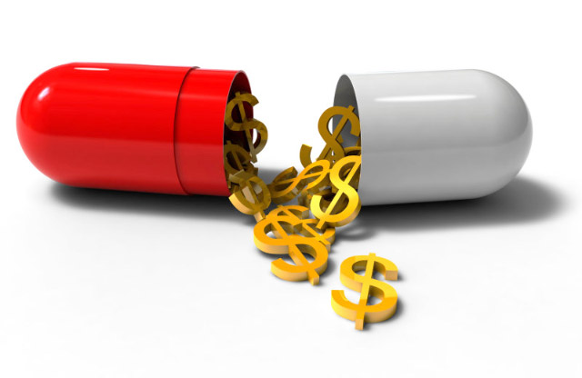
Price functions
Distribution
Accounting
Stimulating
Regulating
Criterion of rational placement of production

Slide 4
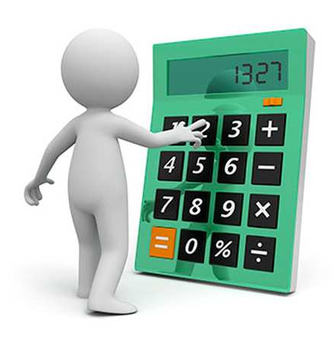
Accounting function
Determines the very essence of the price, that is, being a monetary expression of value, the price shows what it costs society to satisfy a specific need for a particular product.

Slide 5

Stimulating function
It is expressed in the encouraging or stimulating effect of the price on production and consumption.

Slide 6
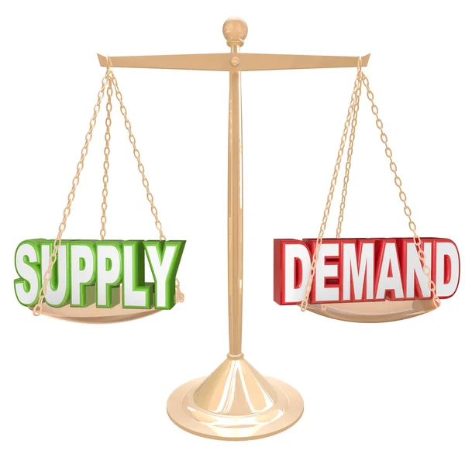
Regulatory function
Prices are the link between production and consumption, supply and demand.

Slide 7
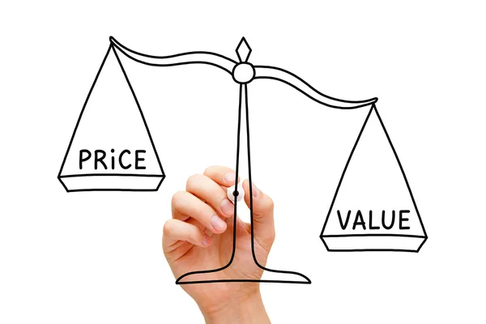
Distribution function
The only one of all functions has a state scale, since it involves the participation of the price in the expansion and redistribution of national income between the branches of the economy, different forms of ownership, regions of the country, the accumulation fund and the consumption fund, different social groups of the population.

Slide 8

Price as a criterion for rational placement of production
This function shows that with the help of the mechanism of the prices transferring the capital from one sector of economy into another one, where the rate of return is higher, is carried out.

Slide 9
Classification prices
According to the degree of government influence on pricing:
Free prices;
Regulated prices
Fixed prices;
Depending on the forms and spheres of trade
Wholesale prices;
Retail prices
Tariffs;
Auction and exchange prices
They are formed on the corresponding types of markets that belong to the free market type.
World market prices
Established for the goods of this group on the world market and determined by international trade organizations for a certain period

Slide 10
Pricing factors
Pricing factors
Internal
Life cycle stage
Costs
Marketing strategy
Marketing objectives
External
Competitors
Members of the building channels
State regulation
Consumers

Slide 11
Stages of drug pricing
Analysis of factors affecting the price policy of a pharmaceutical enterprise
Internal factors
External factors
Choosing a pricing strategy
Choice of pricing model and method
Price calculation

Slide 12
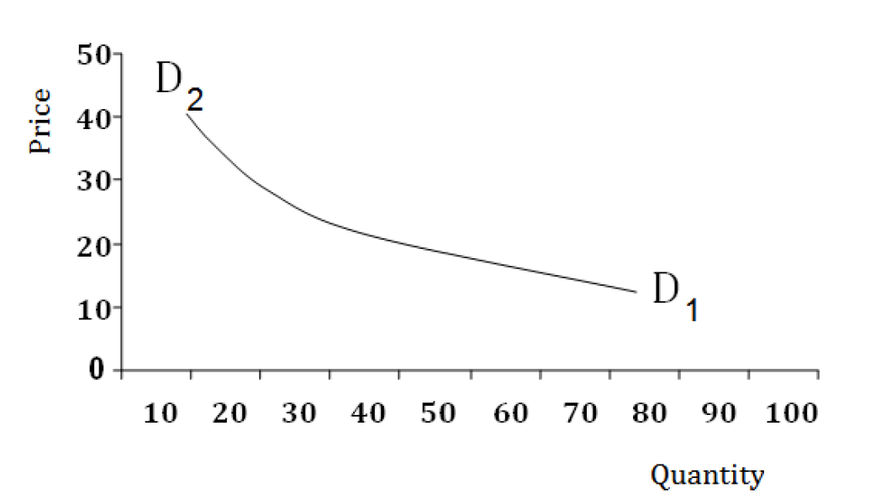
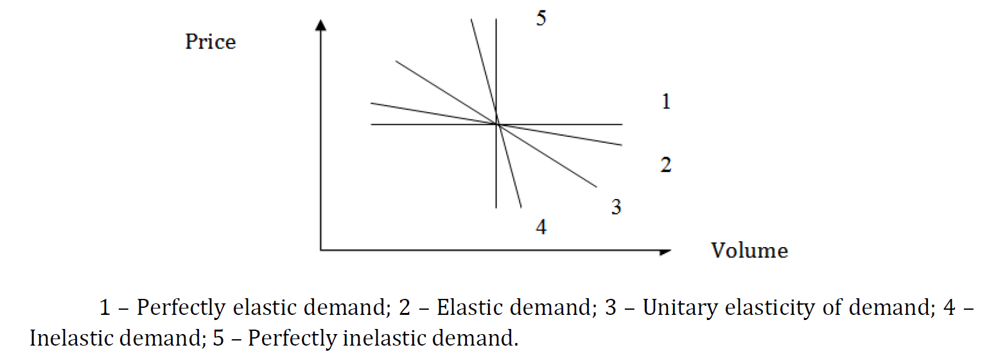
Law of demand
The demand curve shows :
- a larger number of buyers will be able to purchase the product at a low price ;
- if the prices for the goods are high , a certain number of buyers will refuse to buy;

Slide 13
Causes of inelastic demand
has no or almost no substitutes
Medicinal product
there are no competing drugs
has unique or exceptional properties
consumers believe that the price increase is related to the improvement of the quality of the medicinal product or to inflationary processes in the economy
a stable attachment of a significant part of the market to its brand was formed

Slide 14
FACTORS INFLUENCING THE PRICE ELASTICITY OF MEDICINE DEMAND
interchangeability of the drug | the more analogue drugs on the market, the higher the elasticity of demand for it (one generic drug can be replaced by another with the same active substance);
the importance of medicines for the consumer | innovative drugs can become such, medical services for a sick person are often inelastic;
the specific weight of the medicinal product in the consumer's income | the greater the share of medicinal products in the consumer's budget, the higher the price elasticity of demand for them;
time factor | the longer the decision-making period, the more elastic the demand for the drug.

Slide 15
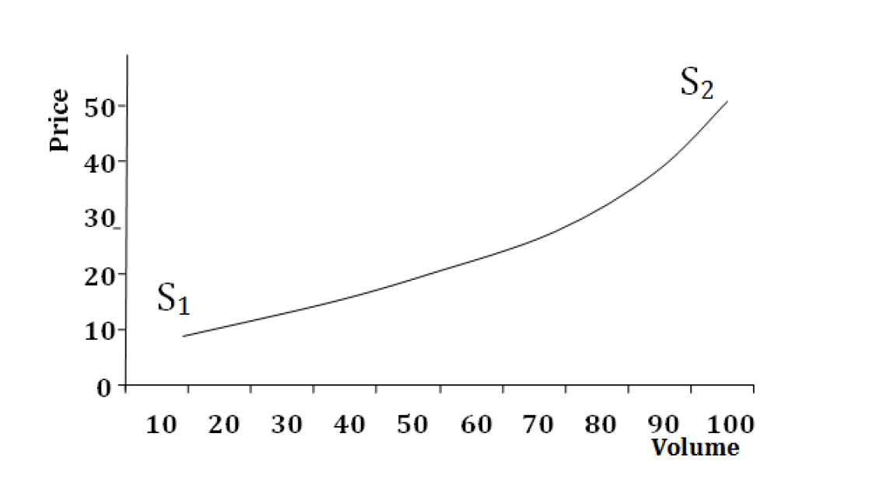
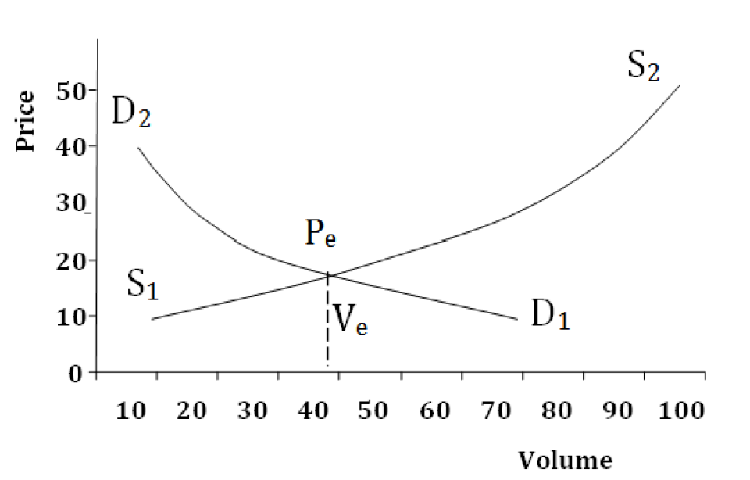
Law of supply
Supply is the total volume of goods that sellers are ready to offer at a specific time, in a specific place at alternative prices.
The equilibrium price indicates that the sellers' price is the same as the buyers' price.

Slide 16
Market penetration strategy
Strategy for "price-performance" indicators
Pricing strategies
Strategy of the price leader
"Associate" market strategy
Skimming strategy
"prestigious pricing" strategy
Strategy of discriminatory prices
Discount pricing strategy
Flexible pricing strategy
Unstable price strategy
Competitive pricing strategy
Unrounded pricing strategy
Mass procurement strategy

Slide 17

Market penetration strategy
By setting relatively low prices for their medicines, manufacturers hope to attract a large number of consumers and capture a significant market share. It is typical for manufacturers who are just starting their activities, or are developing a new market segment, or do not have patent protection and a trademark, that is, generic drugs .

Slide 18

The strategy of "removing the cream"
The pharmaceutical firm initially sets high prestige prices for original drugs that do not have analogues, which make them affordable only to consumers with a high level of affluence. After the first wave of sales slows down, the prices are gradually reduced, which makes it possible to gradually involve more and more market segments in the purchase of the medicinal product.

Slide 19

Strategy of "prestigious" prices
Consumers associate high prices with high quality and effectiveness of the drug. They are installed by companies with a high image in the pharmaceutical market. Consumers perceive a high price as a guarantee against fakes, which is especially important for medicinal products.

Slide 20


Strategy of the price leader
Strategy of discriminatory prices
It provides for the production and sale of high-quality, competitive medicines. Relevant for large pharmaceutical companies
is used if a pharmaceutical company sells a medicine at two or more different prices at constant costs.

Slide 21
Pricing models and methods
- Method of allowances
- The method of ensuring target profit on invested capital
cost
Basic pricing models
A pricing model based on market demand
A pricing model based on competition
- The method of maximizing current profit
- The method of setting the price based on the perceived "value" of the medicine
- Methods of establishing contractual prices in conditions of inflation
- Pricing method based on current price level
- The method of determining the price according to the level of competitiveness
- The method of setting the price based on bidding (tender pricing)

Slide 22

Thank you for your attention!

