Slide 1
Ministry of Health of Ukraine
Odesa National Medical University
LECTURE №17:
“Marketing activities of pharmaceutical enterprises”
Odessa – 2025

Slide 2

Sales policy of pharmaceutical enterprises
SALES POLICY is the activity of a pharmaceutical firm aimed at planning, implementing and controlling the movement of medicines to meet consumer demand and generate profits.

Slide 3
TASKS OF DISTRIBUTION POLICY
STRATEGIC TASKS
TACTICAL TASKS
Planning (forecast) future distribution channels
Selection of systems and methods of marketing and related types of channels
Routing of sales
Establish a network of wholesale and retail outlets, warehouses, showrooms, etc.
Operation with existing customers and attract new ones
Search and selection of commercial offers for the supply of goods
Organization of orders, including the transportation of freight and cargo handling operations
Ensuring the effectiveness of marketing
Check the availability of inventory and other logistics
Develop methods of sales promotion, including how to motivate participants in a distribution channel, etc.

Slide 4
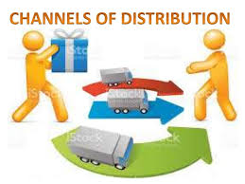
DISTRIBUTION CHANNELS - a collection of pharmaceutical companies or individuals who perform the intermediary functions for the physical movement of medicines and medical products and take over or facilitate the transfer of ownership of medicines from the manufacturer to the consumer.

Slide 5
Functions of distribution channels
1. Reporting – collecting and processing information obtained through market research and for planning and organization processes of distribution of goods.
2. Promotion – the development and distribution by means of marketing communication of information about products to attract buyers.
3. Establish contacts and negotiations – establishing and maintaining relationships with potential buyers, an agreement on prices, volumes and terms of delivery
4. Ordering – the conclusion of contracts with other members of distribution channel to purchase products by manufacturer, monitor their implementation.

Slide 6
Functions of distribution channels
5. Adapt products to customer requirements – production, sorting, packing and wrapping, assembling products, after sales service.
6. Physical movement of goods – the organization of transportation and warehousing.
7. Financing – search and distribution of the funds needed to cover the operating cost of the distribution channel.
8. Risk-taking – the responsibility for all processes in the channel of distribution

Slide 7
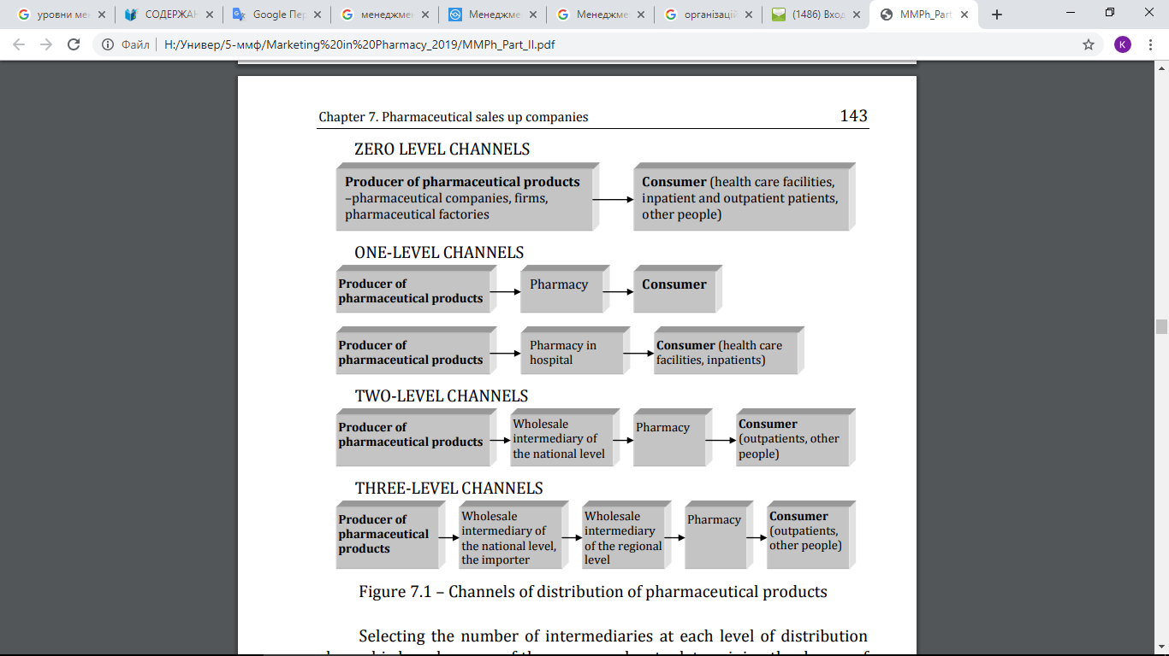
EXAMPLES OF VARIOUS DISTRIBUTION CHANNELS

Slide 8
Targets for drug pricing
LENGTH OF THE SALES CHANNEL determines the number of intermediaries through which medicines pass on the path from manufacturer to consumer.
LEVEL OF THE DISTRIBUTION CHANNEL - Any intermediary who performs any work on the promotion of medicines to the consumer.

Slide 9
Width of distribution channel, (or the method of distribution of medicinal products), is the number of independent participants at each channel level.
intensive distribution
use of numerous intermediaries in order to reach a wide market, obtain high profits through mass sales and convenience of the place of purchase of medicines for the consumer.
exclusive distribution
limited number of resellers in the geographic region (one or two) to maintain a prestigious image, control over sales channels and generate high profits through high pricing.
selective distribution
selecting the best resellers to combine channel control, a prestigious image with sufficient sales and revenue.

Slide 10
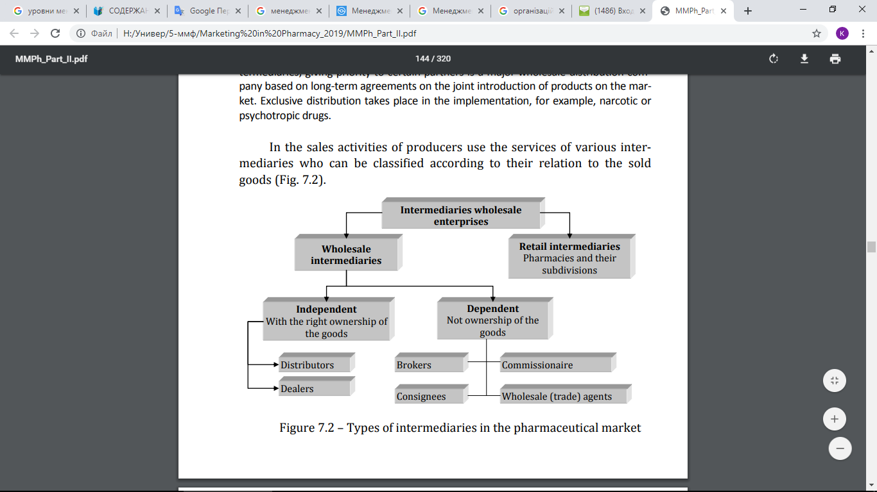

Slide 11

for attention!

