Slide 1

Ministry of Health of Ukraine
Odesa National Medical University
LECTURE
“Marketing communications policy”
Odessa – 2025

Slide 2

Promotion
Promotion is the creation and support term relations between the enterprise and the market in order to activate selling of goods and creating a positive image through information, persuasion and reminders about their activities.

Slide 3
Companies various kinds of activities are constantly engaged in pro-moting their products or services, striving to achieve several purposes:
1
to inform prospective customers about the goods, services, terms of sale
2
to convince the buyer to give preference to these products, go shop-ping in these retail establishments
3
to make the buyer to act to direct his behaviour to the fact that the market offers at the moment and not to delay the purchase for the future
4
to form loyalty to this brand
5
to stimulate process of acquiring of goods and others

Slide 4
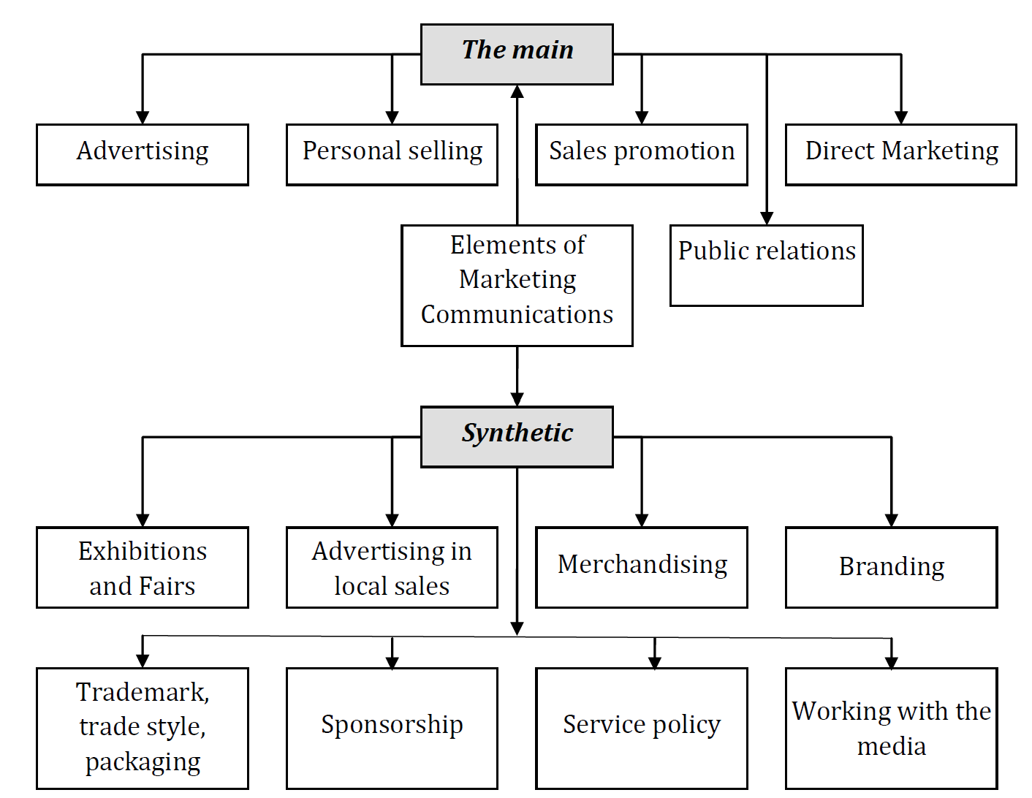
The elements of marketing communications

Slide 5
System of the marketing communication
is tool convincing information about a product or company, the commercial promotion of consumer goods and the good qualities of the company, the tool that prepares an active and potential customer to purchase.
is a combination of techniques used throughout the product life cycle for the three participants in the market (consumer, wholesaler, dealer), for short-term increase in sales and increase the number of new customers.
Advertising
is the process of creating by the seller favorable conditions for complete the purchase potential buyer
Personal selling
Main
Sales promotion
Public relations
are a long-planned effort to create and maintain goodwill and mutual understanding between an organization and the public

Slide 6
Marketing policy communications
is promising course of action which aims to ensure interaction with all subjects of the marketing system to meet the needs of customers and profit.
Management of the promotion or marketing communications is a complex of coordination of various elements of promotion; setting goals which might to be achieved through the use of these elements, estimating costs, sufficient for achieve these objectives, the development of special programs, evaluation of work and taking corrective action if the results are not consistent with the purposes.

Slide 7
Management of marketing communications
Planning
Organization
Motivation
Control
1.Identification of purpose
2. Identify the target audience
3. Determination of the desired feedback
4. Choice of appeals
5. Select means of information dissemination or influence
6. Determination the properties of information source
7. Selection means of the feedback
8. Calculation of the budget
1. The organization of the performers 2. Coordination of all elements of promotion
3. Implementation in uniform style
1.Consumer
2. Intermediaries 3. Sellers
4. Impact on the audience and contact regulatory agencies
1.Establish of feedback (surveys, tests, etc.)
2.Making adjustments
3. Evaluation of results

Slide 8
During planning a marketing communications communicator (company, informant) must:
Define the purpose of complex of marketing communications
Identify their target audience
Determine the feedback
Select an appeal
Choose the tools of dissemination of information
Select the properties which characterize the source of information
Collect the information received through the feedback
Calculate the budget

Slide 9
Factors that determine the structure of a marketing communications system
Goals and objectives require different means of promotion.
Type of product or market
The nature of product promotion strategy
The target audience
Stage of product life cycle
Volume of the market and its concentration
Resource availability and cost of promotion

Slide 10
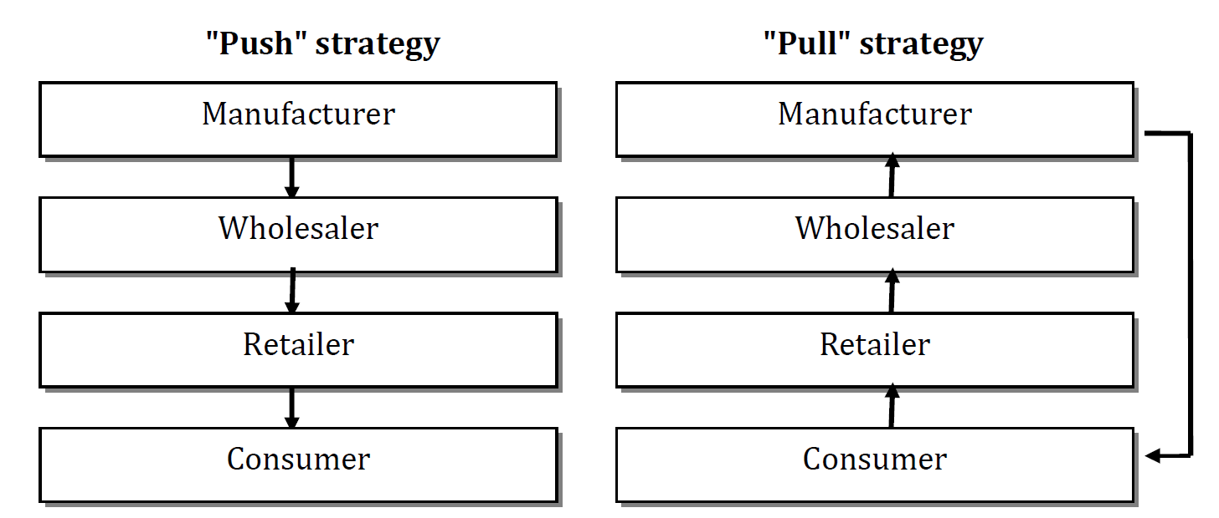
Promotion strategies

Slide 11
Factors that determine the structure of a marketing communications system
Advertising and public relations -awareness-raising;
Sales promotion; - 'pushing' doctors for drug testing
Personal selling - conviction of doctors in the expediency of prescribing this drug to patients with certain pathology and urging pharmacy specialists to take up its sale
Introduction
Advertising and public relations - retain their importance;
Sales promotion and Personal selling - Reduce
Growth
Advertising is reminding
Public relations, Sales promotion and Personal selling -Reduce
Maturity
Decline
Sales promotion - used actively
Advertising , Public relations, Personal selling - sharply reduced

Slide 12
Characteristics of components of the marketing communications system
Advertising is any paid non-personal form of distribution of information about a company and its medicines.
Its unique characteristics are:
expressive in nature, able to effectively present a drug, the pharmaceutical company itself;
mass audience reach
possibility of repeated appeal, ability to persuade, persuasion;
impersonality (compared to a personal sale, advertising is only capable of monologue (except electronic “direct mail”) and not of dialogue with the audience;
some of its types require large allocations (TV advertising), others - much cheaper (newspaper advertising).

Slide 13
Characteristics of components of the marketing communications system
Public Relations is an activity aimed at developing a positive image of the company, its favorable attitude towards it and its medicines.
The peculiarity of this component of the promotion of medicines are:
high reliability of information in the eyes of consumers, because it is presented in the form of news, not an advertisement;
wide audience reach;
long-term effect of public relations;
the content of the information is not always controlled by the pharmaceutical firm;
most often complements advertising.

Slide 14
Characteristics of components of the marketing communications system
A personal selling is an oral presentation of medicines during a conversation with one or more potential buyers for sale.
Personal sale is characterized by:
personal character;
direct, lively dialogue with the audience;
an incentive to respond;
the highest value among all promotions (per contact).

Slide 15
Characteristics of components of the marketing communications system
Sales promotion - are short-term incentives to encourage intermediaries and consumers to buy medicines (discounts, merchandise loans, support for regular customers, etc.).
Feature is:
attractiveness of sales promotion measures in the eyes of intermediaries and consumers;
incentives to purchase;
impulsive;
short-term effect; these measures are unsuitable for forming a strong commitment to a particular brand of medicinal product;
effectiveness when combined with advertising.

Slide 16
Advertising roles:
1. Marketing: consists in influence on a target market through each of the elements of marketing,
2. Communication: is that advertising is a form of mass communication. It transmits various types of marketing information to achieve understanding between buyers and sellers in the market.
3. Economic is seen as a source of information, which increases the sensitivity of consumers to price and stimulate competition.
4. Social
Advertising informs about the new and improved products
-Facilitates comparison of products, enabling the buyer to make a decision on the purchase
-Advertising has an impact on people - Development of advertising is to some extent an indicator of social development.

Slide 17
MODEL OF ADVERTISING INFLUENCE ON POTENTIAL CONSUMER
Consumers
The rationality of choosing a means of advertising distribution
Attention
Form of advertisement
The structure of the advertising appeal
Interest
Content of the advertising appeal
Impulsion
The association of the advertised medicinal product with the specific needs of the consumer
Rational motives
Desire
Emotional motives
Moral and social motives
Act
The decision to purchase the advertised drug

Slide 18
✓ providing free samples of medicines for in-depth clinical research;
✓ presentations of new medicines;
✓ lotteries, contests, quizzes;
✓ different price discounts;
✓ support for regular customers, discounting.
✓ rewarding the best employees;
✓ rewarding them with valuable gifts;
✓ giving the best employees extra days off;
✓ allocation of travel permits, organization of tourist trips at the expense of the company;
organizing competitions of specialists with awarding of winners;
✓ Expanding the participation of forerunners in the profits of a pharmaceutical firm
✓ use a broad arsenal of moral incentives.
Sales promotion
✓ discounts on the batch of purchased medicines;
✓ premiums for the level of medication sales;
✓ competitions and quizzes for pharmacy professionals;
✓ joint advertising;
Га Assistance to pharmacies in the design of service halls, etc.

Slide 19

for attention!

