Slide 1

Ministry of Health of Ukraine
Odesa National Medical University
LECTURE
“Advertising in the pharmaceutical marketing system”
Odessa – 2025

Slide 2

ADVERTISING AND ITS ROLE
Advertising is the best tool for the business enterprise in an attempt to influence the behavior of consumers draw their attention to the production company, to create a positive image of the company to show it to the public good.
Advertising is tool convincing information about a product or company, the commercial promotion of consumer goods and the good qualities of the company, the tool that prepares an active and potential customer to purchase.

Slide 3
Advertising appears in four roles: marketing, communication, economic and social.
The marketing role
consists in influence on a target market through each of the elements of marketing, because it includes a mechanism for the transfer of customer information, in turn, advertising is a component of marketing communications.
The communicative role
is that advertising is a form of mass communication. It transmits various types of marketing information to achieve understanding between buyers and sellers in the market.
On economic role
of the system, there are two views concerning the impact of advertising on the economy.
The social role
1. Advertising informs about the new and improved products
2. Facilitates comparison of products, enabling the buyer to make a decision on the purchase
3. Advertising has an impact on people
4. Development of advertising is to some extent an indicator of social development.

Slide 4
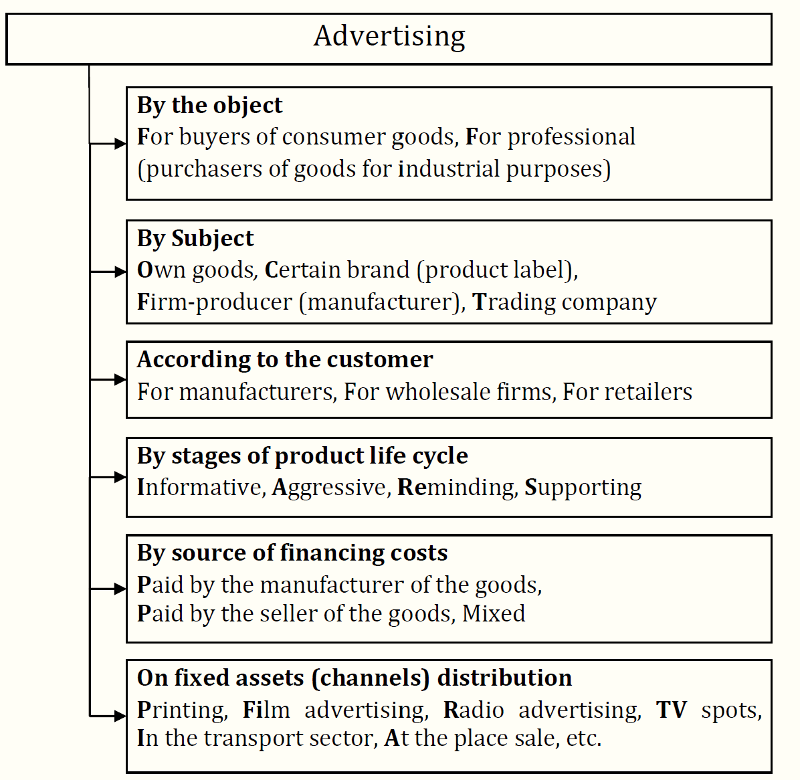
Classification of advertisements

Slide 5
Characteristics of components of the marketing communications system
Its unique characteristics are:
expressive in nature, able to effectively present a drug, the pharmaceutical company itself;
mass audience reach
possibility of repeated appeal, ability to persuade, persuasion;
impersonality (compared to a personal sale, advertising is only capable of monologue (except electronic “direct mail”) and not of dialogue with the audience;
some of its types require large allocations (TV advertising), others - much cheaper (newspaper advertising).

Slide 6
Advertising roles:
1. Marketing: consists in influence on a target market through each of the elements of marketing,
2. Communication: is that advertising is a form of mass communication. It transmits various types of marketing information to achieve understanding between buyers and sellers in the market.
3. Economic is seen as a source of information, which increases the sensitivity of consumers to price and stimulate competition.
4. Social
Advertising informs about the new and improved products
-Facilitates comparison of products, enabling the buyer to make a decision on the purchase
-Advertising has an impact on people - Development of advertising is to some extent an indicator of social development.

Slide 7
MODEL OF ADVERTISING INFLUENCE ON POTENTIAL CONSUMER
Consumers
The rationality of choosing a means of advertising distribution
Attention
Form of advertisement
The structure of the advertising appeal
Interest
Content of the advertising appeal
Impulsion
The association of the advertised medicinal product with the specific needs of the consumer
Rational motives
Desire
Emotional motives
Moral and social motives
Act
The decision to purchase the advertised drug

Slide 8

MANAGEMENT OF ADVERTISING OF PHARMACEUTICAL BRANDS
The development of the pharmaceutical industry and the pharmaceutical market in Ukraine is important not only for the economic, but also for the social and even political aspects of the life of Ukrainian society. In the conditions of tough market competition and the high cost of developing new drugs, pharmaceutical companies are forced to look for additional competitive advantages, such as, for example, brand advertising.
Please read the article by scanning the barcode or use the link
https://www.moderntechno.de/index.php/meit/article/view/meit25-04-070/5411

Slide 9

The Future of Prescription Drug Promotion and Digital Marketing
The Duke-Margolis Center convened a one-day public workshop that explored the state of digital prescription drug promotion, including the marketing technologies and strategies currently available and commonly used by marketers. Participants explored how current and future digital marketing tools can impact patient, HCP, and consumer perceptions and behaviors generally, while diving into specific issues like the presentation of risk information and disclosures of material information necessary to ensure that the prescription drug promotion through these digital platforms and technologies is truthful and non-misleading. Participants discussed emerging trends in both digital and legacy marketing channels and what those trends may mean for public health.
Please view the video by scanning the barcode or use the link
https://www.youtube.com/watch?v=X5w3KsmBNiU

Slide 10

for attention!

