Slide 1
Ministry of Health of Ukraine
Odesa National Medical University
Faculty of Pharmacy
Lecture 2(Part 1)
“Management functions
Odesa 2025

Slide 2

FUNCTIONS OF PHARMACEUTICAL MANAGEMENT
are separate types of management activities (labor processes in the field of management), which provide the formation of methods of managerial influence.

Slide 3
CLASSIFICATION OF MANAGEMENT FUNCTIONS
Based on a place in management
SPECIFIC (special)
GENERAL (basic)
CONNECTING
Based on management processes
Based on management objects
Based on the elements of production and economic activity
direction
Planning
Organization
Motivation
Controlling
Regulation

Slide 4
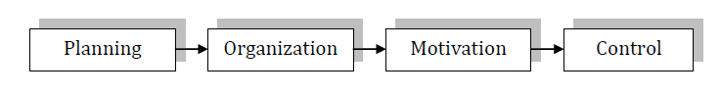
TECHNOLOGY OF MANAGEMENT
it is the sequential flow of general management functions, as a result of which specific management functions are implemented. In this case, the decisive role is played by specific management functions, which are implemented through general management principles.

Slide 5

PLANNING
is a type of management activity (work processes) that determines the perspective and future state of the organization.

Slide 6
PLANNING
STRATEGIC
TACTICAL
current
it is a type of planning that consists in developing a strategy for the organization's activities.
this is a type of planning, which consists in developing mechanisms for implementing the chosen strategy. Includes current and operational planning.
operational

Slide 7
STAGES OF STRATEGIC PLANNING
information support for strategic planning
establishment of the mission, vision and goals of the organization
MISSION is the clear reason for the organization's existence
VISION is an idea about the vision of the future of the organization
the choice of methods for analyzing factors of the internal and external environment
assessment and analysis of environmental factors
assessment and analysis of factors of the internal environment
forecasting the conditions of functioning and the results of production and economic activities of the enterprise
performing calculations, justifications, design solutions
the formation of options for strategies (strategic alternatives)
choice of strategy
assessment of the strategy for compliance with the established criteria

Slide 8

ORGANIZATION
is a type of management activity that reflects the process of creating an organization's management structure.
The organization is based on three categories: authority, responsibility and delegation.

Slide 9
is a limited right to use the resources of an enterprise (material, financial, labor, etc.) and direct the efforts of subordinate employees to fulfill established tasks. Powers are delegated to positions, not to a person.
AUTHORITY
is the duty of an official to fulfill the assigned tasks and ensure their positive solution.
RESPONSIBILITY
is the transfer of tasks and powers to a person who assumes responsibility for their implementation.
DELEGATION

Slide 10
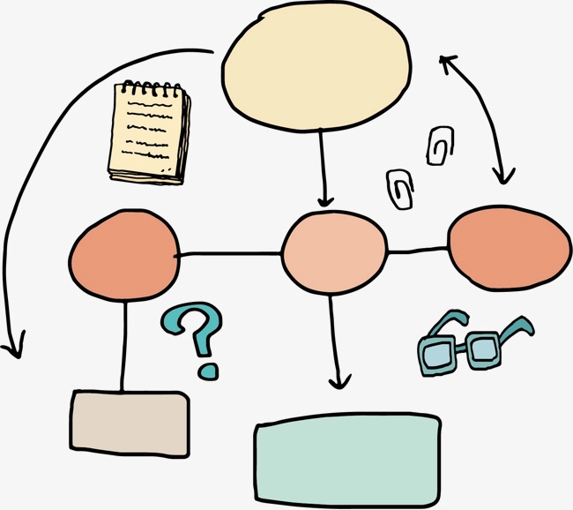
THE ORGANIZATIONAL STRUCTURE OF MANAGEMENT
is a well-organized set of units that form the levels of management, their interconnection and permitting the management of the organization.
There are two main management structures - linear and functional.

Slide 11
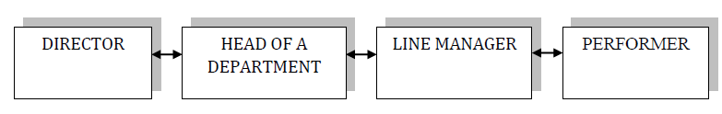
LINEAR ORGANIZATIONAL MANAGEMENT STRUCTURE
a set of mutually subordinate bodies in the form of a hierarchical ladder, where each manager is subordinate to only one manager and all connections with the highest levels of management go through him.

Slide 12
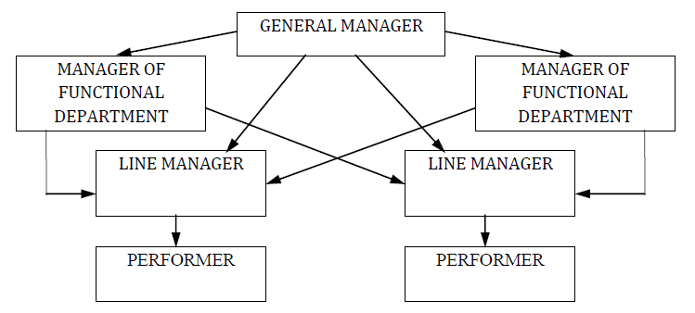
FUNCTIONAL ORGANIZATIONAL MANAGEMENT STRUCTURE
a hierarchy of bodies that ensure the implementation of each management function at all levels, while managers specialize in individual management functions that are performed by relevant specialists.

Slide 13
Motivating
is a type of management activity that provides a process of motivating oneself and other employees to activities that are aimed at achieving personal goals and objectives of the organization.
ALGORITHM OF MOTIVATION
NEEDS INTERESTS INCENTIVES MOTIVES BEHAVIOR REWARDS OBJECTIVES

Slide 14
CONTENT THEORY OF MOTIVATION
(focus on the analysis of human needs, the priority of their motivating action)
Hierarchy of needs A. Maslow
The theory of needs of M. Tugan-Baranovsky
D. McClelland's theory of needs
The ERG theory by K. Alderfer
Herzberg's two-factor theory of needs
Theory "Z" by W. Oachie
Theories "X" and "Y" D. McGregor

Slide 15
CONTENT THEORY OF MOTIVATION
1. The physiological, sexual, symptomatic and practical needs are highlighted.
2. Of particular importance is belonging to nationalities, moral and religious views.
The theory of needs of M. Tugan-Baranovsky
1. Needs are divided into primary [physiological needs (hunger, thirst, sex, etc.), the need for self-preservation (safety, security)] and secondary [social needs (involvement in events, feeling of closeness, love), the need for respect ( recognition from society) and the need for self-affirmation, self-realization]
2. The behavior of people is determined by the needs of the lowest order.
3. After satisfying the needs, their motivating action ceases.
Hierarchy of needs A. Maslow

Slide 16
CONTENT THEORY OF MOTIVATION
1. Three needs that motivate a person: power, success, involvement.
2. Focus on higher-order needs as lower-order needs are already met.
D. McClelland's theory of needs
1. Hygienic and motivational factors are highlighted.
2. Hygienic factors (lower order) prevent discontent with work.
3. Motivational (higher order) affect behavior.
Herzberg's two-factor theory of needs
1. The main groups of needs that motivate a person: existence, connections, growth.
2. If it is impossible to meet the needs of the highest level, efforts to meet the needs of the lower level are increased.
The ERG theory by K. Alderfer

Slide 17
CONTENT THEORY OF MOTIVATION
1. Theory "X" stipulates that workers tend to avoid work and responsibility, so control and threats must be used to stimulate them.
2. Theory “Y” appeal to needs of a higher order: the need for involvement, to have high goals, autonomy and self-expression.
3. Employees are more inclined towards theory "Y," but organizational conditions and behavior of managers predetermine their choice of theory "X".
Theories "X" and "Y" D. McGregor
1. Theory "Z" defines that the basis for the success of employees is a belief in common goals.
2. Significant incentives are trusting relationships and mutual support, complete coordination of actions.
Theory "Z" by W. Oachie

Slide 18
PROCESS THEORY OF MOTIVATION
(focus not only on the needs, but also on the process of stimulation itself, the definition of conditions,
in which the motivation process will be more effective)
S. Adams' theory of justice
Vroom's expectancy theory
Participatory governance theory
J. Atkinson's theory of affective valence
Complex theory of L. Porter and E. Lawler
Material incentive theory
Moral incentive theory

Slide 19
PROCESS THEORY OF MOTIVATION
1. Provides for such expectations: "the effort expended - the expectation of a certain level of results", "the results obtained - the expectation of a certain reward", "the expectation of a valuable reward that can satisfy the needs."
2. Integrity of accounting for all types of expectations.
Vroom's expectancy theory
1. Compliance with the principles of fairness and objectivity in the establishment and distribution of remuneration.
2. Taking into account the possible reaction of employees to unfair motivation.
S. Adams' theory of justice

Slide 20
PROCESS THEORY OF MOTIVATION
1. Involvement of employees in the management of the organization in order to increase their level of satisfaction with work, which will contribute to the growth of more effective activities of organizations.
2. Focuses on the process of meeting the needs of the highest order.
Participatory governance theory
1. Claims that any person seeks to achieve success, assert himself, and realize his own potential.
2. Motivation of activity depends on the desire to achieve success or avoid negative assessment.
J. Atkinson's theory of affective valence

Slide 21
PROCESS THEORY OF MOTIVATION
1. Includes elements of the theory of expectations and the theory of justice.
2. Provides for the satisfaction or displeasure of the employee as a result of the received remuneration for the level of results achieved in the performance of specific tasks, which in turn is determined by the efforts, abilities, character and assessment of the employee's role.
Complex theory of L. Porter and E. Lawler

Slide 22
PROCESS THEORY OF MOTIVATION
1. Focuses on meeting the needs of a higher order (recognition, involvement, respect, etc.).
2. Based on the use of non-material incentives (benefits for medical and sanitary services, transportation, certificates, medals, orders, titles, gratitude, etc.).
Moral incentive theory
1. Provides for the formation and use of systems of material incentives and the distribution of wages in accordance with the action of the distribution law according to the quantity and quality of work.
2. Based on the use of material incentives (forms and systems of payment for work, bonuses, allowances, additional payments, gifts, etc.).
3. Is the most effective in terms of motivation.
Material incentive theory

Slide 23

CONTROL
is a type of management activity to ensure the process by which the organization's management determines how correct its management decisions are, as well as the need for certain adjustments.
The main tasks of control are:
to ensure the achievement of the goals and mission of the organization;
identify deviations and shortcomings;
avoid the accumulation and repetition of errors, minimize losses, overcome complex organizational problems, etc.

Slide 24
CLASSIFICATION OF CONTROL TYPES
1. Within the meaning
financial, production, operational, marketing and other control
2. By stages of implementation of production-economic activities
Preliminary control | is carried out at the entrance to the organization's system and is implemented through rules, procedures, behavior.
Current control | is implemented in the very system-organization in the process of production and economic activities and is in the nature of managerial necessity;
Final control | is carried out at the exit from the system, that is, as feedback is used after the work is done.

Slide 25
CLASSIFICATION OF CONTROL TYPES
3. By the level of centralization of management of control
Centralized | characterized by the presence of specialized control services, the use of harsh rules, “top-to-bottom” influence, and the secrecy of information about control.
Decentralized | based on social norms, values, traditions and corporate culture; focusing on self-control and intragroup control; transparency of information about the purposes, means, timing of control; ensuring bilateral influence.

Slide 26
CLASSIFICATION OF CONTROL TYPES
4. By the level of object control coverage
Continuous | provides for a consistent check of the entire set of controlled objects
Selective | carried out only with respect to individual objects from the entire homogeneous set
One-time | carried out under the influence of factors that accidentally or unexpectedly arise in the process of production and economic activities

Slide 27

REGULATION
is a type of management activity aimed at eliminating deviations, failures, shortcomings, etc. in the managed system by developing and implementing the appropriate measures by the managing system.

