Slide 1
Ministry of Health of Ukraine
Odesa National Medical University
Department of organization and economics of Pharmacy with postdiploma specialization
Lecture 1
“Theoretical foundations of management.
Odesa 2025

Slide 2
The essence of management, marketing and logistics as management theories
“Management” literally means management-related activities. As a scientific management theory, it appeared at the beginning of the 20th century.
Management is the purposeful influence on the team of employees or individual performers in order to fulfill the assigned tasks and achieve certain goals. From a functional point of view, management is the process of planning, organizing, motivating, controlling and regulating, necessary for the formation and achievement of the goals of the organization.
By organizations they mean enterprises, business societies, banks, associations, their departments, bureaus, workshops, etc.
MANAGEMENT OF PURPOSE PEOPLE(goal-oriented people)!

Slide 3
The essence of management, marketing and logistics as management theories
Management
Industrial management
is a set of principles, methods and forms of management, with the aim of increasing its efficiency and increasing profits.
Financial management
is a system of principles and forms for organization of monetary relations of an enterprise, aimed at managing its financial and economic activities.

Slide 4
The essence of management, marketing and logistics as management theories
MARKETING is an activity aimed at creating demand and achieving the goals of an enterprise through the maximum satisfaction of consumer needs.
MANAGEMENT OF EXCHANGE PROCESSES WITH MUTUAL BENEFITS OF THE PARTIES!
To influence consumers, an organization uses a combination of tools (marketing mix) for achieving the desired response from their side. There are main four elements (4P) —product, price, place and promotion.

Slide 5
The essence of management, marketing and logistics as management theories
LOGISTICS is an ordered body of knowledge, as well as purposeful research of the processes of formation and development of end-to-end (integrated) flows in a specific industry or economy as a whole.
MANAGEMENT OF FLOW PROCESSES WITH MINIMIZATION OF THE COSTS OF THEIR IMPLEMENTATION
Logistics activity has an ultimate goal, which is called the “seven rules of logistics”, or the logistics complex “7R”, namely: Right Product, Right Quantity, Right Time, Right Place, Right Cost, Right Condition and Right Information.

Slide 6
Relationship between concepts
"GOVERNANCE" and MANAGEMENT "
GOVERNANCE
MANAGEMENT
purposeful action on an object in order to change its state or behavior in connection with a change in circumstances. You can control technical systems, computer networks, a car, a conveyor belt, an airplane, people, etc.
a kind of management, namely the management of people (employees, collectives of employees, groups, organizations, etc.).

Slide 7
Basic management principles and their characteristics
Principe | Characteristics
Purposefulness | Any activity in the organization should be aimed at achieving specific production and economic goals and fulfilling the assigned tasks
Taking into account the needs and interests | This principle is intended to satisfy the needs and interests of employees in order to achieve the goals of the organization based on the application of motivation.
Hierarchy | The location of management positions in the organizational structure, from the lowest management level to the highest.
Interdependence | The organization consists of internal replacements (goals, structure, technology, employees, tasks, resources), closely dependent one on one. At the same time, environmental factors constantly influence the organization and cause an appropriate reaction from its side.

Slide 8
Basic management principles and their characteristics
Principe | Characteristics
Dynamic balance | Provides for the continuous development of the organization and the maintenance of general equilibrium at each stage of this development
Profitability | Forms the basis for the functioning of the organization from the standpoint of balancing costs, receipts, etc., ensures the development of budgetary relations.
Revitalization | It is a principle that encourages an organization to act, continuous development, innovation, etc.
Consistency | The organization is viewed as an open system consisting of interacting and interrelated elements
Unity | Provides for the presence of a single responsible center that guides and coordinates the organization's activities in order to achieve its goals

Slide 9
Stages of management development
Stage name | School, duration | Stage essence
The stage of developing the science of the managing people in industry | -the school of scientific management (1885–1929), the school of “fordism” (1899–1945), the classical or administrative school (1915–1950). | It was based on improving the efficiency of the organization through the improvement of production processes and operations;
The formation stage of management mechanisms based on the development of human relations | the school of psychology and human relations (1939–1950), the school of behavioral sciences (1950 - our time). | The stage is connected with recognizing the person as a priority factor of production and economic activity

Slide 10
Stages of management development
Stage name | School, duration | Stage essence
The stage of building market-oriented management systems | from the second half of the last century | associated with the emergence of overproduction problems in enterprises, caused by unsecured demand;
The stage of active use of quantitative methods (economic and mathematical) as important areas in forming management methods and their transformation into management decisions | School of Management Science (1950 - our time). | Stage associated with the widespread use in the management of mathematics

Slide 11
Stages of management development
Stage name | School, duration | Stage essence
The stage of formation of integrated management approaches - systemic and situational approaches | since the late 50s-60c | The stage is connected with the consideration of the organization as a system whose activity constantly depends on a variable set of circumstances;
The stage of computerization of management processes | since the 1980s | is associated with the development of information and computer technologies

Slide 12
Comparative characteristics of Japanese and American models of management
Criteria | Japanese model | American model
The nature of management decisions | Consensus decision making | Individual decision making
Responsibility | Collective | Individual
Management structure | Non-standard, flexible | Severely formalized
The nature of control | Collective | Individual control of the head
Сontrol organization | Soft non-formalized control | Clearly formalized strict control procedure
Evaluation of manager's performance | Slow assessment of employee performance and career growth | Quick result evaluation and accelerated promotion

Slide 13
Comparative characteristics of Japanese and American models of management
Criteria | Japanese model | American model
Evaluation of leadership qualities | The ability to coordinate and control | Professionalism and initiative
Assessment of personnel performance | Achievement of collective result | Achievement of individual result
Relations with subordinates | Personal informal relationships | Formal relationship
Career | Promotion according to age, length of service and loyalty to the company | Business career is determined by personal achievements
Leadership training | Universal Leadership Training | Training highly specialized in particular field managers

Slide 14
Comparative characteristics of Japanese and American models of management
Criteria | Japanese model | American model
Salary | In accordance with the result of group work, experience | Pay for individual achievements
Employment period in the company | Long-term employment of a manager in a company, lifetime employment | Employment on a contractual basis, short-term hiring
General control principle | "Down up" | “From the top down”
Staffing table | Lack of clearly defined positions and assignments within the organization | Functional Subordination and Clear Limits of Authority
Professional development | On the job (in the workplace) | Separately, under special training programs

Slide 15
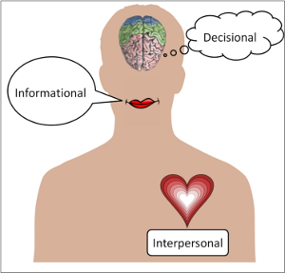
Ten managerial roles for G. Mintsberg
In the late 60s. last century, the American economist Henry Mintzberg identified ten managerial roles that managers perform. These ten roles were grouped into three groups:
interpersonal;
Informational;
decision-making roles

Slide 16
Ten managerial roles for G. Mintsberg
Role (Who) | Definition (Duties) | Actions
Interpersonal roles
Chief (formal head) | Symbolic head, to the duties ─ the implementation of the legal and social actions | Ceremonies, actions that are determined by position or status, meeting visitors, signing
Leader | Responsible for motivating and activating subordinates, hiring, training workers | Virtually all management actions involving subordinates
Link to the external environment (intermediary) | Ensures the functioning of the external contacts network and sources of information, forming a favorable attitude towards the organization and its positive image | Correspondence, participation in meetings, meetings, performing external duties, public relations, mass media

Slide 17
Ten managerial roles for G. Mintsberg
Informational roles
Recipient of information(monitoring) | Searches and receives various specific information (generally current), which is transformed and successfully used, according to the needs of the organization and external conditions | Mail, personal contacts (periodicals, telephone, fax, Internet, E-mail, orientation meetings, travels and inspection visits)
Distributor of Information (informer) | Transmits information coming from external sources or from other subordinates to members of the organization. Some information is factual, and some need to be generalized. | Correspondence with organizations for holding informational meetings, verbal contacts for transferring information to subordinates (reviews, conversations)
Representative of the organization external contacts (speaker) | Transmits information for external contacts of the company regarding plans, policies, actions, results of work, acts as an expert in industry | Participation in meetings, oral public statements, appeals through the media

Slide 18
Ten managerial roles for G. Mintsberg
Decision making roles
Entrepreneur looking for opportunities to improve the organization | Searches for opportunities and development prospects within the organization and externally, develops and implements “improvement projects”, its controlling | Forming a strategy, situation reviews, initiative, contacts, links, search for opportunities
Liquidator violations | Responsible for corrective action when important or unexpected changes needed in the organization | Discussion of strategic and operational issues, including problems and crisis situations
Resource allocator | Makes or approves all significant decisions that relate to the distribution of existing assets or resources of the organization | Compiles schedules, requests for authority, budgets, programing the work of subordinates
Negotiator | Represents the organization in all significant and important negotiations. | Negotiates, concludes agreements, makes decisions

Slide 19
The cycle of management
Planning
Organization
Motivation
Controling
definition of a mission, vision, formulation of a strategy, setting goals etc.
distribution of responsibilities and authorities, work, choice of technology
motivation and stimulation of team work, conflict resolution
elimination of deviations, failures, deficiencies with the help of appropriate measures

Slide 20
Types of responsibility
Legal responsibility
Social responsibility
is the implementation of specific state laws, instructions and regulations that determine what an organization can do and what can’t.
is a voluntary response to the social problems of society by the organization.

Slide 21
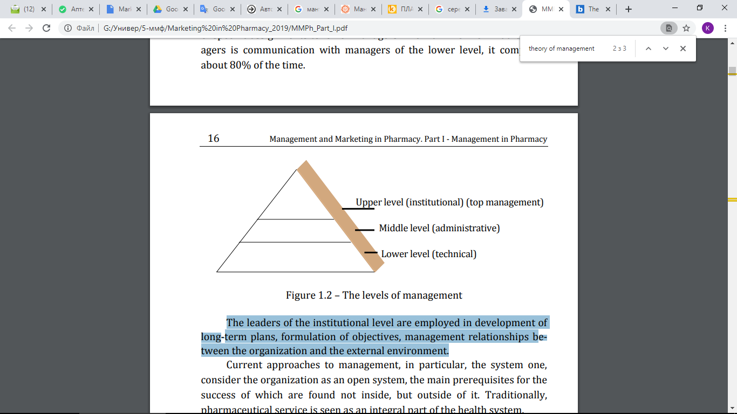
Level structure of management
The structural division of labor employees of the administrative apparatus is of two types: horizontal and vertical.
The horizontal division of labor provides for the appointment of managers to manage individual divisions of the organization that perform specific tasks (for example, pharmacy departments).
Activities aimed at coordinating the work (actions) of individual departments of the organization to achieve its goals, is the essence of management and is called the vertical division of labor. It predetermines the creation of control levels.

