Slide 1
LECTURE 3
Steroid hormones and their analogues: progestogens, androgens and their analogues. Characteristics, classification, relationship between structure and pharmacological action, mechanism of action, methods of obtaining, methods of analysis, application in medicine.

Slide 2
Steroid hormones and their analogues
Progestogen hormones and their semi-synthetic analogues
Progestogen hormones (corpus luteum hormones) and their semi-synthetic analogues, as well as corticosteroids, in most cases:
have methyl groups in positions 10 and 13;
have a keto group in position 3;
have an unsaturated bond in position 4;
do not have an oxygen function in position 11;
unlike corticosteroids, in position 17 instead of the α-keto group they have acetyl or hydroxy- and ethynyl groups.
1

Slide 3
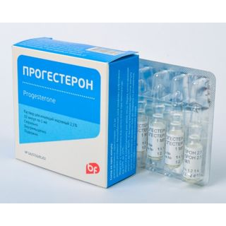
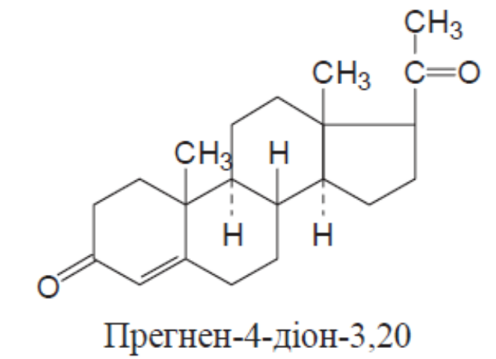
Progesterone
Pregnen-4-dione-3,20
Mechanism of action. The drug causes the transformation of the uterine mucosa from the proliferation phase to the secretory phase, which is necessary for normal implantation of a fertilized egg, and after fertilization promotes its transition to a state necessary for the development of a fertilized egg. Progesterone also reduces the excitability and contractility of the muscles of the uterus and fallopian tubes, which ensures the preservation of pregnancy; stimulates the development of the terminal elements of the mammary glands.
2

Slide 4
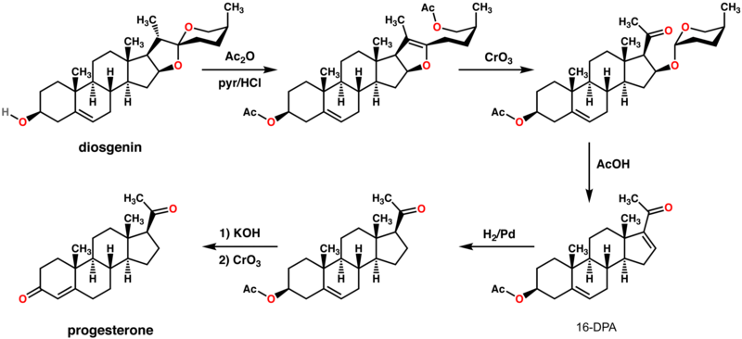
Synthesis.
3

Slide 5
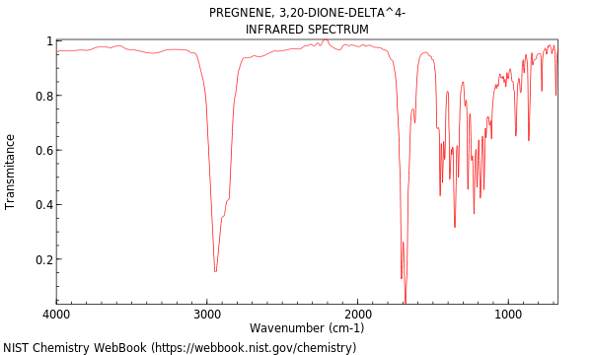
Properties. White crystalline powder. Practically insoluble in water, soluble in ethanol and ether, very slightly soluble in chloroform.
Identification:
ІR spectrophotometry, TLC;
4

Slide 6
a solution of the drug in concentrated H2SO4 after adding water acquires a yellow color with green fluorescence. After adding chloroform, the color disappears (steroid cycle);
when heating an alcoholic solution of progesterone with m-
dinitrobenzene and sodium hydroxide, a pink color appears, which turns into red-brown;
for identification, the decomposition temperature of 2,4-
dinitrophenylhydrazone obtained during quantitative determination is determined (keto group in position 3).
Quantification. Gravimetry based on the products of interaction with 2,4-dinitrophenylhydrazine or spectrophotometry in ethanol solution at λ = 241 нм.
Storage. In a sealed container, protected from light.
Application. Progestogen drug.
5

Slide 7
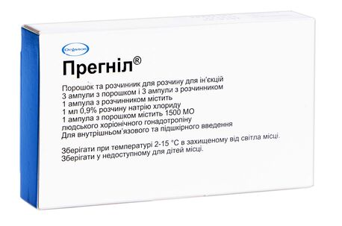
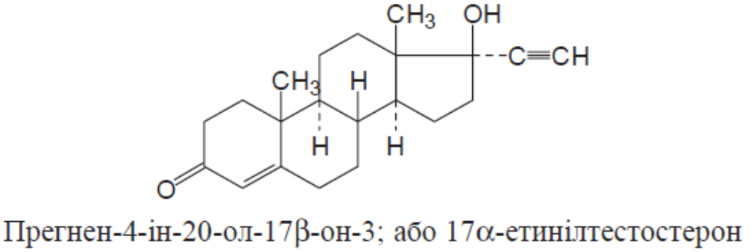
Pregnin
Pregnen-4-in-20-that-17β-on-3
or 17α-ethynyltestosterone
Properties. White or slightly yellowish, odorless crystalline powder. Practically insoluble in water, very slightly soluble in ethanol and ether, slightly soluble in chloroform.
6

Slide 8
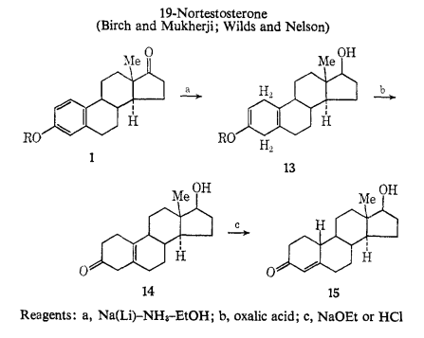
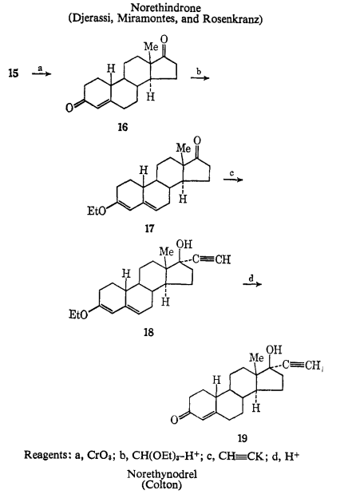
Synthesis.
7

Slide 9
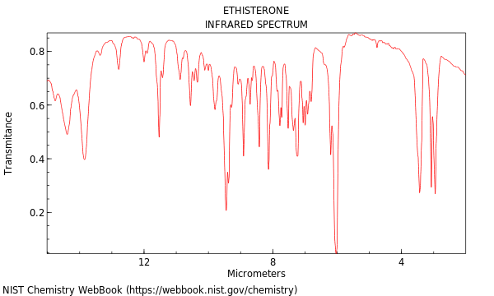
Identification:
ІR spectrophotometry, TLC;
8

Slide 10
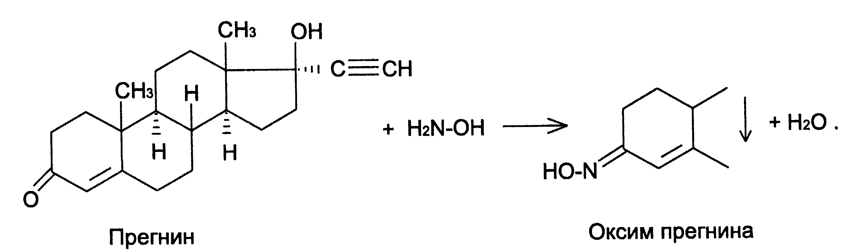
when dissolving pregnin in concentrated H2SO4 and adding water – crimson color with green fluorescence. After adding chloroform and stirring, the lower layer turns orange, the upper one is almost colorless (steroid cycle);
determine the melting point of the oxime (keto group in
position 3).
9

Slide 11
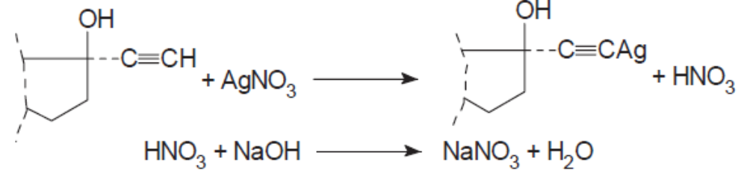
Quantification.
Alkalimetry by substituent. To a solution of the substance in THF, a solution of AgNO3 and the HNO3 that has separated are added, titrated with a NaOH solution using bromocresol green or potentiometrically, s = 1:
Spectrophotometry in alcohol solution at λ = 241 nm compared to standard.
Storage. In a sealed container, protected from light.
Application. Progestogen. 5–6 times less active than progesterone, but retains activity when taken sublingually.
10

Slide 12
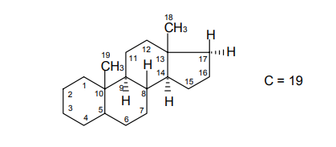
Androgenic hormones and semi-synthetic anabolic substances
Androgenic hormones are produced by the male gonads (testicles) during puberty.
Chemically, these substances are derivatives of the hydrocarbon androstane:
11

Slide 13
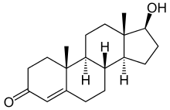
Testosterone, which is an endogenous male sex hormone, in addition to its specific androgenic action, like all androgens, affects nitrogen metabolism and can be considered an endogenous anabolic hormone:
It has been established that the action of testosterone becomes longer after esterification with aliphatic acids. Esters create a kind of depot at the injection site, from which they are gradually absorbed, while testosterone is excreted from the body quite quickly by the kidneys. One of the most active and stable testosterone esters during storage is testosterone propionate.
12

Slide 14
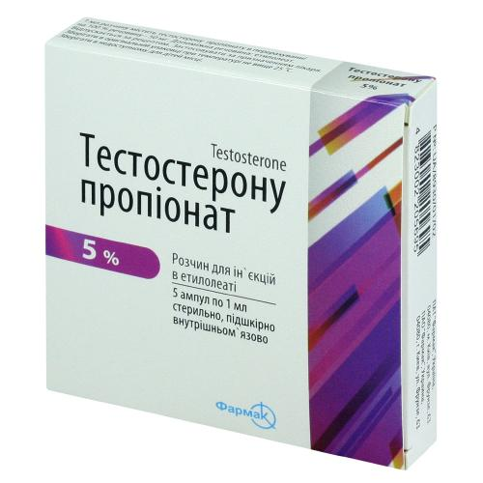
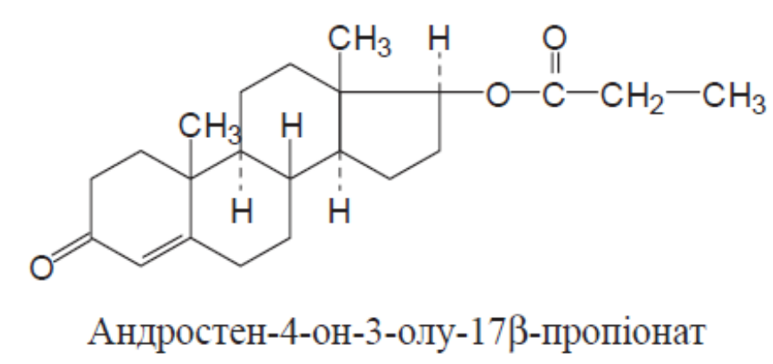
Testosterone Propionate
Androsten-4-one-3-ol-17β-propiateon
Properties. White crystalline powder. Practically insoluble in water, very slightly soluble in chloroform, freely soluble in ethanol and ether..
13

Slide 15
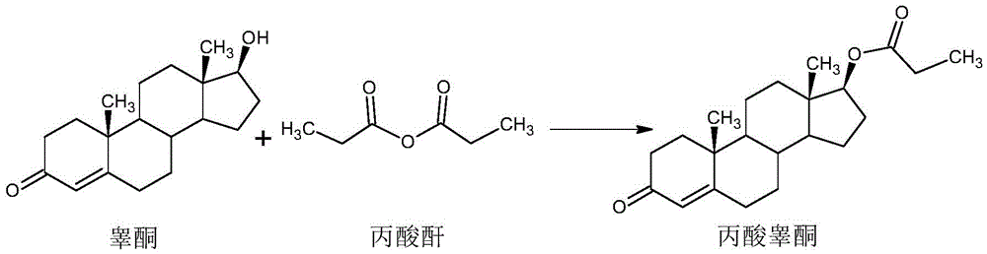
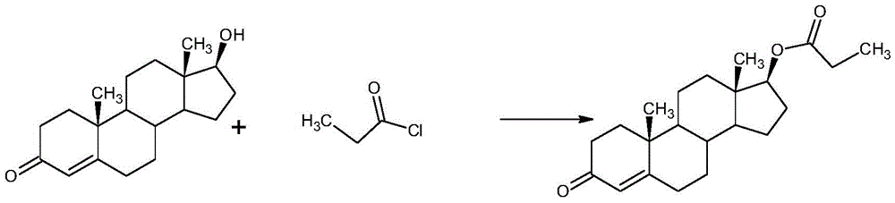
Synthesis.
14

Slide 16
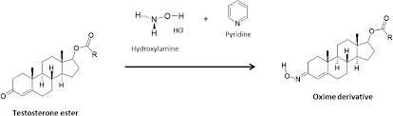
Identification:
determine the melting point; establish the melting point of the oxime (166–171 °C; keto group in position 3) and testosterone, the product of alkaline hydrolysis (150–156 °С);
M.p. 166–171 °С
15

Slide 17
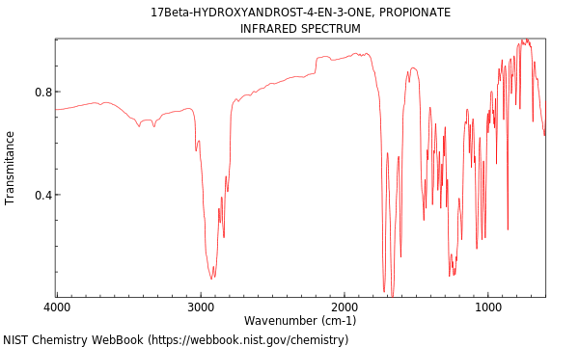
identified by IR absorption spectrum;
16

Slide 18
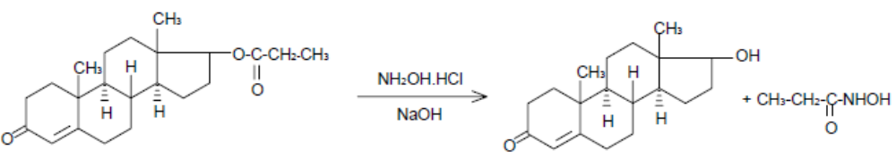
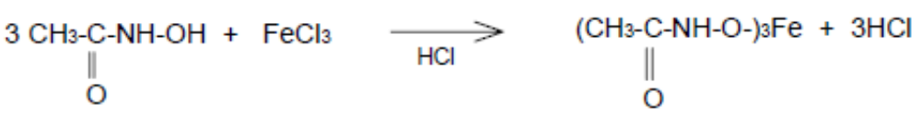
as the testosterone propionate ester gives a red-brown
color in the hydroxam test reaction (17 β-propionate):
Quantification. Spectrophotometry.
Storage. In a sealed container, protected from moisture and light.
Application. Androgenic drug for the treatment of climacteric, vascular and nervous disorders, as well as breast and ovarian cancer in women.
17

Slide 19
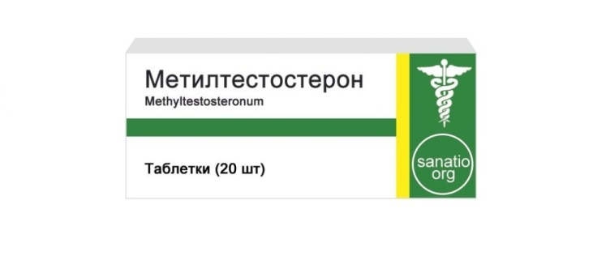
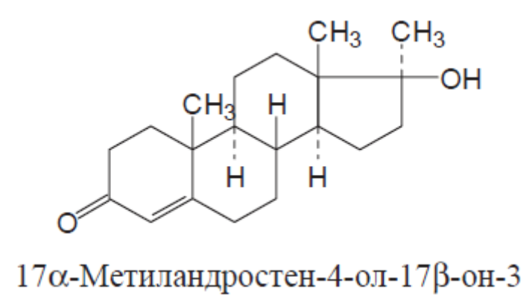
Methyltestosterone
17α-methylandrosten-4-ol-17β-one-3
Properties. White, odorless, crystalline powder. Practically insoluble in water, sparingly soluble in ether, slightly soluble in oils, soluble in acetone, freely soluble in ethanol.
18

Slide 20
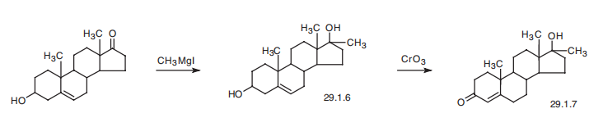
Synthesis.
19

Slide 21
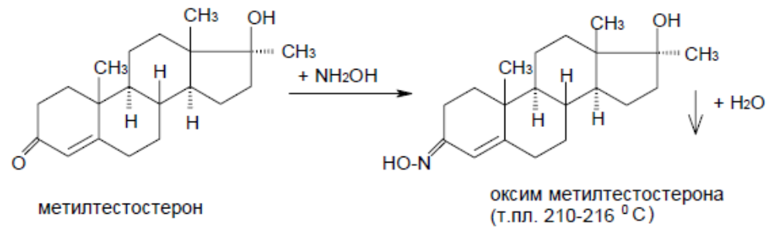
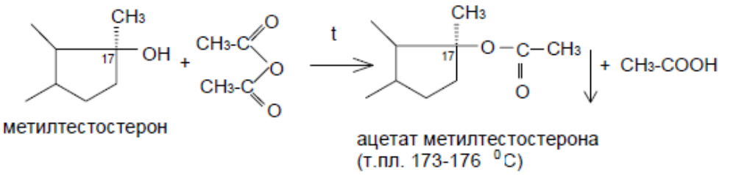
Identification:
when dissolving the drug in concentrated H2SO4, an orange-yellow color appears; after adding water, an orange-yellow color with green fluorescence (steroid cycle);
for identification, the melting point of the oxime (keto group in position 3) and acetate (oxy group in position 17) is also determined:
20

Slide 22
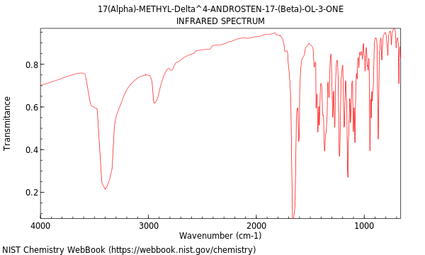
IR absorption spectrum of methyltestosterone
21

Slide 23
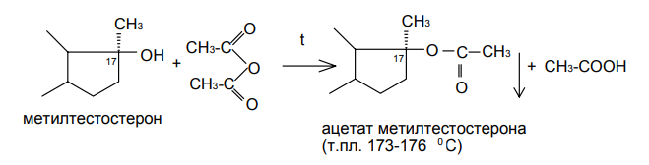
the alcohol group of methyltestosterone at the 17-position causes an ester formation reaction, which has a characteristic melting point:
Qantification. UV spectrophotometry at λ = 240 нм.
Storage. In a sealed container, protected from moisture and light.
Application. Androgenic drug, synthetic analogue of testosterone. 2–3 times less active than testosterone propionate, but retains activity when taken orally and sublingually. Sexual underdevelopment, functional disorders in the sexual sphere, menopause in men; dysfunctional uterine bleeding in the premenopausal and menopausal periods, breast and ovarian cancer.
22

Slide 24
Anabolic steroids
Anabolic drugs(anabolica < Greek anabole – rise; syn.: anabolics) – drugs that enhance protein biosynthesis, stimulate regeneration processes. Widely used in medical practice to activate anabolic processes in case of exhaustion in the postoperative period, with severe infections, myocardial infarction, osteoporosis, growth retardation in children, delayed union of fractures, etc.
Classification.
Anabolic drugs are divided into steroid (metandienone, nandrolone) and non-steroidal (inosine, orotic acid).
Steroid drugs include compounds of male sex hormones, such as medroxytestosterone propionate, testenate. However, their use as therapeutic anabolic drugs is hindered by androgenic properties. In this regard, compounds were synthesized that are structurally similar to steroid substances, but which have predominantly anabolic activity - metandienone, nandrolone. They were called anabolic steroids.
23

Slide 25
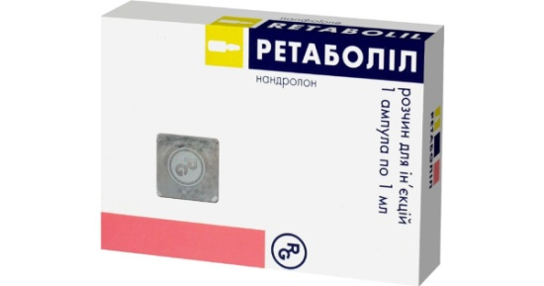
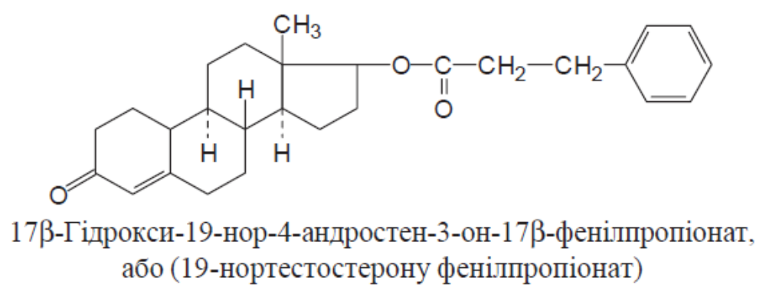
Phenobolin
Nandrolone Phenylpropionate
17β-hydroxy-19-nor-4-androstene-3-one17β-phenylpropionate
or 19-nortestosterone phenylpropionate
Mechanism of action. Stimulates the synthesis of nucleic acids and protein in the body (activating reparative processes in bone and muscle tissues), has a positive effect on nitrogen metabolism (retaining nitrogen in the body, reducing urea excretion by the kidneys).
24

Slide 26
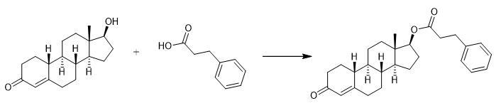
Synthesis.
25

Slide 27
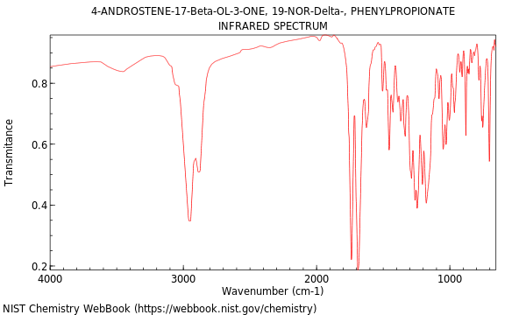
Properties. White, sometimes with a cream tint, crystalline powder. Practically insoluble in water, sparingly soluble in ethanol, freely soluble in chloroform and acetone.
Identification: M. p. (95–99 °C), IR spectrum, TLC.
26

Slide 28
Quantification. Spectrophotometry.
Storage. In a place protected from light.
Application. Anabolic steroid. After a single injection, the effect lasts for 7–15 days. Phenobolin is 2 times weaker in androgenic effect, and 2–5 times more active in anabolic effect than testosterone.
27

Slide 29
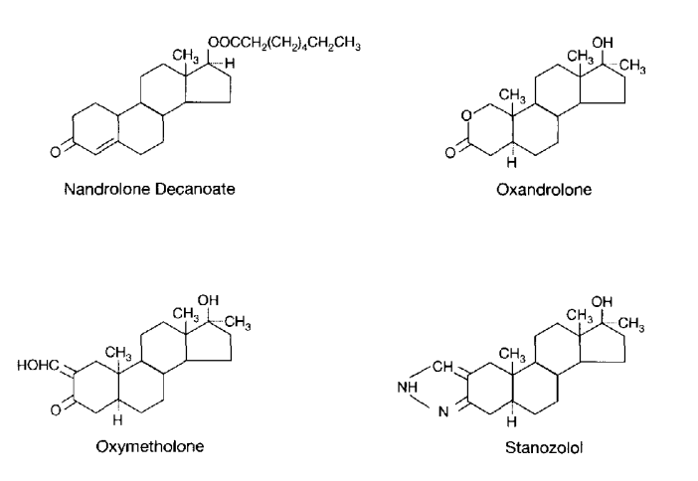
Structures of the most commonly used anabolic androgenic steroids in the United States
28

Slide 30
The most common drugs from the group of anabolic androgenic steroids in the United States, approved by the US Food and Drug Administration, are:
nandrolone decanoate;
oxandrolone;
oxymetholone;
stanozolol.
Nandrolone was synthesized in 1950 and 1953.
Oxandrolone was synthesized in 1962.
Oxymetholone was synthesized in 1959.
The synthesis of stanozolol, the first in a series of anabolically active steroids in which the heterocyclic ring is fused to the A ring of the sterane skeleton, was carried out in 1959.
In general, most synthetic androgens, including those shown in the figure, demonstrate a favorable anabolic-androgenic ratio compared to methyltestosterone, which is confirmed by tests on animal models.
29

Slide 31
Literature
Pharmaceutical Chemistry: A Textbook for Students. higher pharmacy. textbook lock and pharmac. f-tiv higher. honey. textbook lock ІІІ – ІV levels of accreditation / P.О. Bezugly, I.S. Gritsenko, І.В. Ukrainets' and others. - Vinnytsia: New book, 2011. - 560 p.
Pharmaceutical chemistry. Lectures for english-speaking students: the study guide for students of higher schools / V. A. Georgiyants [et al.] ; ed. by: V. A. Georgiyants, P. O. Bezugly ; NUPh. – Kharkiv : NPhaU : Original, 2013. – 528 p
Pharmaceutical Encyclopedia / ed. council and the author of the foreword VP Black; Nat. pharmacy. University of Ukraine. - 2nd ed., Reworked. and add. - Київ: МОРІОН, 2010. - 1632 с.
State Pharmacopoeia of Ukraine: in 3 volumes / SE "Ukrainian Scientific Pharmacopoeial Center for Quality of Medicines". - 2nd type. - Kharkiv, 2015. - Vol.1. –1135 s.
State Pharmacopoeia of Ukraine: in 3 volumes / State Enterprise "Ukrainian Scientific Pharmacopoeial Center for Quality of Medicines". - 2nd ed., Kharkiv: State Enterprise "Ukrainian Scientific Pharmacopoeial Center for Quality of Medicines", 2014. - Vol. 2. - 724 p.
State Pharmacopoeia of Ukraine: in 3 volumes / State Enterprise "Ukrainian Scientific Pharmacopoeial Center for Quality of Medicines". - 2nd ed., Kharkiv: State Enterprise "Ukrainian Scientific Pharmacopoeial Center for Quality of Medicines", 2014. - Vol. 3. - 732 p.

