Slide 1
LECTURE 4
Steroid hormones and their analogues: estrogens and their analogues, synthetic compounds of estrogenic action. Characteristics, classification, relationship between structure and pharmacological action, mechanism of action, methods of obtaining, methods of analysis, application in medicine.

Slide 2
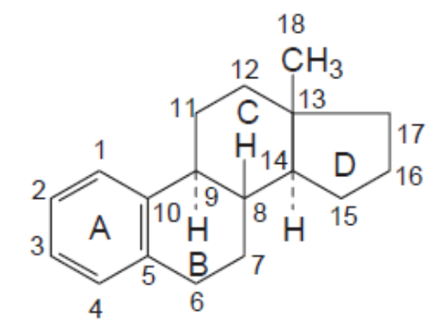
Estrogen hormones and their analogues
Estrogens (Latin: oestrogena) are natural female sex hormones and drugs with the activity of female sex hormones. The structure of estrogen hormones is based on the hydrocarbon estran:
The characteristic structural features of estrogens, which distinguishes them from other steroid hormones, are:
aromatic ring A;
a phenolic hydroxyl is necessarily present at position 3;
estrogens do not have a methyl group at position 10.
there must be an oxygen function - at position 17- a keto group
(estrone) or a hydroxyl group (estradiol, ethinyl estradiol).
1

Slide 3
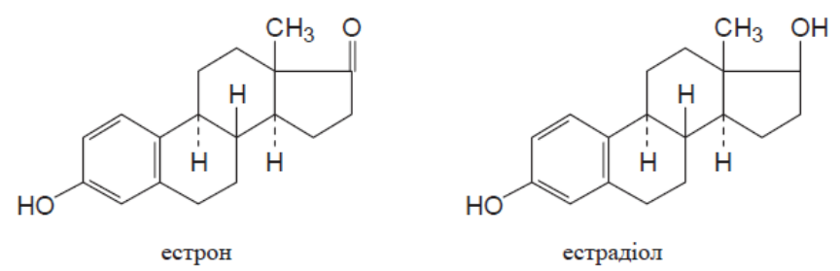
Natural hormones of this series are:
estrone estradiol
Estradiol has approximately twice the activity, but is rapidly inactivated and excreted from the body.
Esters of estradiol (benzoate and dipropionate) are slowly absorbed, slowly excreted and have a long-lasting effect on the body.
Ethinyl estradiol, like pregnenone, has an ethinyl radical at position 17. Its introduction leads to a significant increase in activity. In addition, ethinyl estradiol is not destroyed in the gastrointestinal tract and is effective when taken orally.
Mechanism of action. E. selectively accumulate in target organs - the uterus, vagina, mammary glands, anterior pituitary gland, liver, where they bind to a specific extranuclear protein estrophilin, receptors of the plasma membranes of target cells, forming hormone-receptor complexes with them. They penetrate the nucleus, activate DNA and RNA synthesis, and affect protein synthesis.
2

Slide 4
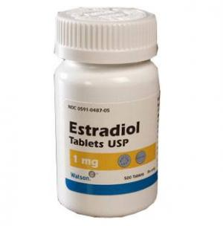
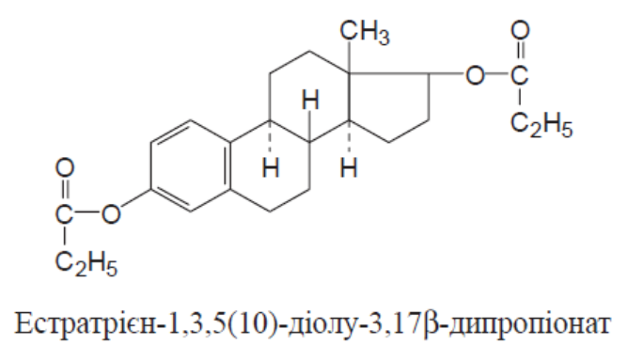
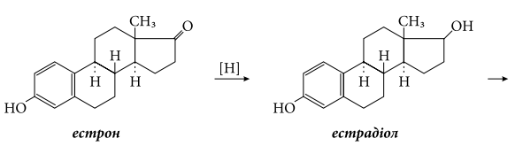
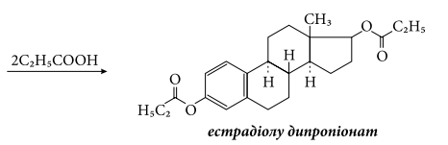
Estradiol dipropionate
Estratriene-1,3,5(10)-diol-3,17β-dipropionate
Properties. White crystalline powder. Practically insoluble in water, sparingly soluble in alcohol and oils.
Synthesis.
3

Slide 5
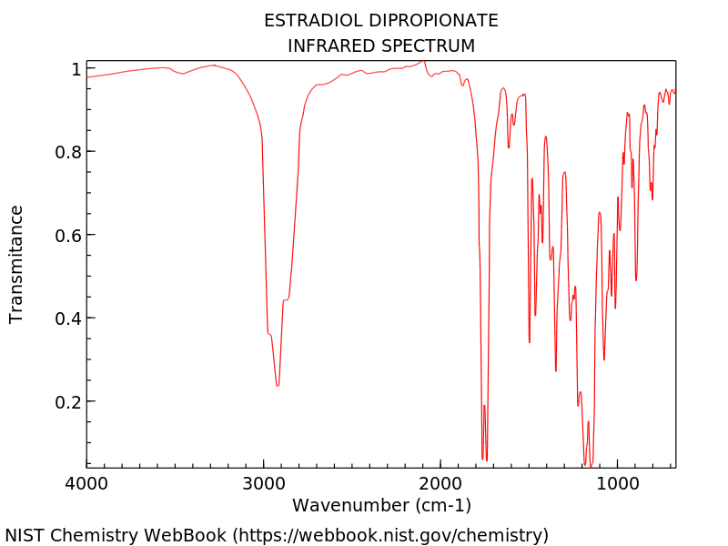
Identification:
physicochemical methods: IR and UV spectrophotometry;
4

Slide 6
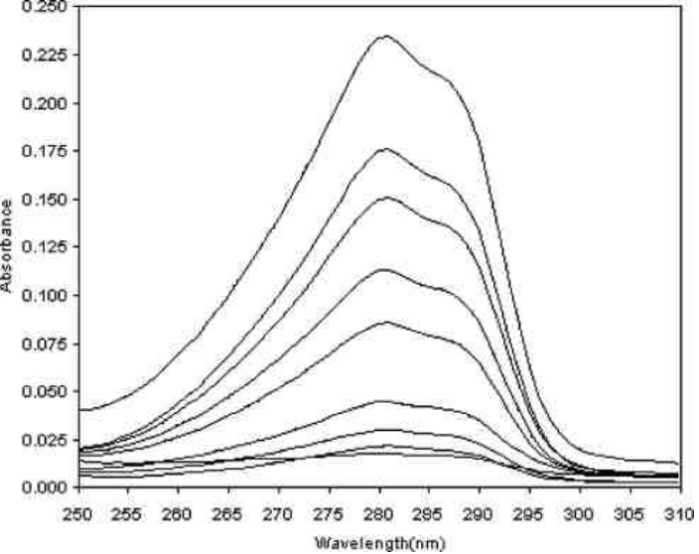
UV spectrum of estradiol dipropionate
5

Slide 7
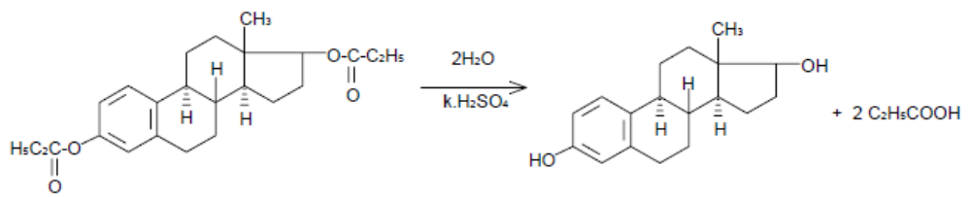
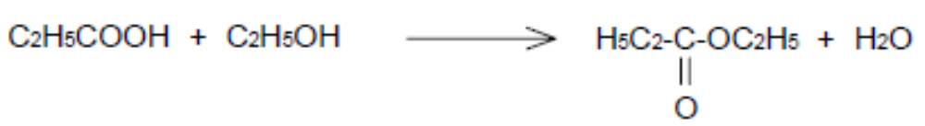
after alkaline hydrolysis, estradiol is isolated, for which the melting point is determined;
estradiol dipropionate is hydrolyzed by concentrated H2SO4. Further heating in the presence of ethanol leads to the formation of ethyl ester of propionic acid, which has a characteristic odor:
6

Slide 8
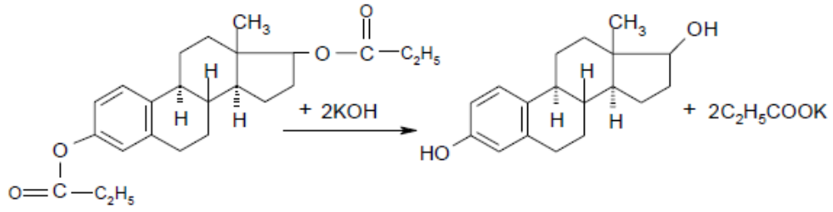

Quantification. Alkalimetry, back titration. The substance is hydrolyzed with an alcoholic solution of potassium hydroxide, the excess of which is titrated with a solution of hydrochloric acid using phenolphthalein, s = ½:
Application. Pathological conditions caused by ovarian failure; prevention and treatment of osteoporosis; prostate carcinoma.
7

Slide 9
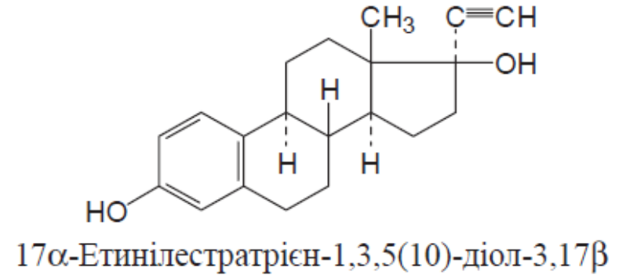
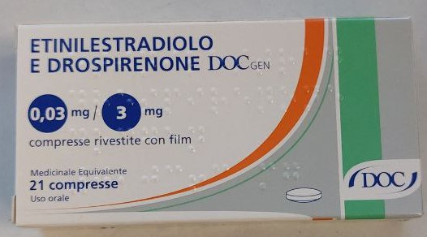
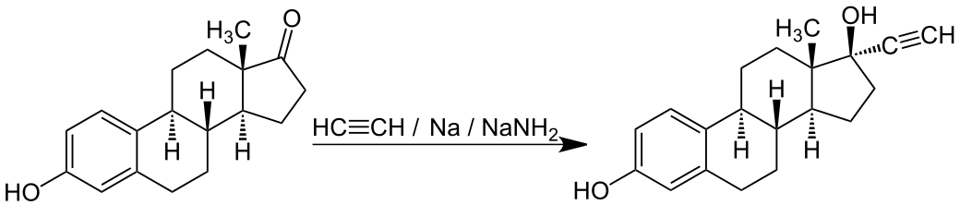
Ethinylestradiol
17α-Ethynylestra-1,3,5(10)-triene-3,17β-diol
Properties. White or creamy-white, odorless, fine-crystalline powder. Practically insoluble in water, slightly soluble in alkali metal hydroxide solutions, soluble in alcohol, chloroform, freely soluble in acetone, dioxane and ether.
Synthesis.
estrone
8

Slide 10
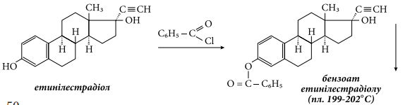
Identification:
when dissolved in concentrated H2SO4 – an orange-red color appears with yellow-green fluorescence in reflected light (steroid cycle). When adding a solution of ferrum(III) ammonium sulfate and water, the solution darkens and a reddish-brown precipitate forms;
IR and UV spectrophotometry, TLC are used;
the meltig point of benzoate (phenolic hydroxyl) is determined:
9

Slide 11
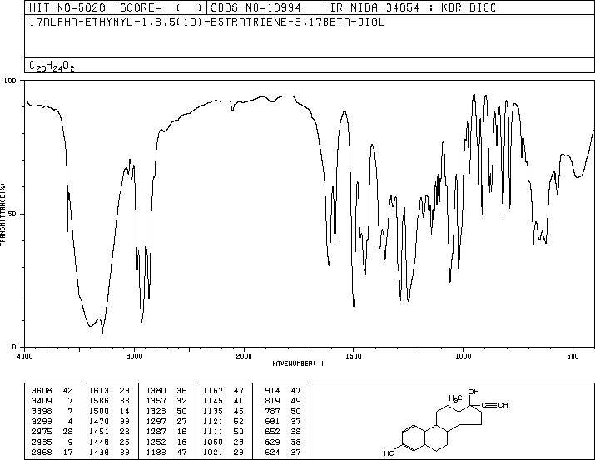
IR spectrum of ethinylestradiol
10

Slide 12
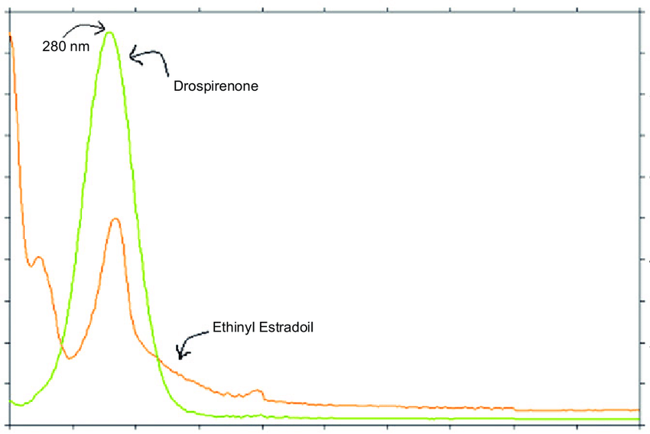
UV spectrum of ethinylestradiol
11

Slide 13
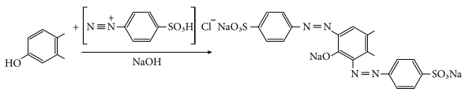
Quantification. Alkalimetry by substituent (see pregnin), or spectrophotometry or photocolorimetry by the formation of a bis-diazo compound in an alkaline medium upon interaction with a diazo reagent:
Storage. In a place protected from light.
Application. Estrogenic drug. Taken orally. Included in birth control pills.
12

Slide 14
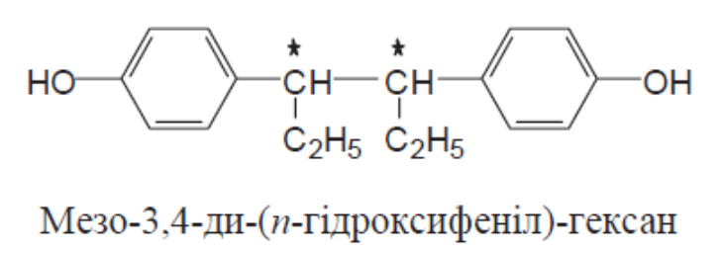
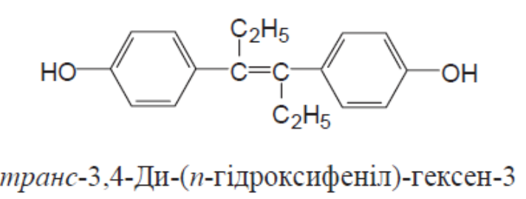
Synthetic compounds with estrogenic action
Substances with estrogenic activity have been found not only among steroids, but also among aromatic compounds. It is assumed that the estrogenic effect depends on the presence of aromatic nuclei in the molecule. An important role belongs to hydroxyl and ketone groups, which are able to form H-bonds and interact with proteins in the body.
For the manifestation of estrogenic action, the distance between functional groups is important. It has been established that the distance between OH groups (in positions 3 and 17) in estradiol is 1.1 nm, in the meso-form of sinestrol - 1.2 nm, in the trans-isomer of diethylstilbestrol - 1.22 nm. At the same time, the cis-isomer of diethylstilbestrol, the distance between hydroxyls in which is 0.75 nm, is physiologically inactive.
Sinestrol
Diethylstilbestrol
13

Slide 15
Properties. Synthetic estrogens (sinestrol and diethylstilbestrol) are white crystalline powders (sinestrol may have a yellowish tint) without odor. Practically insoluble or very slightly soluble in water. Sinestrol is easily soluble in ethanol, diethylstilbestrol is slightly soluble in chloroform, soluble in solutions of alkali metal hydroxides.
14

Slide 16
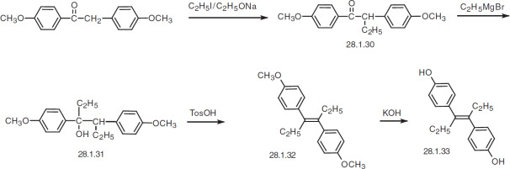
Synthesis of diethylstilbestrol.
15

Slide 17
Identification:
When a chloroform solution of sinestrol interacts with concentrated H2SO4 in the presence of formalin, the chloroform layer turns cherry-red (phenyl radicals). A solution of diethylstilbestrol in concentrated H2SO4 has an orange color, which gradually disappears after dilution with water; when bromine water is added to a solution of sinestrol in glacial acetic acid, a yellow precipitate is formed (see quantitative determination).
Diethylstilbestrol with bromine water in the presence of liquid phenol forms an emerald-green color when heated; after adding a few grains of sugar and heating, the color turns dark blue and then brownish-cherry;
the presence of phenolic hydroxyls in the molecules of medicinal substances can be detected using ferric (III) chloride. The AND recommends this reaction for the identification of diethylstilbestrol,
alcoholic solutions of which turn green, gradually turning yellow.
16

Slide 18
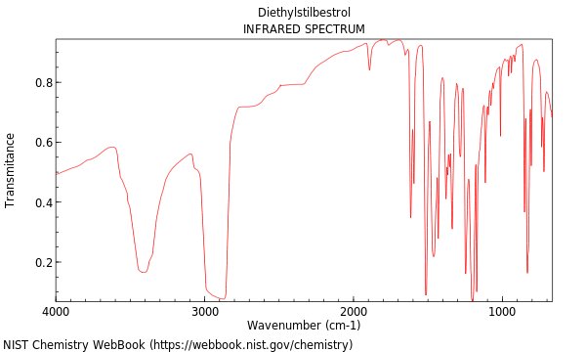
IR spectrum of diethylstilbestrol
17

Slide 19
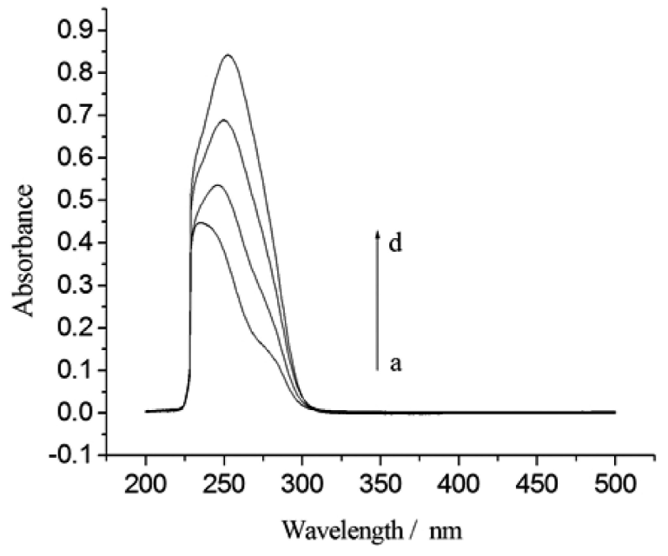
IR spectrum of diethylstilbestrol
18

Slide 20
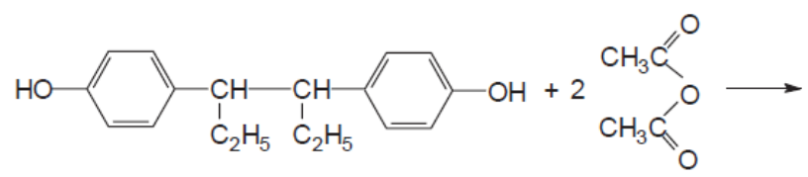
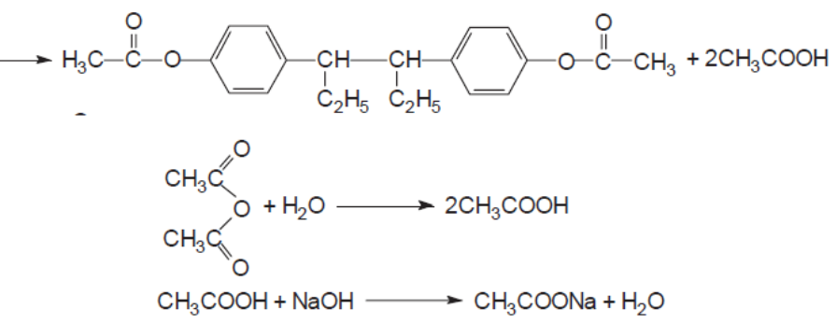
UV spectrophotometry is used for identification;
synthetic estrogens can be identified and quantified by esterification reaction. When sinestrol and diethylstilbestrol interact with acetic anhydride or benzoyl chloride diacetates (dibenzoates) are formed, which have a characteristic melting point.
Quantification.
Acetylation method. It is based on the production of esters by heating with acetic anhydride in the presence of pyridine. The excess acetic anhydride is converted into acetic acid and the amount of acid is titrated with NaOH solution, the indicator is phenolphthalein, s = 1/2. A control experiment is carried out in parallel:
19

Slide 21
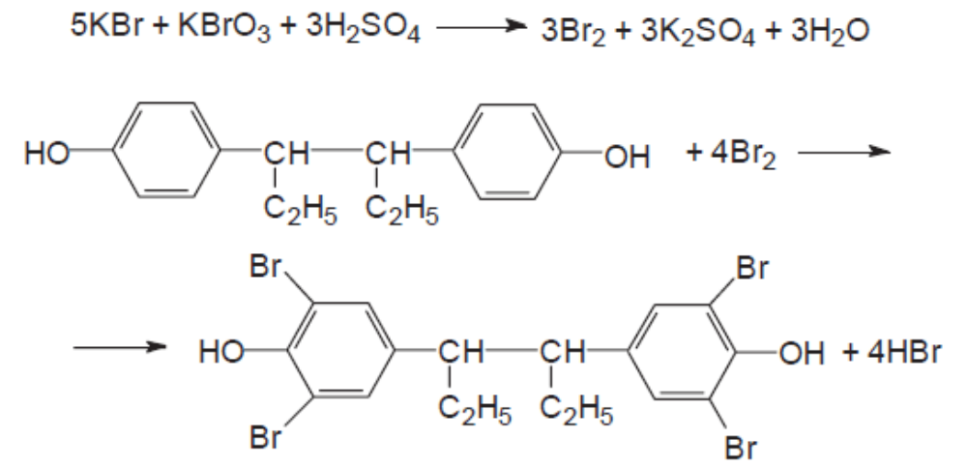
2. Quantitative determination of sinestrol in an oil solution is carried out after extraction with an aqueous solution of sodium hydroxide by the reverse bromatometry method with a control experiment, s = 3/4:
20

Slide 22
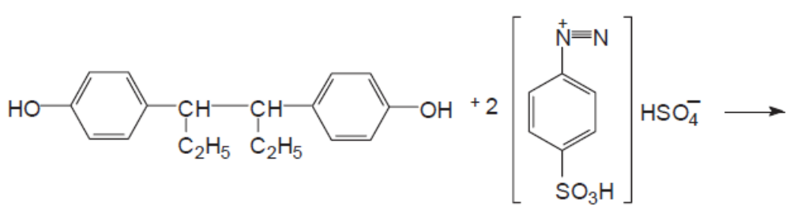
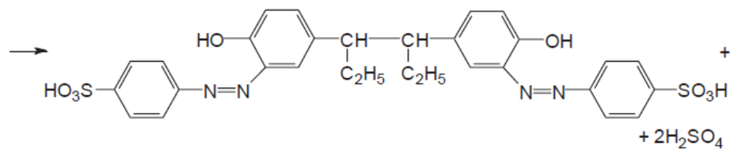
3. Sinestrol and diethylstilbestrol can be determined photometrically by the azo coupling reaction with diazotized sulfanilic acid:
Storage. In a sealed container, protected from light.
Application. In terms of pharmacological action, they are close to natural hormones. When taken orally, they are not destroyed in the gastrointestinal tract, they are quickly absorbed. They are prescribed in the form of 2 mg tablets and intramuscularly in the form of oil solutions (0.1 and 2–3%) for the treatment of malignant neoplasms.
21

Slide 23
Birth control means
Contraceptive drugs (latin anticoncipientia, s. Contraceptiva <contra – against and conceptio – conception) – drugs to prevent pregnancy. Contraception is a method of birth control that interrupts the natural course of events from conception to birth.
Chemical contraceptives are called spermicides. Modern spermicides consist of two components: a chemical substance that destroys the outer shell of sperm and inhibits their mobility or ability to penetrate the egg shell during fertilization, and a base. For most spermicides, the active ingredients are nonoxylon-9, octoxylon, menfegol, benzalkonium chloride. Spermicides are available in the following dosage forms: creams;
gels;
jellies;
foams;
suppositories;
tablets;
soluble films;
tampons.
22

Slide 24
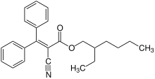

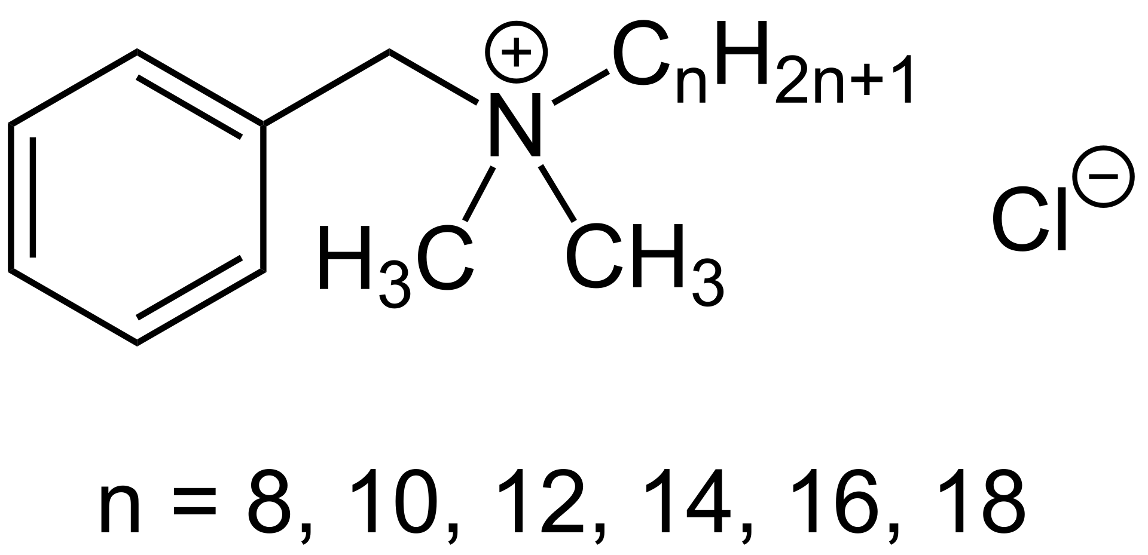
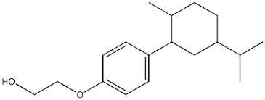
Active ingredients of spermicides
nonoxynol-9
octoxylon
benzalkonium chloride
menfegol
23

Slide 25
Intrauterine devices (IUDs) are divided into two groups - copper-containing and hormone-releasing IUDs. Copper-containing IUDs are made of polyethylene with the addition of silver or gold veins, lavsanethylene bactericidal winding, copper-containing threads with antimicrobial action. The contraceptive effect of copper-containing IUDs is based on a sharp acceleration of the movement of the egg through the fallopian tubes, as a result of which it does not have time to mature.
The mechanism of action of hormone-releasing IUDs is to increase the viscosity of cervical mucus, inhibit endometrial proliferation, and reduce sperm activity. The system has only a local effect, the hormone is not absorbed into the systemic bloodstream, therefore it is devoid of the side effects of systemic hormonal drugs and provides high contraceptive effectiveness.
Hormonal contraception (HC) is oral contraceptives (hormonal birth control pills); injectable contraceptives (contraceptive injections); subcutaneous implants (capsules that are injected subcutaneously). HC includes analogues of two natural female sex hormones produced by the ovaries, estrogen and progesterone.
24

Slide 26
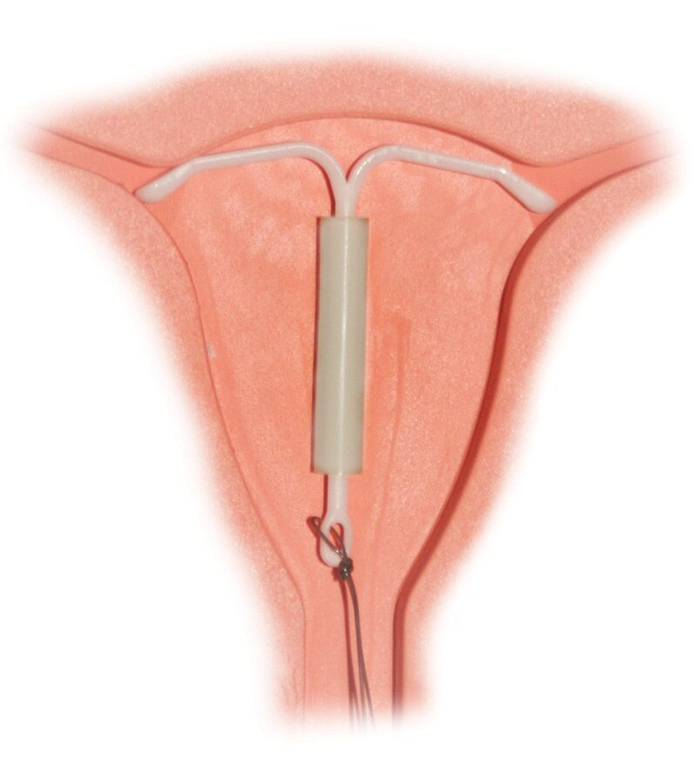
Mirena coil on a uterine dummy
With a failure rate of 0.8% (copper) and 0.2% (hormone), it is one of the most effective contraceptives, having the best reviews, along with contraceptive implants. As of 2007, it was the most common form of reversible contraception, used by 180 million women worldwide.
25

Slide 27
Long-acting hormonal contraceptives (injectables) create a depot of the contraceptive drug in the body for a certain period. After this, the drug is gradually absorbed into the blood, and the contraceptive effect occurs. After this, the drug is gradually absorbed into the blood, and the contraceptive effect occurs. The drug is administered 1 time in 3 months i.m., contains only one hormone progesterone. In addition, the drug thickens cervical mucus, which makes it difficult for sperm to penetrate the uterus, and changes the uterine mucosa in such a way that pregnancy becomes practically impossible. The triple mechanism of action of injectable contraceptives makes them one of the most reliable. The effectiveness when the injection dates are observed is 98%.
Subcutaneous implants are silicone capsules containing low doses of progestogen. The capsules are injected subcutaneously into the shoulder area. The mechanism of action is similar to the mechanism of action of injectable contraceptives. The drug has a shelf life of 5 years. During this time, the hormone is gradually absorbed into the blood, causing a reliable contraceptive effect (about 99%).
26

Slide 28
Literature
Pharmaceutical Chemistry: A Textbook for Students. higher pharmacy. textbook lock and pharmac. f-tiv higher. honey. textbook lock ІІІ – ІV levels of accreditation / P.О. Bezugly, I.S. Gritsenko, І.В. Ukrainets' and others. - Vinnytsia: New book, 2011. - 560 p.
Pharmaceutical chemistry. Lectures for english-speaking students: the study guide for students of higher schools / V. A. Georgiyants [et al.] ; ed. by: V. A. Georgiyants, P. O. Bezugly ; NUPh. – Kharkiv : NPhaU : Original, 2013. – 528 p
Pharmaceutical Encyclopedia / ed. council and the author of the foreword VP Black; Nat. pharmacy. University of Ukraine. - 2nd ed., Reworked. and add. - Київ: МОРІОН, 2010. - 1632 с.
State Pharmacopoeia of Ukraine: in 3 volumes / SE "Ukrainian Scientific Pharmacopoeial Center for Quality of Medicines". - 2nd type. - Kharkiv, 2015. - Vol.1. –1135 s.
State Pharmacopoeia of Ukraine: in 3 volumes / State Enterprise "Ukrainian Scientific Pharmacopoeial Center for Quality of Medicines". - 2nd ed., Kharkiv: State Enterprise "Ukrainian Scientific Pharmacopoeial Center for Quality of Medicines", 2014. - Vol. 2. - 724 p.
State Pharmacopoeia of Ukraine: in 3 volumes / State Enterprise "Ukrainian Scientific Pharmacopoeial Center for Quality of Medicines". - 2nd ed., Kharkiv: State Enterprise "Ukrainian Scientific Pharmacopoeial Center for Quality of Medicines", 2014. - Vol. 3. - 732 p.

