Slide 1
Aliphatic vitamins. Characteristics, classification, relationship between structure and pharmacological action, mechanism of action, methods of obtaining, methods of analysis, application in medicine.
Lecture 5

Slide 2


Vitamins
Vitamins (lat. life life + aminus - ie nitrogen-containing substances necessary for life) - low molecular weight organic substances of various chemical structure, which are biological catalysts of chemical reactions that take place in a living cell, necessary for normal metabolism and vital functions of the organism.
The term V. suggested in 1911–1912, the Polish scholar K. Funk.
On Today, about 30 V. and vitamin-like compounds are known. The human body and animals do not synthesize vitamins or synthesize them in insufficient quantities (nicotinic acid) and therefore must receive them with food.
Classification. As individual V. were discovered, they were designated letters of the Latin alphabet(eg A, B, C, etc.). With the selection of new V. in the individual state began to notice the similarity of their structure and the difference of biological action, so the letters began to add numerical indices (B₁, В₂, К₁ etc.).
Classification by was also introduced physical properties, according to which all V. are divided into two groups: water and fat-soluble.
K. Funk
1884–1967

Slide 3
Classifications
By physiological action V. are divided into several groups:
V., which increase the overall reactivity of the organism (B₁, В₃, PP, A, C);
antihemorrhagic (C, K);
antianemic (B₁₂, В₆, C);
anti-infective (C, A).
The most successful can be considered Chemical classification, according to which all vitamins are divided into the following groups:
I. Aliphatic vitamins: ascorbic acid (vitamin C),
pangamate acid (vitamin B₁₅), pantothenic acid (vitamin B₃).
II. Vitamins of alicyclic series: retinols (vitamins of group A),
calciferols (vitamins of the group D).
III. Aromatic vitamins: vitamins of group K.
IV.Vitamins of the heterocyclic series: tocopherols (vitamins of group E),
bioflavonoids (vitamins of group P), nicotinic acid and its amide
(PP vitamins), pyridoxines (B6 vitamin), thiamine (vitamin
B₁), folic acid (vitamin B_{c}), riboflavin (vitamin B₂),
cobalomins (B₁₂).

Slide 4
A classification based on physical properties was also introduced, according to which all vitamins are divided into two groups: water-soluble and fat-soluble.
Properties of water- and fat-soluble vitamins
 | water- -soluble vitamins | fat-soluble vitamins
Absorption | Directly into the blood | First into the lymph, then into the blood
Transport | In free form | Need many transport proteins
Storage | Circulate freely in water-filled parts of the body | Circulate freely in water-filled parts of the body
Excretion | Excess is quickly excreted by the kidneys | Excess is more difficult to remove, accumulates in adipose tissue
Toxicity | For some vitamins, it is possible to reach toxic concentrations when taken in the form of dietary supplements. | More likely to reach toxic concentrations when taken in supplement form
Need | Regular use is required (at least 1-3 days) | Use may be less frequent (once a week, or even a month)
2

Slide 5
Aliphatic vitamins
To derivatives of polyoxy-γ-lactones of unsaturated carboxylic acids belongs to ascorbic acid. It is widespread in nature. The plant world is especially rich in it: fresh vegetables, fruits, glycine, etc. In industry, ascorbic acid is synthesized from D-glucose.
To aliphatic vitamins, derivatives of gluconic acid esters, belongs to pangamate acid (vitamin B₁₅). In medicine, its calcium salt is used. Pangamate acid is part of rice bran, yeast, blood, liver. The chemical structure is etherD-gluconic and dimethylaminoacetic acids.
To aliphatic vitamins, derivatives of β-amino acids, belongs to pantothenic acid. It is rich in yeast, caviar, liver and egg yolk. The chemical structure of pantothenic acid is an amide formed by β-alanine and α, γ-dioxy-β, β-dimethylbutyric (pantothenic) acid.
In medical practice, the calcium salt of pantothenic acid is used.

Slide 6
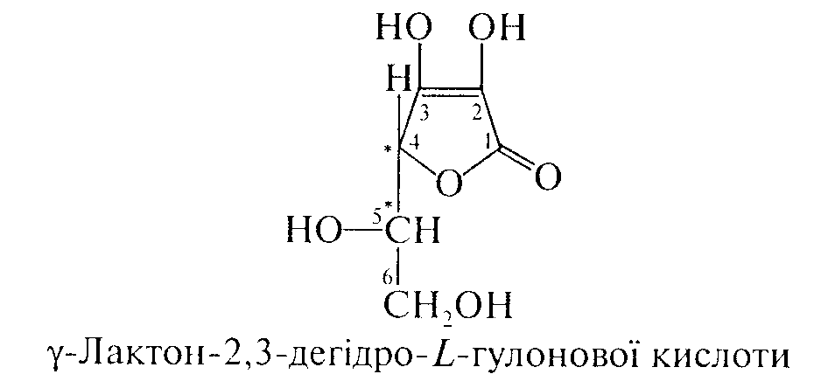
Ascorbic acid (Acidum ascorbinicum)
IUPAC name (5R)-[(1S)-1,2-Dihydroxyethyl]-3,4-dihydroxyfuran-2(5H)-one
Mechanism of action. The main effects of ascorbic acid are associated with its participation in redox reactions as a result of its transformation into dehydroascorbic acid. This process is reversible and is accompanied by the transfer of hydrogen atoms (H+). Ascorbic acid can act as a donor of H+ during the reduction of the substrate or an acceptor of H+ during its oxidation. Due to this, ascorbic acid takes part in all metabolic processes occurring in the human body. Ascorbic acid (vitamin C) as an antioxidant, metabolic and redox regulating agent increases the body's adaptive capabilities, increases its resistance to infections.

Slide 7
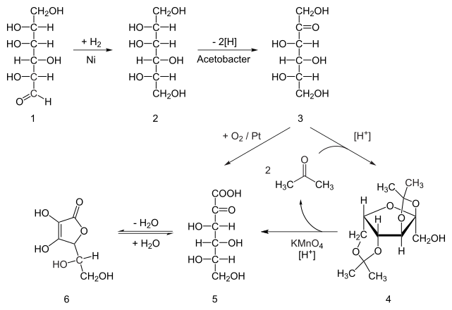

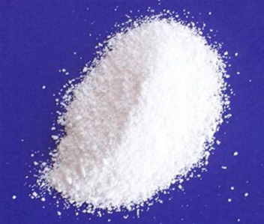
Synthesis.
6

Slide 8
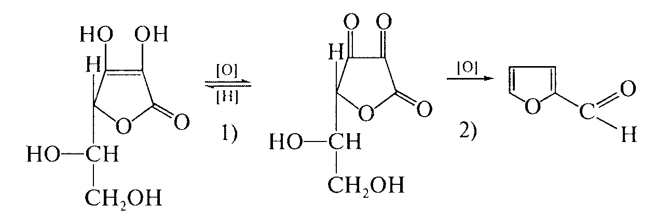
Properties. White or almost white crystalline powder or colorless crystals that change color under the influence of air and moisture, dissociation constant pKa1 = 4.17, pKa2 = 11.57. Easily soluble in water (1: 3.5), propylene glycol (1: 20), soluble in 96% alcohol (1: 25), glycerin (1: 1000), practically insoluble in ether. Melts at a temperature of about 190 °C with decomposition. Due to the enediol group, it exhibits both reducing and acidic properties.
Ascorbic acid is oxidized in two stages:reversible oxidation to dehydroascorbic acid (I); irreversible process, which ultimately leads to furfural (II):
(I) (II)

Slide 9
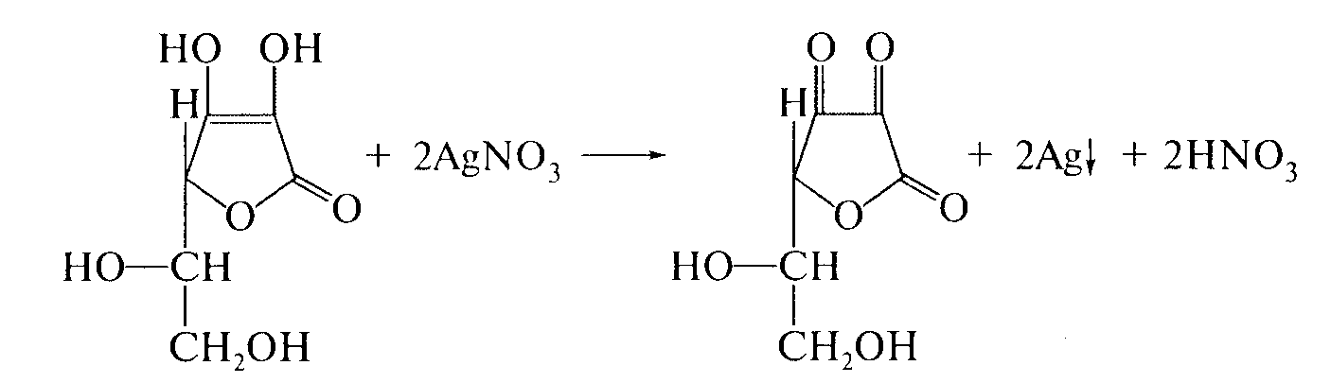
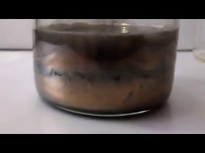
Identification:
AgNO₃ solution is added to the drug solution - dark precipitate of Ag forms:

Slide 10
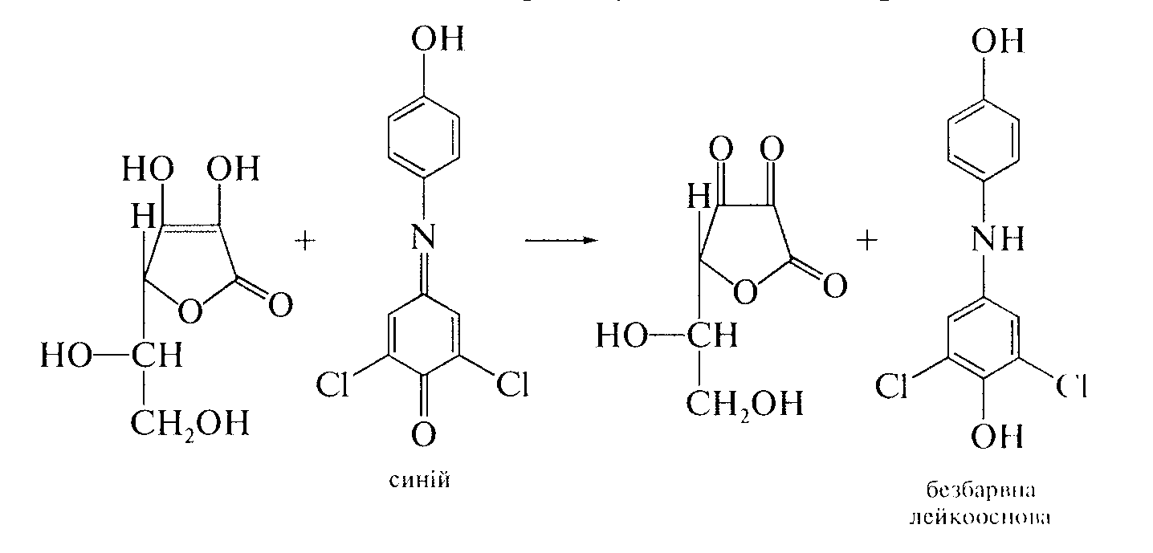
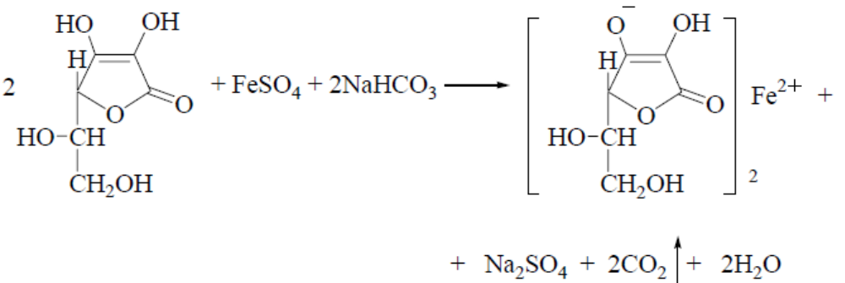
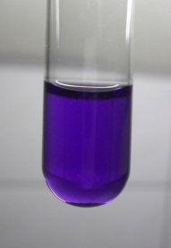
when adding to the solution of ascorbic acid 1 drop of solution
2,6-dichlorophenolindophenol its blue color disappears:
ascorbic acid with FeSO₄ in the presence NaHCO₃ forms
iron ascorbate, colored purple:

Slide 11
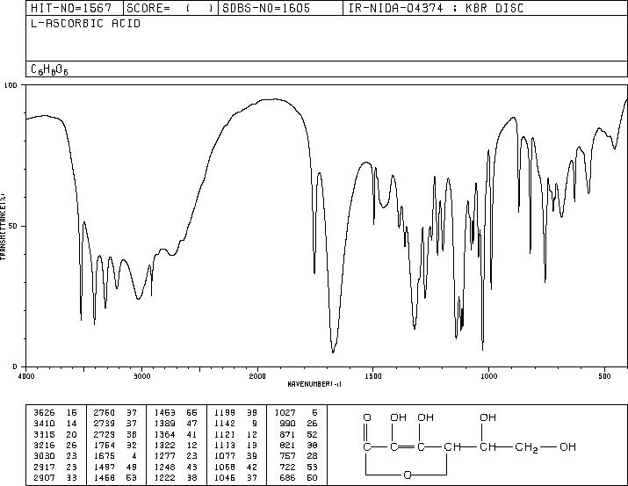
IR absorption spectrum of ascorbic acid
10

Slide 12
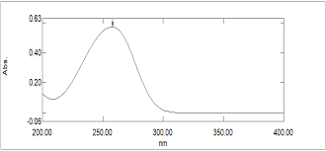
UV spectrum of ascorbic acid
11

Slide 13
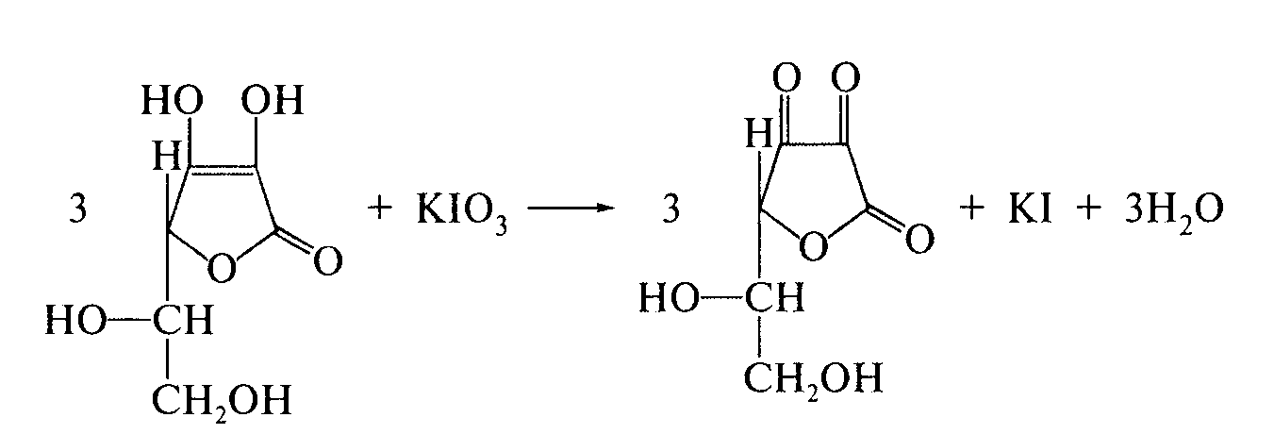
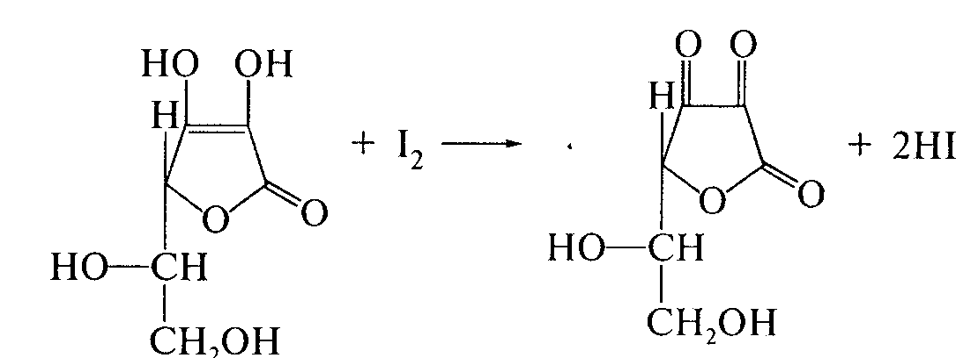
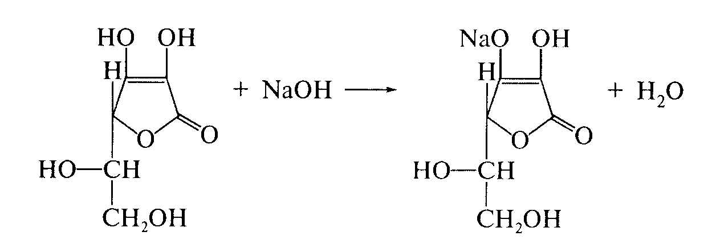
Quantitative definition.
Iodatometry, direct titration in an acidic environment in the presence of potassium iodide, indicator - starch, s = 3:
2. Iodometry, direct titration without indicator, s = 1/2:
3. Alkalimetry, direct titration, indicator - phenolphthalein, s = 1:

Slide 14
4. Titration with a solution of sodium 2,6-dichlorophenolindophenolate,
s = 1/2. The method is used to determine the content of ascorbic acid
acids in vegetable raw materials.
Storage. In a well-sealed dark glass container. Produced in powders, tablets or pills, injectable solutions.
Application. For prophylactic and therapeutic purposes in scurvy (scurvy), bleeding of various etiologies, infectious diseases and intoxications, liver and kidney diseases.
Natural sources: orange, grapefruit, sorrel, pepper, strawberries, berries, cabbage, potatoes, lemon, mango, tangerine, spinach, black currant, tomato, rosehip. Ascorbic acid is synthesized in the body of all animals, except humans, monkeys and guinea pigs.

Slide 15

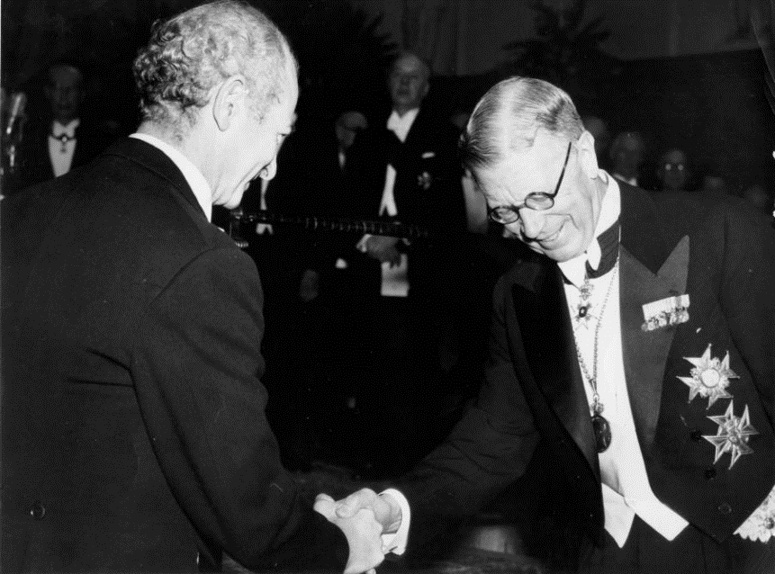
Linus Pauling (1901) - 1994) - American chemist, winner of the Nobel Prizes in Chemistry (1954) and Peace (1962), as well as the International Lenin Prize "For Strengthening Peace Among Nations" (1970).
In the book "Vitamin C and the Common Cold", published in 1970, Pauling outlined his evidence in support of the therapeutic properties of vitamin C. In the early 1970s, he formulated the theory of orthomolecular medicine ("right molecules in the right amounts"), which emphasized the importance of vitamins and amino acids.

Slide 16
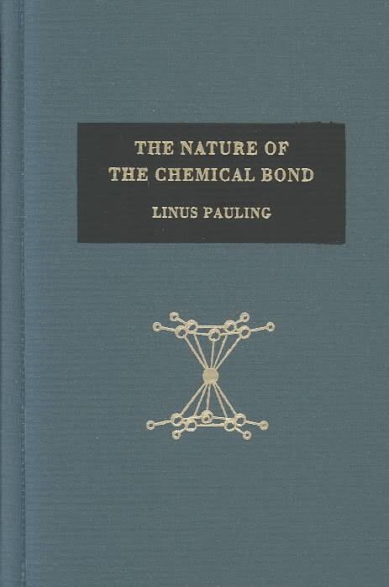
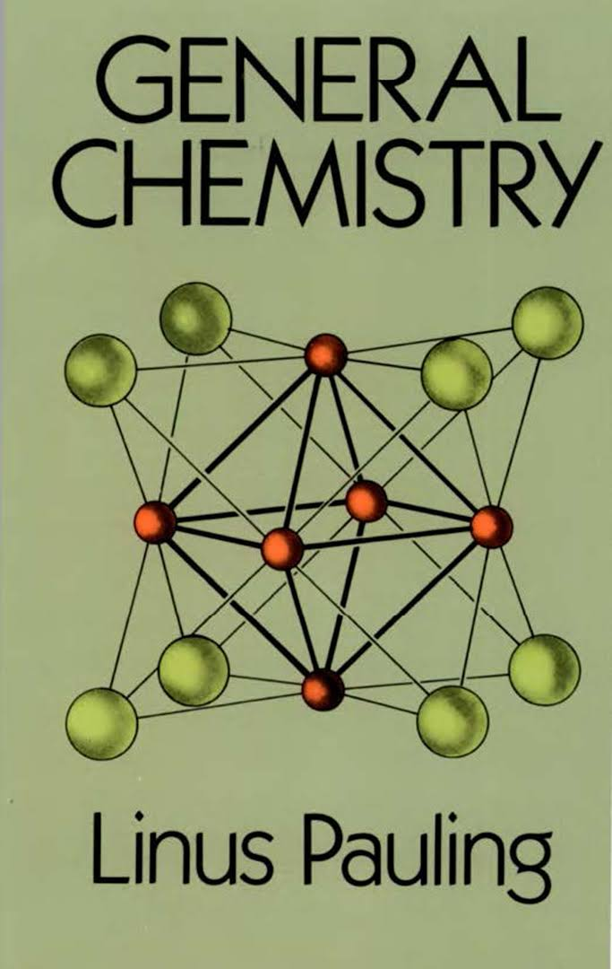
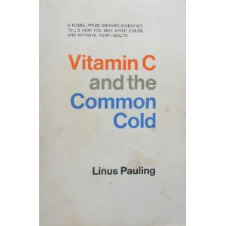
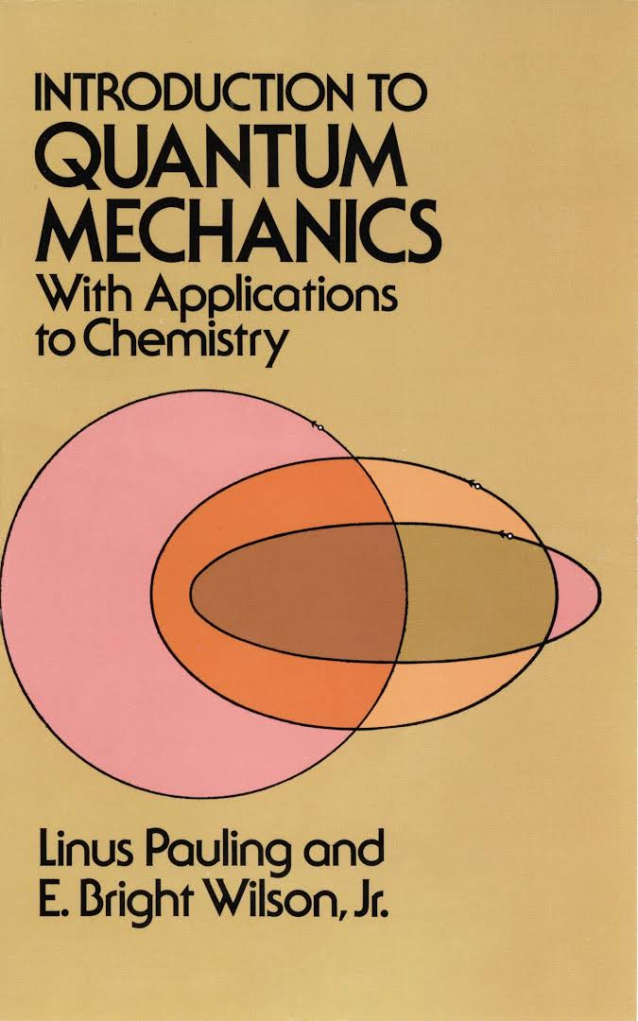
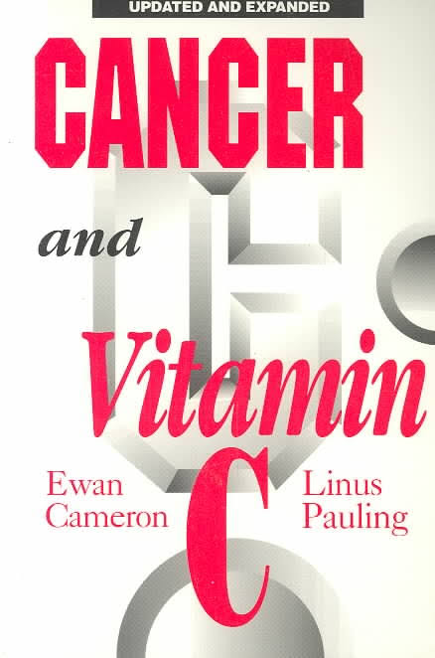

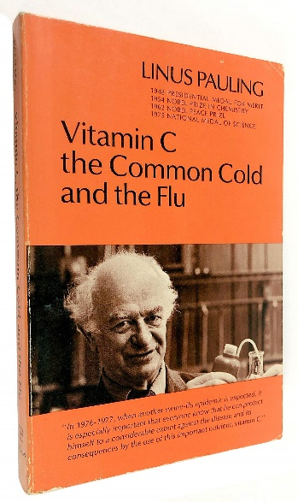

Some books written by L. Pauling
15

Slide 17
Daily intake of vitamin C
L. Pauling proposed to increase the daily dose of vitamin C in 100 - 200 times (up to 10 g), assuming such ultra-high doses are optimal for health.
Gender | Age | Norms of consumption of ascorbic acid (vitamin C) in mg / day
Infants | up to 6 months | 40
Infants | 7-12 months | 50
Children | 1-3 years old | 15
Children | 4-8 years old | 25
Children | 9-13 years old | 45
Girls | 14-18 years old | 65
Boys | 14-18 years old | 75
Men | 19 years and older | 90
Women | 19 years and older | 75

Slide 18
L. Pauling proposed to increase the daily dose of vitamin C intake by 100-200 times (up to 10 g), assuming such ultra-high doses to be optimal for health.Pauling believed that taking vitamin C in large doses could contribute to the treatment of many different diseases, including cancer. Several experiments on animal cell model cultures have shown that vitamin C can destroy some tumor cells (regenerated cells of model cell cultures). However, no such effect has been found in living humans: systematic meta-reviews of clinical trials with hundreds of thousands of patients demonstrate that taking vitamin C and other antioxidant supplements for all types of digestive system tumors does not affect tumor development and does not improve patient survival.

Slide 19
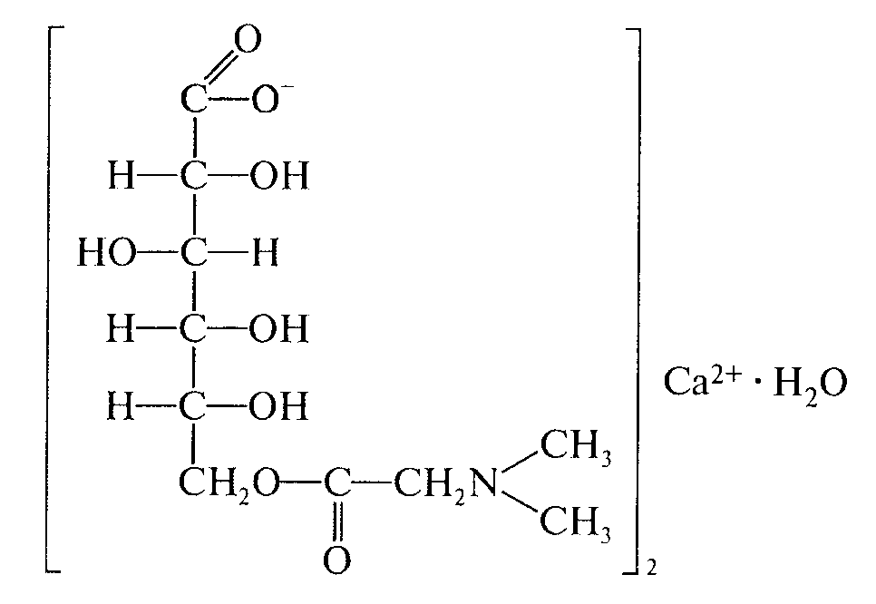
Calcium pangamate (Calcium pangamas, vitamin B₁₅)
Mechanism of action. Stimulates cellular metabolism. Is a source of active methyl groups and calcium ions for biosynthetic processes. Improves lipid metabolism, increases the absorption of oxygen by tissues, increases the content of creatine phosphate in muscles and glycogen in muscles and liver, eliminates the effects of hypoxia.

Slide 20
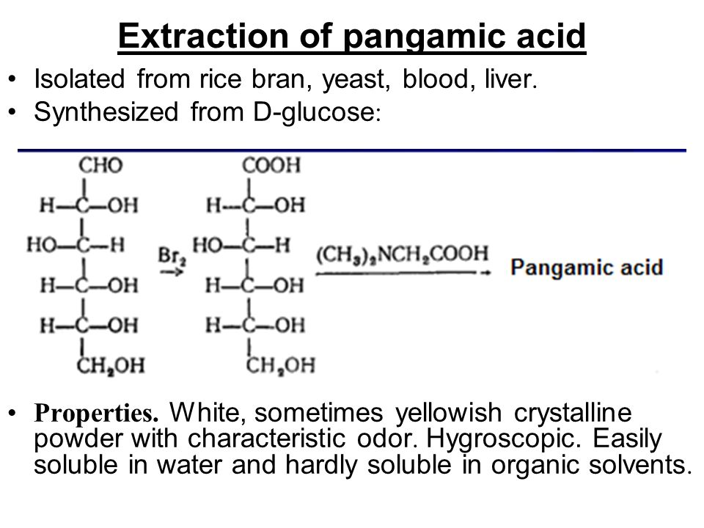
Synthesis.
Neutralization of pangamic acid with calcium carbonate produces calcium pangamate in high yield.
Properties. White, sometimes with a yellowish tinge crystalline powder with a characteristic odor. Hygroscopic. Easily soluble in water and practically insoluble in organic solvents.
18

Slide 21
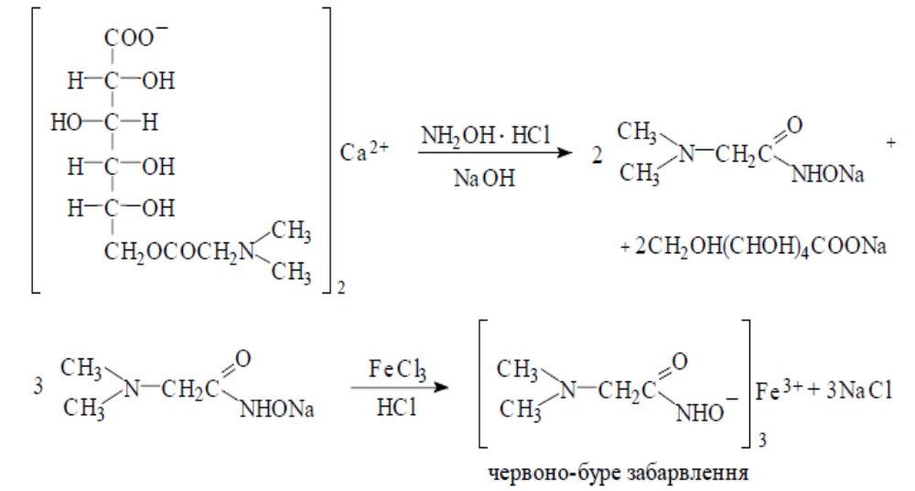
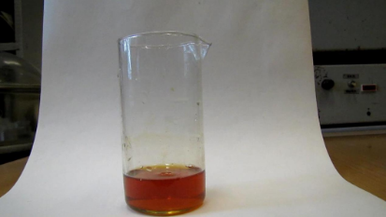
Identification:
by IR spectroscopy;
the substance reacts with calcium ions;
the residue of gluconic acid is confirmed by reaction with salts
iron (III) for the formation of light green color;
when heating a solution of the substance with NaOH the smell of amines is felt;
reaction of formation of colored iron hydroxamate (ester
group):

Slide 22
Quantitative definition. Given that the substance, in addition to calcium pangamate, contains 25% calcium gluconate and 6% calcium chloride, quantify the content of:
Nitrogen - by acidimetry in a non-aqueous medium (3.6-4.2
%);
Calcium - by complexometry (5.8-7.4%);
Chlorides - by the method of inverse(back) argentometry according to Volgard (no more than 2.2%);
4. Sums of carboxyl groups - by ion exchange chromatography
(11.0–15.0%).
Storage. In a dry place, in well-sealed glasses.
Application. In various forms of atherosclerosis, liver cirrhosis, alcoholism and other diseases. Used in the form of tablets. Calcium pangamate has a positive effect on metabolism - improves lipid metabolism, increases tissue oxygen uptake.

Slide 23
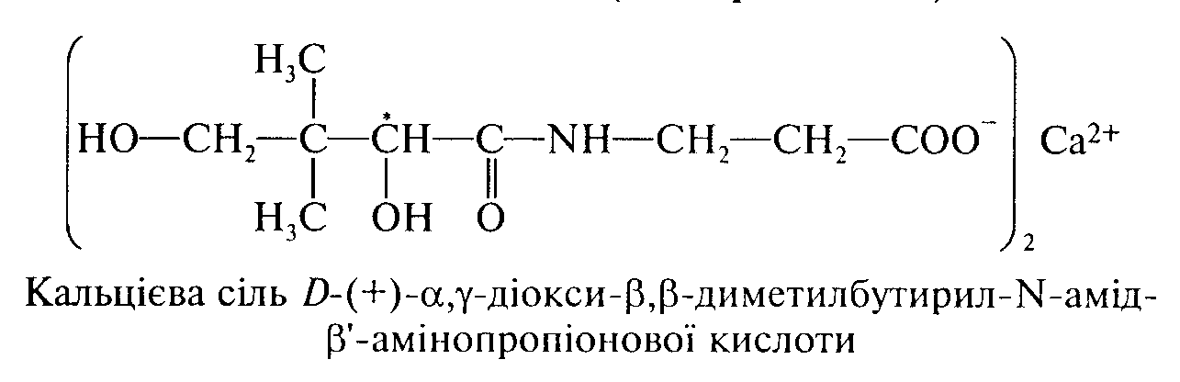
Calcium pantothenate (Calcii pantothenas, vitamin B₅)
IUPAC Name: calcium;3-[[(2R)-2,4-dihydroxy-3,3-dimethylbutanoyl]amino]propanoate
Mechanism of action. Absorbed in the intestine, vitamin B₅participates in the synthesis of acetylcoenzyme A. The main function of acetyl-CoA is that it is an acceptor and transporter of acid (acyl) residues. This coenzyme (A-CoA) is necessary for the normal course of many metabolic processes: it is involved in the oxidative decarboxylation of keto acids (eg, pyruvic, α-ketoglutaric), in the synthesis of citric acid (including the tricarboxylic acid cycle), corticosteroids, and It involves the synthesis of fatty acids, cholesterol, sex hormones.

Slide 24
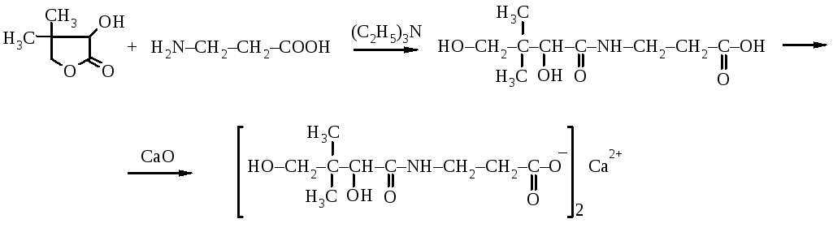
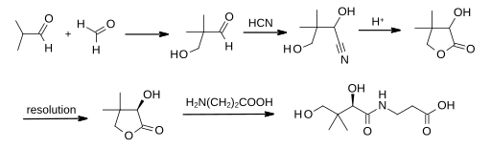
Synthesis.
22

Slide 25
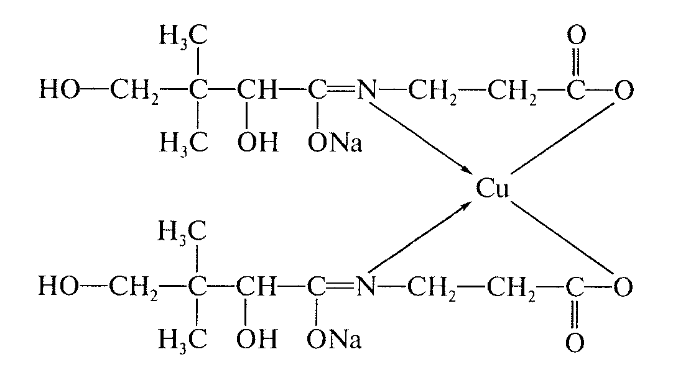
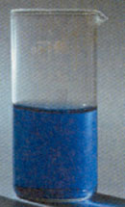
Properties. White odorless fine crystalline powder. Easily soluble in water, very slightly soluble in organic solvents.
Identification:
Polarymetry -specific rotation from +25 to +28 ◦(5% aqueous solution);
the substance reacts with calcium ions;
with a solution of copper (II) sulfate - CuSO4 - in an alkaline medium substance
forms a complex of blue color (β-alanine):

Slide 26
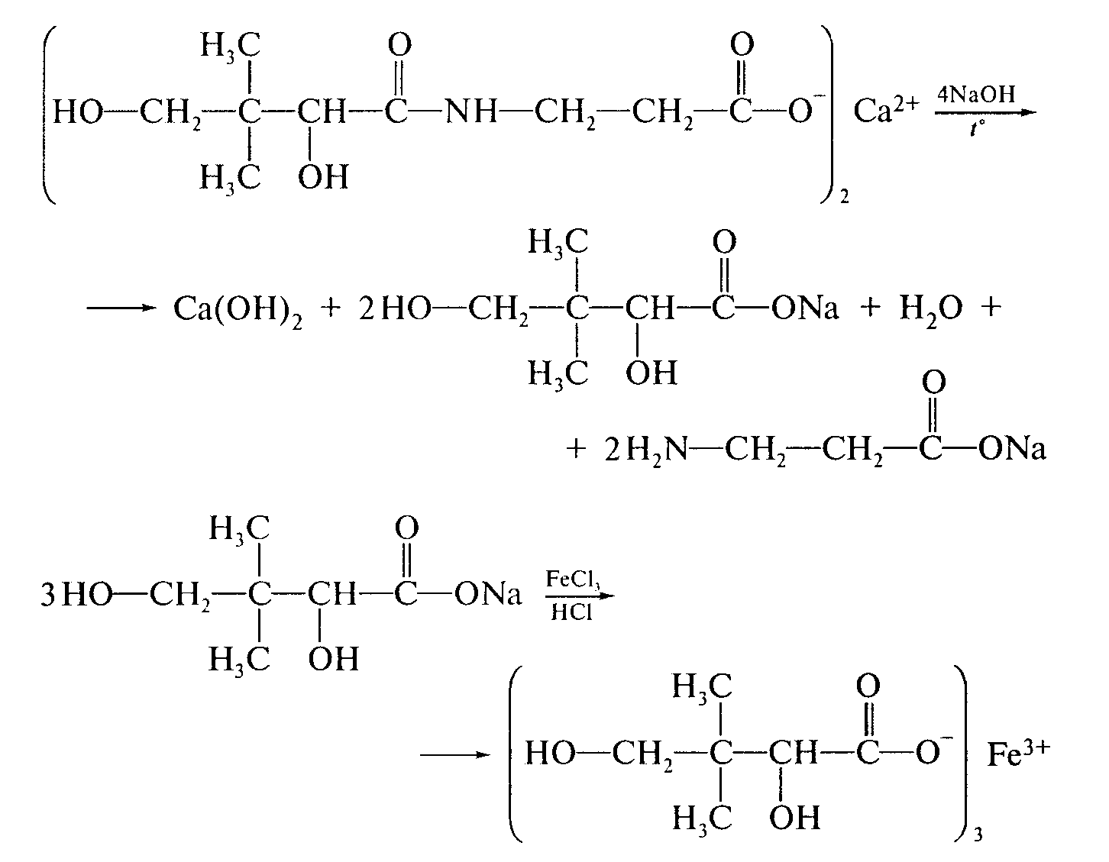
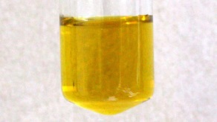
The residue of α,γ-dihydroxy-β,β-dimethylbutyric acid is determinedafter alkaline hydrolysis. The substance is boiled with NaOH solution,after cooling, acidified with hydrochloric acid anda solution of FeCl3 is added - a yellow color is formed:
24

Slide 27
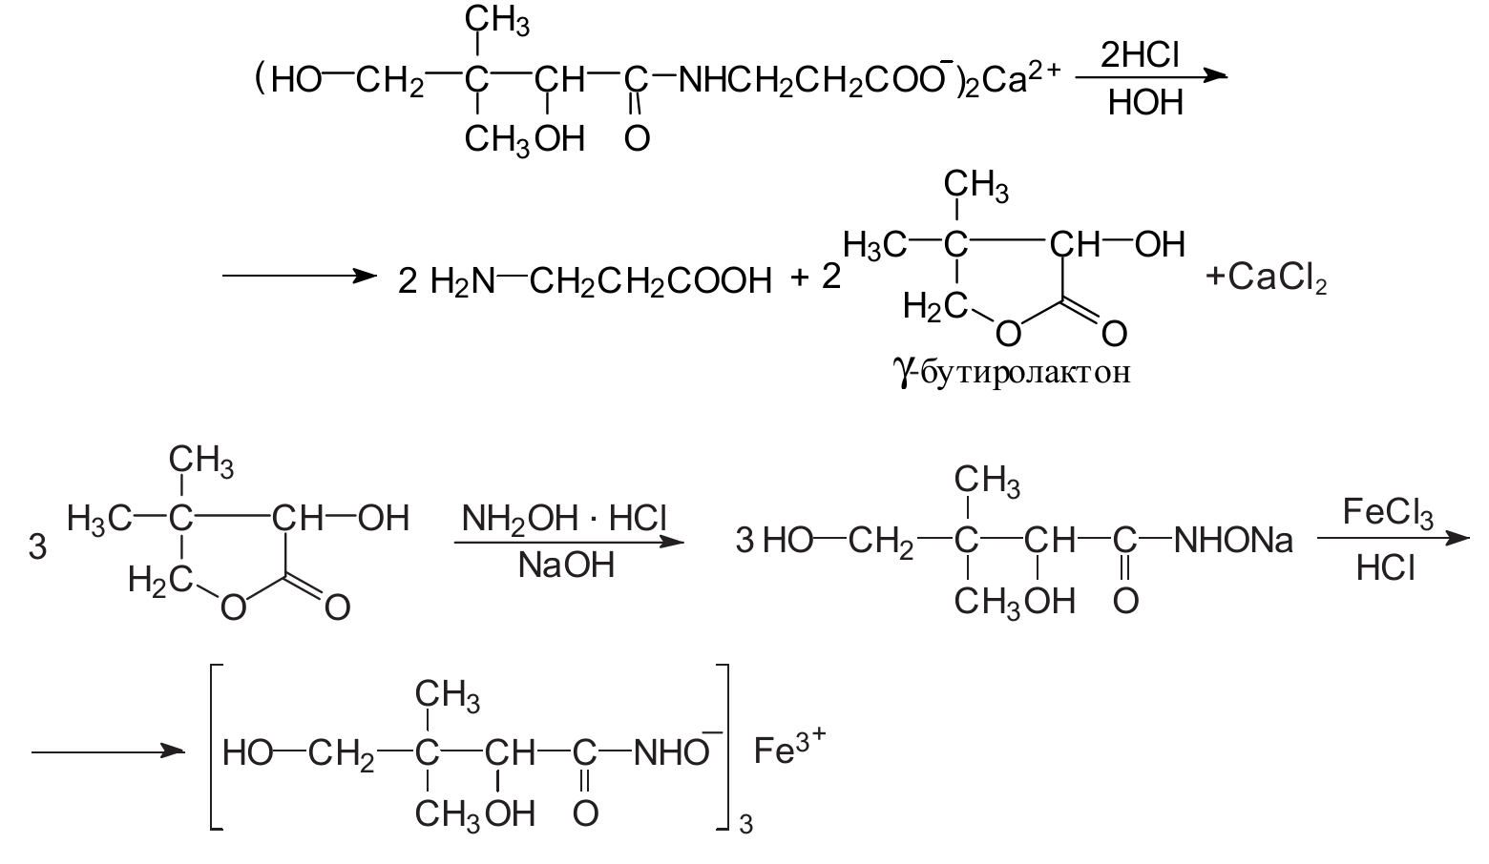

reaction to form colored ferric hydroxamate :
25

Slide 28
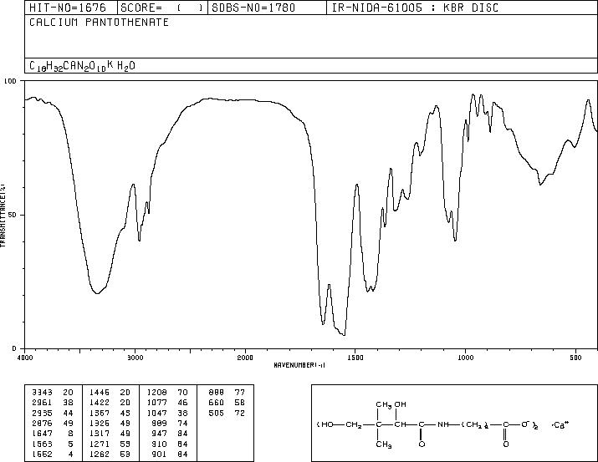
IR absorption spectrum of calcium pantothenate
26

Slide 29
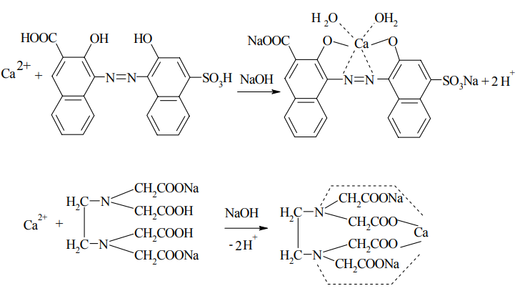
Quantitative definition.
The content of calcium cations (8.2–8.6%) is determined complexometrically, and the content of nitrogen (5.7–6.0%) is determined by the method of determining nitrogen in organic compounds:
27

Slide 30
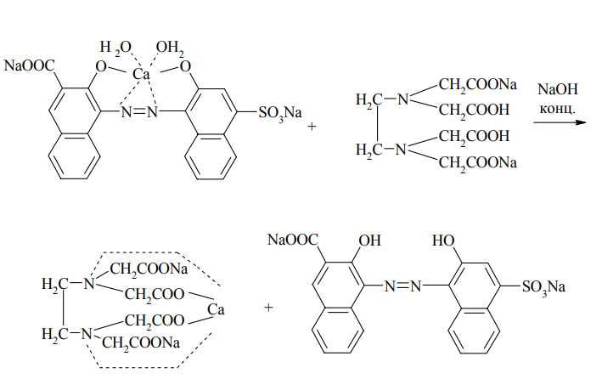
Storage. In a dry place at room temperature, in well-sealed glasses.
Application.
For the treatment of neuralgia, eczema, allergies, polyneuritis and other diseases associated with metabolic disorders, as well as inflammatory processes.
28

Slide 31
Literature
Pharmaceutical Chemistry: A Textbook for Students. higher pharmacy. textbook lock and pharmac. f-tiv higher. honey. textbook lock ІІІ – ІV levels of accreditation / P.О. Bezugly, I.S. Gritsenko, І.В. Ukrainets' and others. - Vinnytsia: New book, 2011. - 560 p.
Pharmaceutical chemistry. Lectures for english-speaking students: the study guide for students of higher schools / V. A. Georgiyants [et al.] ; ed. by: V. A. Georgiyants, P. O. Bezugly ; NUPh. – Kharkiv : NPhaU : Original, 2013. – 528 p
Pharmaceutical Encyclopedia / ed. council and the author of the foreword VP Black; Nat. pharmacy. University of Ukraine. - 2nd ed., Reworked. and add. - Київ: МОРІОН, 2010. - 1632 с.
State Pharmacopoeia of Ukraine: in 3 volumes / SE "Ukrainian Scientific Pharmacopoeial Center for Quality of Medicines". - 2nd type. - Kharkiv, 2015. - Vol.1. –1135 s.
State Pharmacopoeia of Ukraine: in 3 volumes / State Enterprise "Ukrainian Scientific Pharmacopoeial Center for Quality of Medicines". - 2nd ed., Kharkiv: State Enterprise "Ukrainian Scientific Pharmacopoeial Center for Quality of Medicines", 2014. - Vol. 2. - 724 p.
State Pharmacopoeia of Ukraine: in 3 volumes / State Enterprise "Ukrainian Scientific Pharmacopoeial Center for Quality of Medicines". - 2nd ed., Kharkiv: State Enterprise "Ukrainian Scientific Pharmacopoeial Center for Quality of Medicines", 2014. - Vol. 3. - 732 p.

