Slide 1
Vitamins of the alicyclic, aromatic series. Characteristics, classification, relationship between structure and pharmacological action, mechanism of action, methods of obtaining, methods of analysis, application in medicine.
Lecture 6

Slide 2
Classifications
By physiological action V. are divided into several groups:
V., which increase the overall reactivity of the organism (B₁, В₃, PP, A, C);
antihemorrhagic (C, K);
antianemic (B₁₂, В₆, C);
anti-infective (C, A).
The most successful can be considered Chemical classification, according to which all vitamins are divided into the following groups:
I. Aliphatic vitamins: ascorbic acid (vitamin C),
pangamate acid (vitamin B₁₅), pantothenic acid (vitamin B₃).
II. Vitamins of alicyclic series: retinols (vitamins of group A),
calciferols (vitamins of the group D).
III. Aromatic vitamins: vitamins of group K.
IV.Vitamins of the heterocyclic series: tocopherols (vitamins of group E),
bioflavonoids (vitamins of group P), nicotinic acid and its amide
(PP vitamins), pyridoxines (B6 vitamin), thiamine (vitamin
B₁), folic acid (vitamin B_{c}), riboflavin (vitamin B₂),
cobalomins (B₁₂).

Slide 3
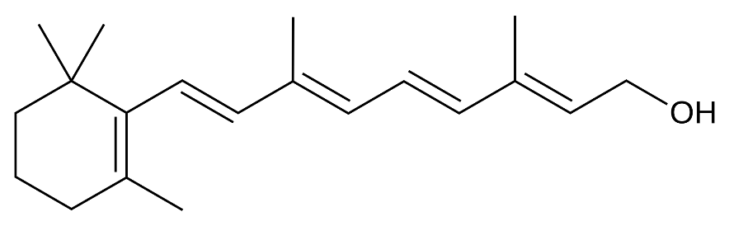
Вітаміни аліциклічного ряду
The alicyclic vitamins include retinols (vitamins of group A) and calciferols (vitamins of group D). The retinol molecule is based on a trimethylcyclohexane ring connected to a tetraenol conjugated chain, which ends with a hydroxyl or aldehyde group.
Discovered in 1913 by two independent groups of scientists (McCollut – Davis and Osborne). The first of the discovered vitamins, in connection with which it received the letter designation "A" in accordance with the alphabetical nomenclature. Retinol was obtained from the liver of fish in 1909. In 1928, Euler established that in some plants there are substances that have provitamin activity, that is, they are precursors of vitamins. The provitamins of vitamin A are α-, β- and γ-carotenes.
1

Slide 4
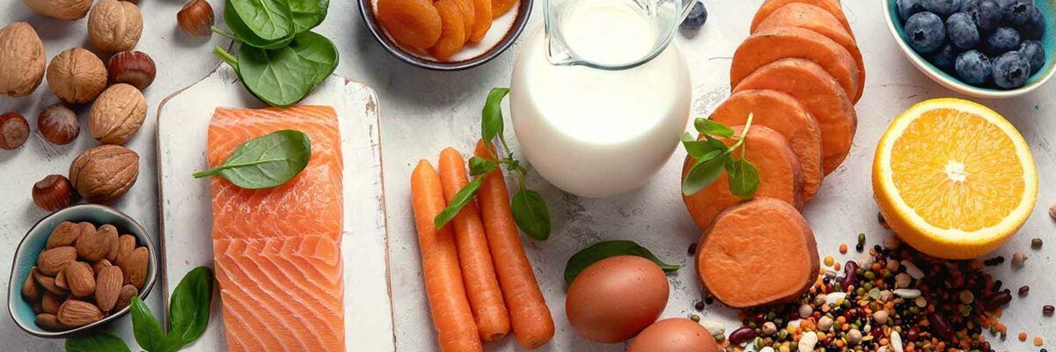
Sources of vitamin A
Animal foods(sources of vitamin A)
Liver of cattle;
Cod liver and fatty fish (salmon, herring);
Milk, cheese, butter;
Eggs.
Products of plant origin (sources of provitamin A)
pumpkin;
carrots;
various types of cabbage;
bell peppers;
spinach;
broccoli;
green onions;
soybeans, peas;
peaches;
apricots;
melon;
mango;
watermelon;
rose hips;
cherries;
nectarines.
2

Slide 5
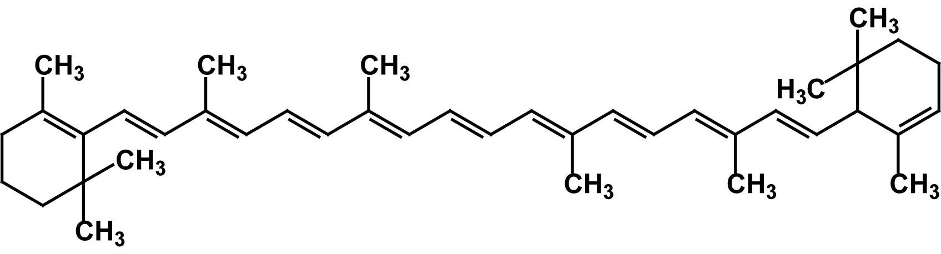
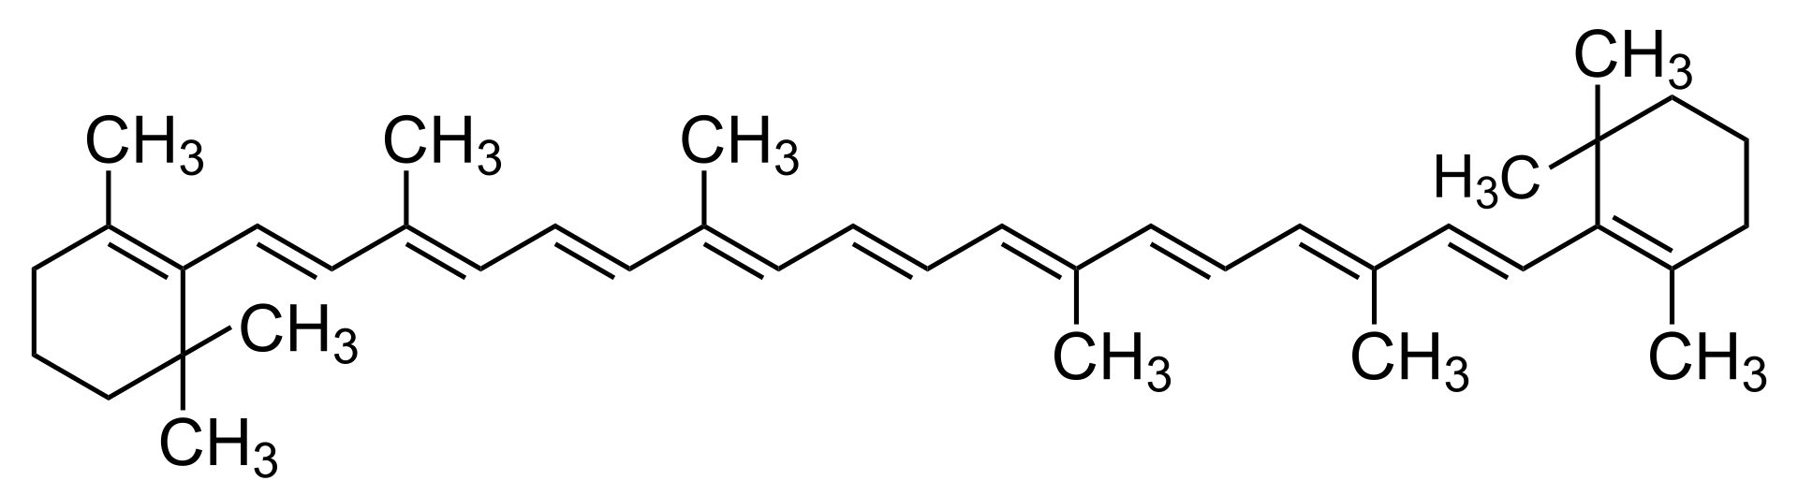
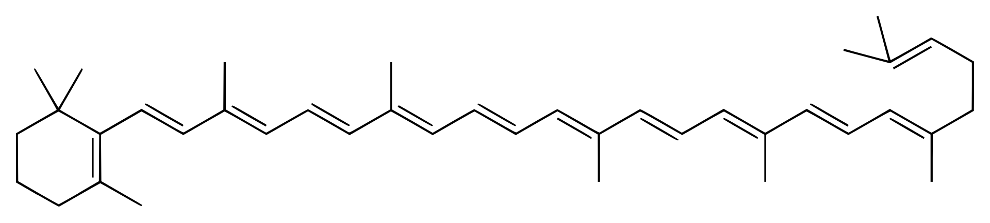
Vitamin A provitamins
α- carotene
β- carotene
γ- carotene
3

Slide 6
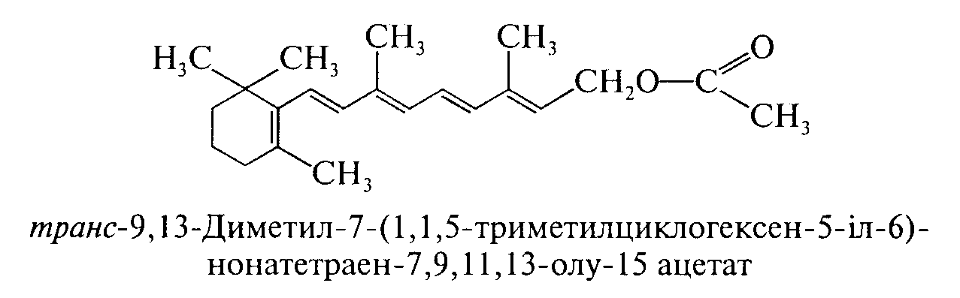
Retinol acetate (Retinoli acetas)
IUPAC Name: 3,7-Dimethyl-9-(2,6,6,-trimethyl-1-cyclohexen-1-yl)-2,4,6,8-nonatetraen-1-ol acetate, (all trans)-;
Mechanism of action. Retinal is involved in the formation of visual purple. It combines with a specific retinal protein - opsin, forming rhodopsin. Under the influence of light energy, rhodopsin is split, forming luminorhodopsin and metarhodopsin. The latter combines with water and breaks down into its original components: retinal and opsin. The energy released during the splitting of rhodopsin excites the receptors of the optic nerve. Retinol also contributes to the fixation of glycogen in the muscles, heart and liver, stimulates the conversion of pyruvate and regulates the metabolism of phospholipids. It enhances the proliferation of epithelial cells, rejuvenates the cell population, stimulates the synthesis of rhodopsin in the retina of the eye, improves the regeneration process, has an antioxidant and immunomodulatory effect.
4

Slide 7
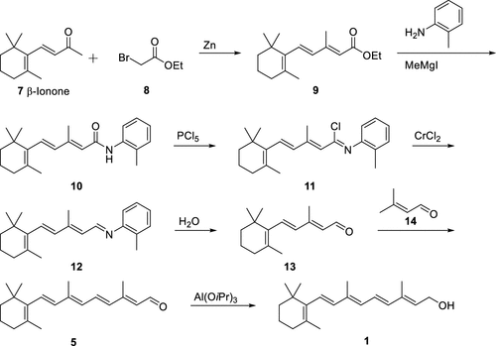
Synthesis.
First published synthesis of retinol( Kuhn and Morris, 1937)
5

Slide 8
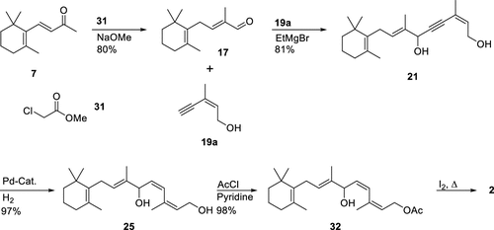
Synthesis.
Synthesis of retinol acetate(Isler et al., 1947)
6

Slide 9
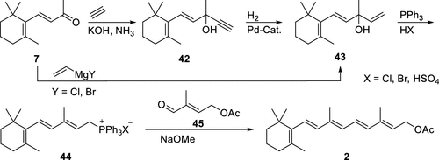
Synthesis.
BASF process for the synthesis of vitamin A acetate
7

Slide 10
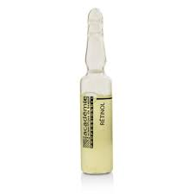
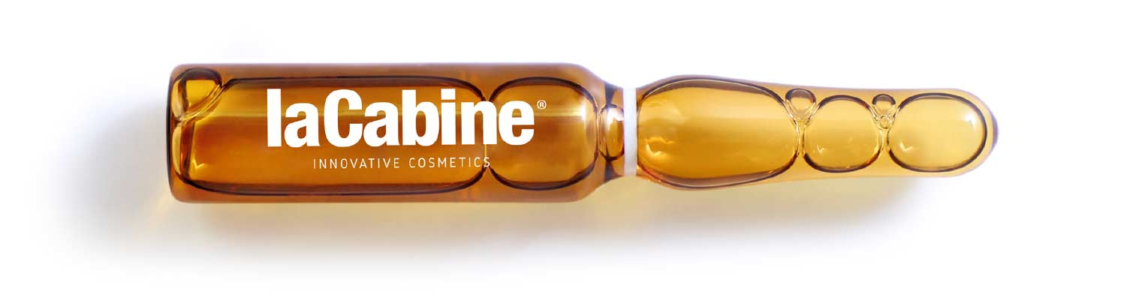
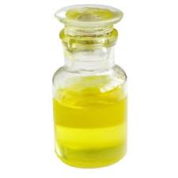
Properties. White or pale yellow crystals with a faint odor. Extremely unstable under the action of oxygen, air and light. Practically insoluble in water, soluble in 96% alcohol, chloroform, ether and oils.
8

Slide 11
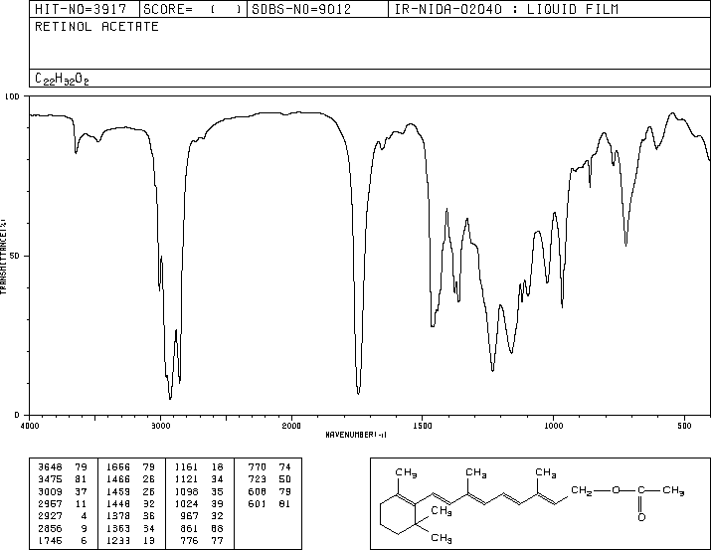
IR spectrum of retinol acetate
9

Slide 12
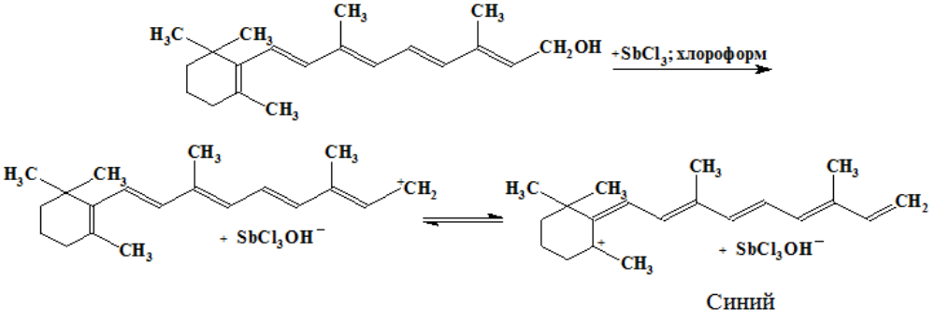

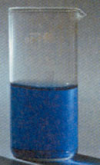
Identification: color reaction with antimony (III) chloride in chloroform medium - there is a blue color:
Quantitative definition. UV spectrophotometric method.
Storage. Due to the fact that the substance is easily oxidized, it is stored in ampoules sealed in a stream of nitrogen, which protect from light at a temperature not exceeding +5 ° C. Oil solutions of retinol acetate are stored in filled, well-sealed dark glass beakers at a temperature not exceeding +10 ° C.
Application. With beriberi, skin diseases and lesions, eye diseases. Prescribe retinol acetate in the form of pills, granules, oil solutions internally, intramuscularly and topically.

Slide 13
Table of daily intake of retinol (vitamin A)
Gender | Age | Consumption rates, mcg/day
Babies | Up to 6 months | 400
Babies | 7-12 months | 500
Children | 1-3 years | 300
Children | 4-8 years | 400
Children | 9-13 years | 600
Men | 14 years and older | 900
Women | 14 years and older | 700
11

Slide 14
Vitamins of group D
Vitamin D (calciferol, anti-rickets vitamin) exists in the form of several compounds that differ in chemical structure and biological activity.
For humans and animals, vitamins D2 and D3 are considered active drugs, although other vitamins of the group are also known, for example, vitamin D4 (dihydroergocalciferol). Natural products contain mainly provitamins D2 and D3, respectively - ergosterol and cholesterol.
In 1924, A. Hess and M. Weinstock and independently G. Steenbock from vegetable oils and food products after exposure to UV radiation with a wavelength of 280-310 nm obtained an active drug that prevents the development of rickets in children.
In 1932, A. Windaus isolated ergosterol from yeast and showed that the true vitamin D was not ergosterol, but its conversion product formed by UV irradiation, which was designated vitamin D2, or calciferol. In 1956, the International Commission on Chemical Nomenclature proposed a new name for vitamin D2 – ergocalciferol.
12

Slide 15
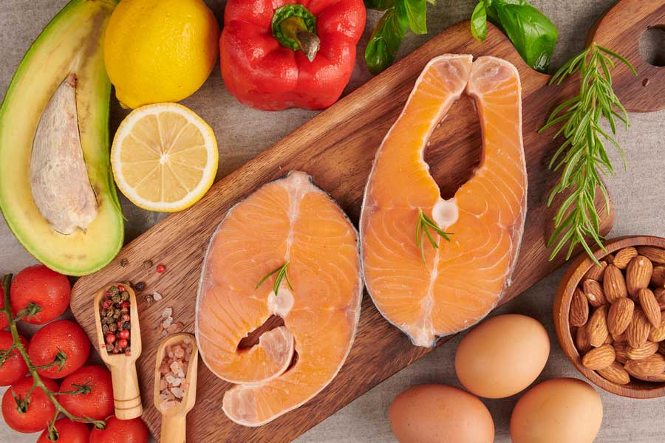
Sources of vitamin D
- Sunlight (UV light);
- Foods:
Oily fish (salmon, sardines, tuna);
Fish oil;
Eggs;
Dairy products (milk, yogurt, cheese);
Cereals
13

Slide 16
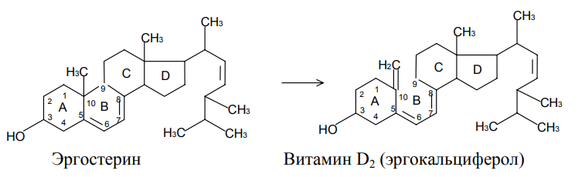
From a chemical point of view, ergosterol is a monoatomic unsaturated cyclic alcohol, the structure of which is based on a condensed cyclopentaneperhydrophenanthrene ring system; under the influence of UV radiation, ergosterol is converted into vitamin D₂ through a number of intermediate products :
Еrgosterol Ergocalciferol (vitamin D₂)
As can be seen, vitamin D₂ is formed from ergosterol as a result of the cleavage between the 9th and 10th carbon atoms of the ring under the influence of UV radiation.
14

Slide 17
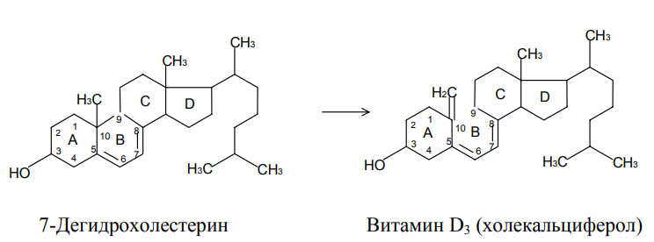
Born in 1936 in the laboratory of A. Windaus, they saw an active drug made from fish oil called vitamin D₃. The precursor to vitamin D₃ is 7-dehydrocholesterol, which, when exposed to UV light, is converted into the active vitamin D₃:
7-dehydrocholesterol Vitamin D₃ (cholecalciferol)
Завдяки наявності холестерину та 7- дегідрохолестерину у складі ліпідів шкіри людини є можливість синтезу вітаміну D₃ при сонячному опроміненні або опроміненні ламп ультрафіолетового випромінювання поверхні тіла. Цим прийомом широко користуються при лікуванні рахіту у дітей
15

Slide 18
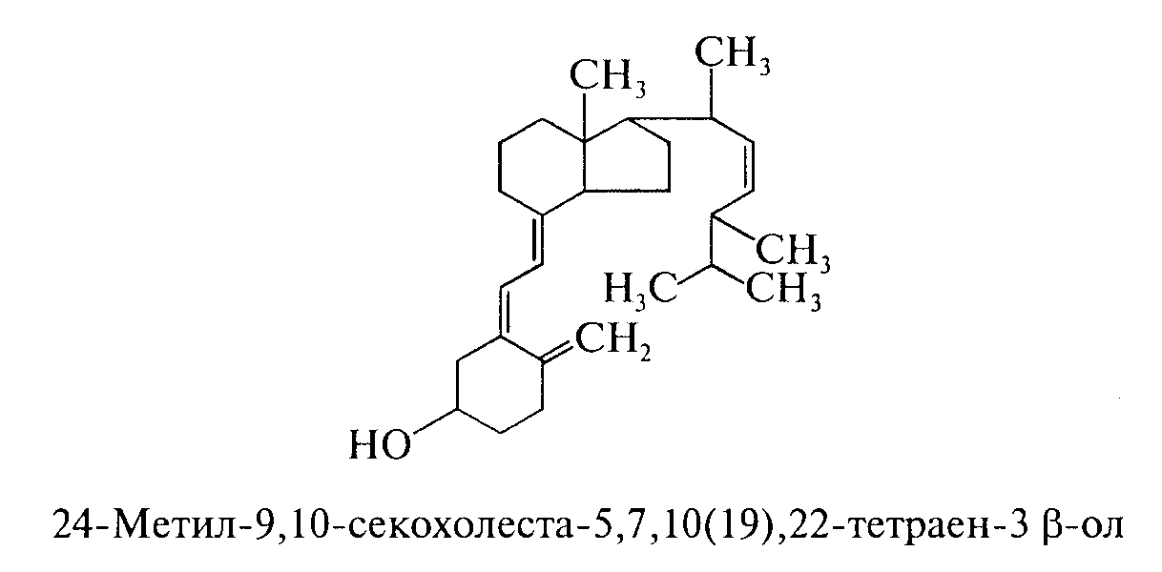
Ergocalciferol (Ergocalciferolum) Vitamin D₂
IUPAC name: (3β,5Z,7E,22E)-9,10-secoergosta-5,7,10(19),22-tetraen-3-ol
Mechanism of action. Regulates the metabolism of phosphorus and calcium in the body, promotes their absorption in the intestine by increasing the permeability of its mucous membrane and adequate deposition in bone tissue. The effect of ergocalciferol is enhanced by the simultaneous intake of calcium and phosphorus compounds.

Slide 19
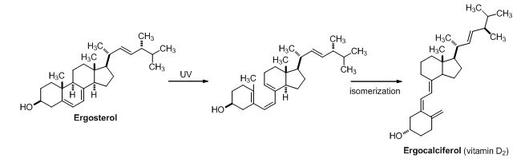
Synthesis.
Remove ergosterol, which is extracted from yeast, using UV light.
17

Slide 20
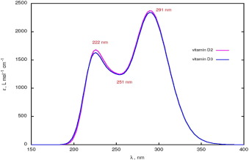
UV spectrum of ergocalciferol (vitamin D₂)
18

Slide 21
Properties. Crystalline powder of white or slightly yellowish color or white or almost white crystals. Practically insoluble in water, easily soluble in 96% alcohol, soluble in fatty oils. Sensitive to air, heat and light. Solutions in volatile solvents are unstable and should be used immediately after cooking. Temperature-dependent and time-dependent reversible isomerization to preergocalciferol is possible in solutions. The activity of the substance is due to both components. A solution of ergocalciferol in oil is a clear oily liquid from light yellow to dark yellow.
Identification:
by IR spectroscopy;
when interacting with a solution of antimony (III) chloride in the presence
acetyl chloride forms an orange-pink color.
Quantitative definition. Carried out by liquid chromatography.
Storage. Ergocalciferol is stored in an airtight container, under nitrogen, in a dark place at a temperature of 2 to 8 ° C. The contents of the open container should be used immediately.
Application. In medical practice, use alcohol (0.5%) and oil (0.125%) solutions of the vitaminD₂ for the prevention and treatment of rickets, as well as in bone diseases associated with impaired calcium metabolism.

Slide 22
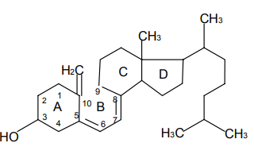
Cholecalciferol (Vitamin D₃)
Seco-9,10-cholestatriene-5,7,10(19)-ol3β-(5Z,7E)
Properties. Bare-free crystals or odorless white crystalline powder. Practically insoluble in water, insoluble in ethanol, chloroform and ether. Pitome wrapping from 105 ^{о} to 112 ^{о}.

Slide 23
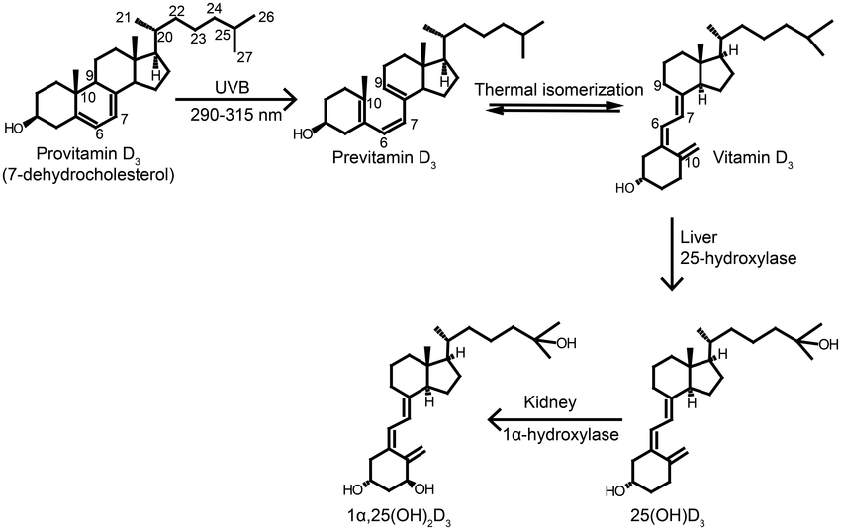
Synthesis.

Slide 24
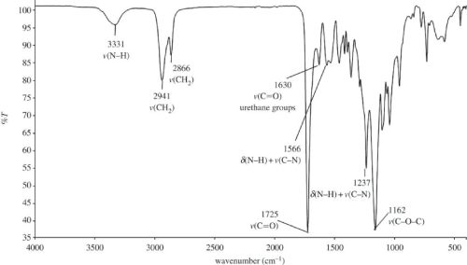
IR absorption spectrum of cholecalciferol (Vitamin D₃)
22

Slide 25
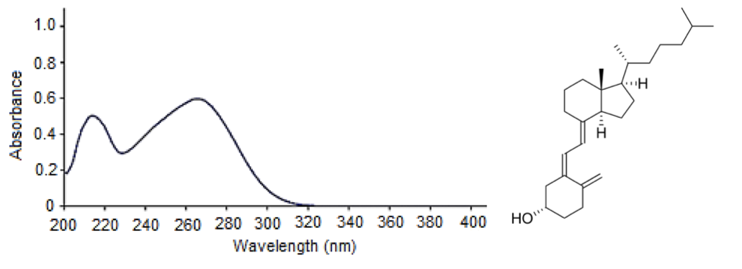
UV- spectrum of cholecalciferol (Vitamin D₃)
23

Slide 27
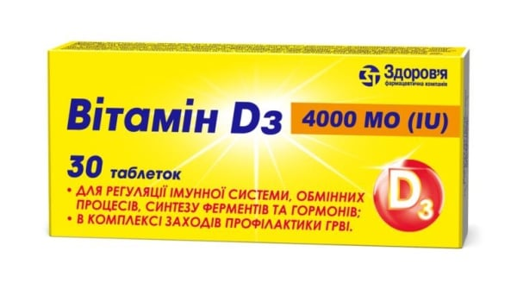
Storage. In a hermetically sealed container, protected from light, in an inert atmosphere (nitrogen), free from oxygen, in a cool place. Even without light, it gradually decomposes in a humid atmosphere, the decomposition is accelerated by increasing temperature. Store at 2-8 °C.
Uses. Prevention of rickets;prevention of vitamin D3 deficiency in high-risk groups who do not have absorption disorders;prevention of rickets in premature newborns;prevention of vitamin D3 deficiency in malabsorption;treatment of rickets and osteomalacia;supportive treatment of osteoporosis;treatment of hypoparathyroidism.
24

Slide 28
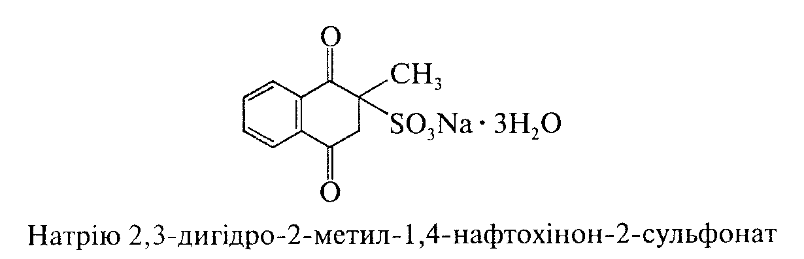
Aromatic vitamins
Aromatic vitamins include derivatives of 2-methyl-1,4-naphthoquinone(vitamins of group K). They have antihemorrhagic action and are involved in the formation of prothrombin.
In medical practice, a synthetic analogue of K vitamins - vikasol is used.
Vikasolum
Sodium 2,3-dihydro-2-methyl-1,4-naphthoquinone-2-sulfonate
Mechanism of action. Stimulates the synthesis of prothrombin and proconvertin, enhances the synthesis of II, VII, IX, X coagulation factors and as a consequence increases blood clotting. It has hemostatic properties, as vitamin K deficiency leads to increased bleeding.

Slide 29
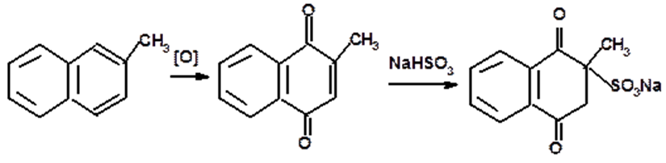
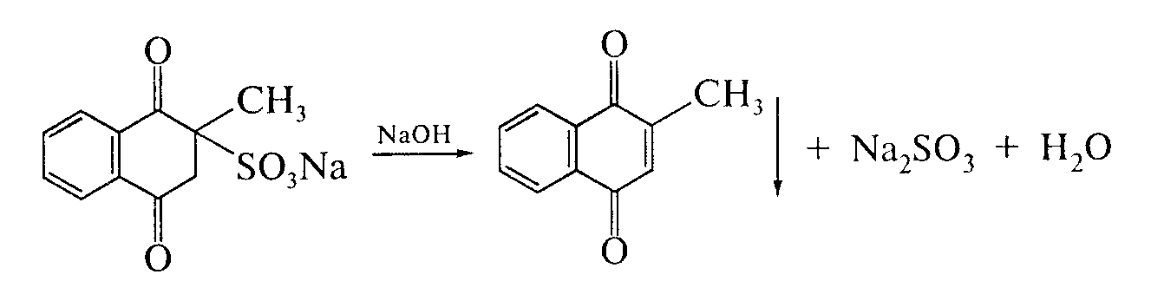
Synthesis.
Properties. White, sometimes with a yellowish tinge odorless crystalline powder. Easily soluble in water, sparingly soluble in alcohol, very slightly soluble in ether.
Identification:
when interacting with the solution NaOH precipitates 2-methyl-1,4-
naphthoquinone, which is extracted with chloroform, is purified from
impurities and determine the melting point (104–107 °C):

Slide 30
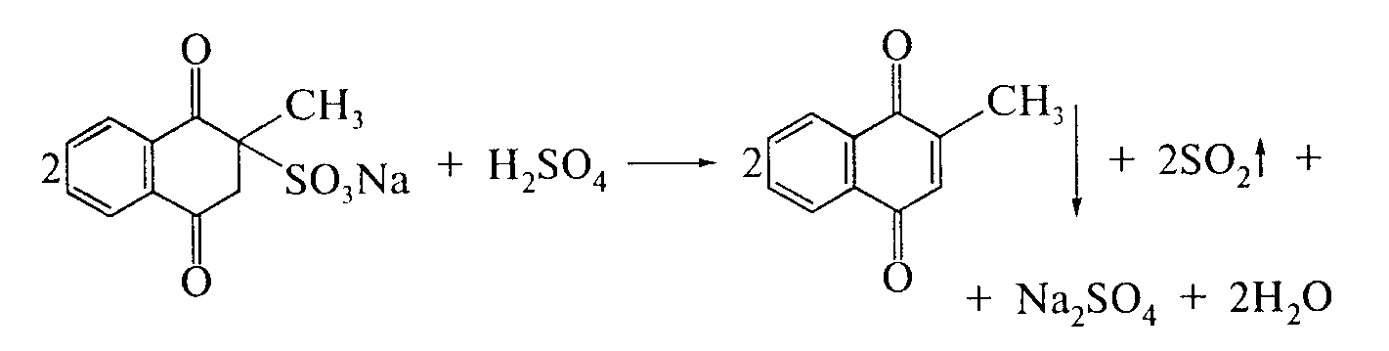
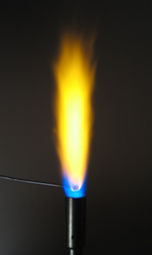
when Vikasol interacts with concentrated sulfuric acid
the smell of sulfur (IV) oxide (sulfur dioxide):
the substance reacts with sodium ions:
Specific impurities. Sodium bisulfite and 2-methyl-1,4-naphthohydroquinone-3-sulfonate.
Sodium bisulfite is quantified by iodometric method (not more than 2%).
2-Methyl-1,4-naphthohydroquinone-3-sulfonate is determined using at-phenanthroline - no precipitate should form (impurity is not allowed).

Slide 31
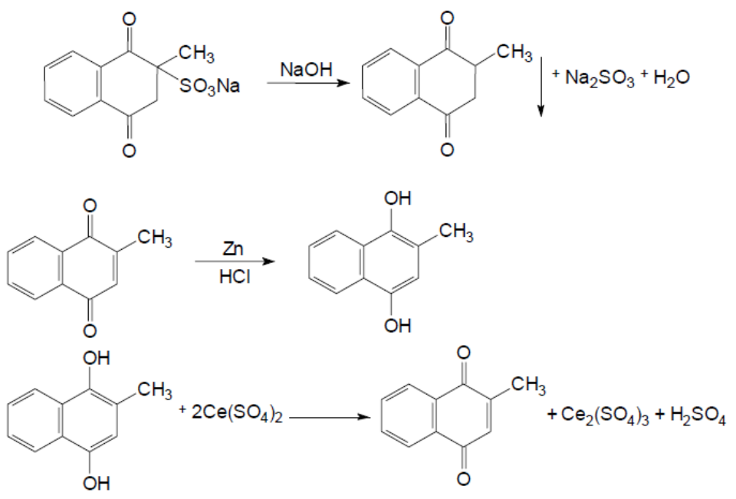
Quantitative definition. Cerimetry, direct titration, indicator - at-phenanthroline, s = 1/2. 2-methyl-1,4-naphthoquinone is precipitated by reaction with sodium hydroxide and extracted with chloroform. After removal of chloroform, it is reduced in an acidic medium to 2-methyl-1,4-dihydroxynaphthalene, which is then titrated with a solution of cerium (IV) sulfate to a green color:
Storage. In a well-sealed container that protects from light.
Application. To increase blood clotting in various bleedings. Available in powders, tablets and solutions.

Slide 32
Literature
Pharmaceutical Chemistry: A Textbook for Students. higher pharmacy. textbook lock and pharmac. f-tiv higher. honey. textbook lock ІІІ – ІV levels of accreditation / P.О. Bezugly, I.S. Gritsenko, І.В. Ukrainets' and others. - Vinnytsia: New book, 2011. - 560 p.
Pharmaceutical Encyclopedia / ed. council and the author of the foreword VP Black; Nat. pharmacy. University of Ukraine. - 2nd ed., Reworked. and add. - Київ: МОРІОН, 2010. - 1632 с.
State Pharmacopoeia of Ukraine: in 3 volumes / SE "Ukrainian Scientific Pharmacopoeial Center for Quality of Medicines". - 2nd type. - Kharkiv, 2015. - Vol.1. –1135 s.
State Pharmacopoeia of Ukraine: in 3 volumes / State Enterprise "Ukrainian Scientific Pharmacopoeial Center for Quality of Medicines". - 2nd ed., Kharkiv: State Enterprise "Ukrainian Scientific Pharmacopoeial Center for Quality of Medicines", 2014. - Vol. 2. - 724 p.
State Pharmacopoeia of Ukraine: in 3 volumes / State Enterprise "Ukrainian Scientific Pharmacopoeial Center for Quality of Medicines". - 2nd ed., Kharkiv: State Enterprise "Ukrainian Scientific Pharmacopoeial Center for Quality of Medicines", 2014. - Vol. 3. - 732 p.

