Slide 1
Heterocyclic vitamins: derivatives of chroman, rutin, derivatives of pyridine. Characteristics, classification, relationship between structure and pharmacological action, mechanism of action, methods of obtaining, methods of analysis, application in medicine.
LECTURE 7

Slide 2

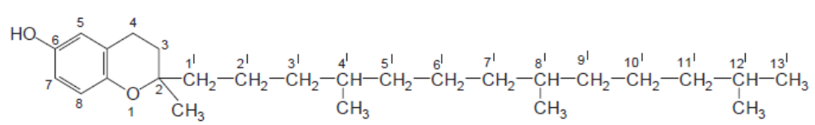
HETEROCYCLIC VITAMINS
Derivatives of chroman
Vitamins of the heterocyclic series, chroman derivatives(vitamins of group E - tocopherols), are contained in oils, and also in green parts of plants, especially in young sprouts of cereals. They are also present in small quantities in milk, butter, egg yolks, meat, fats.
In industry, vitamin E is extracted from natural sources or as a result of synthesis.
The structure of vitamins of group E is based on the tocol molecule:
Tocopherols differ in the number of methyl groups in the chromium nucleus; There are seven natural vitamins of group E. The most active - α-tocopherol. Tocopherol acetate is used in medical practice.

Slide 3
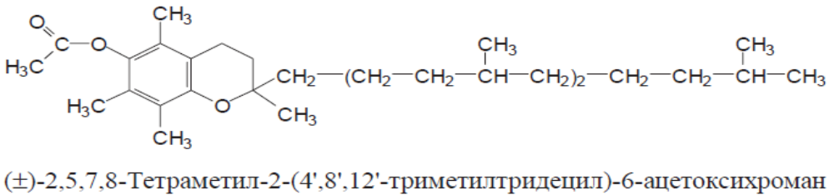

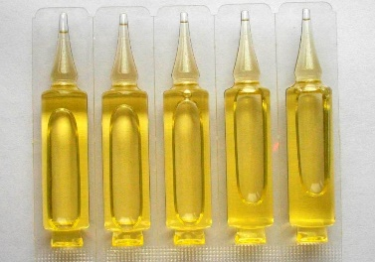
α-Tocopheryl acetate (alpha-tocopherol acetate), vitamin E acetate
(Tocopheroli acetas)
IUPAC name: (2R)-2,5,7,8-Tetramethyl-2-[(4R,8R)-4,8,12-trimethyltridecyl]-3,4-dihydro-2H-1-benzopyran-6-yl acetate
Mechanism of action. Blocks the participation of oxygen in the oxidation of polyunsaturated fatty acids, participates in phosphorylation processes. Supports the normal function of the gonads. Inhibits cholesterol synthesis, reduces myocardial oxygen demand, improves blood supply to tissues, including myocardium, and has an antioxidant effect, prevents increased permeability and fragility of capillaries.
Properties.Light yellow, clear, thick, oily liquid with a faint odor. Practically insoluble in water, soluble in 95% alcohol and very soluble in ether, acetone, chloroform and oils. Under the action of light tocopherol acetate oxidizes and darkens.

Slide 4
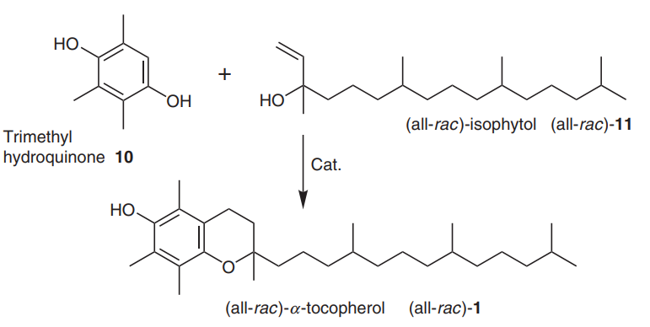
Synthesis.

Slide 5
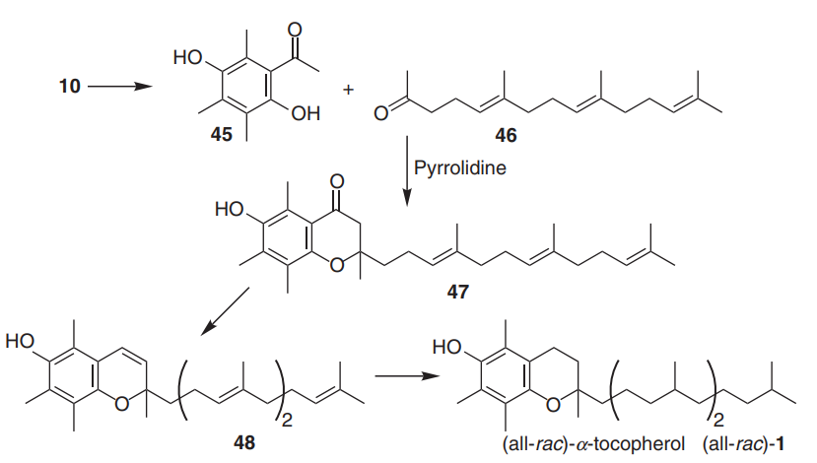
Synthesis.

Slide 6
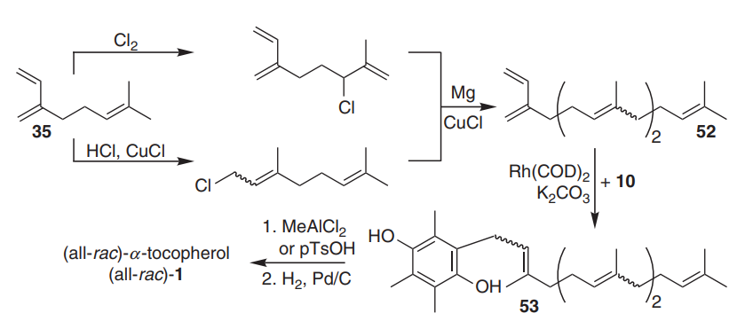
Synthesis.

Slide 7
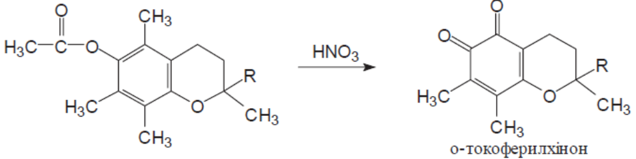
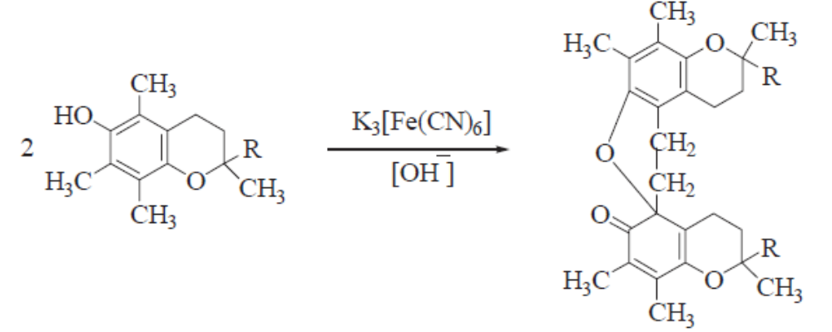
Identification:
oxidation with fuming nitric acid, when heated on a water heater - there is a red-orange color:
tocopherol acetate is hydrolyzed with a solution of KOH in absolute alcohol (when heated), then add concentrated sulfuric acid - the smell of ethyl acetate- pieasant frutty odour.
in the oxidation of tocopherol by potassium hexacyanoferrate (III) in an alkaline environment is formed colored di-α-tocopherol:

Slide 8
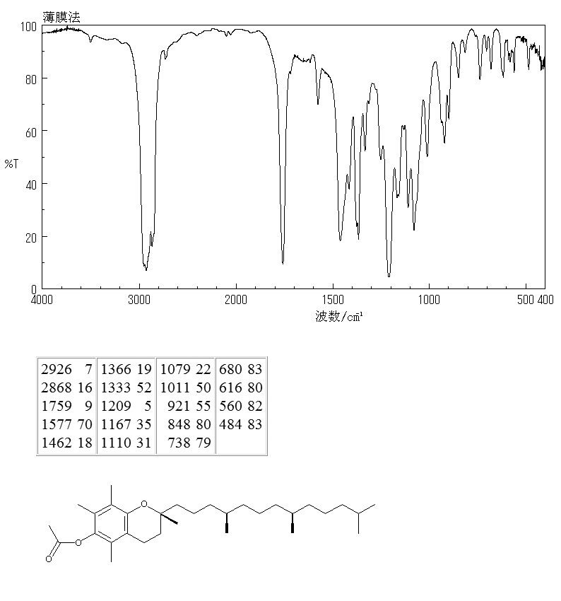
IR absorption spectrum of tocopherol acetate
7

Slide 9
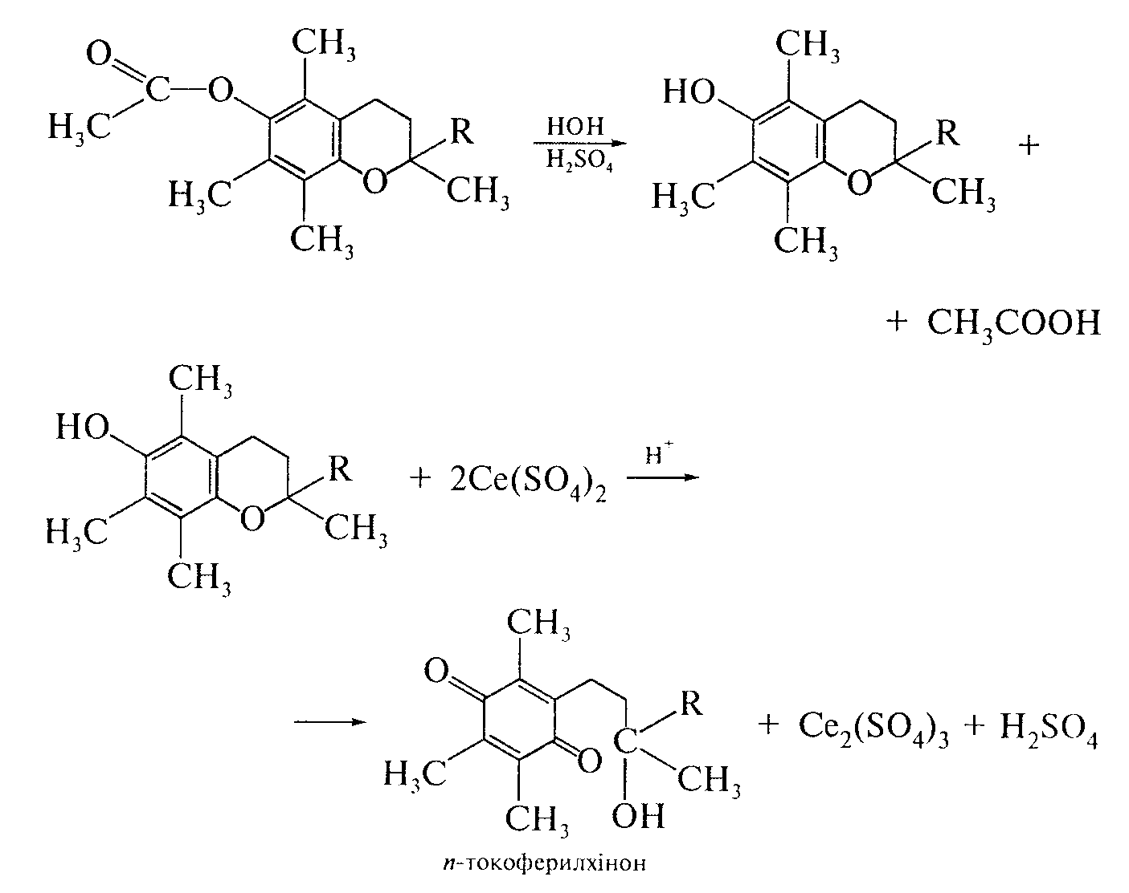
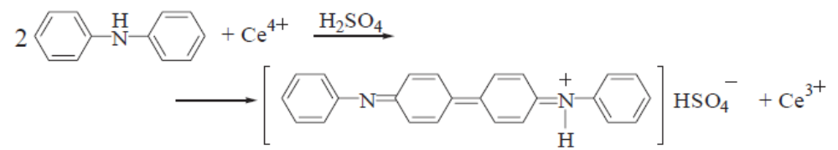
Quantitative definition. Cerimetry, direct titration after hydrolysis, indicator - diphenylamine, s = 1/2:
In parallel, conduct a control experiment.

Slide 10
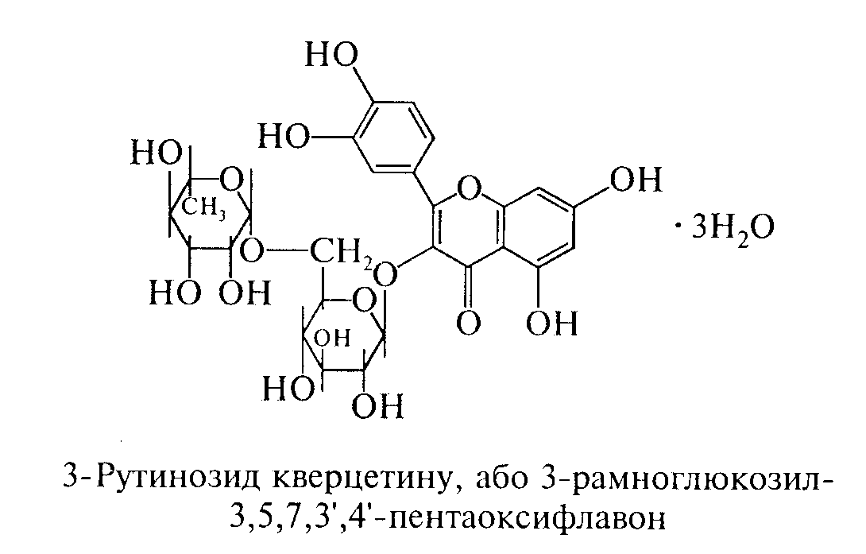
Storage. In hermetically sealed, dark glass jars, in a cool, dark place.
Application. In nervous diseases, muscular dystrophies, sclerosis, to improve vision, in radiation sickness use alcohol or oil concentrate containing from 0.3 to 2% α-tocopherol, ampoule solution containing 0.05; 0.1 and 0.2 g of α-tocopherol in 1 ml of oil and pills.
Routine (Rutinum)
IUPAC name: 2-(3,4-dihydroxyphenyl)-5,7-dihydroxy-3--4H-chromen-4-one
Mechanism of action.Promotes the conversion of ascorbic acid into dehydroascorbic acid and prevents further transformation of the latter into diketogulonic acid. Therefore, most of the effects of rutin are mediated by ascorbic acid.

Slide 11
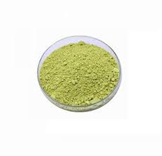
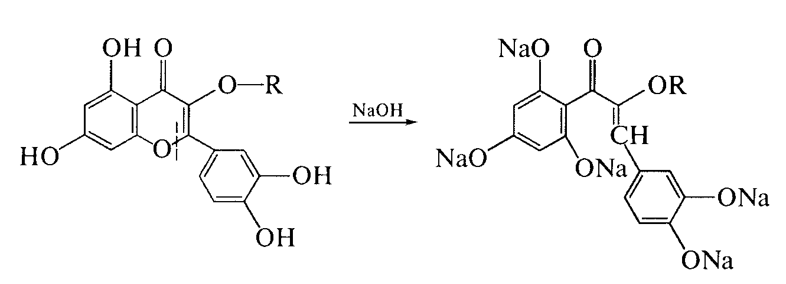
Properties. Greenish-yellow fine crystalline powder without smell and taste. Practically insoluble in water, sparingly soluble in alcohol, sparingly soluble in boiling alcohol, practically insoluble in solutions of acids, ether, chloroform, acetone and benzene, soluble in dilute alkali solutions.
Rutin is a glycoside and in acid hydrolysis gives the aglycone quercetin and disaccharide - rutinosis, which consists of glucose and rhamnose.
Identification:
when dissolving the substance in a solution of sodium hydroxide appears
yellow-orange color. As a result of the reaction flavonoid
turns into a chalcone:

Slide 12
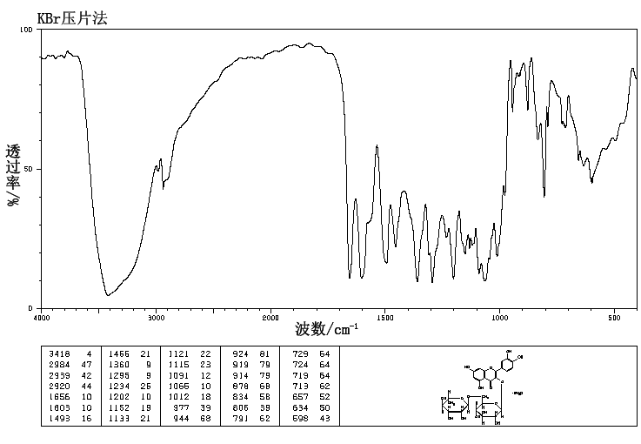
IR absorption spectrum of rutin

Slide 13
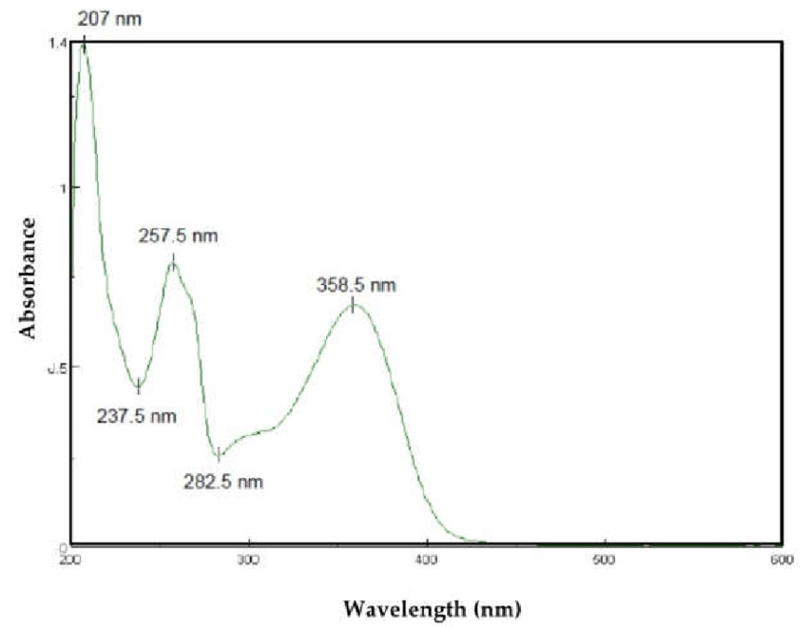
UV spectrum routine

Slide 14
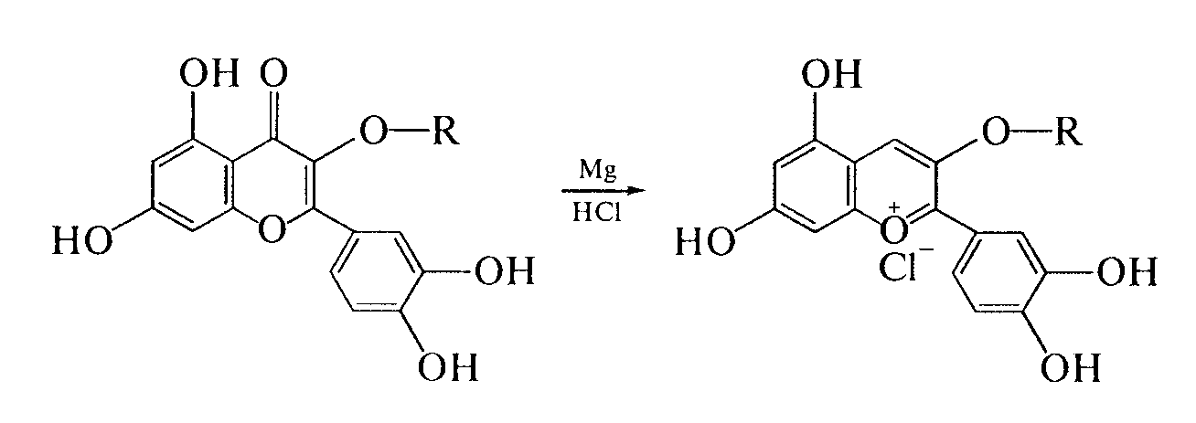
rutin is restored in an acidic environment, while
pyrile salts are formed, which have a red color
(cyanine reaction):
the glucose residue is detected after acid hydrolysis by the reaction
with Fehling's reagent;
the presence of absorption maxima in the UV spectrum at 259 and 362.5 nm.
Quantitative definition. Spectrophotometry.
Storage. In a sealed container that protects from light.
Application. Rutin regulates vascular permeability, enhances the action of ascorbic acid. It is used for the prevention and treatment of hypo- and beriberi P, as well as for the treatment of diseases associated with impaired vascular permeability and capillary damage. Tablets containing rutin and ascorbic acid are produced under the name "Askorutin".

Slide 15
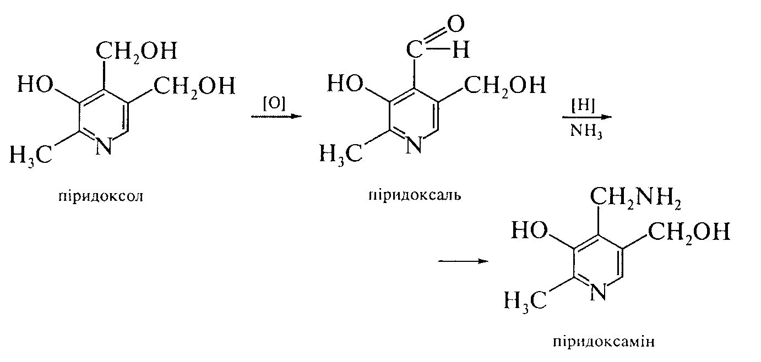
Pyridine derivatives
Vitamins derived from pyridine include nicotinic acid, its amide (PP vitamins) and oxymethylpyridine vitamins (group B₆).
Nicotinic, or β-pyridinecarboxylic, acid was first obtained synthetically by K. Huber in 1867 during the oxidation of nicotine with chromic acid. Its vitamin properties were discovered in 1937 - 1938. In natural raw materials there is not nicotinic acid itself, but nicotinamide, which is part of many enzymes. Thus, nicotinic acid is a provitamin of nicotinamide.
Vitamins B ₆ represented by related substances: pyridoxol (pyridoxine), pyridoxal and pyridoxamine, which are sequentially convertedare in each other:

Slide 16
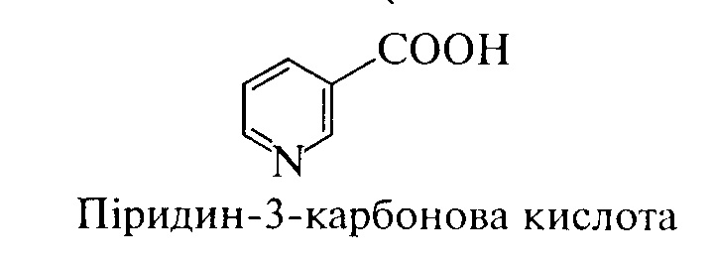
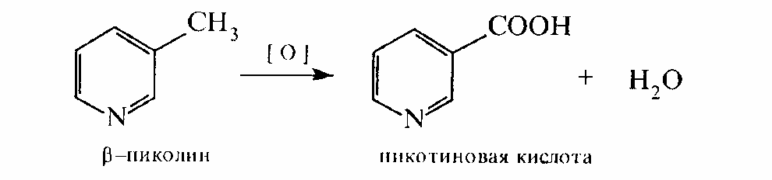
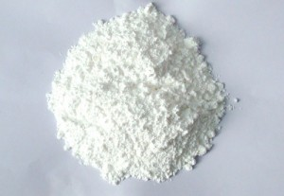
Nicotinic acid (Acidum nicotinicum)
Pyridine-3-carboxylic acid
Mechanism of action.Nicotinic acid is a prosthetic group of enzymes codehydrase I and codehydrase II - enzymes that carry hydrogen and carry out redox processes. Codehydrase II is also involved in the transport of phosphate. Nicotinic acid deficiency leads to pellagra. Nicotinic acid improves carbohydrate metabolism, dilates blood vessels.
Synthesis.
ᵝ- pyccoline nicotinic acid
Properties. White, odorless, slightly acidic crystalline powder. Insoluble in water and 95% alcohol, soluble in hot water, very insoluble in ether. Soluble in acids and bases.

Slide 17
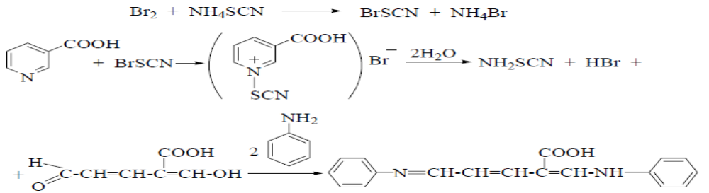
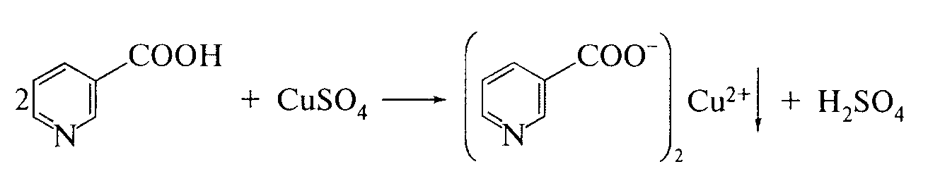
Identification:
physicochemical methods: determination of Melting point, IR- spectroscopy;
substance when interacting with a solution of cyanobromide reactive( qualitative reaction to the pyridine cycle) adding aniline solution forms a yellow color:
Non-pharmacopoeial reactions:
reaction on the pyridine ring with 2,4-dinitrochlorobenzene;
formation of copper nicotinate of blue colour:

Slide 18
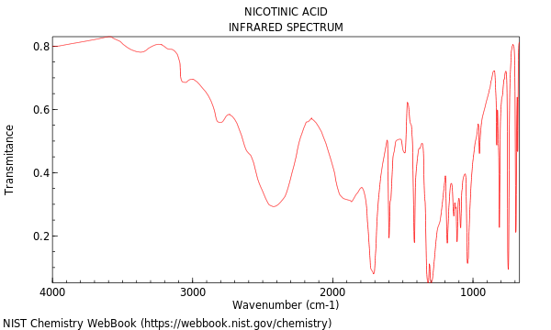
IR absorption spectrum of nicotinic acid
17

Slide 19
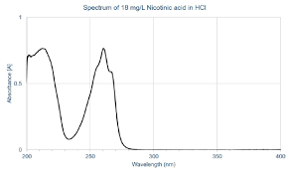
UV spectrum of nicotinic acid
18

Slide 20
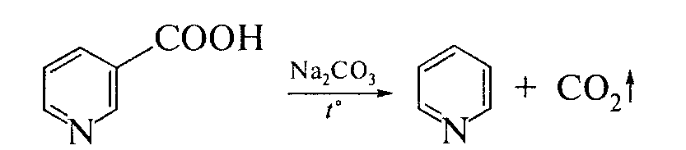
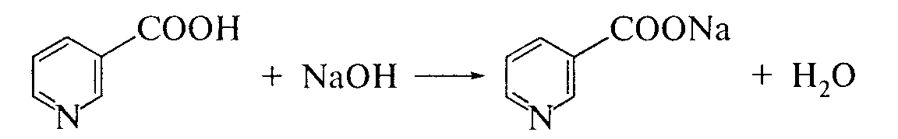
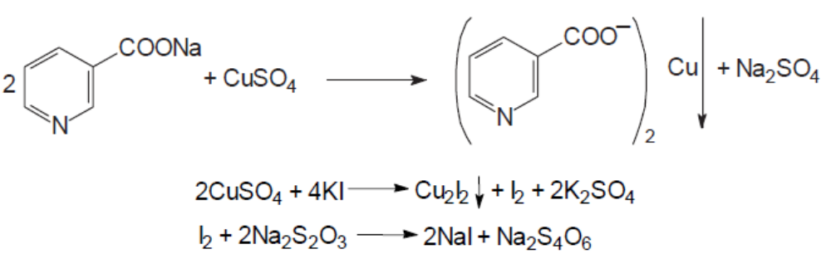
when heated, the substance with anhydrous sodium carbonate occurs
the smell of pyridine:
Quantitative definition.
Alkalimetry, direct titration, indicator - phenolphthalein, s = 1. In parallel, conduct a control experiment (SPU):
2. In solutions for injection, the quantitative content of nicotinic acid is determined by cupriodometric method after neutralization with a solution of sodium hydroxide, the indicator is starch, s = 2:

Slide 21
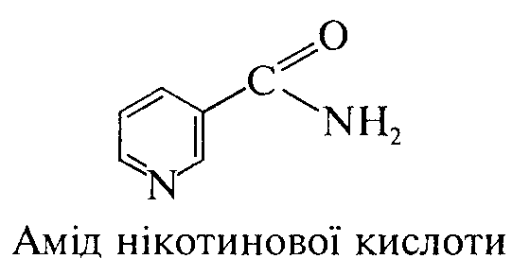
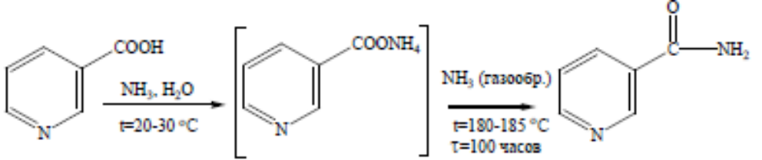
Storage. In a sealed container that protects from light.
Application. Antipelagic agent. Nicotinic acid has a vasodilating and hypocholesterolemic effect, so it is prescribed for liver disease, vasospasm of the extremities, kidneys, brain, infectious diseases. Causes side effects: redness of the face, a feeling of blood flow to the head.
Nicotinamid (Nicotinamidum)
Synthesis.
Properties. White fine crystalline powder with a very faint odor, bitter in taste. Easily soluble in water and alcohol, soluble in glycerin, very slightly soluble in ether and chloroform.

Slide 22
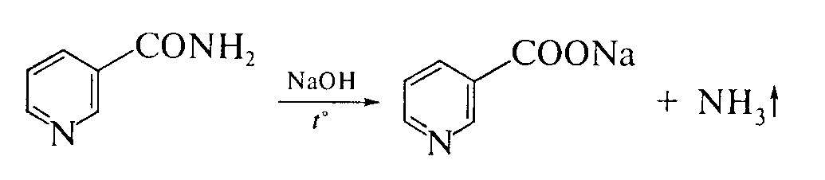
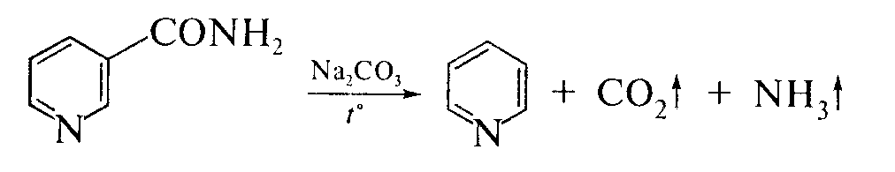
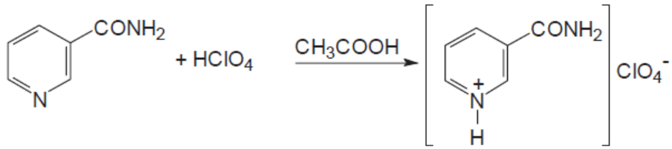
Identification:
physicochemical methods: determination of so-called pl., IR spectroscopy;
release of ammonia when heating the substance with a solution NaOH:
Schiff base formation reaction upon interaction with cyanbromide
reagent and aniline;
Non-pharmacopoeial reaction. Nicotinamide decomposes when heated with
crystalline sodium carbonate - there is an odor of pyridine:
Quantitative definition. Acidimetry in a non-aqueous medium, indicator - crystalline violet, s = 1:

Slide 23
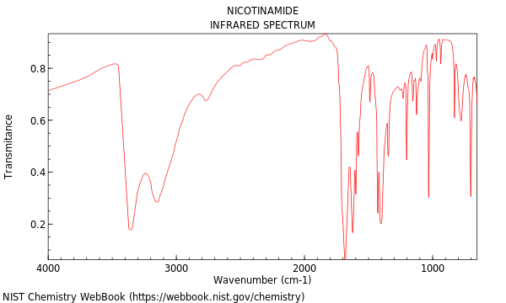
IR absorption spectrum of nicotinamide
22

Slide 24
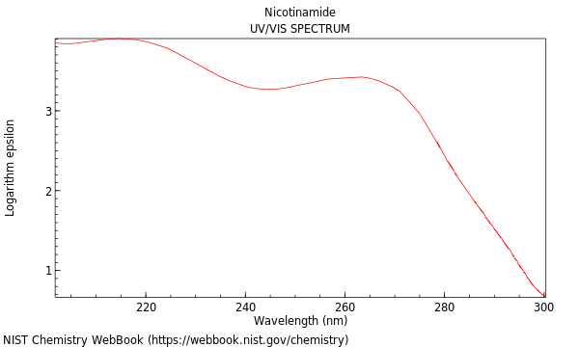
UV spectrum of nicotinamide
23

Slide 25
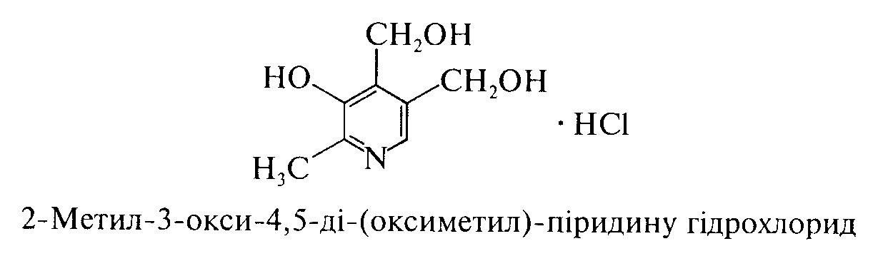
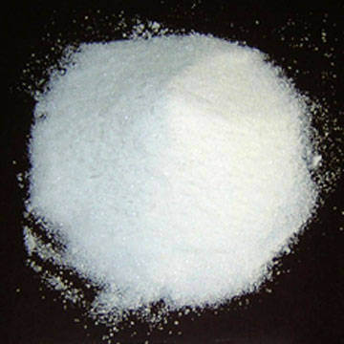
Storage. In tight sealed container that protects from light.
Application. Similar to nicotinic acid, but it does not cause side effects.
Pyridoxine hydrochloride (Pyridoxins hydrowithchloride) (SPU)
IUPAC name: 4,5-Bis(hydroxymethyl)-2-methylpyridin-3-ol
Mechanism of action. Stimulates hematopoiesis. In phosphorylated form it is part of enzymes involved in the processes of decarboxylation, amino acid reamination, as well as lipid metabolism. Needed for normal CNS function.
Properties. White, odorless, fine-crystalline powder, bitter in taste. Easily soluble in water, sparingly soluble in 95% alcohol, practically insoluble in ether.

Slide 26
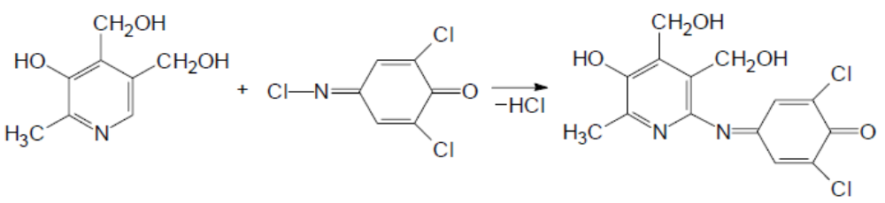
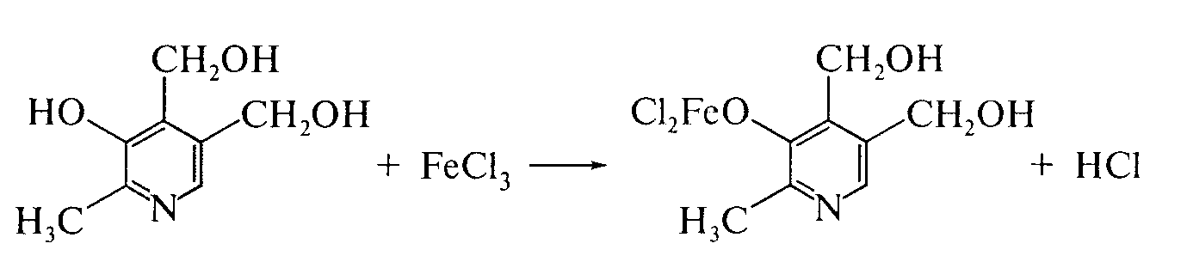
Identification:
physicochemical methods: IR and UV spectroscopy, TLC (as
developer using 2,6-dichloroquinone chloride):
substance gives characteristic reactions to chlorides.
Non-pharmacopoeial reactions:
when interacting with a solution of iron (III) chloride is formed red
color that disappears with the addition of sulfuric acid (reaction
on phenolic hydroxyl):

Slide 27
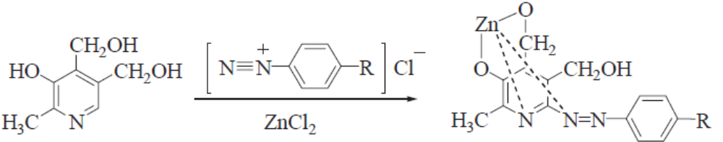
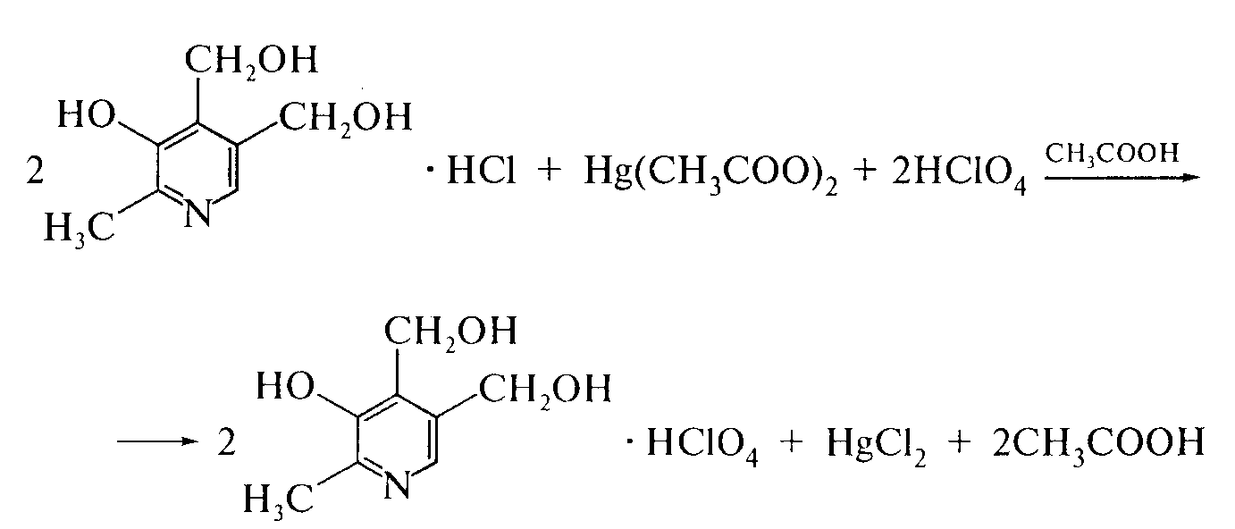
pyridoxine reacts by azo coupling with diazonium salts.
The formed azo dyes give colored complexes with salts
heavy metals, in particular zinc:
Quantitative definition.
Acidimetry in a non-aqueous medium in the presence of mercury (II) acetate, indicator - crystalline violet, s = 1. In parallel, conduct a control experiment:

Slide 28
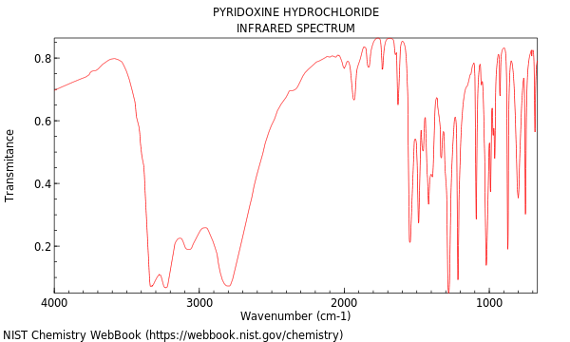
IR absorption spectrum of pyridoxine hydrochloride

Slide 29
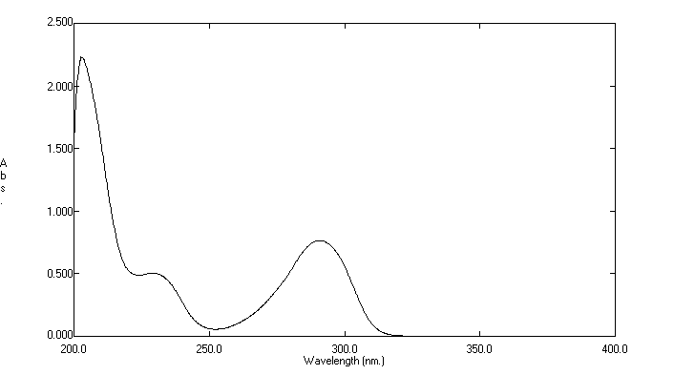
UV spectrum of pyridoxine hydrochloride

Slide 30
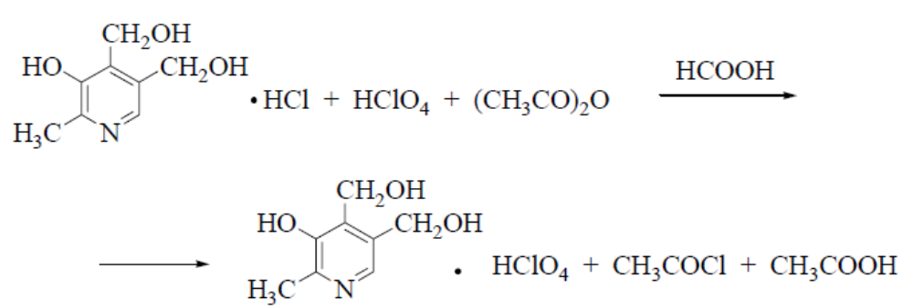
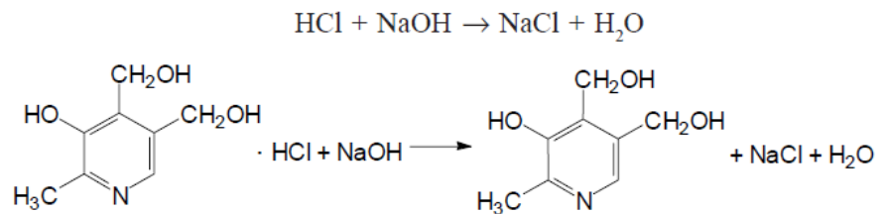
2. Acidimetry in a non-aqueous medium in a mixture of formic acid and acetic anhydride potentiometrically, s = 1. In parallel, conduct a control experiment:
3. Alkalimetry, direct titration in a mixture of 0.01 M solution of hydrochloric acid and 96% alcohol potentiometrically (HFC). The difference in titrant volumes between two potential jumps on the titration curve is taken into account:
Storage. In well-sealed dark glass jars.
Application. With various forms of parkinsonism, chorea, acute and chronic hepatitis.

Slide 31
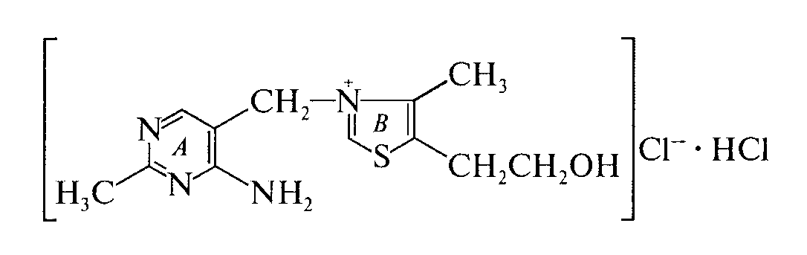
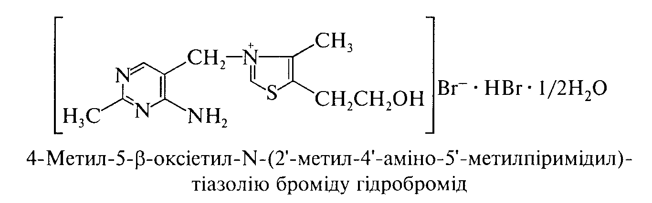
Derivatives of pyrimidine and thiazole
Molecule of pyrimidine-thiazole vitamins (B₁ - thiamines) consists of two heterocycles - pyrimidine (AND) and thiazole (IN), interconnected by a methylene group:
In medical practice, thiamine hydrobromide, thiamine hydrochloride, diphosphorus ester of thiamine hydrochloride (cocarboxylase) are used.
Thiamine hydrobromide (Thiamini hydrobromidum)
Mechanism of action. IN the body as a result of phosphorylation processes is converted into cocarboxylase, which is a coenzyme of many enzymatic reactions. The drug restores vitamin B deficiency₁, which plays an important role in metabolism and neuro-reflex regulation.

Slide 32
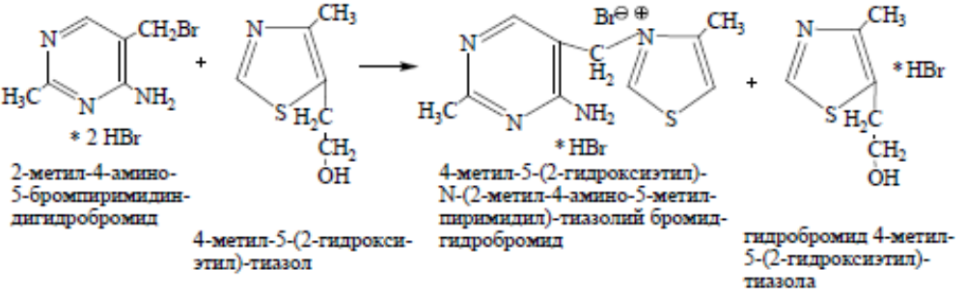
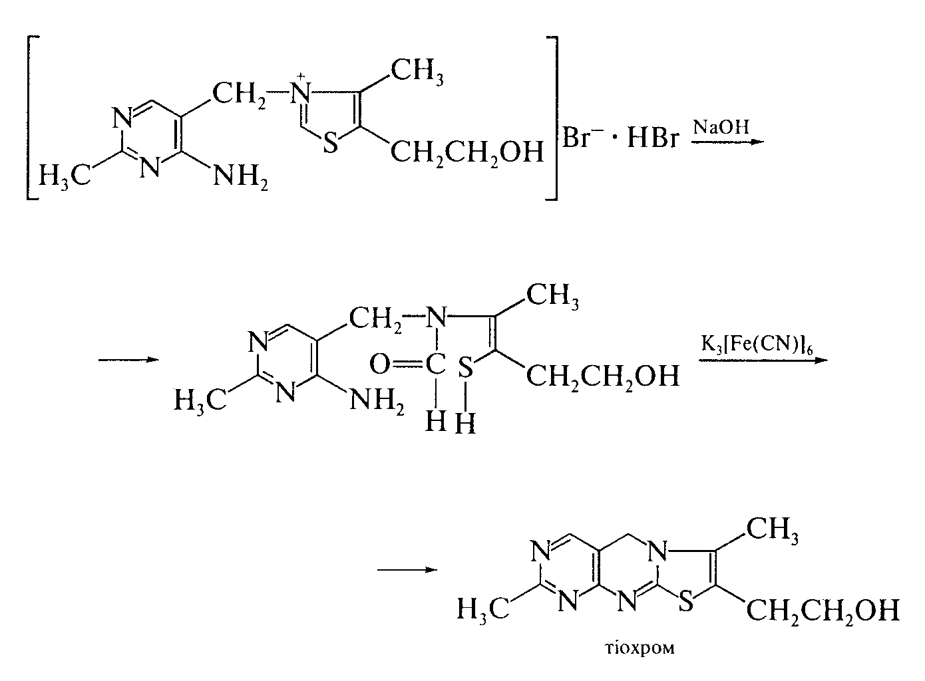
Synthesis.
Properties. White, sometimes with a slightly yellowish tinge crystalline powder with a faint characteristic odor. Easily soluble in water and methyl alcohol, sparingly soluble in ethyl alcohol, practically insoluble in ether.
Identification:
by IR spectroscopy;
“Thiochromic test” oxidized by potassium ferricyanide in
alkaline environment with the formation
thiochrome, which is extracted
isoamyl or butyl
alcohol, - blue fluorescence
in UV light:
the substance gives characteristic reactions
on bromides.

Slide 33
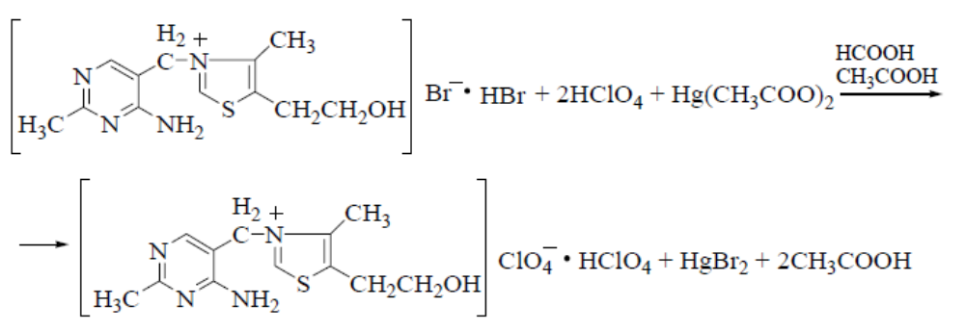

Quantitative definition.
Acidimetry in a non-aqueous medium in the presence of mercury (II) acetate potentiometrically, s = 1/2 (SPhU):
2. Gravimetry after precipitation of the drug substance with silicic tungstic acid. Sediment composition:SiO₂· 12WO₃· 2C₁₂H₁₇BrN₄OS. The mass of the precipitate multiplied by 0.25 (F - gravimetric factor) corresponds to the amount of thiamine bromide.
3. Alkalimetry, direct titration, indicator - bromophenol blue or phenolphthalein, s = 1.
Argentometry by the method of Faience, indicator - bromothymol blue,
s =1/2:
Storage. In a hermetically sealed container that protects from light.

Slide 34



Thiamine hydrochloride (Thiamini hydrochloride)
Mechanism of action. Due to phosphorylation, it forms thiamine pyrophosphate, which is a coenzyme of numerous decarboxylases involved in the metabolism of pyruvate, alpha-ketoglutarate; also plays an important role in carbohydrate metabolism. Reduces vitamin B deficiency₁, has a metabolic, immunostimulatory, antioxidant, ganglioblocking effect.
Synthesis.
Properties. White or almost white crystalline powder or colorless crystals. Easily soluble in water, soluble in glycerin, slightly soluble in 96% alcohol.

Slide 35

Identification:
by IR spectroscopy;
thiochrome formation similar to thiamine bromide;
the substance gives characteristic reactions to chlorides.
Quantitative definition.
1. Acidimetry in a non-aqueous medium in a mixture of formic acid and acetic anhydride potentiometrically, s = ½ (SPhU):
2. Alkalimetry in a mixture of 0.01 M hydrochloric acid solution and
96% alcohol potentiometrically (SPhU). Take into account
the difference in titrant volumes between two potential jumps on
titration curve, s = 1/2.

Slide 36

Storage. Similar to thiamine bromide.
Application. Hypovitaminosis and beriberi B₁; intestinal malabsorption, starvation, chronic alcoholism, liver dysfunction; pregnancy, breastfeeding, period of intensive growth, neuritis, radiculitis, neuralgia, peripheral paresis and paralysis, myocardial infarction, intoxication, peripheral vascular spasm, heart failure; intestinal atony, dermatosis, eczema, psoriasis, herpes, thyrotoxicosis.
Cocarboxylasum
Mechanism of action. Is a component of non-protein part (coenzyme) of enzymes that regulate metabolic processes. It is formed in the body from thiamine due to its phosphorylation. It plays a particularly important role in carbohydrate metabolism.
Application. It is prescribed for arrhythmia, coronary insufficiency and other cardiovascular diseases.

Slide 37

Isoaloxazine derivatives
For the first time isoaloxazine vitamins (vitamin B₂) was isolated from whey. The name of vitamin B₂ "riboflavin" comes from the fact that it contains a residue of polyhydric alcohol, a derivative of ribose sugar, and its solutions are yellow (Latin. flavus - yellow).
Riboflavin is found in whey, liver, kidneys, baker's and brewer's yeast; in cereals - millet, barley; in vegetables - spinach and tomatoes.
Riboflavin (Riboflavinum)
Mechanism of action. Regulates redox processes, participates in the processes of protein, fat, carbohydrate metabolism, maintaining normal visual function of the visual organ, synthesis of hemoglobin and erythropoietin, increases the content of glycogen in the liver and improves its antitoxic function.

Slide 38


Synthesis.
Properties. Yellow-orange crystalline powder with a faint specific odor, bitter in taste. Unstable to light. Insoluble in water, practically insoluble in 95% alcohol, ether, acetone, benzene and chloroform, soluble in alkali solutions.
Identification:
physicochemical methods: determination of specific rotation, IR
spectroscopy, TLC;
the solution of the substance in penetrating light has a pale greenish-yellow color, in reflected light - intense yellowish-green fluorescence, which disappears with the addition of solutions of mineral acids or alkali metal hydroxides (SPhU).

Slide 39


When sodium hydrosulfite is added, both the fluorescence and the color of the solution disappear:
Cleanliness test. Determine lumiflavin, which is formed due to changes in the chemical structure of the substance under the action of light and alkaline environment:
Determination of lumiflavin impurity is carried out by TLC method: it is based on its solubility in chloroform (riboflavin is insoluble in chloroform) - the color of the filtrate should not exceed the standard.

Slide 40
Quantitative definition.
Spectrophotometry (SPhU).
Photocolorimetry.
Fluorometry.
Alkalimetry by substitution after oxidation of potassium periodate (KIO4).
Alkalimetry by substitution after interaction with solution of silver
nitrate, s = 1.
Storage. In a sealed container, protected from light.
Application. Hypo- and avitaminosis B₂, gemeralopia, conjunctivitis, keratitis, iritis, corneal opacity, cataracts, ulcers that do not heal for a long time, radiation sickness, malnutrition, asthenia, hepatitis, liver cirrhosis, gastrointestinal disorders, anemia, leukemia
Pterin derivatives
Pterin vitamins, which include folic acid (vitamin B_{c}) contained in the green leaves of spinach, parsley, lettuce; in legumes and cereals (wheat, rye, corn), as well as in yeast, liver. Folic acid plays an important role in hematopoiesis and is also a factor in the growth of microorganisms

Slide 41


Acid foil (Acidum folicum)
The daily requirement of folic acid is 400 mcg

Slide 42

Mechanism of action. Folic acid belongs to the B vitamins and is synthesized in the human body by the intestinal microflora. After taking the drug, folic acid is reduced to tetrahydrofolic acid, which is a coenzyme involved in various metabolic processes. It is necessary for the normal development of other blood cells, including the formation and maturation of megaloblasts and the formation of normoblasts. In combination with vitamin B₁₂(cyanocobalamin) stimulates hematopoiesis, in part - erythropoiesis. Participates in the synthesis of amino acids (including methionine, serine, glycine and histidine), nucleic acids, purines, pyrimidines, participates in the metabolism of choline.
Properties. Crystalline powder of yellowish or orange color. Practically insoluble in water and most organic solvents. Soluble in dilute acids and alkali solutions. Decomposes under the action of light, hygroscopic.
Folic acid is an amphoteric compound: the main properties are due to pteridine nitrogen, acid - carboxyl groups and hydroxyl in position 4.

Slide 43



Identification:
physico-chemical methods: determination of specific rotation,
liquid chromatography, TLC.
Non-pharmacopoeial reactions:
oxidation reaction under the action of potassium permanganate with the formation
pteridine-6-carboxylic acid (2-amino-4-hydroxy-6-
pteridinecarboxylic acid), which has a blue fluorescence in
UV light:
determination of UV spectral characteristics
folic acid;
forms insoluble colored complexes
with salts of heavy metals: iwith CuSO₄ - green,
with Co (NO₃)₂ - dark yellow, with FeCl₃ - red
yellow.

Slide 44


Quantitative definition.
Liquid chromatography (SPU).
Photocolorimetric method:

Slide 45

3. Polarographic method. Use the ability of acid
folate reduced in sodium carbonate medium to 7.8-
dihydrofolic acid:
7,8-Dihydrofolic acid is easily oxidized to folic acid even by oxygen, so the polarographic cell is constantly purged with nitrogen.
Storage. In a well-sealed container that protects from light.
Application. To enhance erythropoiesis, in some types of anemia, including anemia and leukopenia caused by drugs and ionizing radiation.

Slide 46

Corin derivatives
Corin vitamins (group B₁₂) was found in natural products of animal origin, mainly in the internal organs. Yes, the richest source of vitamin B.₁₂there are the entrails of fish, its high content in the liver of whales and even greater in the meat of mollusks. In humans and animals₁₂ synthesized by the intestinal microflora and accumulates in the liver, kidneys, intestinal wall.
Daily requirement of vitamin B₁₂ - 3 mcg

Slide 47

Cyanocobalamin (Cyanocobalaminum)
Mechanism of action. In the body (mainly in the liver) is converted into a coenzyme form - adenosylcobalamin, or cobamamide, which is the active form of vitamin B₁₂. Cobamamide is part of many enzymes, including reductase, which reduces folic acid to tetrahydrofolic. Kobamamide is necessary for normal hematopoiesis because it promotes the maturation of red blood cells.
Activates the blood coagulation system, lowers blood cholesterol. Positively affects the function of the liver and nervous system. Increases the ability of tissues to regenerate.

Slide 48

Extraction. Vitamin B₁₂ (cyanocobalamin) is extracted from waste in the production of antibiotics streptomycin and chlortetracycline.
Properties. Crystal powder of dark red color, odorless, hygroscopic. Insoluble in water, soluble in 95% alcohol, practically insoluble in ether, chloroform, acetone.
Identification:
determination of UV spectral characteristics;
cobalt ions are determined after mineralization by fusion
with potassium hydrosulfate by interaction with sodium 1-nitroso-2-
naphthol-3,6-disulfonate - a red color appears.
Quantitative definition. Spectrophotometry.
Storage. In a well-sealed container, in aseptic conditions, in a dark place.
Application. With malignant anemia, various types of anemia, liver disease, nervous system, skin diseases etc.

Slide 49
Literature
Pharmaceutical Chemistry: A Textbook for Students. higher pharmacy. textbook lock and pharmac. f-tiv higher. honey. textbook lock ІІІ – ІV levels of accreditation / P.О. Bezugly, I.S. Gritsenko, І.В. Ukrainets' and others. - Vinnytsia: New book, 2011. - 560 p.
Pharmaceutical chemistry. Lectures for english-speaking students: the study guide for students of higher schools / V. A. Georgiyants [et al.] ; ed. by: V. A. Georgiyants, P. O. Bezugly ; NUPh. – Kharkiv : NPhaU : Original, 2013. – 528 p
Pharmaceutical Encyclopedia / ed. council and the author of the foreword VP Black; Nat. pharmacy. University of Ukraine. - 2nd ed., Reworked. and add. - Київ: МОРІОН, 2010. - 1632 с.
State Pharmacopoeia of Ukraine: in 3 volumes / SE "Ukrainian Scientific Pharmacopoeial Center for Quality of Medicines". - 2nd type. - Kharkiv, 2015. - Vol.1. –1135 s.
State Pharmacopoeia of Ukraine: in 3 volumes / State Enterprise "Ukrainian Scientific Pharmacopoeial Center for Quality of Medicines". - 2nd ed., Kharkiv: State Enterprise "Ukrainian Scientific Pharmacopoeial Center for Quality of Medicines", 2014. - Vol. 2. - 724 p.
State Pharmacopoeia of Ukraine: in 3 volumes / State Enterprise "Ukrainian Scientific Pharmacopoeial Center for Quality of Medicines". - 2nd ed., Kharkiv: State Enterprise "Ukrainian Scientific Pharmacopoeial Center for Quality of Medicines", 2014. - Vol. 3. - 732 p.

