Slide 1
Heterocyclic vitamins: pyrimidine and thiazole derivatives, isoalloxazine derivatives, pterin derivatives, corin derivatives. Characteristics, classification, relationship between structure and pharmacological action, mechanism of action, methods of obtaining, methods of analysis, application in medicine.
LECTURE 8

Slide 2
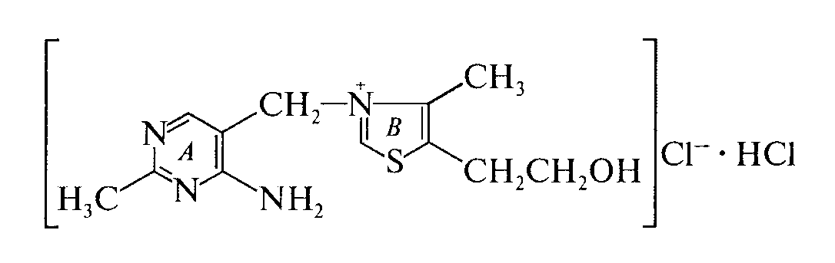
Derivatives of pyrimidine and thiazole
Molecule of pyrimidine-thiazole vitamins (B₁ - thiamines) consists of two heterocycles - pyrimidine (A) and thiazole (B), interconnected by a methylene group:
In medical practice, thiamine hydrobromide, thiamine hydrochloride, diphosphorus ester of thiamine hydrochloride (cocarboxylase) are used.

Slide 3
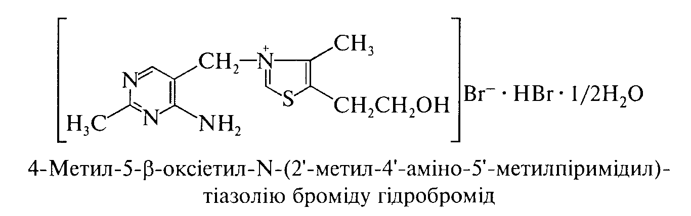
Thiamine hydrobromide (Thiamini hydrobromidum)
IUPAC name: 2-[3-[(4-amino-2-methylpyrimidin-5-yl)methyl]-4-methyl-1,3-thiazol-3-ium-5-yl]ethanol;dibromide;hydrate;dihydrobromide
Mechanism of action. IN the body as a result of phosphorylation processes is converted into cocarboxylase, which is a coenzyme of many enzymatic reactions. The drug restores vitamin B deficiency₁, which plays an important role in metabolism and neuro-reflex regulation.

Slide 4
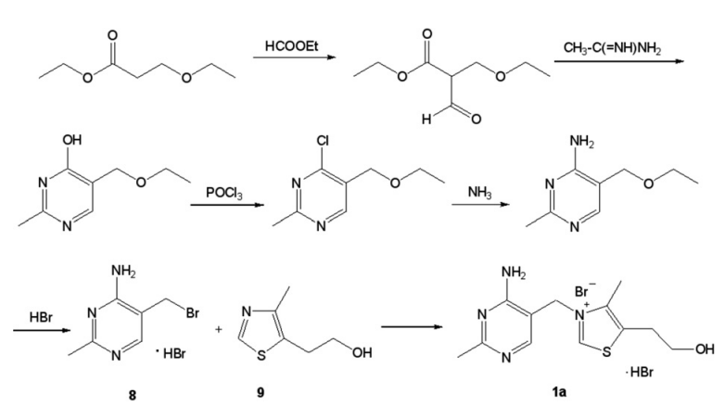
Synthesis.
Williams and Cline (1936)

Slide 5
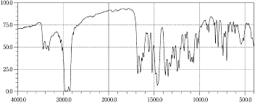
Properties. White, sometimes with a slightly yellowish tinge crystalline powder with a faint characteristic odor. Easily soluble in water and methyl alcohol, sparingly soluble in ethyl alcohol, practically insoluble in ether.
Identification:
by IR spectroscopy;
IR absorption spectrum of thiamine hydrobromide

Slide 6
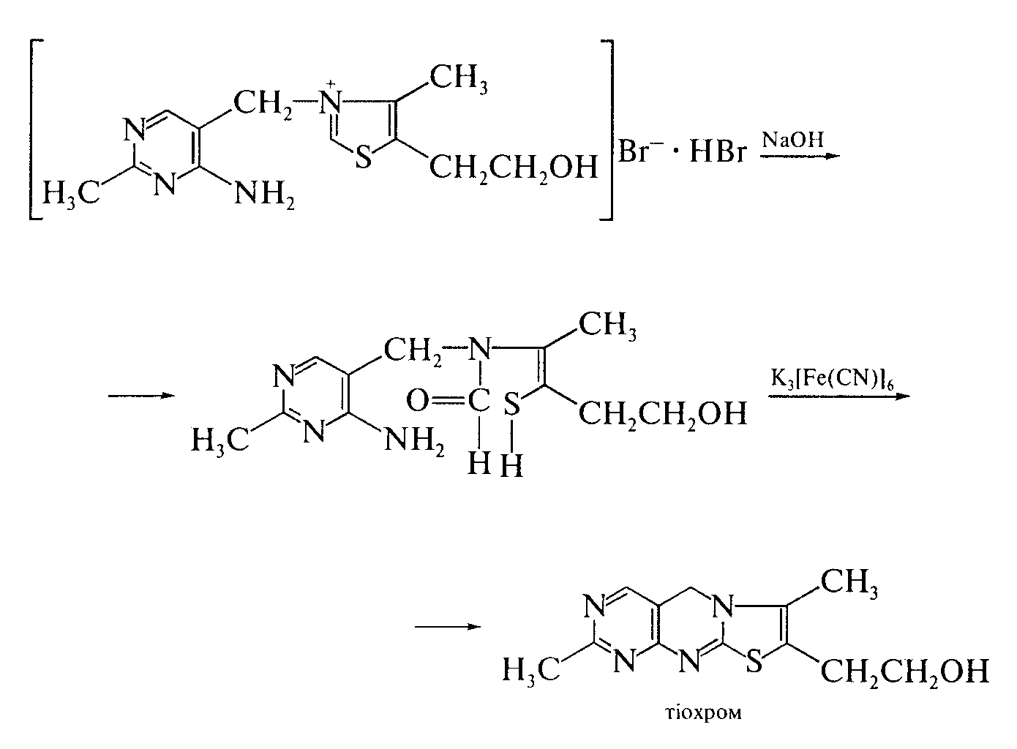
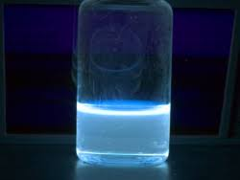

“Thiochromic test” – the substance is oxidized by potassium ferricyanide in alkaline environment with the formation thiochrome, which is extracted isoamyl or butyl alcohol, - blue fluorescence in UV light :
the substance gives characteristic reactions to bromides.
5

Slide 7
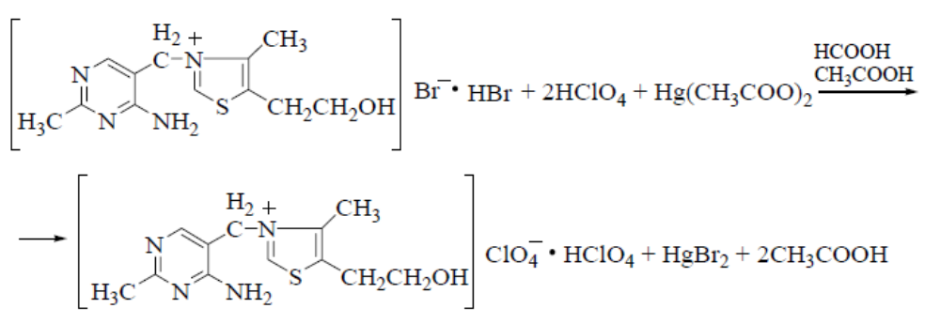
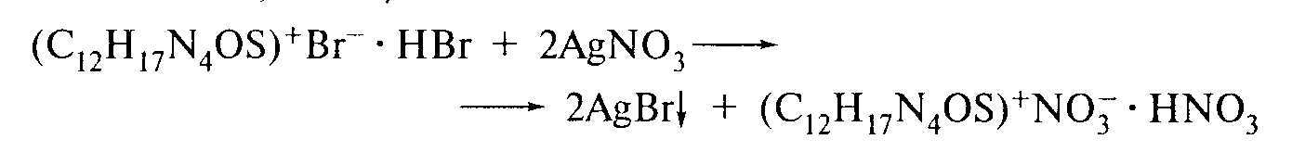
Quantitative definition.
Acidimetry in a non-aqueous medium in the presence of mercury (II) acetate potentiometrically, s = 1/2 (SPhU):
2. Gravimetry after precipitation of the drug substance with silicic tungstic acid. Sediment composition:SiO₂· 12WO₃· 2C₁₂H₁₇BrN₄OS. The mass of the precipitate multiplied by 0.25 (F - gravimetric factor) corresponds to the amount of thiamine bromide.
3. Alkalimetry, direct titration, indicator - bromophenol blue or phenolphthalein, s = 1.
Argentometry by the method of Faience, indicator - bromothymol blue,
s =1/2:
Storage. In a hermetically sealed container that protects from light.

Slide 8
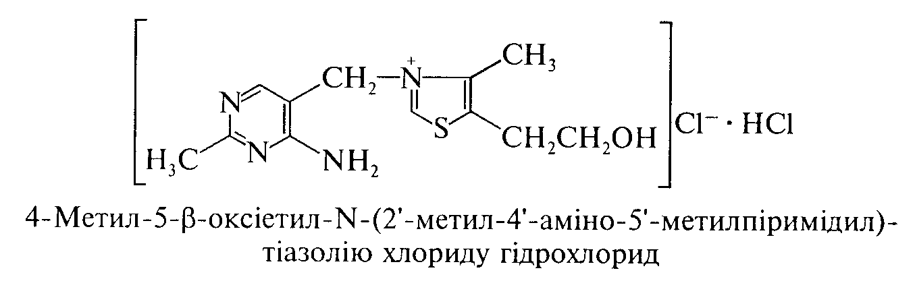
Thiamine hydrochloride (Thiamini hydrochloride)
IUPAC name: 2-[3-[(4-amino-2-methylpyrimidin-5-yl)methyl]-4-methyl-1,3-thiazol-3-ium-5-yl]ethanol;chloride;hydrochloride
Mechanism of action. Due to phosphorylation, it forms thiamine pyrophosphate, which is a coenzyme of numerous decarboxylases involved in the metabolism of pyruvate, alpha-ketoglutarate; also plays an important role in carbohydrate metabolism. Reduces vitamin B deficiency₁, has a metabolic, immunostimulatory, antioxidant, ganglioblocking effect.

Slide 9
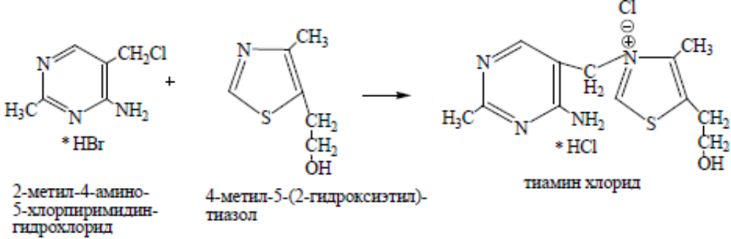
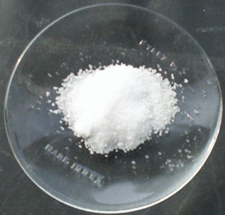
Synthesis.
Properties. White or almost white crystalline powder or colorless crystals. Easily soluble in water, soluble in glycerin, slightly soluble in 96% alcohol.

Slide 10
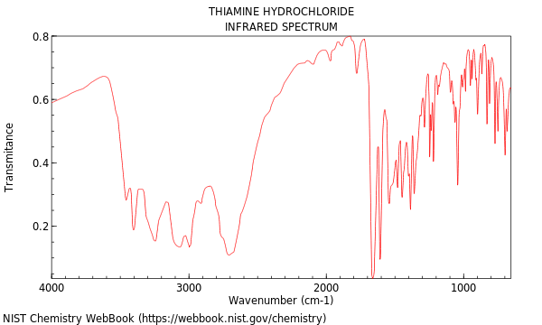
Identification:
by IR spectroscopy;
thiochrome formation similar to thiamine bromide;
the substance gives characteristic reactions to chlorides.
IR absorption spectrum of thiamine hydrochloride

Slide 11
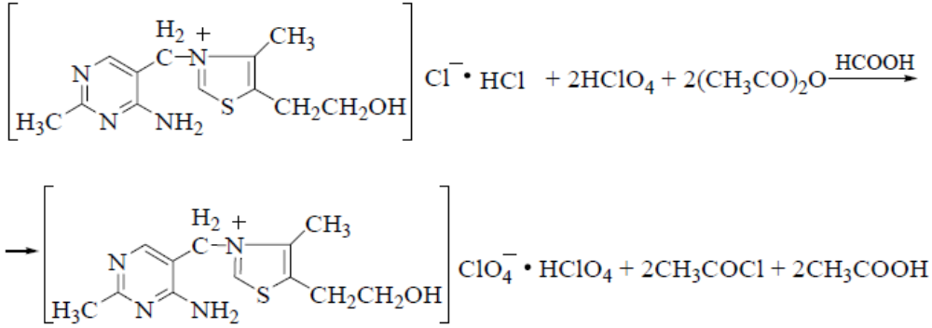
Quantitative definition.
1. Acidimetry in a non-aqueous medium in a mixture of formic acid and acetic anhydride potentiometrically, s = ½ (SPhU):
2. Alkalimetry in a mixture of 0.01 M hydrochloric acid solution and
96% alcohol potentiometrically (SPhU). Take into account
the difference in titrant volumes between two potential jumps on
titration curve, s = 1/2.

Slide 12
Storage. Similar to thiamine bromide.
Application. Hypovitaminosis and beriberi B₁; intestinal malabsorption, starvation, chronic alcoholism, liver dysfunction; pregnancy, breastfeeding, period of intensive growth, neuritis, radiculitis, neuralgia, peripheral paresis and paralysis, myocardial infarction, intoxication, peripheral vascular spasm, heart failure; intestinal atony, dermatosis, eczema, psoriasis, herpes, thyrotoxicosis.

Slide 13
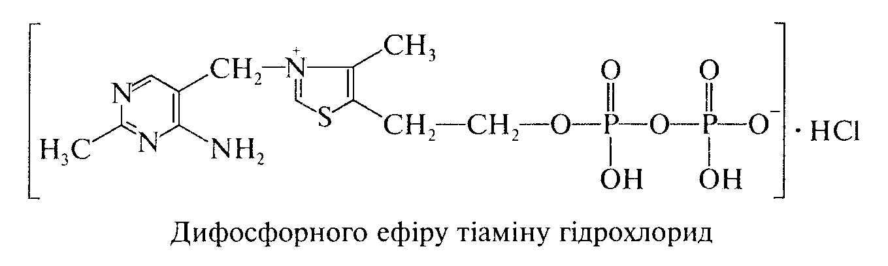
Cocarboxylasum
Thiamine diphosphoric ester hydrochloride
IUPAC name: S-[(2Z)-2-{[(4-amino-2-methylpyrimidin-5-yl)methyl] (formyl)amino}-5-(phosphonooxy)pent-2-en-3-yl] benzenecarbothioa
Mechanism of action. Is a component of non-protein part (coenzyme) of enzymes that regulate metabolic processes. It is formed in the body from thiamine due to its phosphorylation. It plays a particularly important role in carbohydrate metabolism.
Application. It is prescribed for arrhythmia, coronary insufficiency and other cardiovascular diseases.

Slide 14
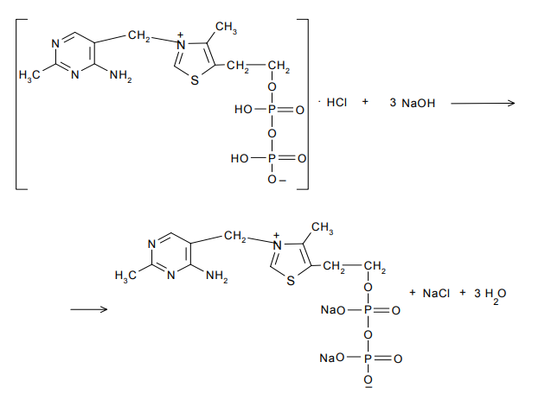
Quantitative determination. Cocarboxylase hydrochloride is quantitatively determined alkalimetrically (titrant – 0.1 M sodium hydroxide solution):

Slide 15
Application.
As part of the complex treatment of:
diabetes mellitus and its complications;
liver diseases regardless of etiology, to increase the activity of hepatocytes to various pathological influences (viral, inflammatory, intoxication);
liver failure;
schemic heart disease;peripheral neuritis;
inflammatory and toxic lesions of the heart muscle (myocarditis);
myocardiopathy.
Daily requirement - 2-3 mg, with physical work, in children, in pregnant women, during breastfeeding, the need for vitamin increases to 5-6 mg per day.

Slide 16
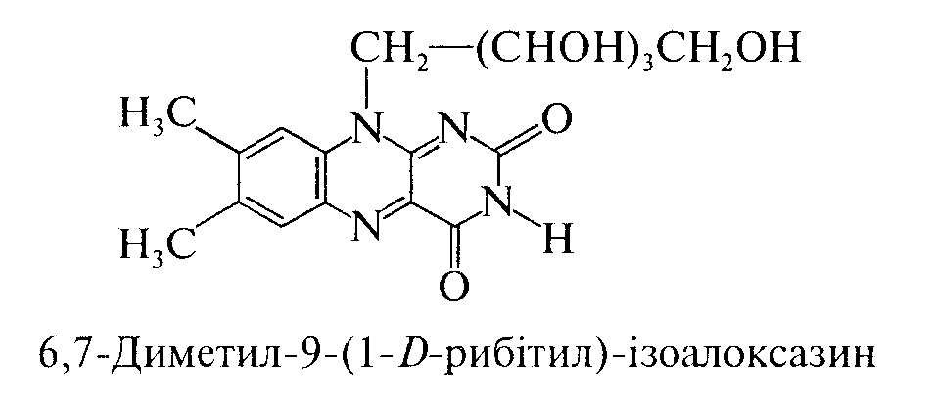
Isoaloxazine derivatives
For the first time isoaloxazine vitamins (vitamin B₂) was isolated from whey. The name of vitamin B₂ "riboflavin" comes from the fact that it contains a residue of polyhydric alcohol, a derivative of ribose sugar, and its solutions are yellow (Latin. flavus - yellow).
Riboflavin is found in whey, liver, kidneys, baker's and brewer's yeast; in cereals - millet, barley; in vegetables - spinach and tomatoes.
Riboflavin (Riboflavinum)
IUPAC name: 7,8-Dimethyl-10-[(2S,3S,4R)-2,3,4,5-tetrahydroxypentyl]benzo[g]pteridine-2,4-dione
Mechanism of action. Regulates redox processes, participates in the processes of protein, fat, carbohydrate metabolism, maintaining normal visual function of the visual organ, synthesis of hemoglobin and erythropoietin, increases the content of glycogen in the liver and improves its antitoxic function.

Slide 17
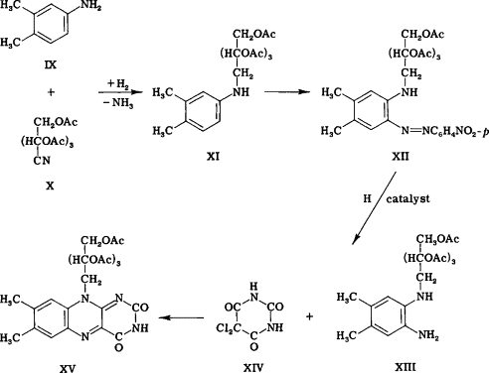
Synthesis.

Slide 18
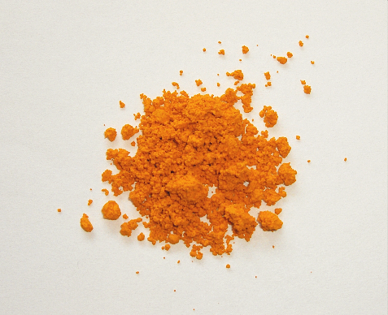
Properties. Yellow-orange crystalline powder with a faint specific odor, bitter in taste. Unstable to light. Insoluble in water, practically insoluble in 95% alcohol, ether, acetone, benzene and chloroform, soluble in alkali solutions.

Slide 19
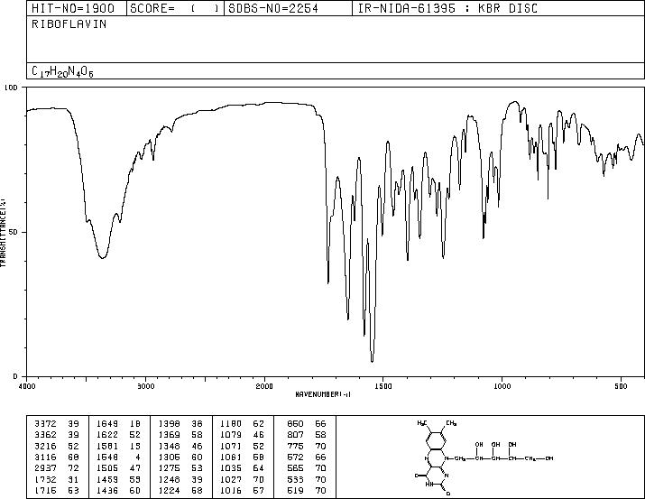
Identification:
physicochemical methods: determination of specific rotation, IR
spectroscopy, TLC;
the solution of the substance in penetrating light has a pale greenish-yellow color, in reflected light - intense yellowish-green fluorescence, which disappears with the addition of solutions of mineral acids or alkali metal hydroxides (SPhU).

Slide 20
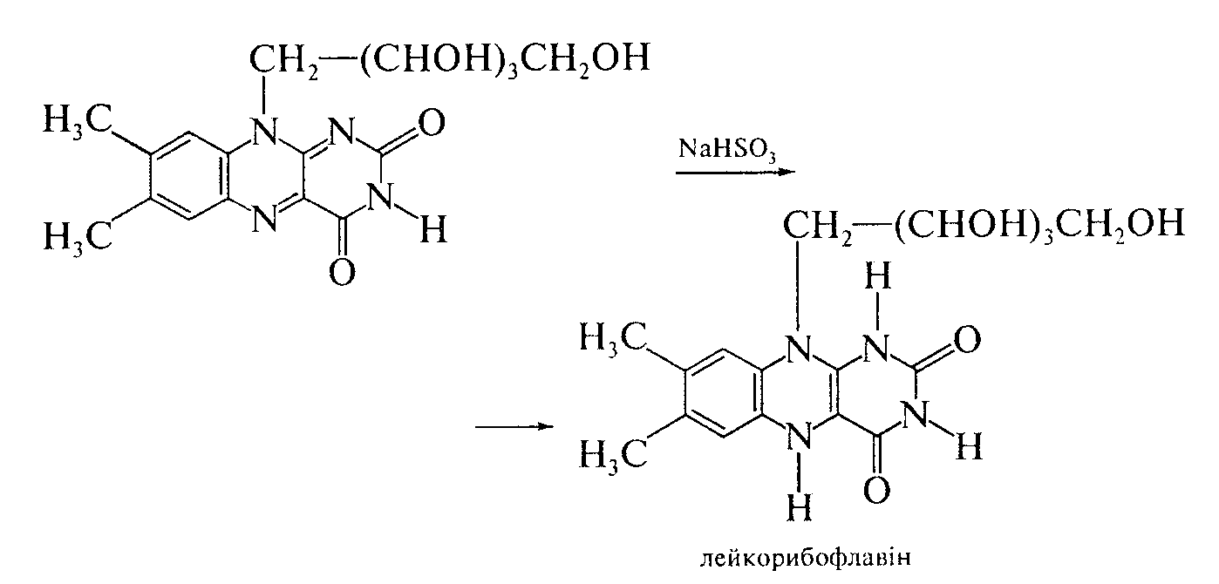
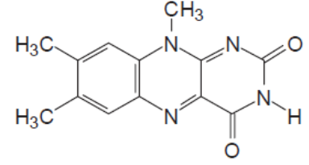
When sodium hydrosulfite is added, both the fluorescence and the color of the solution disappear:
Cleanliness test. Determine lumiflavin, which is formed due to changes in the chemical structure of the substance under the action of light and alkaline environment:
Determination of lumiflavin impurity is carried out by TLC method: it is based on its solubility in chloroform (riboflavin is insoluble in chloroform) - the color of the filtrate should not exceed the standard.

Slide 21
Quantitative definition.
Spectrophotometry (SPhU).
Photocolorimetry.
Fluorometry.
Alkalimetry by substitution after oxidation of potassium periodate (KIO4).
Alkalimetry by substitution after interaction with solution of silver
nitrate, s = 1.
Storage. In a sealed container, protected from light.
Application. Hypo- and avitaminosis B₂, gemeralopia, conjunctivitis, keratitis, iritis, corneal opacity, cataracts, ulcers that do not heal for a long time, radiation sickness, malnutrition, asthenia, hepatitis, liver cirrhosis, gastrointestinal disorders, anemia, leukemia
Pterin derivatives
Pterin vitamins, which include folic acid (vitamin B_{c}) contained in the green leaves of spinach, parsley, lettuce; in legumes and cereals (wheat, rye, corn), as well as in yeast, liver. Folic acid plays an important role in hematopoiesis and is also a factor in the growth of microorganisms

Slide 22
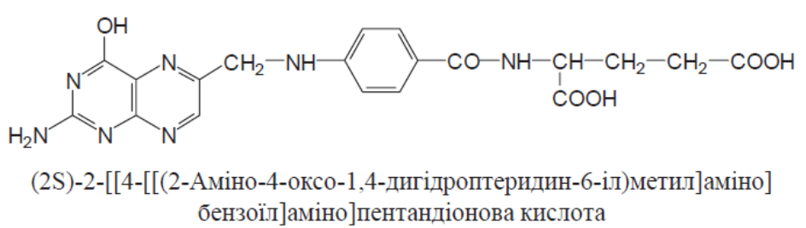
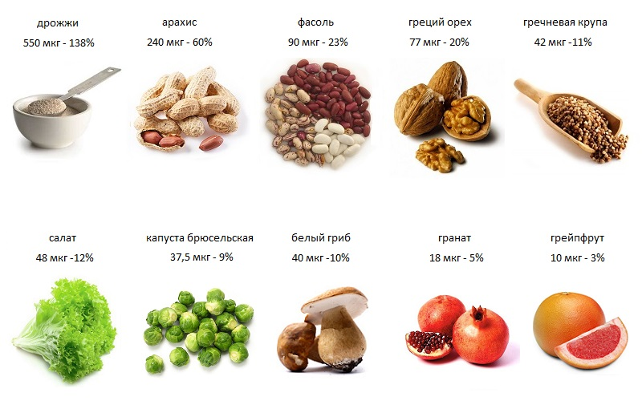
Acid foil (Acidum folicum)
The daily requirement of folic acid is 400 mcg

Slide 23
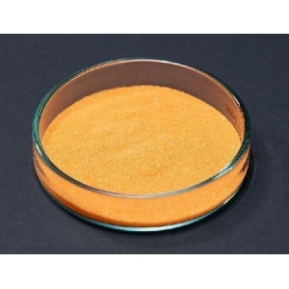
Mechanism of action. Folic acid belongs to the B vitamins and is synthesized in the human body by the intestinal microflora. After taking the drug, folic acid is reduced to tetrahydrofolic acid, which is a coenzyme involved in various metabolic processes. It is necessary for the normal development of other blood cells, including the formation and maturation of megaloblasts and the formation of normoblasts. In combination with vitamin B₁₂(cyanocobalamin) stimulates hematopoiesis, in part - erythropoiesis. Participates in the synthesis of amino acids (including methionine, serine, glycine and histidine), nucleic acids, purines, pyrimidines, participates in the metabolism of choline.
Properties. Crystalline powder of yellowish or orange color. Practically insoluble in water and most organic solvents. Soluble in dilute acids and alkali solutions. Decomposes under the action of light, hygroscopic.
Folic acid is an amphoteric compound: the main properties are due to pteridine nitrogen, acid - carboxyl groups and hydroxyl in position 4.

Slide 24
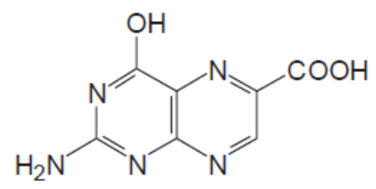
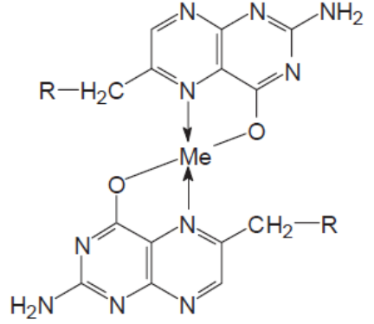
Identification:
physico-chemical methods: determination of specific rotation,
liquid chromatography, TLC.
Non-pharmacopoeial reactions:
oxidation reaction under the action of potassium permanganate with the formation
pteridine-6-carboxylic acid (2-amino-4-hydroxy-6-
pteridinecarboxylic acid), which has a blue fluorescence in
UV light:
determination of UV spectral characteristics
folic acid;
forms insoluble colored complexes
with salts of heavy metals: iwith CuSO₄ - green,
with Co (NO₃)₂ - dark yellow, with FeCl₃ - red
yellow.

Slide 25
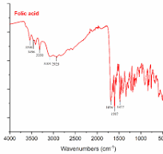
IR absorption spectrum of folic acid

Slide 27
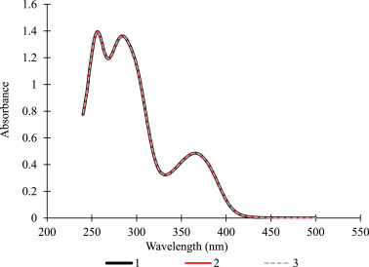
UV spectrum of folic acid

Slide 28
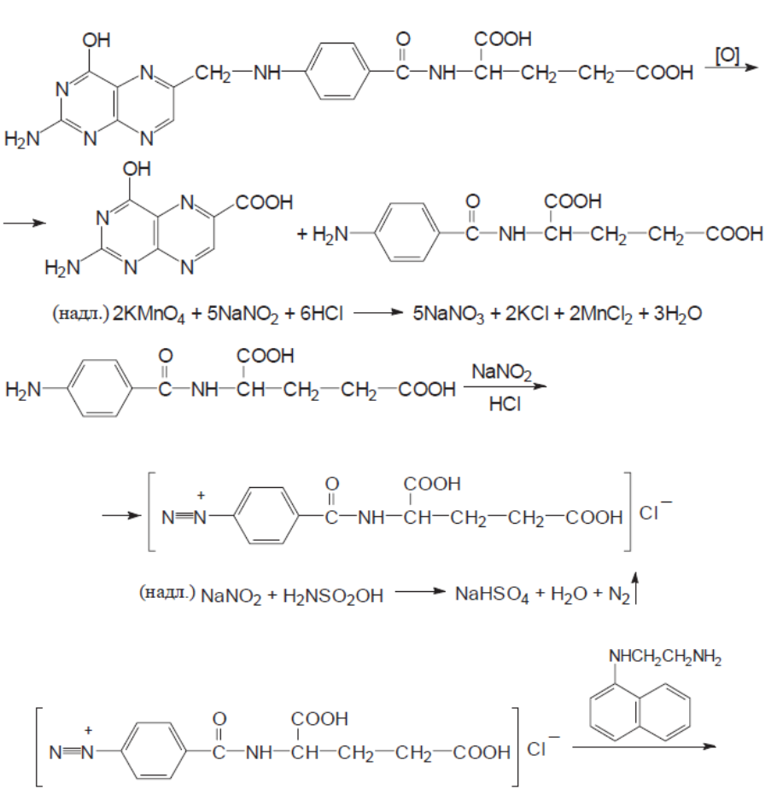
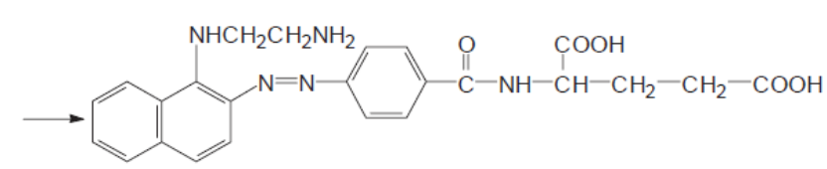
Quantitative definition.
Liquid chromatography (SPU).
Photocolorimetric method:

Slide 29
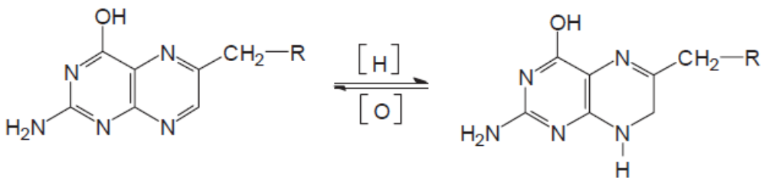
3. Polarographic method. Use the ability of acid
folate reduced in sodium carbonate medium to 7.8-
dihydrofolic acid:
7,8-Dihydrofolic acid is easily oxidized to folic acid even by oxygen, so the polarographic cell is constantly purged with nitrogen.
Storage. In a well-sealed container that protects from light.
Application. To enhance erythropoiesis, in some types of anemia, including anemia and leukopenia caused by drugs and ionizing radiation.

Slide 30
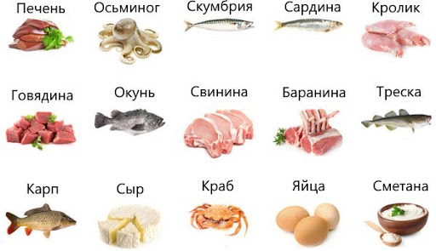
Corin derivatives
Corin vitamins (group B₁₂) was found in natural products of animal origin, mainly in the internal organs. Yes, the richest source of vitamin B.₁₂there are the entrails of fish, its high content in the liver of whales and even greater in the meat of mollusks. In humans and animals₁₂ synthesized by the intestinal microflora and accumulates in the liver, kidneys, intestinal wall.
Daily requirement of vitamin B₁₂ - 3 mcg

Slide 31
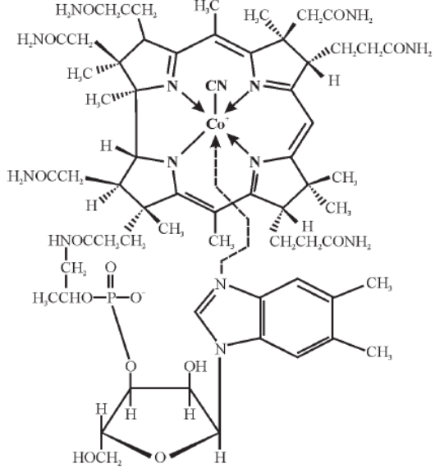
Cyanocobalamin (Cyanocobalaminum)
Mechanism of action. In the body (mainly in the liver) is converted into a coenzyme form - adenosylcobalamin, or cobamamide, which is the active form of vitamin B₁₂. Cobamamide is part of many enzymes, including reductase, which reduces folic acid to tetrahydrofolic. Kobamamide is necessary for normal hematopoiesis because it promotes the maturation of red blood cells.
Activates the blood coagulation system, lowers blood cholesterol. Positively affects the function of the liver and nervous system. Increases the ability of tissues to regenerate.

Slide 32
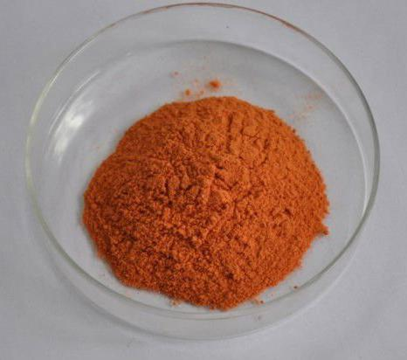
Extraction. Vitamin B₁₂ (cyanocobalamin) is extracted from waste in the production of antibiotics streptomycin and chlortetracycline.
Properties. Crystal powder of dark red color, odorless, hygroscopic. Insoluble in water, soluble in 95% alcohol, practically insoluble in ether, chloroform, acetone.
Identification:
determination of UV spectral characteristics;
cobalt ions are determined after mineralization by fusion
with potassium hydrosulfate by interaction with sodium 1-nitroso-2-
naphthol-3,6-disulfonate - a red color appears.
Quantitative definition. Spectrophotometry.
Storage. In a well-sealed container, in aseptic conditions, in a dark place.
Application. With malignant anemia, various types of anemia, liver disease, nervous system, skin diseases etc.

Slide 33
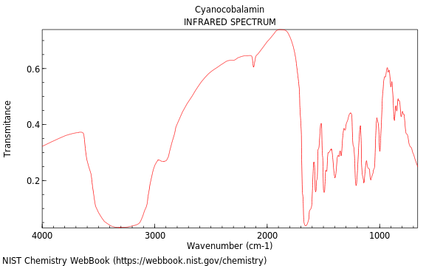
IR absorption spectrum of cyanocobalamin

Slide 34
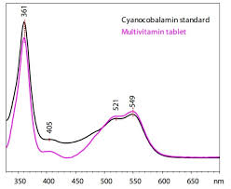
UV spectrum of cyanocobalamin

Slide 35
Literature
Pharmaceutical Chemistry: A Textbook for Students. higher pharmacy. textbook lock and pharmac. f-tiv higher. honey. textbook lock ІІІ – ІV levels of accreditation / P.О. Bezugly, I.S. Gritsenko, І.В. Ukrainets' and others. - Vinnytsia: New book, 2011. - 560 p.
Pharmaceutical chemistry. Lectures for english-speaking students: the study guide for students of higher schools / V. A. Georgiyants [et al.] ; ed. by: V. A. Georgiyants, P. O. Bezugly ; NUPh. – Kharkiv : NPhaU : Original, 2013. – 528 p
Pharmaceutical Encyclopedia / ed. council and the author of the foreword VP Black; Nat. pharmacy. University of Ukraine. - 2nd ed., Reworked. and add. - Київ: МОРІОН, 2010. - 1632 с.
State Pharmacopoeia of Ukraine: in 3 volumes / SE "Ukrainian Scientific Pharmacopoeial Center for Quality of Medicines". - 2nd type. - Kharkiv, 2015. - Vol.1. –1135 s.
State Pharmacopoeia of Ukraine: in 3 volumes / State Enterprise "Ukrainian Scientific Pharmacopoeial Center for Quality of Medicines". - 2nd ed., Kharkiv: State Enterprise "Ukrainian Scientific Pharmacopoeial Center for Quality of Medicines", 2014. - Vol. 2. - 724 p.
State Pharmacopoeia of Ukraine: in 3 volumes / State Enterprise "Ukrainian Scientific Pharmacopoeial Center for Quality of Medicines". - 2nd ed., Kharkiv: State Enterprise "Ukrainian Scientific Pharmacopoeial Center for Quality of Medicines", 2014. - Vol. 3. - 732 p.

