Slide 1
Anorexigenic means. Characteristics, classification, relationship between structure and pharmacological action, mechanism of action, methods of obtaining, methods of analysis, application in medicine.
LECTURE 9

Slide 2
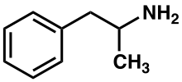
Anorexigenic drugs (Greek. an - negative part + orexis - appetite), a group of drugs that suppress appetite and are used to treat obesity.
Classification. Anorexigenic drugs are divided into:
drugs that affect the catecholaminergic system
(CNS stimulants) - amphetamine, fepranon, desopimon;
drugs that act on catecholaminergic and serotonergic
system - sibutramine. These drugs have an effect on
central mechanisms of appetite regulation, localized in
hypothalamus, activate the saturation center and reduce
the work of the hunger center.
Amphetamine sulfate (Amphetamine sulfas)
∙1 / 2H₂SO₄

Slide 3
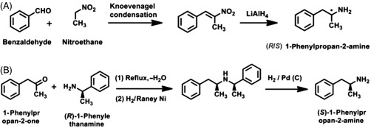
Mechanism of action. The drug enhances the release of norepinephrine and dopamine from the nerve endings and inhibits their reuptake. This leads to stimulation of central adreno- and dopamine receptors and suppression of the hunger center. In addition to anorexigenic action, it has a psychostimulant effect and a pronounced peripheral sympathomimetic effect.
Synthesis.
Properties. White powder, easily soluble in water, slightly soluble in alcohol, practically insoluble in ether.

Slide 4
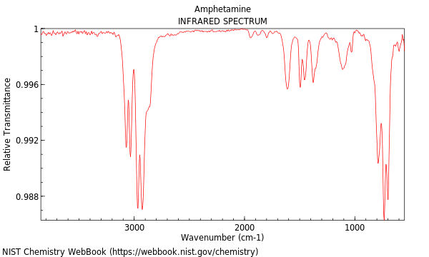
Identification:
by the magnitude of the specific optical rotation;(Polarimetrty)
by the IR absorption spectrum of the substance;
IR absorption spectrum of amphetamine

Slide 5
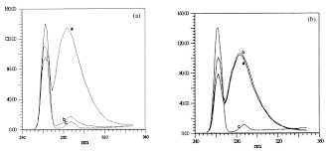
UV spectrum of amphetamine (a)

Slide 6

when heating the substance with a solution of formaldehyde in concentrated sulfuric acid produces an orange color, turning dark brown;
the substance gives the reactions on sulfates:
Quantitative definition. By the method of acidimetry in a non-aqueous medium (anhydrous acetic acid) potentiometrically.
Storage. Store in a well-sealed container, in a dark place.
Application. With narcolepsy, mental depression, to improve mental and physical performance in healthy people. Due to possible side effects, it is used very rarely.
Side effects. Dizziness, chills, nausea, anorexia, insomnia, tachycardia, arrhythmia, hypertension, allergic reactions.

Slide 7
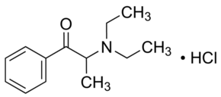
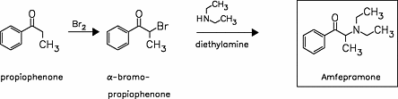
Fepranon (Phepranonum)
Mechanism of action. Stimulates the center of satiety and inhibits the center of hunger; stimulates the cortex of the cerebral hemispheres, has virtually no peripheral adrenostimulatory effect. Increases metabolism (slightly),contributes to weight loss.
Synthesis.
Properties. White or white with a slightly creamy tint crystalline powder of bitter taste. Easily soluble in water and alcohol.
Storage. In a dry, dark place.
Application. Treatment of alimentary obesity (occurs due to excessive food intake).

Slide 8
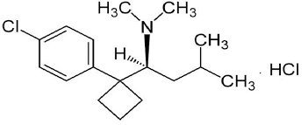
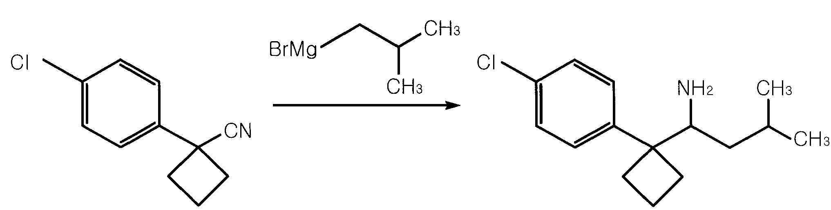
Sibutramine
Mechanism of action. Due to selective inhibition of reuptake of serotonin and norepinephrine, to a lesser extent - dopamine. Accelerates the onset and prolongs the feeling of satiety, which reduces food intake. Increases energy consumption by stimulating thermogenesis by indirect activation of β₃-blockers. Acts on both sides of the energy balance and helps to reduce body weight.
Synthesis.
Properties. Crystalline powder from white to cream-white color. Solubility in water: 2.9 mg / ml (at pH 5.2).
Storage. In a dry place at a temperature not exceeding 25 ° C.
Application. Comprehensive maintenance therapy for overweight patients with alimentary obesity.

Slide 9
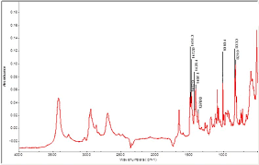
IR absorption spectrum of sibutramine

Slide 10
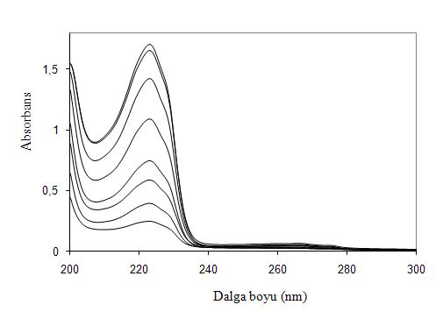
UV spectrum of sibutramine

Slide 11
Sorbents
Sorbents- solids or liquids capable of absorbing gases, vapors and solutes. Solid sorbents are called adsorbents. Sorbents that form a chemical compounds with the absorbed substance are called chemosorbents.
The term "enterosorption"(" Entero "- inside) proposed in 1983 by Ukrainian scientists to designate a new method of sorption therapy, which consisted in daily oral administration of highly active synthetic coal spherical granulation.
Classification. According to the physicochemical (pharmaceutical) principle enterosorbents are classified:
by dosage form and physical properties - granules,
powders, tablets, pastes, gels, suspensions, colloids, encapsulated
materials, food additives, fibers. Application sorbents
used in the form of bandages, napkins, etc .;
by chemical structure - activated carbon, silica gels, zeolites,
aluminogels, oxide and other inorganic sorbents, dietary fibers,
organo-mineral and composite sorbents;

Slide 12
by sorption mechanisms - adsorbents, absorbents, ion exchange
materials, sorbents-complexing agents, sorbents with
catalytic properties;
by selectivity - non-selective, selective mono-, bit- and
multifunctional sorbents.
Some experts consider the most acceptable chemical classification for enterosorbents:
carbon enterosorbents of I – IV generations;
enterosorbents based natural and synthetic resins,,
synthetic polymers and lipidsnot amenable
digestion;
silicon-containing enterosorbents, including organosilicon,
aerosols and clays;
natural organic enterosorbents food-based
fibers, hydrolyzed lignin, chitin, pectins and alginates;
combined enterosorbents, which include two and
more types of the mentioned enterosorbents.

Slide 13
Carbon enterosorbents
Activated charcoal (Carbo activatus)
Pharmacological properties.Adsorbent. Has high surface activity and high sorption capacity. Absorbs toxic substances from the digestive tract, salts of heavy metals, alkaloids and glycosides, drugs, promoting their excretion from the body. Adsorbs gases on its surface. AC in tablets has a lower adsorption capacity compared to powder, but more convenient to use. The drug is not toxic. AC is not absorbed, well excreted by the intestines.
Receiving. Obtained by pyrolysis of hardwood without air access. To increase the adsorption capacity of coal is treated with superheated steam at 800 ° C. Then the coal is treated with solutions of zinc chloride, magnesium chloride, sodium hydroxide or phosphoric acid, followed by heating to 300-400 ° C. Next, the coal is thoroughly washed with water to clean the impurities and dried. The drug has micropores - visible under a microscope d = 1∙10^{–1} to 1∙10^{–3}cm; ultrapores - invisible under a microscope d = 9.2∙10^{–7}cm. Ultrapores play a major role in adsorption processes. Their total surface area of ​​1 g of activated carbon is more than 1000 m².

Slide 14
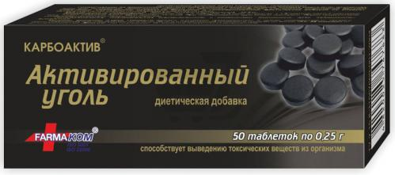
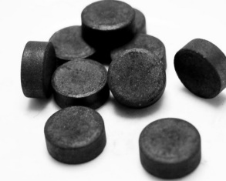
Cleanliness test. Because the drug is used in large doses, AND pays great attention to the purity of activated carbon. The content of impurities of chlorides, sulfates, heavy metals, iron, arsenic is regulated. There should be no sulfides, cyanides CN(-). Determine the adsorption capacity of activated carbon with methylene blue and the degree of grinding.
Storage. In the original packaging, separately from substances and materials that emit vapors and gases, at a temperature not exceeding 25 ° C.
Application. Food poisoning, acute poisoning by food, household and industrial poisons, alkaloids, drugs, salts of heavy metals; dyspepsia, flatulence; preparation for X-ray examinations.

Slide 15
Carbolong
Pharmacological properties.Carbolong provides efficient absorption of endo- and exotoxins, gases, alkaloids and other chemical compounds due to their physical sorption in the pores and subsequent removal from the body with a mass of sorbent in the intestinal contents. Carbolong stimulates motility and improves intestinal circulation. Unlike ordinary activated carbon, Carbolong has prolonged action (36-48 hours) and shows high adsorption activity throughout the passage through the digestive tract.
Receiving. (Ukrainian consortium "Ecosorb", Kyiv) The drug is made on the basis of granular activated carbon, which, in turn, is obtained from the seeds of apricots, plums, peaches, walnut or coconut shells. This raw material is burned without access to oxygen, and then activated. The obtained activated carbon undergoes several stages of processing in order to remove minor impurities of substances that pose a potential threat to the body.
Storage. In a dry place at a temperature not exceeding 30 ° C, separate from substances and materials that emit gases and vapors.
Application. Acute poisoning by household, industrial and food poisons, drugs, alkaloids, salts of heavy metals, dyspepsia, flatulence, food poisoning.

Slide 16
Silicon-containing enterosorbents
White coal
Pharmacological properties. "White Coal®" - enterosorbent, the active substance of which is silicon dioxide (SiO₂) with a particle size of 7-10 nm, which allows to reach the area of ​​the active sorption surface 300-400 m²per 1 g. High dispersion of silicon dioxide provides a large active sorption surface and sorption capacity of the drug. The non-porous structure of silicon dioxide particles provides a high rate of sorption. The lack of pores also explains the weak sorption of low molecular weight compounds, including minerals and vitamins.
It has significant adsorption activity against substances of protein nature, which promotes the excretion of exo- and endotoxins, toxic products of incomplete decomposition of large organic compounds, pathogenic antigens and allergens of microbial or other origin. Actively sorbs pathogenic microflora in the intestine - up to 10¹⁰ microbial bodies per 1 gram of substance, which provides pronounced antimicrobial and antidiarrheal effects.

Slide 17
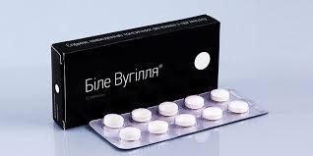
Silicon dioxide (Silicon (IV) oxide) exhibits chemical and microbiological resistance: it does not decompose in organic solvents and biological fluids, including gastric juice, and the structure of its particles does not change with changing pH.
Storage. In the original packaging at a temperature not exceeding 25 ° C.
Application. In 2017, White Coal® tablets, which have been known since their inception (2008), were received drug status.
As monotherapy or in complex therapy: acute intestinal diseases (salmonellosis, food poisoning); acute diarrhea of ​​various etiologies; exogenous intoxication with household and industrial toxins (alkaloids, salts of heavy metals, other substances), drugs, alcohol and food overload.

Slide 18
Silix (Atoxil)
Pharmacological properties. Silix is ​​an inorganic polymer with the General formula (SiO₂)_{n}, has high chemical purity, homogeneity, biological and thermal stability, physiologically harmless. The particle size ranges from 5 to 20 nm, in connection with which the drug is considered to be highly dispersed silica. The drug has a sorption effect. By adsorption binds and removes from the body toxins of exogenous and endogenous origin, food and bacterial allergens, microbial endotoxins, toxic products formed during the breakdown of proteins in the intestine.
Storage. Store at a temperature not exceeding 25 ° C.
Application. In the complex therapy of acute intestinal infections of any genesis, including food poisoning, diarrhea of ​​non-infectious origin, dysbacteriosis, purulent-septic diseases, acute poisoning by potent and toxic substances, including drugs and ethyl alcohol, in exogenous and endogenous intoxications, which develop acutely (influenza, SARS, etc.); with food and drug allergies, viral hepatitis and chronic renal failure.

Slide 19
Antidotes
Antidotes (Greek. anti - against + didonai- give) - drugs that have the ability to eliminate or reduce the specific effects of xenobiotics due to its immobilization (eg chelating agents), reducing the concentration (adsorbents) or counteracting at the level of effective systems (pharmacological antagonists). A. are used to treat poisoning. The best therapeutic effect is when A. is administered immediately or in the first hours after the poison enters the body.
Classification. Has a conditional nature; in clinical toxicology:
Adsorbents, the action of which is based on physical processes.
Chemicals that neutralize the poison as a result of chemical
reactions (reducing agents, oxidants, chelating agents, etc.).
Antidotes that form in the body compounds with high
affinity for the toxicant (amyl nitrite, methylene blue, nitrite
sodium).
Biochemical (metabolic, toxic-kinetic) substances having
the ability to modify the metabolism of the poison.
Pharmacological antagonists competing with the poison in action on
enzymes, receptors and physiological systems.
Immunological antidotes.

Slide 20
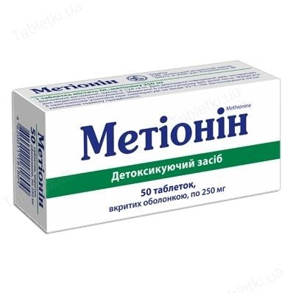
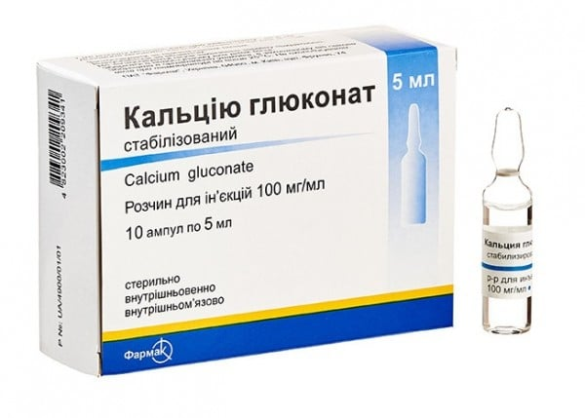
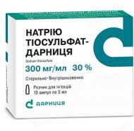
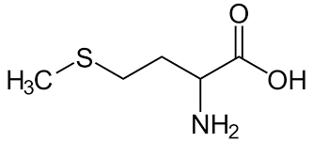
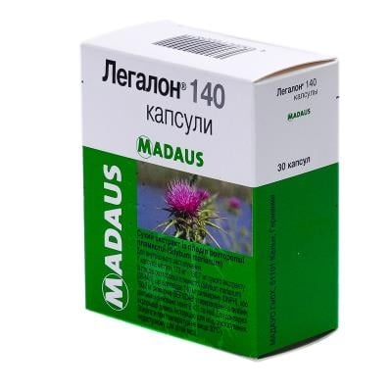
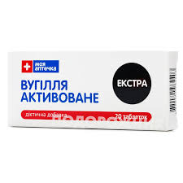
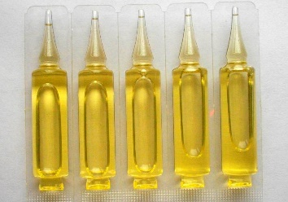
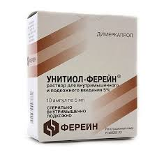

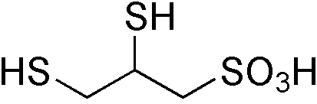
Some common antidotes
Na₂S₂O₇
Ca(C₁₂H₂₂O₁₄)
carbon
Tocopherol acetate

Slide 21
Antidotes most commonly used in acute poisonings
Unitiol. It belongs to the universal type of antidotes, does not have high toxicity. It is used for poisoning with salts of heavy metals (mercury, lead, etc.), in case of overdose with cardiac glycosides, in case of poisoning with chlorinated hydrocarbons.
Lipoic acid. It is most often used as an antidote for poisoning with toxins of pale toadstool. The effect of using lipoic acid for mushroom poisoning is possible only when the antidote is administered in the first few hours after poisoning.
Tocopherol acetate. The drug is an antidote for poisoning with cardiac glycosides, nicotine, dichloroethane, potassium and ergot.
Calcium gluconate. This substance is well known to everyone and is often perceived as the simplest and most harmless drug. And in fact, it is calcium gluconate that is most often used as an antidote for snake bites and stinging insects.
Potassium chloride. Most effective as an antidote for cardiac glycoside poisoning. Side effects include irritation of the gastric mucosa and hyperkalemia.
Sodium thiosulfate. An antidote used for lead, arsenic, hydrocyanic acid, mercury, and iodine poisoning. Side effects of sodium thiosulfate include nausea, skin rashes of various types, and thrombocytopenia.

Slide 22
Antidotes most commonly used in acute poisonings
EDTA (calcium tetacin). Used only for poisoning with heavy metal salts (mercury, lead, etc.). The antidote is able to form complexes with metals that are easily soluble. It is this ability that allows for the rapid and most complete elimination of heavy metal salt compounds from the body through the urinary system.
Nalorphine. Used for poisoning with drugs from the morphine group. When using nalorphine, a drug withdrawal syndrome is subsequently noted - the patient is worried about headaches, sleep disturbances, nausea, and depressive states.
Methylene blue. Used for poisoning with hydrogen sulfide, cyanides, sulfonamides, nitrates, and naphthalene.
Ethyl alcohol. Antidote for poisoning with methyl alcohol and ethylene glycol. As a side effect, myocardial activity is impaired (its contractility decreases).
Potassium chloride. Most effective as an antidote for cardiac glycoside poisoning. Side effects include irritation of the gastric mucosa and hyperkalemia.

Slide 23
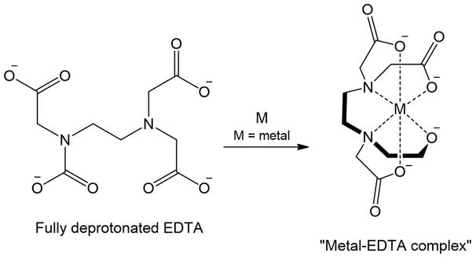
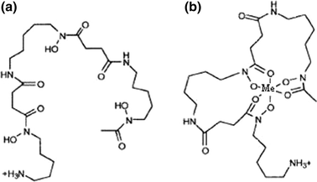
Complexones
The most effective antidotes for acute poisoning are considered Complexones - chelating compounds (deferoxamine, edetate sodium calcium, penicillamine, unithiol).
Mechanism of action. Complexons due to the presence in their structure of such functional groups as -OH, -CH and -NH, can give electrons for binding to metal cations, ie to form coordination-covalent bonds:
EDTA
Deferoxamine

Slide 24
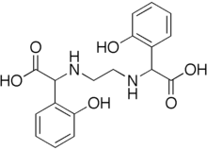
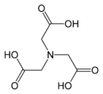

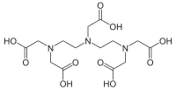
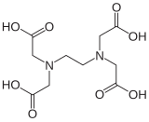

Aminopolycarboxylic acids as complexing agents
IDCA
ЕDDНА(Ethylenediamine
Dihydroxyphenyl Acetate)
НТА
ЕDТА
DTPA
ЕHТА
Aminopolycarboxylic acids (APCAs) are chemical compounds containing one or more nitrogen atoms linked through carbon atoms to two or more carboxyl groups. APCAs that have lost acidic protons form strong complexes with metal ions. This property makes APCAs useful chelators in a wide range of medical and environmental applications.

Slide 25
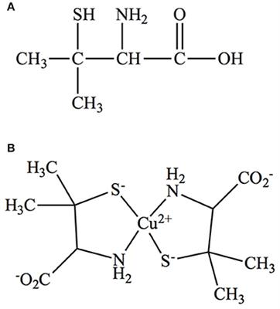
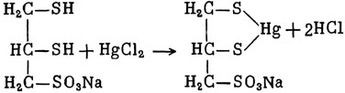
Complexones
Unithiol
Penicillamine
The effectiveness of a chelate compound is determined by the number of ligands in its base capable of binding to the metal. The more of them, the more stable the metal-chelate complex. But complexones have low selectivity. Along with toxic agents, they can bind endogenous ions necessary for the body, such as calcium and zinc. The end result of such interaction is determined by the affinity of toxic exogenous and essential (endogenous) metals to chelating drugs.

Slide 26
Literature
Pharmaceutical Chemistry: A Textbook for Students. higher pharmacy. textbook lock and pharmac. f-tiv higher. honey. textbook lock ІІІ – ІV levels of accreditation / P.О. Bezugly, I.S. Gritsenko, І.В. Ukrainets' and others. - Vinnytsia: New book, 2011. - 560 p.
Pharmaceutical chemistry. Lectures for english-speaking students: the study guide for students of higher schools / V. A. Georgiyants [et al.] ; ed. by: V. A. Georgiyants, P. O. Bezugly ; NUPh. – Kharkiv : NPhaU : Original, 2013. – 528 p
Pharmaceutical Encyclopedia / ed. council and the author of the foreword VP Black; Nat. pharmacy. University of Ukraine. - 2nd ed., Reworked. and add. - Київ: МОРІОН, 2010. - 1632 с.
State Pharmacopoeia of Ukraine: in 3 volumes / SE "Ukrainian Scientific Pharmacopoeial Center for Quality of Medicines". - 2nd type. - Kharkiv, 2015. - Vol.1. –1135 s.
State Pharmacopoeia of Ukraine: in 3 volumes / State Enterprise "Ukrainian Scientific Pharmacopoeial Center for Quality of Medicines". - 2nd ed., Kharkiv: State Enterprise "Ukrainian Scientific Pharmacopoeial Center for Quality of Medicines", 2014. - Vol. 2. - 724 p.
State Pharmacopoeia of Ukraine: in 3 volumes / State Enterprise "Ukrainian Scientific Pharmacopoeial Center for Quality of Medicines". - 2nd ed., Kharkiv: State Enterprise "Ukrainian Scientific Pharmacopoeial Center for Quality of Medicines", 2014. - Vol. 3. - 732 p.

