Slide 1
Anti-ulcer drugs. Characteristics, classification, relationship between structure and pharmacological action, mechanism of action, methods of obtaining, methods of analysis, application in medicine
LECTURE 10

Slide 2
Antiulcer drugs
Antiulcer drugs - a group of drugs used in the treatment of gastric and duodenal ulcers, gastroesophageal reflux, hyperacid gastritis and other gastrointestinal diseases caused by hypersecretion.
Table. Classification of antiulcer drugs
Antisecretory drugs |  |  | Antacids and enveloping drugs (monocomponent and combined)
H⁺/K⁺ -ATPase inhibitors | H₂-histamine blockers | M₁- anticholinergics
Omeprazole Pantoprazole Lansoprazole Rabeprazole | Ranitidine Famotidine Nizatidine | Pirenzepine Telenzepine | Aluminum phosphate Simaldrate Aluminum hydroxide+ Magnesium hydroxide Carbaldrate Calcium carbonate+Magnesium carbonate
Gastroprotectors | Antihelicobacter drugs | Combined and other antiulcer drugs
Bismuth preparations Sucralfate Misoprostol Methyluracil | Bismuth preparations Metronidazole Tinidazole Amoxicillin | Bismuth preparations Drotaverine Licorice extract Mebeverine Plantaglucid

Slide 3
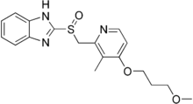
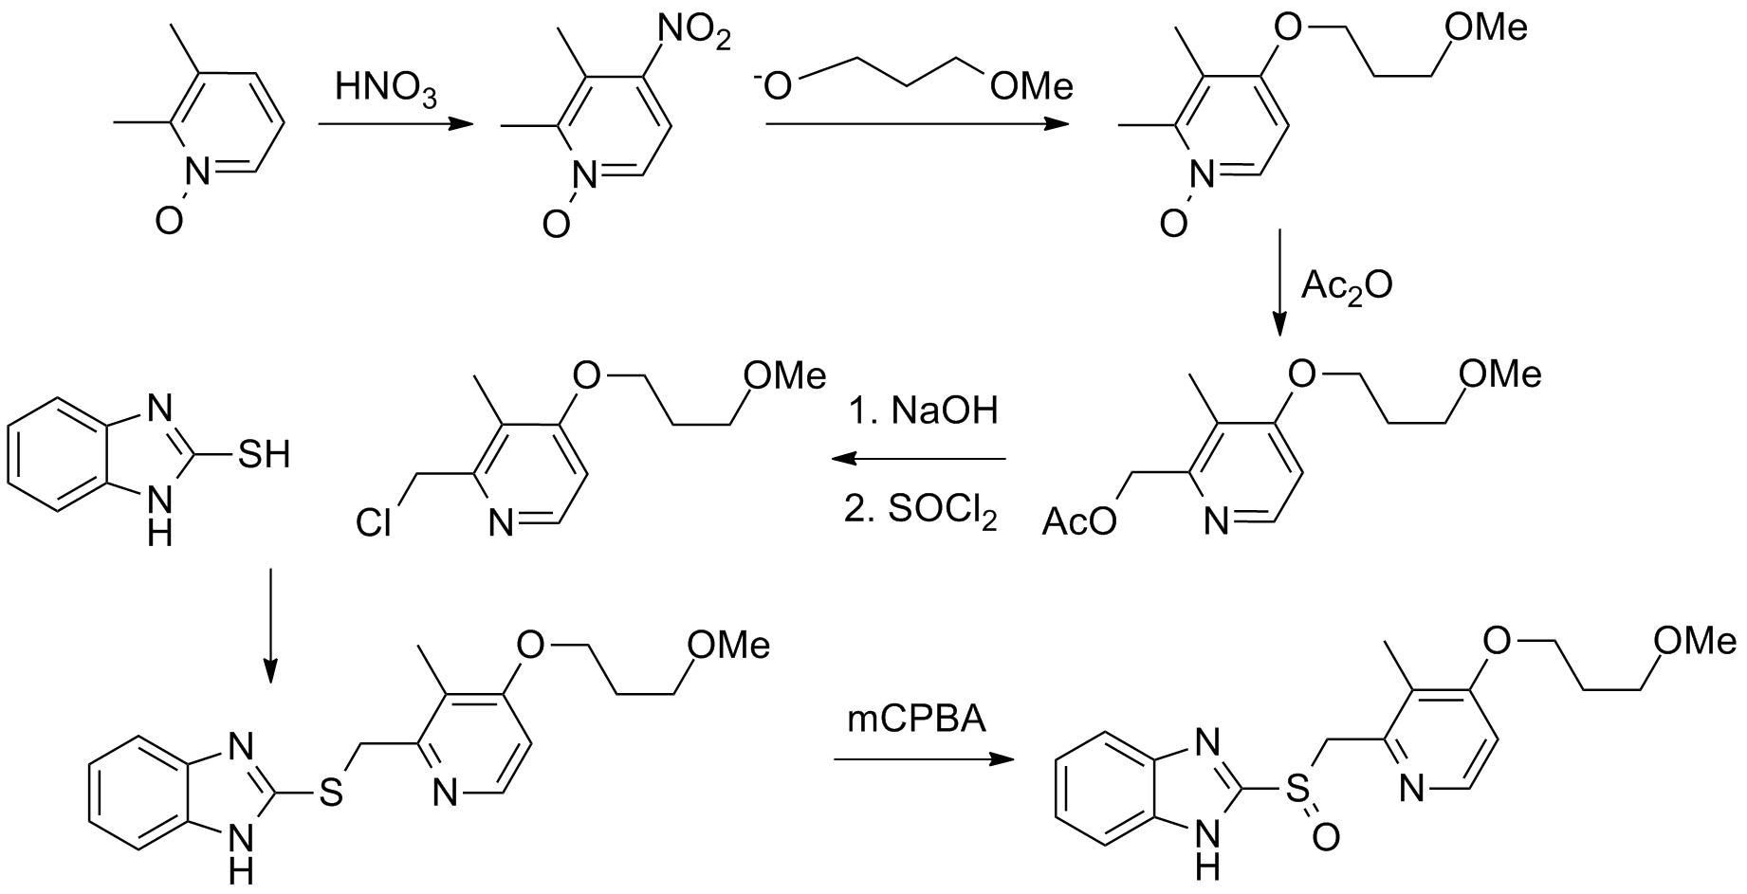
Rabeprazole (Rabeprazole)
Mechanism of action. The mechanism of action of the drug is to inhibit the enzyme of parietal cells of the stomach H + / K + ATPase (also called proton pump), which blocks the transfer of hydrogen ions from parietal cells into the gastric cavity and inhibits the final stage of hydrochloric acid secretion.
Synthesis.

Slide 4
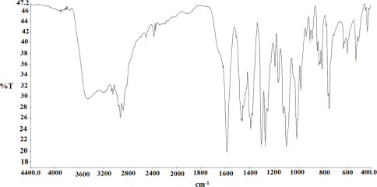
IR absorption spectrum of rabeprazole
4

Slide 5
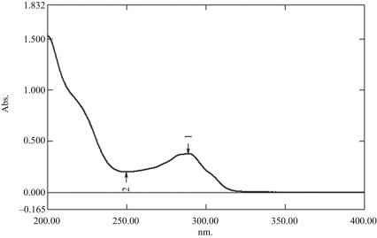
УФ-спектр рабепразолу
5

Slide 6
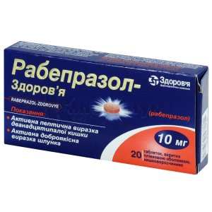
Properties. White or yellowish-white crystalline powder. Very soluble in water and methanol, freely soluble in ethanol, chloroform and ethyl acetate, insoluble in ether andN-hexanes.
Storage. Store in the original package at a temperature not exceeding 25 ° C.
Application. Active peptic ulcer of the duodenum, active benign gastric ulcer. It is also used for the prevention and treatment of medical lesions of the stomach and duodenum caused by nonsteroidal anti-inflammatory drugs and thienopyridines.

Slide 7
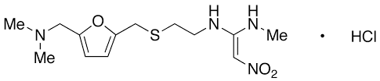
Ranitidine hydrochloride (Ranitidine hydrochloride)
Mechanism of action. The mechanism of action is due to competitive inhibition of H₂-histamine receptors on the membranes of parietal cells of the gastric mucosa. Reduces basal and stimulated secretion of hydrochloric acid,, reducing the volume of gastric juice.

Slide 8
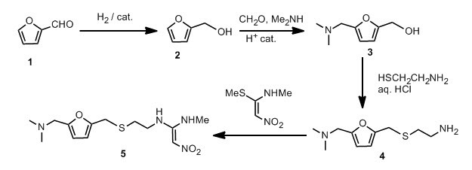
Synthesis.
Properties. White or pale yellow crystalline powder. Easily soluble in water, slightly soluble in dehydrated alcohol and very slightly soluble in dichloromethane.

Slide 9
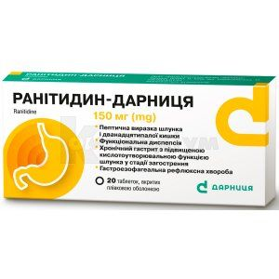
Storage. Store in the original package at a temperature not exceeding 25 ° C.
Application. Peptic ulcer of the stomach and duodenum, not associated with Helicobacter pylori (in the acute phase),, including ulcers associated with non-steroidal anti-inflammatory drugs; functional dyspepsia; chronic gastritis with increased acid-forming function of the stomach in the acute stage.

Slide 10
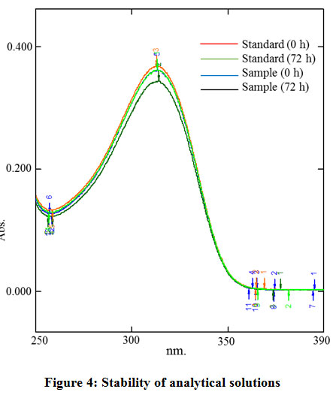
UV absorption spectrum of ranitidine hydrochloride

Slide 11
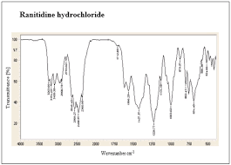
IR absorption spectrum of ranitidine hydrochloride

Slide 12
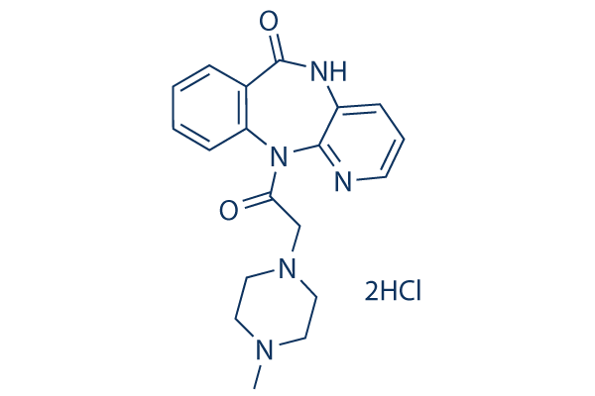
Pirenzepinum
Mechanism of action. Selective blocker M₁-cholinoreceptors of the lining and main cells of the gastric mucosa. Reduces basal and stimulated secretion of hydrochloric acid, peptic activity of gastric juice, slightly reduces the tone of gastric smooth muscle.

Slide 13
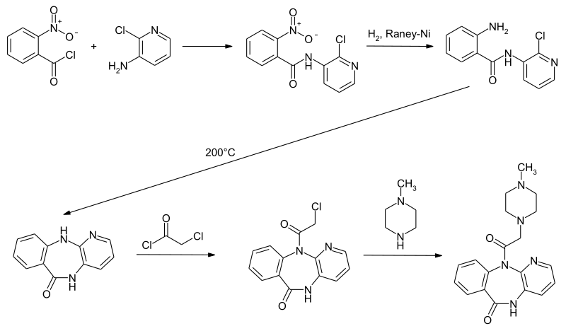
Synthesis.

Slide 14
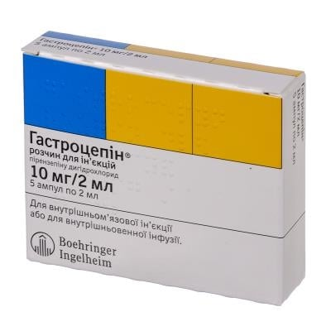
Properties. White powder, slightly soluble in water, practically insoluble in ether, easily soluble in methanol.
Identification:
identified by the IR absorption spectrum of the substance;
by HPLC, spectrophotometric method.
Quantitative definition. Quantitatively determined by alkalimetric titration with potentiometric fixation of the end point of the titration.
Storage. Store in a dark place.
Application.With peptic ulcer of the stomach and duodenum; erosive-ulcerative lesions of the gastrointestinal tract; stress ulcers; chronic hyperacid gastritis, duodenitis; erosive gastritis, esophagitis; reflux esophagitis; Zollinger-Ellison syndrome; bleeding from erosions and ulcerative lesions in the upper gastrointestinal tract; peptic ulcers of the intestine.

Slide 15
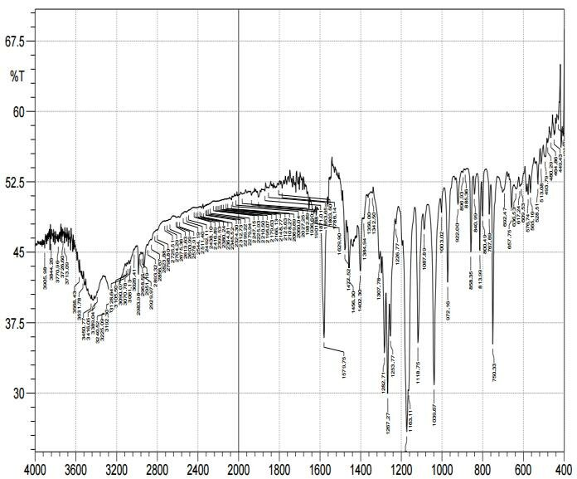
IR absorption spectrum of pirenzepine

Slide 16
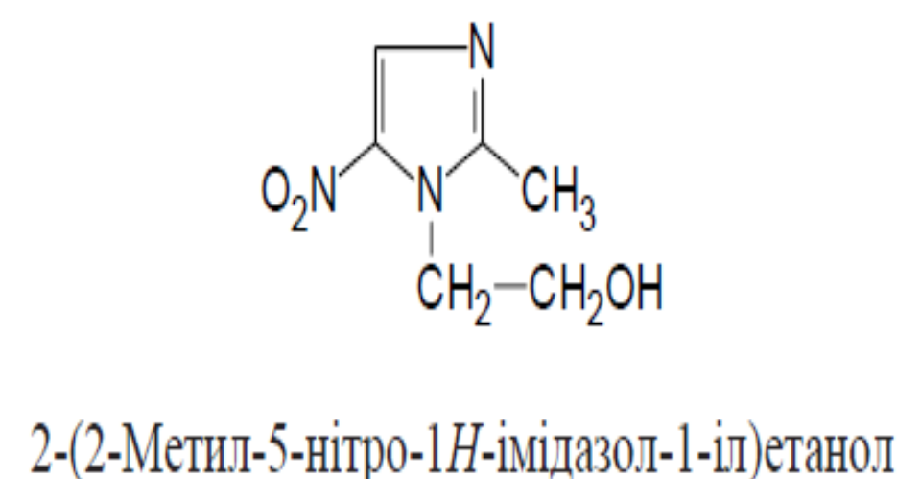
Metronidazole (Metronidazole)
Mechanism of action.It consists in the biochemical reduction of the 5-nitro group of metronidazole by intracellular transport proteins of anaerobic microorganisms and protozoa. The reduced 5-nitro group of metronidazole interacts with the DNA of microorganisms, inhibiting its synthesis, which leads to the death of microorganisms.

Slide 17
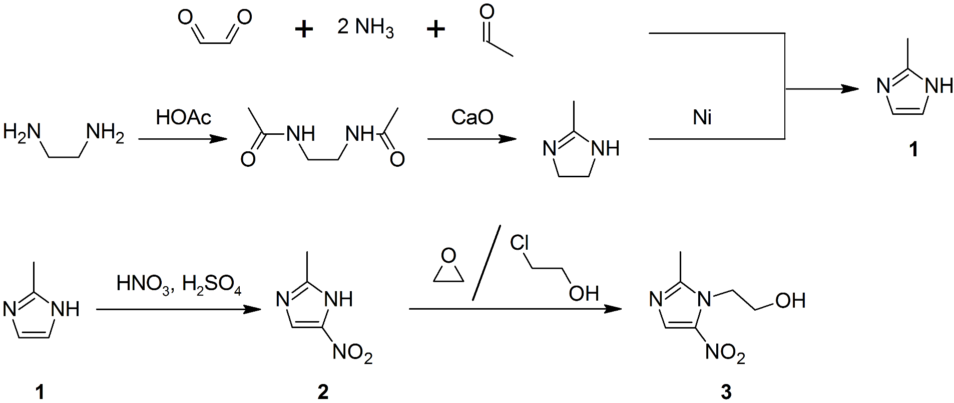
Synthesis

Slide 18
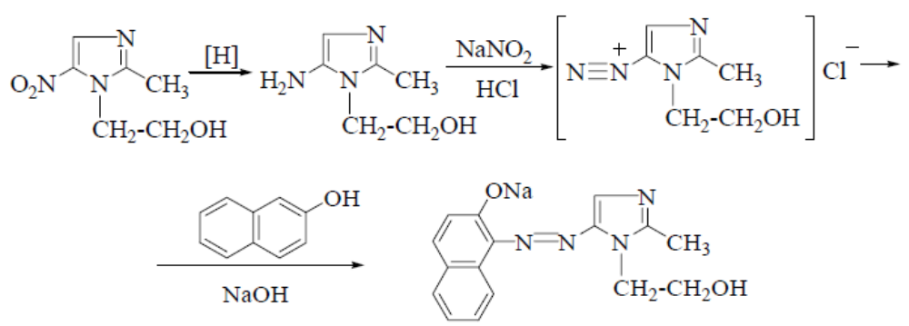
Properties. White or slightly greenish-yellowish odorless crystalline powder. Insoluble in water, sparingly soluble in ethanol.
Identification:
physicochemical methods: determination of so-called area, IR and UV
spectroscopy;
when heated with 4% solution NaOH red appears violet color, which turns yellow with the addition of hydrochloric acid, and when alkalized occurs again;
For melting point of picrate (148–153 ° С);
the reaction of azo dye formation after preliminary reduction of the nitro group to the amino group:

Slide 19
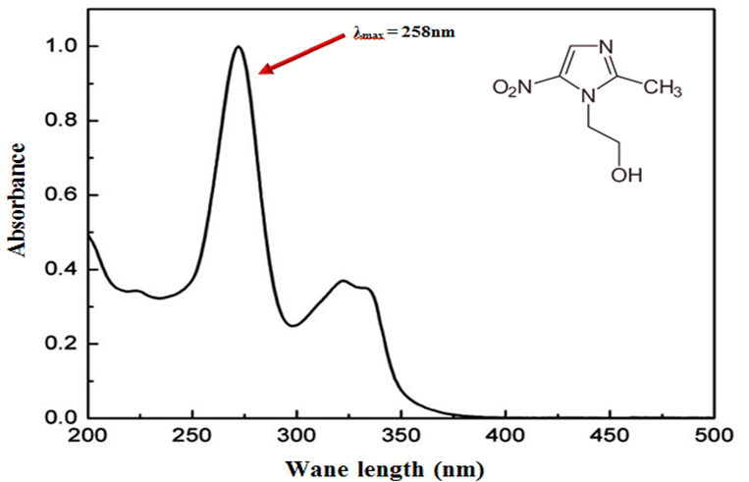
UV spectrum of metronidazole

Slide 20
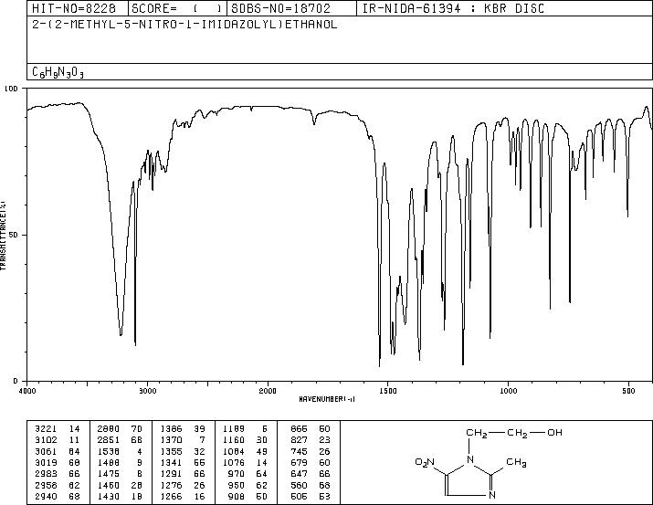
IR absorption spectrum of metronidazole

Slide 21
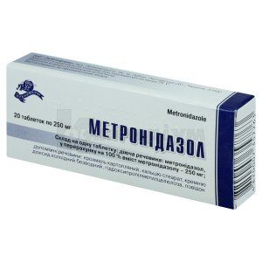
Quantitative definition.
Acidimetry in non-aqueous medium, indicator - crystalline violet, s = 1.
UV spectrophotometry.
Photocolorimetry.
Storage. In a sealed container, in a dark place.
Application. Antiprotozoal agent with a broad spectrum of action.
Antibacterial agent for the treatment of anaerobic infections.
Also used to treat stomach ulcers and for
sensitization to alcohol in alcoholism.

Slide 22
Quantitative definition.
Acidimetry in non-aqueous medium, indicator - crystalline violet, s = 1.
UV spectrophotometry.
Photocolorimetry.
Storage. In a sealed container, in a dark place.
Application. Antiprotozoal agent with a broad spectrum of action.
Antibacterial agent for the treatment of anaerobic infections.
Also used to treat stomach ulcers and for
sensitization to alcohol in alcoholism.
Remedies for alcoholism
Classification. Drug treatment of alcoholism involves the use of drugs, which can be divided into two groups:
aversive drugs (from the Latin aversio - disgust) cause negative effects in combination with alcohol;
anticraving drugs - do not cause adverse effects with alcohol, designed exclusively for the treatment of addiction, reduce pathological addiction to alcohol, increase the duration of remission, reduce alcohol consumption and the severity of alcohol excesses.

Slide 23
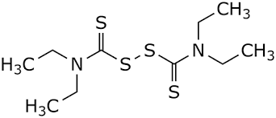
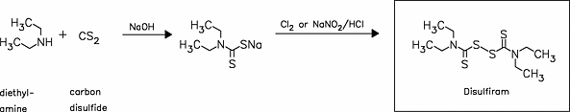
Disulfiramum
Mechanism of action. It acts by inhibiting the enzyme acetaldehydrogenase (ALDH2), which leads to the unpleasant sensation of a hangover immediately after drinking alcohol.
Synthesis.

Slide 24
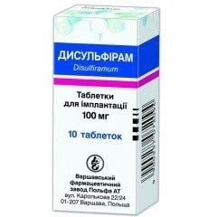
Properties. White or almost white crystalline powder, practically insoluble in water, easily soluble in methylene chloride, soluble in ether, moderately soluble in 96% alcohol.
Identification:
identified by T PL, by the IR absorption spectrum of the substance;
by TLC;
by the reaction of a methanolic solution of the substance with a solution of copper (II) chloride - a yellow color appears, which turns greenish-yellow.
Quantitative definition. Quantitatively determined by argentometry in acetone in the presence of potassium nitrate potentiometrically.
Storage. Store at a temperature not exceeding 25 ºC.
Application. Treatment of chronic alcoholism in cases where it is not possible to obtain a therapeutic effect by other methods (psychotherapy, the use of apomorphine, etc.).

Slide 25
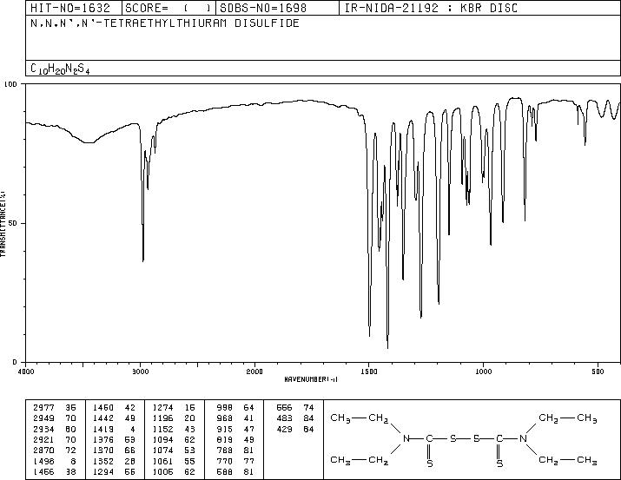
IR absorption spectrum of disulfiram

Slide 26

Cyanamide (Cyanamide)
Mechanism of action. The action of cyanamide is based on the blockade of enzymatic biotransformation of ethyl alcohol, leads to an increase in the concentration of the metabolite of ethyl alcohol - acetaldehyde, which causes negative sensations (hot flashes, nausea, tachycardia, shortness of breath), which make alcohol consumption extremely unpleasant.
Synthesis.
CaCN₂ + H₂O + CO₂ → CaCO₃ + H₂NCN
Properties. White crystalline powder.
Storage. Store in a dark place at a temperature not exceeding 25 ° C.
Application. Treatment of chronic alcoholism and prevention of relapses.

Slide 27
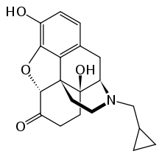
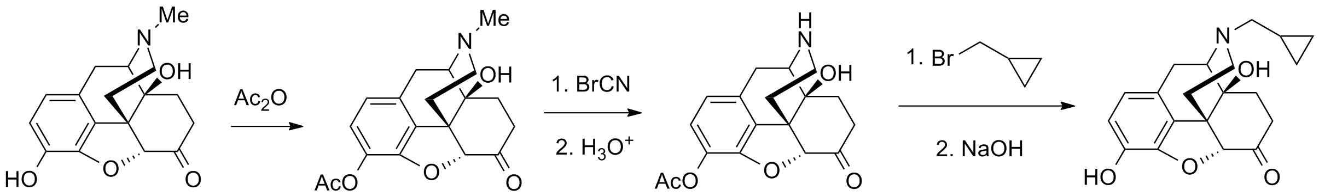
Naltrexone
Mechanism of action. Competitive opiate receptor antagonist. Naltrexone blocks the pharmacological effect of exogenously administered opiates by competitively binding opiate receptors. This blockade can be removed by administering large doses of opiates. Due to the blockade of opiate receptors, alcohol dependence is eliminated. Does not cause addiction and drug dependence.
Synthesis.

Slide 28
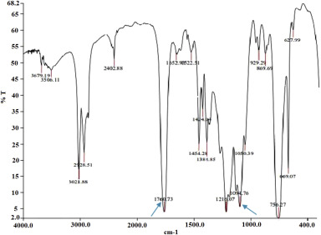
IR absorption spectrum of naltrexone

Slide 29
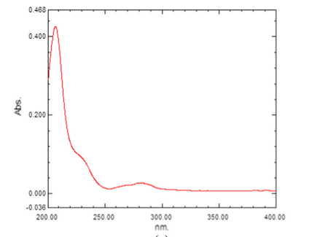
UV spectrum of naltrexone

Slide 30
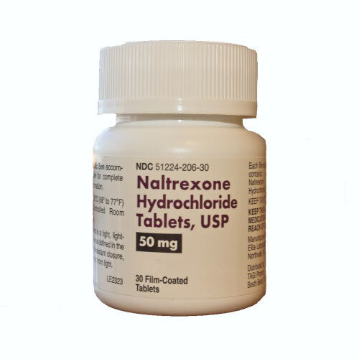
Storage. Store in a dark dry place at a temperature not exceeding 25 ºС.
Application. Prescribed in the complex therapy of alcoholism to curb the urge to drink alcohol, prevent excessive alcohol consumption, reduce the level of alcohol-induced euphoria, as well as to reduce the frequency of relapses.

Slide 31
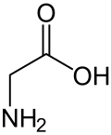
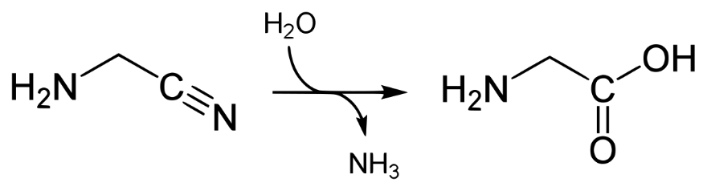
Glycine (Glycinum)
Mechanism of action. Improves metabolic processes in brain tissues; reveals sedative, hypnotic, psychostimulant, natotropic and anxiolytic action; reduces cravings for alcohol and manifestations of withdrawal syndrome.
Synthesis.
Properties. White crystalline powder, slightly soluble in water, slightly soluble in 96% alcohol, practically insoluble in ether.

Slide 32
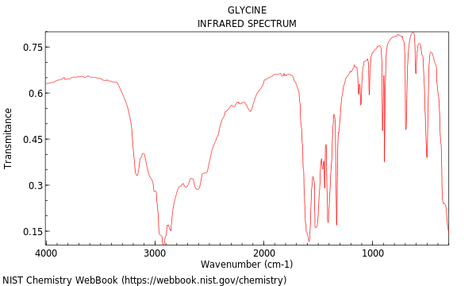
IR absorption spectrum of glycine

Slide 33
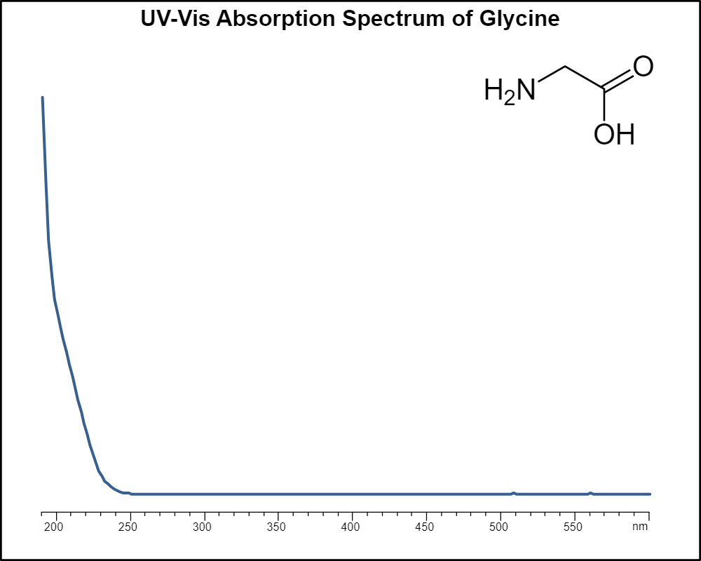
UV spectrum of glycine

Slide 34
Identification:
identified by the IR absorption spectrum of the substance;
by TLC;
carry out the oxidative decarboxylation reaction drug by the action of sodium hypochlorite concentrated at boiling with the addition of hydrochloric acid and resorcinol in an alkaline environment (the solution turns purple color with greenish-yellow fluorescence, after a few minutes the color of the solution turns orange, then yellow, and intense fluorescence remains).
Quantitative definition. Quantitatively determined by titration with a 0.1 M solution of perchloric acid in a mixture of formic anhydrous acid - glacial acetic acid (1:10) with potentiometric indication of the equivalence point.
Storage. Store in the original package at a temperature not exceeding 25 ° C.
Application. In the period of remission in depressive states, increased irritability, sleep disorders, memory impairment, mental retardation in children, senile dementia. Additionally - in chronic alcoholism, acute withdrawal period, vegetative-vascular dystonia with asthenic syndrome, muscular dystrophy.

Slide 35
Literature
Pharmaceutical Chemistry: A Textbook for Students. higher pharmacy. textbook lock and pharmac. f-tiv higher. honey. textbook lock ІІІ – ІV levels of accreditation / P.О. Bezugly, I.S. Gritsenko, І.В. Ukrainets' and others. - Vinnytsia: New book, 2011. - 560 p.
Pharmaceutical chemistry. Lectures for english-speaking students: the study guide for students of higher schools / V. A. Georgiyants [et al.] ; ed. by: V. A. Georgiyants, P. O. Bezugly ; NUPh. – Kharkiv : NPhaU : Original, 2013. – 528 p
Pharmaceutical Encyclopedia / ed. council and the author of the foreword VP Black; Nat. pharmacy. University of Ukraine. - 2nd ed., Reworked. and add. - Київ: МОРІОН, 2010. - 1632 с.
State Pharmacopoeia of Ukraine: in 3 volumes / SE "Ukrainian Scientific Pharmacopoeial Center for Quality of Medicines". - 2nd type. - Kharkiv, 2015. - Vol.1. –1135 s.
State Pharmacopoeia of Ukraine: in 3 volumes / State Enterprise "Ukrainian Scientific Pharmacopoeial Center for Quality of Medicines". - 2nd ed., Kharkiv: State Enterprise "Ukrainian Scientific Pharmacopoeial Center for Quality of Medicines", 2014. - Vol. 2. - 724 p.
State Pharmacopoeia of Ukraine: in 3 volumes / State Enterprise "Ukrainian Scientific Pharmacopoeial Center for Quality of Medicines". - 2nd ed., Kharkiv: State Enterprise "Ukrainian Scientific Pharmacopoeial Center for Quality of Medicines", 2014. - Vol. 3. - 732 p.

