Slide 1
Topic 1. The evolution of the global development of quality management science and its role in pharmacy.
Odessa National Medical University
Department of General and Clinical Pharmacology and Pharmacognosy
Discipline «Qualiti systems in pharmacy»
Lecturer: Eberle L.V.
Candidate of Biological Sciences, Associate Professor of the Department of General and Clinical Pharmacology and Pharmacognosy

Slide 2
Relevance of the topic. The pharmaceutical industry in developed countries is among the most dynamic and profitable sectors. However, it also functions as a unique market segment regulated by governmental authorities and controlled by insurance medicine. Enterprises that successfully restructure and withstand intense competition will be able to compete in international markets.
Objective: to form theoretical knowledge of the evolution of the global development of quality management science and its role in pharmacy among higher education students.
Lecture plan and organizational structure:
Key terms in quality management.
Stages of development in quality management worldwide.
Fundamental concepts of quality management.

Slide 3

Key terms in quality management
The category of "quality" has a multifaceted nature in terms of its origin and existence, applicable in various spheres of societal activity. Therefore, it can be considered a philosophical, social, and economic category, among others.
According to the international standard ISO 9000:2000, quality is understood as the degree to which a set of inherent characteristics of an object (product or service) meets the requirements established in regulatory documents.
Quality management refers to the actions carried out during the development, production, and realization of an object to form, ensure, and maintain the specified level of quality.
Quality management is implemented within the framework of a quality management system. A quality management system (quality system) is a management system for directing and controlling an organization concerning quality.
The quality loop/cycle is a conceptual model of interdependent activities that affect quality at various stages of the product or service lifecycle.

Slide 4
Stages of development in quality management worldwide
The stages of quality management development in the world began with individual quality control, which was prevalent in production until the late 19th century. In this form of management, one worker or a small group of workers were responsible for manufacturing products. Each worker had the opportunity to fully control the quality of their work, thereby ensuring the quality of the product.
The development of industrial production and the deepening of internal work division led to the emergence of workshop quality control in the early 20th century. In this form of management, functions, and responsibilities for quality were distributed among individual workers and workshop supervisors. Workshop control was based on the principles of scientific quality management developed by the renowned American expert Frederick Taylor. Taylor’s methodology aimed to set tolerances for quality indicators, measure their values, and classify production as acceptable or defective based on whether the indicator fell within the tolerance. However, the concepts of "quality standard", "tolerance" and "defect" were only applied to individual products (components and parts) and did not extend to batches (flows) of production and technological processes.

Slide 5
Acceptance quality control. During the Second World War, the development of mass production in industrial enterprises and the increase in production volumes led to the separation of technical control from production operations. Independent technical control services with staff controllers headed by a chief were established in industrial enterprises, who were subordinate to the enterprise’s management.
Statistical quality control. The most significant characteristic of the spread of statistical quality control was the transition from 100 % inspection to sampling inspection, where control data are systematically sampled during the production process according to a predetermined plan and processed using mathematical statistical methods. The industrial application of statistical quality control methods is associated with the work of Walter Shewhart, an expert from an American company. In 1924, he developed Statistical Quality Control (SQC). Shewhart demonstrated that all types of products and services, as well as the processes where they are formed, are subject to deviations from specified values, which he termed variations. For continuous monitoring of the situation, he proposed using control charts with control limits – Shewhart charts. Thus, the main idea of W. Shewhart’s quality management model was to improve quality by reducing process variability.

Slide 6

Total quality control. This concept was introduced by Armand Feigenbaum back in 1957. He proposed making total quality control the responsibility of a special administrative department solely dedicated to quality control. Feigenbaum’s main idea was to implement quality at the early stages of product creation rather than merely inspecting the quality of the finished product. Based on the general methodology of total quality control, Feigenbaum put forward the concept of Total Quality Control (TQC). Within this concept, quality was regarded as the singular and most significant force in organizational success and company growth.
The implementation and development of the TQC concept varied unevenly across different countries. Despite originating from the USA and Europe, this system gained the most widespread adoption in Japan.
Feigenbaum’s main objectives for TQC included:
predictive elimination of potential discrepancies in the production process at the design stage,
quality control of incoming products (incoming quality control),
production management,
supervision of compliance with specified quality requirements.

Slide 7
It was in Japan that the ideas of TQC were met with enthusiasm, and they received further development thanks to Professor Kaoru Ishikawa. Ishikawa advocated for involving all employees of the company in the quality improvement process. Therefore, the Japanese approach became known as Company Wide Quality Control (CWQC). According to this new approach to quality management, companies focused on the following goals:
  Quality above short-term profits.
  People in the management system – involving all employees in the quality management process.
  Consumer-centricity – shifting the mindset towards the perspective of the consumer.
  Wide implementation of statistical control methods.
The pioneers of quality management concepts contributed to the transition to the era of total quality management.

Slide 8
The concept of product quality assurance based on international standards ISO 9000
The international standards in the field of quality management, ISO 9000 series, are based on the principles of the modern concept of Total Quality Management (TQM). The ISO standards concept answers the question of what needs to be done to ensure quality, while the TQM concept addresses how to do it.
The primary philosophy of TQM is based on the principle of "continuous improvement." Regarding quality, the guiding principle is "striving for zero defects", for costs – "zero non- productive costs" and for supplies – "just in time".

Slide 9
12 principles underlying TQM:
All organization activities are oriented towards satisfying the needs and expectations of customers, upon which its success in the market economy depends.
Viewing production relationships among employees as customer-supplier relationships.
Continuous improvement of production and quality activities.
Comprehensive and systematic solutions for quality assurance tasks at all stages of an object's life cycle.
Shifting the main efforts in quality towards human resources (emphasis on employee attitudes towards work, on leadership style).
Involvement of all personnel in addressing quality problems (quality is everyone’s business).
Continuous improvement of organization employees’ competence.
Focus not on detecting, but on preventing non-conformities.
Approach to quality assurance as a continuous process, where the quality of the object at the final stage is a result of achieving quality at all previous stages.
Optimization of the relationship in the triad "quality – costs – time".
Ensuring the accuracy of quality data through the use of statistical methods.
Continuous quality improvement.

Slide 10
Fundamental concepts of quality management
The modern market economy puts forward fundamentally new requirements for the quality of products produced. This is due to the fact that now the survival of any company, its stable position in the market of goods and services of a high level of competitiveness. In turn, competitiveness is associated with the action of several dozen factors, among which two main ones can be distinguished - the price level and product quality. Moreover, the second factor of increase comes to the fore. Quality management is one of the key functions of both corporate and project management, the main means of achieving and maintaining the competitiveness of any enterprise.
Product quality is one of the main criteria for the functioning of an enterprise in a relative market and predominantly non-price competition. Increasing the technical level and quality of products, achieving the pace of scientific and technological progress and increasing production efficiency in general, has a significant impact on the intensification of the economy, the competitiveness of domestic goods and the living standards of the country's population.
Therefore, the problem of ensuring and improving the quality of products is relevant for all countries' enterprises. The success and efficiency of the national economy largely depend on its solution.
The most famous concepts
The concept of Walter Shewart
The concept of Edward Deming
Joseph Juran’s Concept
Armand Feigenbaum’s Concept
The Ettinger – Sittig Concept
Kaoru Ishikawa’s Concept
Genichi Taguchi’s Concept
Philip Crosby’s Concept

Slide 11
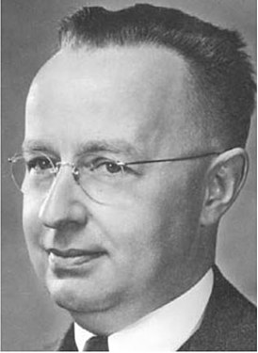
The concept of Walter Shewart
American scientist Dr. Walter Shewhart, who worked as an engineer at Western Electric, proposed replacing the tolerance approach to product quality control and management (Taylor's approach) with a method aimed at ensuring the stability of technological processes and reducing their variations. This, in fact, revolutionary idea, substantiated by W. Shewhart in 1924, only half a century later received general recognition and widespread use in industrial production.
W. Shewhart proposed a tool for process quality control - control charts, which later became known as Shewhart control charts. The basic concept underlying Shewhart charts is the distinction between two types of variability (variability)
Walter Shewart
W. Shewart first proposed a cyclical model that divides quality management into 4 stages. The idea of this cycle was later developed, refined, and recommended for use by his student Edward Deming. In memory of the joint work of these outstanding scholars, the cycle is also called the Deming – Shewart cycle.

Slide 12
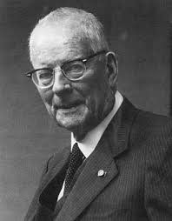
The concept of Edward Deming
E. Deming first justified and formulated the necessity to abandon the control of production as a management principle, focusing on managing production processes instead, and demonstrated the advantage of investing in preventive actions. Deming’s principle of continuous improvement suggests that the process of quality management, assurance, and further improvement occurs continuously. According to Deming, the quality management model (Deming cycle) is implemented based on the following actions:
  Planning (Plan)
  Execution (Do)
  Check (Check)
  Action (Action)
Edward Deming

Slide 13
This cycle became the basis of the Total Quality Management (TQM) concept.
In his book "Out of the Crisis," published in 1986, E. Deming formulates 14 key principles of quality management and considers them as the basis for transforming American industry. Deming’s postulates orient companies toward long-term and sustainable work, urging managers to create conditions for continuous improvement of enterprise activities, prioritizing the interests and aspirations of people.
An illustrative example of Deming’s philosophy, expressed in his 14 postulates, can be the "Joiner Triangle" proposed by Brian Joiner, the leader of the American company "Joiner Associates Inc.". All vertices of the triangle have a direct connection with Deming’s postulates:
passion for quality,
all as one team,
scientific approach.

Slide 14
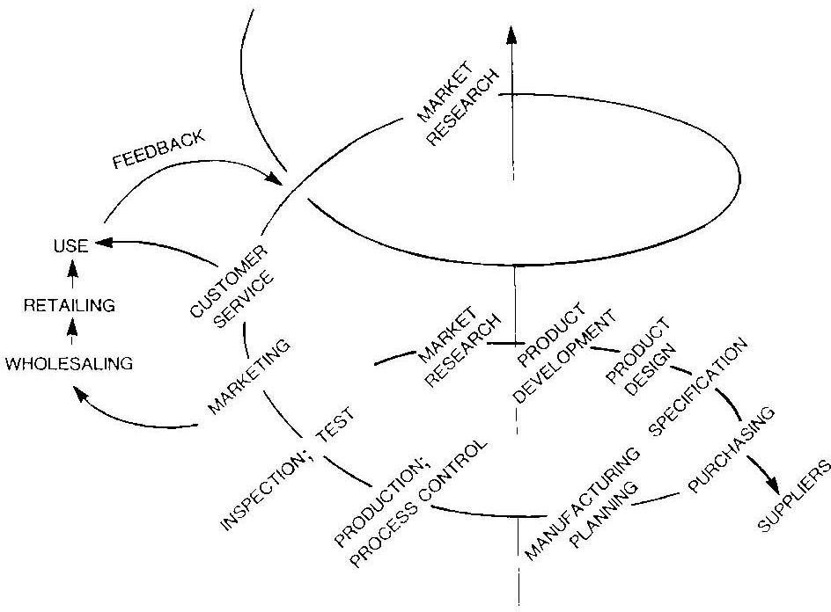
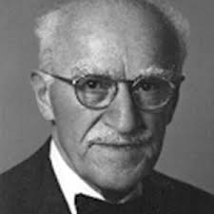
Joseph Juran’s Concept
J. Juran was the first to justify the transition from quality control to quality management. He developed the famous "Juran’s Quality Spiral" (or "Juran’s Spiral"). This timeless spatial model defines the main stages of quality management work.
Joseph Juran

Slide 15

Joseph Juran is the author of the concept of Annual Quality Improvement (AQI). The most important principles of AQI are:
planning by management of quality improvement measures at all levels and in all areas of enterprise activity;
development of measures aimed at preventing errors in quality management;
transition from administration (top-down orders) to systematic management of all activities in the quality sphere.

Slide 16

The Ettinger – Sittig Concept
Among the quality management models developed in the 1950s, the Ettinger – Sittig model stands out. Unlike Feigenbaum’s model, this model takes into account the need to manage functional quality and the influence of demand on product quality. According to this model, the first stage of each quality management cycle is studying demand.
Armand Feigenbaum’s Concept
A. Feigenbaum developed a five-level model of quality management system.
The basic first level involves preparing for the design of the quality assurance system. The second level entails designing the quality assurance system.
The third level is the activation stage of the system. The fourth level involves implementing the system. The final fifth level is comprehensive quality control.
Armand Feigenbaum

Slide 17
Here are Dr Feigenbaum’s elements of total quality to lead to a total customer focus:
Quality is the customers perception of what quality is, not what a company thinks it is.
Quality and cost are the same - not different.
Quality is an individual and team commitment.
Quality and innovation are interrelated and mutually beneficial.
Managing Quality is managing the business.
Quality is a principal.
Quality is not a temporary or quick fix but a continuous process of improvement.
Productivity gained by cost effective demonstrably beneficial Quality investment.
Implement Quality by encompassing suppliers and customers in the system.

Slide 18
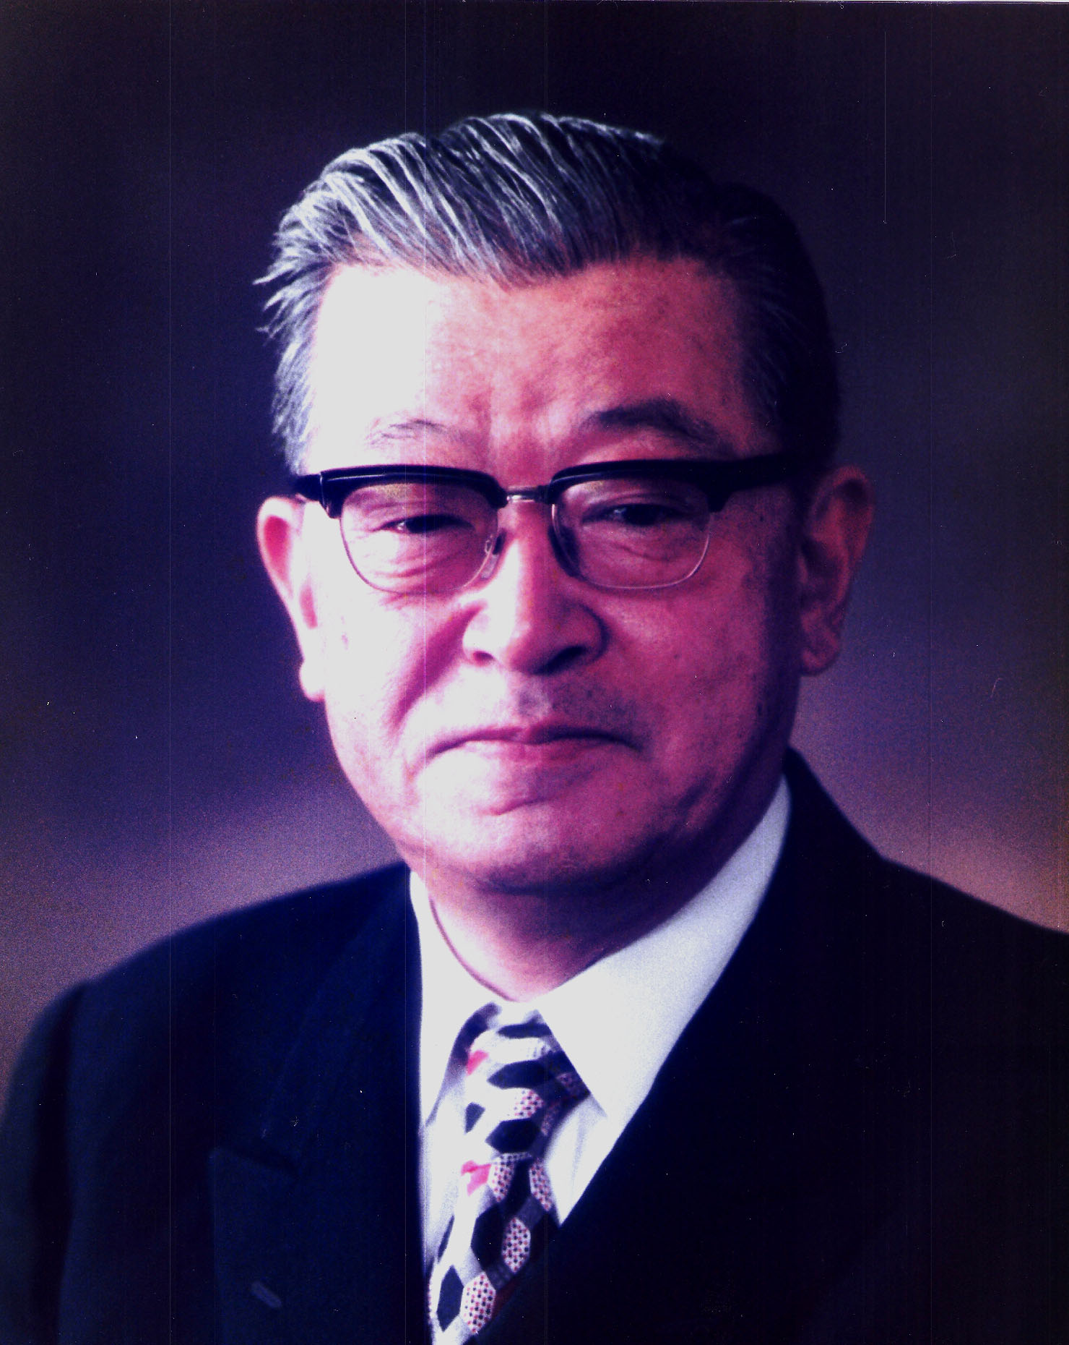

Kaoru Ishikawa’s Concept
K. Ishikawa formulated the basic principles of the role of quality management in the Japanese economy. In the early 1950s, he began a campaign to train top-level managers of firms in statistical control methods. Ishikawa introduced an original graphical method for analyzing cause-and-effect relationships to world practice, which became known as his "Ishikawa diagram" and became part of the seven tools of quality control.
Kaoru Ishikawa

Slide 19
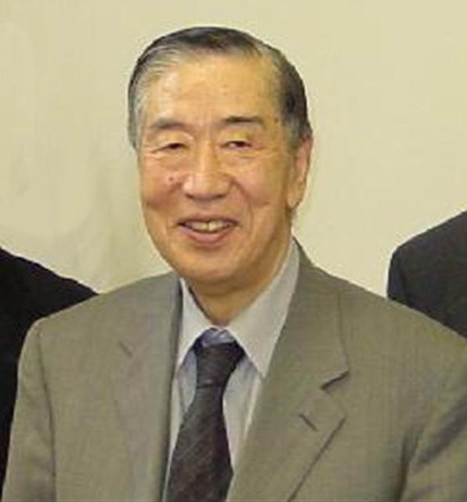
Genichi Taguchi’s Concept
G. Taguchi named his concept "quality engineering". The key principle of Taguchi’s concept is managing deviations from the nominal value.
Taguchi’s methods allow for designing products and processes that are insensitive to the influence of "noise", which are variable factors causing dispersion of parameter values that are difficult, impossible, or expensive to change.
From an economic standpoint, even minor "noises" reduce profits because they increase production costs and warranty expenses.
Taguchi emphasizes the stages preceding product design, as it is at these stages that the task of achieving robustness is addressed.
Genichi Taguchi

Slide 20
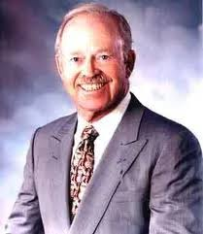
Philip Crosby’s Concept
In his "Zero Defects" concept, Philip Crosby argues that improving quality does not require significant expenses because, in reality, improving quality simultaneously increases productivity. This is because many cost items associated with eliminating detected defects and reworking defective products are reduced. Therefore, the key to the success of the "Zero Defects" program is the principle of not accepting any initial level of acceptability for defects (zero defect level).
Philip Crosby

Slide 21
Crosby’s 14 principles ("absolutes") outlining the sequence of actions to ensure quality in enterprises also gained wide popularity.
Clear definition of the organization’s management commitment to quality, as well as their responsibility in decision-making.
Form a team that will implement the quality assurance program.
Determine methods for assessing quality at all stages of its formation, as well as current and potential quality problems.
Organize accounting and determination of costs associated with quality assurance.
Communicate the management’s quality policy to all employees of the enterprise, ensuring conscious employee attitudes towards quality. Define the costs of poor-quality work and convey this information to subordinates.
Develop procedures for corrective actions in quality assurance.
Develop a program for defect-free production (the "zero defects" system).
Organize training for mentors who will implement the zero-defect program.
Organize regular quality days (zero defects days).
Motivate employees to set personal goals that imply quality improvement.
Develop procedures to eliminate the causes of defects.
Develop a program for the moral encouragement of employees for meeting quality requirements.
Create a task force (special committee) consisting of quality professionals to implement the zero-defect program.
Organize ongoing training for personnel in the field of quality.

Slide 22
Comparison of quality management concepts
 | Philip Crosby | Edward Deming | Joseph Juran
The concept of quality | Compliance with established requirements | Predictable degree of uniformity and reliability at low cost in line with market needs | Suitability for use
Degree of responsibility of senior management | Full responsibility for quality | Responsible for 94% of quality issues | Less than 20% of product quality problems arise due to poor employee performance
Performance standards and motivation | Implementation of the concept of "zero defects" | Multidimensional quality assessment, use of statistical methods to measure efficiency in all areas; criticism of the concept of "zero defects" | To achieve high results, avoid large campaigns
General approach | Prevention of possible defects, not quality control after the fact | Reducing the level of unstable quality through continuous improvement; abandoning total quality control | General approach to quality management; special attention to the human factor
Structure | 14 stages of quality assurance | 14 principles of quality management | 10 stages of quality improvement

Slide 23
 | Philip Crosby | Edward Deming | Joseph Juran
Statistical Process Control (SPC) | Rejection of statistically possible quality levels (striving for 100% quality) | Using statistical quality control methods | Recommends using SPC, but warns that it can lead to an instrumental approach
The basis for quality improvement | A process, not a separate program; the main tasks of quality improvement | Constant reduction of unstable quality; abandonment of tasks; not provided with the means to solve them | Team approach with consistent project implementation
Quality assurance costs | Costs as a result of non-compliance; quality is free | Not optimal; continuous quality improvement | Quality is not free; there are no optimal conditions
Purchasing and receiving materials | Government requirements; supplier is considered an extension of the business; most defects enter the production system through suppliers | Quality control is a late step; sampling leads to poor quality materials entering the system; statistical diagnostics and control charts must be used | The problems are complex; a formal general quality inspection should be carried out
Supplier rating | Expedient + customer rating; quality check not advisable | Not conducted, criticizes most rating systems | It is being done, but it is necessary to assist the supplier in improving the quality of raw materials.

Slide 24
So, starting from the 1920s until the early 1980s, the main problem of quality was perceived and addressed by experts primarily as an engineering-technical issue of controlling and managing the variability of production and manufacturing processes, while the management problem was seen mainly as an organizational and even socio-psychological issue. In the 1950s- 1980s, there was an active convergence of quality assurance methods with the concepts of general management. Quality systems began to widely incorporate the toolkit of management science. Addressing quality challenges required the creation of an adequate organizational structure. This structure should include all departments, and moreover, every employee of the company, at all stages of the product life cycle or quality loop. From these considerations, the concept of TQM logically emerged. The implementation of TQM into the activities of modern enterprises has become one of the most significant innovations in ensuring a proper level of quality and competitiveness in recent years.

Slide 25
Thank you for your attention!

