Slide 1
Topic 2. Regulatory framework for quality management of medical products.
Odessa National Medical University
Department of General and Clinical Pharmacology and Pharmacognosy
Discipline «Qualiti systems in pharmacy»
Lecturer: Eberle L.V.
Candidate of Biological Sciences, Associate Professor of the Department of General and Clinical Pharmacology and Pharmacognosy

Slide 2
The relevance of the topic. Since the 1990s, various industry-specific versions of international quality standards have been emerging. Establishing effective and efficient quality management systems in enterprises that comply with the provisions of international standards is a guarantee of meeting consumer requirements and, consequently, the economic success of the enterprise.
Objective: to form theoretical knowledge of higher education students on the application of general principles and basic methods of development, implementation, maintenance, and improvement of quality management systems of pharmaceutical enterprises/organisations in accordance with the provisions of international standards.
Lecture plan and organizational structure:
Basic types of standards.
ISO 9000 series standards.
ISO 10000 series standards.
ISO 13485 standard.
ISO 14000 series standards.
ISO 19011 standard.
ISO 22000 standard.
Standards for social responsibility.
ISO 27000 series standards.
ISO 31000 series standards.
ISO 37001 standard.
Standards for health and safety management systems.

Slide 3

Basic types of standards
Since the 1990s, various sectoral versions of international quality standards have been developed.
A standard is a regulatory document based on consensus (general agreement of the majority of interested parties), adopted by a recognized body, establishing rules, guidelines, or characteristics for general and repeated use, aimed at achieving an optimal level of orderliness in a certain area.
An international standard is a standard adopted by an international standardization organization and available for a wide range of users.
An international standardization organization is an organization engaged in standardization, membership in which is open to the relevant national bodies of all countries. One such organization is the International Organization for Standardization (ISO).

Slide 4
A national standard is a standard adopted by the national standardization body and available to a wide range of users.
A national standardization body is a standardization body recognized at the national level, with the right to be a national member of relevant international and regional standardization organizations.
International standards do not have mandatory status for all participating countries. Any country in the world has the right to apply or not apply them. The decision to apply the ISO international standard is mainly related to the country’s level of participation in international division of labor and the state of its foreign trade.
International standards are adopted as national standards provided they are accepted by the national standardization body.

Slide 5
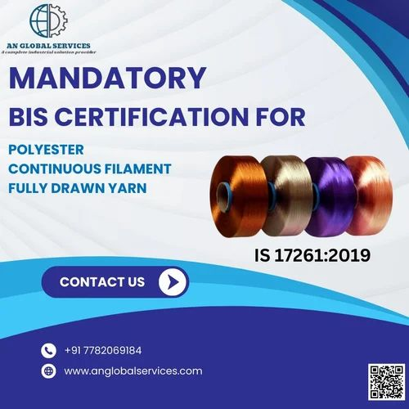

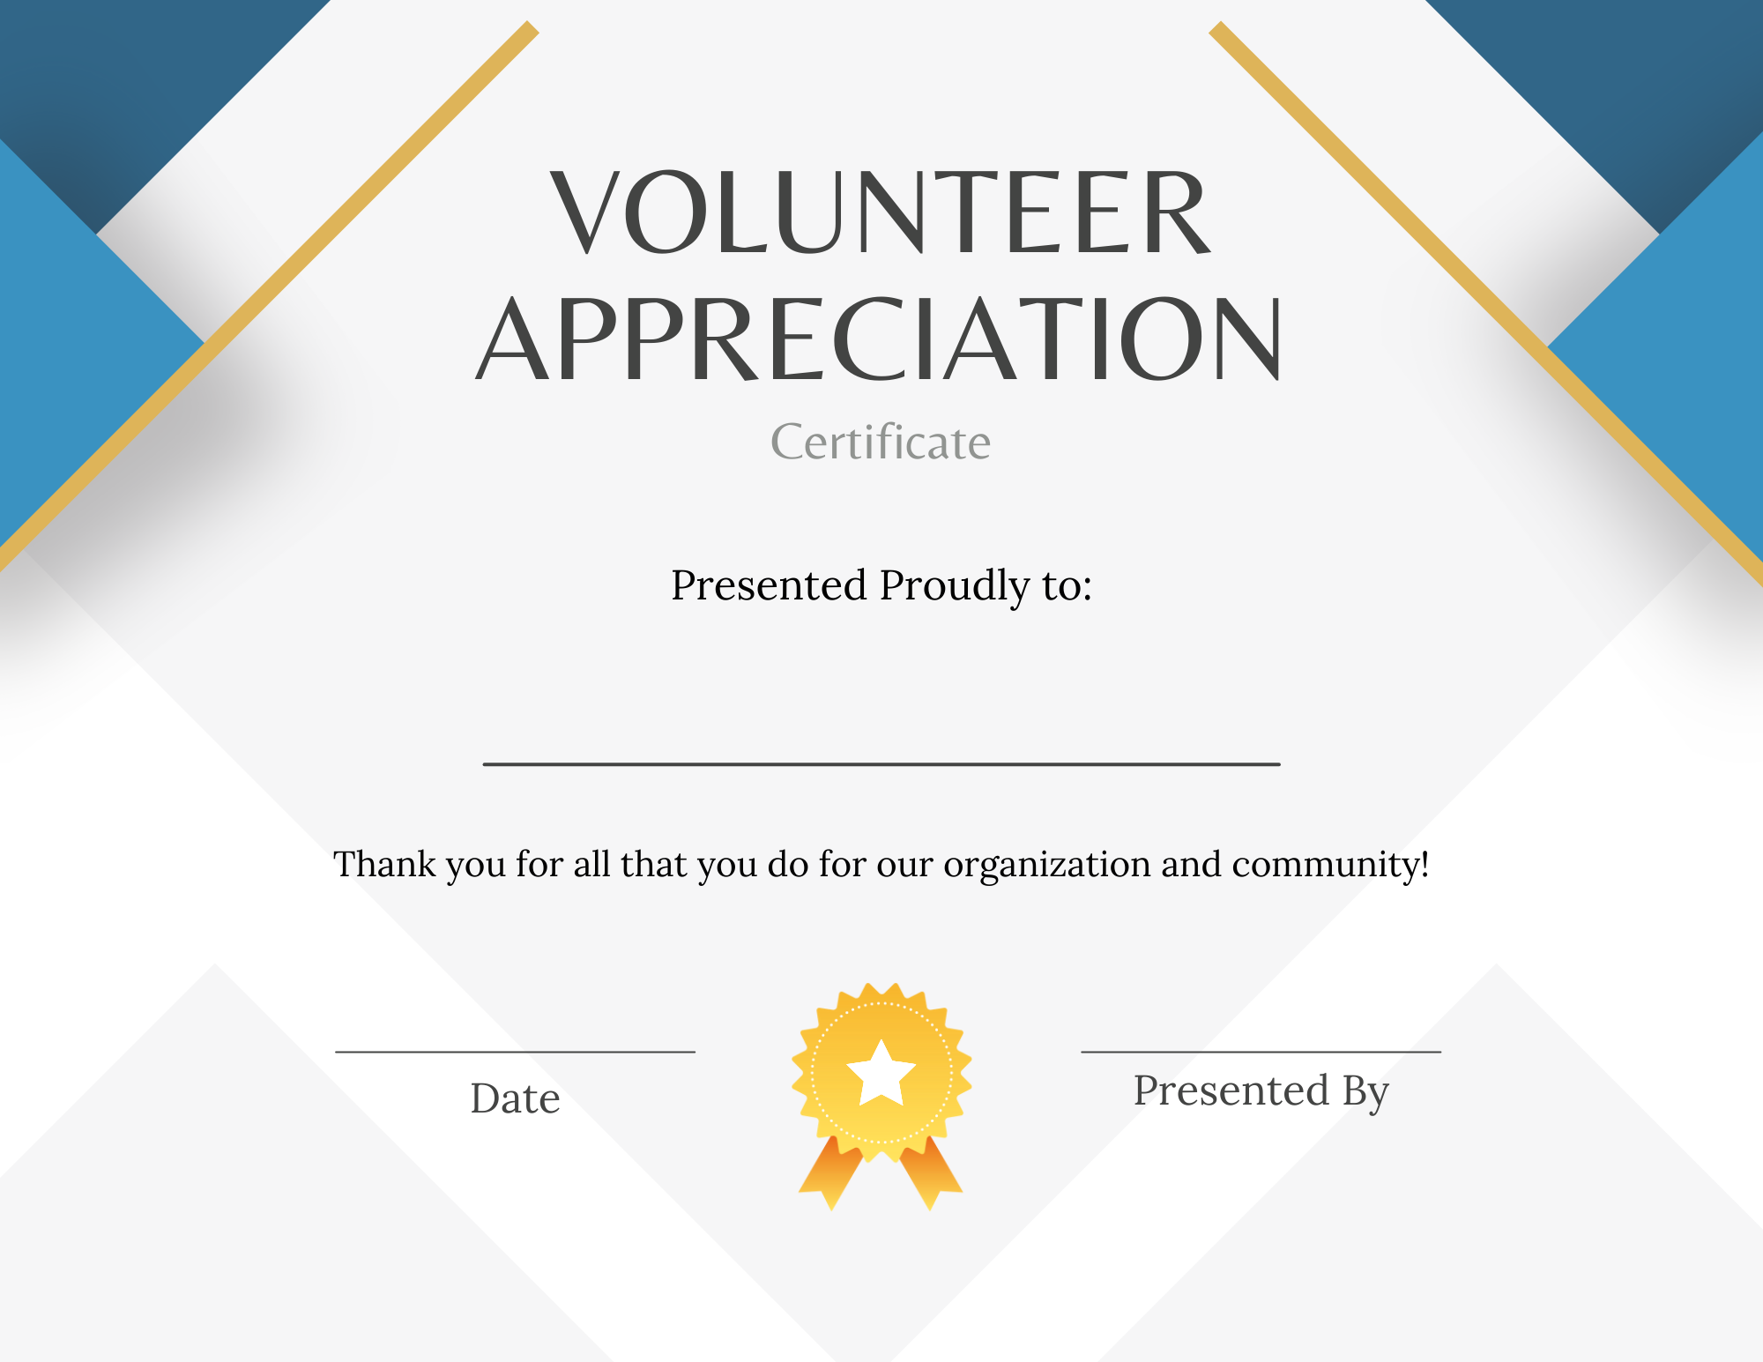
Types of Certification:
Mandatory Certification. Certification for compliance with requirements that are classified by regulatory documents as mandatory and must be complied with, as well as requirements provided for by current legislative acts; conducted only by state certification bodies.
Voluntary Certification. Certification for compliance with requirements that are not classified by regulatory documents as mandatory requirements.

Slide 6
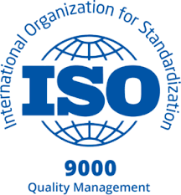
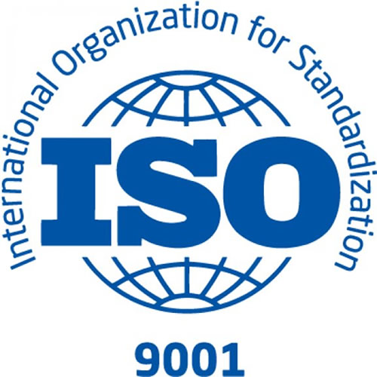
ISO 9000 Series Standards
ISO 9000:2015 Quality management systems — Fundamentals and vocabulary.
This standard contains basic concepts, principles, and terminology of quality management systems, as well as the basis for other quality management system standards. Every organization intending to establish and implement a quality system should refer to this standard.
ISO 9001:2015 Quality management systems — Requirements
The standard contains a comprehensive list of quality system elements relevant to all stages of the product lifecycle and corresponding measures, from which an organization can select and apply elements according to its needs. All requirements are generic and intended for application in any organization, regardless of its type or size, as well as the type of products and services it produces or provides.

Slide 7
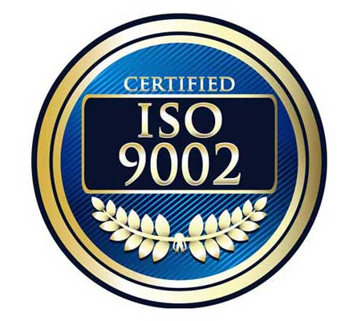

ISO/TS 9002:2016 Quality management systems — Guidelines for the application of ISO 9001:2015
The standard provides guidance on implementing the requirements of ISO 9001:2015, including examples. It is useful both in preparing a quality management system for certification and for further development.
ISO 9004:2018 Quality management — Quality of an organization — Guidance to achieve sustained success.
This standard contains guiding principles for enhancing an organization's ability to achieve sustained success through evaluation and improved effectiveness. It is useful for organizations already certified that strive to achieve the best results beyond basic requirements.

Slide 8
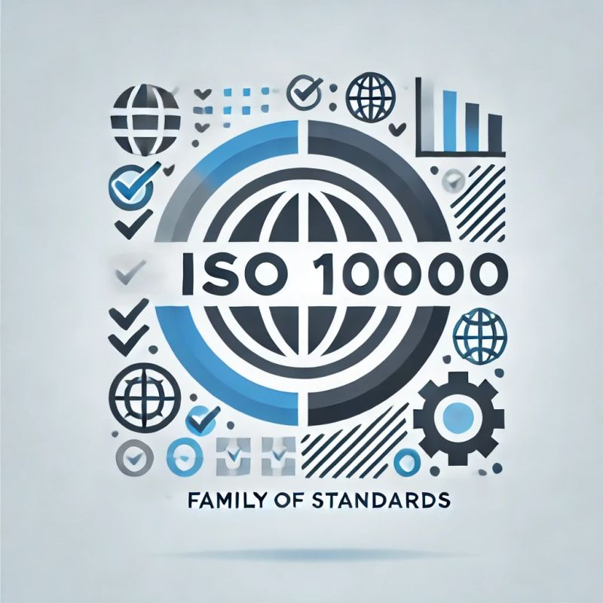
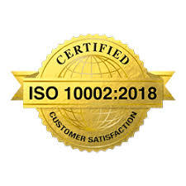
ISO 10000 Series Standards
The ISO 10000 series standards are companion standards that support the ISO 9000 series of standards.
ISO 10001:2018 Quality management — Customer satisfaction — Guidelines for codes of conduct for organizations
The standard for codes of corporate ethics in customer interaction covers issues such as product delivery and service provision, product returns, handling of customer information, advertising, and after-sales service conditions.
ISO 10002:2018 Quality management — Customer satisfaction — Guidelines for complaints handling in organizations
The standard for handling customer complaints provides guidance for organizations in planning, designing, developing, implementing, supporting, and improving an effective process for handling complaints related to any type of activity associated with products and services.

Slide 9
ISO 10003:2018 Quality management — Customer satisfaction — Guidelines for dispute resolution external to organizations
The standard for resolving disputes outside the organization helps organizations plan, maintain, and improve an effective process for resolving disputes outside the organization. It also assists in selecting service providers for dispute resolution and developing recommendations to avoid similar situations in the future by increasing customer satisfaction.
ISO 10004:2018 Quality management — Customer satisfaction — Guidelines for monitoring and measuring
The standard for monitoring customer satisfaction provides recommendations for identifying and implementing processes for monitoring and assessing customer satisfaction.
ISO 10005:2018 Quality management — Guidelines for quality plans
The standard contains guiding principles for the development and implementation of action plans to ensure proper quality – quality programs.

Slide 10
ISO 10006:2017 Quality management — Guidelines for quality management in projects This standard provides guidelines for quality management in projects.
ISO 10007:2017 Quality management — Guidelines for configuration management
The purpose of this standard is to enhance the overall understanding of the subject matter and promote the use of configuration management.
ISO 10012:2003 Measurement management systems — Requirements for measurement processes and measuring equipment
This standard establishes general requirements and provides guidance on managing measurement processes and metrological confirmation of suitability for measuring equipment used to maintain and demonstrate compliance with metrological requirements.
ISO 10013:2021 Quality management systems — Guidance for documented information This standard provides guidance on the development and maintenance of documentation necessary to ensure the effective functioning of a quality management system tailored to the specific needs of the organization.

Slide 11
ISO 10014:2021 Quality management systems — Managing an organization for quality results — Guidance for realizing financial and economic benefits
This standard is intended for top management. It provides guidance on realizing financial and economic benefits through effective implementation of the eight quality management principles outlined in ISO 9000:2005.
ISO 10015:2019 Quality management — Guidelines for competence management and people development.
ISO 10018:2020 Quality management — Guidance for people engagement
This standard provides guidance on involving personnel in the implementation of a quality management system within the organization and enhancing their participation, as well as increasing their competence within the organization.
ISO 10019:2005 Guidelines for the selection of quality management system consultants and use of their services
This standard is intended to assist organizations in selecting a consultant for their quality management system.

Slide 12

ISO 13485 Standard
EN ISO 13485:2016/A11:2021 Medical devices — Quality management systems — Requirements for regulatory purposes (ISO 13485:2016)
This standard establishes the requirements for a quality management system when an organization needs to demonstrate its ability to consistently provide medical devices and related services that consistently meet customer and applicable regulatory requirements.

Slide 13
ISO 14000 Series Standards
International ISO 14000 series standards are designed for companies and organizations of any type that need practical tools to manage their environmental responsibilities.
The main standards in this series include:
ISO 14001:2015 Environmental management systems — Requirements with guidance for use.
The standard establishes the requirements that enable any organization to develop, implement, maintain, and improve an environmental management system.
ISO 14004:2016 Environmental management systems — General guidelines on implementation
The standard is of a recommendatory nature and contains guidelines for the creation, implementation, operation, and improvement of an environmental management system, as well as its interaction with other management systems of the organization.
ISO 14050:2020 Environmental management — Vocabulary
The standard defines the main concepts related to the environmental activities of organizations, as published in the ISO 14000 series of international standards.

Slide 14

ISO 19011 Standard
ISO 19011:2018 Guidelines for auditing management systems.
The standard contains guidelines for planning and conducting management system audits.
ISO 22000 Standard
ISO 22000:2018 Food safety management systems — Requirements for any organization in the food chain
The standard establishes requirements for a food safety management system that enables an organization, directly or indirectly involved in the food chain, to plan, implement, maintain, and update its food safety management system. This ensures that products and services are safe when used as intended.

Slide 15



Standards for social responsibility
ISO 26000 Standard
ISO 26000:2010 Guidance on social responsibility.
Social responsibility is the ability of an organization or enterprise to assess the social consequences of its activities.
ISO 26000 standard provides instructions on the basic principles of social responsibility and ways to integrate socially responsible behavior into existing strategies, systems, practices, and processes of the organization.

Slide 16

The International Standard SA 8000:2014 (Social Accountability 8000)
Standard defines requirements for social protection, enabling organizations to develop, implement, and maintain policies and management methods for social protection issues.
The United Nations Global Compact
The idea of the United Nations Global Compact was proposed at the 1999 World Economic Forum. It is a special initiative of UN Secretary-General Kofi Annan, whose mission is to call on companies to build their activities and strategies based on the 10 Principles in the areas of human rights, labor relations, environmental protection, and anti-corruption efforts.

Slide 17
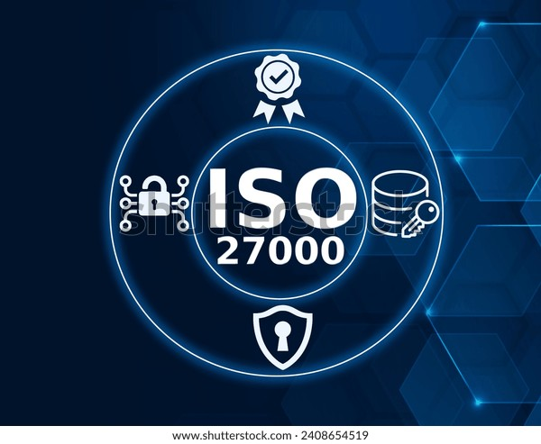
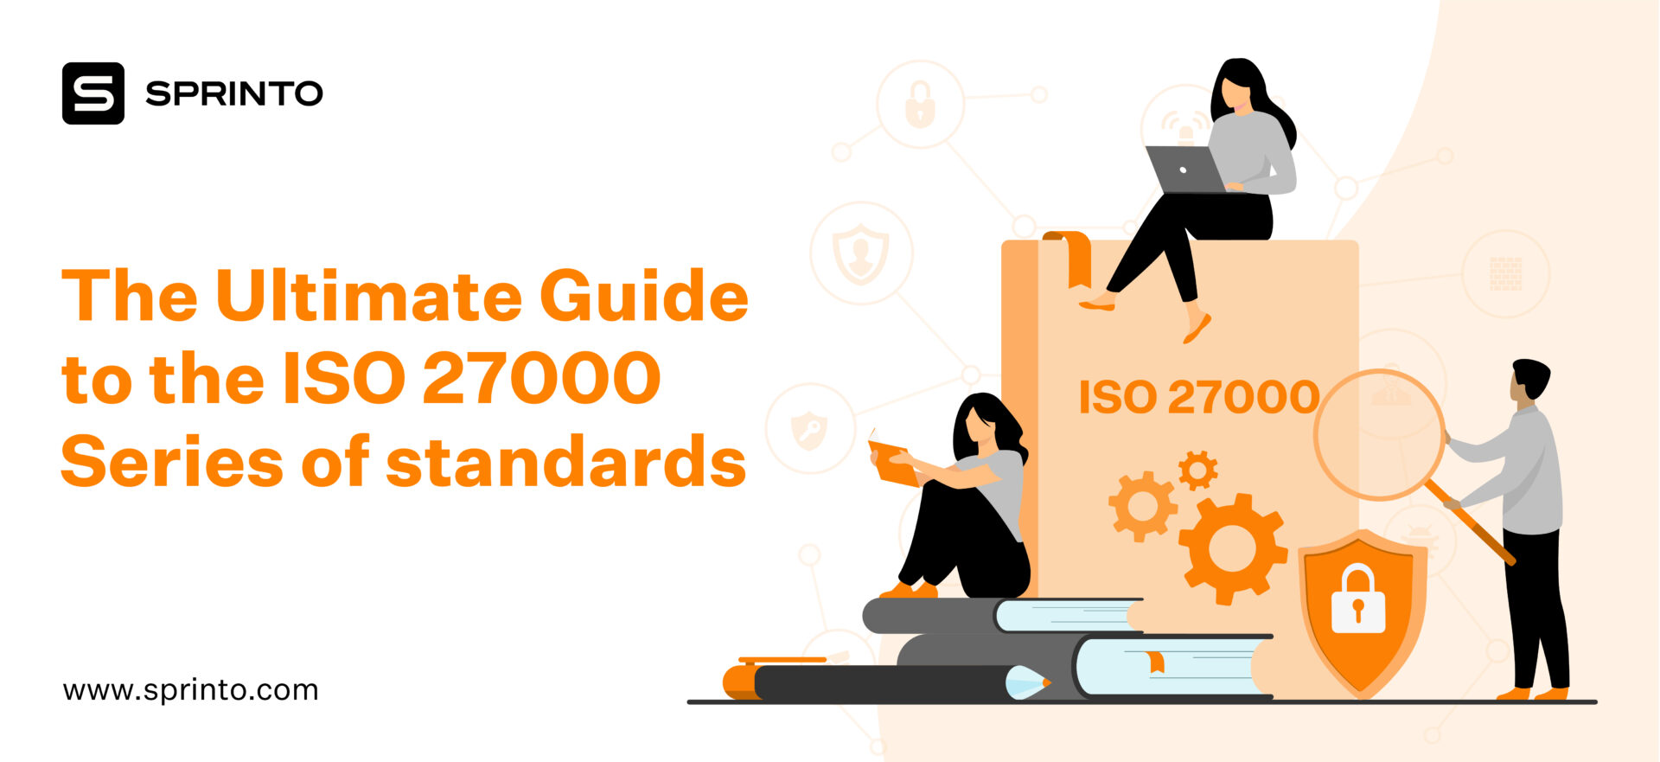
ISO 27000 Series Standards
ISO/IEC 27000:2018 Information technology — Security techniques — Information security management systems — Overview and vocabulary
The standard contains terms and definitions used in the standards of information security management systems.
ISO/IEC 27001:2022 Information security, cybersecurity and privacy protection — Information security management systems — Requirements
The standard establishes requirements for an information security management system to demonstrate an organization’s ability to protect its information resources.
ISO/IEC 27002:2022 Information security, cybersecurity and privacy protection — Information security controls
The standard provides the best practical advice on information security management for those responsible for creating, implementing, or maintaining information security management systems.

Slide 18
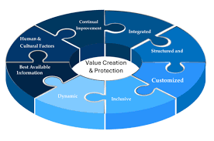
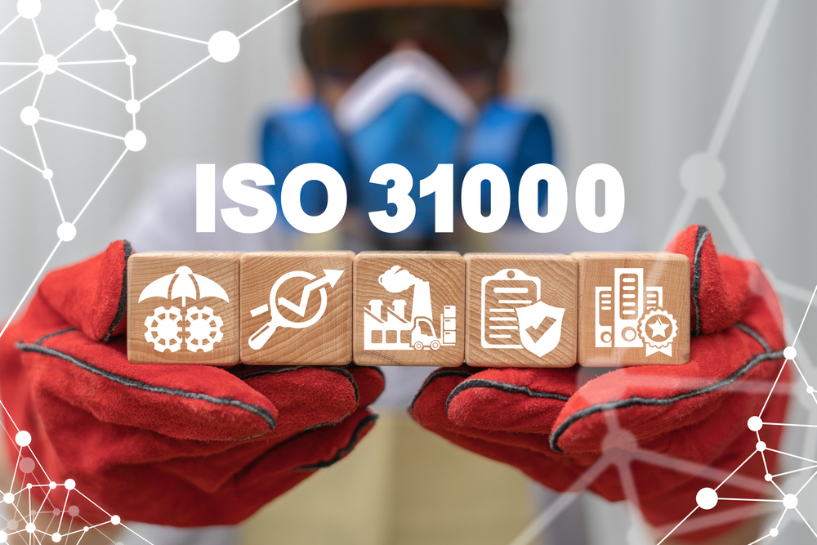
ISO 31000 Series Standards
ISO 31000:2018 Risk management — Guidelines
The standard contains descriptions of the principles and processes upon which risk management is based.
ISO/TR 31004:2013 Risk management Guidance for the implementation of ISO 31000 Status : Withdrawn
IES 31010:2019 Risk management — Risk assessment techniques
The standard presents modern methodologies for selecting and applying general risk assessment methods, considering their application scope, advantages, and disadvantages for each.

Slide 19
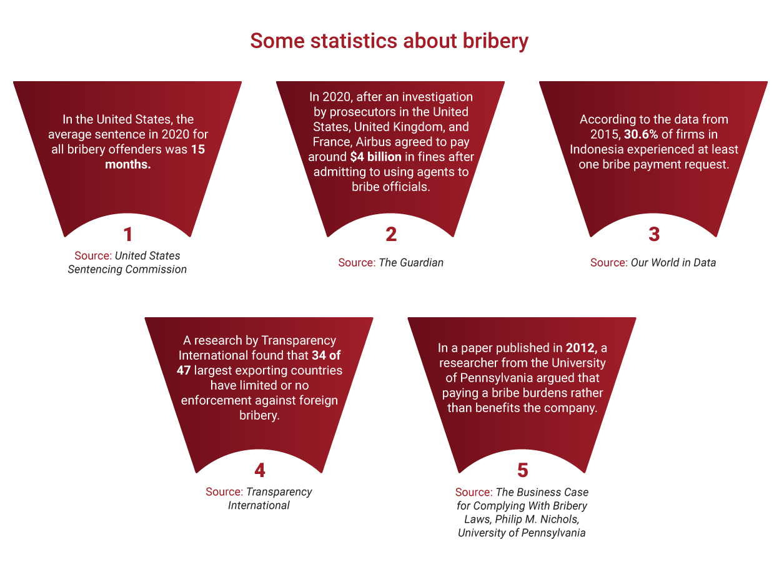
ISO 37001 Standard
ISO 37001:2016 Anti-bribery management systems – Requirements with guidance for use As of the current period, a new version of the ISO/DIS 37001 standard is being developed to replace ISO 37001:2016.
The standard defines requirements and provides guidance on the development, implementation, maintenance, and improvement of anti-corruption management systems.

Slide 20
Standards for the health and safety management system
OHSAS 18001 Standard
OHSAS 18001:2007 Occupational Health and Safety Management Systems.
Requirements.
The OHSAS 18001 standard sets forth requirements for occupational health and safety management systems in the workplace and is designed to assist organizations in controlling the health and safety of employees in the workplace.

Slide 21

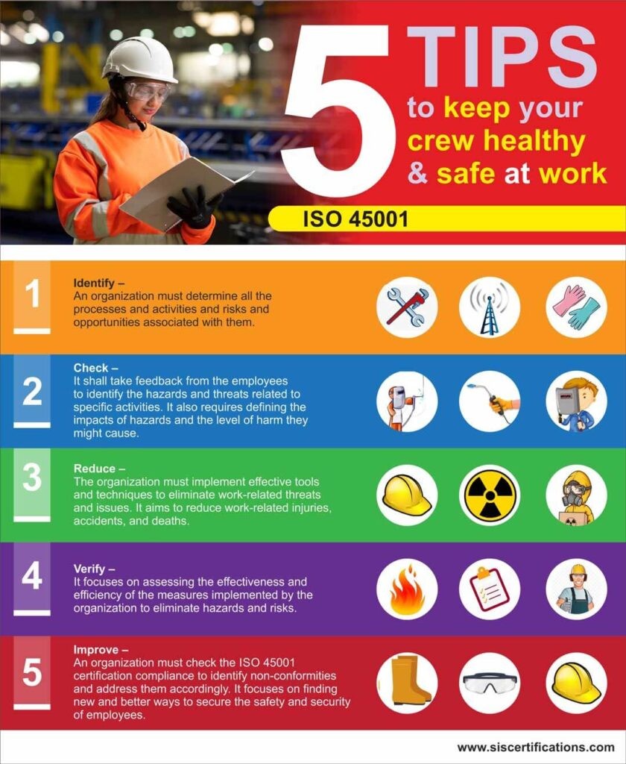
ISO 45001 Standard
ISO 45001:2018 Occupational health and safety management systems – Requirements with guidance for use.
The ISO 45001 standard is based on the guiding principles of the International Labour Organization (ILO) and the British standard OHSAS 18001. It is expected that ISO 45001 will replace OHSAS 18001.
This standard establishes requirements for an occupational health and safety management system and provides guidelines for their implementation, enabling organizations to create safe and healthy working conditions, preventing injuries and ill-health associated with work, and actively improving their performance in occupational health and safety.

Slide 22
Thank you for your attention!

