Slide 1
Topic 4. Statistical methods of quality control.
Odessa National Medical University
Department of General and Clinical Pharmacology and Pharmacognosy
Discipline «Qualiti systems in pharmacy»
Lecturer: Eberle L.V.
Candidate of Biological Sciences, Associate Professor of the Department of General and Clinical Pharmacology and Pharmacognosy

Slide 2
The relevance of the topic. Today, high product quality is regarded as one of the important conditions for economic development, which determines the pace of industrial growth in the country, the efficiency of labor resource utilization, the success of foreign trade, and national prestige. Striving to enter global markets with intense competitive battles, domestic enterprises are actively implementing quality management systems that meet recognized international requirements and stimulate continuous product improvement. Effective management of production process quality is impossible without the use of statistical methods that can timely, promptly, and objectively reflect changes in the process.
Objective: to provide higher education students theoretical knowledge regarding statistical methods of quality control.
Lecture plan and organizational structure:
The essence of statistical methods of quality control.
Checklist.
Pareto diagram.
Ishikawa cause-and-effect diagram.
Histogram.
Scatter diagram.
Control chart.
Stratification.

Slide 3
The essence of statistical methods of quality control
The main task of statistical methods in the quality management of production processes is to guarantee and maintain quality at all stages of production to obtain high-quality end products. Therefore, statistical process management and fact-based decision-making are the main requirements of the international standards ISO 9000 series for quality systems, which can be met through the implementation of statistical methods at enterprises.
The terminological basis for the use, selection and implementation of statistical methods is laid down in the international standard ISO/TR 10017:2021 Quality management ‒ Guidance on statistical techniques for ISO 9001:2015.

Slide 4
Statistical methods help to optimize the process of finding the causes of nonconformities, increase the accuracy and reliability of conclusions, and the effectiveness of measures developed to eliminate the identified causes of failures and defects. The use of statistical methods in production practice leads to a significant reduction in costs and an increase in product quality, which is associated with production and quality analyses, process analyses, process control, and acceptance sampling:
Quality analysis is based on the premise that if it is impossible to achieve perfect quality, a certain level of defects is acceptable, for which selective control methods can be created.
Process analysis is an analysis that allows understanding the relationship between causal factors and outcomes such as quality, cost, productivity, etc.
Process control involves identifying the causal factors that affect the uninterrupted functioning of the production process.
Acceptance sampling is a selective quality control of products based on the application of mathematical statistics methods to check the compliance of product quality with the established requirements.

Slide 5
Among the statistical methods of quality control, the most common are the so-called seven elementary quality control tools:
Checklist;
Pareto diagram;
Ishikawa cause-and-effect diagram;
Histogram;
Scatter diagram;
Control chart;
Stratification.
Checklist
Whatever the task of the quality management system, which combines the sequence of application of statistical methods, always begins with the collection of initial data.
A control sheet is a form for recording data during control, on which the controlled parameters are applied.
The purpose of the control sheet is to
to facilitate the process of collecting data on controlled parameters and identifying defects,
automatically organize data to facilitate its further use.

Slide 6
Pareto diagram
A Pareto diagram is a bar graph that helps identify the primary causes (factors) of losses. A Pareto diagram is created as follows:
Collect data on defects and their number.
Determine the total number of defects of each type that occurred over a certain period of time.
A bar graph is created in which the height of each column corresponds to the number of defects of a certain type. The columns are arranged in descending order of the number of defects from left to right. The main task of creating a diagram is to identify those few types of defects that have an absolute and relative majority. The elimination of these defects will ultimately result in increased product quality and the best economic effect.
Often, a Pareto diagram reveals a pattern based on the Pareto principle (the 80 % to 20 % rule), according to which most effects are caused by relatively few causes.

Slide 7
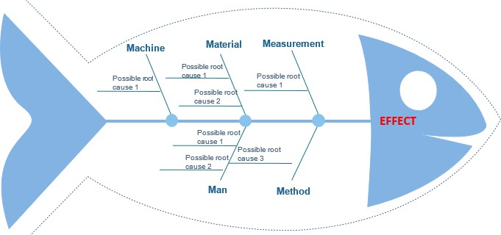
Ishikawa cause-and-effect diagram
The Ishikawa diagram is a graphical method of studying the most significant cause-and- effect relationships between factors and consequences in a situation or problem under study.
The Ishikawa diagram ("fish skeleton") is used when it is necessary to investigate and depict all potential causes with effects that arise during the production process. The diagram is visually based on a clear relationship between causes and effects, quality indicators and factors that influence them. "Causes" are labeled on the left side of the diagram, and effects are labeled on the right side of the diagram.

Slide 8
Building a cause and effect diagram.
When constructing a K. Ishikawa diagram, a horizontal line with an arrow ("spine") is drawn in the center, at the end of the arrow, on the right side, a quality indicator is written in the frame ‒ this is the object of analysis / quality indicator (consequence).
Large primary arrows ("big bones") are drawn to the central horizontal line representing the object of analysis. The main causes (of the first level) are placed on the "big bones" and connected with the "spine" by sloping arrows. When structuring the diagram at the level of primary arrows, in many real situations, one can use the rule proposed by Kaoru Ishikawa himself, known as the "5Ms": materials, methods, measuring, men, and machines. This rule suggests that, in general, there are five possible main causes of certain effects.
Further, to each primary arrow, secondary-level arrows ("middle bones") are drawn, to which, in turn, tertiary-level arrows ("small bones") and so on are drawn until all arrows representing factors that have a significant impact on the object of analysis are included in the diagram.
Thus, Ishikawa’s cause-and-effect diagram allows identifying key relationships between various factors and gaining a more thorough understanding of the analyzed process. It also helps determine the main factors contributing the most significant contribution to the problem under consideration and prevents or eliminates their effects.

Slide 9
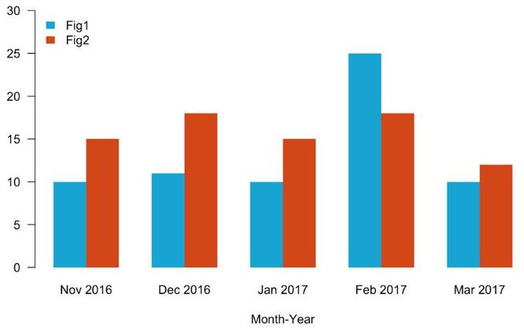
Histogram
A histogram is a column chart that is used to graphically represent data grouped by the frequency of falling into a certain interval. The intervals are the bases of the columns into which the data set is divided. The height of the columns is proportional to the frequency of the observation results falling into the corresponding interval.
The histogram is created in the following sequence:
  a table of initial data is compiled;
  the range of the analyzed parameter is estimated;
  the width of the range is determined;
  the starting point of the first interval is set;
  select the final number of intervals.
Therefore, constructing a histogram helps narrow down the search for problematic areas by demonstrating models of deviation from the desired mean level.

Slide 10
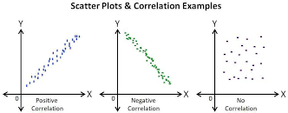
Scatter diagram
A scatter diagram is used to identify the dependence of one variable (product quality indicator, process parameters, etc.) on another. The diagram does not answer the question of whether one variable is the cause of another, but it can clarify whether a causal relationship exists in this case and what its strength is.
The most common statistical method for identifying such a relationship is correlation analysis, based on the estimation of the correlation coefficient. Correlations are described by the corresponding equations.
The data displayed by a scatter diagram form a correlation field. The relationship between related datasets is established based on the shape of the field. The closer the points are to the diagonal line, the greater the dependence between the two specified parameters.

Slide 11
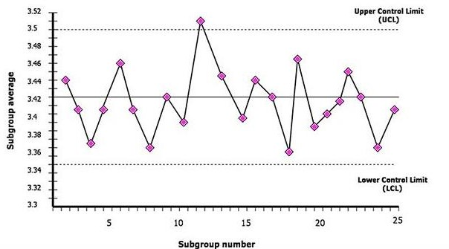
Control chart
A control chart is a type of graph, but it differs from a regular graph by the presence of lines called dimensional control limits.
Any control chart consists of a center line, a pair of control limits, one above (upper limit) and one below (lower limit) the center line, and the values of product quality indicators plotted on the chart to determine suitability for use.
If all the points (values of product quality indicators) are within the control limits, the production process is considered to be in a quality state, and the products comply with the technological process and the standard. If there is an outlier point, this indicates the detection of deviations from the established norm, inconsistencies, defects and rejects, and the process is considered to be out of control. In this case, it is necessary to take corrective actions to return the quality system to the standard, or to find new conditions for manufacturing products.
The control chart helps to identify and subsequently take into account mistakes and compensate for shortcomings.

Slide 12
Stratification
Stratification is the division of the obtained data into separate groups depending on the selected stratifying factor. Any parameter that determines the specifics of the conditions of occurrence and receipt of data can be selected as a stratifying factor.
According to this method, statistical data are stratified, i.e., data are grouped depending on the conditions of their receipt, and each group of data is processed separately. Data divided into groups according to their characteristics are called layers (strata), and the process of dividing into layers (strata) is called stratification.
The method of stratification is often used in evidence-based medicine during clinical trials. The essence of the method lies in considering factors in the study that may influence the experiment’s outcome. For example, in a clinical trial of a drug whose effect may vary depending on the age of the subject, patients are initially divided into subgroups based on age, and then randomization is conducted separately for each subgroup.

Slide 13
Thank you for your attention!

