Slide 1
Topic 5. Regulation and documentation of pharmaceutical quality management processes.
Odessa National Medical University
Department of General and Clinical Pharmacology and Pharmacognosy
Discipline «Qualiti systems in pharmacy»
Lecturer: Eberle L.V.
Candidate of Biological Sciences, Associate Professor of the Department of General and Clinical Pharmacology and Pharmacognosy

Slide 2
The relevance of the topic. Document management processes for any pharmaceutical company are one of the cornerstone elements of the management system. The use of modern, effective methods and tools for document management is critical and necessary at all stages of the document flow. Implementation of a project to implement a quality management system at a pharmaceutical company requires the establishment of clear algorithms for performing document and record management activities as processes that achieve the planned results, as well as systematic tracking of the performance indicators of these processes and implementation of actions for their continuous improvement.
Objective: to provide higher education students with theoretical knowledge regarding the regulation and documentation of processes within the pharmaceutical quality system.
Lecture plan and organizational structure:
The essence of documenting the quality management system at a pharmaceutical enterprise.
Quality manual.
Process execution methodologies.
Third-level quality management system documents.
Fourth-level quality management system documents.
"Inter-process" documents.
Formulating the document control procedure.

Slide 3
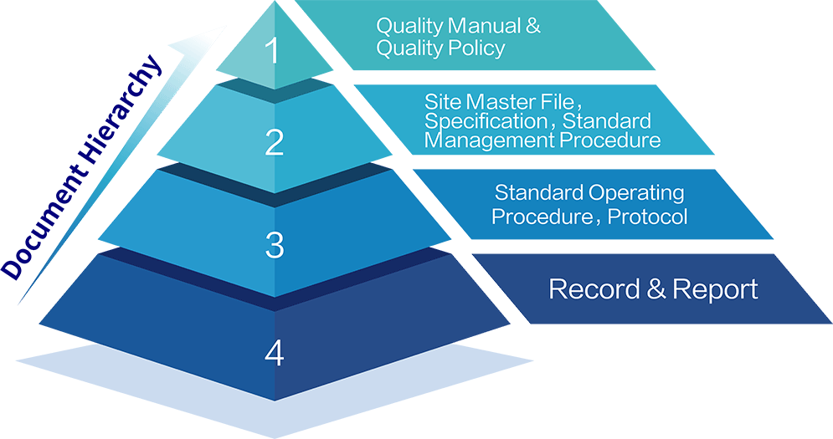
The essence of documenting the quality management system at a pharmaceutical enterprise
According to the requirements of ISO 9001:2015 Quality management systems. Requirements the organization must document its quality management system, i.e. describe in the relevant documents all the processes of the system being established.
According to ISO 9001, at the most general level, the documentation of the quality management system should include:
  documented quality policy and objectives;
  quality manual;
  documented methods and protocols required by the standard;
  documents, including protocols, that the organization has identified as necessary to ensure the effective planning, operation and control of its processes.
The structure of the quality management system documentation is hierarchical.

Slide 4

Typical levels of quality management system documentation
First-level quality management system document: Quality manual
Quality manual is a conceptual document describing the quality management system. This document reflects all activities of the pharmaceutical company that affect the quality of products.
The quality manual may include the quality policy and objectives (but they may be in a separate document).
The quality policy should contain commitments to meet the requirements and continuously improve the performance of the quality management system.
Quality objectives are formed on the basis of the organization’s quality policy and must be achievable.

Slide 5
Second-level quality management system documents: Process execution methodologies (Documented procedures)
Process execution methodologies describe the interrelated processes and activities necessary for implementing the quality management system, specifically detailing the execution of activities at the level of each individual process. Second-level methodologies may include graphical representations of activities in the form of flowcharts, which visually demonstrate the process flow, the order of interaction of internal subprocesses (operations), and the connections between them. They should contain references to accompanying documentation, define conditions for measurements, monitoring, and analysis of the process, include criteria for its effectiveness, references to reporting forms, and provide a detailed description of the distribution of responsibilities and authorities within the process, among other things. Process execution methodologies are usually developed by process owners (managers), coordinated among managers of all other processes within the quality management system, and approved by top management.

Slide 6
Third-level quality management system documents
The third level logically consists of specific instructions describing the algorithms for performing individual types of work (operations) within the quality management system processes, as well as documents containing requirements for the characteristics of raw materials, materials, equipment, facilities, products, personnel, etc. Such documents in a pharmaceutical company include:
standard operating procedures (SOPs),
work, technological, job-specific, and any other instructions,
specifications,
standards,
technical conditions,
analytical normative documentation, and more.
According to ISO 10013:2021 Quality management systems. Guidance for documented information, work instructions are detailed descriptions of how to perform tasks and record results. Work instructions can include detailed written descriptions, job sequence charts, templates, equipment operating instructions, drawings, or a combination of these.
The third level is the most numerous. Usually, such documents should be developed by individuals responsible for performing the described operation, and coordinated and verified by employees from standardization, quality management departments, and so on.

Slide 7
Fourth-level quality management system documents
This level may consist of record forms (protocols) that need to be maintained during or after the execution of processes and operations at various levels. Within the quality management system, protocols document the parameters of work execution and/or contain the characteristics of their results (e.g., test protocols, analysis reports, inspection records, validation and qualification work records, process control charts, product research results, system operation reports, etc.). These specific documents are necessary to confirm the proper execution of certain operations and processes and also provide information for their monitoring and analysis.

Slide 8
"Inter-process" documentsє
"Inter-process" documents can include provisions, internal standards, regulations, methodologies, and others that establish policies or general rules for performing certain tasks throughout the organization (e.g., "Rules for Documenting the Quality Management System"). These documents are not appropriately classified under any specific process, nor is it practical to create a separate process for the activities they regulate.
Quality management system documentation can be on any medium, such as paper or electronic.
The sequence of developing quality management system documentation does not necessarily have to follow the documentation hierarchy. Process execution methodologies and work instructions are often developed before the final version of the quality manual is completed.

Slide 9
Formulating the document control procedure
The ISO 9001 standard requires defining criteria and methods for all processes within the quality management system, including the document control process, to ensure their effective functioning and control. The standard also mandates the monitoring, measurement, and analysis of processes, as well as taking necessary actions to achieve planned results and ensure continuous improvement.
Based on this, it is necessary to:
Regulate all stages of the document lifecycle within the quality management system of the organization: from the initiation of their development, coordination, approval, distribution, and ensuring personnel awareness of their provisions, to updating, withdrawal, replacement, archiving, and destruction.
Clearly establish the objectives and tasks of the document control process, as well as all other "process" attributes: necessary resources and actions for managing it.

Slide 10
The resources of the process are determined by the organization and usually are not a problematic issue. The outputs of the process should be systematically evaluated and analyzed to identify discrepancies, take corrective actions, and continuously improve the process, which is the responsibility of the process manager. The set of managerial actions is typically described in the corresponding process execution methodology "Document Control within the Quality Management System". It is crucial that such a process execution methodology reflects all stages of the PDCA cycle during process regulation.
Therefore, it should be acknowledged that in establishing a quality management system at a pharmaceutical company, there are quite complex issues regarding the implementation of an effective document control system that complies with ISO 9001 and all other established requirements. Optimizing document control will ultimately have a positive impact on product quality, stability, and the effectiveness of all quality management system processes.

Slide 11
Thank you for your attention!

