Slide 1

MINISTRY OF HEALTH OF UKRAINE
ODESSA NATIONAL MEDICAL UNIVERSITY
Department of organization and economics of pharmacy with post-diploma specialization
Lecture №2 Classifying and coding of goods.
Prepared by
senior teacher Oksana Stepanova

Slide 2
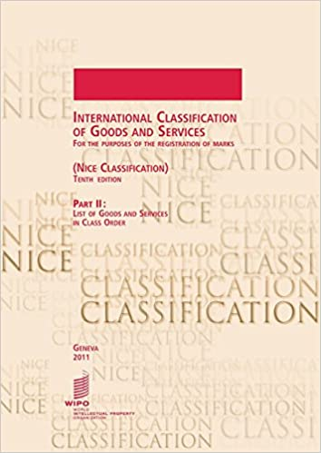
The important concept at work with the information is classification of objects.
Classification is a method of distribution of objects (subjects, the phenomena, processes, concepts) to classes according to the certain attribute. The object is understood as any subjects, processes, and the phenomenon of material or non-material property.
The system of classification allows to group objects and to allocate to the certain classes which will be characterized by a number of the common properties.
Classification of objects is a procedure of grouping at the qualitative level, directed to allocation of homogeneous properties.

Slide 3
With reference to the information as to object of classification the allocated classes are named as information objects. Properties of the information object are defined by the information parameters named essential elements.
Essential elements are represented as the numerical data, for example, weight, cost, year, or attributes, and for example, color, mark of machine, a surname.
At any classification it is desirable, that the following requirements were observed:
Completeness of scope of objects of considered area;
Un-ambiguity of essential elements
An opportunity of inclusion of new objects.
Essential element is a logically indivisible information element describing certain property of object, processes, the phenomenon, etc.

Slide 4
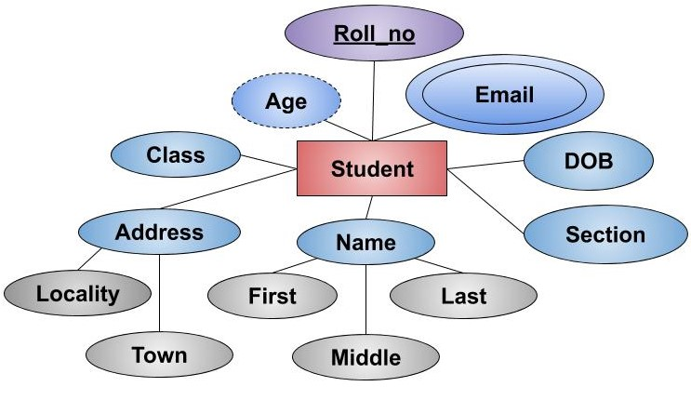
The qualifier is the systematized arch of names and codes of classification groupings.
At classification concepts a classification attribute and the value of a classification attribute which allow for establishing similarity or distinction of objects are widely used.
The approach to classification with association of these two concepts in one, is named as an attribute of classification. The attribute of classification also has a synonym, i.e. the basis of division.

Slide 5


Slide 6
Three methods of classification of objects are developed:
Hierarchical
Facet
facet is a group of headings which all define a certain method of classification. That is, a facet is a way in which a resource can be classified; for example, classified by color, classified by geography, classified by subject, etc.)
Descriptor
Descriptor system is a semi-hierarchical system with several descriptors for describing the state of goods and other objects of nature; Descriptor subsets should be selected for the study goals.

Slide 7
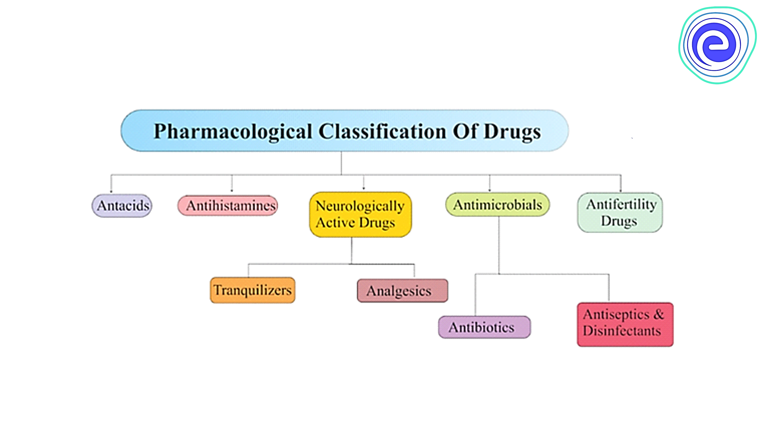

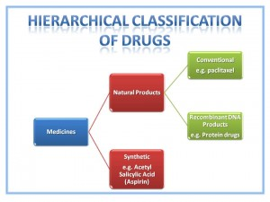
Hierarchical system of classification.
The hierarchical system of classification is created by the following method:
The initial set of elements makes 0-1 level and shares depending on the chosen classification attribute on classes (grouping) which form the 1st level.
Each class of the 1st level according to a classification attribute shares on subclasses which form the 2nd level;
Each class of the 2nd level similarly shares on groups which form the 3rd level, etc.

Slide 8
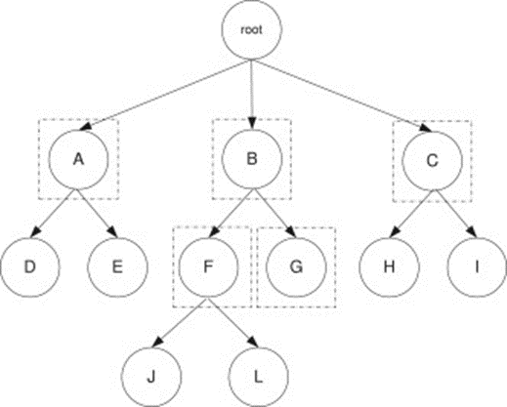
Hierarchical system of classification.
Remember –in hierarchical system of classification the special attention should be given to a choice of classification attribute.
In hierarchical system of classification each object at any level should be related to one class which is characterized by concrete value of the chosen classification attribute.

Slide 9

Advantages of hierarchical system of classification:
Simplicity of construction;
Use of independent classification attributes in various branches of hierarchical system .
Disadvantages of hierarchical system:
Rigit structure which leads to the complexity of modification as it necessary to redistribute all classification groupings;
Impossibility to group objects on beforehand not stipulated combinations of attributes

Slide 10
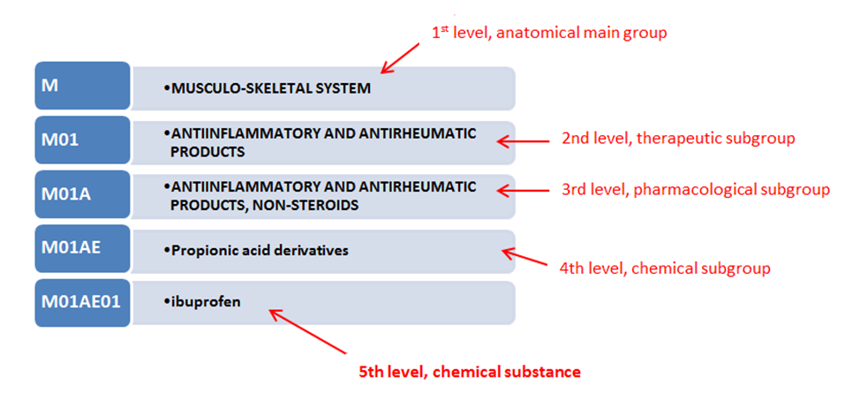
Example the hierarchical classification: Anatomical Therapeutic Chemical Classification System (ATC)

Slide 11
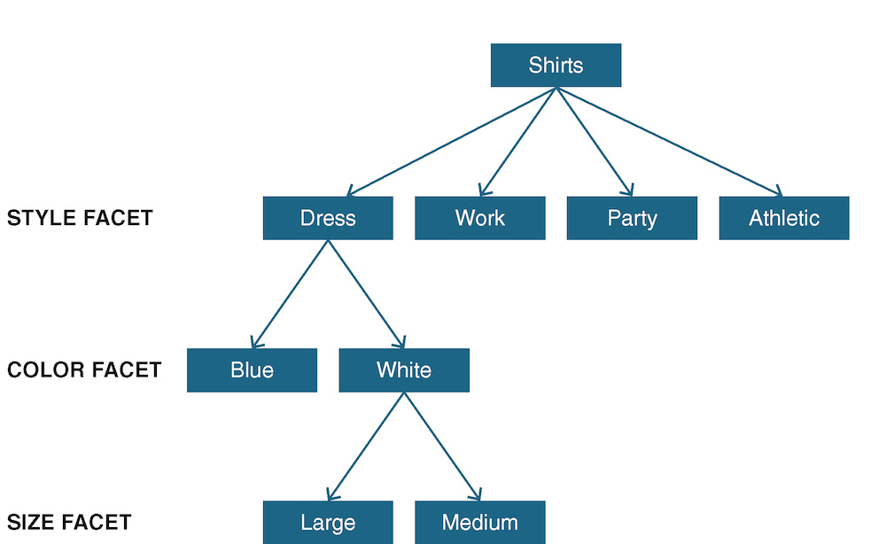
Faceted classification
Faceted classification means breaking subjects into standard component parts, or facets. Faceted method of classification is based on parallel division of subjects by classification attributes.
Faceted method of classification allows for removing or adding new classification attributes (facets), thus it posses more flexible structure.

Slide 12
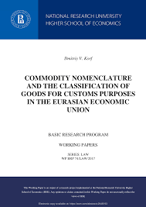
The classification of goods according to the Foreign Economic Activity Commodity Nomenclature of the Customs Union (hereinafter referred to as the FEACN of the CU) is one of the most relevant issues for participants of the foreign economic activity (hereinafter referred to as the FEA).
The accuracy of the classification of goods is of great importance for better objectivity of customs statistics of the foreign trade, used in the course of development of the customs policy of the Member States of the Customs Union, and for adoption of specific measures for its implementation during customs clearance and control of goods and vehicles.
Participants of the FEA shall determine, on their own, the code of goods crossing the customs border.

Slide 13
Criteria and rules of classification
Criteria of classification – a property or characteristic of an object (product) that forms the basis of its classification (purpose, type of material, structure, construction, manufacturing process, finishing etc.).
The classification of goods is based on criteria, such as the raw materials in use, chemical composition, application etc.
Creation of the commodity nomenclature used today in the international practice of the FEA is preceded by a long history.
For the purpose of state regulation of export and import of goods in the Customs Union, the international classifier – Foreign Economic Activity Commodity Nomenclature of the Customs Union (FEACN of the CU) – is used.
It is based on the experience in international trade and provisions of the International Convention on the Harmonized Commodity Description and Coding System.
Thus, the FEACN of the CU is based on the nomenclature of the Harmonized Commodity Description and Coding System and the Combined Nomenclature of the European Community.

Slide 14

The Harmonized Commodity Description and Coding System, also known as the Harmonized System (HS) of tariff nomenclature is an internationally standardized system of names and numbers to classify traded products.
It came into effect in 1988 and has since been developed and maintained by the World Customs Organization (WCO) (formerly the Customs Co-operation Council), an independent intergovernmental organization based in Brussels, Belgium, with over 200 member countries.
Harmonized system – a commodity nomenclature that includes commodity items and sub-items, relevant digit codes divided into groups and sections based on certain criteria, notes and fundamental rules of interpretation of the Harmonized System.
The basic principle of the Harmonized System consists in mandatory comparability of national and international data on foreign trade of any country.

Slide 15
The primary function of the Harmonized System is to act as a basis for customs tariffs worldwide.
The basic provisions of the Convention defines the following:
certain countries or groups of countries acceded thereto may, based on the Harmonized System, develop their commodity nomenclature and customs tariffs with a better level of detail of commodity sub-items in complementary structural elements in addition to a six-digit code specified in the nomenclature of the Harmonized System.
The classification scheme of the Harmonized System meets the following three conditions:
goods are divided into groups so that goods within each group have one common criterion. All parts of the classification are independent and can be subdivided;
goods can be only classified at a time based on one main criterion;
goods shall be first classified based on more general criteria, and then – based on more detailed (specific) criteria.

Slide 16
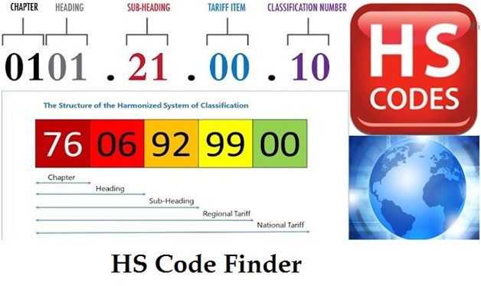
Today there are more than 170 countries that develop their customs tariffs and commodity nomenclatures based on the Harmonized Commodity Description and Coding System.
Together with creation of the nomenclature of the Harmonized System, the International Convention as to application thereof has being developed in parallel.
Thus, the Harmonized System is the first international nomenclature that takes into account the requirements of foreign trade statistics.
The commodity group includes the first two digits, the commodity item – four digits, sub-item – six digits and sub-sub-item – ten digits.

Slide 17
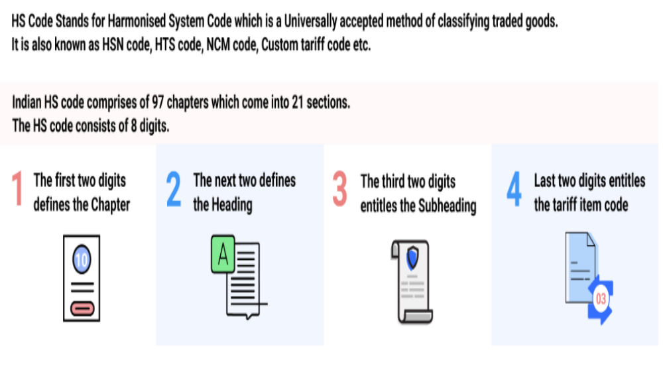

Slide 18
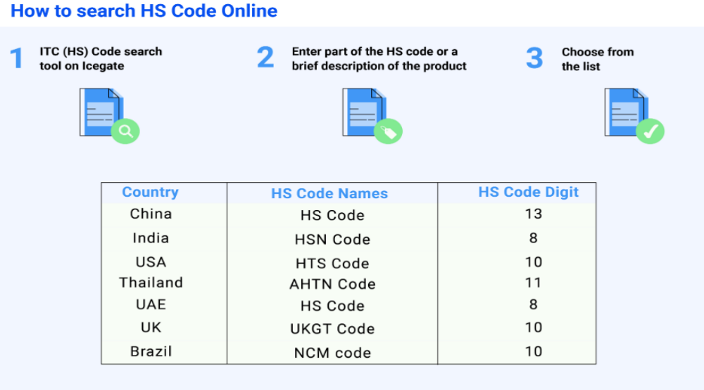

Slide 19

For almost all countries, the classification of goods follows the Harmonized System (HS) of Classification.
Every product has an international 6-digit code which is used to determine the product’s tariff rate.
Countries can add up to 4 additional digits. The first six digits represent the “root” of the international coding. The last four digits are “country-specific.”
The Harmonized System is a very large list, comprised of:
21 sections, divided by product or material
97 chapters (the first 2 digits of the HS number)
Each chapter is then divided into headings (the first 4 digits of the HS number)
Each heading is then divided into subheadings (6 digits)
The correct classification of an imported good is generally made by the importer and then verified by the Customs Office.

Slide 20

https://www.trade.gov/sites/default/files/2021-10/Understand_Your_Product%27s_Harmonized_System_%28HS%29_Code_Open Captioned.mp4

Slide 21

System of Coding
Common concept:
The System of Coding is applied to replacement of name of object (code) worth a view to maintain the convenient and more effective processing of the information.
System of Coding is the set of rules of a code designation of objects
Coding is the procedure of assignment to object of a code designation.
There are two groups of the methods used in system coding form:
The classification system of coding focused on carrying out the preliminary classification of object either on the basis of hierarchical system or on the basis of facet systems;
The registration system of coding which is not demanding preliminary classification of objects.

Slide 22
The code is constructed on the basis of the alphabet consisting of letters, figures and symbols.
The code is characterized by:
The length – a number of positions in a code
Structure – the order of an arrangement in a code of the symbols used for a designation of a classification attribute.
Two systems of coding are widely used:
UPC and EAN systems.
The Universal Product Code (UPC) (UPC code) is a barcode symbology that is widely used in the United States, Canada, Europe, Australia, New Zealand, and other countries for tracking trade items in stores.
UPC (technically refers to UPC-A) consists of 12 numeric digits that are uniquely assigned to each trade item.
The UPC-A and EAN-13 barcode symbol (graphic) & numbers are technical the same but are used in two different geographical areas. If you have or own a UPC you also have an EAN to use in the rest of the world. Think of them like two sides of the same coin.

Slide 23
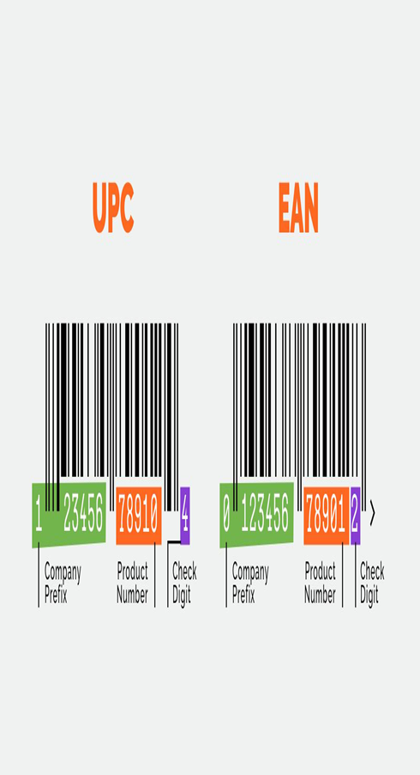
The U.P.C. stands for Universal Product Code (aka: UPC-A) and E.A.N. stands for European Article Number (aka: EAN-13 or International Article Number). The UPC was the original format for product barcodes in the 1970s. Later on, as demand in Europe, Asia and Australia grew country codes were added to the front of the barcode number increasing it to 13 digits. USA and Canada have a country code of zero which is not printed under the barcode nor is it entered in US and Canadian Inventory Point of Sale systems.
If you look at the graphic above with the EAN barcode and UPC barcode side by side, you will see they are exactly the same. The width of the bars and the width of the spaces between the bars are exactly the same. The only major difference is the placement of the numbers below (human readable numbers) which are there only as a back-up in case the barcode doesn’t scan properly and the information has to be manually entered into the register, POS (point of sale system).

Slide 24
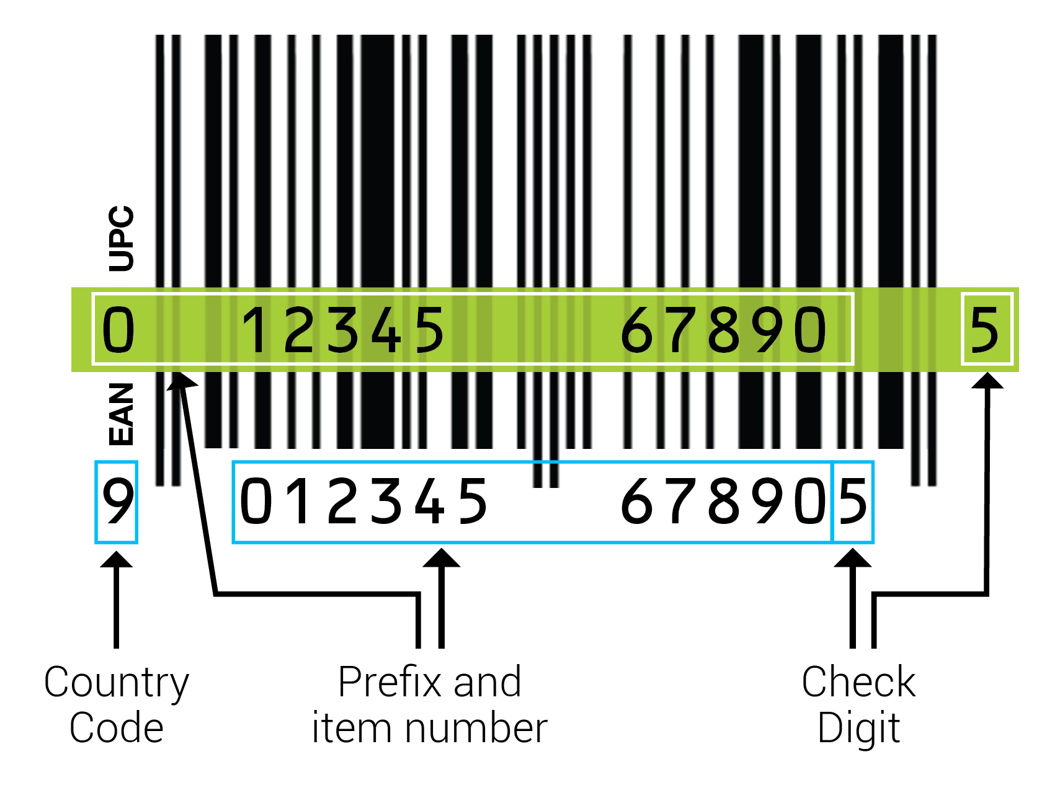
The European Article Number (also known as EAN) is a Global Trade Item Number standard describing a barcode symbology and numbering system. It's used in global trade to identify a specific retail product type, from a specific manufacturer.
EAN-13 Standard Used Worldwide
The most commonly used EAN standard is the thirteen-digit EAN-13.
EAN-13 barcodes are actually 12-digit UPC codes with prepended digit 0. European Article Numbers can also be used as numbers for other purposes such as wholesale ordering or accounting.

Slide 25
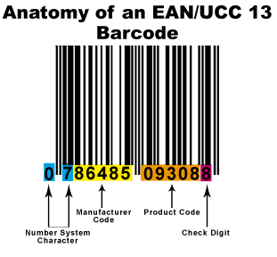
An EAN-13 bar code is divided into four areas: 1) The number system, 2) The manufacturer code, 3) the product code, and 4) the check digit.
Normally the first number system digit is printed just to the left of the bar code, the second number system digit is printed as the first character of the group of six numbers on the left-hand side below the bar code, the manufacturer code is the next five digits on the left-hand side below the bar code, the product code product code is the first five digits on the right-hand side below the bar code, and the check digit is the last digit on the right-hand side below the bar code.

Slide 26
Check Digit:
The check digit is an additional digit used to verify that a bar code has been scanned correctly.
Since a scan can produce incorrect data due to inconsistent scanning speed, print imperfections, or a host of other problems, it is useful to verify that the rest of the data in the bar code has been correctly interpreted. The check digit is calculated based on the rest of the digits of the bar code.
Normally, if the check digit is the same as the value of the check digit based on the data that has been scanned, there is a high level of confidence that the bar code was scanned correctly.

Slide 27
The method of calculating the check digit
The steps for calculating the check digit are as follows:
Consider the right-most digit of the message to be in an "odd" position, and assign odd/even to each character moving from right to left.
Sum the digits in all odd positions, and multiply the result by 3.
Sum the digits in all even positions.
Sum the totals calculated in steps 2 and 3.
The check digit is the number which, when added to the totals calculated in step 4, result in a number evenly divisible by 10.
If the sum calculated in step 4 is evenly disivisible by 10, the check digit is "0" (not 10).

Slide 28
The method of calculating the check digit
This is easier to understand with an example.
Let's calculate the checksum digit for the bar code 0075678164125. Actually, we know the checksum digit is the last digit in the bar code, "5".
This means the "message" itself of the bar code is really 007567816412 (we just dropped the last character of the bar code). This represents a number system of "00", a manufacturer code of "75678" and a product code of "16412". Thus, we must calculate a check digit for the message 007567816412.
Barcode | 0 | 0 | 7 | 5 | 6 | 7 | 8 | 1 | 6 | 4 | 1 | 2
Position | E | O | E | O | E | O | E | O | E | O | E | O
Weighting | 1 | 3 | 1 | 3 | 1 | 3 | 1 | 3 | 1 | 3 | 1 | 3
Calculation | 0 * 1 | 0 * 3 | 7 * 1 | 5 * 3 | 6 * 1 | 7 * 3 | 8 * 1 | 1 * 3 | 6 * 1 | 4 * 3 | 1 * 1 | 2 * 3
Weighted Sum | 0 | 0 | 7 | 15 | 6 | 21 | 8 | 3 | 6 | 12 | 1 | 6

Slide 29
The method of calculating the check digit
Summing up the weighted sum for each digit, we get 0 + 0 + 7 + 15 + 6 + 21 + 8 + 3 + 6 + 12 + 1 + 6 = 85. This is the checksum value. However, there is only one checksum digit. The checksum digit is the value which must be added to the checksum value in order to make it even divisible by 10. In this case, the next number following 85 which is evenly divisible by 10 is the number 90. We must add 5 to 85 to get 90, therefore our check digit is "5". We subsequently append the original bar code message (007567816412) with our newly calculated check digit (5), to arrive at the final value of 0075678164125.
Comparing this with our original bar code, we find that our calculated check digit is in fact the same as the check digit that we found on the bar code. Our calculation, therefore, is correct.

Slide 30

The method of calculating the check digit

