Slide 1
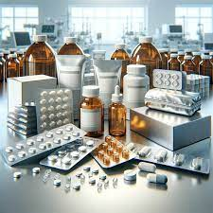

Lecture №3. Packaging, labeling of finished medicinal products. Closers. Packaging materials in pharmacy.
MINISTRY OF HEALTH OF UKRAINE
ODESSA NATIONAL MEDICAL UNIVERSITY
Department of organization and economics of pharmacy with post-diploma specialization
Prepared by senior teacher Oksana Stepanova

Slide 2
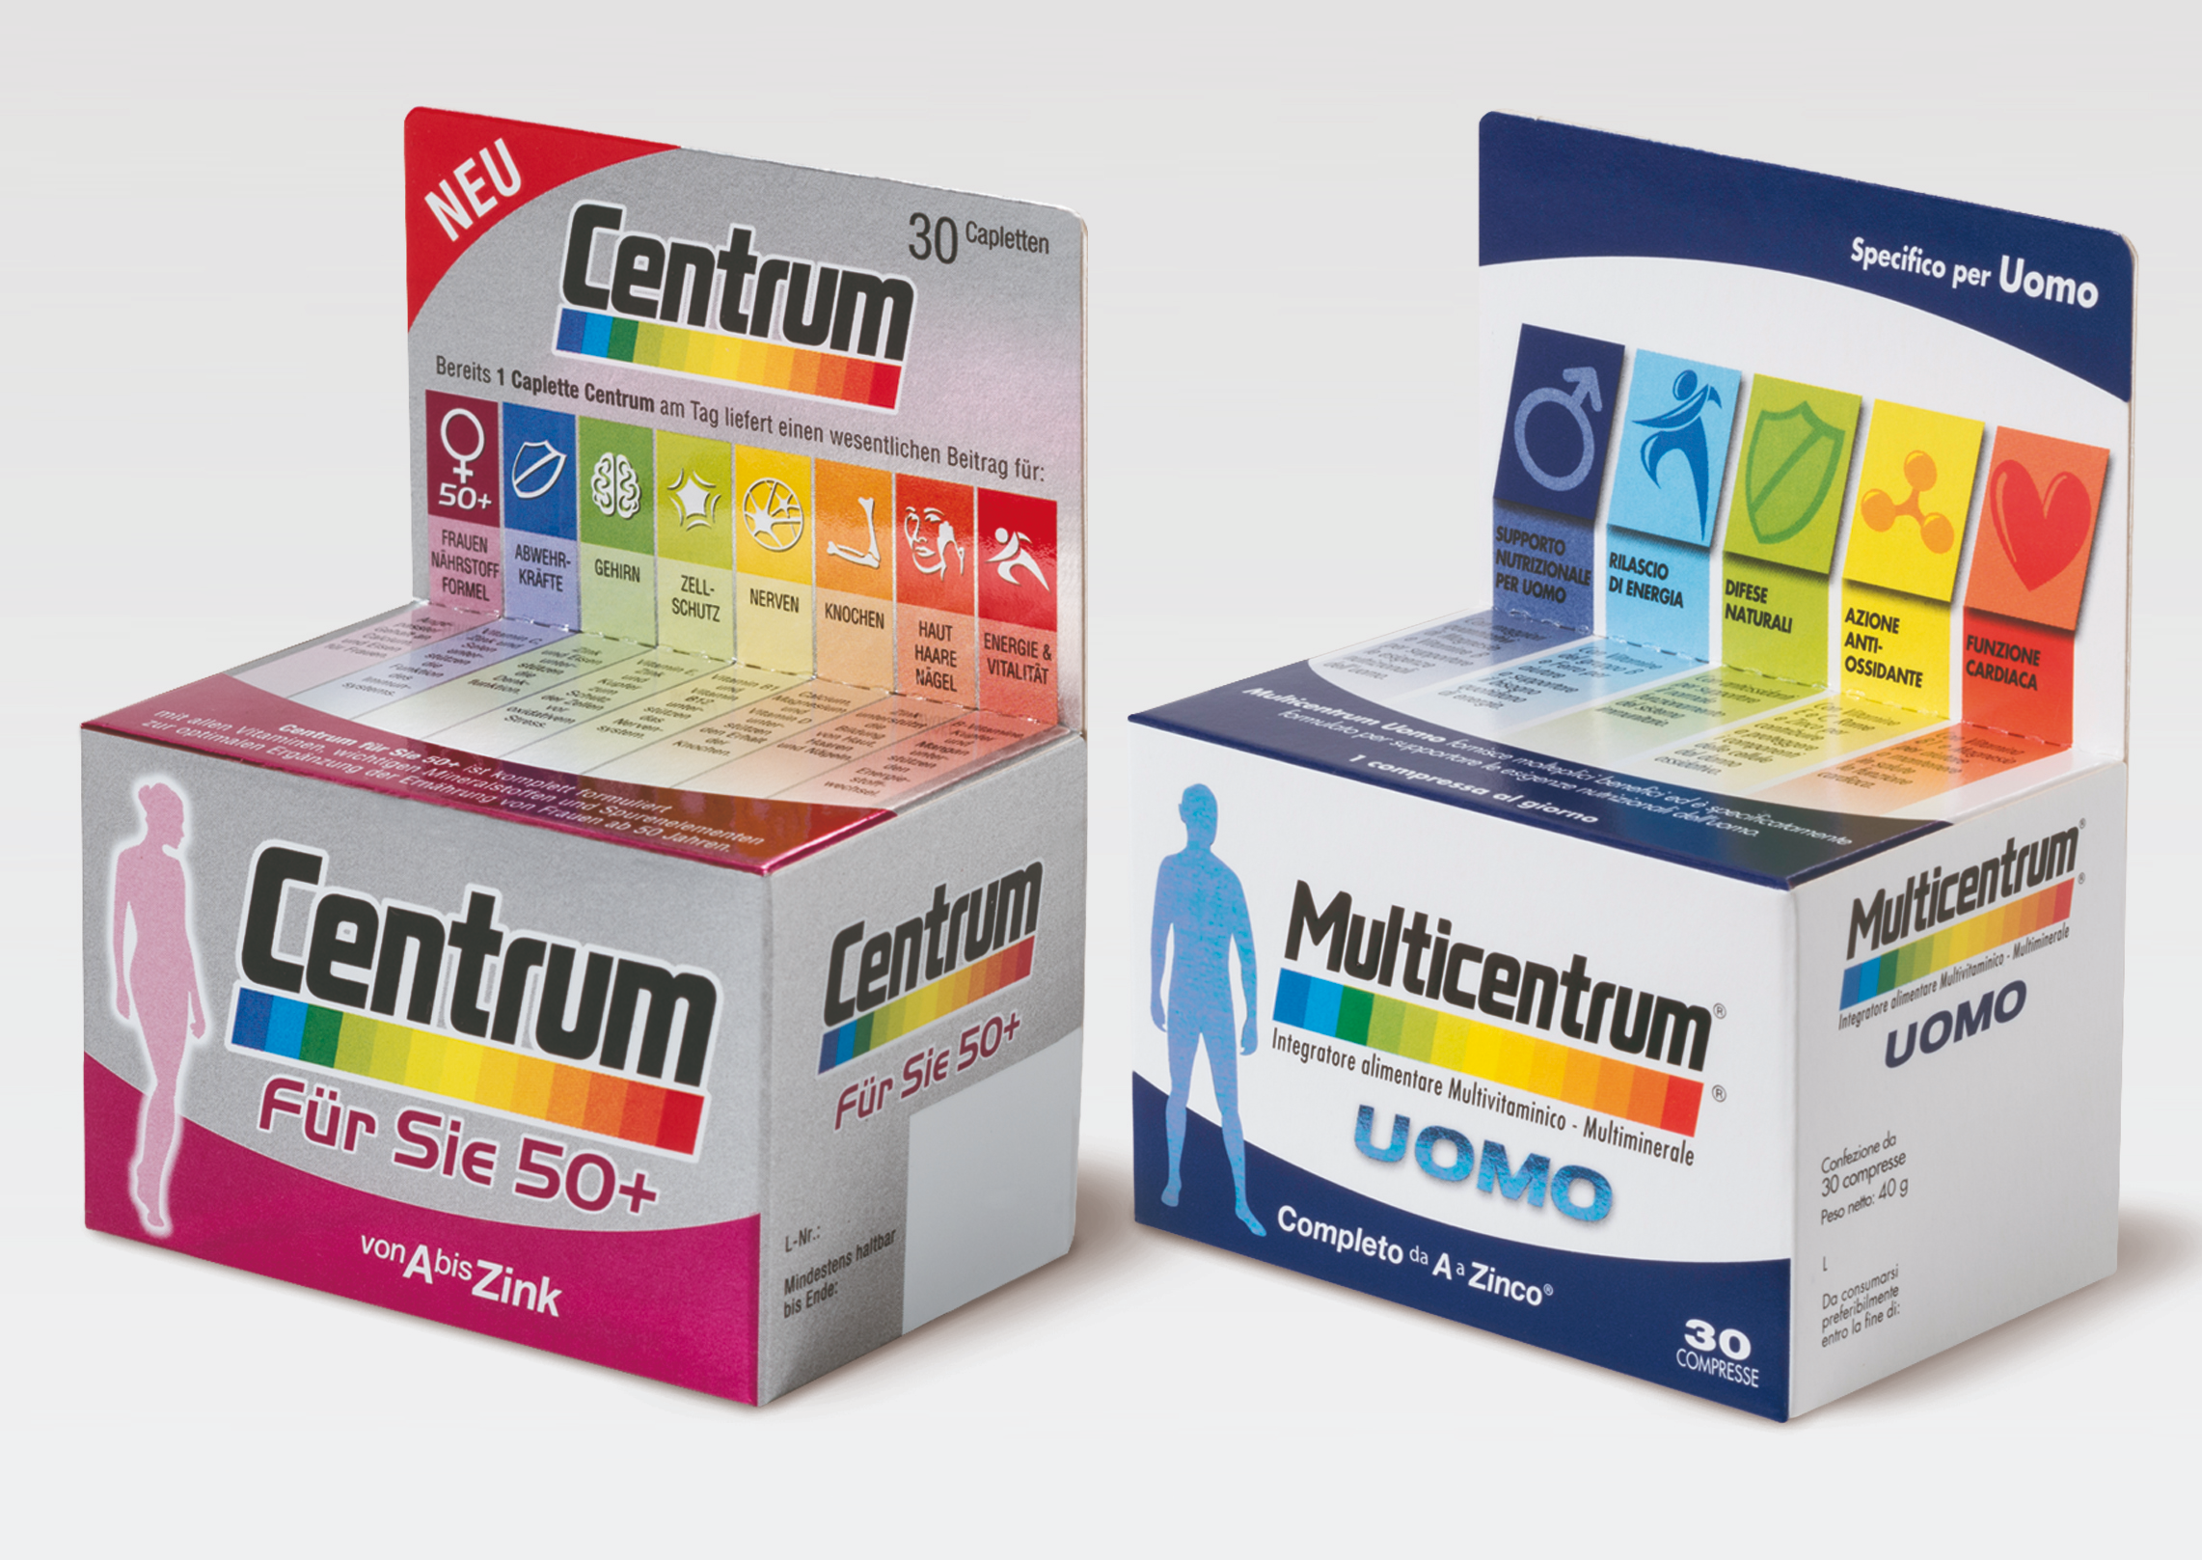
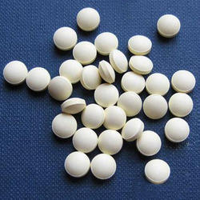
Pharmaceutical packaging (or drug packaging) is the packages and the packaging processes for pharmaceutical preparations. It involves all of the operations from production through drug distribution channels to the end consumer.
Finished Product is means a Licensed Product in a finished pharmaceutical dosage form that is suitable for commercial sale following Regulatory Approval thereof. It is the medicinal product that has undergone all stages of production, including packaging in its final container. The specifications for release of the finished product must comply with the regulations. The specifications of the finished product at manufacture may be different from those of the medicinal product at expiry.
Bulk product is any product that has completed all the processing stages up to, but not including, final packaging.

Slide 3
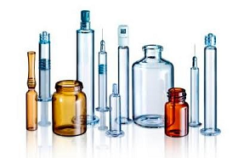
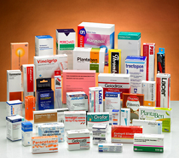
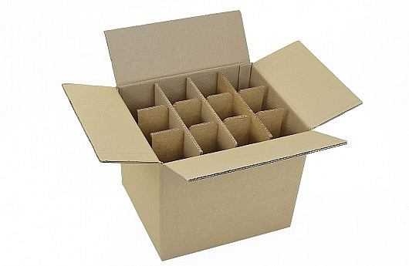
Types of packaging
Primary packaging is the packaging in direct contact with the product itself and is sometimes referred to as consumer or retail packaging. The main purpose of primary packaging is to protect and/or preserve, contain and inform the consumer. Typical containers are ampoules, vials, bottles,
Secondary packaging component means a packaging component that is not and will not be in direct contact with the dosage form (boxes…..).
Tertiary packaging facilitates the protection, handling and transportation of a series of sales units or secondary packaging in order to group everything into unit loads during transit. This type of packaging is rarely seen by the consumer.

Slide 4
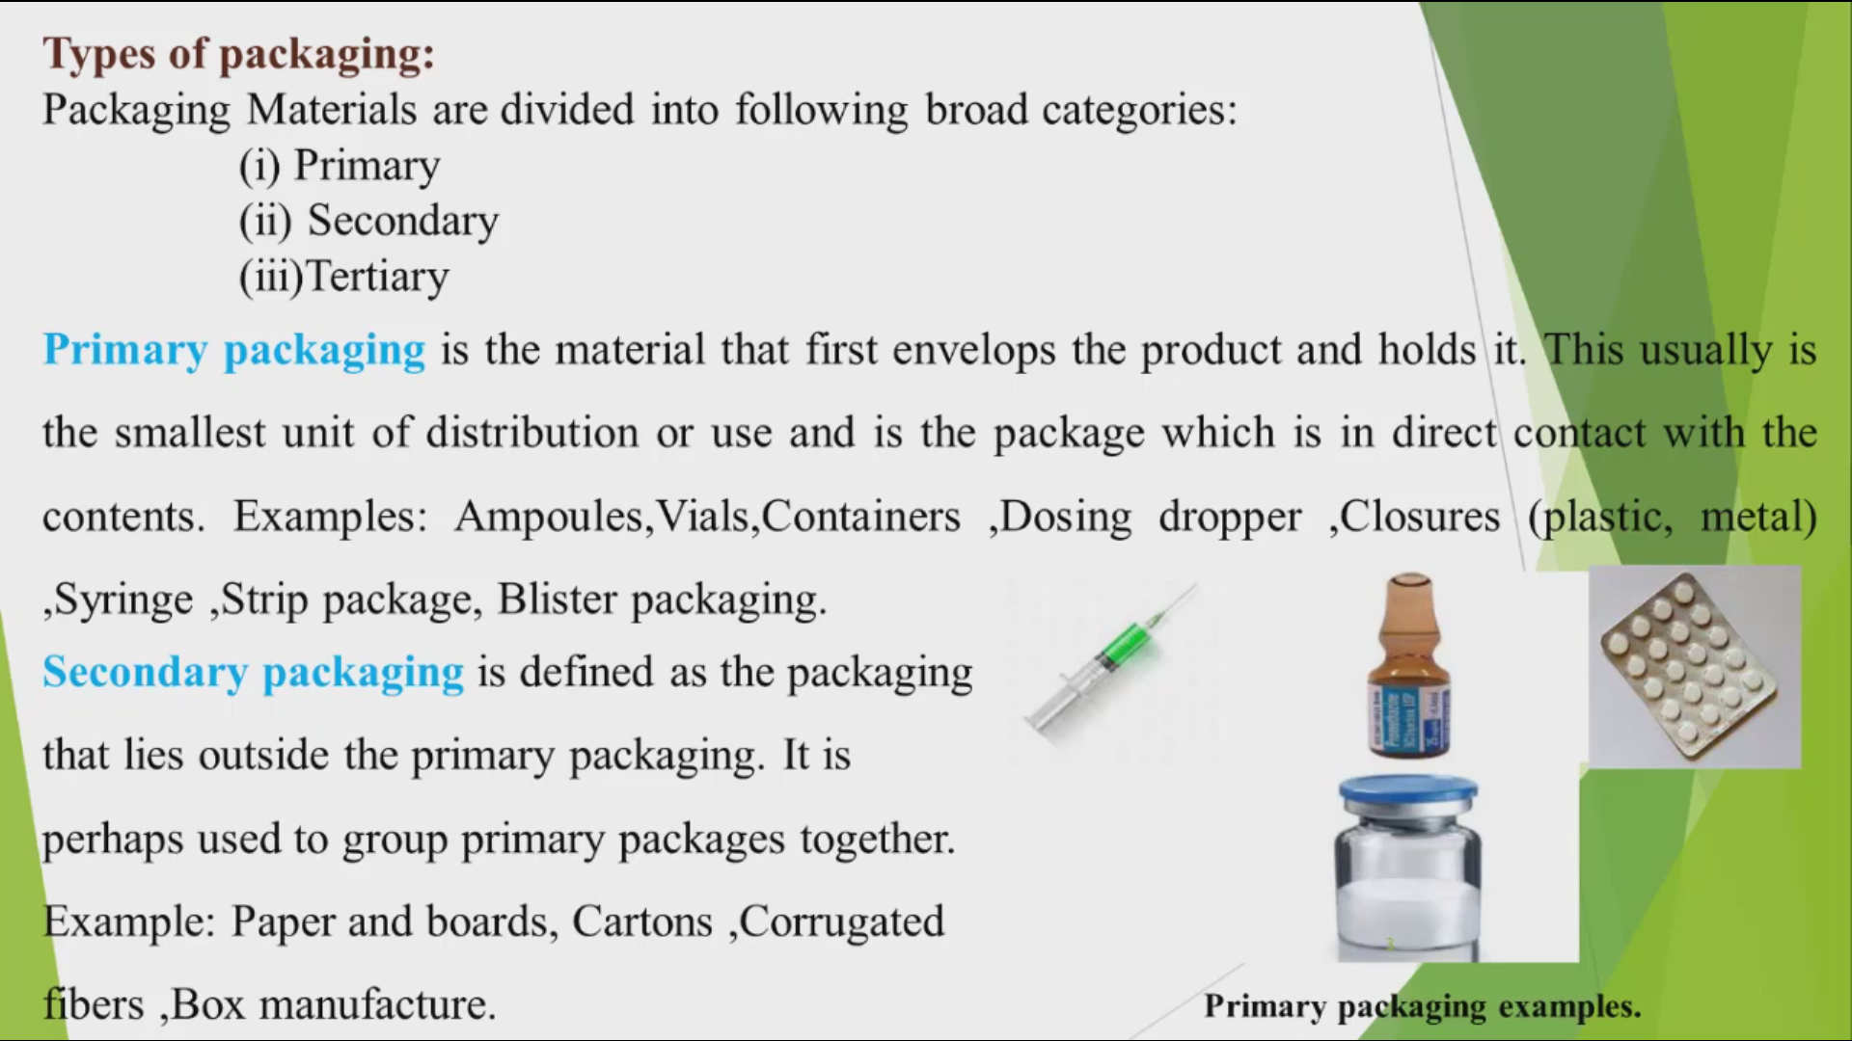

Slide 5
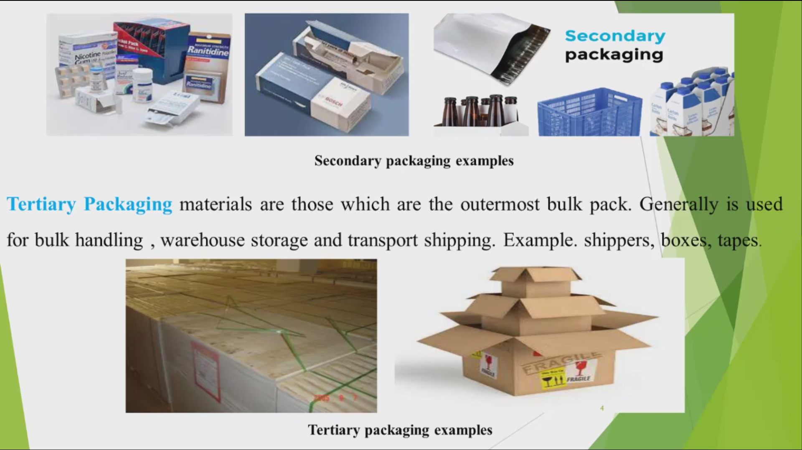
https://www.youtube.com/watch?v=Yg8-TyZd7W0
https://www.youtube.com/watch?v=bpl69Yw9H80
Automatic blister packing machine for capsule & Tablets
Blister Feeding Systems
https://www.youtube.com/watch?v=S-N3MrO3HtI
How It's Made - Pharmaceutical Blister Packs

Slide 6
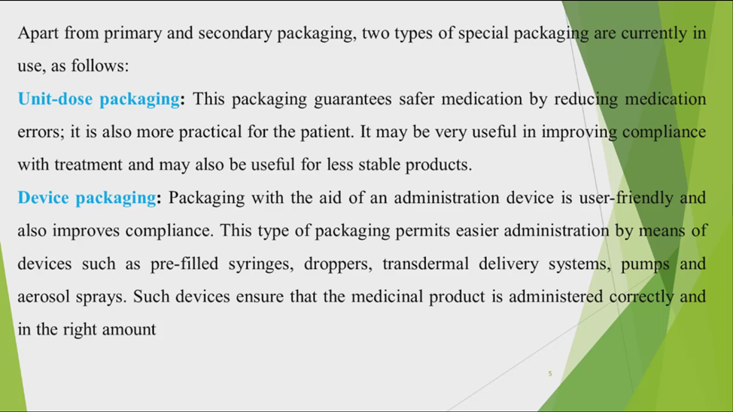

Slide 7
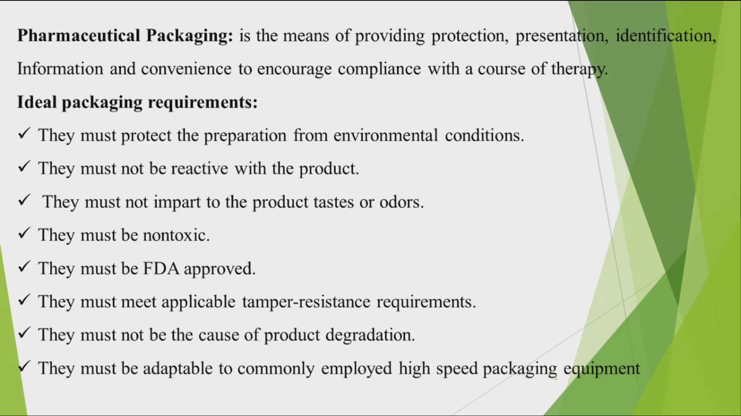

Slide 8
Functions of packaging
Containment
Protection
Presentation and information
Compliance
Protection of patients
Detection of counterfeiting
1.

Slide 9
Containment
The containment of the product is the most fundamental function of packaging for medicinal products. The design of high-quality packaging must take into account both the needs of the product and of the manufacturing and distribution system. This requires the packaging:
not to leak, nor allow diffusion and permeation of the product;
to be strong enough to hold the contents when subjected to normal handling;
not to be altered by the ingredients of the formulation in its final dosage form.
Protection
The packaging must protect the product against all adverse external influences that may affect its quality or potency, such as:
light
Moisture
oxygen
biological contamination
mechanical damage.
The compatibility of the packaging with the active pharmaceutical ingredients is very important in maintaining the integrity of the product.
https://www.youtube.com/watch?v=XjhqU5L4fG0
https://www.youtube.com/watch?v=yeKqwmuVyzE
ABB Robotics - Pharmaceutical Packing
Pharmaceutical Bottle Washing + Filling + Capping + Labeling Line

Slide 10
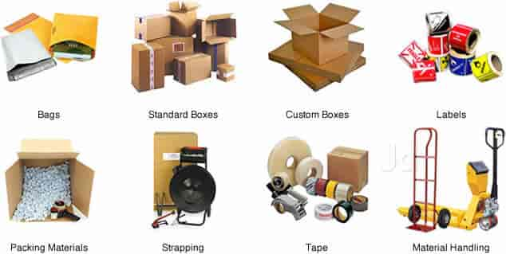
Storage. Packaging materials should be stored in accordance with GMP for storage areas. The characteristics of the active pharmaceutical ingredients will determine whether different packaging will be needed. For example, the packaging requirements of medicinal products kept at temperatures between 2 and 8°C may differ from those of products intended for tropical countries or light-sensitive products

Slide 11
Containers
A container for pharmaceutical use is an article which holds or is intended to contain and protect a drug and is or may be in direct contact with it. The closure is a part of the container
The container and its closure must not interact physically or chemically with the substance within in any way that would alter its quality. The following terms include general requirements for the permeability of containers:
Well-closed containers must protect the contents from extraneous matter or from loss of the substance under normal conditions of handling, shipment or storage.
Tightly closed containers must protect the contents from extraneous matter, from loss of the substance, and from efflorescence, deliquescence or evaporation under normal conditions of handling, shipment or storage.
Hermetically closed containers must protect the contents from extraneous matter and from loss of the substance, and be impervious to air or any other gas under normal conditions of handling, shipment or storage.

Slide 12
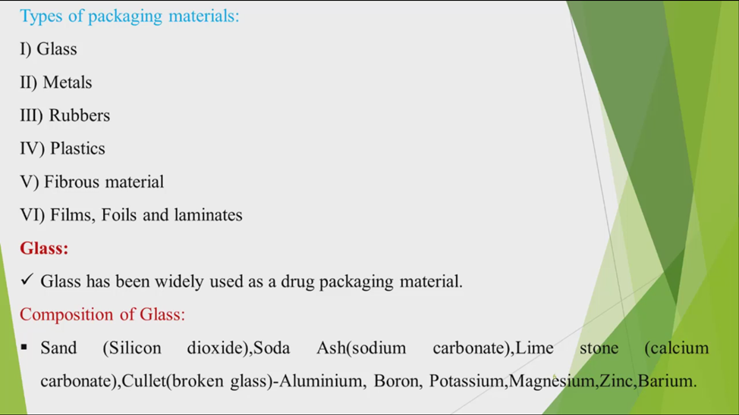
Packaging materials in pharmacy.

Slide 13
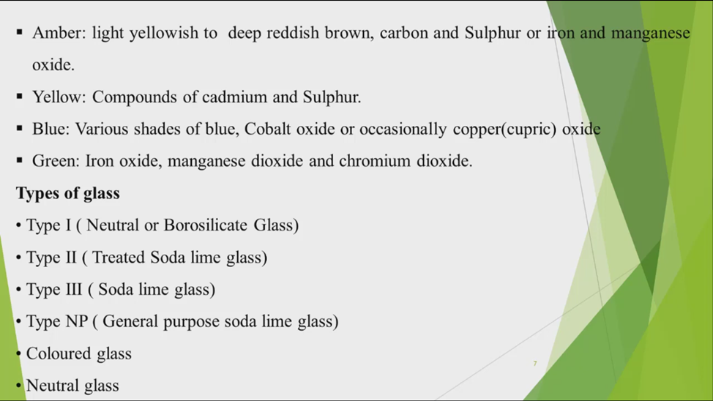

Slide 14
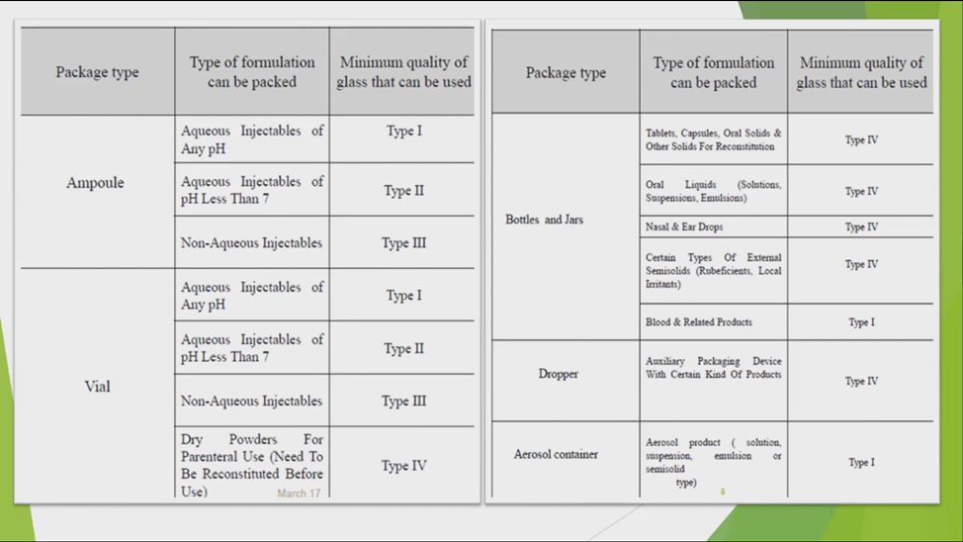

Slide 15
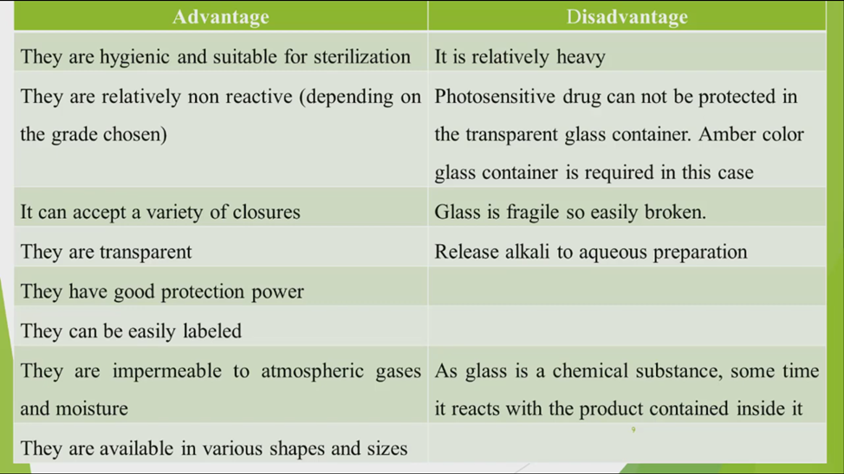

Slide 16
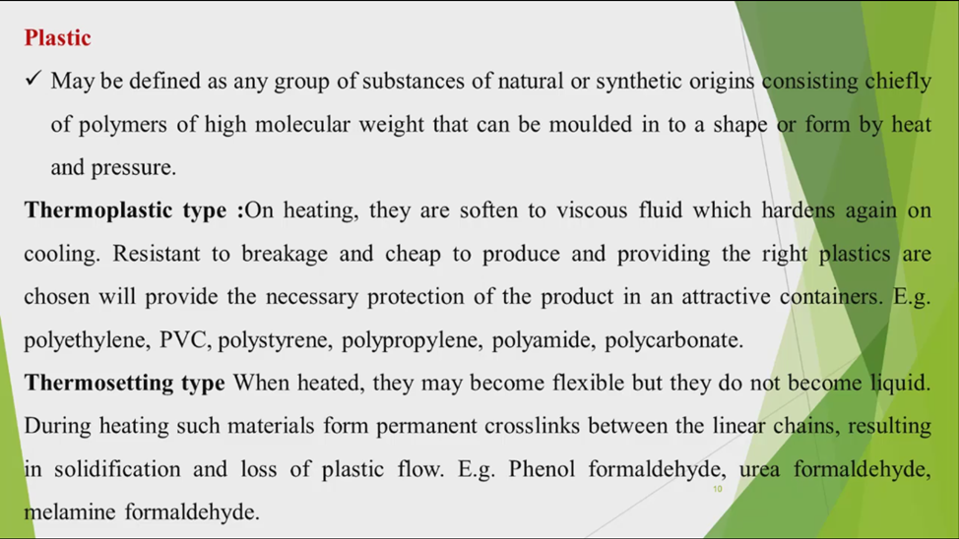

Slide 17
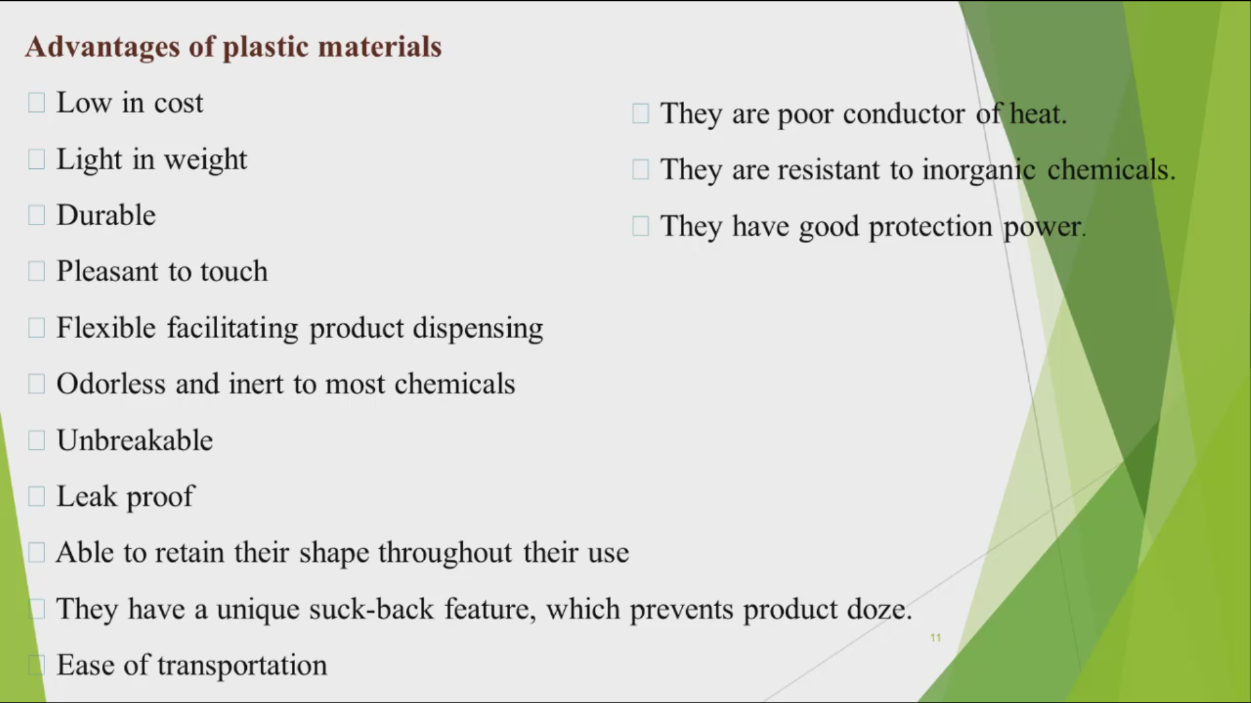

Slide 18
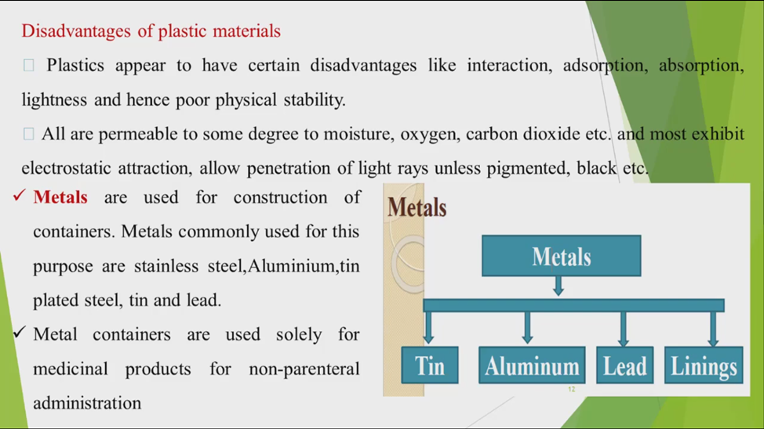

Slide 19
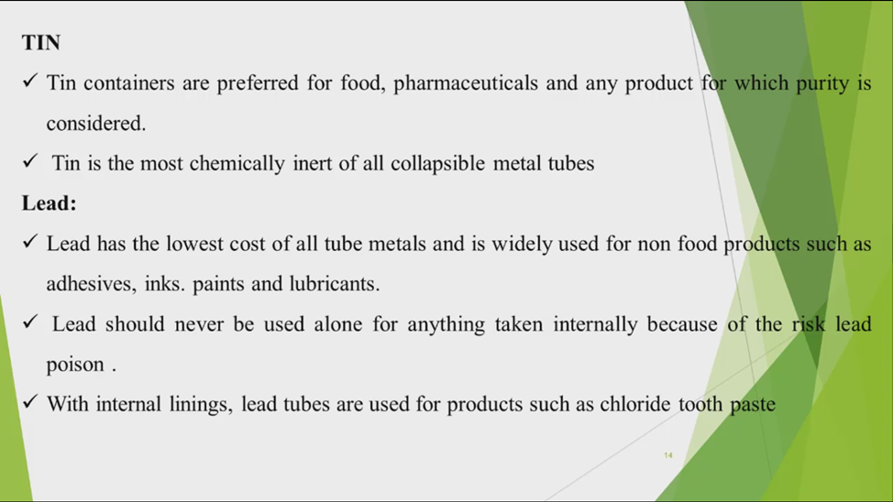

Slide 20
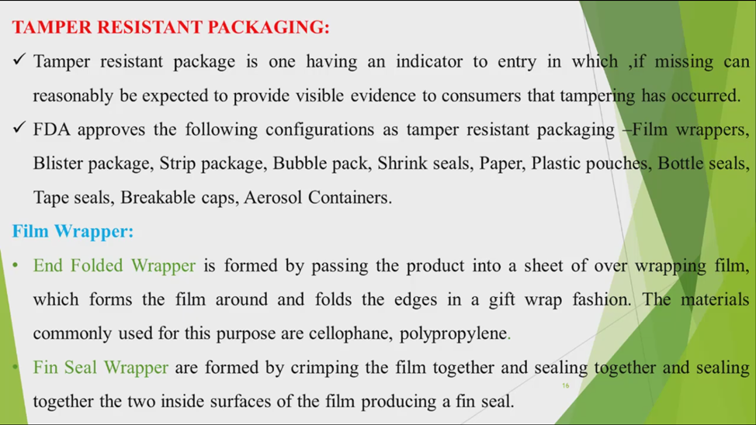

Slide 21
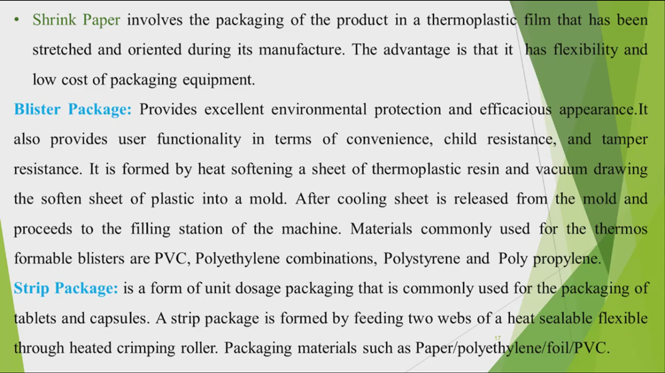

Slide 22
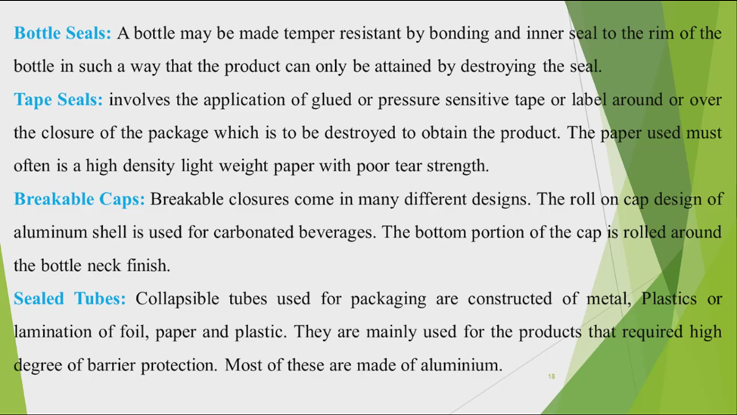

Slide 23
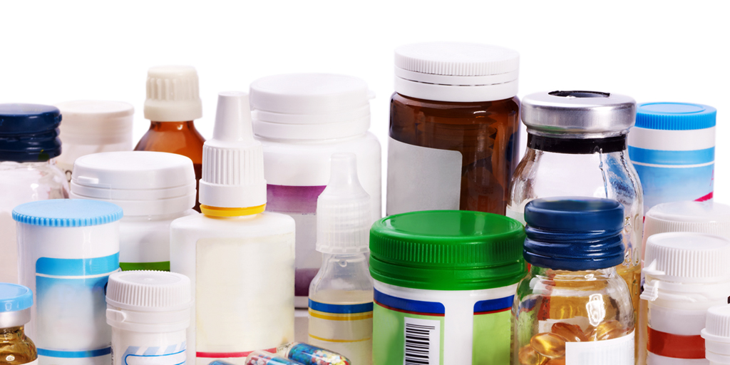
Closures
Packaging closures are an important piece of the total packaging solution. All bottles, jars and even some flexible packages require a closure to seal the contents of what is inside. Closures perform a variety of functions based on the size and contents of the container they are sealing. A closure is typically used to seal a container after the initial opening in order to preserve the product for use at a later time. Closures also assist in the dispensing of the product.
Closures are devices and techniques used to close or seal container such as a bottle, jug, jar, tube, can, etc. Closures can be a cap, cover, lid, plug, etc.

Slide 24

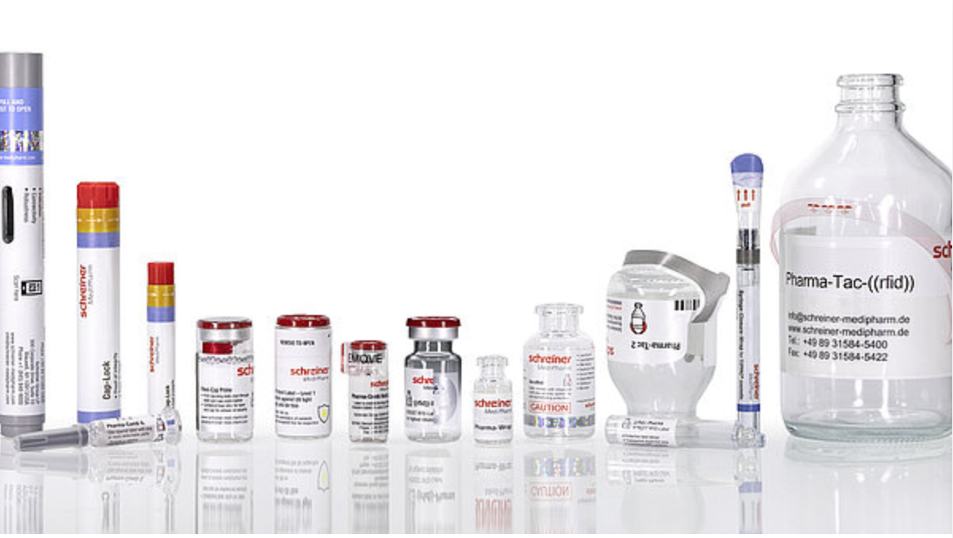
Depending on the contents and container, closures have several functions:
Keep the container closed and the contents contained for the specified shelf life until time of opening
Provide a barrier to dirt, oxygen, moisture, etc. Control of permeation is critical to many types of products: foods, chemicals, etc.
Keep the product secure from undesired premature opening
Provide a means of reclosing or reusing the container
Assist in dispensing and use of product
Allow reasonable ease to open the container by the intended user.

Slide 25
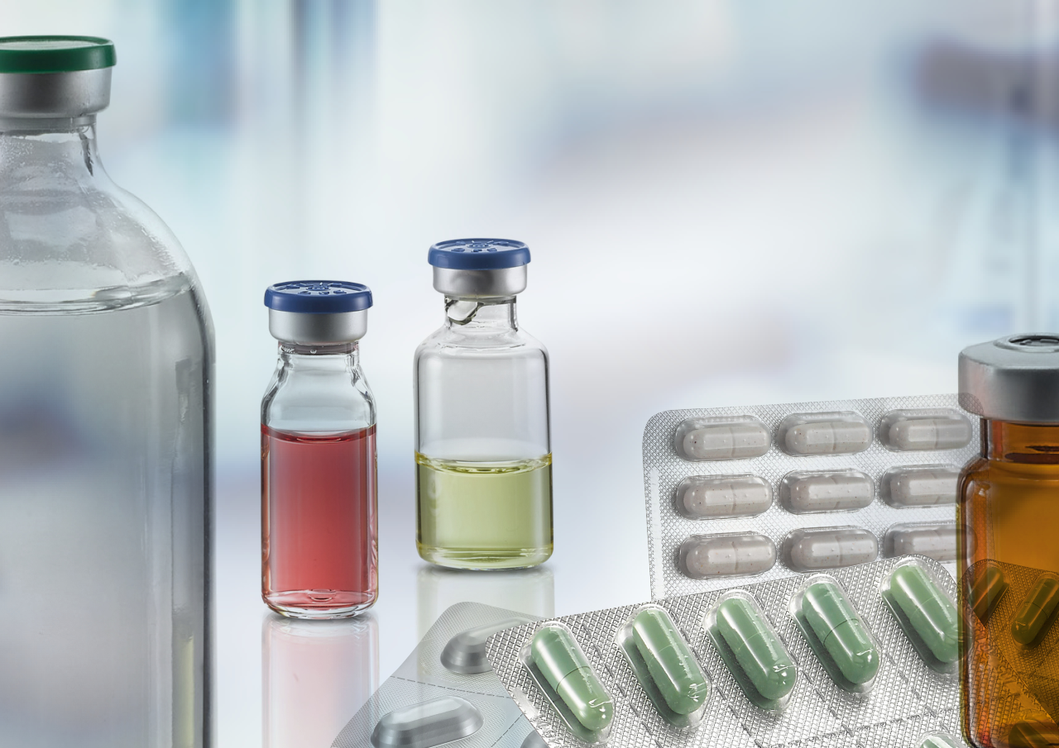
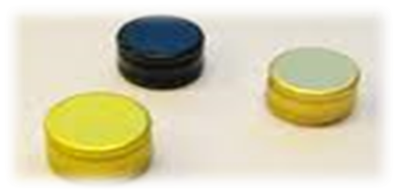
Closures used for the purpose of covering drug containers after the filling process should be as inert as possible. They should not give rise to undesired interactions between the contents and the outside environment, and should provide a complete seal. Besides their protective function, closures must also allow the easy and safe administration of the drug.

Slide 26
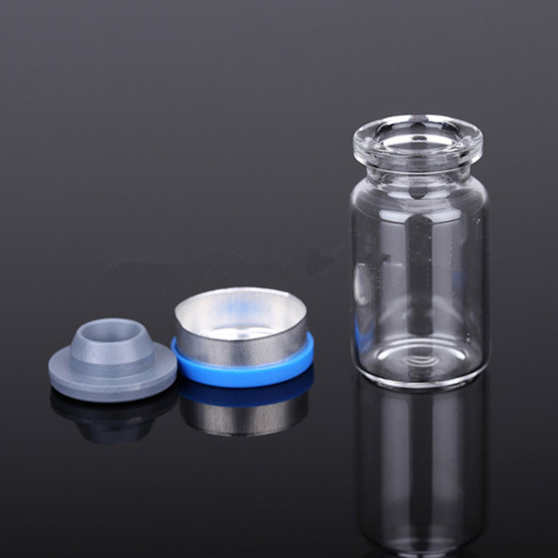
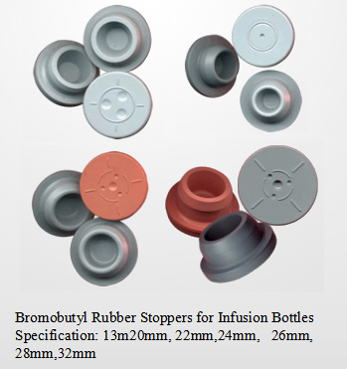


Depending on the type of container, closures may have different shapes and sizes, e.g. stoppers for infusion or injection bottles or plungers for prefilled syringes.
A special design of stopper may also be required for some pharmaceutical production processes such as lyophilization.
Closures, as primary packaging components, are of critical importance and must be carefully selected.
They are an essential component of the container and, as such, an integral part of the drug preparation.

Slide 27
Сlosures
The following types of closures are most common in the pharmaceutical industry
CT - Continuous Thread Closures: These are the most basic and commonly used packaging closure. They pair with a container that has a continuous spiral protruding on the outside of the finish or neck, as the closure itself has a thread on the inside of it. These are typically used across a number of industries including food, household items, pet products, and health & beauty.
CR or CRCs - Child Resistant Closures: These are typically used for products that are required by the Consumer Product Safety Commission to be packaged in child-resistant packaging. That means the packaging must be significantly difficult for children under five years old to open within a reasonable amount of time, while not being overly difficult for a typical adult to use properly. These are typically used for pharmaceuticals and chemical products.
TE - Tamper Evident Closures: These are used when the closure has to provide assurance that the original product is intact. These are very common in the food, beverage, and health and beauty industries. These also provide anti-counterfeiting protection for over-the-counter (OTC) pharmaceuticals and nutraceuticals.

Slide 28
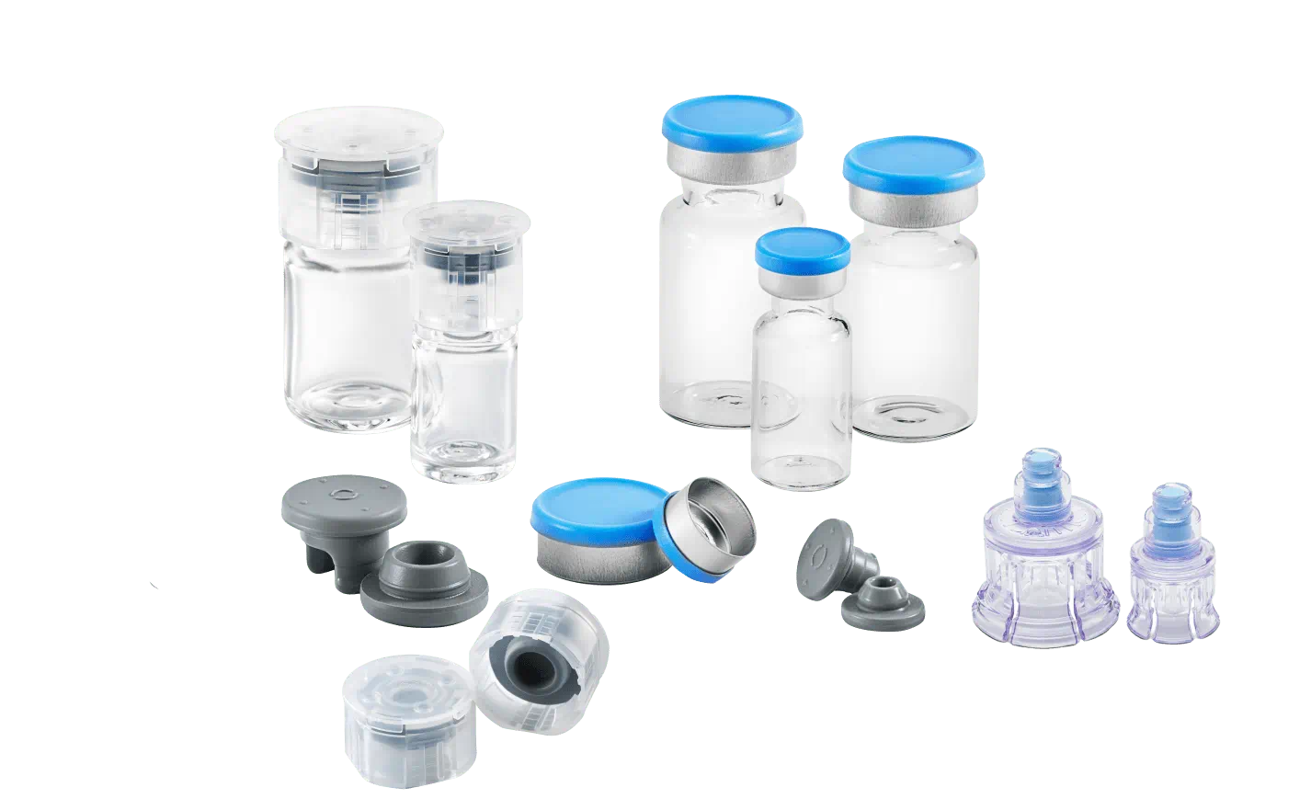
Сlosures
Closures are available in five basic designs:
Screw on, threaded or lug
Crimp on(crowns)
Press on(snap)
Roll on and
Friction

Slide 29
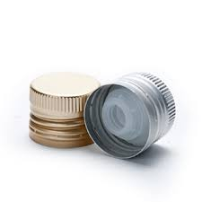
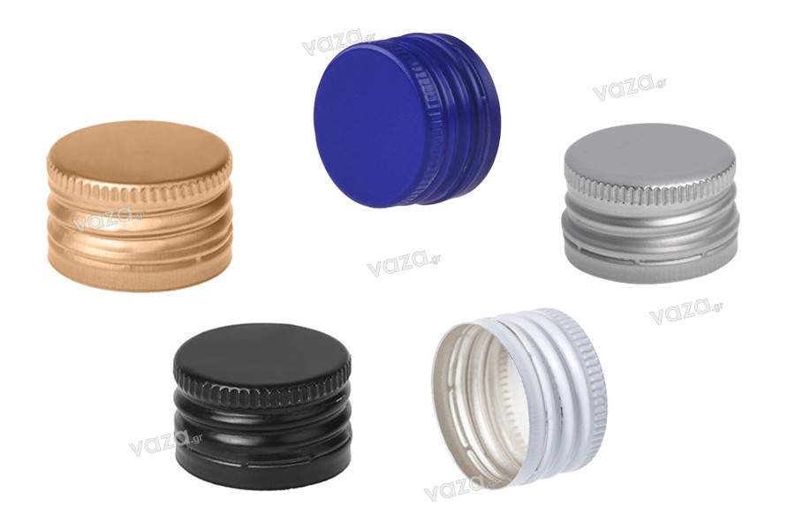
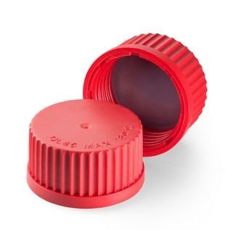
Threaded screw cap:
When a screw cap is applied, its threads engaged with the corresponding threads molded on the neck of the bottle.
The liner in the cap, pressed against the opening of the container, seals the product in the container and provide the resistance to chemical and physical reaction with the product.
The screw cap is commonly made of metal or plastics. The metal is usually tin plate or aluminum and in plastic is thermoplastic and thermosetting material.

Slide 30
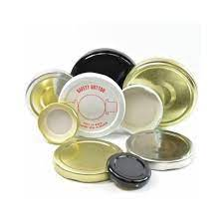
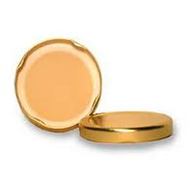
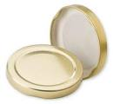
Lug cap:
The lug cap is similar to the threaded screw cap and operates on the same principle.
It is simply an interrupted thread on the glass finish, instead of a continuous thread.
Unlike the threaded closure, it requires only a quarter turn.
The lug cap is used for both normal atmosphere pressure and vacuum pressure closing.

Slide 31
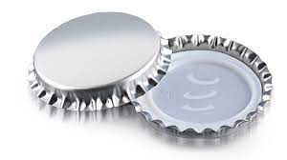

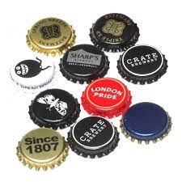
Crown caps:
This style cap is commonly used as a crimped closure for beverage bottles.

Slide 32
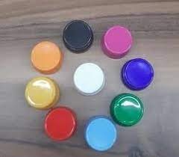
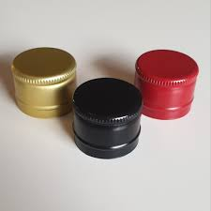
Roll-on closures
The aluminum roll on cap can be seal securely, opened easily and resealed effectively.
Resalable, non resalable and pilfer proof types of roll on closures are available for use on glass or plastic bottles.

Slide 33
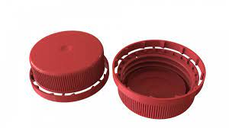
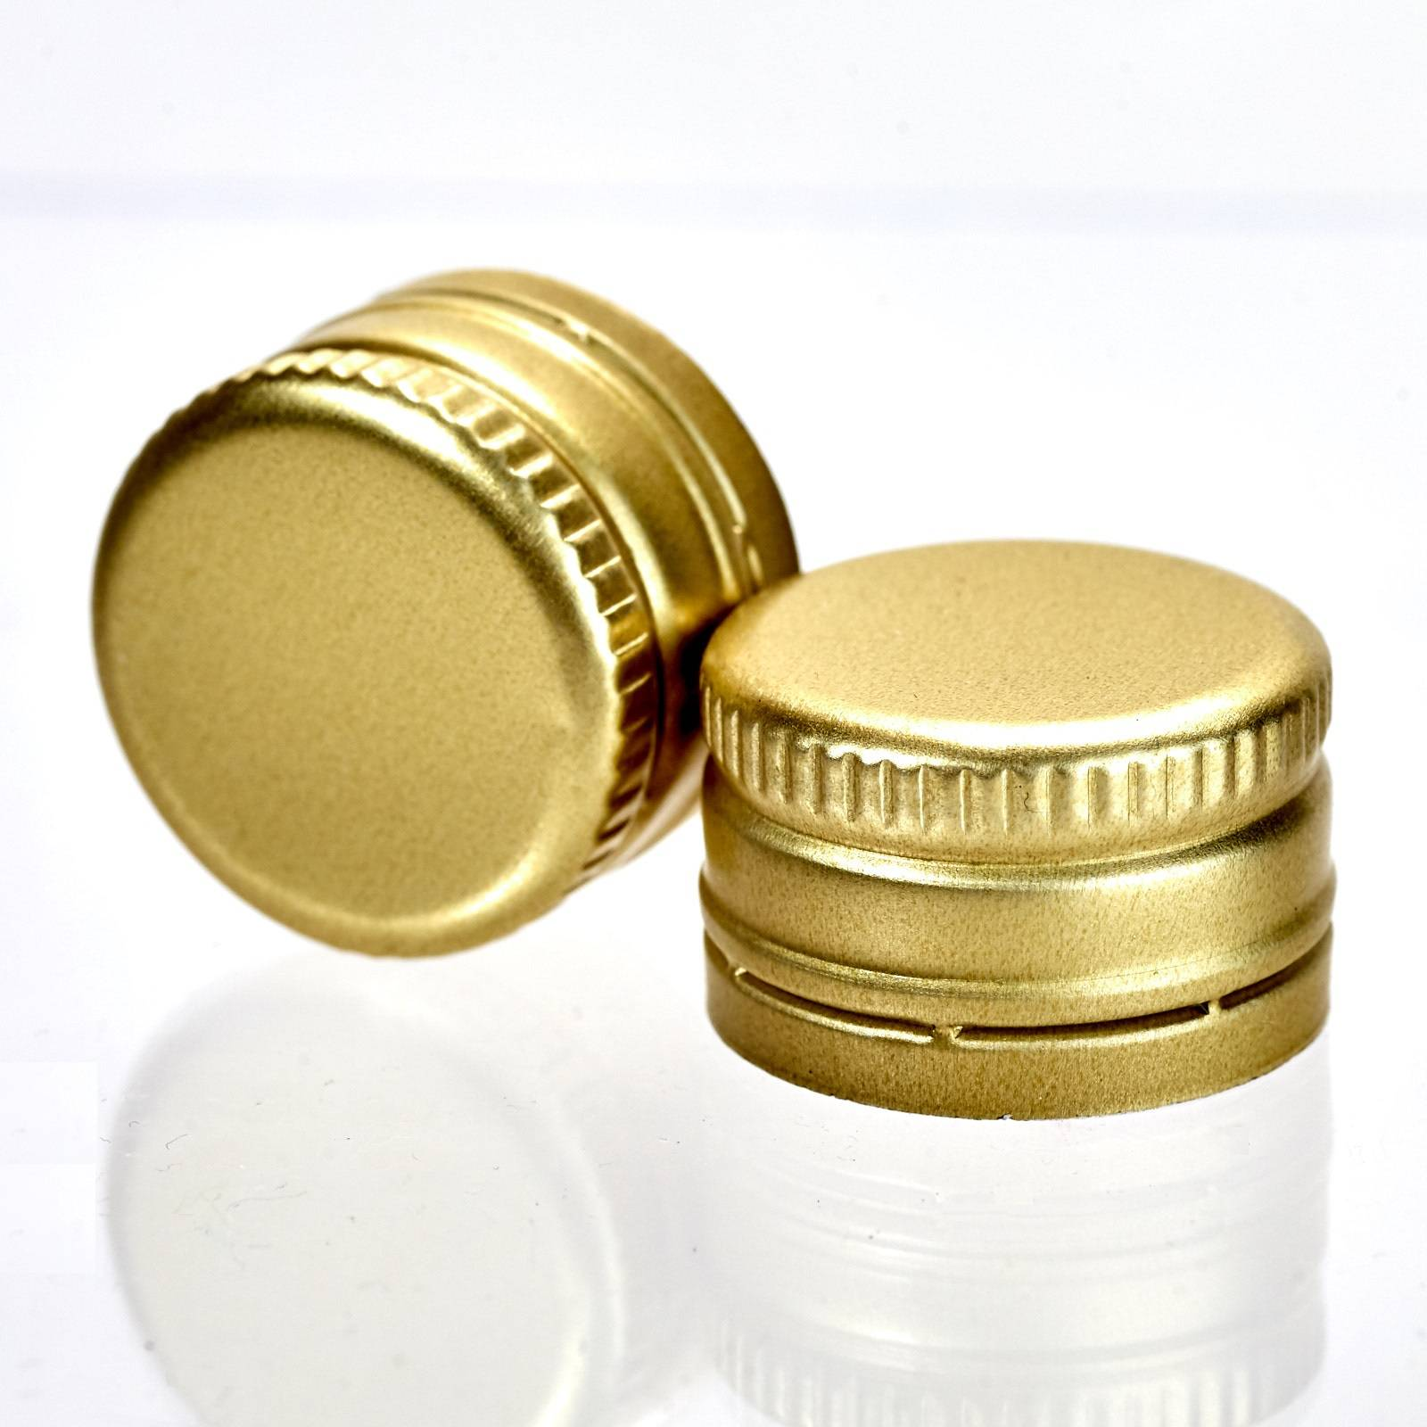
Pilfer proof closures
It is similar to roll on closure but has a greater skirt length.
This additional length extends below the threaded portion and fastened to the basic cap by the series of narrow bridges.
When the closure is removed the extra portion remains in the space on neck of the container, this indicates that the package has been opened.

Slide 34

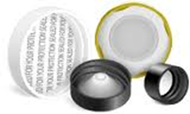
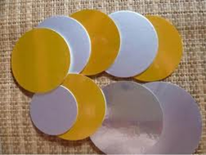
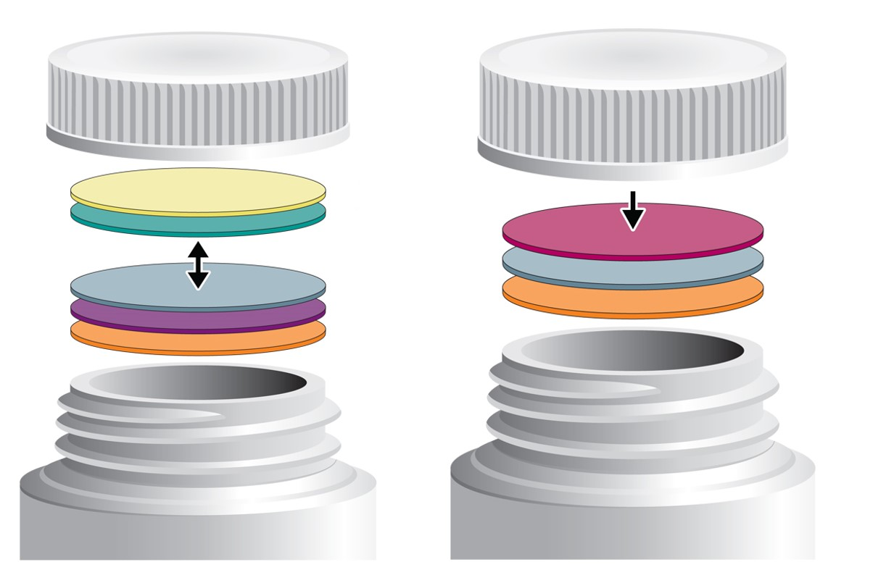
CLOSURE LINERS:
A liner may be defined as any material that inserted in a cap to effect a seal between the closure and the container.
It is of two types:
Homogeneous liner
These are one piece liners available as disk or a ring of rubber or plastic.
It can be withstand high temperature sterilization.
Heterogeneous liners
These are composed of layers of different materials chosen for specific requirements.
It consists of facing and backing. Facing is in contact with product and backing provides questioning effect.

Slide 35
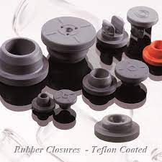
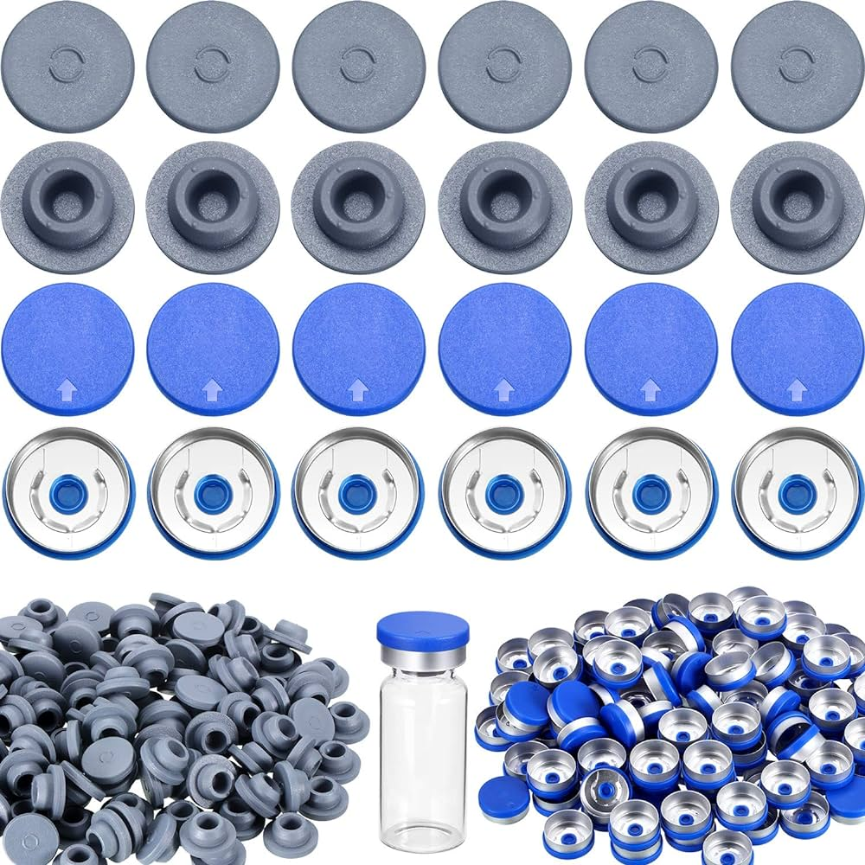
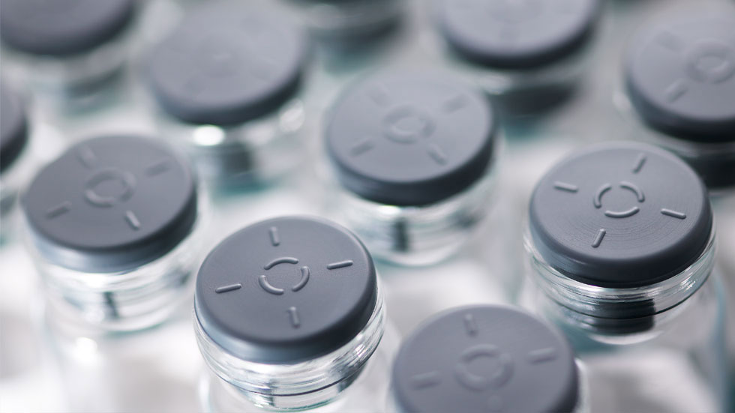
RUBBER:
Rubber is used mainly for the construction of closure meant for vials, transfusion fluid bottles, dropping bottles and as washers in many other types of product.
BUTYL RUBBER:
Advantages:
Water Permeability to water vapor .
absorption is very low.
They are relatively cheaper compared to other synthetic rubbers.
Disadvantages:
Slow decomposition takes place above 130⁰C.
Oil and solvent resistance is not very good.

Slide 36
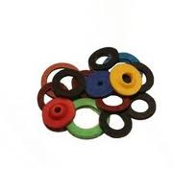
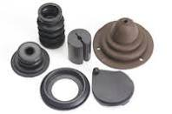

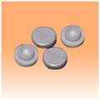
NITRILE RUBBER:
Advantages:
Oil resistant due to polar nitrile group.
Heat resistant.
Disadvantages:
Absorption of bactericide and leaching of extractives are considerable.
CHLOROPRENE RUBBERS:
Advantages:
Oil resistant.
heat stability is good.

Slide 37



TAMPER RESISTANT PACKAGING:
The requirement for tamper resistant packaging is now one of the major considerations in the development of packaging for pharmaceutical products.
Tamper resistant package is one having an indicator to entry in which, if breached or missing, can reasonably be expected to provide visible evidence to consumers that tampering has occurred.

Slide 38

The European Committee for Standardization (CEN) has defined a child-resistant package as one “which makes it difficult for young children to gain access to the contents, but which is not too difficult for adults to use properly in accordance with the requirement of this European standard”
The three most common reclosable child-resistant types of closure are the
“press–turn”,
“squeeze–turn”
combination lock.
https://www.youtube.com/watch?v=KRgWIBfPulA
4Dpro: Track and trace in pharmaceutical packaging lines | SICK AG

Slide 39
Thank you for your attention.

Slide 40

https://www.youtube.com/watch?v=S-N3MrO3HtI
How It's Made - Pharmaceutical Blister Packs
https://www.youtube.com/watch?v=yeKqwmuVyzE
ABB Robotics - Pharmaceutical Packing
https://www.youtube.com/watch?v=XjhqU5L4fG0
Pharmaceutical Bottle Washing + Filling + Capping + Labeling Line
https://www.youtube.com/watch?v=KRgWIBfPulA
https://www.youtube.com/watch?v=Yg8-TyZd7W0
Automatic blister packing machine for capsule & Tablets
https://www.youtube.com/watch?v=bpl69Yw9H80
Blister Feeding Systems
https://www.youtube.com/watch?v=KRgWIBfPulA
4Dpro: Track and trace in pharmaceutical packaging lines | SICK AG
https://www.today.com/health/child-safety-caps-do-they-really-protect-your-kids-t14111
Фильм дети

