Slide 1
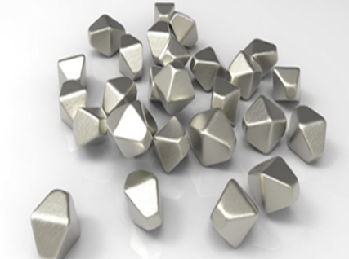
MINISTRY OF HEALTH OF UKRAINE
ODESSA NATIONAL MEDICAL UNIVERSITY
Department of Pharmacy Organization and Economics
with post-diploma specialization
Basics of materials science. Metal materials.
Prepared by senior teacher
Stepanova Oksana

Slide 2
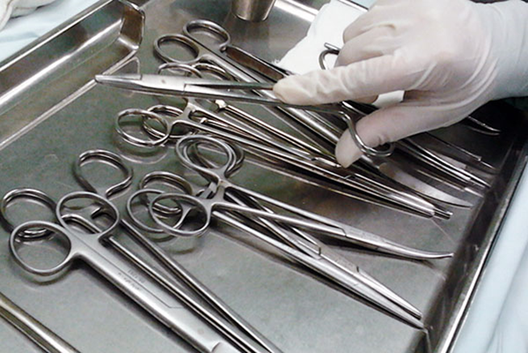
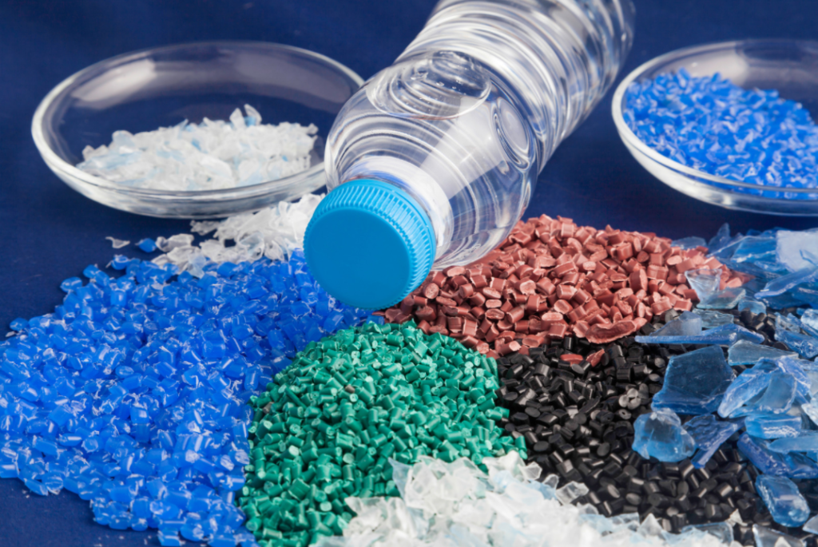
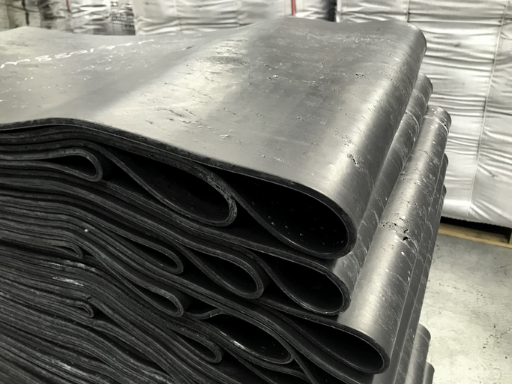
Materials science
Materials science is the science that studies the properties of materials, their origin, structure and possible changes that occur under the influence of various factors. Many materials are used to manufacture medical instruments, devices, appliances, equipment, etc:
metals and their alloys
plastic masses
rubber
glass
ceramics
leather and its substitutes;
wood, etc.
Notes:
Materials science is one of the priority areas of modern science that studies the structure, structure, properties of materials and the relationship between them, investigates the dependence of structure and properties on the methods of production and processing of materials, as well as their change under the influence of external factors: power, thermal, radiation, etc. Based on the study of the properties of materials, indicators for their most efficient and rational use are determined, and technologies for the manufacture of various products from them are developed. Therefore, knowledge of the basic information on this science, which is necessary to determine the quality indicators of materials for the manufacture of medical devices, is extremely important in the process of becoming a pharmacist. Translated with DeepL.com (free version)

Slide 3
Materials for the manufacture of medical devices must meet the following requirements:
be harmless, biologically inert and non-toxic to body tissues and not emit substances harmful to the human body;
be resistant to sterilization and disinfection;
be mechanically stable, retain a constant shape and volume;
have good technological properties (e.g., when casting, stamping and other types of processing);
be resistant to corrosion.

Slide 4
Materials science
These requirements create additional restrictions on the choice of materials. For example, many plastics cannot be used to make syringes because they deform (lose their shape) during high-temperature sterilization.
Makers of devices used in medicine and healthcare need to be careful about their choice of raw materials. Not only must the material meet the engineering requirements of the application, but it must not pose any additional risk when in contact with the human body or the many types of chemicals that are often found in a clinical environment.
Notes:
Materials science is one of the priority areas of modern science that studies the structure, structure, properties of materials and the relationship between them, investigates the dependence of structure and properties on the methods of production and processing of materials, as well as their change under the influence of external factors: power, thermal, radiation, etc. Based on the study of the properties of materials, indicators for their most efficient and rational use are determined, and technologies for the manufacture of various products from them are developed. Therefore, knowledge of the basic information on this science, which is necessary to determine the quality indicators of materials for the manufacture of medical devices, is extremely important in the process of becoming a pharmacist. Translated with DeepL.com (free version)

Slide 5
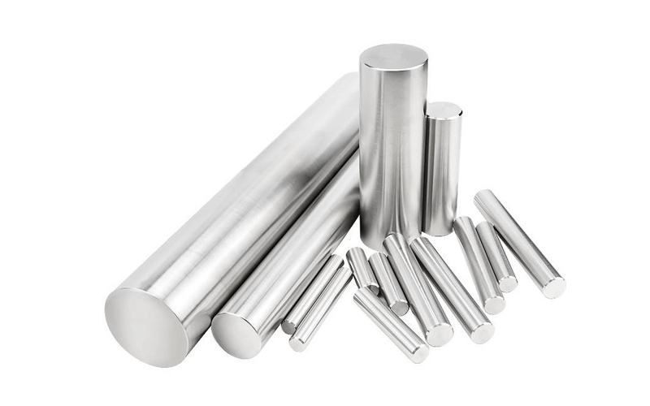
Metal materials
There are several types of pure metals and metal alloys used in medicine that have
proven their value in medicine and healthcare. We’ll explore how biocompatibility
affects metals in medicine and then look at the eleven most common types and their
use.
Notes:
Materials science is one of the priority areas of modern science that studies the structure, structure, properties of materials and the relationship between them, investigates the dependence of structure and properties on the methods of production and processing of materials, as well as their change under the influence of external factors: power, thermal, radiation, etc. Based on the study of the properties of materials, indicators for their most efficient and rational use are determined, and technologies for the manufacture of various products from them are developed. Therefore, knowledge of the basic information on this science, which is necessary to determine the quality indicators of materials for the manufacture of medical devices, is extremely important in the process of becoming a pharmacist. Translated with DeepL.com (free version)

Slide 6
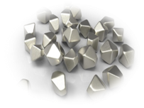
Biocompatible materials
Biocompatible materials used in a healthcare environment must meet specific criteria that most other products don’t.
For example, they may need to be non-toxic in the presence of
human tissue or fluids. Or, they might have to resist chemicals, like
cleaners and disinfectants, which are used for sterilization. And medical metals used for implants must be non-magnetic and non-corrosive in addition to being non-toxic.
New metal alloys, as well as other materials like plastic and ceramic, are constantly being evaluated for their use as biocompatible
materials. In addition, some materials may be perfectly safe for
short-term contact but not for permanent implants.
Notes:
Materials science is one of the priority areas of modern science that studies the structure, structure, properties of materials and the relationship between them, investigates the dependence of structure and properties on the methods of production and processing of materials, as well as their change under the influence of external factors: power, thermal, radiation, etc. Based on the study of the properties of materials, indicators for their most efficient and rational use are determined, and technologies for the manufacture of various products from them are developed. Therefore, knowledge of the basic information on this science, which is necessary to determine the quality indicators of materials for the manufacture of medical devices, is extremely important in the process of becoming a pharmacist. Translated with DeepL.com (free version)

Slide 7

The most common metals used for surgical
instruments are:
Stainless steel
Titanium
Tantalum
Platinum
Palladium
https://www.youtube.com/watch?v=dWhY7XHEt_Y
Why These Metals Are Used In Medical Product Design? Medical Devices
Notes:
Materials science is one of the priority areas of modern science that studies the structure, structure, properties of materials and the relationship between them, investigates the dependence of structure and properties on the methods of production and processing of materials, as well as their change under the influence of external factors: power, thermal, radiation, etc. Based on the study of the properties of materials, indicators for their most efficient and rational use are determined, and technologies for the manufacture of various products from them are developed. Therefore, knowledge of the basic information on this science, which is necessary to determine the quality indicators of materials for the manufacture of medical devices, is extremely important in the process of becoming a pharmacist. Translated with DeepL.com (free version)

Slide 8
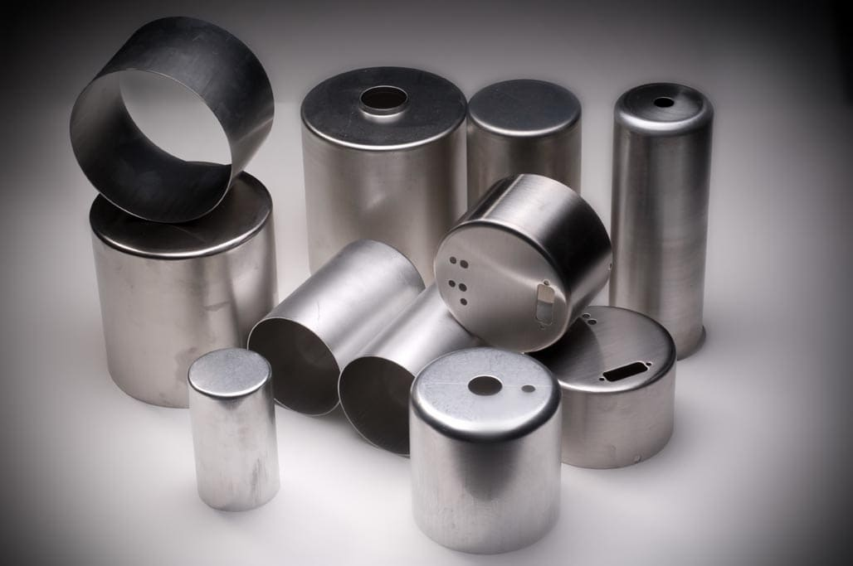
Each material has specific mechanical, chemical and technological properties.
Ductility and malleability
Ability to withstand high temperatures
Wear and tear
Resistance to corrosion
Biocompatibility
Magnetic Properties
Glare
Ergonomics
Notes:
Materials science is one of the priority areas of modern science that studies the structure, structure, properties of materials and the relationship between them, investigates the dependence of structure and properties on the methods of production and processing of materials, as well as their change under the influence of external factors: power, thermal, radiation, etc. Based on the study of the properties of materials, indicators for their most efficient and rational use are determined, and technologies for the manufacture of various products from them are developed. Therefore, knowledge of the basic information on this science, which is necessary to determine the quality indicators of materials for the manufacture of medical devices, is extremely important in the process of becoming a pharmacist. Translated with DeepL.com (free version)

Slide 9
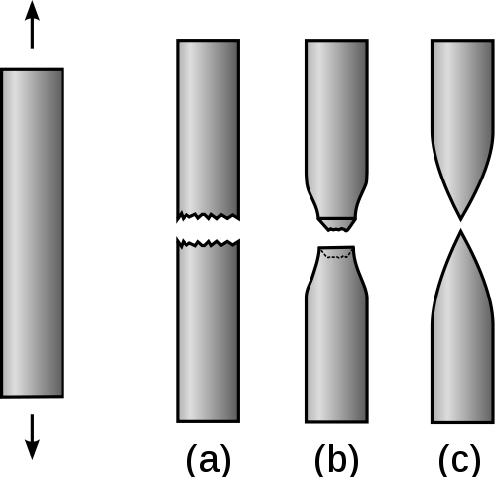

Ductility and malleability
The metal must be relatively malleable so it can be shaped without causing flaws. However, it must not be too malleable as it will need to hold its
shape once manufactured. Depending on the instrument/application, the
metal used may also need to be fairly ductile. Many surgical instruments
are long and thin, e.g. scalpels, forceps, scissors, etc. They should not breakoff during the operation. The lowest modulus required for surgical instruments is 100GPa.
Notes:
Materials science is one of the priority areas of modern science that studies the structure, structure, properties of materials and the relationship between them, investigates the dependence of structure and properties on the methods of production and processing of materials, as well as their change under the influence of external factors: power, thermal, radiation, etc. Based on the study of the properties of materials, indicators for their most efficient and rational use are determined, and technologies for the manufacture of various products from them are developed. Therefore, knowledge of the basic information on this science, which is necessary to determine the quality indicators of materials for the manufacture of medical devices, is extremely important in the process of becoming a pharmacist. Translated with DeepL.com (free version)

Slide 10

Ability to withstand high
temperatures
Surgical instruments are subjected to elevated temperatures during the sterilization process. The instruments are sterilized by scolding hot steam at a minimum of 121 degree Celsius temperature for at least 30 minutes. There should be minimum dimensional change in the instrument after repeated sterilizations.
Notes:
Materials science is one of the priority areas of modern science that studies the structure, structure, properties of materials and the relationship between them, investigates the dependence of structure and properties on the methods of production and processing of materials, as well as their change under the influence of external factors: power, thermal, radiation, etc. Based on the study of the properties of materials, indicators for their most efficient and rational use are determined, and technologies for the manufacture of various products from them are developed. Therefore, knowledge of the basic information on this science, which is necessary to determine the quality indicators of materials for the manufacture of medical devices, is extremely important in the process of becoming a pharmacist. Translated with DeepL.com (free version)

Slide 11
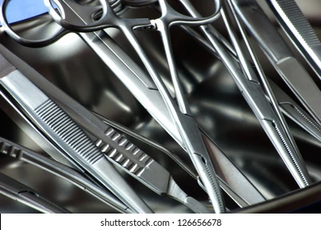
Wear and tear
Surgeons require instruments that perform correctly every time they are used. Wear and tear affects surgical instruments as after a certain
usage they will not perform as required.
For example, scissors may become blunt and not cut tissue easily.
Notes:
Materials science is one of the priority areas of modern science that studies the structure, structure, properties of materials and the relationship between them, investigates the dependence of structure and properties on the methods of production and processing of materials, as well as their change under the influence of external factors: power, thermal, radiation, etc. Based on the study of the properties of materials, indicators for their most efficient and rational use are determined, and technologies for the manufacture of various products from them are developed. Therefore, knowledge of the basic information on this science, which is necessary to determine the quality indicators of materials for the manufacture of medical devices, is extremely important in the process of becoming a pharmacist. Translated with DeepL.com (free version)

Slide 12

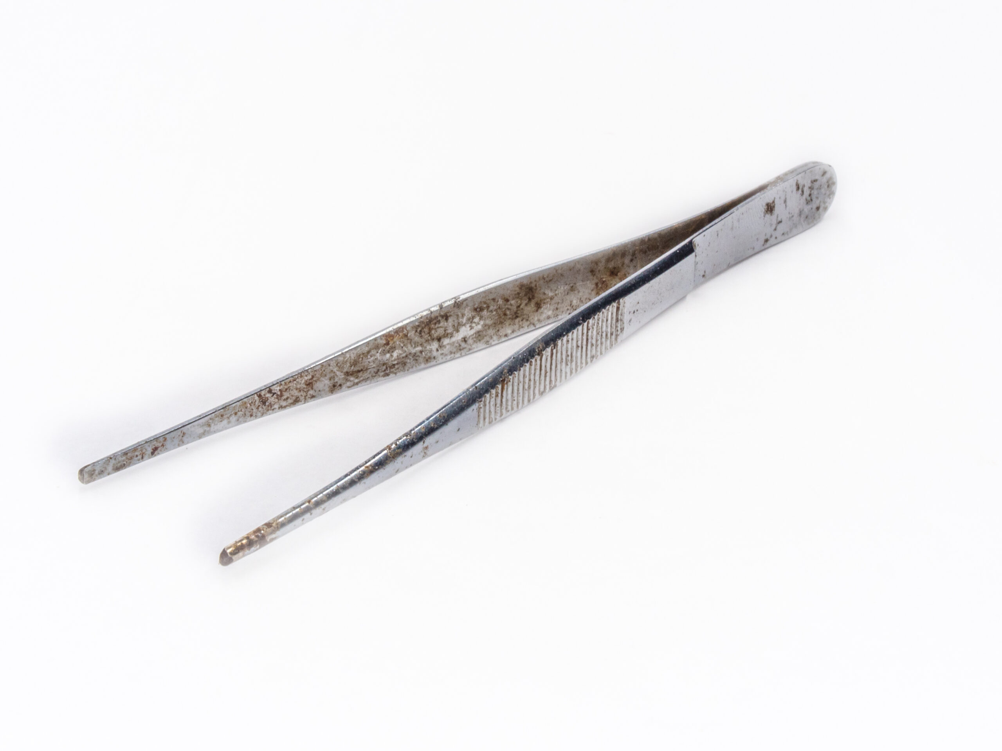
Resistance to corrosion
Surgical instruments are increasingly exposed to bodily
fluids, tap water and cleansers. Bodily fluids such as
blood or pus generally contain chloride ions, which can corrode the instruments. They are also washed under the tap water to remove bodily fluids from them.
The water may contain high concentration of minerals such
as chlorine, sodium and magnesium. These can cause severe
stains and corrosion if left to sit on the instruments.
Hospitals generally use distilled water to partly eliminate the problem.
Various cleansers are used to clean the instruments from bacteria and infections. They could be either an alkaline solution or an acidic solution with varying ph. This acidic/alkaline solution may, over time, corrode the surgical instruments.
Notes:
Materials science is one of the priority areas of modern science that studies the structure, structure, properties of materials and the relationship between them, investigates the dependence of structure and properties on the methods of production and processing of materials, as well as their change under the influence of external factors: power, thermal, radiation, etc. Based on the study of the properties of materials, indicators for their most efficient and rational use are determined, and technologies for the manufacture of various products from them are developed. Therefore, knowledge of the basic information on this science, which is necessary to determine the quality indicators of materials for the manufacture of medical devices, is extremely important in the process of becoming a pharmacist. Translated with DeepL.com (free version)

Slide 13
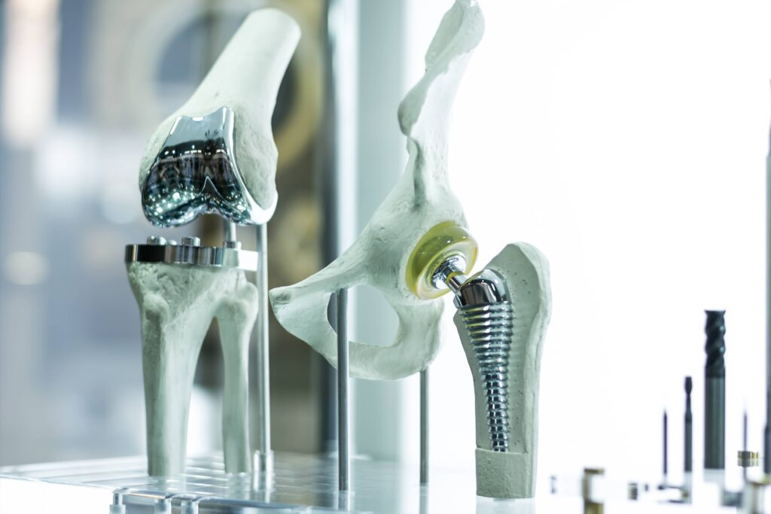
Biocompatibility
In simple terms, biocompatibility is a material’s compatibility with living tissue. Biocompatible materials do not produce a toxic or immunological response when exposed to the body or bodily fluids. Elements such as nickel, chromium, and cobalt are likely to cause allergic and tissue hypersensitivity problems.
Notes:
Materials science is one of the priority areas of modern science that studies the structure, structure, properties of materials and the relationship between them, investigates the dependence of structure and properties on the methods of production and processing of materials, as well as their change under the influence of external factors: power, thermal, radiation, etc. Based on the study of the properties of materials, indicators for their most efficient and rational use are determined, and technologies for the manufacture of various products from them are developed. Therefore, knowledge of the basic information on this science, which is necessary to determine the quality indicators of materials for the manufacture of medical devices, is extremely important in the process of becoming a pharmacist. Translated with DeepL.com (free version)

Slide 14
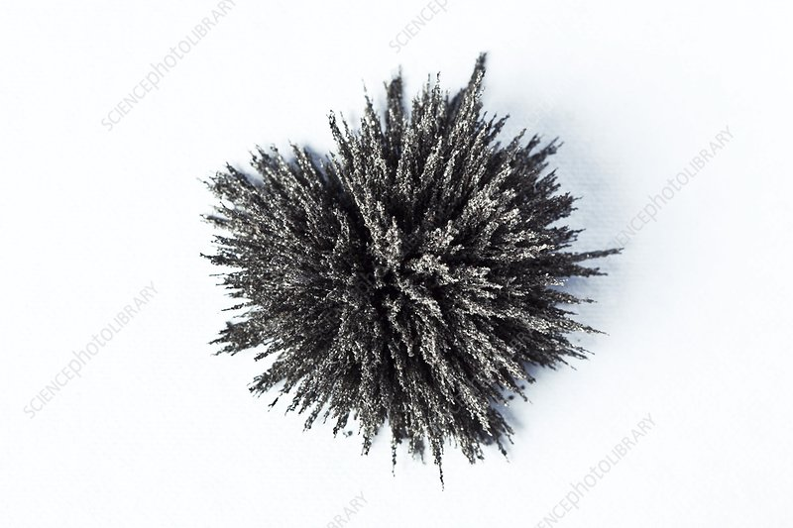
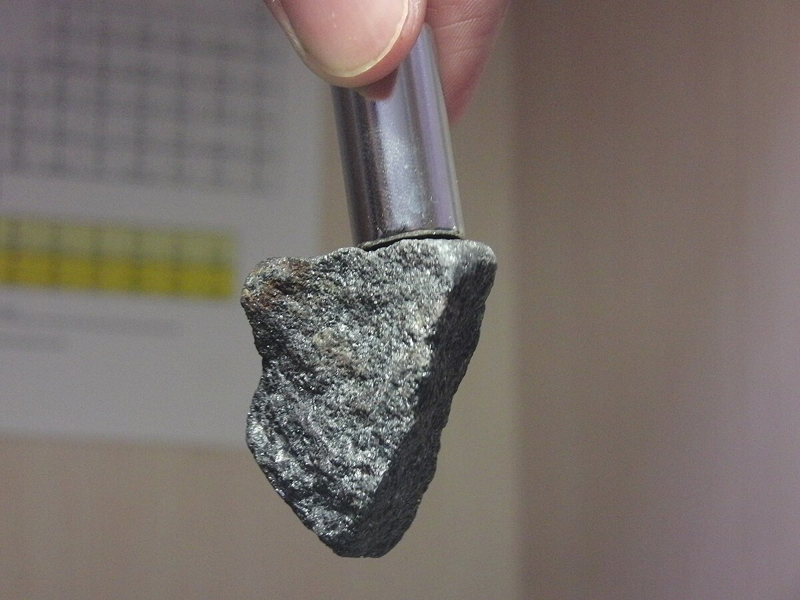
Magnetic Properties
Surgical instruments are sometimes subjected to a magnetic field in the operating room such as a from an MRI, which generates a magnetic field of ~1.5 Tesla. This magnetic
field can affect surgical instruments in numerous ways
including:
Unwanted movement caused by the magnetic field interactions (i.e. the missile effect)
Heating of instruments because of radio frequency (RF)power deposition Artifacts associated with the use of the
instrument
Non-magnetic instruments such as stainless steel, titanium alloys etc. are recommended in such environments.
Notes:
Materials science is one of the priority areas of modern science that studies the structure, structure, properties of materials and the relationship between them, investigates the dependence of structure and properties on the methods of production and processing of materials, as well as their change under the influence of external factors: power, thermal, radiation, etc. Based on the study of the properties of materials, indicators for their most efficient and rational use are determined, and technologies for the manufacture of various products from them are developed. Therefore, knowledge of the basic information on this science, which is necessary to determine the quality indicators of materials for the manufacture of medical devices, is extremely important in the process of becoming a pharmacist. Translated with DeepL.com (free version)

Slide 15
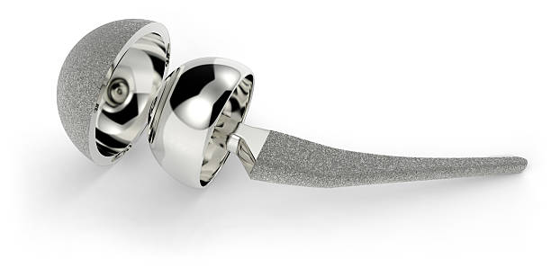
Glare
By anodizing the surgical instruments, manufacturers change the surface
properties of the metal. This makes the surgical instruments non-reflective. When the surgeon/lab operators are
working under operating lights or a microscope, an anti-glare surface is important.
Notes:
Materials science is one of the priority areas of modern science that studies the structure, structure, properties of materials and the relationship between them, investigates the dependence of structure and properties on the methods of production and processing of materials, as well as their change under the influence of external factors: power, thermal, radiation, etc. Based on the study of the properties of materials, indicators for their most efficient and rational use are determined, and technologies for the manufacture of various products from them are developed. Therefore, knowledge of the basic information on this science, which is necessary to determine the quality indicators of materials for the manufacture of medical devices, is extremely important in the process of becoming a pharmacist. Translated with DeepL.com (free version)

Slide 16
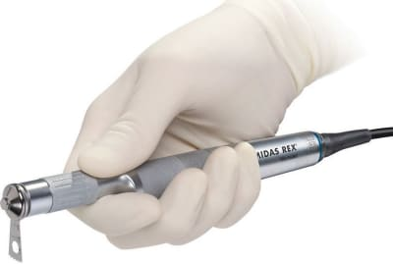
Ergonomics
Lightweight surgical instrument are simply
easier to handle, especially during long
surgical procedures, dissections or when
performing repetitive tasks. This means that titanium surgical tools are more suitable
than their stainless steel counterparts.
When it comes to biomedical instruments,
not all metals are up to the job, especially
base metals. In fact, most surgical instruments are made from metal alloys. Stainless
steel has traditionally been the metal
alloy of choice, but there are alternatives
when necessary.
Notes:
Materials science is one of the priority areas of modern science that studies the structure, structure, properties of materials and the relationship between them, investigates the dependence of structure and properties on the methods of production and processing of materials, as well as their change under the influence of external factors: power, thermal, radiation, etc. Based on the study of the properties of materials, indicators for their most efficient and rational use are determined, and technologies for the manufacture of various products from them are developed. Therefore, knowledge of the basic information on this science, which is necessary to determine the quality indicators of materials for the manufacture of medical devices, is extremely important in the process of becoming a pharmacist. Translated with DeepL.com (free version)

Slide 17
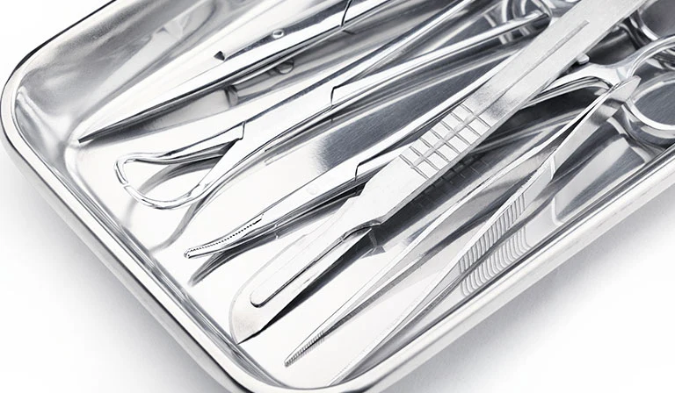
Stainless steel
Stainless steel is a steel alloy, mostly composed of iron
and about 10% chromium. Small amounts of other
metals like nickel, titanium, and copper may also be
present. Additionally, carbon is a common non-metal
additive in stainless steel. Stainless steel’s chromium
content is largely responsible for increasing the alloy’s
corrosion resistance — it prevents the iron from oxidizin.If there’s no oxidation, there’s no opportunity for rust to develop.
Notes:
Materials science is one of the priority areas of modern science that studies the structure, structure, properties of materials and the relationship between them, investigates the dependence of structure and properties on the methods of production and processing of materials, as well as their change under the influence of external factors: power, thermal, radiation, etc. Based on the study of the properties of materials, indicators for their most efficient and rational use are determined, and technologies for the manufacture of various products from them are developed. Therefore, knowledge of the basic information on this science, which is necessary to determine the quality indicators of materials for the manufacture of medical devices, is extremely important in the process of becoming a pharmacist. Translated with DeepL.com (free version)

Slide 18
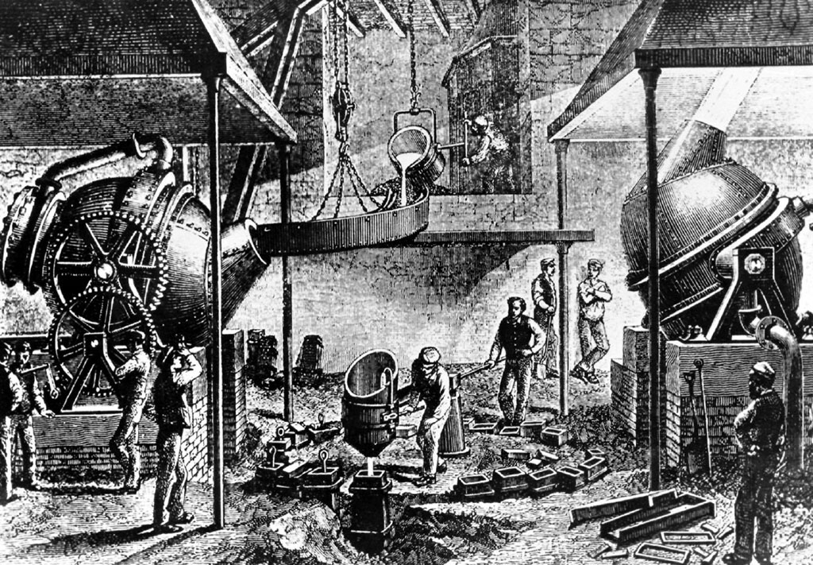
THE ORIGINS OF TODAY’S STEEL ALLOYS
Steel was first made by mining iron ore from the ground, smelting the ore in a furnace to remove impurities, and adding carbon. Today’s steel-making process involves recycling existing steel. Whether it’s mined from the Earth or recycled, steel is a combination of iron and carbon.
Notes:
Materials science is one of the priority areas of modern science that studies the structure, structure, properties of materials and the relationship between them, investigates the dependence of structure and properties on the methods of production and processing of materials, as well as their change under the influence of external factors: power, thermal, radiation, etc. Based on the study of the properties of materials, indicators for their most efficient and rational use are determined, and technologies for the manufacture of various products from them are developed. Therefore, knowledge of the basic information on this science, which is necessary to determine the quality indicators of materials for the manufacture of medical devices, is extremely important in the process of becoming a pharmacist. Translated with DeepL.com (free version)

Slide 19
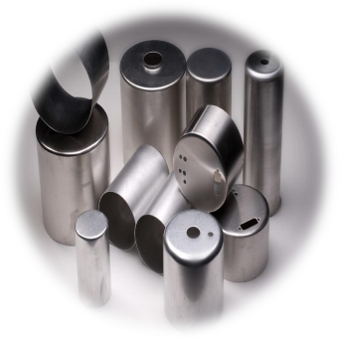
THE ORIGINS OF TODAY’S STEEL ALLOYS
Steel is made of four distinct groups:
stainless
carbon tool
alloy
Of the four main types of steel (stainless,
carbon, tool, alloy), stainless steel is known as the most corrosion resistant. Still, stainless
steel isn’t completely resistant to corrosion.
Under certain conditions, like repeat
exposure to highly concentrated salt water,
even stainless steel will corrode.
Notes:
Materials science is one of the priority areas of modern science that studies the structure, structure, properties of materials and the relationship between them, investigates the dependence of structure and properties on the methods of production and processing of materials, as well as their change under the influence of external factors: power, thermal, radiation, etc. Based on the study of the properties of materials, indicators for their most efficient and rational use are determined, and technologies for the manufacture of various products from them are developed. Therefore, knowledge of the basic information on this science, which is necessary to determine the quality indicators of materials for the manufacture of medical devices, is extremely important in the process of becoming a pharmacist. Translated with DeepL.com (free version)

Slide 20

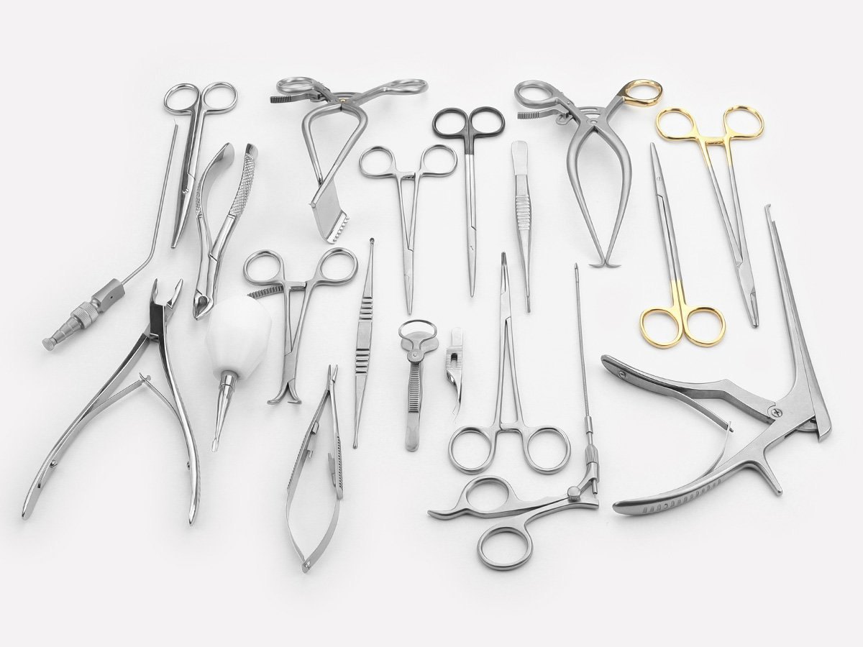
SURGICAL STEEL
Surgical steel is a variety of stainless steel that’s used in biomedical
applications. Sometimes referred to as surgical stainless, surgical
steel has no formal definition. Still, stainless steel varieties with the
greatest levels of corrosion resistance are those designated for
biomedical use. Some commonly accepted types of surgical steel
include austenitic 316 stainless and martensitic 440 and 420 stainless
Notes:
Materials science is one of the priority areas of modern science that studies the structure, structure, properties of materials and the relationship between them, investigates the dependence of structure and properties on the methods of production and processing of materials, as well as their change under the influence of external factors: power, thermal, radiation, etc. Based on the study of the properties of materials, indicators for their most efficient and rational use are determined, and technologies for the manufacture of various products from them are developed. Therefore, knowledge of the basic information on this science, which is necessary to determine the quality indicators of materials for the manufacture of medical devices, is extremely important in the process of becoming a pharmacist. Translated with DeepL.com (free version)

Slide 21
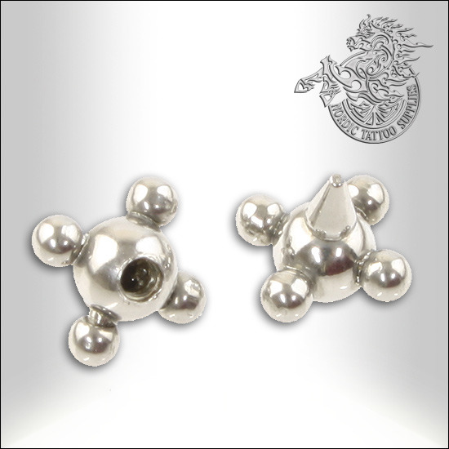
STAINLESS STEEL
Stainless steel is known for being the most corrosion resistant of the four groups. Stainless steel typically includes chromium, nickel, or molybdenum, with these alloys making up around 11-30 percent of the steel. Of the four steel groups, stainless steel is the most widely known. It is commonly used in food handling, food processing, medical instruments, hardware, and appliances.
Notes:
Materials science is one of the priority areas of modern science that studies the structure, structure, properties of materials and the relationship between them, investigates the dependence of structure and properties on the methods of production and processing of materials, as well as their change under the influence of external factors: power, thermal, radiation, etc. Based on the study of the properties of materials, indicators for their most efficient and rational use are determined, and technologies for the manufacture of various products from them are developed. Therefore, knowledge of the basic information on this science, which is necessary to determine the quality indicators of materials for the manufacture of medical devices, is extremely important in the process of becoming a pharmacist. Translated with DeepL.com (free version)

Slide 22
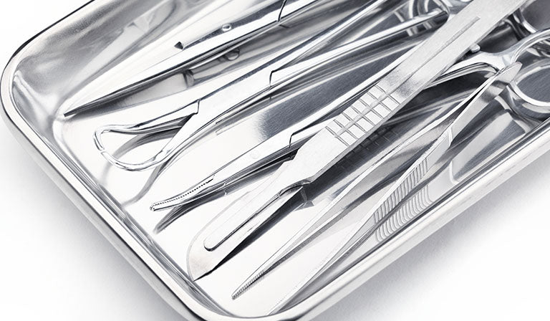
STAINLESS STEEL
Most surgical tools are made from 440 stainless
steel. It’s not as corrosion resistant as 316 but the
higher carbon content means it can be heat treated
to create very sharp edges for cutting instruments.
Stainless steel is commonly used for orthopedics like
replacement hip joints, or to stabilize broken bones
with screws and plates. It’s also used for surgical tools like tweezers, forceps, hemostats, and other equipment that has to be durable and also easily cleaned and
sterilized. And stainless steel mesh is sometimes used for intravascular stents.
Notes:
Materials science is one of the priority areas of modern science that studies the structure, structure, properties of materials and the relationship between them, investigates the dependence of structure and properties on the methods of production and processing of materials, as well as their change under the influence of external factors: power, thermal, radiation, etc. Based on the study of the properties of materials, indicators for their most efficient and rational use are determined, and technologies for the manufacture of various products from them are developed. Therefore, knowledge of the basic information on this science, which is necessary to determine the quality indicators of materials for the manufacture of medical devices, is extremely important in the process of becoming a pharmacist. Translated with DeepL.com (free version)

Slide 23
Stainless steel pros and cons
Stainless steel contains some percentage of iron, and that means it can still pose the risk of corrosion over time.
This can potentially cause damage to surrounding
tissue as the implant breaks down. Other medical
metals, such as titanium or cobalt chrome, have
more corrosion resistance but they’re more
expensive.
https://www.youtube.com/watch?v=n2b7lGqYrGQ
Why Stainless Steel is the Standard Alloy for Surgical Instruments
Notes:
Materials science is one of the priority areas of modern science that studies the structure, structure, properties of materials and the relationship between them, investigates the dependence of structure and properties on the methods of production and processing of materials, as well as their change under the influence of external factors: power, thermal, radiation, etc. Based on the study of the properties of materials, indicators for their most efficient and rational use are determined, and technologies for the manufacture of various products from them are developed. Therefore, knowledge of the basic information on this science, which is necessary to determine the quality indicators of materials for the manufacture of medical devices, is extremely important in the process of becoming a pharmacist. Translated with DeepL.com (free version)

Slide 24
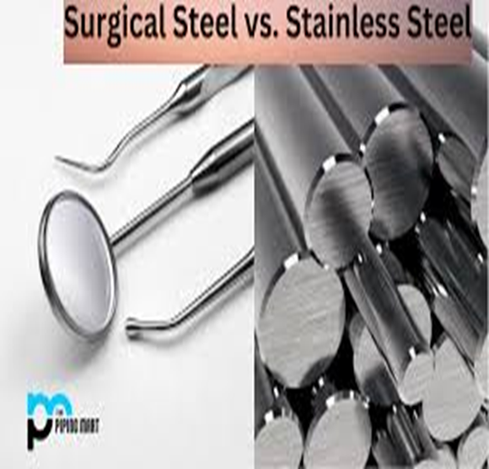
SURGICAL STEEL VS. STAINLESS STEEL
KEY DIFFERENCES
While surgical steel is a type of stainless steel, all stainless steels are not surgical steels. Surgical steels are those with the greatest amount of corrosion resistance and are designated for biomedical applications. When compared to other steel types, stainless steel is typically the most expensive. Then, among stainless steel, surgical steel is the most expensive.

Slide 25

SURGICAL STEEL VS. STAINLESS STEEL
USES
Because of material expense, stainless steels are different from “general use” steels, like carbon steel and tool steel. Most often, stainless steels are used in culinary applications. Cutlery, cookware, appliances, and kitchen fixtures made of stainless steel are very popular and sought after. Stainless steel is also used for various components within the automotive and aerospace industries and in some construction applications.
Surgical steel’s uses are relegated to biomedical applications. Surgical instruments like forceps, retractors, and needle holders are made from surgical steel, but that’s not all. Surgical steel has a long history of use in orthopedic and dental implant devices.

Slide 26
SURGICAL STEEL
Surgical steel is a variety of stainless steel that’s used in biomedical
applications. Sometimes referred to as surgical stainless, surgical
steel has no formal definition. Still, stainless steel varieties with the
greatest levels of corrosion resistance are those designated for
biomedical use. Some commonly accepted types of surgical steel
include austenitic 316 stainless and martensitic 440 and 420 stainless
Notes:
Materials science is one of the priority areas of modern science that studies the structure, structure, properties of materials and the relationship between them, investigates the dependence of structure and properties on the methods of production and processing of materials, as well as their change under the influence of external factors: power, thermal, radiation, etc. Based on the study of the properties of materials, indicators for their most efficient and rational use are determined, and technologies for the manufacture of various products from them are developed. Therefore, knowledge of the basic information on this science, which is necessary to determine the quality indicators of materials for the manufacture of medical devices, is extremely important in the process of becoming a pharmacist. Translated with DeepL.com (free version)

Slide 27
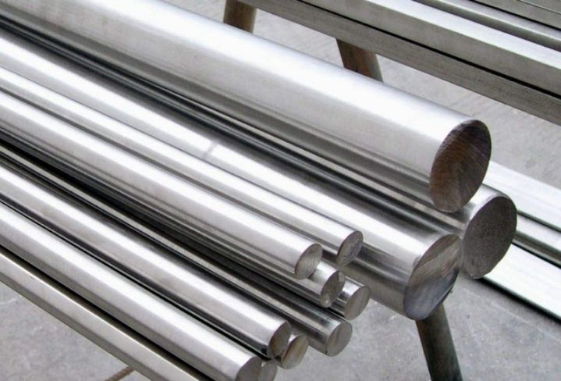
CARBON STEEL
Carbon steel and stainless steel have the same basic ingredients of iron and carbon, but where their composition differs is in alloy content.
Carbon steel has under 10.5 percent alloy content. It’s common to see carbon steel broken down into three subcategories: low carbon steel (0.03-0.15% carbon), medium carbon steel (0.25%-0.50% carbon), and high carbon steel (0.55%-1.10% carbon).
As the percentage of carbon increases, the steel becomes harder and more difficult to bend or weld. Low carbon steels are more commonly used due to having lower production costs, greater ductility, and increased ease of use in manufacturing.
https://www.youtube.com/watch?v=wv_F7E9rquk
Steel Types - Stainless Steel Vs Carbon Steel Explained.
Notes:
Materials science is one of the priority areas of modern science that studies the structure, structure, properties of materials and the relationship between them, investigates the dependence of structure and properties on the methods of production and processing of materials, as well as their change under the influence of external factors: power, thermal, radiation, etc. Based on the study of the properties of materials, indicators for their most efficient and rational use are determined, and technologies for the manufacture of various products from them are developed. Therefore, knowledge of the basic information on this science, which is necessary to determine the quality indicators of materials for the manufacture of medical devices, is extremely important in the process of becoming a pharmacist. Translated with DeepL.com (free version)

Slide 28
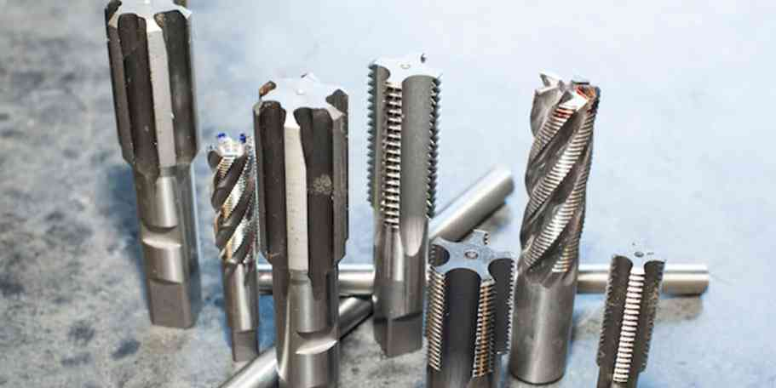
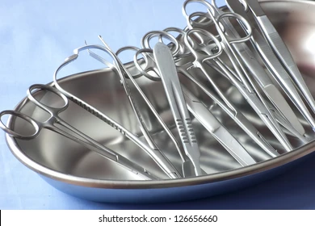
TOOL STEEL
Tool steels have a carbon content between 0.5% and
1.5%. Tool steel contains other additives, including
tungsten, chromium, vanadium, and molybdenum. Tool steels are known for their hardness and their ability to
hold a cutting edge at elevated temperatures. This,
combined with being resistant to wear and deformation,
makes tool steel perfectly suited for use in machining
and tool making.
Notes:
Materials science is one of the priority areas of modern science that studies the structure, structure, properties of materials and the relationship between them, investigates the dependence of structure and properties on the methods of production and processing of materials, as well as their change under the influence of external factors: power, thermal, radiation, etc. Based on the study of the properties of materials, indicators for their most efficient and rational use are determined, and technologies for the manufacture of various products from them are developed. Therefore, knowledge of the basic information on this science, which is necessary to determine the quality indicators of materials for the manufacture of medical devices, is extremely important in the process of becoming a pharmacist. Translated with DeepL.com (free version)

Slide 29
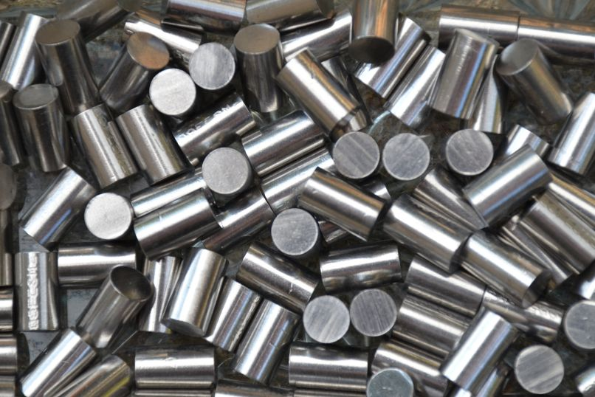
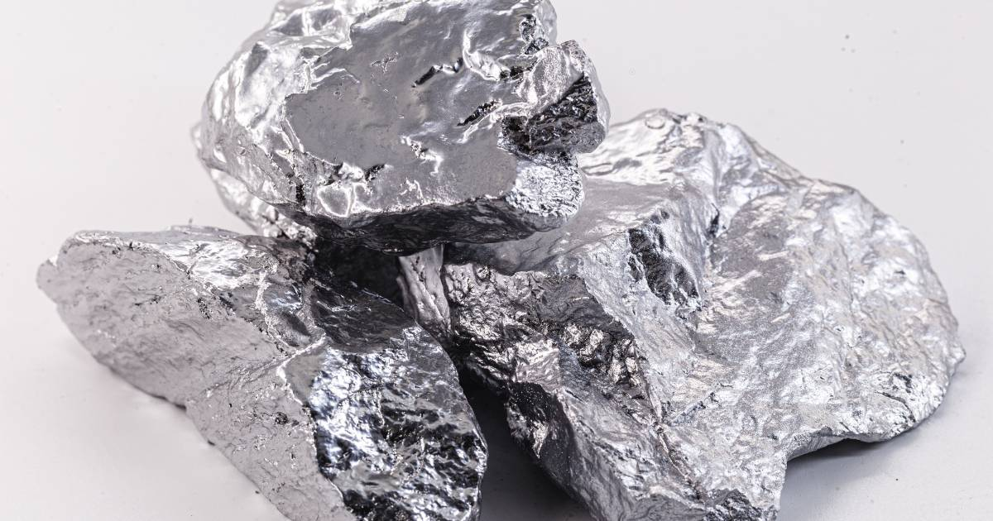
ALLOY STEEL
Alloy steel is steel that includes about 5% alloying elements in its composition. These alloying elements can include manganese, chromium, vanadium, nickel, and tungsten.
The addition of alloying elements increases overall machinability and corrosion resistance.
https://www.youtube.com/watch?app=desktop&v=inZczv3bLu4
Manufacturing of surgical instruments
Notes:
Materials science is one of the priority areas of modern science that studies the structure, structure, properties of materials and the relationship between them, investigates the dependence of structure and properties on the methods of production and processing of materials, as well as their change under the influence of external factors: power, thermal, radiation, etc. Based on the study of the properties of materials, indicators for their most efficient and rational use are determined, and technologies for the manufacture of various products from them are developed. Therefore, knowledge of the basic information on this science, which is necessary to determine the quality indicators of materials for the manufacture of medical devices, is extremely important in the process of becoming a pharmacist. Translated with DeepL.com (free version)

Slide 30
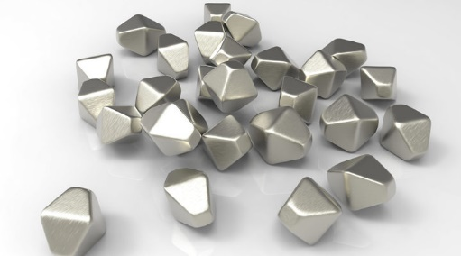
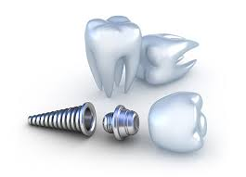
TITANIUM
TITANIUM is one of the most versatile metals used in
internal applications. It resists corrosion and connects to human bone when properly treated, with fewer negative
reactions than other metals.
Since the 1960s, titanium has become a favorite for
medical and surgical equipment. It is perfect for
surgical equipment and implants due to its toughness
and tensile strength and is used for forceps, needles,
orthopedic rods, dental implants, pacemakers, etc.
The hardness and strength of titanium increase about
20% on heat treatment.
Notes:
Materials science is one of the priority areas of modern science that studies the structure, structure, properties of materials and the relationship between them, investigates the dependence of structure and properties on the methods of production and processing of materials, as well as their change under the influence of external factors: power, thermal, radiation, etc. Based on the study of the properties of materials, indicators for their most efficient and rational use are determined, and technologies for the manufacture of various products from them are developed. Therefore, knowledge of the basic information on this science, which is necessary to determine the quality indicators of materials for the manufacture of medical devices, is extremely important in the process of becoming a pharmacist. Translated with DeepL.com (free version)

Slide 31

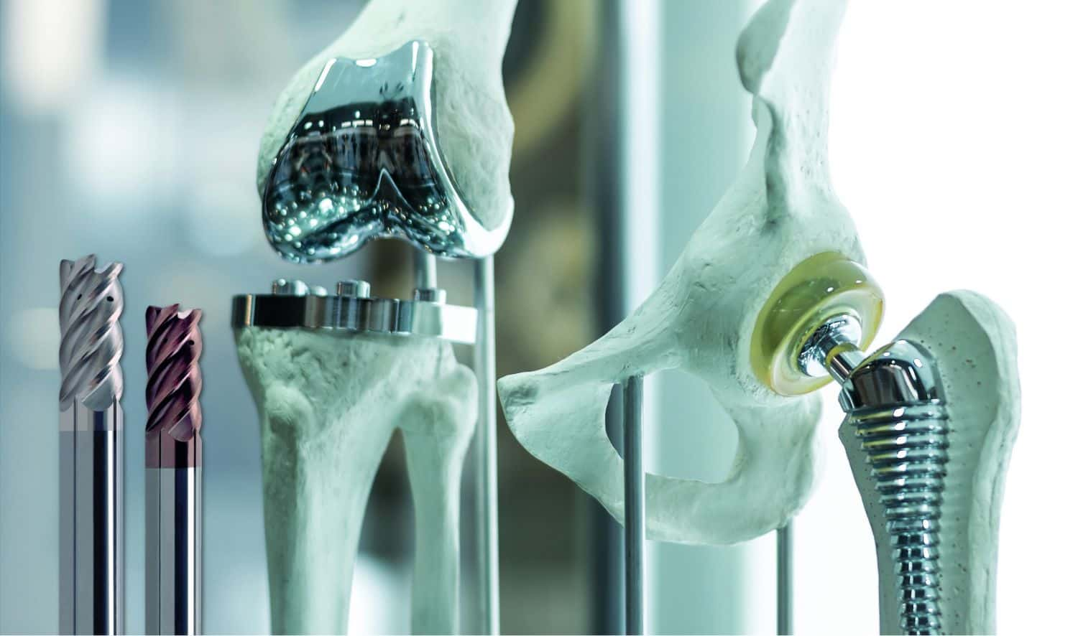
TITANIUM
TITANIUM is one of the most versatile metals used in
internal applications. It resists corrosion and connects to human bone when properly treated, with fewer negative
reactions than other metals.
Since the 1960s, titanium has become a favorite for
medical and surgical equipment. It is perfect for
surgical equipment and implants due to its toughness
and tensile strength and is used for forceps, needles,
orthopedic rods, dental implants, pacemakers, etc.
The hardness and strength of titanium increase about
20% on heat treatment.
Notes:
Materials science is one of the priority areas of modern science that studies the structure, structure, properties of materials and the relationship between them, investigates the dependence of structure and properties on the methods of production and processing of materials, as well as their change under the influence of external factors: power, thermal, radiation, etc. Based on the study of the properties of materials, indicators for their most efficient and rational use are determined, and technologies for the manufacture of various products from them are developed. Therefore, knowledge of the basic information on this science, which is necessary to determine the quality indicators of materials for the manufacture of medical devices, is extremely important in the process of becoming a pharmacist. Translated with DeepL.com (free version)

Slide 32
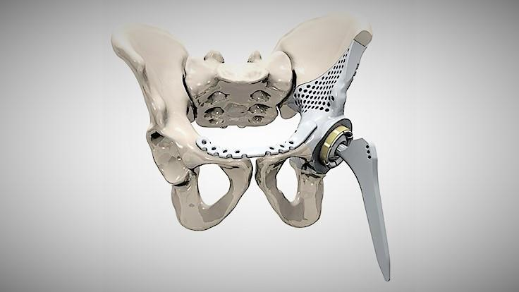
TITANIUM
Some of the characteristics that make titanium a suitable choice for implants include:
Titanium is 100% corrosion-resistant, making it suitable for equipment used within the body and for implants.
It has almost the same tensile strength as carbon steel.
It is lighter and more flexible than some other metals.
Titanium is more heat-resistant than stainless steel.
It is biocompatible and does not act as a foreign stimulus to the body, leading to an infection.
Notes:
Materials science is one of the priority areas of modern science that studies the structure, structure, properties of materials and the relationship between them, investigates the dependence of structure and properties on the methods of production and processing of materials, as well as their change under the influence of external factors: power, thermal, radiation, etc. Based on the study of the properties of materials, indicators for their most efficient and rational use are determined, and technologies for the manufacture of various products from them are developed. Therefore, knowledge of the basic information on this science, which is necessary to determine the quality indicators of materials for the manufacture of medical devices, is extremely important in the process of becoming a pharmacist. Translated with DeepL.com (free version)

Slide 33
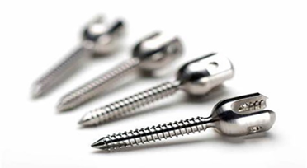
TITANIUM
Pure titanium has low density, high strength,
and high corrosion resistance and is also a good
candidate material when processing or forming
into subassemblies or finished components. It is considered to be physiologically inert. Titanium alloys Ti-6Al-4V and Ti-6Al-4V ELI are
especially nonreactive with fluids in the human body and are commonly used in medical
devices due to the low risk of rejection.
Notes:
Materials science is one of the priority areas of modern science that studies the structure, structure, properties of materials and the relationship between them, investigates the dependence of structure and properties on the methods of production and processing of materials, as well as their change under the influence of external factors: power, thermal, radiation, etc. Based on the study of the properties of materials, indicators for their most efficient and rational use are determined, and technologies for the manufacture of various products from them are developed. Therefore, knowledge of the basic information on this science, which is necessary to determine the quality indicators of materials for the manufacture of medical devices, is extremely important in the process of becoming a pharmacist. Translated with DeepL.com (free version)

Slide 34
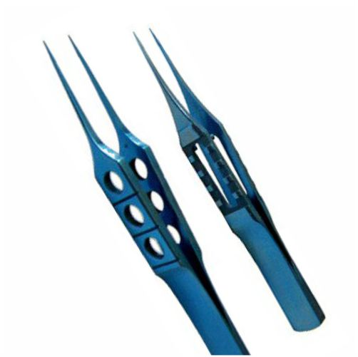
TITANIUM
Pure titanium has low density, high strength,
and high corrosion resistance and is also a good
candidate material when processing or forming
into subassemblies or finished components. It is considered to be physiologically inert. Titanium alloys Ti-6Al-4V and Ti-6Al-4V ELI are
especially nonreactive with fluids in the human body and are commonly used in medical
devices due to the low risk of rejection.
Notes:
Materials science is one of the priority areas of modern science that studies the structure, structure, properties of materials and the relationship between them, investigates the dependence of structure and properties on the methods of production and processing of materials, as well as their change under the influence of external factors: power, thermal, radiation, etc. Based on the study of the properties of materials, indicators for their most efficient and rational use are determined, and technologies for the manufacture of various products from them are developed. Therefore, knowledge of the basic information on this science, which is necessary to determine the quality indicators of materials for the manufacture of medical devices, is extremely important in the process of becoming a pharmacist. Translated with DeepL.com (free version)

Slide 35
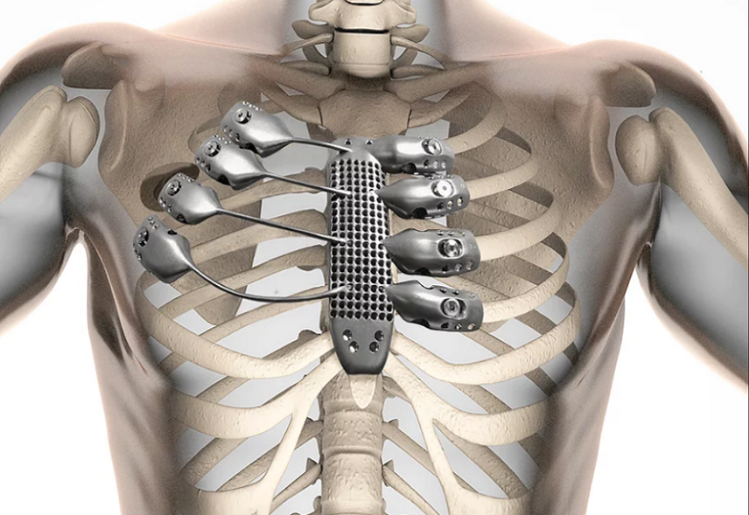
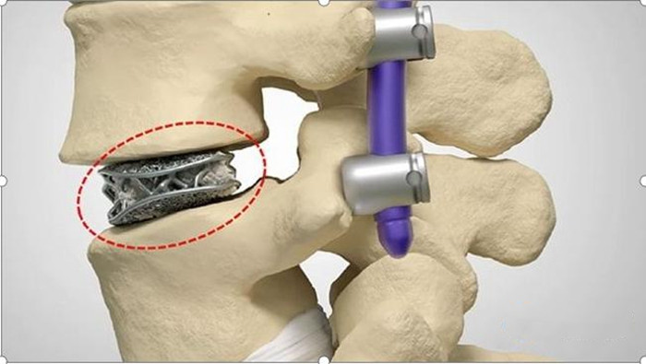
TITANIUM
Some of the most common uses for titanium are
in orthopedic surgery; hip, knee, spinal, facial,
and shoulder and elbow joint replacements are
among the multiple uses for this material.
In addition to its use inside the body, titanium is
an ideal choice for surgical instruments, such as drills, forceps, retractors, scissors, needle
holders, and Lasik eye surgery equipment.
The metal is also compatible with MRIs or CT
scans.
Notes:
Materials science is one of the priority areas of modern science that studies the structure, structure, properties of materials and the relationship between them, investigates the dependence of structure and properties on the methods of production and processing of materials, as well as their change under the influence of external factors: power, thermal, radiation, etc. Based on the study of the properties of materials, indicators for their most efficient and rational use are determined, and technologies for the manufacture of various products from them are developed. Therefore, knowledge of the basic information on this science, which is necessary to determine the quality indicators of materials for the manufacture of medical devices, is extremely important in the process of becoming a pharmacist. Translated with DeepL.com (free version)

Slide 36
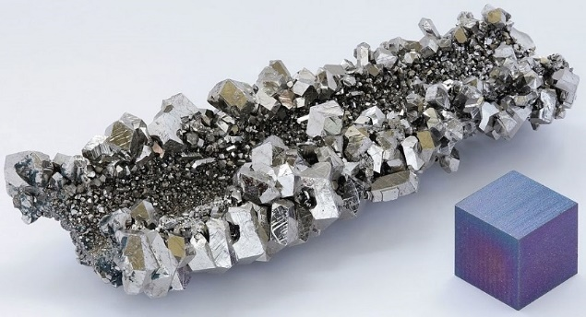
NIOBIUM
There is growing interest in niobium and its alloys for use in medical devices. It is often found in devices such as pacemakers because the metal is physiologically inert.
Niobium treated with sodium hydroxide forms a porous layer that aids Osseointegration, which also makes it an attractive alternative for internal medical applications.
Notes:
Materials science is one of the priority areas of modern science that studies the structure, structure, properties of materials and the relationship between them, investigates the dependence of structure and properties on the methods of production and processing of materials, as well as their change under the influence of external factors: power, thermal, radiation, etc. Based on the study of the properties of materials, indicators for their most efficient and rational use are determined, and technologies for the manufacture of various products from them are developed. Therefore, knowledge of the basic information on this science, which is necessary to determine the quality indicators of materials for the manufacture of medical devices, is extremely important in the process of becoming a pharmacist. Translated with DeepL.com (free version)

Slide 37
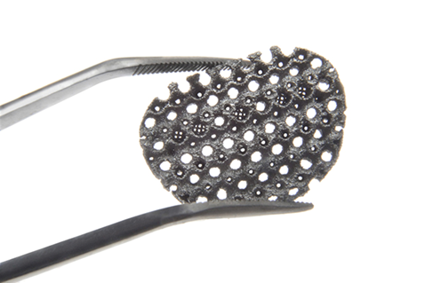

TANTALUM
Is another increasingly popular metal that has
been used in medical devices as simple as
diagnostic marker bands and as a catheter plastic
compounding additive for more than 40 years.
Tantalum is especially useful in shaped-wire
applications due to its high ductility and its
corrosion resistance, which makes it attractive for
implants. Tantalum can be easily welded and
exhibits good dielectric properties.
Notes:
Materials science is one of the priority areas of modern science that studies the structure, structure, properties of materials and the relationship between them, investigates the dependence of structure and properties on the methods of production and processing of materials, as well as their change under the influence of external factors: power, thermal, radiation, etc. Based on the study of the properties of materials, indicators for their most efficient and rational use are determined, and technologies for the manufacture of various products from them are developed. Therefore, knowledge of the basic information on this science, which is necessary to determine the quality indicators of materials for the manufacture of medical devices, is extremely important in the process of becoming a pharmacist. Translated with DeepL.com (free version)

Slide 38
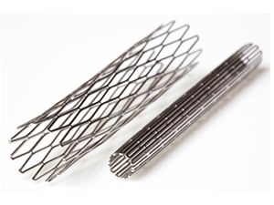
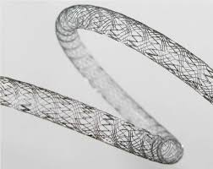

NITINOL
NITINOL is a nickel-titanium (about 51% Ni) shape
memory alloy with superelastic properties—a reversible response to an applied stress. Shape memory refers to Nitinol’s ability to undergo deformation at one
temperature, and then recover its original shape upon heating above its transformation temperature.
Nitinol’s light weight and unique properties make it
especially attractive for use in biomedical applications including heart valve tools, staples, bone anchors,
sophisticated septal defect devices, and a variety of
implants. Other uses include diagnostic guide wires and repositionable wire markers to locate breast tumors for
less invasive lumpectomy procedures in treating breast cancer.
Notes:
Materials science is one of the priority areas of modern science that studies the structure, structure, properties of materials and the relationship between them, investigates the dependence of structure and properties on the methods of production and processing of materials, as well as their change under the influence of external factors: power, thermal, radiation, etc. Based on the study of the properties of materials, indicators for their most efficient and rational use are determined, and technologies for the manufacture of various products from them are developed. Therefore, knowledge of the basic information on this science, which is necessary to determine the quality indicators of materials for the manufacture of medical devices, is extremely important in the process of becoming a pharmacist. Translated with DeepL.com (free version)

Slide 39


COPPER
Recently, the medical industry has focused research dollars into copper and its alloys. Previously off limits for most medical purposes due to its thrombogenic
risks, copper has found new interest in the device
community. At the heart of this interest is the fact that
properly shielded copper can be effectively used to
carry signals to small implants and diagnostic tools.
Due to its high conductivity, it is possible to embed
smaller copper wires into devices to take the place of
larger or more expensive materials to send and
receive signals or carry electrical charges to
accomplish tasks inside the body.
Notes:
Materials science is one of the priority areas of modern science that studies the structure, structure, properties of materials and the relationship between them, investigates the dependence of structure and properties on the methods of production and processing of materials, as well as their change under the influence of external factors: power, thermal, radiation, etc. Based on the study of the properties of materials, indicators for their most efficient and rational use are determined, and technologies for the manufacture of various products from them are developed. Therefore, knowledge of the basic information on this science, which is necessary to determine the quality indicators of materials for the manufacture of medical devices, is extremely important in the process of becoming a pharmacist. Translated with DeepL.com (free version)

Slide 40
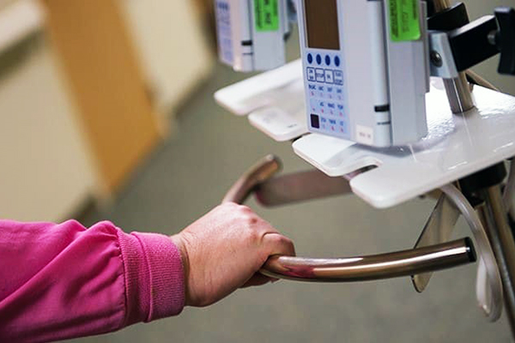
COPPER
Antibacterial properties of copper
But copper really shines as a medical metal because of its outstanding antiviral and antibacterial properties. That’s why copper is an ideal material for surfaces that are constantly being touched, like door handles, bed rails, and switches. Copper is unique in that more than 400 different copper alloys have been approved by the FDA as biocidal to prevent the spread of viruses like SARS-CoV-2.
Notes:
Materials science is one of the priority areas of modern science that studies the structure, structure, properties of materials and the relationship between them, investigates the dependence of structure and properties on the methods of production and processing of materials, as well as their change under the influence of external factors: power, thermal, radiation, etc. Based on the study of the properties of materials, indicators for their most efficient and rational use are determined, and technologies for the manufacture of various products from them are developed. Therefore, knowledge of the basic information on this science, which is necessary to determine the quality indicators of materials for the manufacture of medical devices, is extremely important in the process of becoming a pharmacist. Translated with DeepL.com (free version)

Slide 41
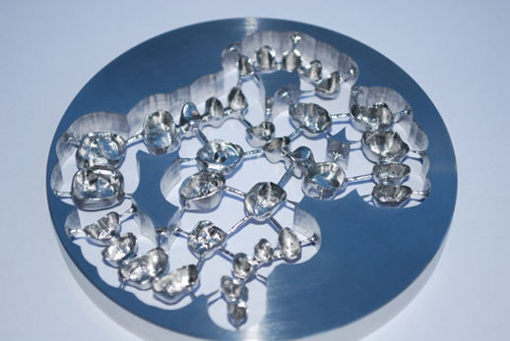
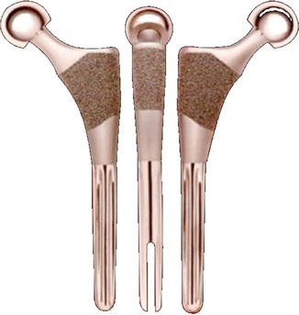
COBALT CHROME
Cobalt chrome has high wear resistance and is used for joint replacements and for dental implants. It can be electropolished so that the surface is very
smooth to prevent contamination. Although it’s
very hard, cobalt chrome parts can be CNC
machined or 3D printed.
Cobalt chrome pros and cons
Cobalt chrome alloys are excellent medical metals for hip and shoulder socket replacements.
There has been some concern that, as they eventually wear out over time, cobalt, chromium and
nickel ions may be released into the bloodstream.
Notes:
Materials science is one of the priority areas of modern science that studies the structure, structure, properties of materials and the relationship between them, investigates the dependence of structure and properties on the methods of production and processing of materials, as well as their change under the influence of external factors: power, thermal, radiation, etc. Based on the study of the properties of materials, indicators for their most efficient and rational use are determined, and technologies for the manufacture of various products from them are developed. Therefore, knowledge of the basic information on this science, which is necessary to determine the quality indicators of materials for the manufacture of medical devices, is extremely important in the process of becoming a pharmacist. Translated with DeepL.com (free version)

Slide 42
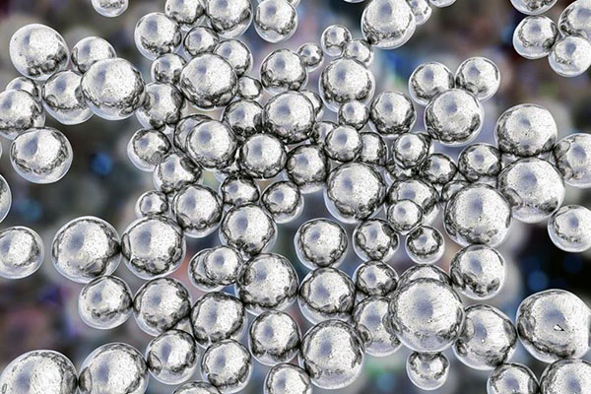
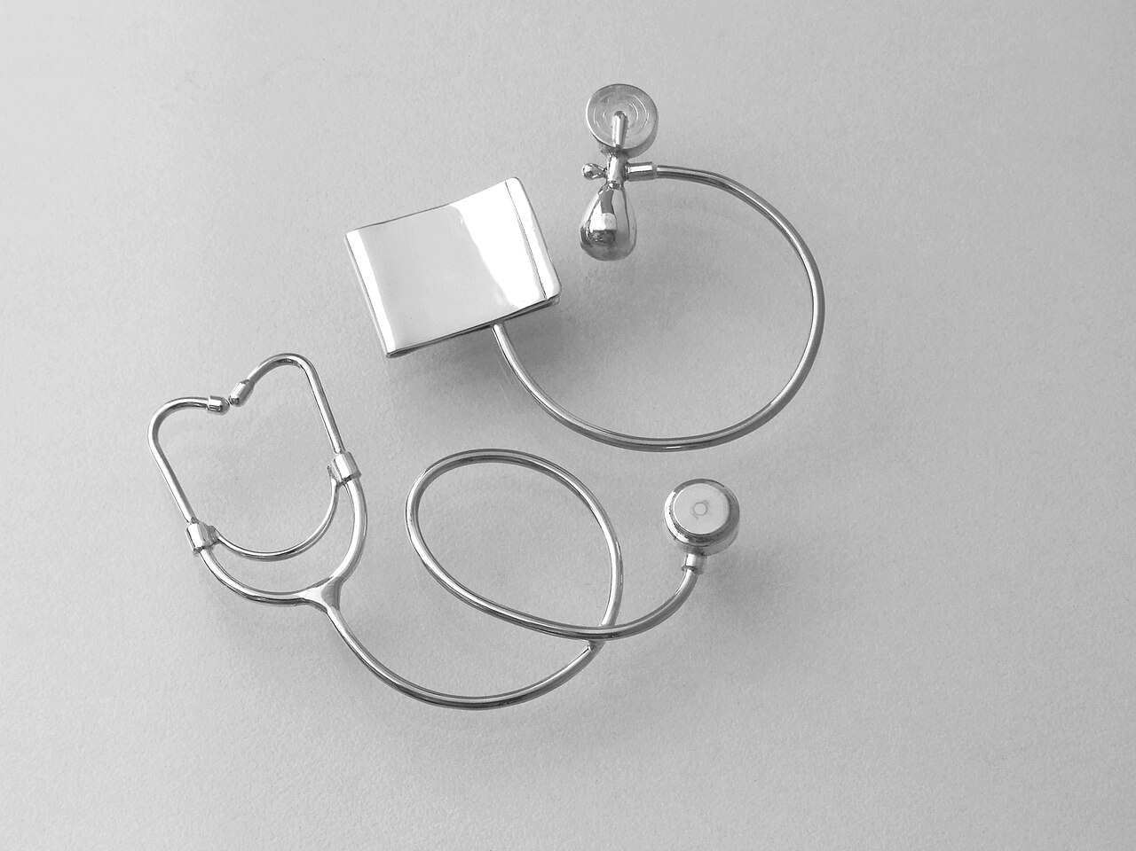
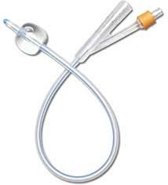
SILVER
Silver acts much like copper in that it’s naturally antimicrobial. This makes it useful for stents, non-load-bearing implants, and even mixed into cementitious compounds used for bone plaster. Silver is also alloyed with zinc or copper to make dental fillings.
Notes:
Materials science is one of the priority areas of modern science that studies the structure, structure, properties of materials and the relationship between them, investigates the dependence of structure and properties on the methods of production and processing of materials, as well as their change under the influence of external factors: power, thermal, radiation, etc. Based on the study of the properties of materials, indicators for their most efficient and rational use are determined, and technologies for the manufacture of various products from them are developed. Therefore, knowledge of the basic information on this science, which is necessary to determine the quality indicators of materials for the manufacture of medical devices, is extremely important in the process of becoming a pharmacist. Translated with DeepL.com (free version)

Slide 43



GOLD
Probably the very first medical metal, gold has good
corrosion resistance and biocompatibility. Because of
its plasticity, it’s easy to form and was commonly used
in the past for many kinds of dental repair. This practice is no longer common and now gold is being replaced by other synthetic materials.
Gold does exhibit some biocidal properties so it can
be found in antitumor treatments. But of course, gold
is expensive and rare, and is usually limited to very
thin plating's instead of solid gold. Gold plating's are
common on wires, conductors,
Notes:
Materials science is one of the priority areas of modern science that studies the structure, structure, properties of materials and the relationship between them, investigates the dependence of structure and properties on the methods of production and processing of materials, as well as their change under the influence of external factors: power, thermal, radiation, etc. Based on the study of the properties of materials, indicators for their most efficient and rational use are determined, and technologies for the manufacture of various products from them are developed. Therefore, knowledge of the basic information on this science, which is necessary to determine the quality indicators of materials for the manufacture of medical devices, is extremely important in the process of becoming a pharmacist. Translated with DeepL.com (free version)

Slide 44
GOLD
Probably the very first medical metal, gold has good
corrosion resistance and biocompatibility. Because of
its plasticity, it’s easy to form and was commonly used
in the past for many kinds of dental repair. This practice
is no longer common and now gold is being replaced by
other synthetic materials.
Gold does exhibit some biocidal properties so it can
be found in antitumor treatments. But of course, gold
is expensive and rare, and is usually limited to very
thin plating's instead of solid gold. Gold plating's are
common on wires, conductors, and other micro-electronic components used in sensors and electro-stimulation
implants.
Notes:
Materials science is one of the priority areas of modern science that studies the structure, structure, properties of materials and the relationship between them, investigates the dependence of structure and properties on the methods of production and processing of materials, as well as their change under the influence of external factors: power, thermal, radiation, etc. Based on the study of the properties of materials, indicators for their most efficient and rational use are determined, and technologies for the manufacture of various products from them are developed. Therefore, knowledge of the basic information on this science, which is necessary to determine the quality indicators of materials for the manufacture of medical devices, is extremely important in the process of becoming a pharmacist. Translated with DeepL.com (free version)

Slide 45
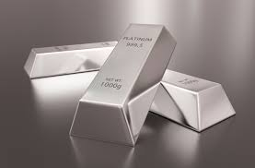
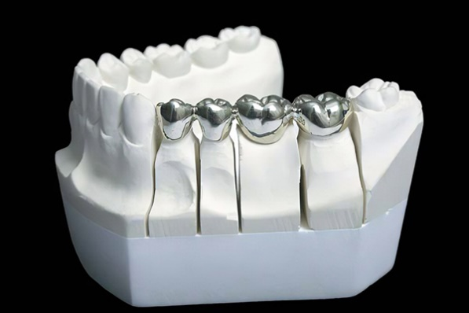
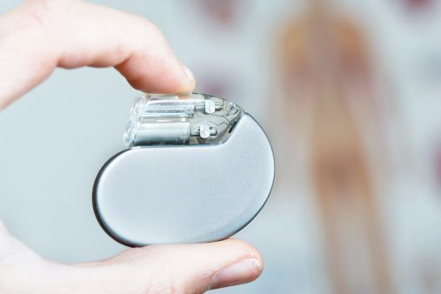
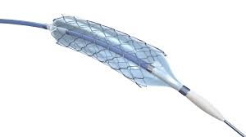
PLATINUM
Another highly stable inert metal, platinum is biocompatible and is also an excellent conductor. Very fine platinum wires are used for internal electronic implants, such as pacemakers and hearing aids. It’s also showing promise in applications for neurological disorders and in monitoring brain waves.
Notes:
Materials science is one of the priority areas of modern science that studies the structure, structure, properties of materials and the relationship between them, investigates the dependence of structure and properties on the methods of production and processing of materials, as well as their change under the influence of external factors: power, thermal, radiation, etc. Based on the study of the properties of materials, indicators for their most efficient and rational use are determined, and technologies for the manufacture of various products from them are developed. Therefore, knowledge of the basic information on this science, which is necessary to determine the quality indicators of materials for the manufacture of medical devices, is extremely important in the process of becoming a pharmacist. Translated with DeepL.com (free version)

Slide 46
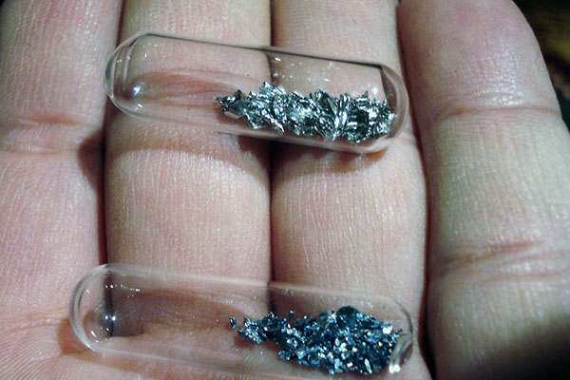

IRIDIUM
The main use of Iridium, or iridium oxide, is to coat the wiring used for electro-stimulation devices.
Notes:
Materials science is one of the priority areas of modern science that studies the structure, structure, properties of materials and the relationship between them, investigates the dependence of structure and properties on the methods of production and processing of materials, as well as their change under the influence of external factors: power, thermal, radiation, etc. Based on the study of the properties of materials, indicators for their most efficient and rational use are determined, and technologies for the manufacture of various products from them are developed. Therefore, knowledge of the basic information on this science, which is necessary to determine the quality indicators of materials for the manufacture of medical devices, is extremely important in the process of becoming a pharmacist. Translated with DeepL.com (free version)

Slide 47
Thank you for your attention!

