Slide 1


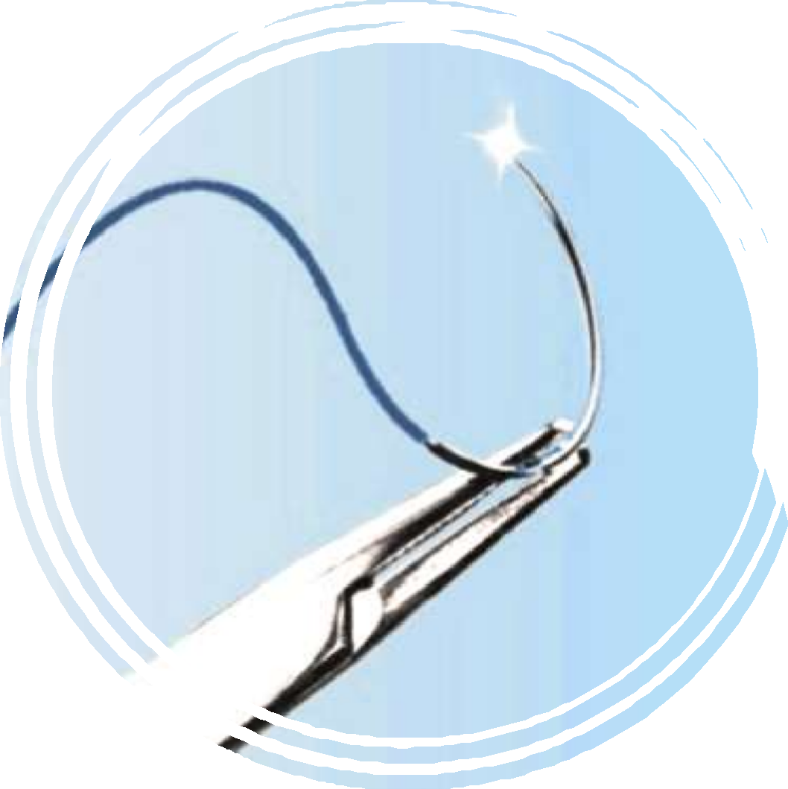


MINISTRY OF HEALTH OF UKRAINE
ODESSA NATIONAL MEDICAL UNIVERSITY
Department of Pharmacy Organization and Economics with post -diploma specialization
SURGICAL SUTURES AND
NEEDLES

Slide 2


INTRODUCTION HISTORICAL BACKGROUND SUTURES
Characteristics
Classification
Clinical Considerations
NEEDLES
Characteristics Anatomy
Clinical Considerations
PACKAGING
ALTERNATIVES CONCLUSION REFERENCES
OUTLINE

Slide 3


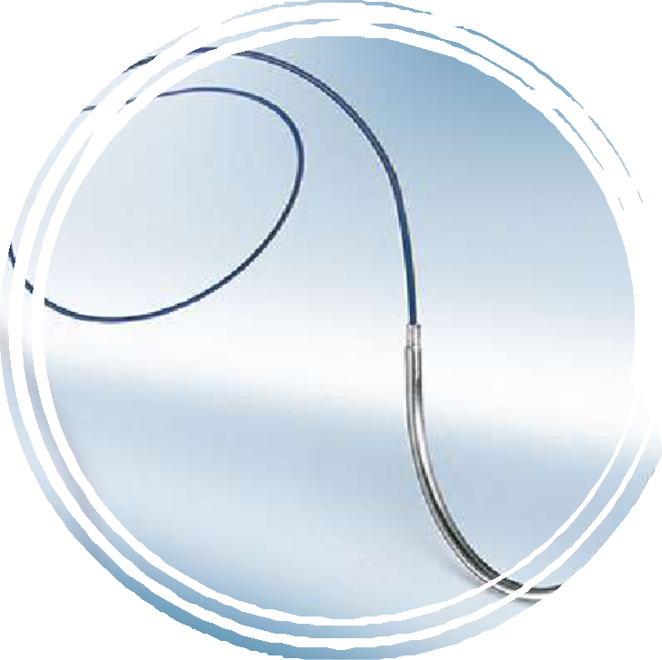


INTRODUCTION
Most traumatic and surgical wounds require some kind of closure. The use of surgical sutures and needles are the most common methods of primary closure.
A proper understanding of sutures and the principles underlying their choice can help the surgeon achieve optimal
results.

Slide 4
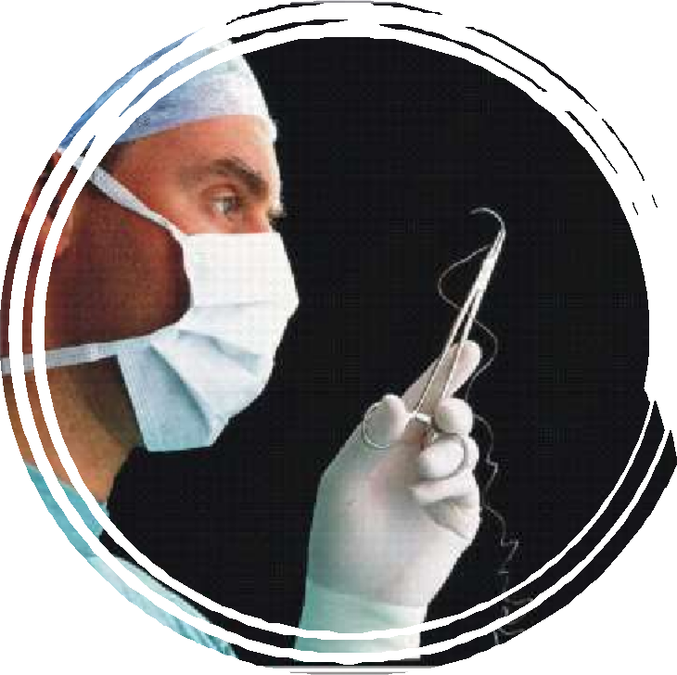
Definition
A suture is any strand of material used to ligate blood vessels and approximate tissues, maintaining their tensile strength until adequate healing is achieved. They are generally applied using a needle with an attached length of thread.
A surgical needle is a needle designed to
carry sutures when applying stitches to tissues.
Surgical Sutures and Needles

Slide 5
Characteristics of an ideal suture:
Physical characteristic such as, breaking strength, elasticity, capillarity and memory are used to describe of sutures.
It should be non-capillary, non-allergic, non-electrolytic and non-carcinogenic.
It should produce knots which hold securely without cutting and fraying.
It should be resistant to infection
It should be easily sterilised without alteration of the physio-chemical properties.
It should not be expensive.
The suture can be classified according to several parameters that relate to your source material, structure and permanence in the tissues.

Slide 6


HISTORICAL BACKGROUND
Ancient Times
Egyptians used plant materials like hemp, cotton or animal material such as tendons, silk, and arteries to suture wounds as early as 3000BC.
Blood vessels ligated in East Africa with tendon strips and wounds approximated with acacia thorns held firmly with vegetable strands wound around them in a figure of eight.
South American tribes apposed wounds by having large ants bite edges together like clips before twisting their bodies off.

Slide 7




HISTORICAL BACKGROUND
1000BC-CE
Indian surgeons used horsehair,
cotton and leather sutures.
Linen and silk sutures and metal clips called “fibulae” used in Rome to close gladiatorial wounds.
End of 19th Century
Advances in textile industry led to use of silk and catgut as sutures. In 1860’s, Lister advocated for tanning of catgut with chromic to increase durability in tissues. His technique for catgut sterilization was finally perfected in 1906.

Slide 8




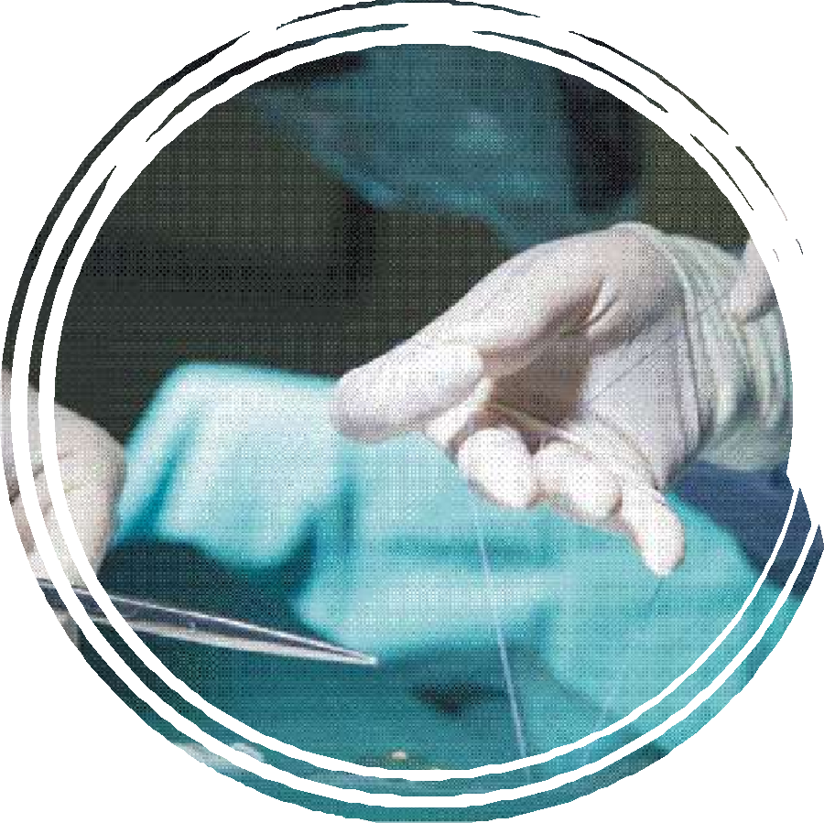

SUTURES
CHARACTERISTICS CLASSIFICATIONS
CLINICAL CONSIDERATIONS

Slide 9








CHARACTERISTICS
The Ideal Suture
Strong
Have and maintain adequate tensile strength until its purpose is served. It should not shrink in the tissues.
Inert
It should stimulate minimal tissue reaction and should not create a situation favourable to bacterial growth.
Safe
It should be non- electrolytic, non-capillary, non-allergenic, non- carcinogenic and non- thrombogenic (in vascular surgery).

Slide 10


CHARACTERISTICS
The Ideal Suture
Pliable
The material should handle comfortably and naturally by the surgeon and a knot should hold securely without fraying or cutting.
Cheap
It should be inexpensive and easily sterilized.

Slide 11



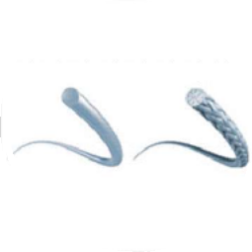

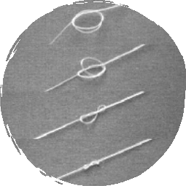
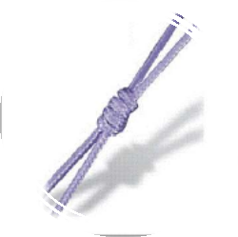


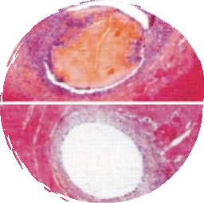

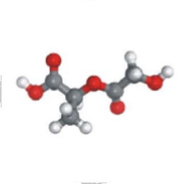
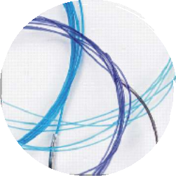
CLASSIFICATION
Sutures are generally classified according to the following characteristics.
Physical Structure Monofilament, Braided
Tensile Behaviour
Elastic, Plastic
Tensile Strength
High, Low
Biological Behaviour Proteolytic, Hydrolytic
Absorbability Absorbable, Non- absorbable
Origin Natural, Synthetic

Slide 12
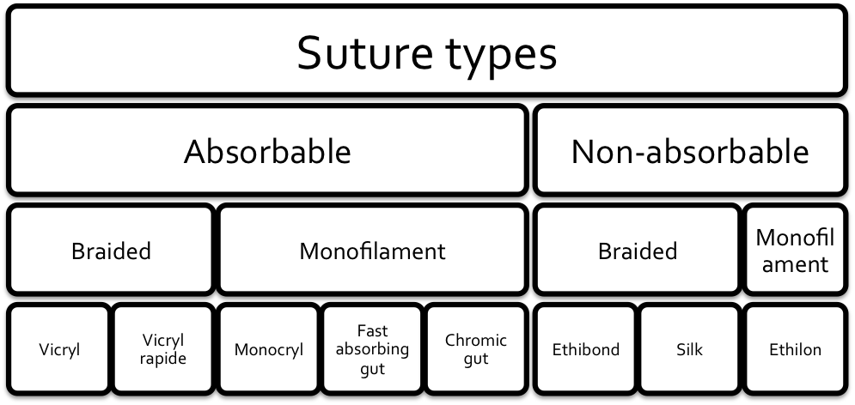
CLASSIFICATION

Slide 13
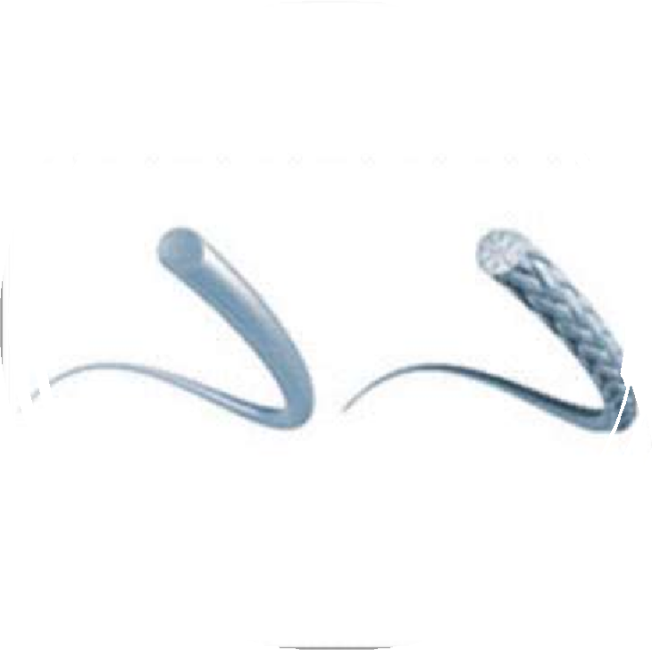
Physical Structure
This refers to the texture of the suture derived from it being a single strand of material (monofilament), or a weave of several strands (multifilament or braided).
Monofilament, Braided

Slide 14
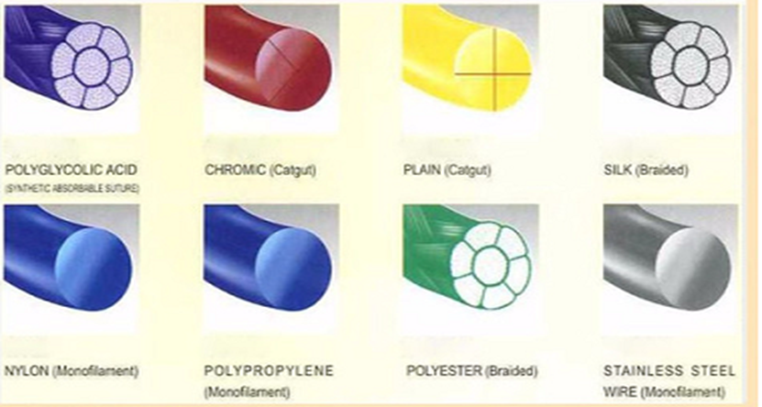
Physical Structure
Monofilament, Braided

Slide 15
Physical Structure
 | Monofilament | Multifilament
Advantages | Less tissue drag – resistance when pulled through tissues Minimal tissue trauma – less sawing action Minimal scarring | Greater tensile strength Easier handling – flexibility and pliability Better knot security – fewer knots needed
Disadvantages | Easy to damage from forceps grip Less knot security Difficult handling Less tensile strength | More tissue drag, trauma and scarring except when coated Capillary action, interstices – more likely microbial infection and sinus formation

Slide 16
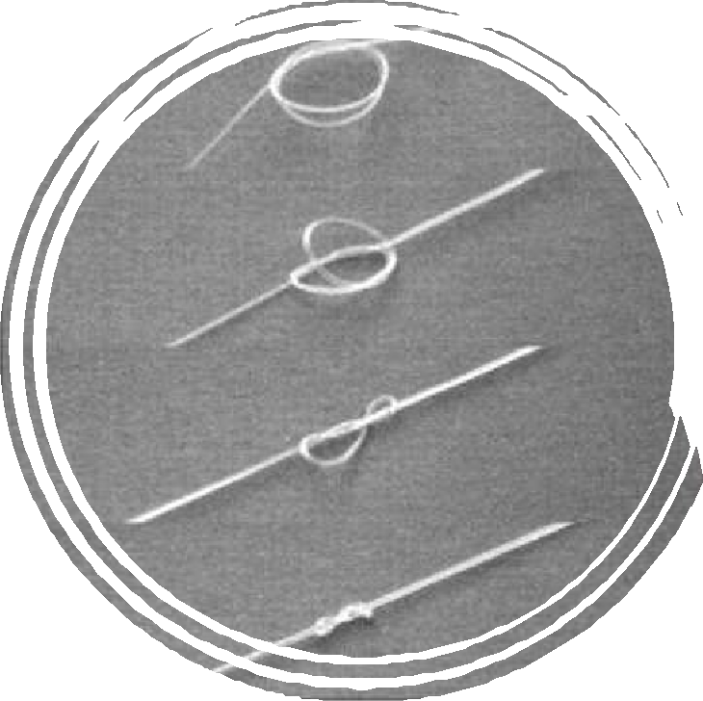
Sutures can be classified according to tensile behaviour into elastic (high-memory) and plastic (low-memory).
Memory is defined as the ability of a suture to return to its original strength and coil once any tension acting on it is released.
Synthetic sutures have more tendency to demonstrate memory.
The greater the memory of a suture, the lesser its knot security.
Tensile Behaviour
Plastic, Elastic

Slide 17

Tensile Strength
This is expressed as the force required to break a suture when its two ends are pulled apart. This is a useful approximation of its strength in the tissues (strength in vivo). It depends on:
  Time in vivo
  Caliber
  Material
15

Slide 18
Tensile Strength
Time in Vivo
Non-absorbable sutures retain their tensile strength in vivo much longer than absorbable sutures. Most non- absorbable sutures however, do not maintain their tensile strength indefinitely and may degrade or fracture with time.
Caliber
The tensile strength of any given suture material would fall with a decrease in caliber.
Caliber is classified according to diameter
in tenths of a millimeter.
Metric (EurPh) | Diameter Range (mm) | USP
1 | 0.100-0.149 | 5-0
1.5 | 0.150-0.199 | 4-0
2 | 0.200-0.249 | 3-0
3 | 0.300-0.349 | 2-0
3.5 | 0.350-0.399 | 0
4 | 0.400-0.499 | 1
5 | 0.500-0.599 | 2

Slide 19
Tensile Strength
Material
The tensile strength of sutures vary from one material to the other.
And the tensile strength of various materials degrade at different rates in vivo.
Absorbable sutures lose their tensile strength faster when exposed to digestive enzymes in the gut.

Slide 20
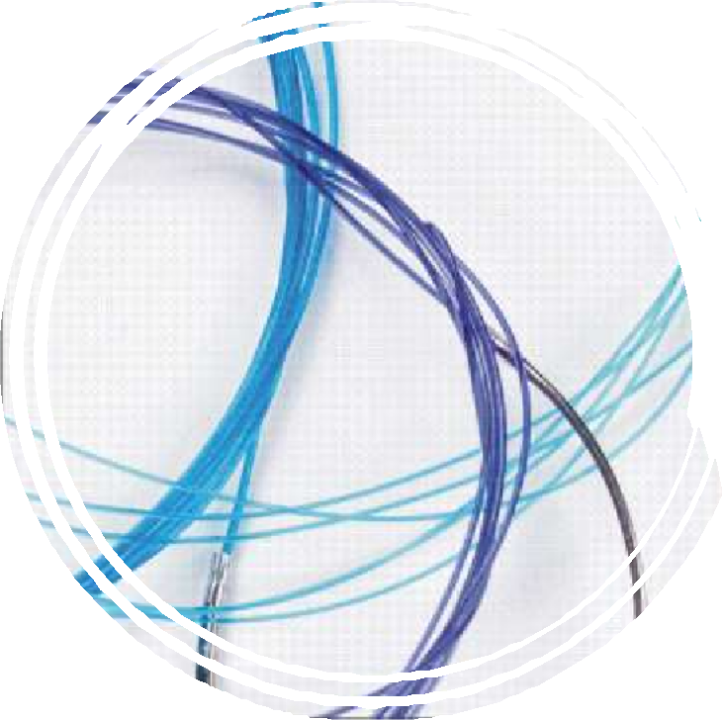
Absorbability
Absorbable sutures are sutures that undergo rapid degradation in tissues, losing their tensile strength within 60 days.
Non-absorbable sutures generally maintain their tensile strength in tissues for longer than 60 days.
Absorbable, Non-absorbable

Slide 21
Absorbable sutures are made from collagen fibers of healthy mammals (natural) or biodegradable chemical polymers (synthetic).
Absorbable sutures are degraded by tissue enzymes while non-absorbable are encapsulated and walled off by tissue fibroblasts.
Absorbability
Absorbable, Non-absorbable

Slide 22
Absorbability
Factors that affect absorbability of a suture include
  Origin – natural or synthetic
  Exposure to digestive enzymes in the gut
  Exposure to fluid – in vitro or in vivo e.g. pus, urine
  Fever or infection
  Protein deficiency
Absorbable, Non-absorbable

Slide 23
Absorbability
 | Absorbable | Non-absorbable
Advantages | No residual foreign body left in vivo Useful in fast-healing tissue | Prolonged wound support time
Disadvantage | Short tissue support time | Foreign body left Cost and trauma of suture removal May stick out and/or lead to sinus formation

Slide 24
Absorbability
Tensile strength and absorbability of sutures
Suture | Tensile Strength Loss | Absorption in Tissue
Catgut | 15 days | 60 days
Chromic Catgut | 30 days | 80-120 days
Polyglyconic acid (Dexon) | 30 days | 90 days
Polyglactin (Vicryl) | 32 days | 70 days
Irradiated Polyglactin (Vicryl Rapide) | 14-21 days | 56-70 days
Polydioxanone | 56 days | 180 days
Nylon | 25% in 2 years | –
Prolene | Indefinite | –
Dacron | Indefinite | –

Slide 25
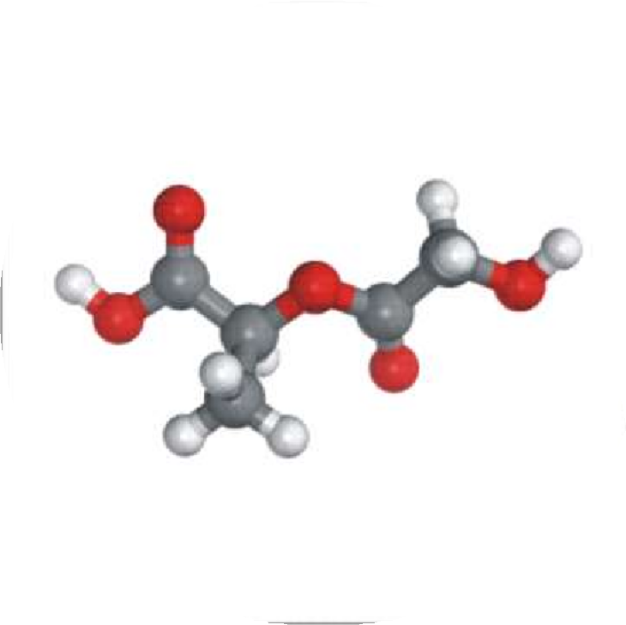
Origin
Sutures can be classified based on their origin into natural and synthetic.
Natural sutures have biological origins while synthetic sutures come from chemical polymers.
Natural, Synthetic

Slide 26
Origin
 | Natural | Synthetic
Advantages | Better handling and knot security Rapid absorption of natural absorbable sutures – suitable for apposition of rapidly healing tissues and ligation of superficial vessels | Absorption by hydrolysis – provokes less inflammatory response Synthetic absorbable sutures have predictable rate of absorption
Disadvantages | Natural absorbable sutures provoke a worse tissue reaction They fray during knot construction More variability in tensile strength in vivo | Poor handling – monofilament

Slide 27
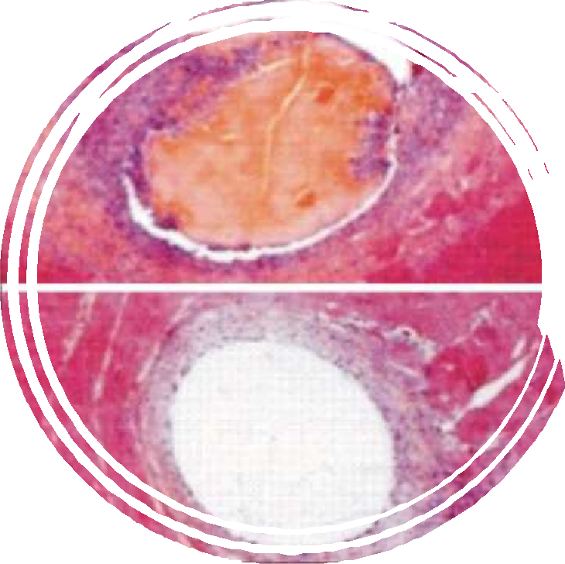

Biological Behaviour
This refers to the behaviour of suture materials within tissues.
Natural sutures such as catgut are degraded by proteolysis which involves and entirely unpredictable process and can cause varying severity of tissue irritation. Hence, catgut is seldom used.
Synthetic polymers are degraded by hydrolysis. Their in vivo degradation process is more predictable.
Proteolytic, Hydrolytic

Slide 28
Biological Behaviour
Evidence indicates that cancer cells migrate to sites where sutures persist therefore synthetic sutures may be less carcinogenic on account of more predictability and less tissue reaction.
Catgut has been banned in Europe and Japan on account of fears that it may transmit bovine spongiform encephalopathy.
Proteolytic, Hydrolytic

Slide 29


Monofilament absorbable sutures – when there is a risk of infection.
Thin monofilament absorbable sutures – running intradermal sutures.
The smallest suture usable – suturing cosmetically sensitive skin. (Trials show no major difference between absorbable and non-absorbable sutures in cosmesis, complications or scarring).
Sutures with longer absorption time – if using absorbable sutures for areas where more strength is required.
CLINICAL CONSIDERATIONS
Choosing Your Sutures

Slide 30
CLINICAL CONSIDERATIONS
Choosing Your Sutures
Non-absorbable or slow absorbing sutures – for slow healing tissues or where prolonged tension is required for adequate healing like fascia, tendons, ligaments and bones.
Absorbable sutures – fast healing tissues like stomach, colon, and bladder.
Absorbable sutures – for ligatures.
Natural sutures are not advisable within the gut due to digestion.
Synthetic absorbable sutures – tracts prone to stone formation
e.g. urinary and bilary.
Non-absorbable sutures – vascular surgery.
https://www.youtube.com/watch?v=CHMO-fUi8Js common sutures
https://www.youtube.com/watch?v=vRTNwSweU5Y surgical suture needles
https://www.youtube.com/watch?v=cfZz9D9yKWA !!! 30 мин

Slide 31

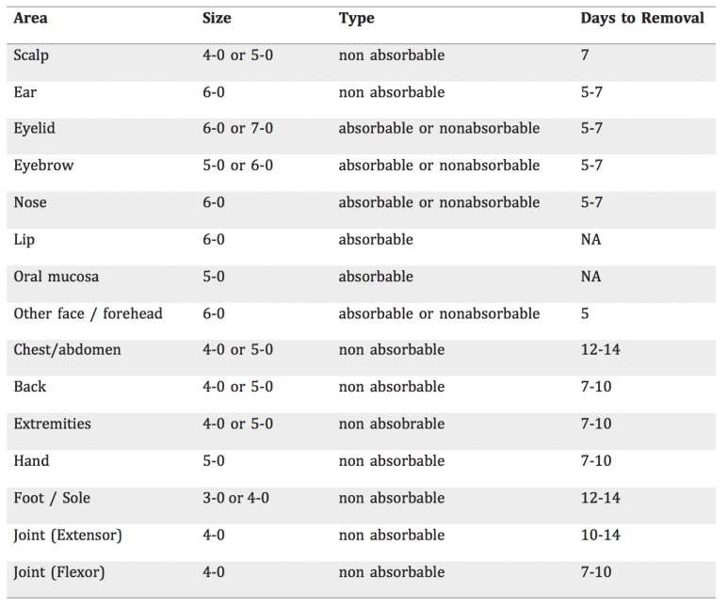

CLINICAL CONSIDERATIONS
Size, type and intervals for removal of skin sutures

Slide 32
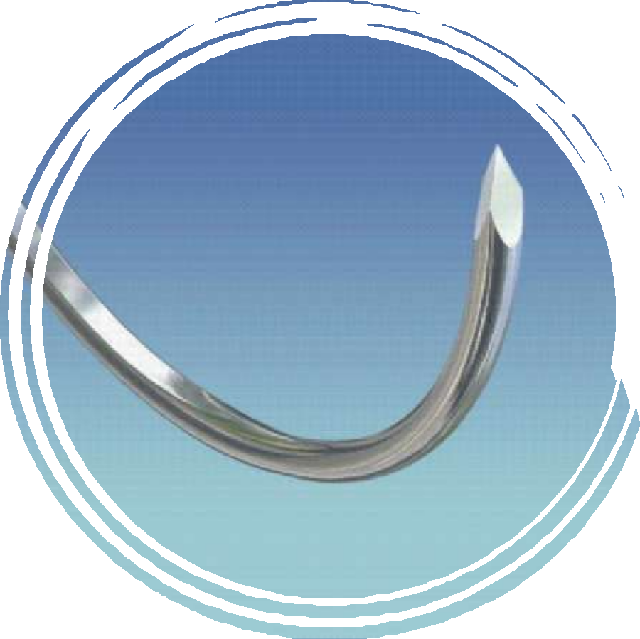
NEEDLES
CHARACTERISTICS ANATOMY
CLINICAL CONSIDERATIONS

Slide 33
Characteristics of the ideal surgical needle
It is made of high-quality stainless steel
It has the smallest diameter possible
It is stable in the grasp of the needle holder
It is capable of implanting suture material
through tissue with minimal trauma
It is sharp enough to penetrate tissue with minimal resistance
It is sterile and corrosion-resistant to prevent introduction of microorganisms or foreign materials into the wound
CHARACTERISTICS

Slide 34
ANATOMY
Basic Design Specifications Shapes
Butt: Eye or Swage Body and Tip

Slide 35
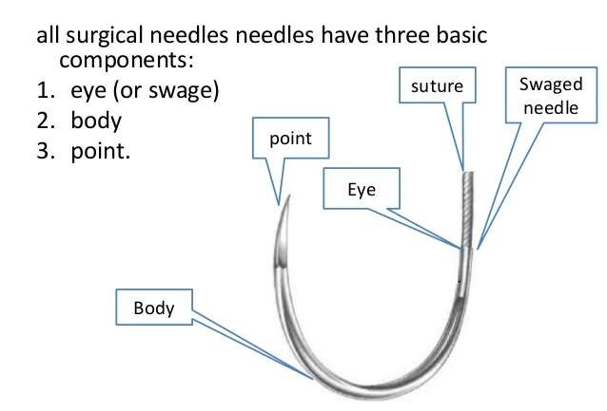

Basic Design
All surgical needles have three basic components:

Slide 36
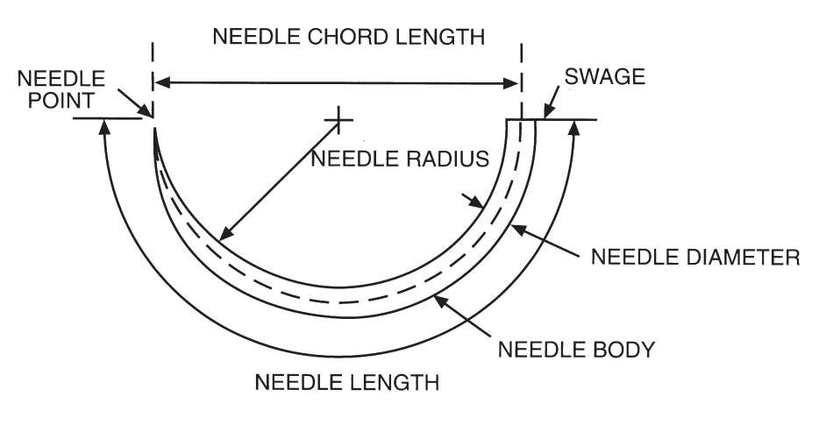
Specifications

Slide 37
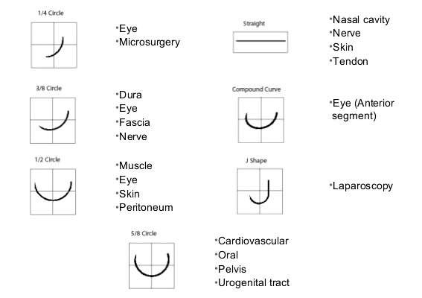
Shapes

Slide 38
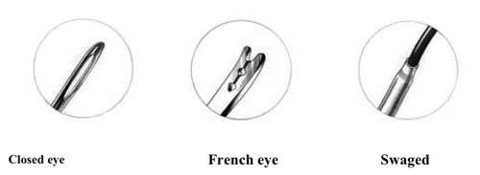
Butt: Eye or Swage
Disadvantages of eyed to swaged needles
Time consuming
Traumatic – tissue disruption
Repeated use

Slide 39
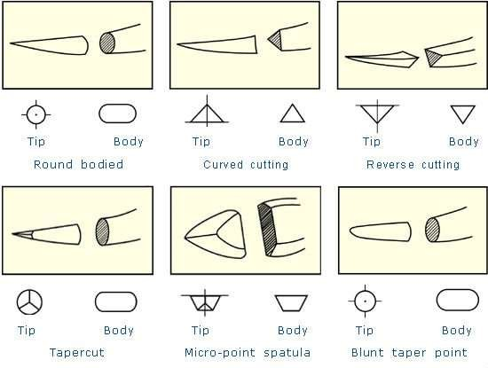
Body andTip

Slide 40
Straight needles are used by hand on easily accessible tissues like skin, nerves and blood vessels.
Needles with shallower curvatures like ¼ and ⅜ are useful in superficial procedures and on easily accessible convex surfaces. Examples include subcuticular skin closure and eye surgeries.
Needles with deeper curvatures like ½ and ⅝ are ideal for operating in confined spaces and deep cavities like the pelvis.
J-shaped and half-curved needles are used for laparoscopic procedures while compound needles are ideal for anterior segment eye surgeries.
CLINICAL CONSIDERATIONS
Choosing Your Needles: Shapes

Slide 41
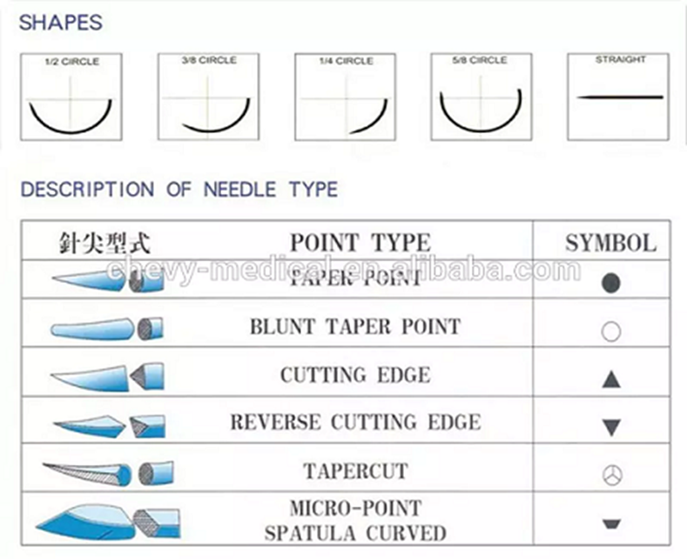

Slide 42
CLINICAL CONSIDERATIONS
Choosing Your Needles: Body and Tip
Cutting needles are used in tough tissues like skin and tendons. They are also ideal for cosmetic and ophthalmic surgery where minimal trauma is paramount. Reverse-cutting needles serve the same functions but are stronger and less likely to cut through tissues.
Round-bodied needles spread tissues apart as they pass through with minimal cutting and are ideal for easily penetrated tissues like abdominal viscera and peritoneum. They are also less likely to cause leakage of needle tracks after internal anastomoses.
Blunt tipped needles are ideal for easily pliable tissues like liver and kidneys.
The spatula needle used in ophthalmic surgeries to penetrate between corneal and scleral layers without tissue disruption.

Slide 43

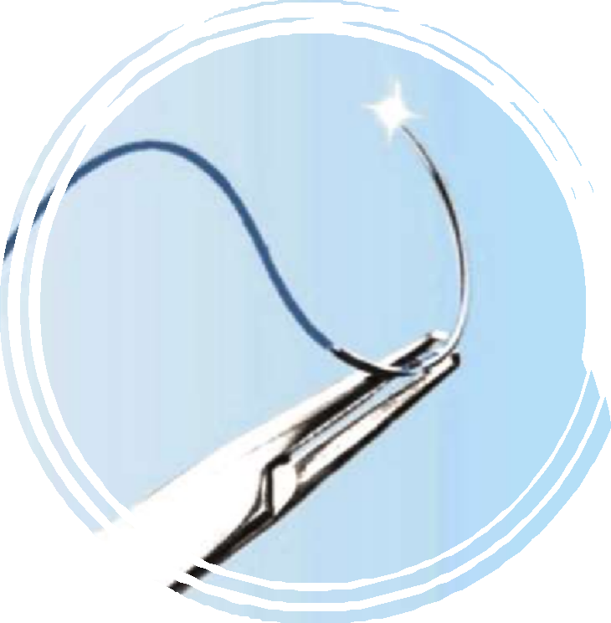
CLINICAL CONSIDERATIONS
Grip the needle with optimal force using a needle holder selected to match its size and strength to avoid damage and distortion of its curvature.
Needle holders with worn, nicked or defective jaws can cause needle instability and subsequent tissue trauma.
Do not grip the needle at its tip to avoid bluntness, or at its butt to avoid instability. It is best to place your grip one-third the length of the needle from the butt.
Using Your Needles

Slide 44
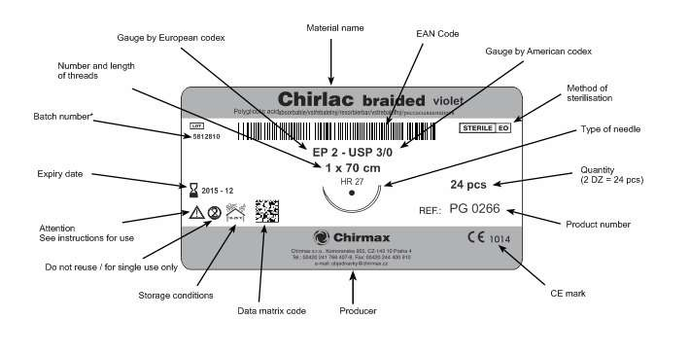
PACKAGING

Slide 45

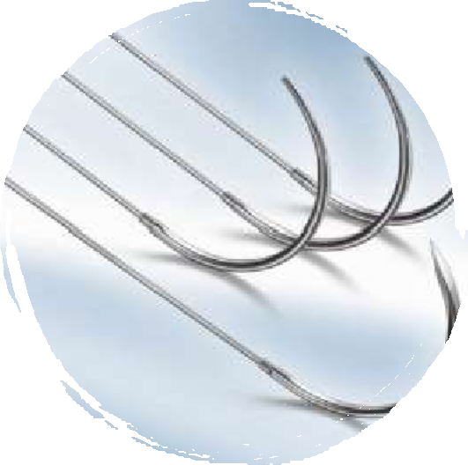
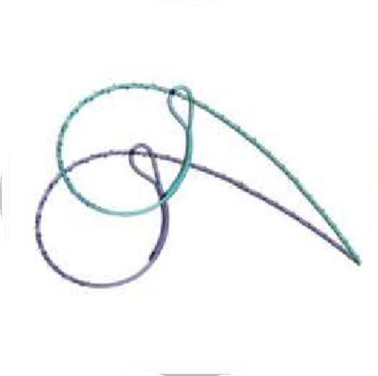
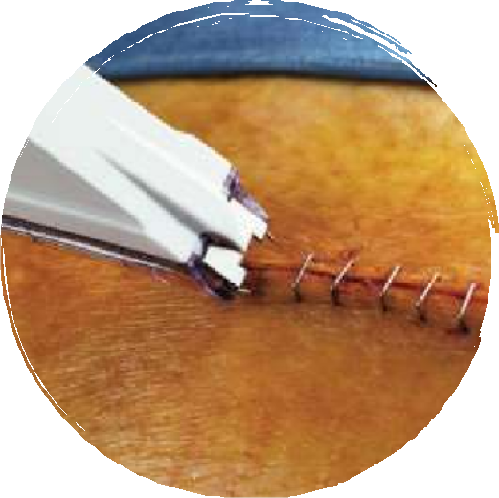

ALTERNATIVES
Alternatives to traditional sutures include the following.
Metallic Sutures
Stainless steel, aluminum, silver etc
Barbed Sutures
Knotless sutures
Surgical Staples
Skin staples
Advantages: Inert. High tensile strength for longer period. Aluminum sutures cause rapidly increasing wound tensile strength even after removal of sutures. Silver has antibiotic properties.
Disadvantages: Difficult to knot, pain when sutures fracture in vivo.
Advantages: Tissue passage in only one direction. Distributes tension uniformly along length of wound. Does not need knots and therefore reduces length of surgery and mass of foreign body in vivo.
Disadvantages: Cutting barbs into a suture reduces its functional diameter and consequently, its tensile strength.
Advantages: Useful in apposition of wounds under tension. Quick placement. Minimal tissue reaction. Absorbable staples useful in laparoscopic surgeries.
Disadvantages: Cost. Less precise wound edge alignment
42

Slide 46
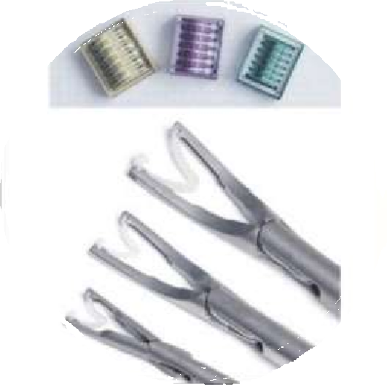
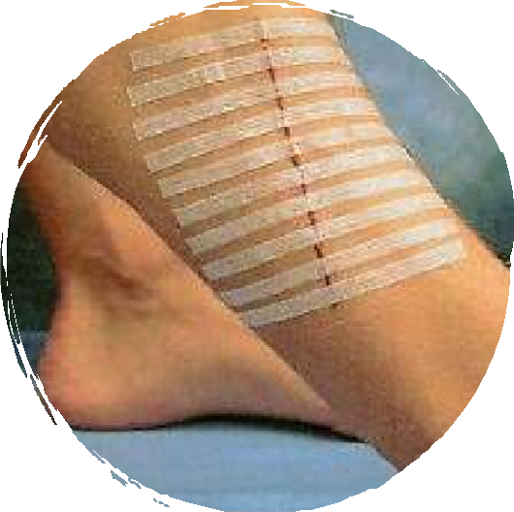

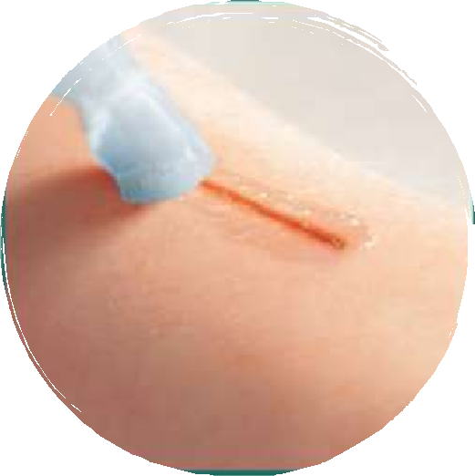
ALTERNATIVES
Skin Tapes
Sutureless skin closure
Skin Adhesives
Acrylate superglues
Surgical Clips
Advantages: Essential in laparoscopic surgery.
Good residual vascular length of grafts in transplant surgery.
Disadvantages: Cost. Metallic clips may interfere with CT and erode into tissues.
Advantages: Prevents tension across wound, avoids post-operative scarring. Reduces time of surgery.
Disadvantages: Loss of adhesiveness may lead to wound dehiscence. Difficulty ensuring accurate skin edge apposition. Effectiveness depends largely on skill of operator.
Advantages: Rapid, painless application. Good cosmesis – no suture marks. Blocks pin point skin haemorrhages. Bacteriostatic.
Disadvantages: Less tensile strength. High cost.

Slide 47

CONCLUSION
The use of sutures and needles for primary closure and ligature is of utmost importance in surgery. There is a great variety of these suited for different procedures and operations. The surgeon now has options to work with and by an in-depth understanding, will achieve the best outcomes.

Slide 48
REFERENCES
Bailey, H.H., Love, R.J., 2018. Bailey & Love's Short Practice of Surgery. 27th ed. Boca Raton, Florida: CRC
Press.
Badoe, E.A., Archampong, E.Q., 2015. Baja's Principles and Practice of Surgery. 5th ed. Tema: Ghana Publishing Corporation.
Al-Fallouji, M.A., 1998. Postgraduate Surgery The Candidate's Guide. 2nd ed. Jordan Hill, Oxford:
Butterworth-Heinemann.
Edlich, R.F., 2010. Scientific basis for the selection of skin closure techniques. Journal of Environmental Pathology, Toxicology, and Oncology, [Online]. 29(4), 363-72. Available
at: https://www.ncbi.nlm.nih.gov/pubmed/21284598 [Accessed 13 April 2019].
Rose, J., Tuma, F., (2019) Sutures And Needles. [ONLINE] Available at: https://www.ncbi.nlm.nih.gov/books/NBK539891/#article-29779.s1 (Accessed 13 April 2019).
Medscape. 2018. Suturing Techniques Periprocedural Care. [ONLINE] Available
at: https://emedicine.medscape.com/article/1824895-periprocedure#b5. [Accessed 13 April 2019].
Jamaica Hospital. 2016. History of Sutures. [ONLINE] Available
at: https://jamaicahospital.org/newsletter/?p=3250. [Accessed 13 April 2019].

Slide 49
REFERENCES
Arfan, A.S., (2015), Surgical Needles Basics [ONLINE]. Available
at: https://www.slideshare.net/shourov999/surgical-needles-basics [Accessed 13 April 2019].
Docnesia.com. 2018. Surgical Instruments 101 (Blade, Suture, Needle). [ONLINE] Available
at: http://docnesia.com/en/instrumen-bedah-101-blade-benang-jarum/. [Accessed 13 April 2019]
Basrah Teaching Hospital, (2013), Suture in Ophthalmic Surgery [ONLINE]. Available
at: https://www.slideshare.net/doctorofeye/suture-in-ophthalmic-surgery [Accessed 13 April 2019].
Chirmax, (2019), Labels Description [ONLINE]. Available
at: https://www.chirmax.cz/chirmax_multi/index.php?stranka_id=86&jazyk=3j [Accessed 13 April 2019].
Quizlet, (2019), Sutures-Surgical Needle [ONLINE]. Available at: https://quizlet.com/169812539/sutures- surgical-needle-flash-cards/ [Accessed 13 April 2019].
Canadiem, (2015), Nice threads: a guide to suture choice in the ED [ONLINE]. Available at: https://canadiem.org/nice-threads-guide-suture-choice-ed/ [Accessed 13 April 2019].
Laboratory Equipment. 2019. Understanding and Selecting Surgical Suture and Needle. [ONLINE] Available at: https://www.laboratoryequipment.com/article/2013/09/understanding-and-selecting-surgical-suture- and-needle. [Accessed 16 June 2019].

Slide 50
REFERENCES
Greenberg, J.A., Randi, H.G., 2013. Barbed Suture: A Review of the Technology and Clinical Uses in Obstetrics and Gynecology. Reviews in Obstetrics and Gynecology, [Online]. 6(3-4), 107-115. Available at: https://www.ncbi.nlm.nih.gov/pmc/articles/PMC4002186/ [Accessed 16 July 2019].
Medscape. 2018. What are the advantages and disadvantages of the use of staples for wound closure?. [ONLINE] Available at: https://www.medscape.com/answers/1824895-32143/what-are-the-advantages- and-disadvantages-of-the-use-of-staples-for-wound-closure. [Accessed 16 July 2019].
Medscape. 2018. What are the advantages of superglues (tissue adhesive) for wound closure?. [ONLINE] Available at: https://www.medscape.com/answers/1824895-32144/what-are-the-advantages-of- superglues-tissue-adhesive-for-wound-closure. [Accessed 16 July 2019].
Lui, Y., Huang, Z., et al, 2018. Staplers or clips? A systematic review and meta-analysis of vessel controlling devices for renal pedicle ligation in laparoscopic live donor nephrectomy. Medicine, [Online]. 97(45), 13116. Available at: https://journals.lww.com/md-
journal/Fulltext/2018/11090/Staplers_or_clips A_systematic_review_and.50.aspx [Accessed 16 July 2019].
Al-Mubarak, L., Al-Haddab, M., 2013. Cutaneous Wound Closure Materials: An Overview and
Update. Journal of Cutaneous and Aesthetic Surgery, [Online]. 6(4), 178-188. Available
at: https://www.researchgate.net/publication/259957582_Cutaneous_Wound_Closure_Materials_An_Ove rview_and_Update[Accessed 16 July 2019].
47

Slide 51
THANK
YOU
48

