Slide 1
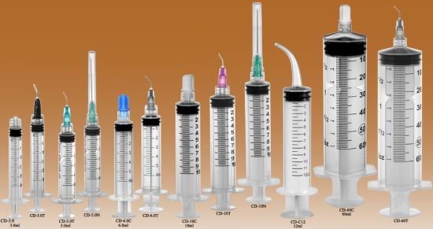
COMMODITY ANALYSIS OF INSTRUMENTS AND DEVICES FOR PUNCTURES, INJECTIONS, TRANSFUSIONS AND SUCTION.

Slide 2
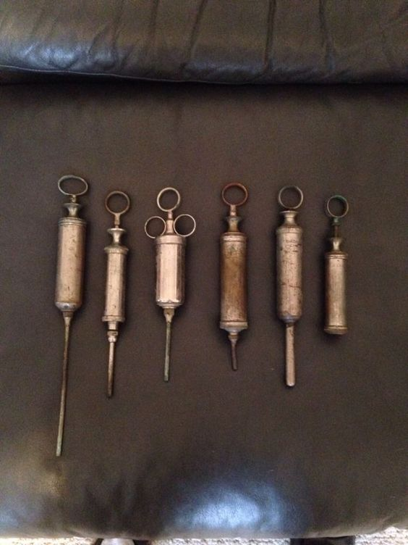
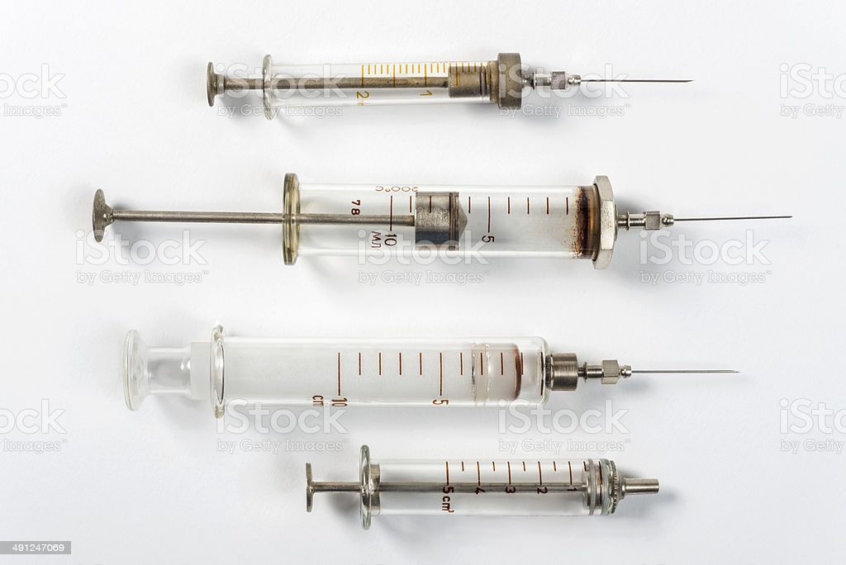
Syringes were invented long before hypodermic needles. their origins are found in Greek and roman literature. Simple piston syringes for delivering ointments and creams for medical use were described by galen (129-200 ce) and an egyptian, Amar bin ali al-mawsili, reported using glass tubes to apply suction for cataract extraction from about 900 ce.
Medical syringes were once made of metal or glass, and required cleaning and sterilization before they could be used again. now most syringes used in medicine are plastic and disposable.

Slide 3
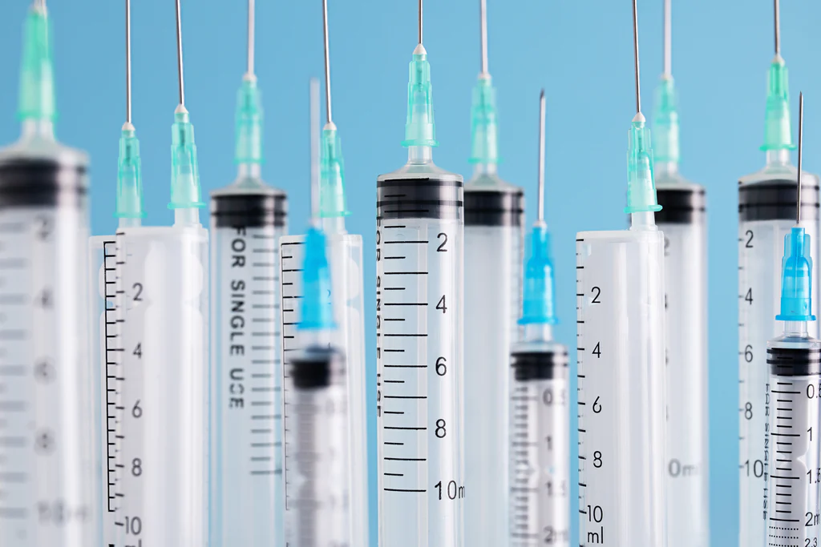
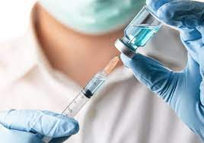
The syringe is nothing but a tube with a nozzle with a piston for sucking in and ejecting the liquid in a thin stream, which is then used for body cavities or cleaning wounds, or are fitted with a hollow needle for injecting or withdrawing fluids.
According to the World Health Organization, about 90% of the medical syringes are used to administer drugs, 5% for vaccinations and 5% for other uses such as blood transfusions.

Slide 4
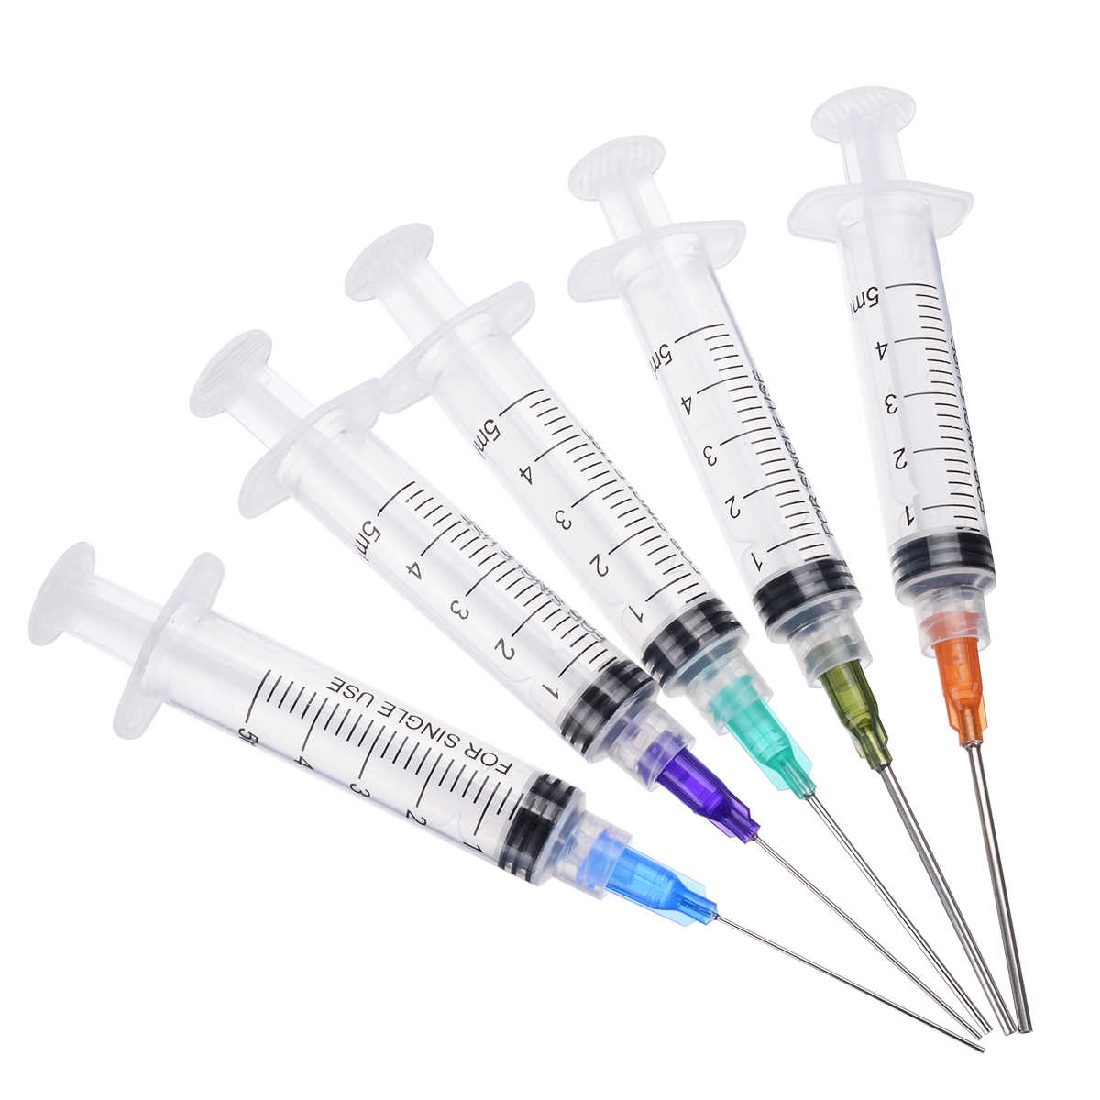

Syringe:
A medical device that is used to inject fluid into, or withdraw fluid from, the body. A medical syringe consists of a needle attached to a hollow cylinder that is fitted with a sliding plunger. The downward movement of the plunger injects fluid; upward movement withdraws fluid.

Slide 5
The syringe is nothing but a tube with a nozzle with a piston for sucking in and ejecting the liquid in a thin stream, which is then used for body cavities or cleaning wounds, or are fitted with a hollow needle for injecting or withdrawing fluids.
According to the World Health Organization, about 90% of the medical syringes are used to administer drugs, 5% for vaccinations and 5% for other uses such as blood transfusions.

Slide 6
The various uses of syringe includes:
Injecting medicines into the body is step one.
Into the bloodstream intravenous treatment
Applying substances such as glue or lubricants
Previously, syringes were formed of metal or glass and had to be cleaned and sterilised before being used again, but now medications are given using plastic and disposable syringes.

Slide 7
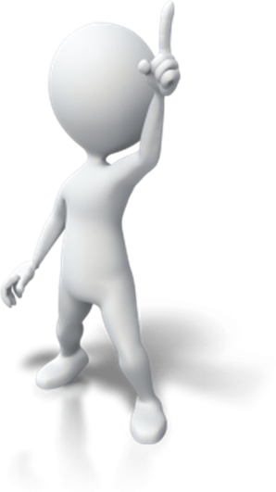
The Types of Disposable Syringes
While simple in concept, syringes have multiple variants and parts that are interchangeable depending on the intended use of the syringe. Generally speaking, these are factors that may vary dependent on the syringe being used.
Size
Tip
With / Without Needles
Needle Length
2-part Disposable Syringe
3-part Disposable Syringe

Slide 8
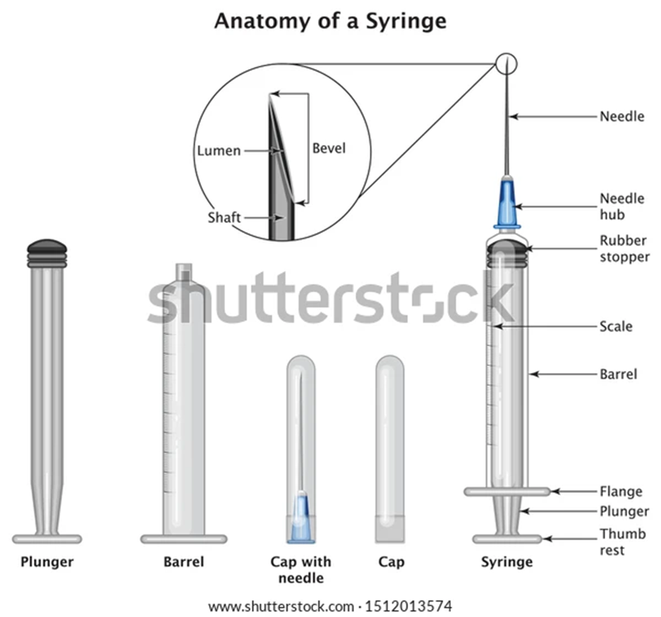

Slide 9
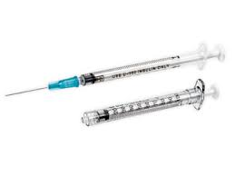
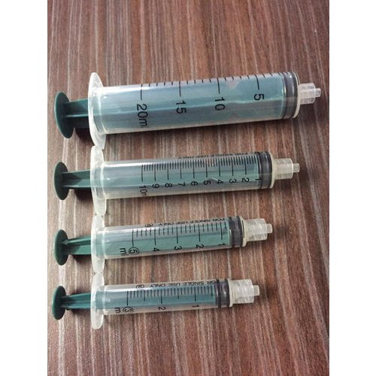
Classification of disposable syringes
By on their capacity of the cylinder:
• small capacity (0.3; 0.5 and 1 ml) - for accurate administration drug, as well as for vaccination and allergy intradermal tests;
• standard capacity (from 2 to 22 ml) - for subcutaneous use (syringes up to 3 ml),intramuscular (2 to 6 ml), intravenous(10 to 22 ml) and other injections;

Slide 10
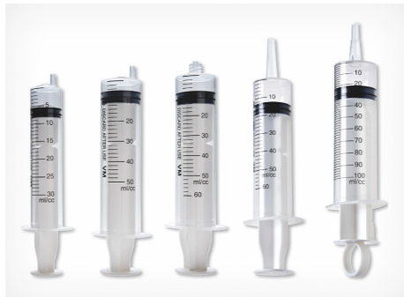
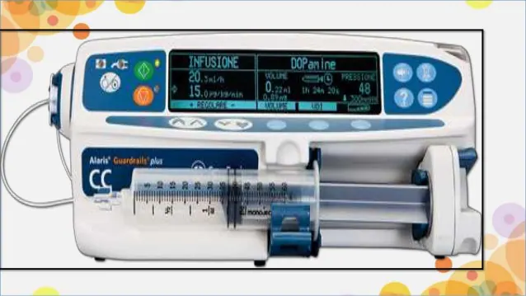
• large capacity (30, 50, 60 and 100 ml) - for liquid suction, introduction of nutrient media, washing cavities.

Slide 11
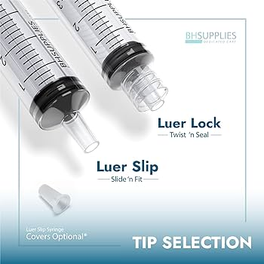
German surgical instrument maker Hermann Luer invented Luer Lock and Luer Slip syringes in the late 1800s. He designed them to provide a leak-free connection between needles and syringes while maintaining a continuous fluid flow lumen.
Luer Lock Tip
At the tip of a Luer Lock syringe, you’ll find an internal thread where the needle attaches in a screw-like fashion. Turning the needle clockwise locks it in place. Turning counterclockwise allows it to detach.
The Benefits of a Luer Lock
The advantage of a Luer Lock design is that it creates a more secure attachment. This allows for the connection to sustain higher pressures with a reduced risk of leaks or pop-off.

Slide 12
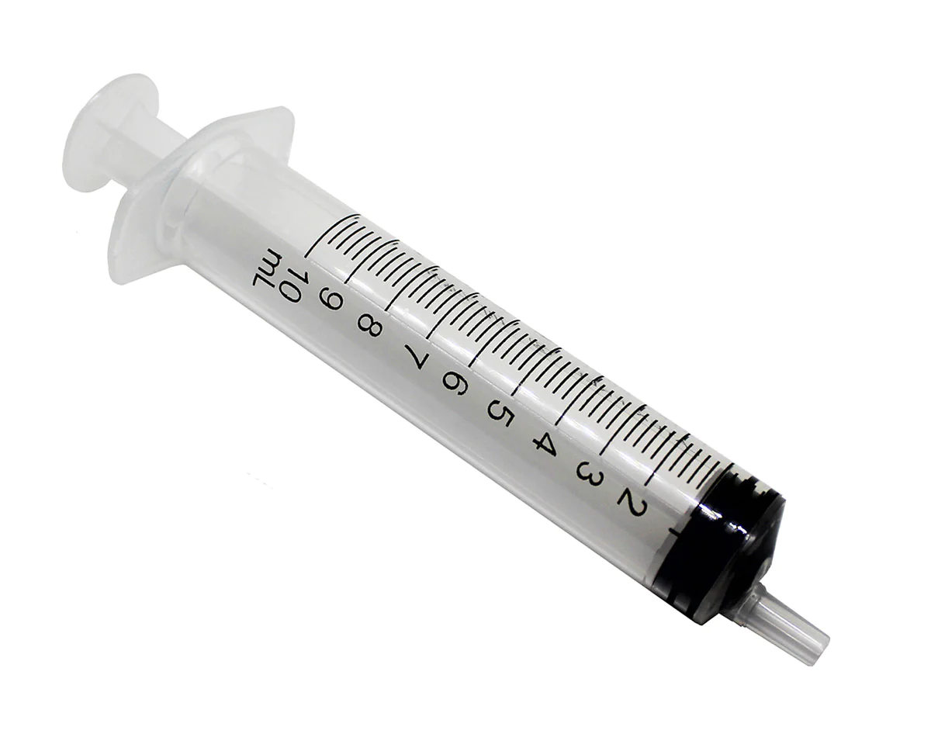
Luer Slip Tip
Luer Slip syringes use a friction-fit connection method. A needle’s hub is pushed onto the syringe tip in a twisting motion for a tight fit.
The Benefits of a Luer Slip
A Luer Slip design allows for a needle to be conveniently attached more quickly.
Luer Slip

Slide 13
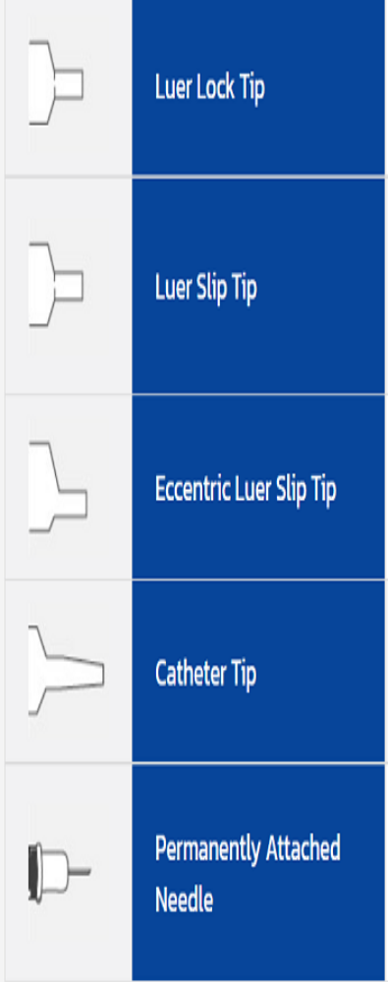
Generally used for injections requiring a secure connection of the syringe to another device. The tip is threaded for a “locking” fit, and is compatible with a variety of needles, catheters and other devices.
Luer Slip Tip A friction-fit connection that requires the clinician to insert the tip of the syringe into the needle hub of other luer connection in a push-and-twist manner. This will ensure a connection that is less likely to detach. Simply sliding the attachment device onto the syringe tip may not ensure a secure fitting.
Eccentric Luer Slip Tip Allows for work requiring closer proximity to the skin. Generally used for venipunctures and aspiration of fluids. (Also see luer slip instructions above.)
Catheter Tip Used for flushing (cleaning) catheters, gastrostomy tubes and other devices. Insert catheter tip securely into catheter or gastrostomy tube. If leakage occurs, refer to your facility’s guidelines.
Permanently Attached Needle Most commonly found in insulin and ‘tuberculin’ syringes. Permanently attached needles, also known as integral needles, reduce the ammount of medication waste and allow accurate mixing of different medications into one syringe.

Slide 14
The second classification consists of:
1) Insulin Syringes.
2) Tuberculin Syringes.
3. Multi-Shot Needle Syringe
4) Venom Extraction Syringe
5) Oral Syringe
6) Dental Syringe

Slide 15
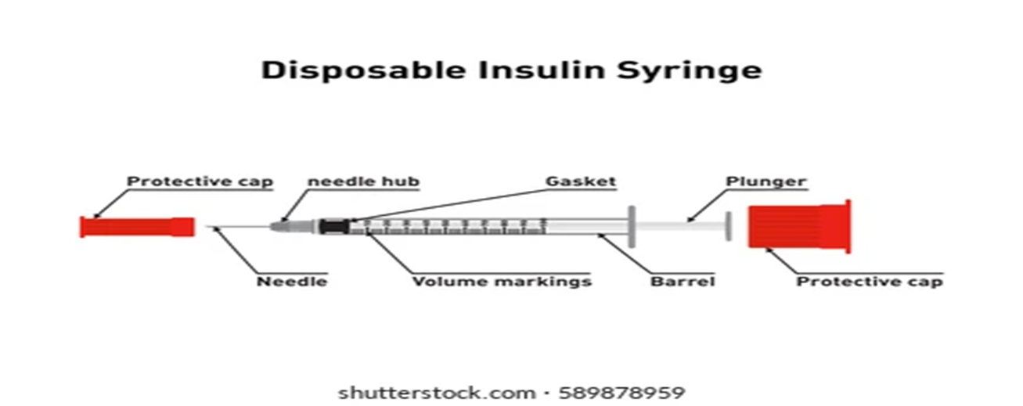
Insulin Syringe
Small in size, hold between 0.3 and 1 ml of medication.
Calibrated in units (mostly up to 100 units).
Designed for self injection.
Used to give subcutaneous injection.

Slide 16
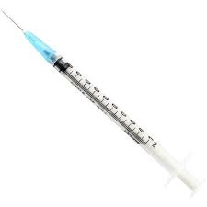

One of the more common types of syringes, these are for single-use and are inexpensive. They commonly have a U-100 marking on them that indicates the concentration of 100 units of insulin per 1 ml. and often incorporate a fine needle.
BD Ultra-Fine Short Needle Insulin Syringe can be used to inject insulin.
Tuberculin Syringe:
1. Small in size, hold up to 1 ml of fluid
2. Calibrated in millimeters.
3. Has a long thin barrel with a pre-attached needle used for tuberculosis testing.
4. Injected right into the skin (intradermal vaccine).

Slide 17
Multi-Shot Needle Syringe
These special syringes are designed to refill after each injection from a built-in reservoir to give several dosages using the same syringe. These types of needles are rarely used due to a risk of contamination.

Slide 18
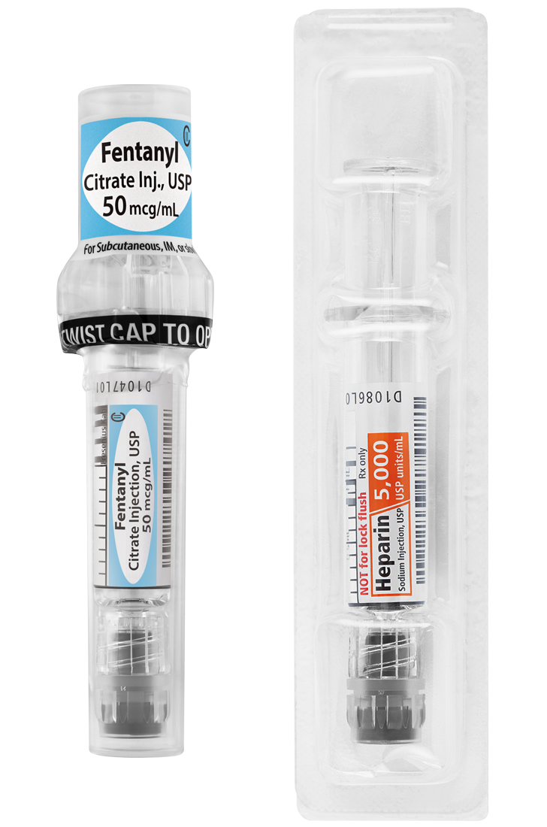
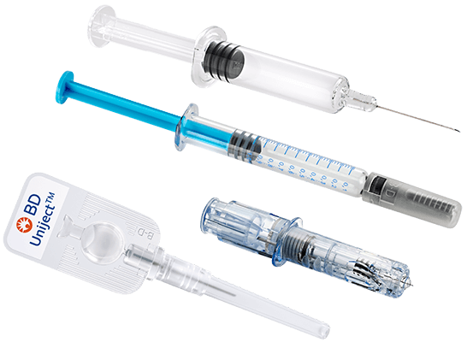
A prefilled syringe is a single-dose packet of vaccine or drugs to which a needle has been fixed by the manufacturer.
Prefilled syringes have actually been around for more than two decades.
The advantages prefilled syringes have over traditional packaging in vials include ease of use. Prefilled syringes essentially eliminate the processes that are required before you use a drug in a vial. Additionally, it helps
eliminate dosing errors because prefilled syringes actually contain the exact dose. Many Pharmaceuticals manufacturers overfill vials by up to 25% to make sure the end user is guaranteed to withdraw the dose required.

Slide 19

Venom Extraction Syringe
These syringes are specially designed to extract exudate (venom) from the wound without puncturing the wound. These syringes create a vacuum that sucks out the poison from the wound.

Slide 20
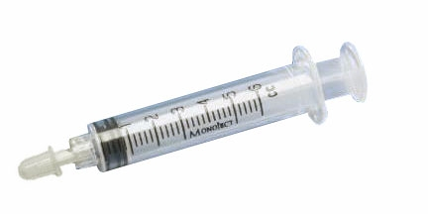
Oral Syringe
These are syringes that are used as a measuring instrument for measuring the dosage of medicines accurately. They are often used with small children or animals to deliver drugs directly into the mouth.

Slide 21
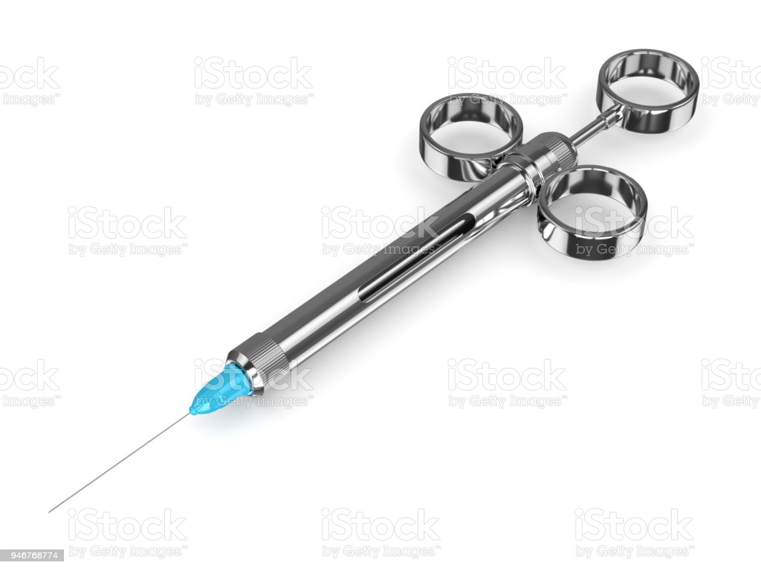
Dental Syringe
The dentist uses these syringes to administer the anesthetic solution. And it is also used to supply water, compressed air, or mist to the oral cavity for cleaning debris away from the area the dentist is working on.

Slide 22
Types of injection needles:
Needles are mainly differentiate on the basis of length and diameter.
Length range: ½ inch-3 inches.
Needle Length – The length of a needle usually parallels the intended depth of injection. Longer needles are used to insert areas deeper into the body (Such as with intramuscular injections) while shorter needles can be used for injections closer to the surface.
Diameter range: 7 gauge-33 gauge.
As the needle gauge gets bigger, the needle’s diameter gets smaller.

Slide 23
Gauge selection is based on:
1) Concentration of medication given.
2) Body size and age of an individual.
3) Mobility status of the patient.
4) Required absorption rate for medication.
Long needles are use for intramuscular medications and shorter needles for subcutaneous medications.

Slide 24
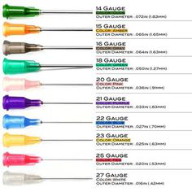
1. Intravenous needle:
Inserted into the vein of a person.
2. Safety needles:
These are use nowadays in almost all medical setting, to reduce the risk of the patient getting stuck with an infect needle.
3. Winged needle:
It is also name as a butterfly needle, hold by its wings and attach to a slender, flexible catheter line. Various needles commonly utilized with injections gauges in relation to their colors.

