Slide 1

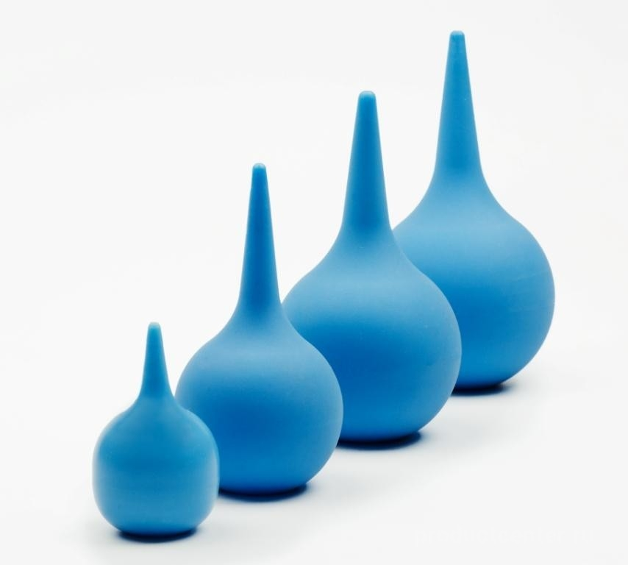
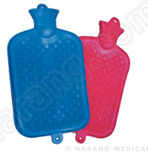
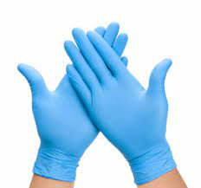
MINISTRY OF HEALTH OF UKRAINE
ODESSA NATIONAL MEDICAL UNIVERSITY
Department of Pharmacy Organization and Economics
LECTURE № 5. COMMODITY ANALYSIS OF RUBBER PRODUCTS AND PATIENT CARE ITEMS.
Prepared by senior teacher Oksana Stepanova

Slide 2

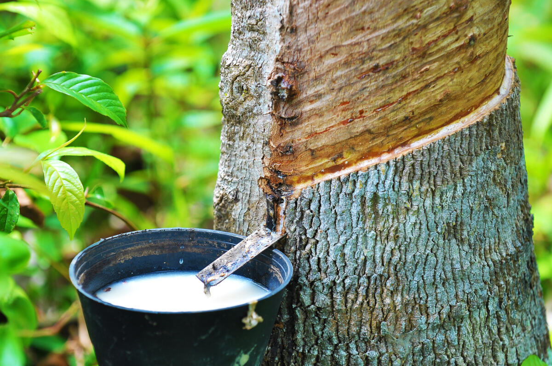
Rubber is a versatile material that has become increasingly important in the medical industry over the years. As one of the world’s fastest growing and largest industries, the health care sector makes up more than 10% of the gross domestic product of most developed countries.
Versatility of rubber
Rubber has become a common base for medical supplies because of its low cost and availability. Initially, natural rubber was used, but after the synthetic form of the material, silicone, became widely available, this was an added bonus. Patients who were allergic to natural rubber were able to use synthetic rubber, maximising the use of rubber products in every department.

Slide 3
The medical industry consists of various sectors, including the manufacture of medical equipment to diagnose and monitor health conditions, the production of medicines and medical products, hospitals, GPs’ surgeries, health care facilities and more.
A very wide range of categories of care depend on rubber. Rubber’s versatility enables it to set a standard for medical supplies.
Can anything replace rubber?
At the moment, rubber remains a very important material when it comes to the medical industry, not only because of its versatility and ability to adapt, but also because it’s cost-effective. There is currently no viable alternative to the widespread use of rubber and latex.
Ar eport in the Medical Device and Diagnostic Industry Magazine said that a “direct replacement material” with all the properties of natural rubber wasn’t available. It stated that silicone was a good alternative for people with rubber allergies and suggested thermoplastic elastomers could be used instead of natural rubber in some medical devices.

Slide 4
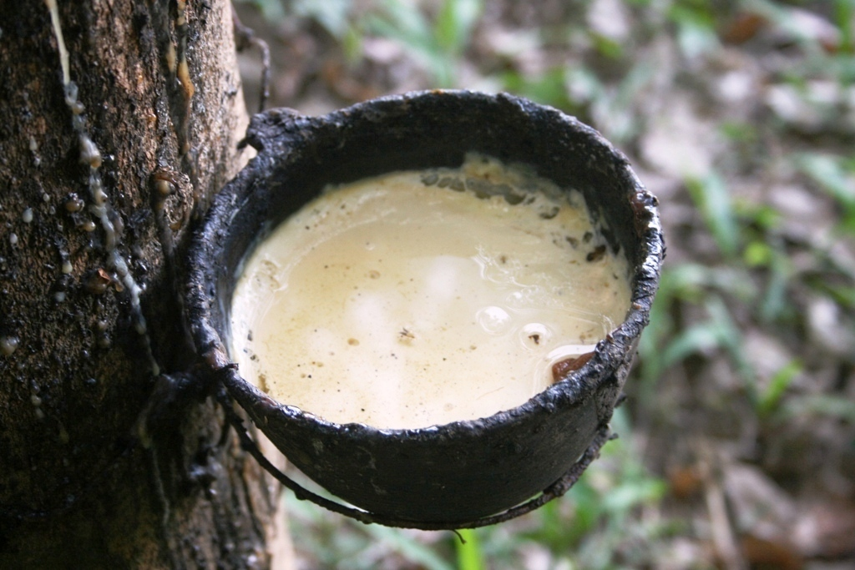
Types of rubber used in making medical products
Natural and Synthetic Rubber
Natural Rubber is an elastic substance obtained from the latex sap of trees, especially those trees which belong to the genera Hevea and Ficus. Technically speaking, natural rubber is an elastomer or an elastic hydrocarbon polymer.
Latex - a milky white liquid, which contains 34-37% rubber, water, protein, resin , sugar and mineral salts. For mixing rubber latex and coagulating solution of acetic or formic acid. The resulting gel is washed with water, passed through rollers, making the plates are dried at a temperature of 45 degrees.
How is Natural Rubber Made? The raw material from which natural rubber is made comes from the sap of rubber trees. The rubber plants are tapped for collecting the rubber latex. For this, an incision is made into the bark of the rubber tree and the latex sap is collected in cups. After collecting the latex sap, the raw natural rubber is refined to convert it into a usable rubber. Initially an acid was added to the latex which used to make the sap set like a jelly.

Slide 5
In the year 1839, Charles Goodyear invented a more sophisticated way of making rubber stronger and more elastic.his was the process of rubber vulcanising - heating in the presence of sulfur.Vulcanization prevents the polymer chains from moving independently.
As a result, when stress is applied the vulcanized rubber deforms, but upon release of the stress, the product reverts to its original shape. The process of vulcanization makes natural rubber a more coherent substance, somewhat soft and having elasticity.The unprocessed natural rubber is sticky, deforms easily when warm, and is brittle when cold. In such a state, it cannot be used to make products having a good level of elasticity.
Properties of Natural Rubber has such characters
as elasticity, toughness, impermeability, adhesiveness, and electrical resistance. All these properties of rubber make it useful as an adhesive, coating composition, a molding compound, and an electrical insulator.

Slide 6
Natural rubber has certain unique properties such as follows:
• Rubber is elastic as well as water-resistant.
• It is resistant to alkalies and weak acids.
• It traps air and thus it floats.
• It is a bad conductor of electricity and thus doesn't conduct electricity.
• Natural rubber combines high strength (tensile and tear) with outstanding resistance to fatigue.
• It has high resistance to cutting, chipping and tearing.
• Natural rubber forms an excellent barrier to water.

Slide 7
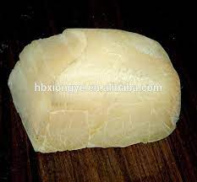
Synthetic Rubber is any type of artificial elastomer, invariably a polymer. It is produced in factories with the use of different catalysts. The feedstocks for synthetic rubber industry are products of the petrochemical industry.
These rubbers are divided into organic, which mainly consist of hydrocarbons or their derivatives; elementoorganic that contain atoms of silicon, sulfur. Raw material for synthetic rubber used oil, natural gas and coal.
Natural or synthetic rubber- both of them in their native form are useless. After addition of chemicals, these rubbers take on properties that cannot be competed by any other known material in the world. Depending on the chemicals used, products made of rubber can be soft, resilient, and/or hard in varying degrees.

Slide 8
Rubber compounds - a composition based on natural rubber, which contain other substances necessary for the processing of natural rubber in rubber. Rubber compounds contain vulcanization accelerators, fillers, plasticizers, substances that prevent the aging of rubber
The technological process of manufacturing medical rubber products consists of the following stages:
1. Obtaining a rubber mixture;
2. Manufacture of semi-finished products - this operation is performed for rubber heaters, ice bubbles, liners, catheters, tubes;
3. Forming or obtaining rubber products is carried out by one of the following methods:

Slide 9
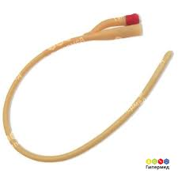
Extrusion begins with an unvulcanized compound being fed into an extruder.
Once it’s inside the extruder, it gets carried forward to a dye, which is a specialized manufacturing tool used to shape the rubber. Once the compound reaches the dye, the pressure from the process forces it through the opening of the extruder. Then, the extruded product will need to be vulcanized prior to being defined “usable”. Extrusion manufacturing has the advantage of being able to produce products in high volumes at a lower production cost. Some of the common rubber products produced from extrusion include probes, tubing, etc.

Slide 10
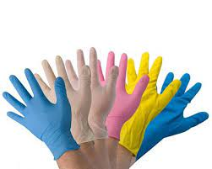
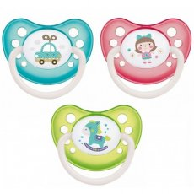
Latex dipping occurs when thin walled molds are immersed into latex compounds and then slowly withdrawn. The thickness of the dipped product can be increased by re-dipping the product. After the dipping process occurs, the product is finished by vulcanization. The main advantage of dip molding includes being able to dip latex products with thinner walls and to create more complex shapes than extrusion. Some of the common dip molded products include rubber gloves, nipples, condoms, etc.

Slide 11
Latex dipping occurs when thin walled molds are immersed into latex compounds and then slowly withdrawn. The thickness of the dipped product can be increased by re-dipping the product. After the dipping process occurs, the product is finished by vulcanization. The main advantage of dip molding includes being able to dip latex products with thinner walls and to create more complex shapes than extrusion. Some of the common dip molded products include rubber gloves, nipples, condoms, etc.

Slide 12
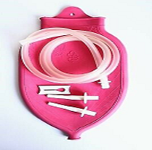
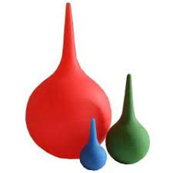
Compression molding is the oldest and least expensive method.
With compression molding, a rubber compound is formed into a blank (chunk of rubber); the blank then gets placed into a mold cavity to be shaped. Some of the common products made with the compression molding process include hot-water bottles, enema syringes, etc.
The last most common manufacturing process is called calendaring, which works by forcing softened material into the center of counter-rotating rollers. This process works best to produce sheets or films of rubber.

Slide 13
Shelf Life of Rubber Products
Rubber products can remain in inventory for long periods of time. Shelf life, the storage period prior to part installation, varies by elastomer type. Storage conditions such as temperature, humidity, ozone, and exposure to light also affect the shelf life of rubber products. By understanding these factors and best practices, buyers can make informed decisions about sourcing elastomers and storing die cut seals, gaskets, and O-rings.
Environmental conditions such as high temperatures and high humidity can cause unwanted physical changes in rubber products. Proper storage conditions won’t guarantee product quality, but they do promote storage life.

Slide 14
Environmental Condition Recommended Storage Condition
Temperature Below 100° F (38° C)
Humidity Less than 75% unless products are stored in sealed, moisture-proof bags
Light Protection from direct sunlight or intense artificial light
Ozone Storage rooms should not contain any ozone-generating equipment
Recommended shelf life for natural rubber, pure gum is 3 – 5 years.

Slide 15
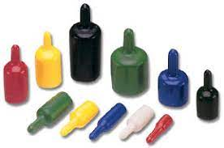
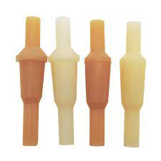
Types of Medical rubber products
Some popular medical rubber products are as follows:
• Rubber Caps/Tabs for Medical use: Rubber caps are specially designed for medical purposes. These are caps on T-piece as the main adjunct which provides pass and injection port for infusion and transfusion sets. They are made of natural rubber and polychloroprene rubber.
• Rubber Tubes for Infusion and Transfusion Set: This is a component of infusions sets, through which the medicine liquid can be added into the infusion canula. It is suitable for medicine liquid addition. Made of synthetic rubber etc.

Slide 16
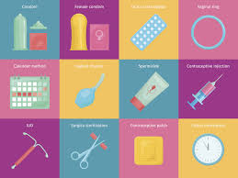
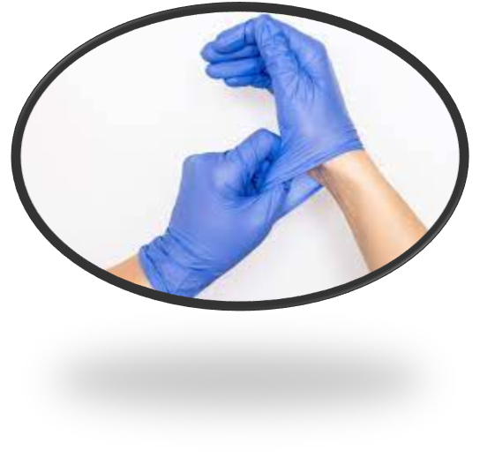
Types of Medical rubber products
• Birth Control Products: Rubber is used to make various products which serve as effective birth control measures like condoms, diaphragms, and cervical caps.
Surgical Gloves: Surgical gloves are made of various types of synthetic rubber as well as from the latex of natural rubber. These gloves are designed with some features which may not be available in normal glove. Such features are like ultra sensitivity, extra flexibility, maximum strength, greater protection, ambidextrous and can be sterilized.

Slide 17
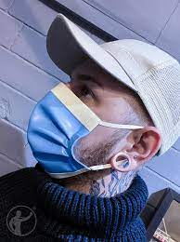
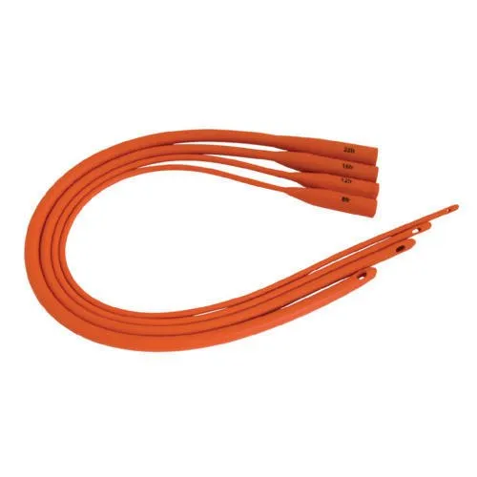
• Rubber Medical Masks: Rubber is also used to make various kinds of masks used for medical purposes. The breathing mask also known as oxygen mask are manufactured using natural rubber and silicone rubber. Such masks are specially designed to provide a tight seal without leakage and are widely used by aviators, medical researchers and other patients that require administration of 100% oxygen.
Rubber Catheters: Rubber is used to make medical catheters.
A catheter is a flexible tube made of latex or silicone and can be inserted into the body creating a way for the passage of fluid or the entry of a medical device. Compared to latex or natural rubber catheter, silicone rubber catheters are believed to be superior as silicone is more bio compatible, causes less cell death, and more resistant to bacterial colonization.

Slide 18
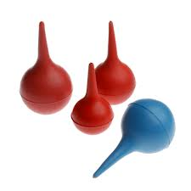
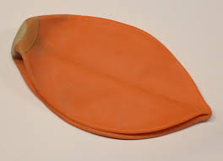
Rubber Bulb Syringe: It is syringe with a hollow rubber bulb and a cannula. The rubber bulb and the cannulla are provided with a check valve. The syringe is used on infants.
Rubber bladders: A bladder is a device made of rubber that can be used for a containing a substance. In medical industry, this is the most common product used in blood pressure monitor units. A typical blood pressure monitor features a neoprene or rubber pump bulb or a rubber bladder that a medical expert squeezes to build air pressure in the system.
This is possibly the best barrier against pathogens such as the AIDS virus (HIV). That is the reason why latex is used in condoms and surgical and medical examination gloves.

Slide 19

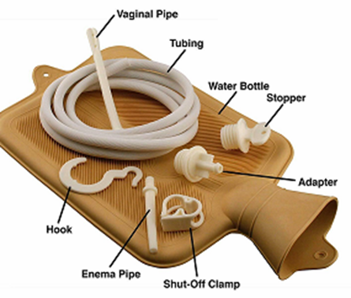
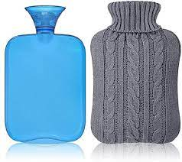
Hot Water Bottle
Hot Water Bottle a rubber container that is filled with hot water and used to warm a bed or a part of the body.
Produced two types: hot-water bottles A and B.
Rubber hot-water bottle of A type is designed for local warming of the body (hot-water bottle with a plug).
Rubber hot-water bottle of B type (combined) is designed for local warming of the body, rinsing and syringing (hot-water bottle with accessories).
Advantages: resistant to multiple disinfections
Suitable for multiple and prolonged use.
Safe for adults and children.
Specifications
Guaranteed shelf life: 3.5 years.
Guaranteed effective life: 2 years.
Contents: Type B kit contains a pipe, tips (pediatric, adult and uterine), a clip.
Package: Individual: polymer pack. Group (corrugated box): type A ― 40 pcs., type A2, A3 ― 30 pcs., type B-1, B-2, B-3 ― 20 pcs.

