Slide 1
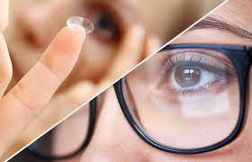
Ophthalmic optics. Product analysis of ophthalmic instruments and devices for vision examination, correction and protection.
ODESSA NATIONAL MEDICAL UNIVERSITY
FACULTY OF PHARMACY
Department of organization and economics of pharmacy
Prepared by senior teacher
Stepanova Oksana

Slide 2
CONTENT
Anatomy of the eye
Refraction in the Eye
Refractive Errors
Types of Lenses for Vision Correction
Eye-glasses Prescription
Eyeglasses for Vision Correction
Types of Contact Lenses
The Contact Lens Prescription
Contact Lens Care Systems & Solutions
Ophthalmic Diagnostic Instruments and Devices

Slide 3
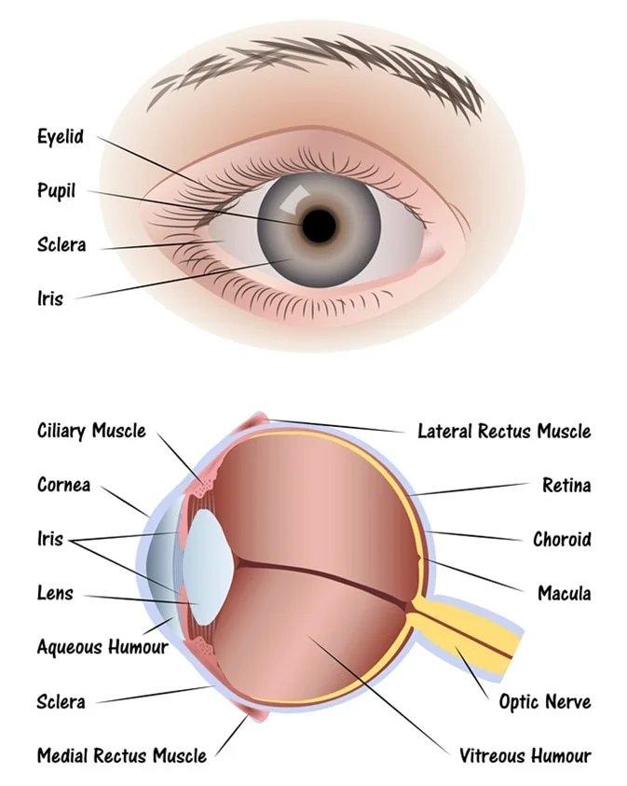
HUMAN EYE STRUCTURE
The eye sits in a protective bony socket called the orbit. Six extraocular muscles in the orbit are attached to the eye. These muscles move the eye up and down and side to side, and rotate the eye.
The extraocular muscles are attached to the white part of the eye called the sclera. This is a strong layer of tissue that covers nearly the entire surface of the eyeball.
surface of the eye and the inner surface of the eyelids are covered with a clear membrane called the conjunctiva.
Light is focused into the eye through the clear, dome-shaped front portion of the eye called the cornea.
Behind the cornea is a fluid-filled space called the anterior chamber. The fluid is called aqueous humor. The eye is always producing aqueous humor.

Slide 4
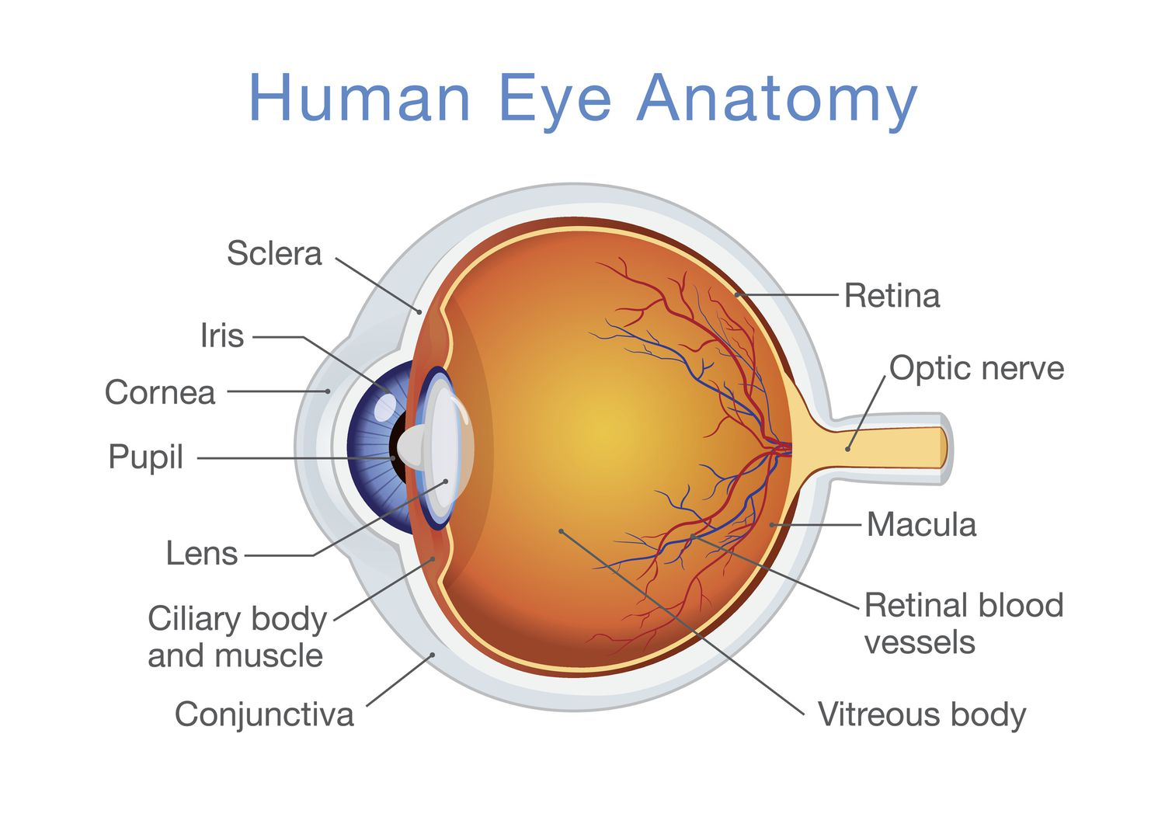
Behind the anterior chamber is the eye’s iris (the colored part of the eye) and the dark hole in the middle called the pupil. Muscles in the iris dilate (widen) or constrict (narrow) the pupil to control the amount of light reaching the back of the eye.
Directly behind the pupil sits the lens. The lens focuses light toward the back of the eye. The lens changes shape to help the eye focus on objects up close. The lens is surrounded by the lens capsule, which is left in place when the lens is removed during cataract surgery. A replacement intraocular lens goes inside the capsule, where the natural lens was.

Slide 5

The vitreous cavity lies between the lens and the back of the eye. A jellylike substance called vitreous humor fills the cavity, nourishing the inside of the eye and helping the eye hold its shape.
Light that is focused into the eye by the cornea and lens passes through the vitreous onto the retina — the light-sensitive tissue lining the back of the eye.

Slide 6
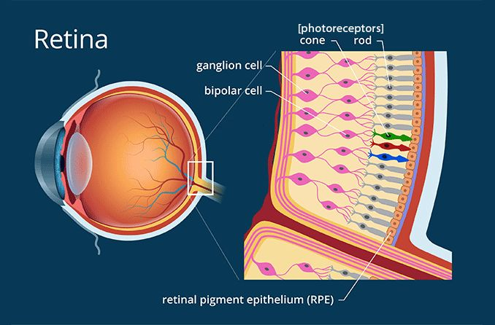
A tiny but very specialized area of the retina called the macula is responsible for giving us our detailed, central vision. The other part of the retina, the peripheral retina, provides us with our peripheral (side) vision.
The retina has special cells called photoreceptors. These cells change light into energy that is transmitted to the brain. There are two types of photoreceptors: rods and cones. Rods perceive black and white, and enable night vision. Cones perceive color, and provide central (detail) vision.
The vitreous cavity lies between the lens and the back of the eye. A jellylike substance called vitreous humor fills the cavity, nourishing the inside of the eye and helping the eye hold its shape.
Light that is focused into the eye by the cornea and lens passes through the vitreous onto the retina — the light-sensitive tissue lining the back of the eye.

Slide 7
Refraction in the Eye
The vision process relies heavily on the ability of the eye to refract light. The main parts of the optical system of the eye include the cornea and the lens of the eye.
CORNEA
The process of vision first starts with the light passing through the cornea. Since the cornea has a spherical surface it acts like a converging lens.
PUPIL AND IRIS
Once the light passes through the cornea it goes through the pupil which is essentially a hole that regulates light intensity by changing its diameter. So when its dark, the pupils dilate , up to about 8mm, so that more light can enter the eye. And when it is bright the pupil shrinks, to an average of 3mm, to restrict the amount of light. The pupil's size is controlled by the iris. Muscles in the iris cause the pupil to shrink or dilate.
THE LENS AND ACCOMMODATION
After light rays travel through the pupil they hit the lens where refraction also takes place.
The eye focuses an image through the process of accommodation, where the ciliary muscles can change the curvature of the lens. When the eye is looking at a distance little accommodation is needed, so the ciliary muscles are relaxed, and the lens has the longest focal length. To see a nearer object, the focal length of the lens needs to decrease to produce the image on the retina, to do this the ciliary muscles contract.

Slide 8
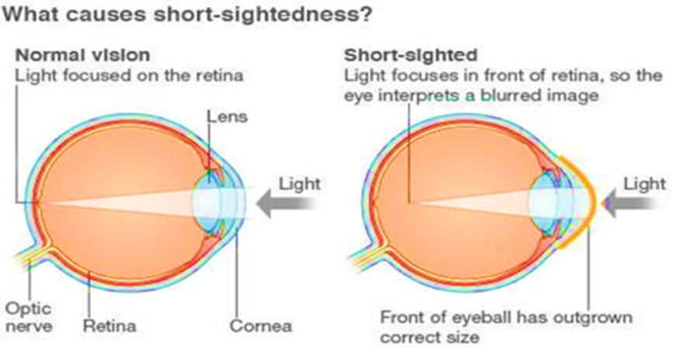
Refraction in the Eye
Emmetropia is the term used to describe an eye without any refractive errors.
Nearsightedness (myopia, shortsightedness) is a condition in which an image of a distant object becomes focused in front of the retina, making distant objects appear out of focus. The condition is usually caused by an elongation of the eyeball that occurs over time.

Slide 9


Slide 10
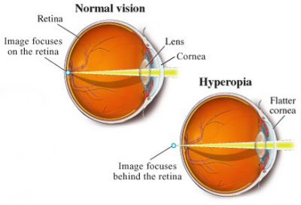
Refraction in the Eye
Farsightedness (hyperopia) is a condition in which an image of a distant object becomes focused behind the retina making objects up close appear out of focus. It is opposite of myopia, and is usually caused by shortening of the eyeball.

Slide 11
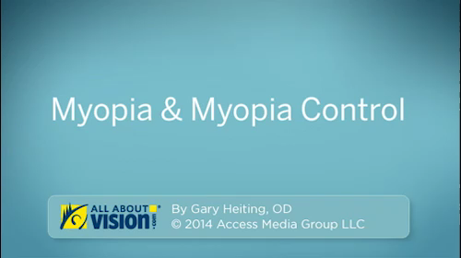

Slide 12

HYPEROPIA (FAR-SIGHTEDNESS)

Slide 13

Difference between Myopia
(Near Sightedness) & Hyperopia (Far-Sightedness)

Slide 14
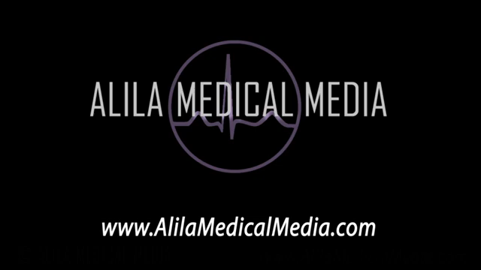
ASTIGMATISM

Slide 15
TYPES OF LENSES FOR VISION CORRECTION
A corrective lens is a lens worn on (contact lens) or before the eye (eyeglass lenses). They are used to treat short-sightedness, long-sightedness, presbyopia, and astigmatism. Biconcave or diverging lenses are required for near-sightedness and biconvex or converging lenses are required for far-sightedness.
Optometrist usually prescribes corrective lenses. The prescription will involve the necessary corrections for refraction errors in each eye, individually for distance vision and near vision, for a total of four possible correction specifications.

Slide 16
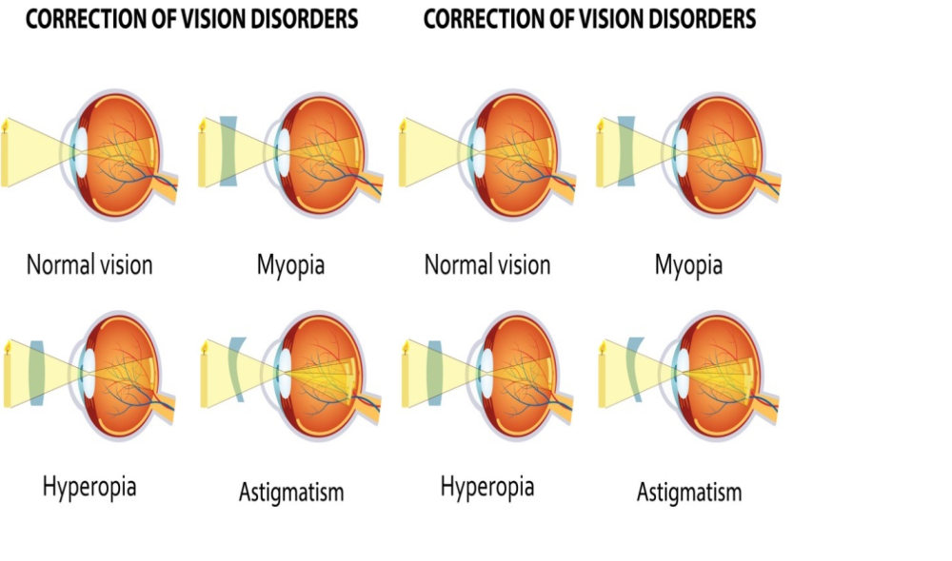

Slide 17
EYE-GLASSES PRESCRIPTION ABBREVIATIONS
The first step to understanding an eyeglass prescription is knowing what "OD" and “OS" mean. They are abbreviations for oculus Dexter and oculus sinister, which are Latin terms for "right eye" and "left eye.“
Your eyeglass prescription also may have a column labeled "OU." This is the abbreviation for the Latin term oculus uterque, which means "both eyes."

Slide 18
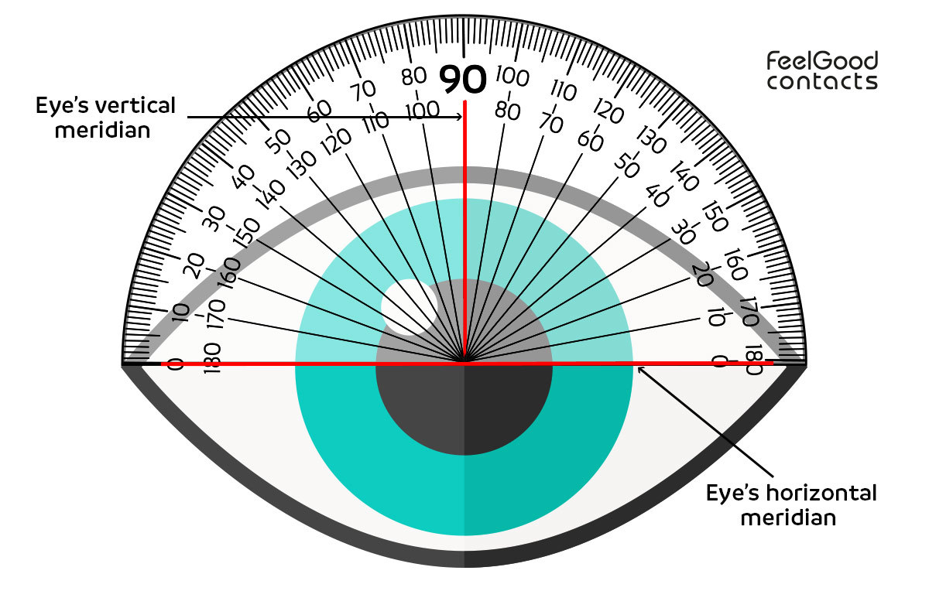
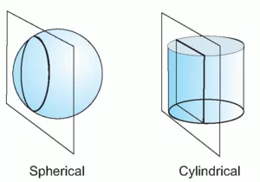
TYPES OF LENSES FOR VISION CORRECTION
Axis. This describes the lens meridian that contains no cylinder power to correct astigmatism. The axis is defined with a number from 1 to 180. The number 90 corresponds to the vertical meridian of the eye, and the number 180 corresponds to the horizontal meridian.
If an eyeglass prescription includes cylinder power, it also must include an axis value, which follows the cyl power and is preceded by an "x" when written freehand.
Cylinder (CYL). This indicates the amount of lens power for astigmatism. If nothing appears in this column, you have little or no astigmatism that requires correction.
The number in the cylinder column may be preceded with a minus sign (for correction of nearsighted astigmatism) or a plus sign (for farsighted astigmatism). Cylinder power always follows the sphere power in an eyeglass prescription.

Slide 19

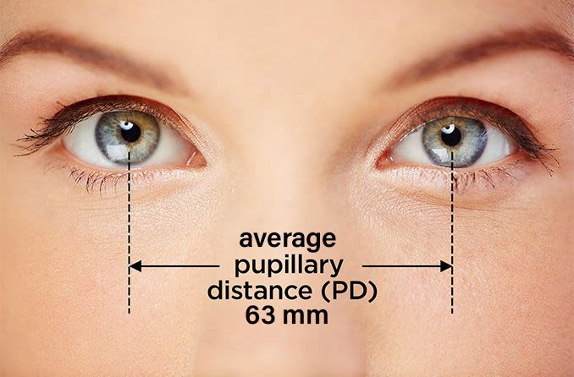
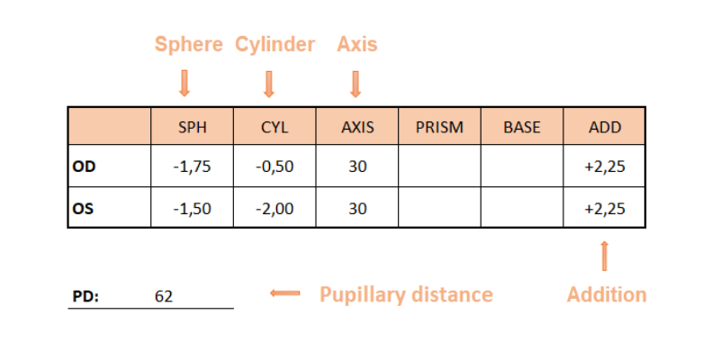
TYPES OF LENSES FOR VISION CORRECTION
PD (Pupillary Distance). It’s a measurement in millimeters between your eyes from the center of one pupil to the center of the other. Typically, adult’s PD falls in a range between 54 and 74 mm, and kids’ is somewhere between 43 and 54 mm. In Ukraine, PD is an obligatory part of the eyeglasses prescription. In some countries PD is not actually a part of your prescription. The optometrist or ophthalmologist rarely determines physical measurements, because that is the job of the optician.
Add. This is the added magnifying power applied to the bottom part of multifocal lenses to correct presbyopia. The number appearing in this section of the prescription is always a "plus" power, even if it is not preceded by a plus sign

Slide 20
Though use of these abbreviated Latin terms is common on prescriptions for glasses, contact lenses and eye medicines, some doctors and clinics have opted to modernize their eyeglass prescriptions and use RE (right eye) and LE (left eye) instead of OD and OS.
On your eyeglasses prescription, the information for your right eye (OD) comes before the information for your left eye (OS).

Slide 21
The eyeglass prescription contains other terms and abbreviations as well. These include:
Sphere (SPH). This indicates the amount of lens power, measured in diopters
(D), prescribed to correct nearsightedness or farsightedness. If the number appearing under this heading has a minus sign (–), you are nearsighted; if it has a plus sign (+), you are farsighted.
The term "sphere" means that the correction for nearsightedness or farsightedness is "spherical," or equal in all meridians of the eye.
Cylinder (CYL). This indicates the amount of lens power for astigmatism. If nothing appears in this column, you have little or no astigmatism that requires correction.
The number in the cylinder column may be preceded with a minus sign (for correction of nearsighted astigmatism) or a plus sign (for farsighted astigmatism). Cylinder power always follows the sphere power in an eyeglass prescription.

Slide 22
Axis. This describes the lens meridian that contains no cylinder power to correct astigmatism. The axis is defined with a number from 1 to 180. The number 90 corresponds to the vertical meridian of the eye, and the number 180 corresponds to the horizontal meridian.
If an eyeglass prescription includes cylinder power, it also must include an axis value, which follows the cyl power and is preceded by an "x" when written freehand.
PD (Pupillary Distance). It’s a measurement in millimeters between your eyes from the center of one pupil to the center of the other. Typically, adult’s PD falls in a range between 54 and 74 mm, and kids’ is somewhere between 43 and 54 mm.
In Ukraine, PD is an obligatory part of the eyeglasses prescription. In some countries PD is not actually a part of your prescription. The optometrist or ophthalmologist rarely determines physical measurements, because that is the job of the optician.

Slide 23
Add. This is the added magnifying power applied to the bottom part of multifocal lenses to correct presbyopia. The number appearing in this section of the prescription is always a "plus" power, even if it is not preceded by a plus sign
Presbyopia is a condition associated with the aging of the eye that results in progressively worsening ability to focus clearly on close objects. Presbyopia is a natural part of the aging process.
Prism. This is the amount of prismatic power, measured in prism diopters
("p. d.")), prescribed to compensate for eye alignment problems. Only a small percentage of eyeglass prescriptions include prism.
Sphere power, cylinder power and add power always appear in diopters. They are in decimal form and generally are written in quarter-diopter (0.25 D) increments.
Axis values are whole numbers from 1 to 180 and signify only a meridional location, not a power. When prism diopters are indicated in decimal form (e.g., 0.5).

Slide 24
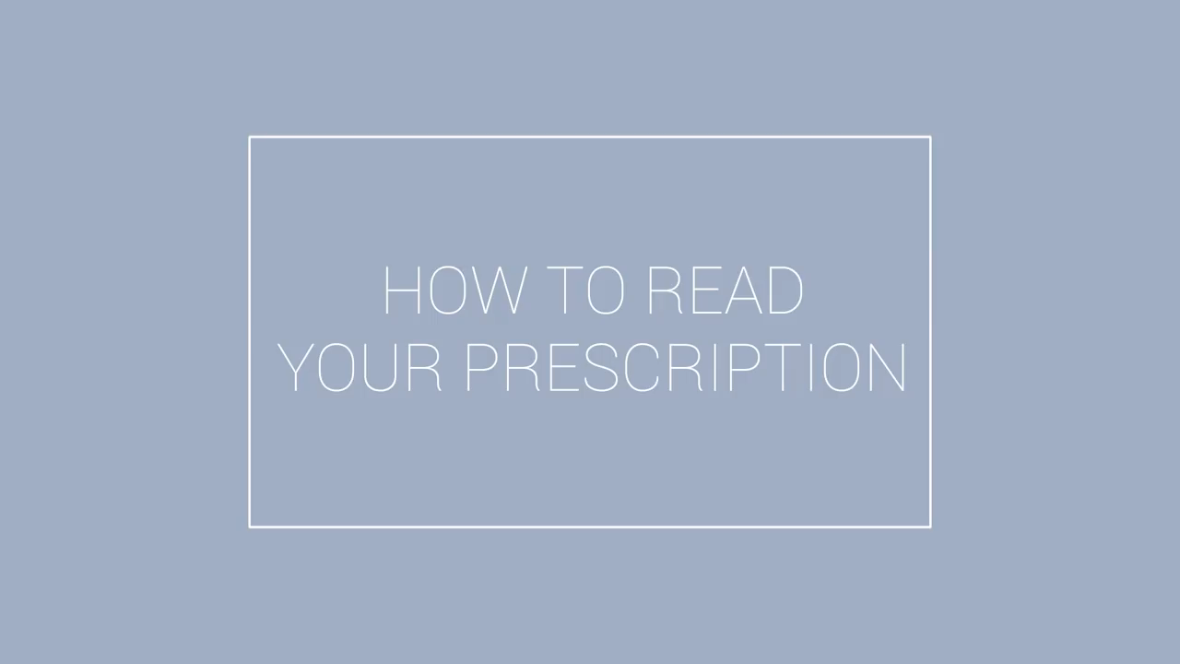

Slide 25
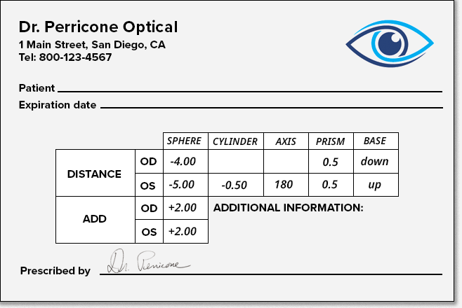
EYE-GLASSES PRESCRIPTION ABBREVIATIONS

Slide 26
https://www.wikihow.com/Read-an-Eyeglass-Prescription
How to Read an Eyeglass Prescription

Slide 27
EYE-GLASSES PRESCRIPTION ABBREVIATIONS
1. Hard (RGP) VS Soft Contact Lenses - Pros and Cons!
https://www.youtube.com/watch?v=PFEL6Nbk9C4
2. Contacts: Daily Vs Monthly (Which Is Better?)
https://www.youtube.com/watch?v=AROyk0aGm44
3. The numbers on your contact lens (what do they mean) | Lens Parameters
https://www.youtube.com/watch?v=zj2R0BQo8Zs
4. How To Remove Contact Lenses Easily - Best Tips For Beginners
https://www.youtube.com/watch?v=AmbwrzrINao

Slide 28

Дякую за увагу

