Slide 1


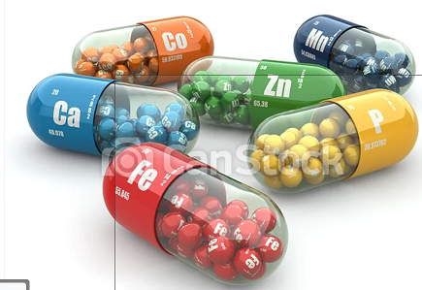
Lecture № 7. Commodity analysis of related products of pharmacy assortment (mineral waters, special food products, medicinal and cosmetic products, essential oils)
MINISTRY OF HEALTH OF UKRAINE
ODESSA NATIONAL MEDICAL UNIVERSITY
Department of Pharmacy Organization and Economics
Prepared by
senior teacher Oksana Stepanova

Slide 2


In today's conditions, there is a high level of competition among pharmacies, which leads to a forced maximum reduction in prices and, as a result, to a decrease in the profitability and unprofitability of pharmacies. With this in mind and with the aim of increasing their turnover, pharmacists see the sense in expanding the list of related products allowed to be dispensed in pharmacies. A significant number of them belong to the category with the conventional name "goods of a limited pharmacy assortment", previously this group occupied only 1-2% of the total turnover of the pharmacy, but now its percentage is constantly growing and is approximately 10%-12%.

Slide 3

Mineral Waters
Mineral waters have been used to treat diseases since ancient times. Folk wisdom very early called attention to the medicinal properties of many mineral springs and elaborated practical means of using them.

Slide 4
According the standard for natural mineral waters cxs 108-1981 adopted in 1981(amended in 2019)
Natural mineral water is water that can be distinguished from ordinary drinking water because:
a) it is characterized by the content of certain mineral salts and their relative proportions, as well as the presence of trace elements or other components;
b) is extracted directly from natural or drilled sources from underground aquifers, for which all possible precautions must be taken within the secured perimeter to avoid contamination, orexternal influence, chemical and physical properties of natural mineral water;
c) the constancy of its composition and the stability of its discharge and its temperature, taking into taken from the cycles of small natural fluctuations; account
d) it is collected under conditions that guarantee the original microbiological purity and chemical composition.

Slide 5
Natural carbonated mineral water is natural mineral water, which, after possible processing and re-incorporation of gas from the same source and after packaging subject to normal technical tolerances, spontaneously has the same carbon dioxide content and stands out markedly under normal conditions of temperature and pressure.

Slide 6
Still natural mineral water
Non-carbonated natural mineral water is natural mineral water, which by its nature and after packaging taking into account the usual technicaltolerance, does not contain free carbon dioxide in excess of the amount required to retain hydrogen
carbonate salts present in dissolved water.

Slide 7
Natural mineral water enriched with carbon dioxide from the source.
Natural mineral water enriched with carbon dioxide from the source is natural mineral water, and after packaging contains more carbon dioxide content than when it appears.

Slide 8
Carbonated natural mineral water is natural mineral water, which after possible processing and after packing became effervescent due to the addition of charcoal dioxide of a different origin.

Slide 9
Transport of natural mineral waters in bulk containers for packaging or any other process to packing is prohibited.
Installations intended for the production of natural mineral waters must be such as to exclude any the possibility of contamination.
For this, in particular:
a) collection facilities, pipes and tanks shall be made of materials suitable for water and in such a way as to exclude the ingress of foreign substances into the water;
b) the equipment and its use for production, especially washing and packaging installations, must meet hygiene requirements;
c) if during production it is found that the water is contaminated, the manufacturer must stop all operations until
the cause of pollution has been eliminated;
d) compliance with the above provisions is subject to periodic checks in accordance with country of origin requirements.

Slide 10
Mineral water is water from a mineral spring that contains various minerals, such as salts and sulfur compounds. Mineral water may be classified as "still"(without gases) or“ sparkling" (carbonated) according to the presence or absence of added gases.

Slide 11
In the European Union, bottled water may be called mineral water when it is bottled at the source and has undergone no or minimal treatment.
Not all waters are created equal – they differ significantly in taste, smell, purity and nutritional value. Here are the main classifications of water according to German (and US) law:
Natural mineral water
Natural mineral water comes from underground, is protected from contamination and bottled directly at the source. It contains vital minerals and trace elements and makes a healthy contribution to the daily diet. The water’s composition of minerals and trace elements may differ significantly from source to source.

Slide 12
Medicinal water
Medicinal waters are special types of mineral waters: they are characterized by a particularly high content of minerals and have a healing and preventative health effect. Healing waters are subject to the German Federal Pharmaceutical Act and must be approved by the Federal Ministry of Health.
Spring water
Like mineral water, spring water is naturally pure, comes from underground reservoirs and is bottled at source. However, it contains less mineral content and trace elements than mineral water and has limited nutritional value. A bottle labeled “spring water” may contain water from different sources, and bottlers may remove iron and add or remove carbon dioxide.
Table water
Table water is not a natural but a manufactured product. Regular tap water, mineral water or spring water may be mixed with ocean water or enriched with minerals or carbon dioxide. Bottled water can be produced and bottled anywhere.

Slide 13
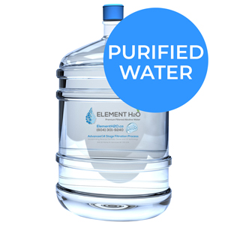
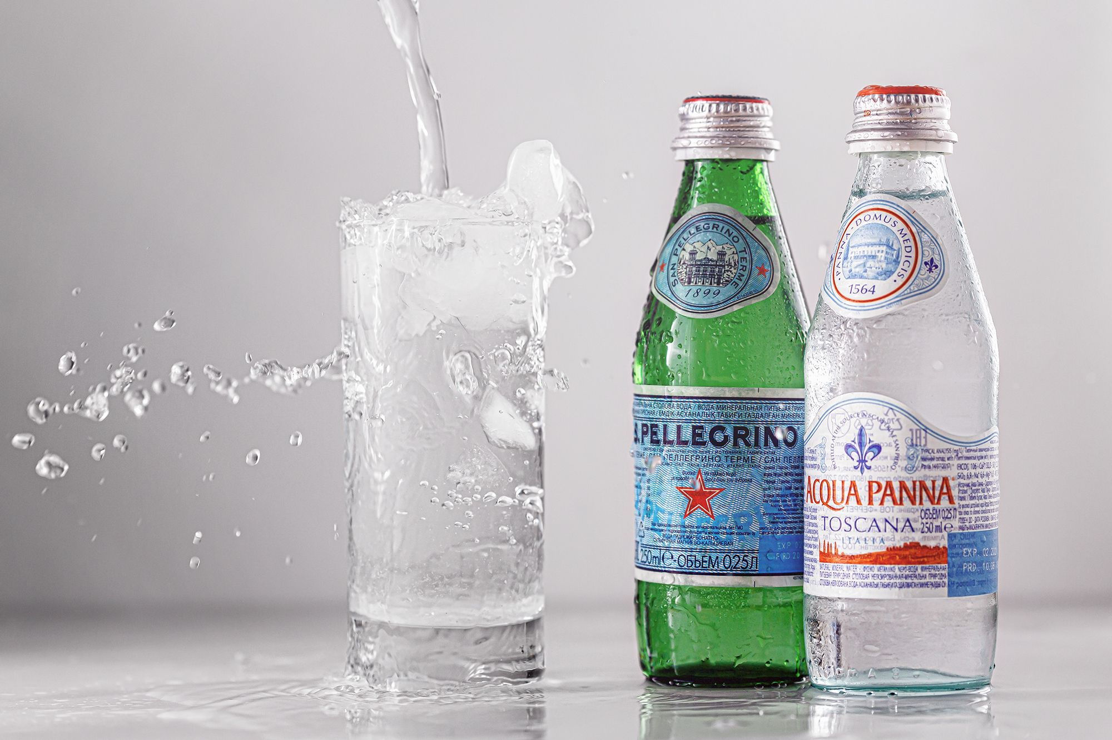

Purified Water – water that has been produced by distillation, deionization, reverse osmosis, or other suitable processes and that meets the definition of “purified water” in the United States Pharmacopeia. May also be called demineralized water, purified drinking water, or alternatively, based on the process used, deionized (drinking) water, distilled (drinking) water, reverse osmosis (drinking) water, etc.
Sparkling Bottled Water – water that, after treatment and possible replacement of carbon dioxide, contains the same amount of carbon dioxide from the source that it had at emergence from the source.
Spring Water – water derived from an underground formation from which water flows naturally to the surface of the earth;

Slide 14
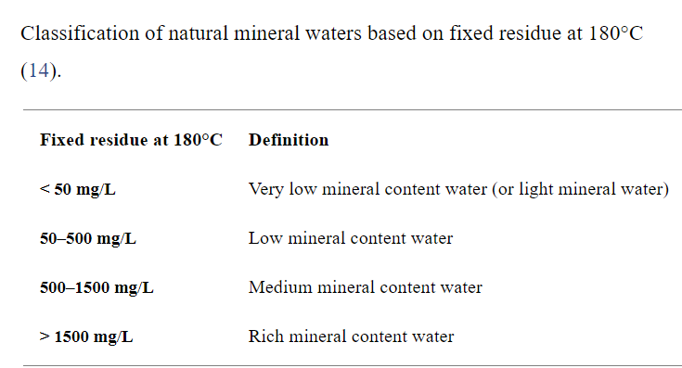
According to the European Legislation (2009/54/EC Directive), physical and chemical characterization is used to make a classification of the different mineral waters, basing on the analysis of main parameters.
First of all, natural mineral waters are classified by the fixed residue at 180°, that is the amount of residual mineral salts (in mg) after the evaporation of 1 L of water at 180°C.

Slide 15
Mineral waters are also classified by other physical parameters, like pH, temperature and hardness.
With regard to pH, mineral waters are classified
acid water (pH<7)
alkaline water (pH>7).
By temperature, mineral waters may be^
cold (< 20°C at source)
hypotermal (20–30°C at source)
mesothermal waters (30–40°C at source)
hyperthermal waters (> 40°C at source).
Hardness indicates the presence of alkaline earth metals and mineral waters may be :
very soft (0–100 mg/L of CaCO3)
soft (100–200 mg/L of CaCO3),
hard (200–300 mg/L of CaCO3 )
very hard (> 300 mg/L of CaCO3 ) (15).

Slide 16
Although in Europe and in United States there are many categorizations of mineral waters, nowadays the 2009/54/EC Directive is the European reference to classify them. As reported in the EC Directive, mineral waters can be:
Water with bicarbonate”, if bicarbonate content is >600 mg/L
“Water with sulfate”, if sulfate content is >200 mg/L
“Water with chloride”, if chloride content is >200 mg/L
“Water with calcium”, if calcium content is >150 mg/L
“Water with magnesium”, if magnesium content is >50 mg/L
“Water with fluoride”, if fluoride content is >1 mg/L (More than 1,5 mg/L of fluoride is unsuitable for children below the age of 7)
“Acid water”, if the CO2 content is >250 mg/L
“Water with sodium”, if sodium content is >200 mg/L. The lettering “indicate for low sodium diet” can be added to labels if sodium content is <20 mg/L.

Slide 17


Baby food. Milk formula
Infant formulas are foods designed to feed babies and infants less than 12 months of age.
Commonly available infant formulas contain purified whey and casein from cow’s milk as a protein source, a blend of vegetable oils as a source of fat, lactose as a source of carbohydrates, a mixture of vitamins and minerals, and other materials depending upon the manufacturer. The manufacturers of infant formulas claim that the composition of these formulas is almost same as that of the mother’s milk.

Slide 18

Although the best food for young ones is breast milk and it is not favorable to replace it with any infant formula.
Breastfeeding gives all children the healthiest start in life.
Breastmilk stimulates brain development and acts as a baby’s first vaccine.
Breastfeeding lowers health-carecosts, creating healthier families and a smarter workforce It also protects mothers’ health.

Slide 19

Global breastfeeding rates remain lower than what is required to protect the health of women and children, according to the 2019 global breastfeeding scorecard. From 2013 –2018, only 43% of newborns initiate breastfeeding within one hour of birth, and only 41% of infants under six months are exclusively breastfed. UNICEF and the World Health Organization (WHO) areleading a global Breastfeeding Advocacy Initiative toincrease the political commitment for breastfeeding, whichis one of the smartest investments a country can make.

Slide 20
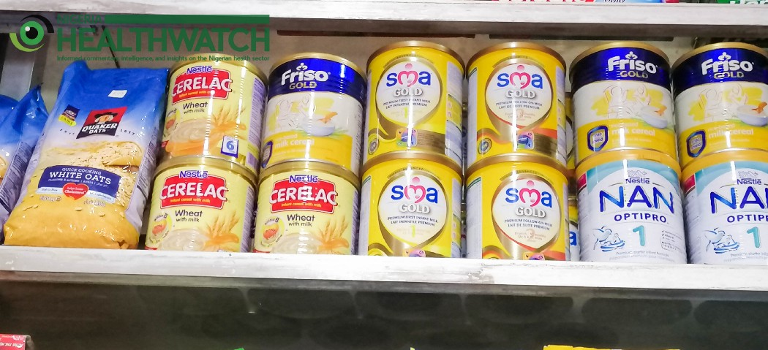
“Breastmilk substitutes (BMS) includeall milk products—such as infant formula, follow-upformula, and growingup milks—marketed for use by infants and children up to 36-months old.” (WHO)
According to the document REGULATION (EU) No 609/2013 OF THE EUROPEAN PARLIAMENT AND OF THE COUNCIL of 12 June 2013 on food intended for infants and young children, food for special medical purposes, and total diet, definition:
Infants’ means children under the age of 12 months;
‘Young children’ means children aged between one and three years;

Slide 21
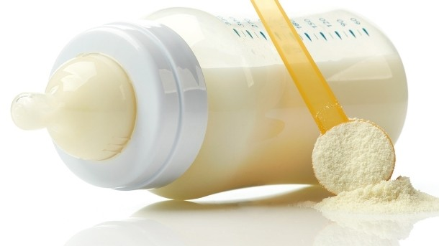
‘Follow-on formulae’ means foodstuffs intended for particular nutritional use by infants when appropriate complementary feeding is introduced and constituting the principal liquid element in a progressively diversified diet of such infants;
Infant formulae means food stuffs intended for particular nutritional use by infants during the first months of life and satisfying by themselves the nutritional requirements of such infants until the introduction of appropriate complementary feeding;
Formula milk, also known as baby formula or infant formula, is usually made from cows' milk that has been treated to make it more suitable for babies. There's a wide range of brands and types of formula available in pharmacies and shops. Always check labels carefully to make sure you're buying a suitable milk for your baby.
Formula comes in 2 different forms: a dry powder you make up with water, or a ready-to-feed liquid formula.

Slide 22
First infant formula (first milk).
Suitable from birth
First infant formula (first milk) should always be the first formula you give to your baby.
The cows' milk in formula contains 2 types of proteins – whey and casein. First infant formula is based on whey protein which is thought to be easier to digest than other types of formula. First infant formula is the only formula your baby needs. Your baby can stay on it when you start to introduce solid foods at around 6 months and drink it throughout their 1st year.
When your baby is 1 year old, they can start to drink whole cows' milk or sheep's or goats' milk (as long as it's pasteurised).

Slide 23
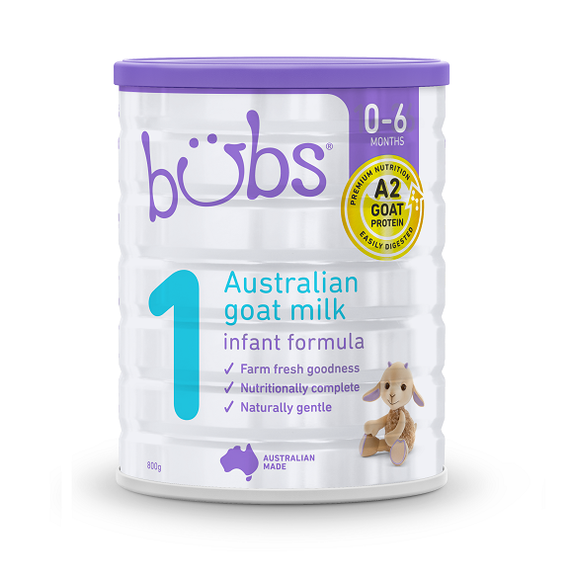
Goats' milk formula
Suitable from birth
They are produced to the same nutritional standards as cow's milk-based formula.
Goats' milk formula is not less likely to cause allergies in babies than cows' milk formula.
Goats' milk formulas are not suitable for infants with cows' milk allergy (also known as cows' milk protein allergy), as the proteins they contain are very similar.

Slide 24
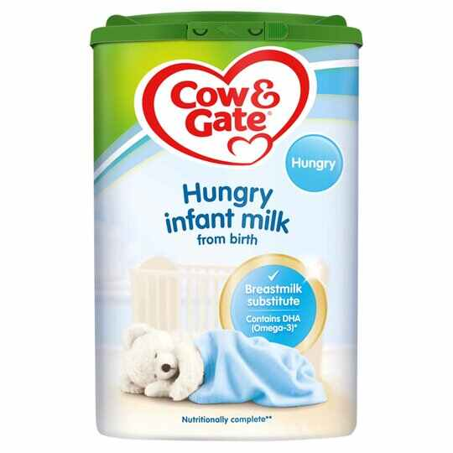
Hungrier baby formula (hungry milk)
Suitable from birth
This type of formula contains more casein than whey, and casein is harder for babies to digest.
Although it's often described as suitable for "hungrier babies", there's no evidence that babies settle better or sleep longer when fed this type of formula.
Anti-reflux (staydown) formula .
Suitable from birth (but only under medical supervision).
This type of formula is thickened with the aim of preventing reflux in babies (when babies bring up milk during or after a feed).

Slide 25
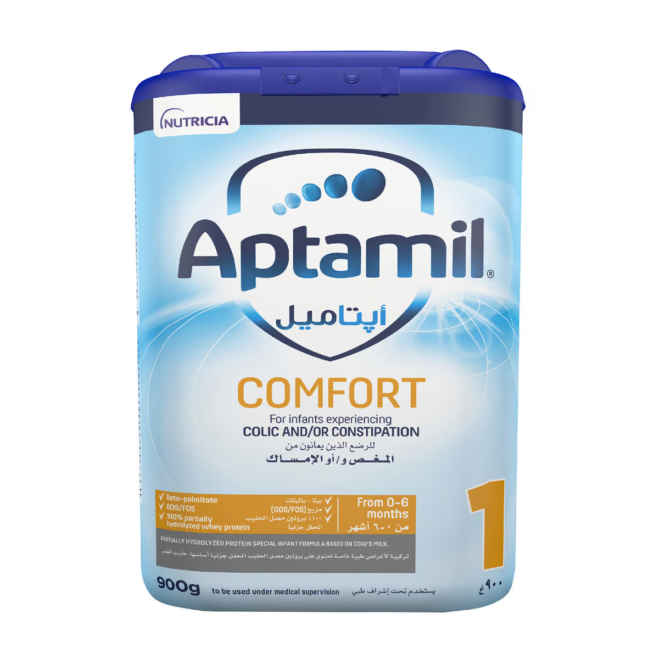

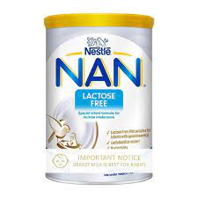
Comfort formula.
Suitable from birth (but only under medical supervision).
This type of formula contains cows' milk proteins that have already been partly broken down (partially hydrolysed). This is supposed to make it easier to digest and help prevent digestive problems such as colic and constipation. Partially hydrolysed formulas are not suitable for babies who have cows' milk allergy.
Lactose-free formula.
Suitable from birth (but only under medical supervision).
This formula is suitable for babies who are lactose intolerant. This means they cannot absorb lactose, which is a sugar that's naturally in milk and dairy products. Lactose intolerance is rare in babies. Symptoms include diarrhoea, abdominal pain, wind and bloating.

Slide 26

Hypoallergenic formula.
Suitable from birth (but only under medical supervision).
If your baby is diagnosed as being allergic to cows' milk, a GP will prescribe an appropriate infant formula with fully hydrolysed (broken down) proteins. It's not suitable for babies with cows' milk allergy.

Slide 27
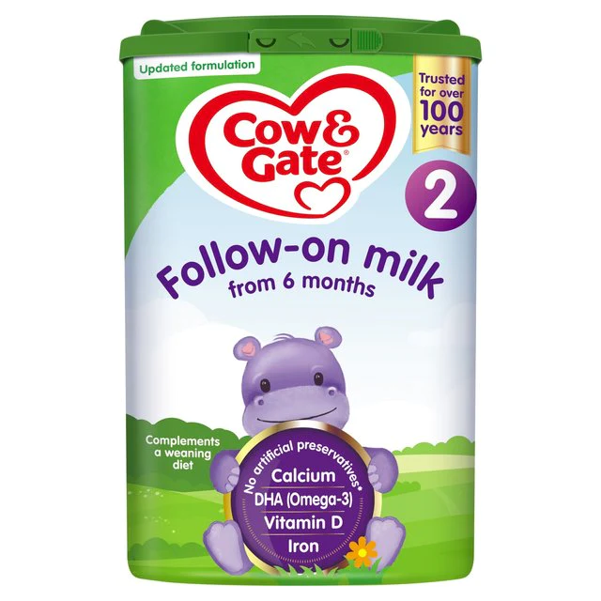
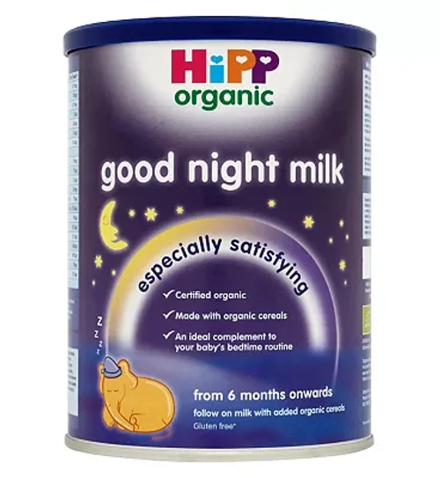
Follow-on formula Suitable from 6 months (but ask a health visitor for advice first).
Follow-on formula should never be fed to babies under 6 months old. The labels on follow-on formula can look very similar to those on first infant formula. Read the label carefully to avoid making a mistake.
Good night milk Suitable from 6 months (but ask a health visitor for advice first).
Some follow-on formula has cereal added to it and is sold as a special formula for babies to have at bedtime. This type of formula is not needed, and there's no evidence that babies settle better or sleep longer after having it.Good night formula should never be given to babies under 6 months old.

Slide 28
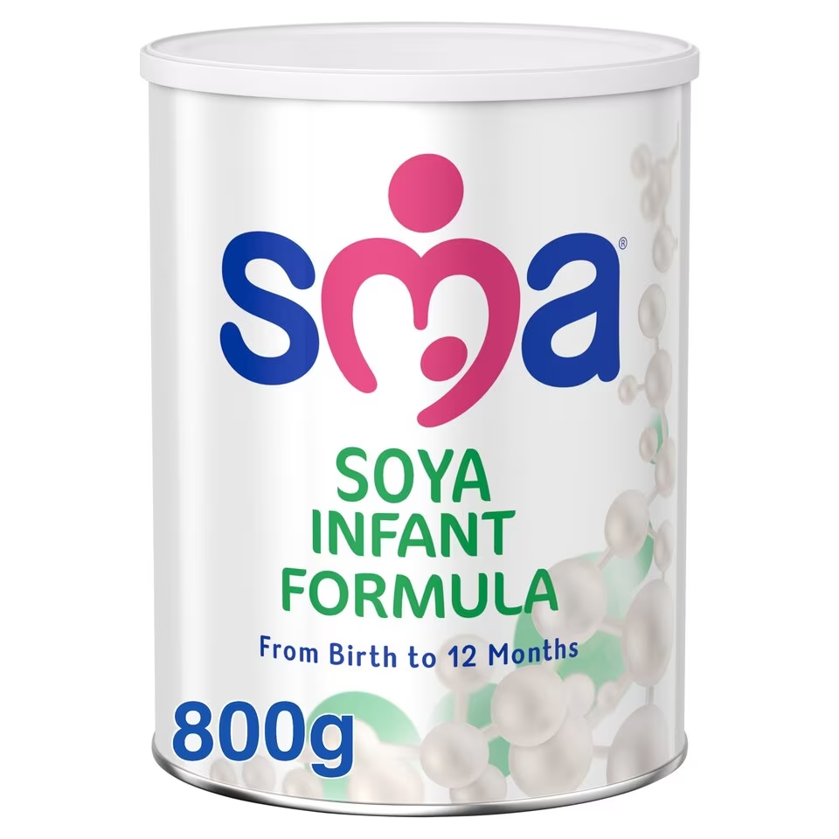
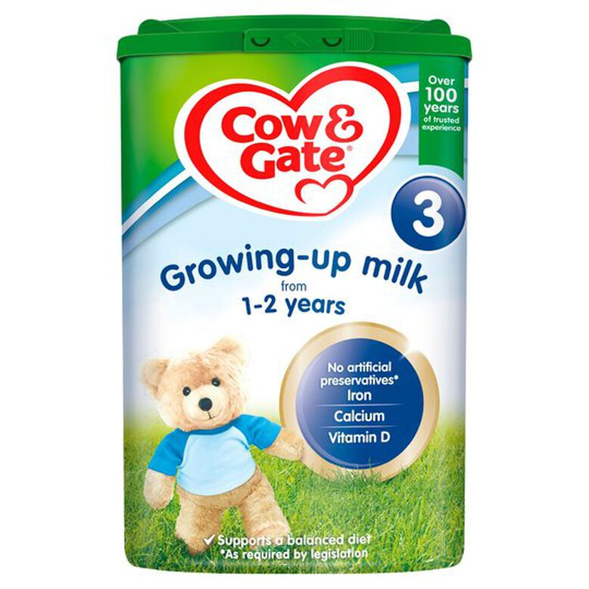
Soya formula. Suitable from 6 months (but only under medical supervision).
Soya formula is made from soya beans, not cows' milk. It's occasionally used as an alternative to cows' milk formula for babies who have cows' milk allergy. There are some concerns about the fact that soya contains phytoestrogens.
Growing-up milk (toddler milk)
Suitable from 1 year (but ask a health visitor for advice first).
Growing-up and toddler milks are marketed as an alternative to whole cows' milk for toddlers and children over 1 year old.

Slide 30

Dietary supplement
Dietary supplement is a manufactured product intended to supplement one's diet by taking a pill, capsule, tablet, powder, or liquid and other substances such as enzymes, extracts, or concentrates.
Dietary supplements, including probiotics, which contain potentially beneficial bacteria or yeasts.
https://www.youtube.com/watch?v=dEQGljAr2OY

Slide 31


Slide 32
1. Dietary Supplements: What Physicians Should Know – Part 1 (Module 1)
https://www.youtube.com/watch?v=GYJYPCJmspE
2. Dietary Supplements: What Physicians Should Know – Part 2 (Module 2)
https://www.youtube.com/watch?v=qqyP-vbtlZY

Slide 33
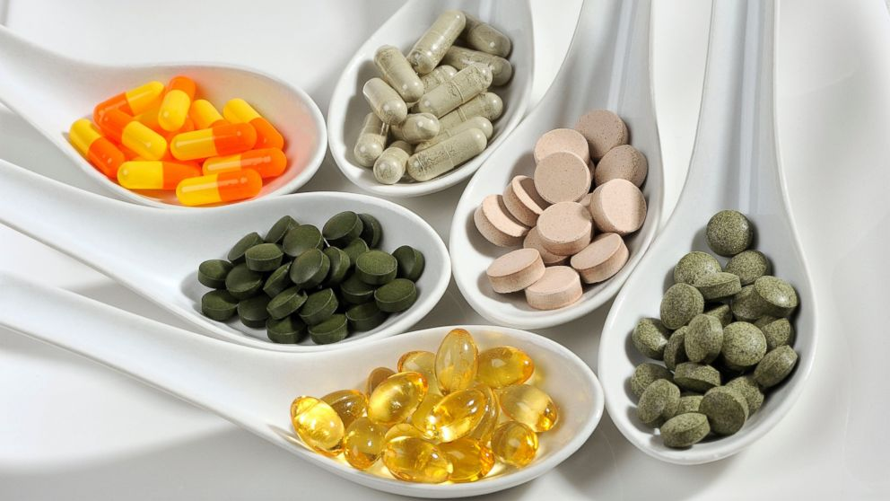
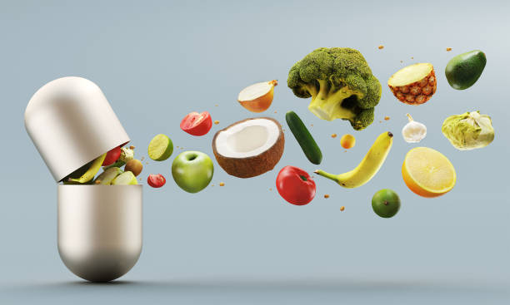
A supplement can provide nutrients either extracted from food sources or that are synthetic in order to increase the quantity of their consumption.
The class of nutrient compounds includes vitamins, minerals, fiber, fatty acids, and amino acids.
Dietary supplements can also contain substances that have not been confirmed as being essential to life, but are marketed as having a beneficial biological effect, such as plant pigments or polyphenols.
Animals can also be a source of supplement ingredients, such as collagen from chickens or fish for example. These are also sold individually and in combination, and may be combined with nutrient ingredients.
The European Commission has also established harmonized rules to help insure that food supplements are safe and appropriately labeled.

Slide 34
Creating an industry estimated to have a 2020 value of $140.3 billion, there are more than 50,000 dietary supplement products marketed in the United States, where about 50% of the American adult population consumes dietary supplements. Multivitamins are the most commonly used product among types of dietary supplements.
The United States National Institutes of Health states that supplements "may be of value" for those who are nutrient deficient from their diet and receive approval from their medical provider.n the United States, it is against federal regulations for supplement manufacturers to claim that these products prevent or treat any disease. Companies are allowed to use what is referred to as "Structure/Function" wording if there is substantiation of scientific evidence for a supplement providing a potential health effect. An example would be "_____ helps maintain healthy joints", but the label must bear a disclaimer that the Food and Drug Administration (FDA) "has not evaluated the claim" and that the dietary supplement product is not intended to "diagnose, treat, cure or prevent any disease", because only a drug can legally make such a claim.
The FDA enforces these regulations and also prohibits the sale of supplements and supplement ingredients that are dangerous, or supplements not made according to standardized good manufacturing practices (GMPs).

Slide 35
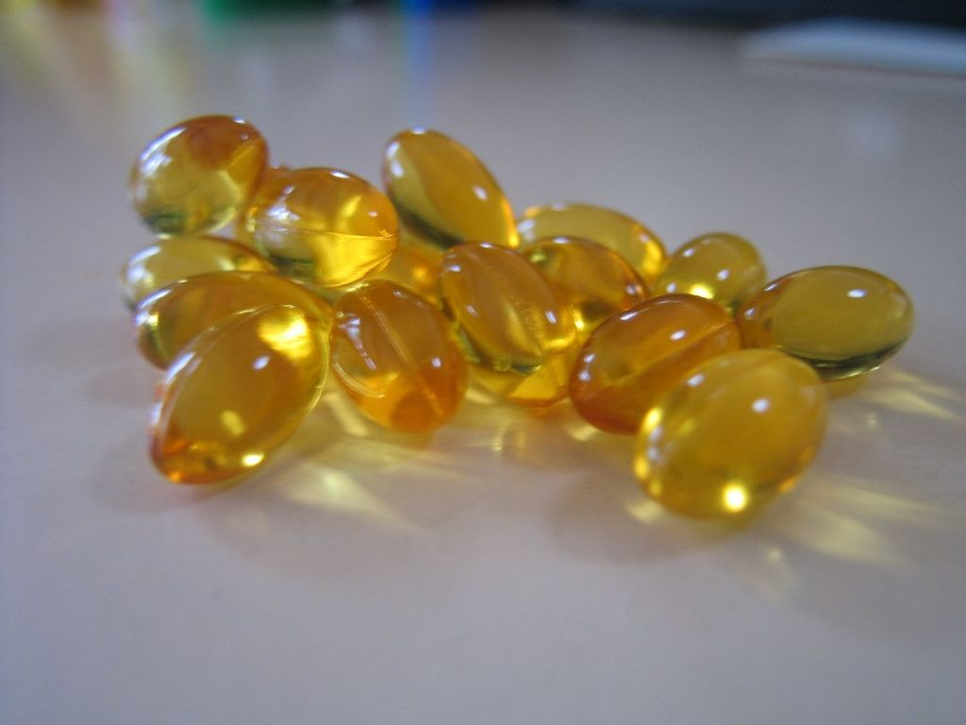
The global dietary supplements market size was valued at USD 140.3 billion in 2020 and is expected to expand at a compound annual growth rate (CAGR) of 8.6% from 2021 to 2028. The increasing consumer awareness regarding personal health and wellbeing is expected to be a key factor driving the market for dietary supplements over the forecast period. The working population around the globe is struggling to fulfill the daily nutrient requirements owing to hectic work schedules and changing lifestyles. This is increasing their dependency on dietary supplements to fulfill the nutrient requirements owing to their high convenience, which, in turn, is expected to drive the market over the forecast period.
Furthermore, a dietary supplement must be labeled as a dietary supplement and be intended for ingestion and must not be represented for use as conventional food or as a sole item of a meal or of the diet. In addition, a dietary supplement cannot be approved or authorized for investigation as a new drug, antibiotic, or biologic, unless it was marketed as a food or a dietary supplement before such approval or authorization. Under DSHEA, dietary supplements are deemed to be food, except for purposes of the drug definition."

Slide 36
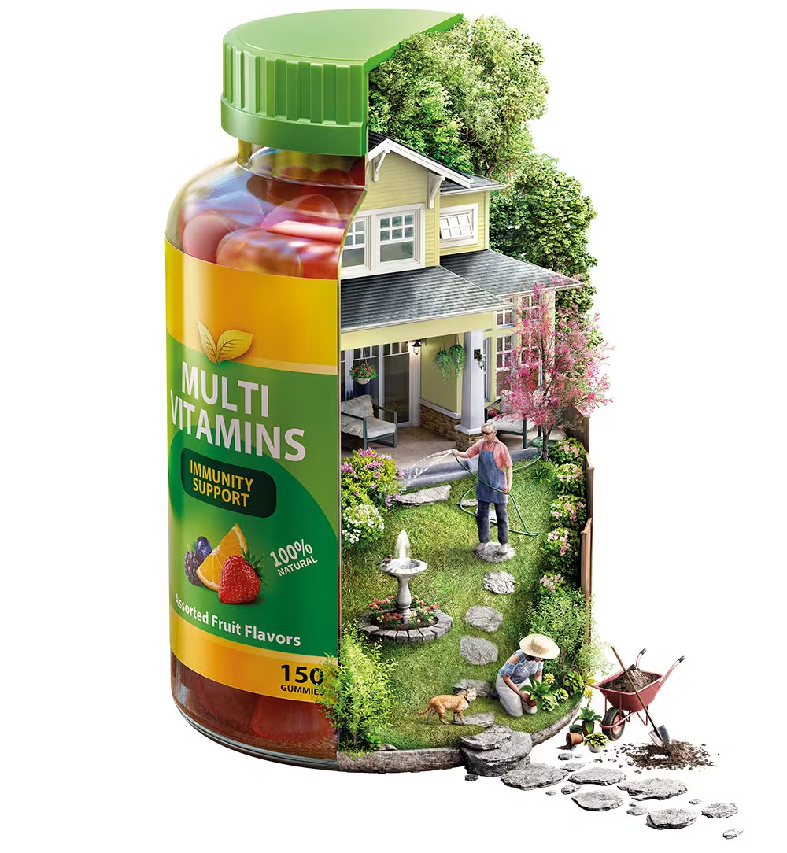
Per DSHEA, dietary supplements are consumed orally, and are mainly defined by what they are not: conventional foods (including meal replacements), medical foods,preservatives or pharmaceutical drugs.
FDA-approved drugs cannot be ingredients in dietary supplements.
Supplement products are or contain vitamins, nutritionally essential minerals, amino acids, essential fatty acids and non-nutrient substances extracted from plants or animals or fungi or bacteria, or in the instance of probiotics, are live bacteria.
Dietary supplement ingredients may also be synthetic copies of naturally occurring substances (example: melatonin)
All products with these ingredients are required to be labeled as dietary supplements.

Slide 37


Dietary supplement products are regulated by the U.S. Food and Drug Administration (FDA). This is probably the most commonly misunderstood fact about the dietary supplements industry. Most of the misunderstanding occurs when people confuse dietary supplements with prescription or over-the-counter (OTC) medicines and expect them to be regulated in the same manner.
Dietary supplements are meant to supplement the diet; accordingly, the Dietary Supplement Health and Education Act of 1994 (DSHEA) defines them as a subset of foods, and they are regulated as such. As is the case with foods, FDA regulates the types of ingredients allowed in dietary supplements and the types of claims that can be made about an ingredient and/or a product.
FDA also has detailed requirements for the labeling of dietary supplements (e.g., nutrition labeling, allergen labeling, statement of identity, and a net quantity statement, among others).

Slide 38
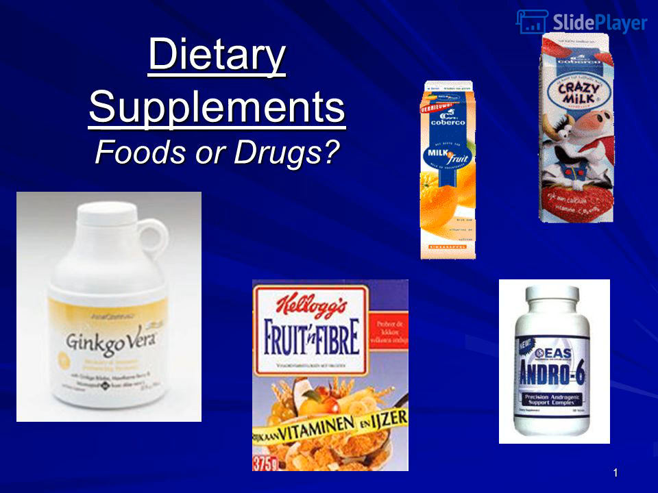

Slide 39


