Slide 1
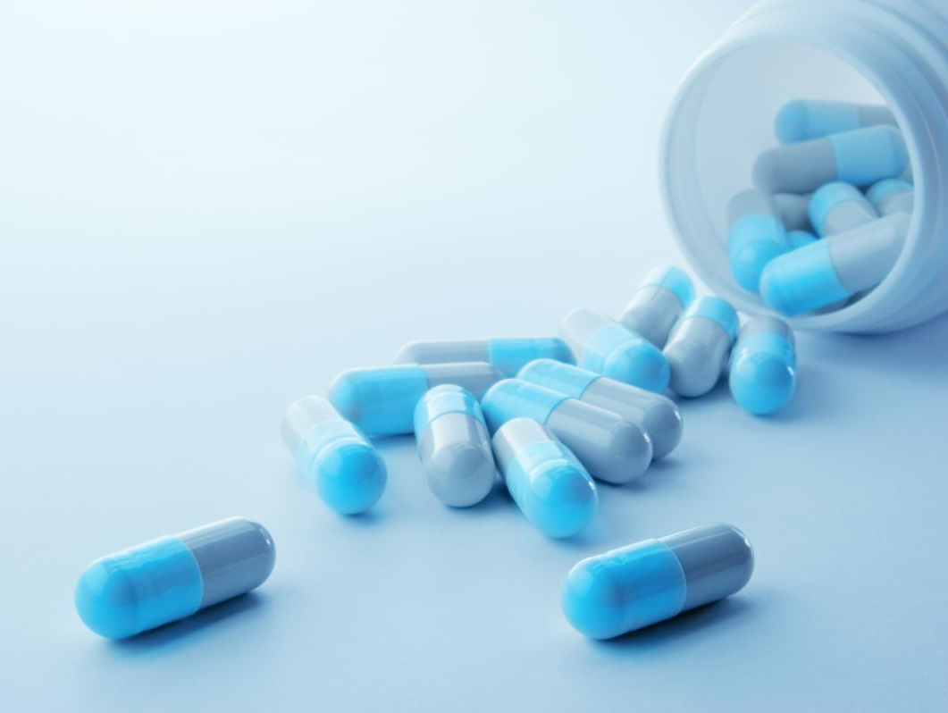
ODESSA NATIONAL MEDICAL UNIVERSITY
FACULTY OF PHARMACY
Department of organization and economics of pharmacy
Protection of the pharmaceutical market from counterfeit, substandard medicines and medical devices.
Prepared by senior teacher
Stepanova Oksana

Slide 2
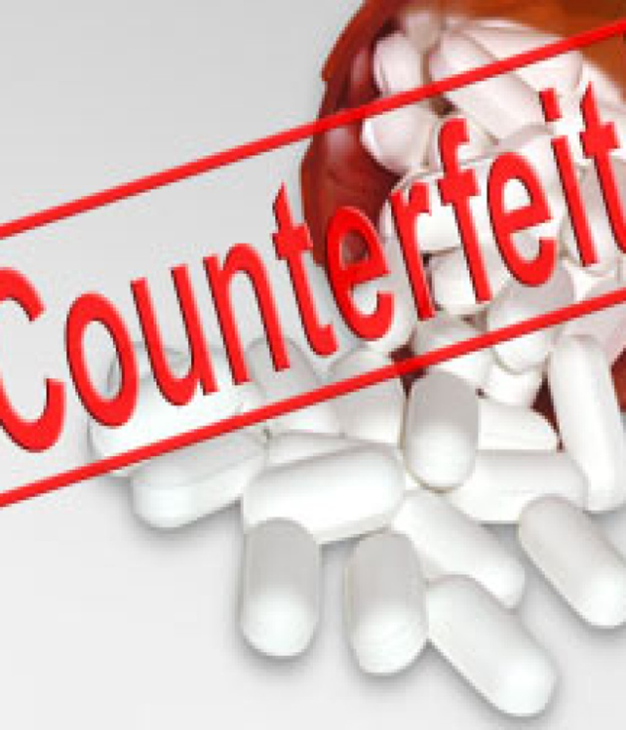
The world problem of falsification of medicines
Access to quality medical products is a crucial element of universal health coverage. Yet, every day, substandard and falsified medical products enter the global supply chain resulting in socioeconomic cost and damage to health.
Substandard and falsified medicines, vaccines and other medical products, such as in vitro diagnostics, not only increase disease prevalence, exacerbate antimicrobial resistance and produce adverse health effects, they also waste resources, result in economic loss and increase outof-pocket spending on medical treatment.
Substandard and falsified medicines are produced, distributed and sold all over the world. Preventing, detecting and responding to them is a persistent public health challenge for WHO Member States.

Slide 3
The world problem of falsification of medicines
Revenues from the sale of counterfeit medicines (CM) exceed the income from the sale of drugs and account for 30 billion dollars per year (5 to 8% of the legal market).
According to the WHO share of CM in the world are 15% of all marketed drugs, up to 30% of drugs – in Africa, Latin America and Southeast Asia, and in some CIS countries – up to 20%. In the U.S., this figure does not exceed 1%. At the same time, according to the WHO, counterfeit are up to 50% of medicines sold over the Internet.

Slide 4
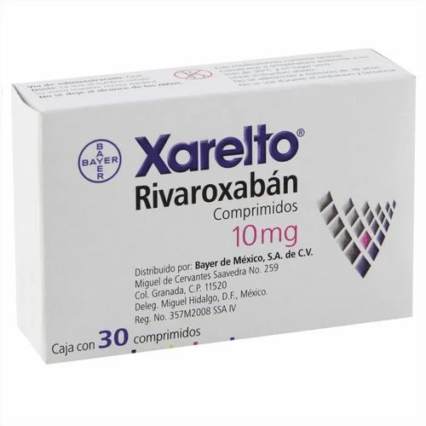
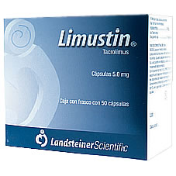
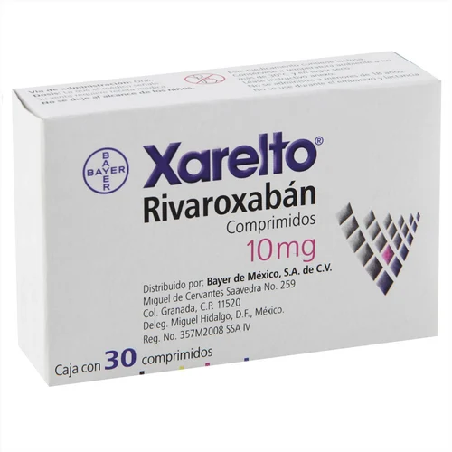
The world problem of falsification of medicines
According to the Drug Enforcement Administration, the U.S. confiscated 9.5 million counterfeit pills from April 2020 to April 2021 – more than the previous two years combined. This is a likely driver of the 100,306 drug overdose deaths in the U.S. over that time.
In addition, from November 2021 to February 2022, counterfeit versions of drugs used for chronic conditions – such as the transplant medication tacrolimus, sold under the brand name Limustin, and the anticoagulant rivaroxaban, or Xeralto – were found on Mexican pharmacy shelves.

Slide 5
The world problem of falsification of medicines
Widely used drugs are cheaply falsified, inexpensive, in demand, and in the last five years there have been cases of falsification of vital and especially expensive drugs (HIV / AIDS drugs, cancer drugs, antibiotics, etc.), lifestyle drugs (Viagra, steroids). hormones to increase muscle volume, psychotropic drugs that help improve mood and general well-being, etc.).
This type of counterfeit products is distributed both through illegal sales channels (for example, smuggling) and through legal means (sold through a network of pharmacies, drugstores, hospitals, other places of sale of medical products).
The Journal of Global Health has estimated the value of the global trade of counterfeit drugs is valued at ~ $300bn, with counterfeit medicine being one of the world’s fastest growing criminal enterprises.

Slide 6
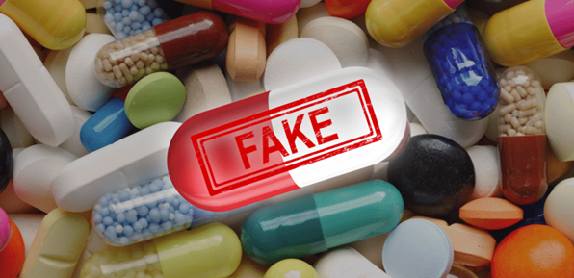
The world problem of falsification of medicines
Counterfeits can be very dangerous and are a serious public health risk. The primary danger in taking a counterfeit medicine is that you are putting something into your body that may not help your current condition and, more alarmingly, could result in harmful effects to your overall health.
Experts at Pfizer have found harmful substances in counterfeit medicines including boric acid, leaded highway paint, floor polish, brick dust and heavy metals. Substandard and falsified medical products contribute to antimicrobial resistance and drug-resistant infections.
Falsified medical products may contain no active ingredient, the wrong active ingredient or the wrong amount of the correct active ingredient. They are also found to commonly contain corn starch, potato starch or chalk. Some substandard and falsified medical products have been toxic in nature with either fatal levels of the wrong active ingredient or other toxic chemicals.

Slide 7
Substandard also called "out of specification", these are authorized medical products that fail to meet either their quality standards or specifications, or both. (WHO)
Unregistered/unlicensed medical products that have not undergone evaluation and/or approval by the National or Regional Regulatory Authority for the market in which they are marketed/distributed or used, subject to permitted conditions under national or regional regulation and legislation.
Falsified medical products that deliberately/fraudulently misrepresent their identity, composition or source.
Any medicinal product with a false representation of: (a) its identity, including its packaging and labelling, its name or its composition as regards any of the ingredients including excipients and the strength of those ingredients; (b) its source, including its manufacturer, its country of manufacturing, its country of origin or its marketing authorization holder; or (c) its history, including the records and documents relating to the distribution channels used. This definition does not include unintentional quality defects and is without prejudice to infringements of intellectual property rights.’;

Slide 8
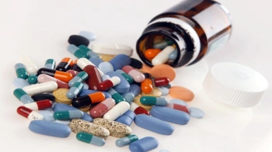
According to the Directive 2011/62/EU OF THE EUROPEAN PARLIAMENT AND OF THE COUNCIL, Falsified medicinal product: Any medicinal product with a false representation of:
its identity, including its packaging and labelling, its name or its composition as regards any of the ingredients including excipients and the strength of those ingredients;
(b) its source, including its manufacturer, its country of manufacturing, its country of origin or its marketing authorization holder;
or (c) its history, including the records and documents relating to the distribution channels used.

Slide 9
Counterfeits include pseudo-drugs and products that are considered by fraudsters to have a therapeutic or prophylactic effect. Distinctive features for such products are:
difference in state registration (certification, conformity assessment);
lack of product in the pharmacy network, sale only through websites or MLM (multi-level marketing, ie from hand to hand);
uniqueness of technology, composition;
guaranteed effect or very high efficiency;
no side effects;
limited offer, promotional price.

Slide 10
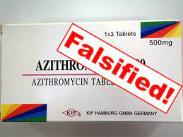
Identifying a substandard or falsified medical product
Some falsified medical products are almost visually identical to the genuine product and very difficult to detect. However, many can be identified by:
examining the packaging for condition, spelling mistakes or grammatical errors;
checking the manufacture and expiry dates and ensuring any details on the outer packaging match the dates shown on the inner packaging;
ensuring the medicine looks correct, is not discolored, degraded or has an unusual smell;
discussing with your pharmacist, doctor or other healthcare professional as soon as possible if you suspect the product is not working properly or you have suffered an adverse reaction; and
reporting suspicious medical products to your National Medicines Regulatory Authority.

Slide 11

Substandard and falsified medical products and the Internet
Rogue online pharmacies frequently use social media platforms to reach potential customers. This suggests that more needs to be done by online platforms like social media, online forums and search engines to identify and stop illegitimate sellers of prescription drugs online.
Unregulated websites, social media platforms, and smartphone applications can also be direct conduits of substandard and falsified medical products. Risks to consumers are significantly increased when obtaining medical products from unlicensed and unregulated sources.

Slide 12
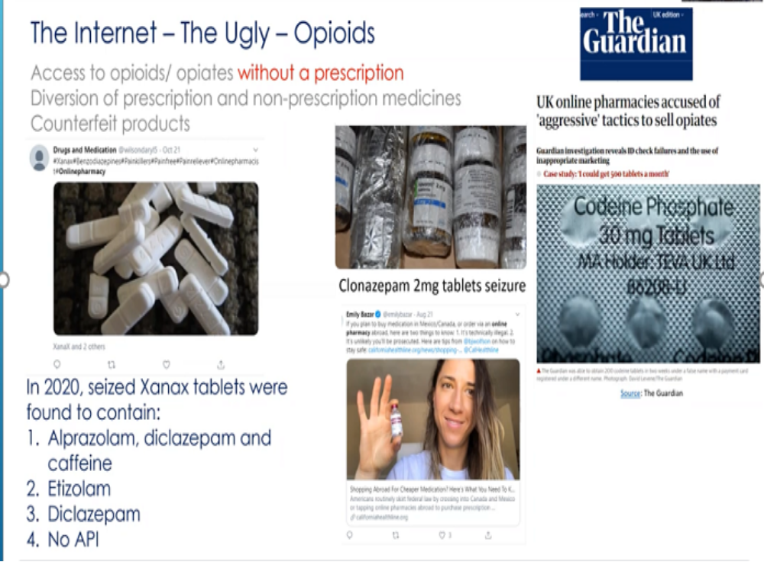

Slide 14

Substandard and falsified medical products and the Internet
Checklist for medicines purchased online
Is it exactly the medicine ordered?
Is it the correct dosage?
Is the packaging in good condition, clean, with a patient information leaflet and in the language in which it was advertised?
Does the medicine look, feel and smell as it should?
Are security seals intact with no signs of tampering?
Does any customs declaration or postal label declare the contents as medicines?
Does the batch number and expiry date on the primary internal packaging match the batch number and expiry date on the secondary (external) packaging?
Have you noticed any unusual activity on your credit card since the purchase?

Slide 15
How technology is evolving to prevent counterfeit activity
Innovative technologies are needed to protect the complex processes (manufacturing and distribution) of medicines to ensure patient safety. These include serialization, authentication, track, and trace, among others. These can be divided into following main categories:
• Radio frequency identification (RFID)
• Advanced computational methods
• Online verification
• Blockchain technologies

Slide 16
Examples of anti-counterfeiting technologies include:
1. Holograms: Holograms are three-dimensional images that are difficult to replicate. They can be applied to packaging, labels, or even the product itself, making it more difficult for counterfeiters to replicate the product.
2. RFID tags: RFID (radio frequency identification) tags are small chips that can be embedded in a product. These tags can be scanned and contain unique information that can be used to authenticate a product.
3. Watermarked packaging: Watermarked packaging involves adding a subtle design or pattern to the package that can be difficult to replicate. This makes it easier to identify an authentic product.
4. QR codes or barcodes: QR codes and barcodes can be added to a product’s packaging and can be scanned by a smartphone or barcode scanner to reveal hidden information or a web page that verifies the product’s authenticity.
5. Cryptography and digital signature: These technologies make use of complex algorithms and a digital signature that can be used to authenticate the product by verifying its signature and encryption.

Slide 17
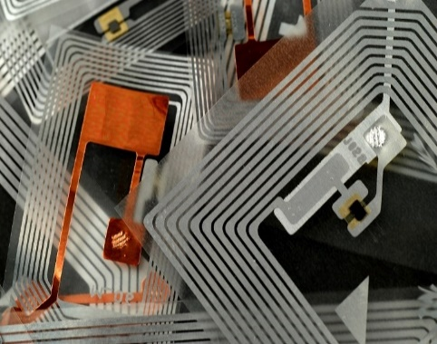
RFID (Radio Frequency IDentification) technology.
Let’s look at what this consists of:
RFID uses an electromagnetic wave system that allows automatic identification of the monitored product, obviating the need for each item to be read individually.
It consists of an alphanumeric identification code (called UID or TID) embedded in a transponder (RFID tags or boards), and a reader with antenna required to read them. RFID tags are affixed to individual products and transceiver antennas are deployed along monitored areas, which track all movement, in and out, of each label/product.
The alphanumeric code inside the chip is indeed the label, which unequivocally guarantees product authenticity and provenance as it is unique and unmodifiable.
This information is stored and, therefore, known exclusively by the person who produced the chip.
This is why RFID technology is proving to be one of the most effective weapons in the fight against counterfeiting – because protects the brand in both of the key aspects that have already been mentioned, product authenticity, and production chain traceability.

Slide 18
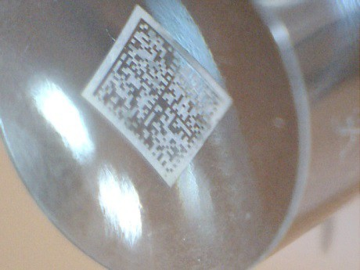
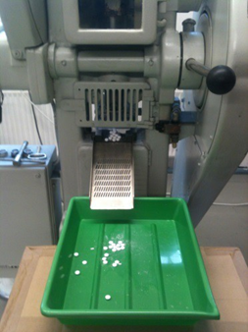
Datamatrix codes for self-verification between product and packaging.
The codes contain enough data for track & trace plus cryptographic signature to check for genuine product.
Datamatrix codes have been laser structured onto the steel tooling used for tablet stamping.
The codes are structured at different surface levels.
The codes have been successfully embossed onto tablets using a normal industrial tableting press.

Slide 19
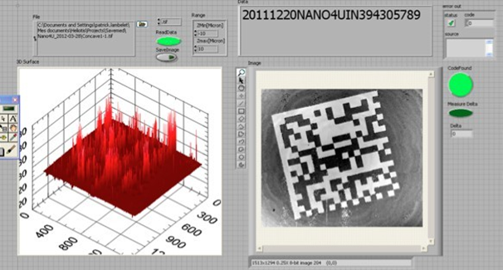
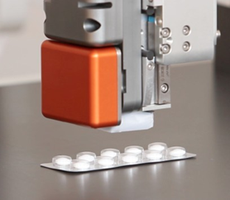
Embossed codes on the tablets can be scanned and read using appropriate «reading» system
The scanner uses a special type of industrially proven tomography to read through clear blister packs or slightly porous materials to detect each interface at a microscopic level.
Algorithms for scanning & decoding have been proven.
Measurement on coated tablets and through coatings has been achieved, hiding the code completely in the surface of, or beneath the coating of, the tablet.

Slide 20
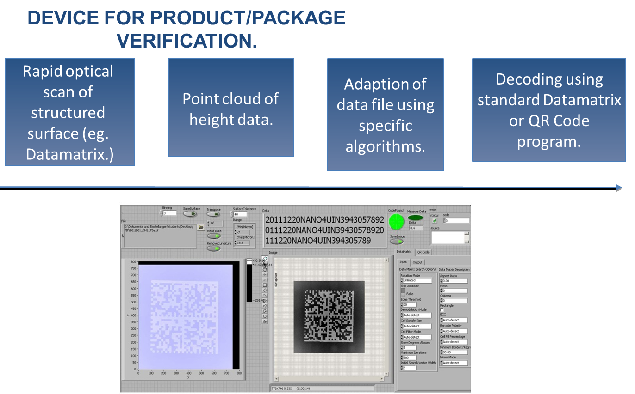

Slide 21
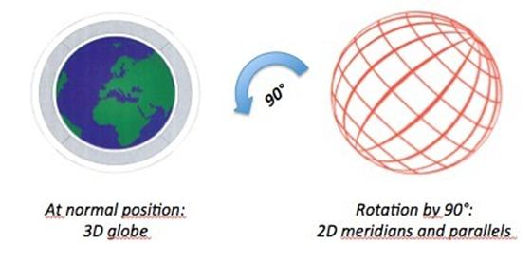

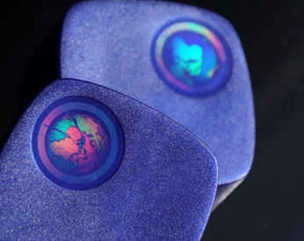
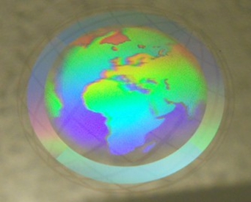
Moulded hologram security features
Level 1: Holographic logo or pattern that diffracts the light to different colours at different angles (see plastic cap picture on previous slide).
Level 2: Complex hologram that changes appearance when viewed from different angles. Example: Globe hologram (see below).
Level 3: Hidden detail (only visible when inspected at a specific point or using a specific method). Examples include microtext, reflected diffractive patterns.

Slide 22
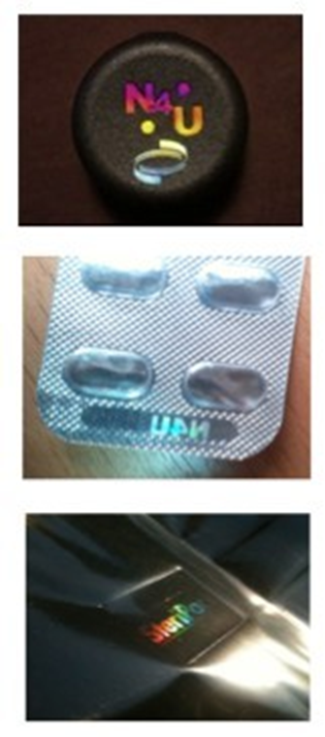
Holograms including covert features
the application of holographic gratings to flat or curved hardened steel surfaces such as those used in injection moulds and embossing tools.
High-contrast holograms have been injection moulded onto plastic packaging directly from injection moulds with no secondary process.
Using inserts from the special steel structuring process, holograms have been directly embossed onto blister packs in a standard packaging line.
Holograms have also been embossed onto medical pouches as part of a standard film converting line.
Optical gratings have been produced to locally couple light into a plastic material and reveal a hologram that was previously not obvious.

Slide 23
Modern day anti-counterfeit solutions
In addition to traditional anti-counterfeiting technologies, such as holograms, RFID tags, and watermarked packaging, there are numerous modern solutions that companies and manufacturers can use to protect their products from counterfeiting. Here are some examples:
1. Blockchain technology: Blockchain technology can be used to create a digital record of a product’s authenticity, making it difficult for counterfeiters to reproduce. This technology can be used to trace a product’s path through the supply chain, allowing companies and consumers to verify a product’s authenticity.
Artificial intelligence (AI) and machine learning (ML): AI and ML algorithms can be used to analyze large amounts of data, such as product images or packaging, to identify unique patterns and characteristics of authentic products. This makes it easier to identify and detect counterfeit products.
NFC (Near Field Communication) tags: NFC tags are small chips that can be embedded in a product and can be scanned with a smartphone. These tags can be used to store information about a product, such as a unique identifier or a link to a website that verifies its authenticity.

Slide 24
Modern day anti-counterfeit solutions
4. Augmented reality (AR): AR technology can be used to create interactive experiences for consumers, such as virtual tours of a manufacturing plant or demonstrations of how a product works. This can help educate consumers about a product and facilitate the identification of authentic products.
5. Encryption: Encryption can be used to protect the authenticity of a product by encrypting information and creating a digital signature. This can verify the authenticity of a product and make it more difficult for counterfeiters to reproduce it.
These modern solutions can be used in conjunction with traditional anti-counterfeiting technologies, providing an additional layer of protection for products. By keeping abreast of new anti-counterfeiting solutions, companies and manufacturers can better protect their products from counterfeiting and ensure customer safety and satisfaction.

Slide 25
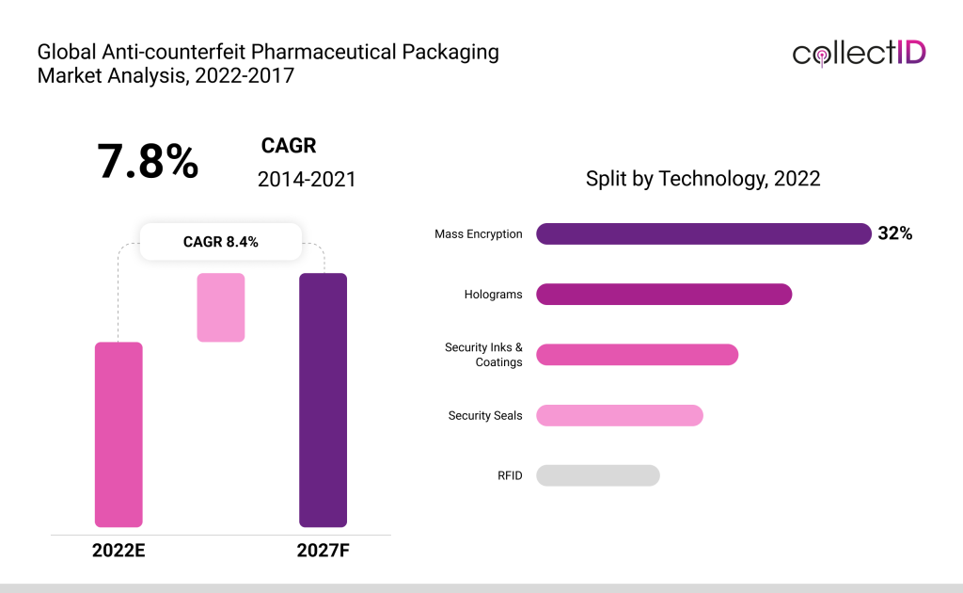

Slide 26
Anti-counterfeiting screening technologies
A variety of screening technologies are employed for a rapid and efficient detection substandard of falsified medicines in the field. These consume fewer resources compared to traditional quality control technologies. The three principle screening technology types are: visual, physical, and chemical.
The visual analysis includes packaging integrity, labelling, dosage units’ inspection, and used product security features such as holograms and microprinting. The physical analysis involves the evaluation of the disintegration and/or dissolution performance and employ microscopy, refractometry, and or refractive index measurements. In the chemical analysis the application of spectroscopy, spectrometry, chromatography, and or wet chemistry are typical methods.

Slide 27
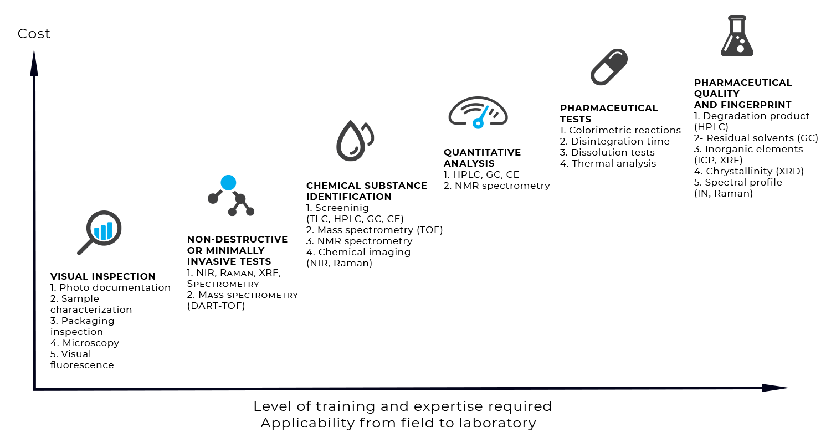

Slide 28
anti-counterfeit packaging strategies
So far, efforts to combat counterfeiting have focused on making the packaging harder to duplicate with unique QR codes. However, these can be peeled off and replaced with fake ones by sophisticated counterfeiters, and a vast majority of consumers do not even know to check for QR codes on their packages. Instead, pharmaceutical companies are focusing on technologies that can be easily tracked throughout the supply chain without the risk of duplication.
There are two types of anti-counterfeit packaging strategies – overt and covert.
Overt packaging technologies are visible and enable quick authentication without the need for sophisticated devices. They typically involve optically uneven package designs such as color-shift inks or holograms, which can be quickly verified by tilting the package at different angles. Holograms in particular can be made invisible to the naked eye and embedded with extra layers such as nano-text to safeguard their uniqueness. Vaccine manufacturers have also started attaching vaccine vial monitors to each unit, which are time-temperature indicators containing an irreversible colourless chemical.

Slide 29
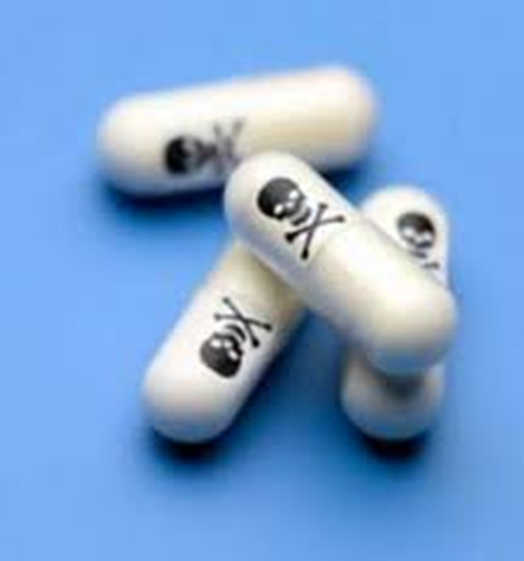
Covert technologies require special detection devices and are thus hard to copy by counterfeiters. Ultraviolet inks, micro-text, molecular markers and biological tracers are frequently used by pharmaceutical companies and can only be checked with specialised lab equipment.
Taggant systems involving radio frequency microchips are also gaining popularity, as they can be scanned from a secure location so that there is no risk of the authentication machine being tampered with. RFID tags are already being used by brands like Pfizer and GSK for some of their drugs. Another up-and-coming solution is the cryptographic signature, which can be embedded invisibly onto any package and also serves as an automatic tracker. Going forward, technologies like cryptography will play a big role in anti-counterfeit strategies, as it is foolproof and involves minimal hassle to mass-encode.

Slide 30
A mixture of covert and overt technologies is generally regarded as ideal for providing security. Security design tapes, for instance, include covert line designs that are extremely difficult to copy and also have the overt protection of being instantly noticeable if tampered with. On the transportation side, pharma companies are investing in special containers that are tamper-proof and provide real-time alerts on their location at any point.
The role of blockchain is also increasing in importance, as it enables full transparency through a virtual ledger to all those authorized to have access. Once the supply chain is fully blockchain-enabled, every customer can track their medicine delivery right from the factory to their doorstep.

Slide 31
In conclusion, packaging in the pharmaceutical industry doesn’t just protect the product but also provides medical, regulatory and marketing information to the customer. Preserving its integrity, therefore, is vital. By adopting a systematic approach to packaging and continuously upgrading it through covert and overt technology, each package can be traced and verified at all times and thus safeguarded from tampering. This, coupled with heightened vigilance and greater awareness about genuine products among consumers, will help to bring down the counterfeit drug menace once and for all.

Slide 33
How Criminals Are Making Millions Counterfeiting Prescription Drugs
https://www.youtube.com/watch?v=-VbiHC4gsTE

