Slide 1
Odessa National Medical University
Faculty of Pharmacy
Department of Organization and Economics of Pharmacy with Post-diploma Specialization
Understanding a Balance sheet

Slide 2
Learning objectives
Identify the importance of financial analysis to pharmacy practice
Describe the impact of financial analysis on customer service
Discuss the importance of accounting as a background for financial analysis and management
Identify and describe the four basic financial statements
Characterise balance sheet

Slide 3
What Is Accounting?
Accounting is the process of recording financial transactions pertaining to a business.
The accounting process includes :
summarizing
analyzing
reporting
These transactions are subject to supervision, regulatory and tax collection authorities

Slide 4
Two important types of accounting
I - managerial accounting
II - cost accounting
Managerial accounting helps management teams make business decisions, while cost accounting helps business owners decide how much a product should cost.

Slide 5
Accounting concepts
Accounting information should be complete in all respects.
Accounting information should be made available to users on a timely basis.
Accounting information should be presented in a manner that is easily understandable to the user.
Accounting information should be relevant to the needs of users.
Accounting information should be reliable.
A business transaction should only be recorded when it can be measured in a currency.
Expenses should be recognized in the same period in which related revenues are recognized.

Slide 6
Accounting records
- general ledger
- all subsidiary ledgers
- invoices
- bank statements
- cash receipts
- checks

Slide 7
What Are Financial Statements?
There are four basic financial statements, including:
1. Balance sheet
2. Income statement
3. Cash flow statement.
4. Shareholder’s (owner’s) equity statement.

Slide 8
Who are the users of the financial statements?
Owners who monitor company profitability (internal)
Managers who make decisions affecting the operations of the various departments and divisions (internal)
Lenders and potential investors who evaluate the business’s financial strength to make appropriate decisions with regards to loaning or in money with the company (external) vesting

Slide 9
Understanding Balance Sheets
The Balance Sheet is the main financial statement.
The Balance Sheet provides a picture of all of a company’s assets, liabilities and owner’s equity at a particular date, or point in time.

Slide 10
What goes on a balance sheet
All balance sheets are organized into three categories:
Assets,
Liabilities, and
Owner’s equity.

Slide 11
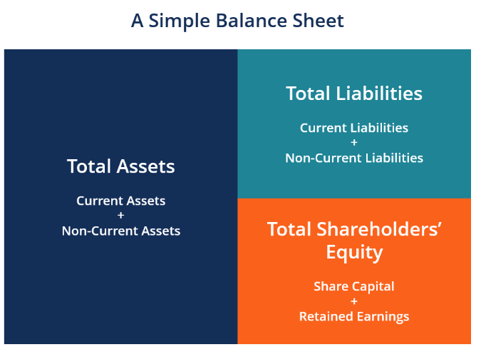

Slide 12
ASSETS -
the things your business owns that have a UAH (or others) value
Anything you expect to convert into cash within a year are called current assets.
CURRENT ASSETS INCLUDE:
Money in a checking account
Money in transit (money being transferred from another account)
Accounts receivable (money owed to you by customers)
Short-term investments
Inventory
Prepaid expenses
Cash equivalents (currency, stocks, and bonds)

Slide 13
Long-term assets
(non-current assets)
Long-term assets, on the other hand, are things you don’t plan to convert to cash within a year.
Long-term assets include:
Buildings and land
Machinery and equipment (less accumulated depreciation)
Intangible assets like patents, trademarks, and goodwill (you would list the market value of what fair price a buyer might purchase these for)
Long-term investments

Slide 14
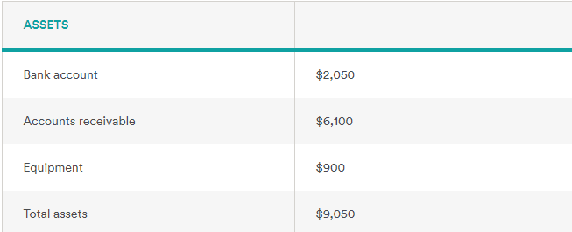
For example: your pharmacy company assets are:

Slide 15
Liabilities
Liabilities—what your business owes to others
classify them as follows
current (due within a year) and
long-term (the due date is more than a year away).

Slide 16
liabilities
Current liabilities might include:
Accounts payable (what you owe suppliers for items you bought on credit)
Wages you owe to employees for hours they’ve already worked
Loans that you have to pay back within a year
Taxes owed
And here are some (non-current) long-term liabilities:
Loans that you don’t have to pay back within a year
Bonds your company has issued

Slide 17
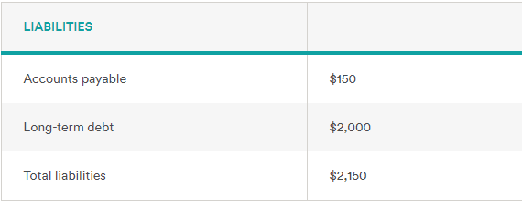
For example: your pharmacy company liabilities are:

Slide 18
Equity
Equity is money currently held by your company. (This category is usually called “owner’s equity” for sole proprietorships and “stockholders’ equity” for corporations.) It shows what belongs to the business owners.
Owners’ equity includes:
Capital (money invested into the business by the owners)
Retained earnings (all your revenue minus all your expenses since launch)

Slide 19
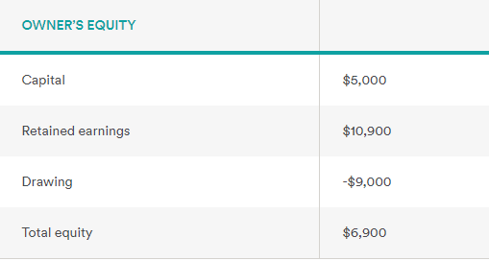
For example: your pharmacy company equity are:

Slide 20
The balance sheet equation
This accounting equation is the key to the balance sheet:
Assets = Liabilities + Owner’s Equity
Assets go on one side, liabilities plus equity go on the other. The two sides must balance—hence the name “balance sheet.”
It makes sense: you pay for your company’s assets by either borrowing money (i.e. increasing your liabilities) or getting money from the owners (equity).

Slide 21
So, What is a balance sheet?
The balance sheet is one of the three main financial statements, along with the income statement and cash flow statement.
A balance sheet gives a snapshot of your financials at a particular moment, incorporating every journal entry since your company launched.
It shows:
what your business owns (assets),
what it owes (liabilities), and
what money is left over for the owners (owner’s equity).
Because it summarizes a business’s finances, the balance sheet is also sometimes called the statement of financial position.
Companies usually prepare one at the end of a reporting period, such as a month, quarter, or year.

Slide 22
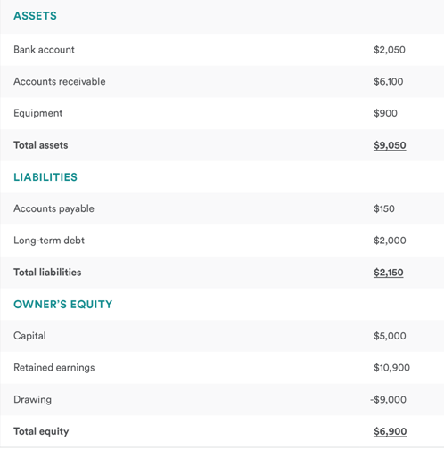
A sample balance sheet:

Slide 23
Now what do I do with it?
Because the balance sheet reflects every transaction since your company started, it reveals your business’s overall financial health. At a glance, you’ll know exactly how much money you’ve put in, or how much debt you’ve accumulated. Or you might compare current assets to current liabilities to make sure you’re able to meet upcoming payments.
You can also compare your latest balance sheet to previous ones to examine how your finances have changed over time. You’ll be able to see just how far you’ve come since day one.

Slide 24
The purpose of a balance sheet
The information in your company’s balance sheet can help you calculate key financial ratios, such as the “debt to equity” ratio, which shows the ability of a business to pay for its debts with equity (should the need arise!).
Even more immediately applicable is the current ratio: current assets / current liabilities. This will tell you whether you have the ability to pay all your debts in the next 12 months.
You can also compare your latest balance sheet to previous ones to examine how your finances have changed over time. You’ll be able to see just how far you’ve come since day one.

Slide 25
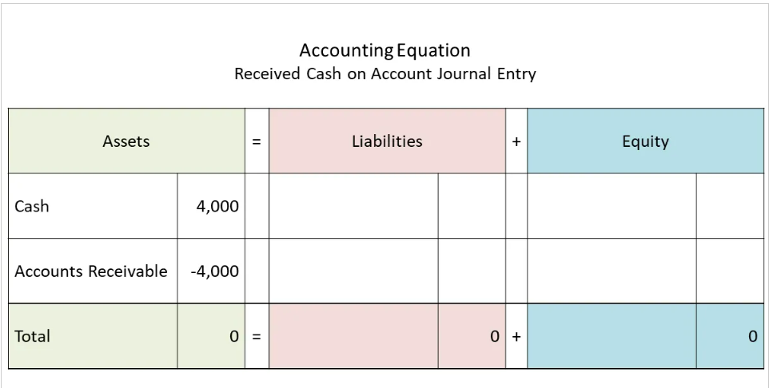
Accounting Equation for Received Cash on Account Journal Entry
The Accounting Equation, Assets = Liabilities + Owners Equity means that the total assets of the business are always equal to the total liabilities plus the equity of the business. This is true at any time and applies to each transaction. For this transaction the Accounting equation is shown in the following table.
In this case one asset cash increases as the cash is received by the business and another asset (accounts receivable) decreases representing money received from the customer to be allocated against customer invoices at a later date.

