Slide 1
Odessa National Medical University
Faculty of Pharmacy
Department of Organization and Economics of Pharmacy with Post-diploma specialization
Cash accounting in pharmacies Cash operations: classification, documentation. Registrars of settlement operations in retail trade. Pharmacy Proceeds

Slide 2
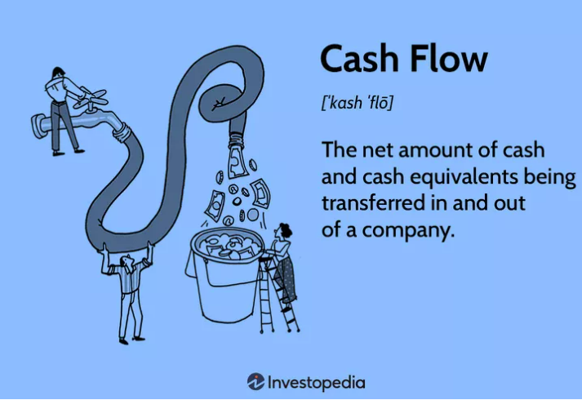
Cash
Cash is the most liquid asset a company can own. A company’s cash account includes all currency and coins owned by the company as well as all deposits in the bank including checking accounts

Slide 3
How many types of cash in an accounting?
It has three main categories –
operating cash flow which includes day-to-day transactions
investing cash flow which includes transactions which are done for expansion purpose, and
financing cash flow which include transactions relating to the amount of dividend paid out to stockholders.

Slide 4
What is cash accounting?
Cash accounting is an accounting method that records income when it is received and records expenses in the period in which they are paid
Under cash accounting, revenues and expenses are recorded at the time that cash is exchanged. When cash is received from a sale, it is recorded in the accounts as a sale, and when payment is made on an expense, it’s recorded as an expense.

Slide 5
Cash accounting in practice
The cash method of accounting is easy to apply. When a company receives money from a customer or pays one of their suppliers, these transactions are recorded for tax purposes.
The benefits of cash accounting
it is often a choice of a companies, because it is such a straightforward way of recording a company’s income and expenses,
Using cash accounting gives you an immediate and up-to-date picture of your cash flow and balances. This can be useful for a small business that might not want to get caught up in too much credit and loans.

Slide 6
How to record your cash transactions
You'll want to record your cash transactions in a number of different ways, depending on the nature of your business.
Sales and Cash Receipts Journal: To simplify your recordkeeping, it is recommended that you combine your sales and cash receipts in a single journal.
Income (receipt) and expense orders Income and expense orders are unified forms approved by the Law for use by organizations or individual entrepreneurs using cash. Depending on what function they carry at the organization’s cash desk - income or expense - there is a cash receipt order and an expense cash order.
Daily Cash Sheet: If cash transactions are a significant part of your business, you should also prepare a daily cash sheet to reconcile your cash received and paid out for the day. If you use a daily cash sheet, you can reconcile your cash receipts with your daily deposit into your bank account.
Cash Disbursements Journal: Your daily cash disbursements should be recorded here.
Bank Reconciliation: Reconciling your records with your monthly bank statement verifies the amount you have in your checking account. It will also help you find bookkeeping errors. It could also enable you to detect (and remedy) irregularities such as employee theft.
Petty Cash Fund: If your customers normally pay by check, having a petty cash fund will provide you with cash on hand to pay miscellaneous small expenses. A petty cash fund isn't necessary if you use a cash register and always have currency on hand, as long you keep track of these small purchases.

Slide 7
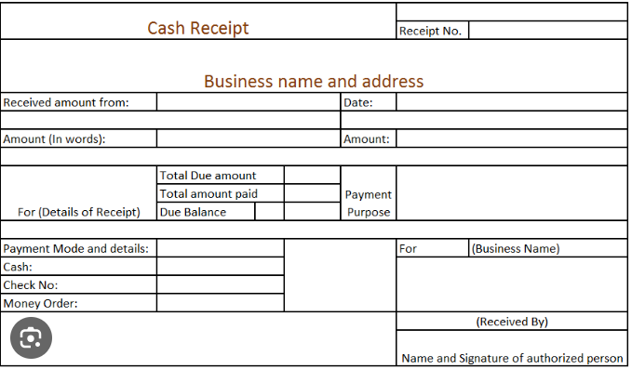
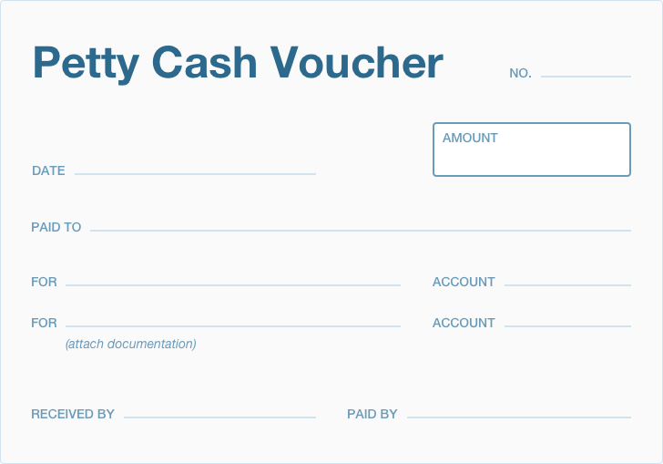

Slide 8
A "cash receipt voucher" or "cash receipt order" is a formal document used to record the receipt of cash into a cash register or petty cash fund. It serves as a record of incoming cash transactions, typically generated at the point of receiving payments from customers or other sources.
Here's a basic description of the document:
1. **Header**: The voucher usually contains a header section where essential information is recorded, such as the name or logo of the company or organization, the voucher number, and the date of issuance.
2. **Details of Transaction**: This section includes details about the transaction, such as the amount received in cash, the purpose or description of the transaction (e.g., sale of goods or services, payment of a debt), and any reference numbers or invoice numbers associated with the transaction.
3. **Accounting Information**: Depending on the organization's accounting practices, the voucher may also include accounting codes or references, such as ledger account numbers or cost center codes, to facilitate tracking and reconciliation.
4. **Authorized Signatures**: To ensure accountability and authorization, there are spaces for signatures of the individuals responsible for receiving and approving the cash receipt. This may include the signature of the cashier or recipient of the cash, as well as an approving authority, such as a supervisor or manager.
5. **Additional Notes or Comments**: There may be space provided for additional notes or comments relevant to the transaction, such as any special instructions or remarks regarding the nature of the payment.
Overall, the cash receipt voucher serves as a vital internal control mechanism for monitoring and tracking cash inflows, ensuring accuracy in financial record-keeping, and providing documentation for auditing purposes.

Slide 9
When is the Incoming Cash Order
(or “cash receipt voucher" or "cash receipt order“) filled out?
When cash is received at the cash desk of an organization or individual entrepreneur, it is necessary to reflect the fact of this business transaction on the accounts of accounting.
It is compiled in a unified manner in a single copy and is signed by the chief accountant, accountant, cashier accountant, organization cashier or other authorized person.
The cash receipt order consists of two blocks:
An Order itself;
A receipt (that, after filling out, is torn off and given to the person who contributed the money to the cashier)
You can write out a receiver either manually or using a computer. Corrections in the receipt order are not allowed. If you make a mistake, the order must be rewritten. Otherwise, such a document is not valid and violates cash discipline.
On the second block of the PKO "Receipt", after filling, the seal of the legal entity or entrepreneur is put. The stamp puts the need so that half falls on the cash receipt order and the second half on the receipt, now there is not.

Slide 10
In what cases is an Incoming Cash Order filled out?
receipt at the cash desk of revenue
total amount at the end of the shift
repayment of borrowed fund
return from the accountable person (your organization issued the employee money for the report, the employee purchased the necessary and brings the balance of the advance payment to the cash desk of the organization or entrepreneur)
withdrawal of funds from the current account of legal entities (if you withdraw money from the organization’s current account for wages, household needs, etc., then this money must first be paid to the organization’s cash desk).

Slide 11
A "cash expenditure order" is a formal document used to authorize the disbursement of cash from a cash register or petty cash fund for specific expenses. It's commonly utilized in businesses or organizations to track and control cash outflows and ensure that expenditures are properly documented and authorized. Here's a description of the typical components of a cash expenditure order:
Header: Similar to other financial documents, the cash expenditure order usually begins with a header section containing essential information such as the name or logo of the company, the order number, and the date of issuance.
Details of Expenditure: This section provides a breakdown of the expenditure, including the amount of cash to be disbursed, the purpose of the expenditure (e.g., office supplies, transportation, maintenance), and any relevant reference numbers or codes associated with the expense.
Accounting Information: To ensure proper accounting and allocation of expenses, the cash expenditure order may include accounting codes or references, such as ledger account numbers or cost center codes, to indicate where the expenditure should be charged.
Authorized Signatures: Accountability and authorization are key aspects of the cash expenditure order. Therefore, there are spaces provided for the signatures of individuals responsible for approving and disbursing the cash. This typically includes the signature of the person authorizing the expenditure (e.g., a manager or supervisor) and the signature of the cashier or person responsible for disbursing the cash.
Receipts or Supporting Documentation: Depending on the organization's policies and procedures, the cash expenditure order may require attaching receipts or other supporting documentation to validate the expenditure and ensure transparency and accuracy in financial record-keeping.
Additional Notes or Comments: There may be space provided for additional notes or comments related to the expenditure, such as any special instructions or remarks regarding the nature of the expense.
Overall, the cash expenditure order serves as a vital internal control tool for managing cash disbursements, ensuring that expenditures are authorized, documented, and properly accounted for, and facilitating transparency and accountability in financial management processes.

Slide 12
When is the cash expenditure order filled out?
By analogy with an incoming cash order, it is filled in when money needs to be given from the organization’s cash desk. So it refers to a document used to authorize the withdrawal of cash from a cash register or petty cash fund for specific expenses.
it is compiled on a unified single copy and is stored in the cash book of the organization.
signed by the chief accountant, accountant, cashier, organization cashier or other authorized person.
You can write out it either manually or using a computer.
Corrections in the cash expenditure order are not allowed. If you make a mistake, the order must be rewritten. Otherwise, such a document is not valid and violates cash discipline.

Slide 13
In what cases is a cash expenditure order filled out?
the need to issue to accountable persons for the purchase of necessary goods or materials for the organization;
issue to accountable persons for personal and travel expenses;
delivery of cash to the bank to the bank account of the organization;
payment of wages (advance) to employees in cash at the checkout;
payment of dividends to founders

Slide 14
Maintaining Daily Cash Sheets
A cash sheet is a daily reconciliation of cash received and cash paid out. If a good deal of your business is transacted in cash, such as in a retail pharmacy, you should prepare a cash sheet at the end of each day.
Maintaining cash sheets provides an alert to any shortage or surplus of cash for the day. Some businesses opt to simply count the cash in the register at the end of the day without maintaining a cash sheet, leaving them clueless to any shortages or overages. A shortage could be the result of theft, or it could simply result from your failure to record a special transaction, such as an expense you paid in cash—but without a cash sheet, you'll never know.

Slide 15
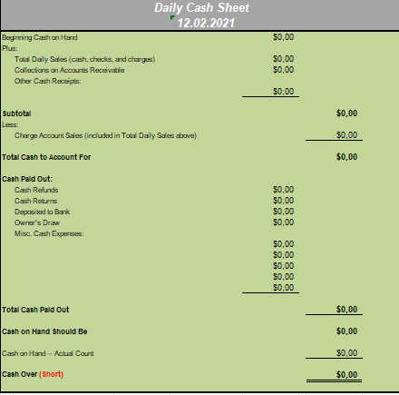
Daily Cash Transaction Worksheet

Slide 16
CASH BOOK : MEANING AND SIMPLE CASH BOOK
Cash Book is a Book in which all cash receipts and cash payments are recorded. It is also one of the books of original entry. It starts with the cash or bank balance at the beginning of the period.
Cash Books may be of the following Types:
1 - Simple Cash Book
2 - Bank Column Cash Book
3 - Petty Cash Book

Slide 17
Single column cash book
The single column cash book (also known as simple cash book) is a cash book that is used to record only cash transactions of a business. It is very identical to a traditional cash account in which all cash receipts are recorded on left hand (debit) side and all cash payments are recorded on right hand (credit) side in a chronological order.
The single column cash book has only one money column on both debit and credit sides titled as “amount” which is periodically totaled and balanced like a T-account. As stated earlier, a single column cash book records only cash related transactions. The entries relating to checks issued, checks received, purchases discount, and sales discount are not recorded in single column cash book.

Slide 18
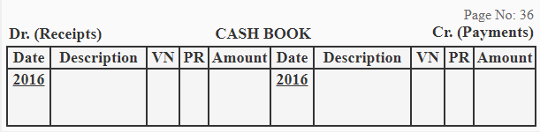
Format:
The purpose of five columns used on both sides of a single column cash book is briefly explained below:
Date: The date column of the cash book is used to record the year, month and actual date of each cash transaction. This column ensures the chronological record of each business transaction involving receipt or payment of cash.
Description: The description column is used to record the account titles to be debited or credited as a result of each cash transaction. A short explanation (also known as narration) of each cash transaction may also be written in this column. This column is sometime titled as “particulars”.
Voucher No: Voucher is a document that supports a business transaction. This column is used to record the serial number of a receipt voucher or payment voucher.
Posting reference: This column is used to write the page number of each ledger account named in the description column of the cash book.
Amount: The amount column of single column cash book is used to record the money value of each cash transaction.

Slide 19
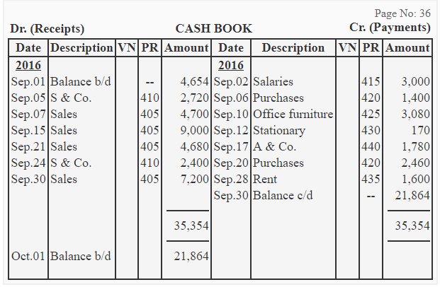
Illustration

Slide 20

POINT OF SALE

Slide 21
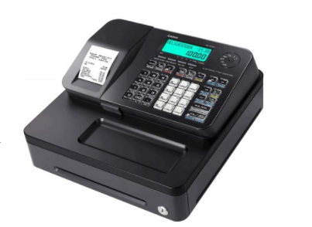
Registrars of settlement operations in retail trade
As the name implies, a cash register is a piece of equipment for registering cash payments. A cash register only handles payment operations at the till. It is not connected to a computerized system
Although the built-in cash drawer clearly makes it ideal as an all-in-one solution for cash payments, you can enter card transactions too by just pushing the appropriate button, after you have processed the card transaction on an independent card machine. Receipts, too, are also printed from the cash register.

Slide 22
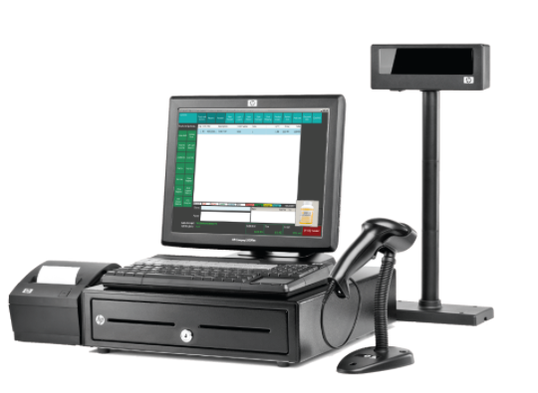
POINT OF SALE (POS)
The point of sale (POS) is the place where a retail transaction is completed. At the point of sale, the merchant calculates the amount owed by the customer, indicates that amount, may prepare an invoice for the customer (which may be a cash register printout), and indicates the options for the customer to make payment. It is also the point at which a customer makes a payment to the merchant in exchange for goods or after provision of a service. After receiving payment, the merchant may issue a receipt for the transaction, which is usually printed but can also be dispensed with or sent electronically.
A cash register (also known as a “till”) is the machine used by businesses to calculate and record financial transactions. Most have a keypad that’s used to input values, as well as the functionality to attach a barcode scanner, cash drawer, receipt printer and scales. Many cash registers today are digital, featuring a touchscreen rather than a manual keypad and mechanical inner.

Slide 23
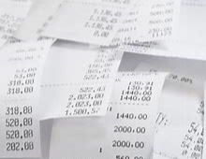
What is a Sales Receipt?

Slide 24
A sales receipt is a document issued by a seller to a buyer as a proof of purchase for goods or services. It serves as evidence that a transaction has occurred and typically includes details such as:
Seller Information: Name or business name, address, contact information, and possibly a logo.
Buyer Information: Name or company name of the purchaser.
Transaction Details: Date and time of the transaction, description of the goods or services purchased, quantity, unit price, and total amount paid.
Payment Information: Method of payment (cash, credit/debit card, check), and any relevant payment details such as card number or check number.
Transaction Number or Receipt Number: A unique identifier for the receipt, which can be useful for tracking purposes.
Tax Information: If applicable, details of any taxes applied to the transaction, such as sales tax or value-added tax (VAT).
Sales receipts are important for both buyers and sellers. For buyers, they provide proof of purchase, which may be necessary for returns, exchanges, or warranty claims. For sellers, they serve as a record of sales transactions for accounting and tax purposes.

Slide 25
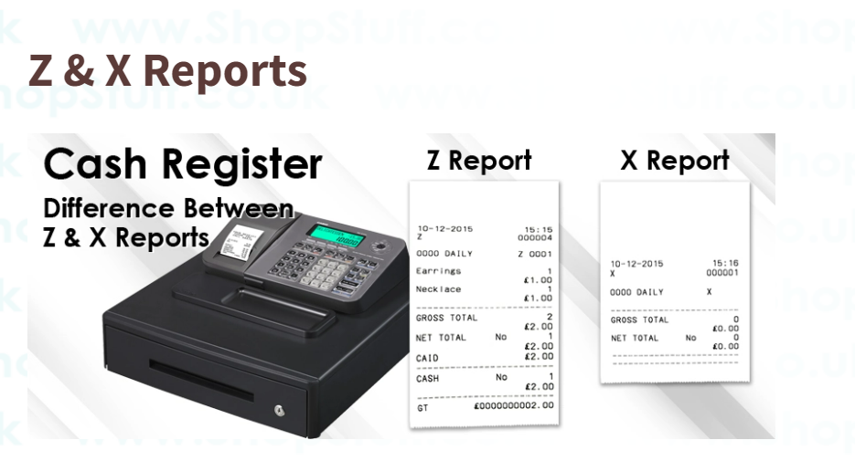
X and Z reports summarize sales, returns, and other activity during a register shift.
X reports cover everything from the register shift opening until when the report is run, and
Z reports cover the entire shift from open to close.
X and Z reports must be run at the register, can be filtered by employee, and can be printed or reprinted as needed.

Slide 26
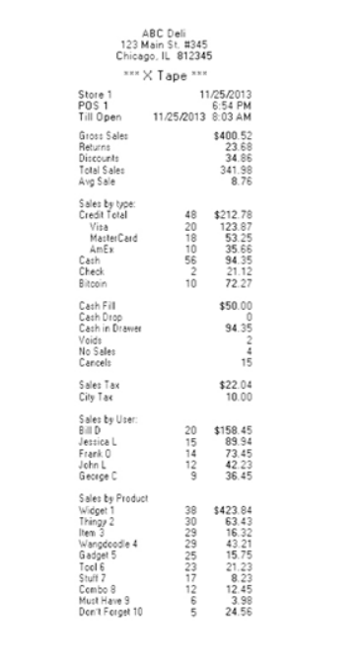
X Report – Mid-Shift
Daily X reports are snapshots of sales and activities. You can generate as many X reports as you like, before the final report of the day, the Z report.
Managers use X reports to check for discrepancies in the cash drawer at the end of a shift. X reports are also used to check the status of sales during the day and the number of money-outs/money-ins that need to be accounted for.

Slide 27
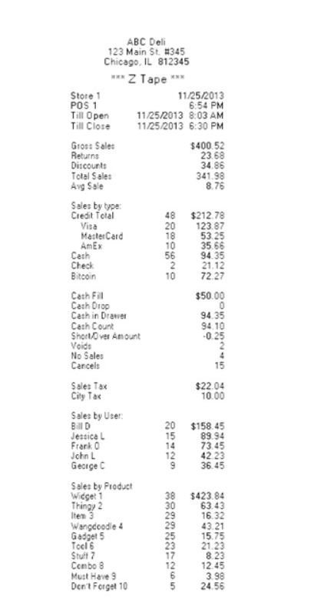
Z Report – End of Shift
The Daily Z report is the end-of-day report run when you are closing the trading day.
The Daily Z report shows the final overview of the day’s sales, refunds, payment methods, and more. Outputting the report also resets the grand totals so a new trading day can start from scratch.
There is no redoing of a Z report. Once it is generated and grand totals are reset, any changes you want to make are moved to the following trading day. This makes a Z report the key sales report of the day for accounting purposes.

Slide 28
Cash balance limit
Cash balance limit in the cash register - the maximum amount of cash that can remain in the cash register after working hours to ensure operations at the beginning of the next working day.

Slide 29
Pharmacy proceeds
"Pharmacy proceeds" typically refer to the income or revenue generated by a pharmacy from the sale of medications, healthcare products, and related services. It represents the total amount of money earned by the pharmacy through its operations.
The term "proceeds" in this context is used to indicate the financial gains or receipts resulting from the sale of pharmaceutical products and services. These proceeds can include revenue from prescription drugs, over-the-counter medications, medical supplies, and other healthcare-related items.
Pharmacy proceeds are a key aspect of the financial performance of a pharmacy business, and tracking and managing them effectively is essential for maintaining profitability and sustainability. This involves monitoring sales, managing inventory, controlling costs, and maximizing revenue through various strategies such as pricing optimization, marketing efforts, and providing quality customer service.

Slide 30
Cash proceed
Cash proceed is collected by pharmacies independently received through the use of payment devices and through financial service points or through relevant services to which, according to the legislation of Ukraine, the right to transport currency and cash collection has been granted

