Slide 1
Odessa National Medical University
Faculty of Pharmacy
Department of Organization and Economics of Pharmacy with postdiploma specialization
Inventory management process in pharmacies: ordering, purchasing, storage and inventory control. Basic principles of medicines’ pricing policy in pharmacies

Slide 2

Learning objectives
After completing this lecture, the student should be recognize the concepts of :
Inventory management process
Stocking
Expiration dates
Turnover of medicines
Ordering of inventory
Availability
Pricing

Slide 3

Content
1/ Inventory management in a pharmacies
2/ Purpose and goals of inventory management
3/ Steps to Master Inventory Management
4/ Organization of Pharmacy Inventory
5/ Medication Supply Chain in Retail Pharmacy Store
6/ Types of Pharmaceutical Distributors
7/ Pharmacy Ordering Process
8/ Pricing and Payment Processes

Slide 4
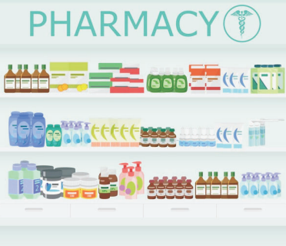
Actuality of Topic
MANAGING PHARMACY INVENTORY
is important to keep product numbers stable and to determine and control the stock levels required for optimal profit. Good inventory management involves having enough inventory on hand to meet the demands of the customer, yet not too much to exceed inventory goals. Pharmacies must stock, or have ready access to, all medications that may be written by the prescribers in their practice. When inventory is “too tight,” a pharmacy frequently runs short of a needed medication. Running short can cause loss of a sale and/or an inconvenience to the patient/client.

Slide 5
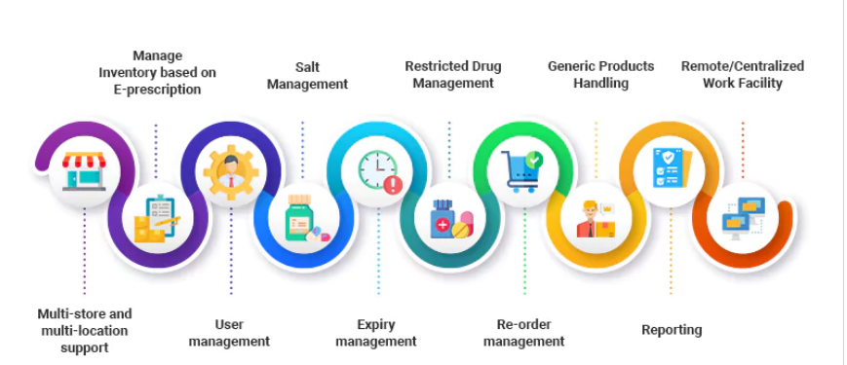
What is Inventory Management?
Inventory management in a pharmacy is vast, complex, and covers many aspects of the pharmacy retail business. You need to have the right solution that helps you in analyzing inventory forecasting, pricing, cost of storing inventory and replenishing exhausted goods, managing space to store inventory, shipping and return/exchange processes and policies, demand and sales forecasting, and inventory status.

Slide 6

Key challenges in stock management in pharmacies
Regulatory compliance
Expiration management
Demand forecasting and stockouts
Overstocking and holding costs
Supplier and purchases order management
Tracking controlled substances
Managing substitutes

Slide 7

Purpose and goals of inventory management
Ensuring there is adequate stock of medications
Minimizing the occurrence of unexpected out-of-stocks to decrease the impact on patient care.
Decreasing the carrying cost of maintaining an inventory.
Lowering costs of ordering medications from wholesalers.
Ensuring minimal time is spent ordering medications and purchasing tasks.
Preventing costs associated with damage and expiration of inventory.
Decreasing total costs to the pharmacy and overall health care organization by focusing on purchasing products with the lowest cost.

Slide 8
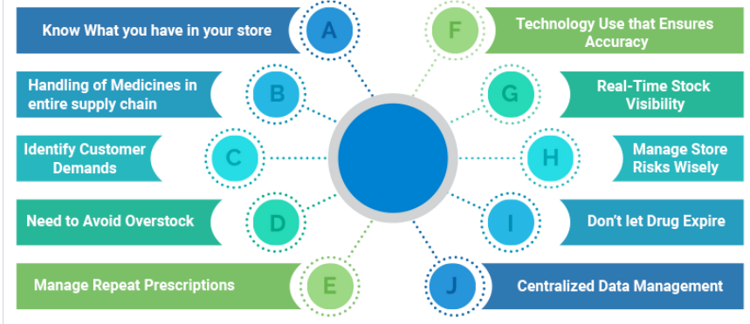
What Steps do Pharmacists Take to Master their Inventory Management?

Slide 9
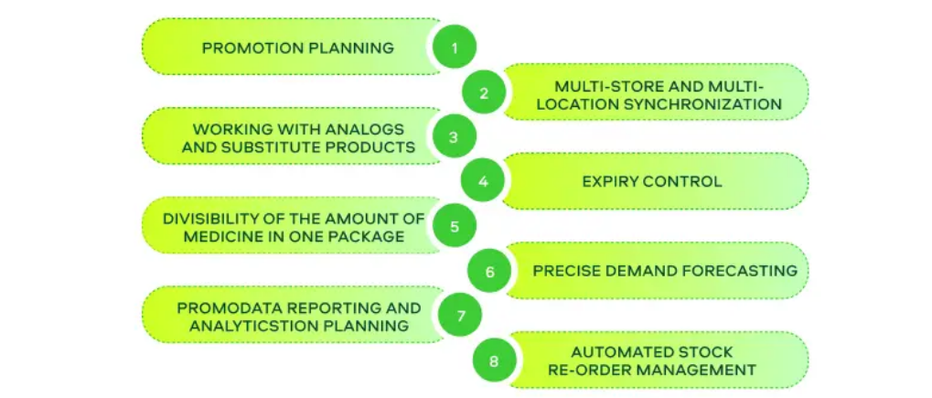
How do you Organize your Pharmacy Inventory?
Main features of the pharmacy inventory management system

Slide 10
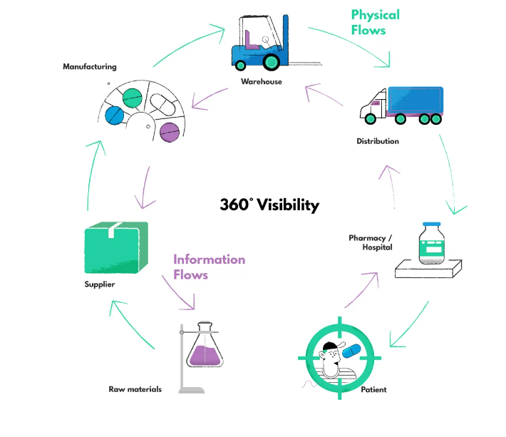
Inventory Management Process for Retail Pharmacy Store
The Medication Supply Chain

Slide 11

Types of Pharmaceutical Distributors
national
regional
specialty
Choosing Reliable Distributor Partners
Cost – Who offers the most competitive pricing and discounts?
Availability – Which distributors have the medications you need in stock without shortages?
Delivery reliability – Who consistently delivers complete, accurate orders on time?
Customer service – Who provides responsive support before/after sales?
Ordering process – Which system is easiest for pharmacy staff to use?
Contract terms – Is the agreement flexible if business needs change?

Slide 12
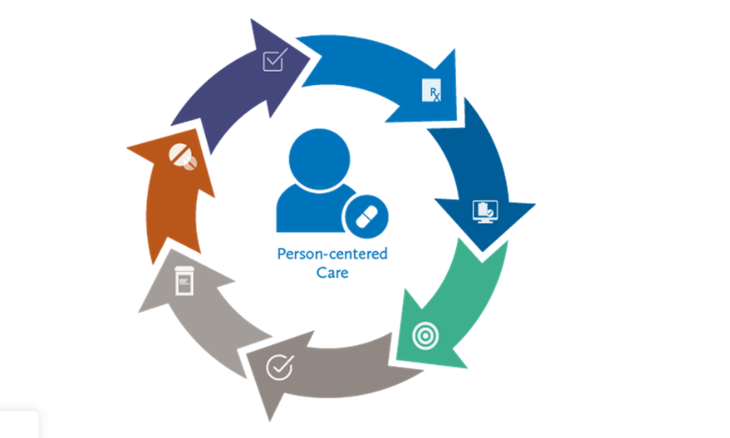
The Pharmacy Ordering Process

Slide 13

Pricing and Payment Processes
Immediate payment
requires the buyer to make payment instantly upon receipt of the goods or services or invoice issuance. This term is often used interchangeably with “cash on delivery” or “payable on receipt.”
Net 7, Net 10, Net 15, Net 60, Net 90, Net xx, etc.
indicate the number of days customers must pay an invoice in full since the invoice date. The word “net” means the total amount paid after discounts. There are many variations of this type of payment term.
Net 30, end of the month (EOM), means the payment is due by the end of the month following the invoice date. This can be useful if your billing cycle doesn't align perfectly with calendar months.

Slide 14
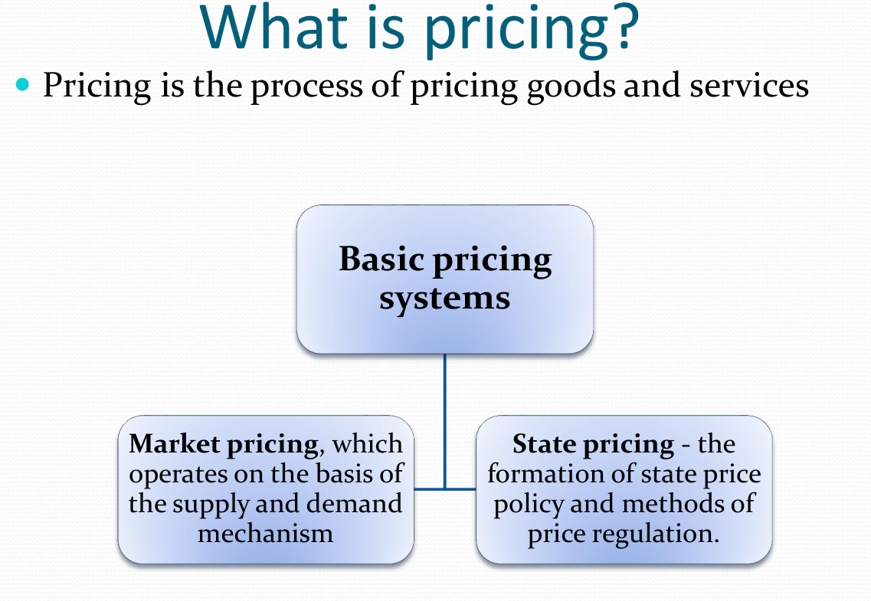

Slide 15
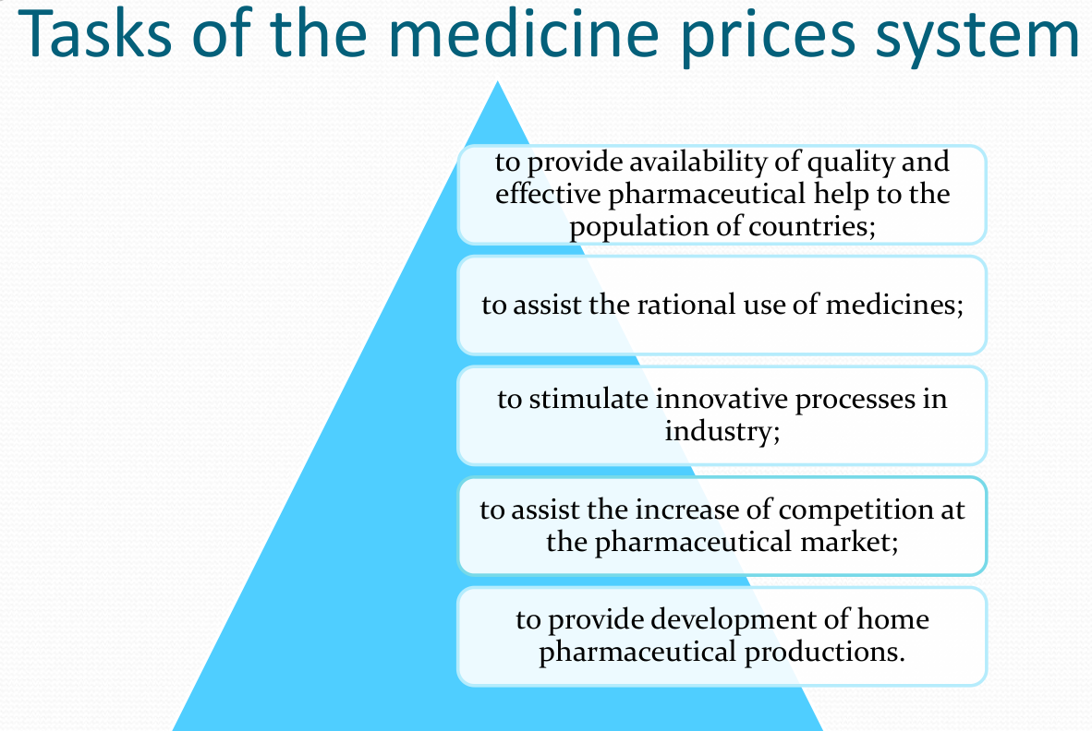

Slide 16
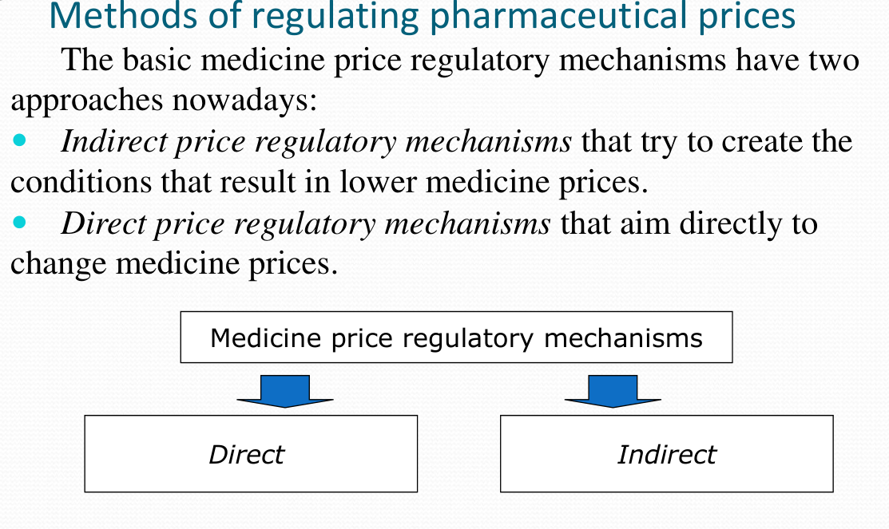

Slide 17
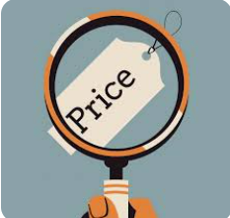
Price regulation for pharmaceuticals in Ukraine is based on the Law on prices and price regulation
The usual price types for the out-patient sector are as follows:
Ex-factory price (price set at the level of the manufacturer)
Pharmacy purchasing price (price set at the level of the distributor/wholesaler)
Pharmacy retail price, also called ‘consumer price’ or ‘end price’ (price set at the level of the pharmacy)

Slide 18
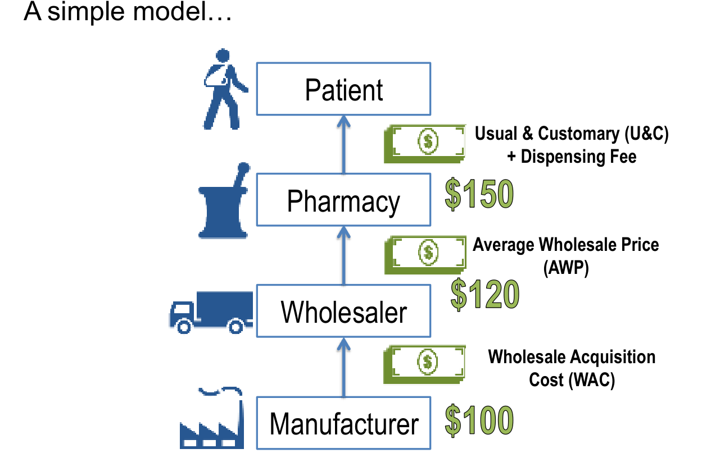

Slide 19

In Ukraine, depending on their perceived importance, medicines are classified using two separate lists:
National List of Essential Medicines
List of Reimbursable Medicines*
*Affordable medicines
On April 1, 2017, the Ukrainian government launched the Affordable Medicines National Prescription Drugs Cost Reimbursement Program providing for full or partial reimbursement of essential medicines for treatment of cardiovascular diseases, asthma diabetes mellitus types 1,2 etc.

Slide 20

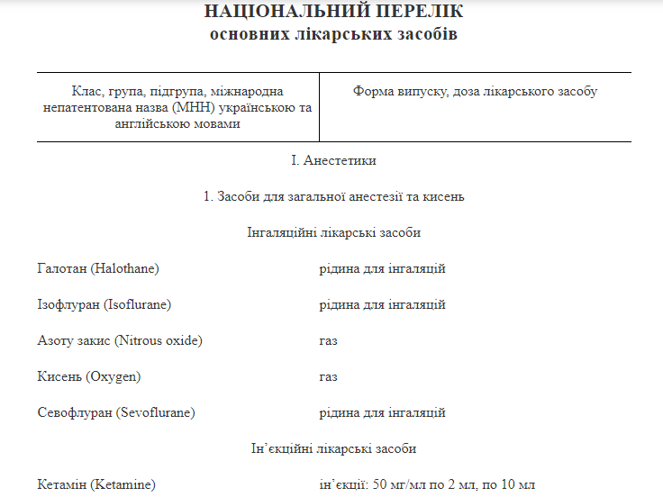
National List of Essential Medicines
https://zakon.rada.gov.ua/laws/show/333-2009-п#n15

Slide 21
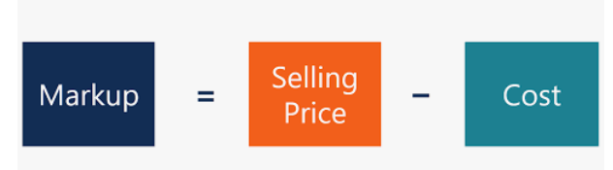
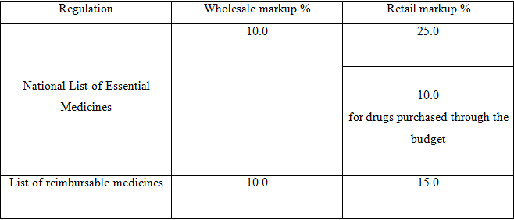
Levels the maximum allowable markup for medicines included on regulatory lists
!!! except for narcotic, psychotropic substances, precursors and medical gases
Mark-ups are not applied to the medicinal products that are not included in the mentioned above lists

Slide 22
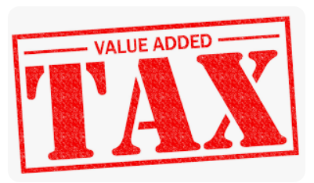
The price of a medicine and, as a result, pharmaceutical expenditure, may be increased by taxes, which are known to account for a considerable part of the medicine price in middle- and low-income countries.
In European countries (as well as in Ukraine), only
value-added tax is applied to medicines.
Reduced value added tax (VAT) rates or VAT exemptions (in special cases) apply to medicines.
The reduced 7% VAT rate (instead of the standard 20% rate) applies to transactions with medicines that have passed state registration

Slide 23
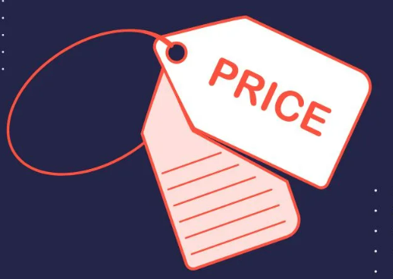
Retail price= Wholesale price + mark-up + VAT(7%)

Slide 24
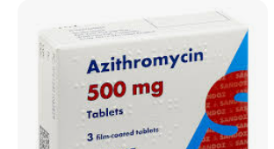
Azithromycin tabs. 500 mg № 3 (pricing example)
PRICING ON DISTRIBUTOR LEVEL
        Manufactory's price – 46.02 UAH
        Wholesale markup – 10 % (1.10)
        Wholesale price without tax 46,02 х 1,10=50.62 UAH
        VAT 7% (1.07) - this tax applies to all registered medicines
        Wholesale price with VAT 50.62*1.07 = 54.16 UAH
PRICING ON PHARMACY LEVEL
Wholesale price 50.62
Retail markup 25% (Azithromycin includes on the National List of Essential Medicines)
Retail price 50.62 х 1,25 (+25%) = 63.27 UAH without VAT
Retail price with VAT 63.27 х 1,07 (+7%) = 67.70 UAH – retail price (end/consumer price) for patients
Retail markup 10% (if purchase by health care institutions at the budget funds)
Retail price without VAT 50.62 х 1,10 = 55.68 UAH
Retail price with VAT 5.68 х 1,07 = 59.58 UAH – retail price (end/consumer price) for health care institutions
Retail mark-up 55,68-50,62=5,06 UAH
63,27-50,62=12,65 UAH

