Slide 1
Odessa National Medical University
Faculty of Pharmacy
Department of Organization and Economics of Pharmacy
Lecture
Organization of Dispensing Narcotic Drugs, Psychotropic Substances and Precursors

Slide 2
Classification-legal group of drugs
Toxic (or Poisonous)
Potent
Narcotic
Psychotropic
Precursors
Analogs of narcotic and psychotropic
General list

Slide 3
Poisonous and Potent drug :
Atropinum (and salts) (Atropini Sulfatis)
Ketaminum
Tetracaine (Dicaine)
Trihexyphenidyl (Cyclodol, Parcopan)
Atracurium
Vecuronium
Pipecuronium
Rocuronium
Suxamethonium
Butorphanolum (Moradol)
Diphenhydraminum (Dimedrol)
Zopiklon (Sonovan, Imovan)
Clonidine (Clophelin)
Metandienonum
Nandrolonum
Promethazinum (Pipolfen)
Drugs that contain Ephedrine (except syrups), Tramadol, Pseudoephedrine and Dextropropoxyphene in composition with other active ingredients
Tropicamid (Midriacil)

Slide 4
Legislative documents
1) The Law of Ukraine “On narcotic drugs, psychotropic substances and precursors” of 15.02.1995 No. 60/95 VR
2) The Law of Ukraine “On Medicines” of 04.04.96 No. 22/96 VR

Slide 5
Basic terms
narcotics – plants, substances or preparations classified as narcotic drugs, psychotropic substances, their analogues representing potential danger to health of population due to consequences that may be caused by their abuse included into the List of narcotic drugs, psychotropic substances and precursors subjected to control in Ukraine
narcotic drugs – substances of synthetical or natural origin included into the List of narcotic drugs, psychotropic substances and precursors subjected to control in accordance with the legislation of Ukraine

Slide 6
Basic terms
psychotropic substances – substances of synthetical or natural origin included into the List of narcotic drugs, psychotropic substances and precursors subjected to control in Ukraine
precursors – substances used upon production, manufacturing, processing of narcotic drugs, psychotropic substances, their analogues included into the List of narcotic drugs, psychotropic substances and precursors subjected to control in Ukraine

Slide 7
Drug Classifications Based On Legal Definitions
List of narcotic drugs, psychotropic substances and precursors - the list of narcotic drugs, psychotropic substances and precursors subjected to control in Ukraine being numbered and consolidated in the relevant schedules and list on the basis of international conventions
The Government passed the Controlled Substances Act in response to the drug epidemic. This List established four drug classifications, or schedules.
What schedule a drug is placed in is determined by the legitimacy and value of potential medical uses, along with the potential for abuse and the level of risk of addiction. Countries must classify certain drugs in certain schedules to comply with certain diplomatic agreements, such as the Single Convention on Narcotic Drugs.

Slide 8
List of narcotic drugs, psychotropic substances and precursors
Schedule I drugs
Schedule
# Schedule | # List | Turnover | Examples
I | 1 | Especially dangerous narcotic drugs turnover of which is prohibited | Heroin, Cannabis Coca leafs Cocaine
 | 2 | Especially dangerous Psychotropic substances, turnover of which is prohibited | Brolamphetamine Meskalin Amphetamine Metakvalon
 | 3 | Plants containing narcotic drugs or Psychotropic substances, which cultivated for industrial purposes | Opium Poppy (Papaver somniferum L), Plant of the Genus of Hemp (Cannabis)
Schedule I drugs have the most regulations and harshest penalties of any drugs. Schedule I drugs have no legitimate accepted medical use and a high potential for abuse

Slide 9
List of narcotic drugs, psychotropic substances and precursors
Schedule II drugs
# Schedule | # List | Turnover | Examples
II | 1 | Narcotic drugs, turnover of which is limited | Buprenorphine Ethylmorphine hydrochloride (Dionine) Fentanyl Metadon Morphine Ethylmorphine Codein Tramadol Trimeperidin
 | 2 | Psychotropic substances, turnover of which is limited | Ketamine Sibutramin Metakvalon
Schedule II drugs have more regulations and harsher penalties than any drug classification other than Schedule I drugs. Schedule II drugs have a legitimate accepted medical use, a high potential for abuse, and a severe dependence risk

Slide 10
List of narcotic drugs, psychotropic substances and precursors
Schedule III drugs
# Schedule | # List | Turnover | Examples
III | 1 | Narcotic drugs, turnover of which is limited, with permissible excluding of certain control measures | Medicines containing one or several ingredients in addition to: Acetyldihydrocodeine, Dihydrocodeine, Aethylmorphine, Pholcodine, Codeine, Nicodicodine, Nicocodine or Norcodeine on the condition that the content of such substances per one dose does not exceed 100 mg; or that their content does not exceed 2.5% of the total dose
 | 2 | Psychotropic substances, turnover of which is limited, with permissible excluding of certain control measures | Barbital Diazepam Meprobamat Nitrazepam Triazolam Phenobarbital Flunitrozepam
Schedule III drugs have less severe penalties than Schedule II drugs. Schedule III drugs have a legitimate acceptable medical purpose, have a lower abuse potential than Schedule I and II drugs, and have a moderate or low potential for addiction.

Slide 11
List of narcotic drugs, psychotropic substances and precursors subjected to control in Ukraine
Schedule IV drugs
# Schedule | # List | Turnover | Examples
IV | 1 | Precursors turnover of which is limited and with established control measures | Erqometrin Erqotamin Efedrin Pseudoephedrine Acetic Acid Anhydride
 | 2 | Precursors with established control measures | Acetone Hydrochloric Acid Kalii Permanganat Sulfat Acid Toluol Ethyl Ether

Slide 12
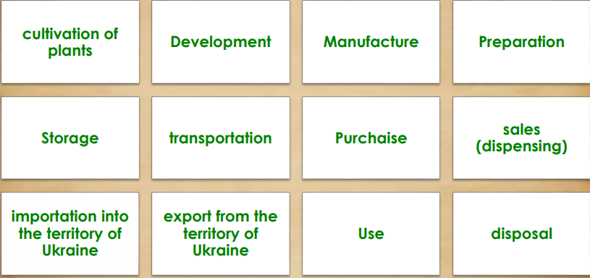
Turnover of narcotic drugs, psychotropic substances and precursors
(main activities)
Types of activities related to narcotic drugs, psychotropic substances and precursors circulation in the territory of Ukraine are subject to licensing by the State Service of Ukraine on medicines and Drugs Control

Slide 13
Procedure of purchasing, transportation, storage, use in compounding, dispensing, and destruction of narcotic drugs, psychotropic substances and precursors in pharmaceutical establishments
Storage of drugs, psychotropic substances and precursors in pharmaceutical establishments (pharmacies, etc.) shall be carried out in amounts not exceeding the three-month need.
The calculation of storage amounts of narcotic drugs, psychotropic substances and precursors in pharmacies is approved by the order of the head of the institution.
Drugs, psychotropic substances and precursors must not be stored in the dispensing area.
In the premises of pharmaceutical establishments where drugs, psychotropic substances and precursors are compounded, such drugs must be stored in amounts not exceeding their daily requirement.
At the end of the working day, narcotic drugs, psychotropic substances and precursors must be carried to the special storage premises for narcotic drugs, psychotropic substances and precursors.
Compounded narcotic drugs, psychotropic substances and precursors must be sealed (in vials with aluminum caps using a special device) and stored until dispensing in the special storage premises.
Narcotic drugs, psychotropic substances and precursors, prescribed in combination with other ingredients, must not be dispensed separately.
The information on the signature and label of narcotic drugs, psychotropic substances and precursors compounded by a pharmacy must meet the requirements established by the Ministry of Health (Order #812).
Dispensing of solid dosage forms of medicines containing narcotic drugs, psychotropic substances and precursors packed in paper or cellophane from pharmaceutical establishments is forbidden.

