Slide 1
Odessa National Medical University
Faculty of Pharmacy
Department of Organization and Economics of Pharmacy with post-diploma specialization
Lecture
Payroll Accounting in Pharmacy
Lecturer
Assoc.prof., PhD in Pharmacy
Oksana Bieliaieva

Slide 2


Definition
SALARY is a fixed amount of money or compensation paid to an employee by an employer in return for work performed. Salary is commonly paid in fixed intervals, usually paid every month
WAGE is a monetary compensation paid by an employer to an employee in exchange for work done. Payment may be calculated as a fixed amount for each task completed or at an hourly or daily rate, or based on an easily measured quantity of work done.

Slide 3

Differences between wages and salary are as follows:
Salaries are generally paid for intellectual job and wages for functional or physical work
Wage earners are paid by the hours or days whereas salary earners are paid by generally in monthly
Salary earners usually receive paid time when they are networking. Wage earners often have to give up pay for time off
Salary is given to those who are engaged in administrative or office work job. Whereas wages are paid to those, who are engaged in manufacturing processes that require unskilled or semi-skilled workers
Salaries are often calculated as packages. Wage earners get paid more for working more than 40 hours per week
Salary workers are rarely offered overtime pay. Salaries can contain all kinds of benefits and perks
Salary is paid on the basis of the performance of an individual. Whereas wages are paid on an hourly basis i.e. the amount of work done in hours.

Slide 4
System of payment
I. TIME RATE SYSTEM
Time Rate System is otherwise called as Time Work, Day Work. It is the oldest method of remuneration. The time rate system is that system of wage payment in which the workers are paid on the basis of time spent by them in the pharmacy.
This Time Rate System calculation is based on the working hours (days) of the employee, that is the amount of time spent on the work along with the amount of work delivered within the specific period of time.
Formula:
Wages= Total hours worked * Wages rate per hour or
Wages= Total days worked * Wages rate per day

Slide 5
System of payment
II. PIECE RATE SYSTEM
It is another system of wage payment in cost accounting. Piece work (or piecework) is any type of employment in which a worker is paid a fixed piece rate for each unit produced or action performed, regardless of time. It is also known as payment by result or output. The total wages earned by a worker is calculated by using the following formula.
Total Wages Earned= Total units of outputs produced * Wage rate per unit of output
or
Total Wages Earned= Output * Piece Rate

Slide 6
Working Time
Generally the length of a working week is restricted to 40 hours (e.g. head of a pharmacy, vice head of a pharmacy, accountant)
Usually, it is a five-day working week (8 hours per day)
For employees performing work under harmful working conditions the working week is limited to 36 hours (7h12min per day) (e.g. pharmacists, provisor-analytic).
36/5= 7.2 = 7h12min per day

Slide 7
Working Time
A shorter working time will be established:
36 hours a week
for employees between 16 and 18 years of age
24 hours a week
for employees between 15 and 16 years of age
school students from 14 to 15 years of age,
working during their vacation

Slide 8
Time Off
Employees are allowed to have breaks for resting and taking meals which last up to two hours. The breaks are not included into the working time.
By a five-day working week employees have two days-off (Saturday and Sunday). If a public holiday or a free day concurs with a day-off, the day-off is postponed to the next working day after such public holiday or a free day. In general, no work shall be done on days-off. It is allowed in exceptional cases that single employees work on such days.
Work on public holidays also is allowed in exceptional cases according to the legislation
There are eleven public holidays a year. Public holidays are paid and not included in the minimum annual holiday entitlement.

Slide 9
Time Off (2025)
January 1, 2024 (Monday) New Year's Day
March 8, 2024 (Friday) International Women's Day
May 1, 2024 (Wednesday) Labor Day
May 6, 2024 (Monday) Easter
May 8, 2024 (Wednesday) Victory Day over Nazism in World War II
June 24, 2024 (Monday) Trinity
June 28, 2024 (Friday) Constitution Day
July 15, 2024 (Monday) Statehood Day
August 26, 2024 (Monday) Independence Day of Ukraine
October 1, 2024 (Tuesday) Defender of Ukraine Day
December 25, 2024 (Wednesday) Christmas

Slide 10
Payroll
The Constitution of Ukraine guarantees everyone the right to get at least the minimum wage as determined by law
The minimum wage in Ukraine is determined at the national level. Minimum wage is revised every year by the Law of Ukraine on State Budget
Starting from 1 January 2025, a minimum wage is UAH8000 а month / UAH 48 an hour

Slide 11
Payroll
The salary in Ukraine is payable to employees twice per month with an interval between payments not exceeding 16 days (advance payment and final salary payment)*
Payroll Cycle - Twice a month:
Cycle 1: 15-20th of each month
Cycle 2: 31-7th of following month
*if payday does occur on a holiday or weekend, it's standard practice for any organization to pay its employees the day before a holiday occurs.

Slide 12
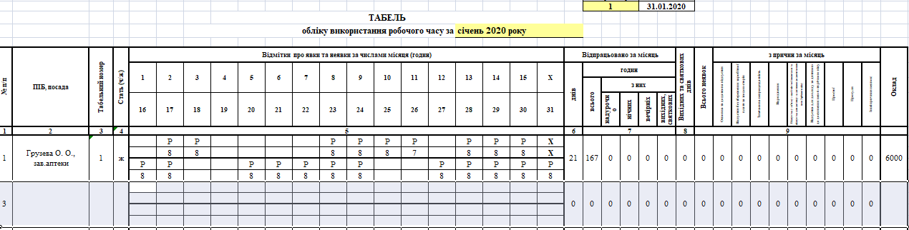
Payroll
The calculation of salary is performed according to the “Timesheet” reflecting the days (hours) worked by each employee. It should contain information on vacation days, sick leave, business trips, overtime, and work on weekends and holidays, etc. It is obligatory to maintain the Timesheet for all the companies in Ukraine (including small enterprises) as the respective documents serve as a grounds for salary accrual.

Slide 13
Components of Labour Remuneration
1- base pay
2- additional pay
3-other incentive-based and compensation pay

Slide 14
Base Pay
Base pay is the initial salary paid to an employee.
It is a fixed amount to be paid to an employee (tariff rate).
It does not include all forms of compensation, for instance, shift differential pay, on-call pay, pay for special assignments and incentive-based pay.
It is the rate of compensation an employee receives in exchange for services.

Slide 15
Base Pay
Base salary is calculated according to the following formula:
an employee’s salary (tariff) rate
------------------------------------------------
number of working days in a month
x
number of days worked according to the Timesheet
How an incomplete month pay is calculated?
Salary for an incomplete month of work is calculated as follows:
monthly rate of pay
------------------------------------
total number of working days in that month
×
total number of days the employee actually worked in that month

Slide 16
Additional pay
Additional pay includes allowances, one-time payments, period activity pay, and temporary increases to hourly rates/salaries, sick pay, holiday pay, overtime, extra workload (fulfillment of duties of a temporary absent official/fulfillment of duties in a vacant office), for a particularly important work, for labour intensity, work on weekends
*extra workload – maximum bonus 50%

Slide 17
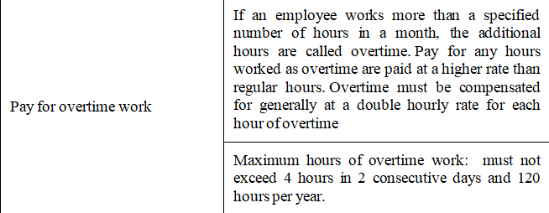
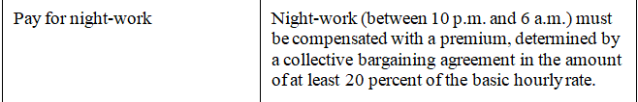
Additional pay

Slide 18
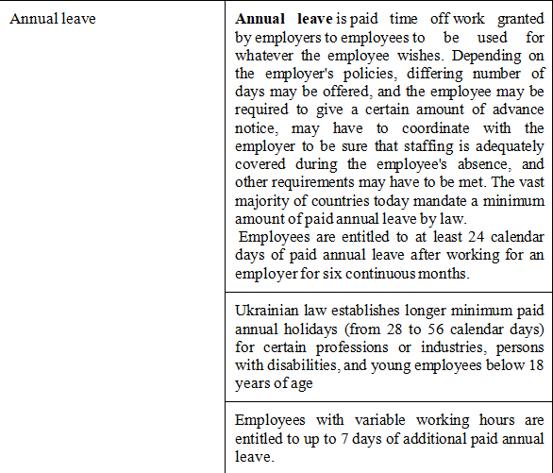
Additional pay
Annual (holiday) leave

Slide 19
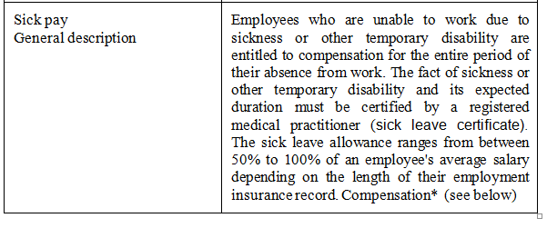
Additional pay
Sick pay

Slide 20
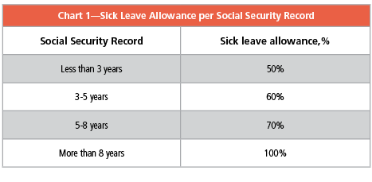
Additional pay
Sick pay
If an employee is absent from work due to sickness, he or she must provide the employer with a document substantiating the absence. An employer compensates the first five calendar days of a sick leave, and the other sick leave days are compensated by the Social Security Fund of Ukraine for Temporary Disability.
According to the decree of the Cabinet of Ministers of Ukraine, all calendar days of sick leave including statutory holidays and non-working days are payable. Sick leave allowance is calculated based on the employee’s average salary to be determined with the application of a special algorithm prescribed by Ukrainian law. Moreover, an employee’s sick allowance depends on his/her social security record

Slide 21
Maternity and Childcare
Additional pay
Maternity and Childcare
Ukrainian law provides maternity leave for pregnant employees who have given birth, of 126 calendar days (or 140 calendar days for multiple births or in case of a complicated confinement). Maternity leave is fully paid (100% of an employee's average salary) from the Social Security Fund of Ukraine.

Slide 22
Payroll Deductions
Mandatory payroll deductions
PERSONAL INCOME TAX (an employee)
at the rate of 18%
MILITARY TAX (an employee)
at the rate of 5%
SOCIAL SECURITY CONTRIBUTIONS (an employer)
Employers are liable to pay Unified Social Security Contributions. The social security contribution in Ukraine is 22% of the gross earnings (salaries and benefits paid to employees)
The 22% from gross salary is divided among different funds (unemployment fund, accident fund, pension contribution and temporary disability fund).

Slide 23
Voluntary Deductions
Voluntary deductions are those that you offer and your employees accept. Such deductions may include:
disability and life insurance;
union dues;
charitable contributions, and other

Slide 24
Thank you
for your attention

