Slide 1
Odessa National Medical University
Faculty of Pharmacy
Department of Organization and Economics of Pharmacy
Pricing and Dispensing of Extemporaneous Medicines in Pharmacies
Lecturer
Assoc.prof., PhD in Pharmacy
Oksana Bieliaieva

Slide 2
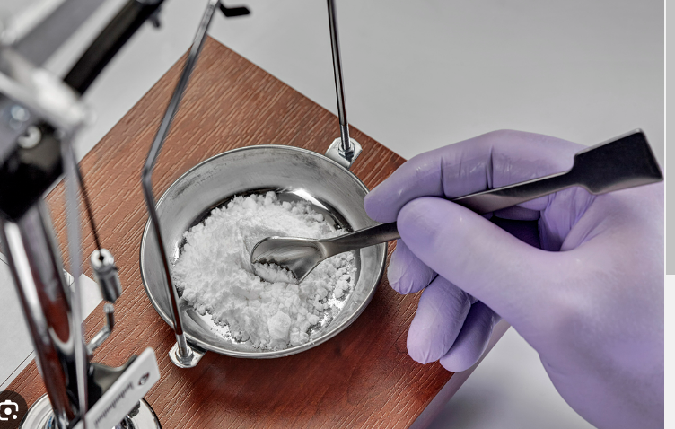
Definition
Compounding is the preparation, mixing, packaging, and labeling of a drug, drug-delivery device, or device in accordance with a licensed practitioner’s prescription, medication order, or initiative based on the practitioner–patient–pharmacist–compounder relationship in the course of professional practice.

Slide 3
The Compounding Process
Compounding includes the following:
Preparation of drug dosage forms for human
Preparation of drugs in anticipation of prescription drug orders, on the basis of routine, regularly observed prescribing patterns
Reconstitution or manipulation of commercial products that may require the addition of one or more ingredients
Preparation of drugs for the purposes of, or as an incident to, research (clinical or academic), teaching, or chemical analysis

Slide 4
Guidelines for distinguishing between compounding and manufacturing
Guidelines for distinguishing between compounding and manufacturing are as follows:
Pharmacists may compound, in reasonable quantities, drug preparations that are commercially available in the marketplace if a pharmacist–patient–prescriber relationship exists and a valid prescription is presented
Pharmacists may compound nonprescription medications in commercially available dosage forms or in alternative dosage forms to accommodate patient needs as allowed by State Services of pharmacy
Pharmacists may compound drugs in limited quantities prior to receiving a valid prescription, on the basis of a history of receiving valid prescriptions
Compounding pharmacies and pharmacists may advertise or otherwise promote the fact that they provide prescription compounding services

Slide 5
Compounding Facility and Equipment
Pharmacies that engage in compounding should have a designated area with adequate space for the orderly placement of the equipment and materials used in compounding activities.
The pharmacist is also responsible for the proper maintenance, cleanliness, and use of all equipment involved in the compounding practice.

Slide 6
Personnel
Only personnel authorized by the responsible pharmacist should be in the immediate vicinity of the drug-compounding operation.
Any person with an apparent illness or open lesion that may adversely affect the safety or quality of a drug preparation being compounded should be excluded from direct contact with components, drug preparation containers, closures, in-process materials, and drug preparations until the condition is corrected or determined by competent medical personnel to not jeopardize the safety or quality of the preparation being compounded.
All personnel who assist in compounding procedures should be instructed to report to the responsible pharmacist any health conditions that may have an adverse effect on drug preparations.

Slide 7
Duties
The pharmacist has the responsibility and authority to inspect and approve or reject all components, drug preparation containers, closures, in-process materials, and labeling, as well as the authority to prepare and review all compounding records to ensure that no errors have occurred in the compounding process.
In addition to compounding, the pharmacist provides other services, such as the following:
Publicizes the availability of both prescription and nonprescription compounding services. These services may include chemicals, and alternative dosage forms
Provides drug searches on specific chemicals in different dosage forms, strengths, bases, and the like to accommodate physicians’ specific needs,
Provides follow-up information in response to a practitioner’s request for information regarding a compounded medication, and
Consults with practitioners regarding a particular dosage form when discussing services with a health care provider.

Slide 8
The Compounding Process
Before the first step in the compounding process is taken, the following questions must be considered:
What are the physical and chemical properties and medicinal and pharmaceutical uses of the drug substance?
Are the quantity and quality of each active ingredient identifiable?
Are excipients present from any source (manufactured products) that may be expected to cause an allergic reaction, irritation, toxicity, or an undesirable organoleptic response by the patient?
For preparations that are to be administered orally, are the active ingredients stable in the normal gastric pH range, or are they subject to extensive hepatic first-pass metabolism?

Slide 9
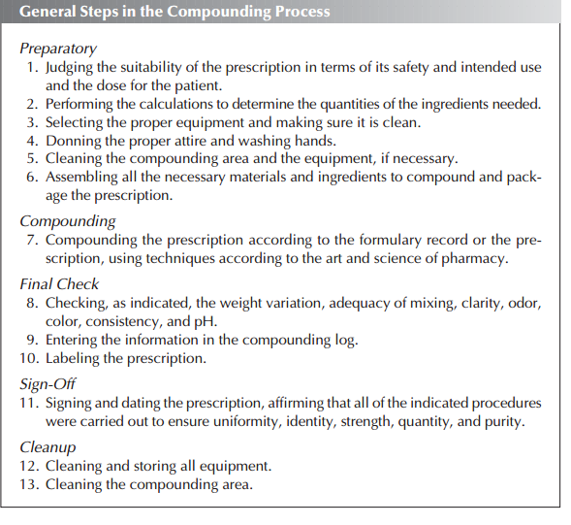

Slide 10
Types of Extemporaneous (compounded) medicines
Extemporaneous (compounded) medicines
the preparation for a particular patient
the preparation on request for compounded medicine from a health care institutions
batch preparation (commonly requested medicines)

Slide 11
A compounded medicine should be prepared only in circumstances where:
• an appropriate commercial product is unavailable
• a commercial product is unsuitable
(e.g. if a patient experienced an allergy to an excipient in the commercial product)

Slide 12
What are compounded medications used for?
Compounded medications can be used for many different purposes, but are more frequently prescribed for pain, thyroid- or hormone-related conditions, and skin problems.
Any doctor can write a prescription for a compounded medication. The most prescriptions come from doctors in these fields:
Dermatologists (skin)
Pain specialists
Podiatrists (feet)
Endocrinologists (hormone imbalances and other endocrine disorders)
Gastroenterologists (digestive system)
Veterinarians

Slide 13
Advantages of extemporaneous medicines
Preparing medications using unique delivery systems
Allowing Alternative Dosage Forms
meeting individual patient needs
Avoiding unwanted ingredients, such as dyes, preservative, lactose, gluten, or sugar.
Adding flavor to make the medication more palatable
not requiring the cost for long-term storage, advertising and promotion
unlicensed medicines

Slide 14

Disadvantages of extemporaneous medicines
1) Shorter expiry date
2) Inadequate number of compounding pharmacies
3) No approved quality standards

Slide 15
Process of supplying extemporaneous medicines
1. Establish the validity of the prescription
2. Check the patient details including age if applicable
3. Check the appropriateness of the prescription including correct dose or strength of medicaments
4. Complete the necessary recording of the prescription (included pricing)
5. Prepare a suitable label including extra warning and/or cautionary and advisory labels, appropriate shelf life and storage conditions
6. Select the appropriate container
7. Prepare the product suitably
8. Check the final product including the label
9. Provide appropriate advice and counselling to the patient

Slide 16
Extemporaneously prepared formulae
An extemporaneously prepared formula is a medicine compounded by a pharmacist from basic ingredients.
All the allowable ingredient prices are listed in Drug Prices of Pharmacy (Drug Tariff)
Price for the supply of an extemporaneously‑prepared pharmaceutical benefit, including a standard formula preparation, is the sum of the following amounts:
(a) the amount in respect of the quantity of each of the ingredients; and
(b) the applicable container fee; and
(c) an extemporaneously‑prepared dispensing fee.

Slide 17
Медична документація ф-1
РЕЦЕПТ № _____
дорослий, дитячий
(потрібне підкреслити) "___" ____________ 20__ р.
(дата виписування рецепта)
За повну вартість
Безоплатно
джерело фінансування __________________________________________
З доплатою
джерело фінансування __________________________________________
Прізвище, ініціали та вік хворого
Номер карти амбулаторного чи стаціонарного хворого ___________
Прізвище та ініціали лікаря ______________________________
Rp:
Rp:
Rp:
Додаткова інформація
Підпис та особиста печатка лікаря
Рецепт дійсний протягом 1 місяця
(друкується на зворотному боці рецептурного бланка)
Штамп аптеки
№ лікарської форми індивідуального виготовлення _____________
Перевірив ___________
Відпустив _________
Прийняв ____________ Виготовив _____________
Place for pricing

Slide 18
Retail Price of Extemporaneous Medicine
Taxa Laborum
Retail price of ingredients and containers
+ VAT (20%)
Total Price of Extemporaneous Medicine

Slide 19
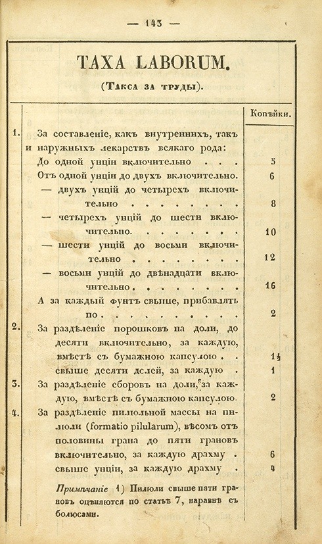
Dispensing fee (Taxa Laborum)
It appeared in 1672 (with the opening of the first pharmacies in Moscow)
It has existed for over 340 years
“Taxa laborum” is the term of Latin origin reflecting dispensing fee for compounding medicines

Slide 20
“Taxa Laborum” (an extemporaneously‑prepared dispensing fee) components
Stock cost
Income
Labor cost
“Taxa Laborum” is established by pharmacies on their own

Slide 21
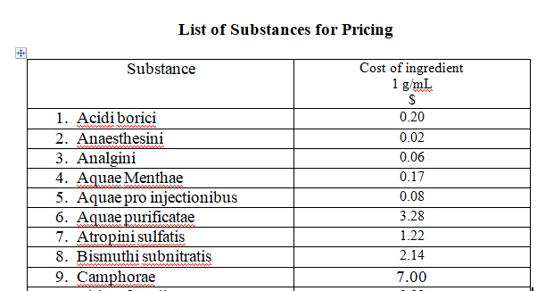
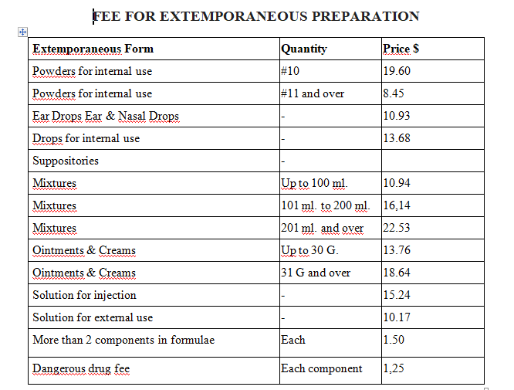
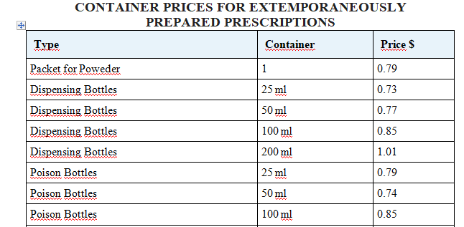

Slide 22
Extemporaneous poweders pricing
Poweders
Distributive method of prescribing
the prescription indicates the amount of a substance per one dose and amount of doses, which are necessary to prepare (this method is the most frequently used)
0.15*0.20*30=0.90 Rp.: Acidi ascorbinici 0,15
0.25*0.89*30=6.67 Calcii glycerophosphatis
0.25*0.123*30=0.92 Sacchari ana 0,25
0.79 M.f.pulv.
19.60+8.45*2+1.50=38.00 D.t.d. N30
S. 1 poweder 3 times per day
Total price : 47.28
+ 20%VAT = 56.74 – end price
(ingredients )
(conteiner )
(Taxa Laborum)

Slide 23
Extemporaneous poweders pricing
Separating method of prescribing - the prescription indicates the total amount of a medicinal powedered substance and the number of doses required
0.3*1.50=0.45 Rp.: Phenobarbitali 0,3
0.1*2.50=0.25 Dibazoli 0,1
0.2*3.20=0.36 Papaverini hydrochloridi 0,2
2.0*0.222=0.444 Sacchari 2,0
0.89 M.f.pulv.
10.89 Divide in partes aequales N10
1.25 S. 1 powder per day
Total retail price 0.45+0.25+0.36+0.444+0.89+10.89+1.89= 15.17 UAH

