Slide 1
Odessa National Medical University
Faculty of Pharmacy
Department of Organization and Economics of Pharmacy
Organization of Stocktaking in Pharmacies

Slide 2
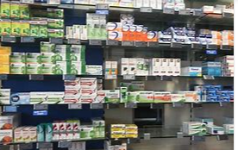
Inventory is the total amount of goods
contained in a pharmacy at any given time
The word 'inventory' can refer to both the total amount of goods and the act of counting them.

Slide 3
Definition, purposes
Stocktaking (Inventory checking, Physical Inventory) - is the process of physical counting, weighing or otherwise calculating of the quantities and condition of all items in stock and recording the results.
The main reasons for doing Stocktaking are as follows:
• To ensure the accuracy of the stock records.
• To verify the value of stock shown in the balance sheet by physical confirmation and value a stock in terms of cost and potential sales.
• To detect wastage or pilfering at an early stage and put in place processes to reduce and or eliminate.
• To reveal any weakness in the system for the supervision and control of stock. i.e. eliminate over- stocking and /or under-stocking.
To identify any missing or damaged items that need to be located, repaired, or replaced

Slide 4
Classification of kinds of stocktakings (inventory)
Opening stocktaking: It takes place at the founding of a company, and shows the assets and liabilities.
Mid-year, year-end stocktaking: It supports the balance sheet of a company. It shows the quantity (value, condition) of all assets that the company has on the balance sheet date, or just a part of it (part stocktaking).
Full (complete) stocktaking: It shows all assets and liabilities of a company on a given date, including the ones not present at an owned site, but at a remote location.
Part stocktaking: It covers an entire section of a type of an asset or liability. We consider as part stocktaking when a single site, warehouse or zone is taken as well.
Handover stocktaking: It is done when the person responsible for an area changes. The previous person responsible passes the assets the new one.
Exceptional stocktaking: The date of the stocktaking is not known for the unit to be inspected (warehouse, store). It is recommended in case of suspected abuse, sales of items of great value or without invoice.

Slide 5
Methods for counting
Computer Generated Count Sheets
– Computer Generated Count Sheets are preprinted lists of inventory generated by software that can be used to record on hand counts.
Manual Count Sheets
– Manual Count Sheets are merely ruled forms that allow to record the product id, quantity and, if needed, retail of merchandise being counted. Unlike Count Sheets that pre-determine the merchandise listed, this manual method can be effective for wall to wall counts.When this method is used, count teams should be used: one person to call out the classes or SKUs, prices and counts while the other records them. This method involves using count sheets and pencils to record inventory numbers manually.
Portable Inventory Devices
– Portable Inventory Scanners can be the most efficient method for taking an inventory, especially when barcodes are used on the merchandise. They eliminate the need for a two person count team, though all detail counts should still be verified.
Inventory Services
– Several third party companies specialize in taking physical counts.

Slide 6

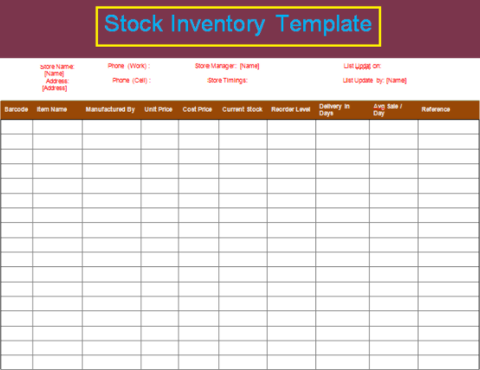
The goal of the annual inventory count is to:
Determine the inventory on hand
Determine the cost of goods sold for the period
Check accuracy of inventory records
Determine amount of inventory lost due to wasted raw materials, shoplifting or employee theft

Slide 7
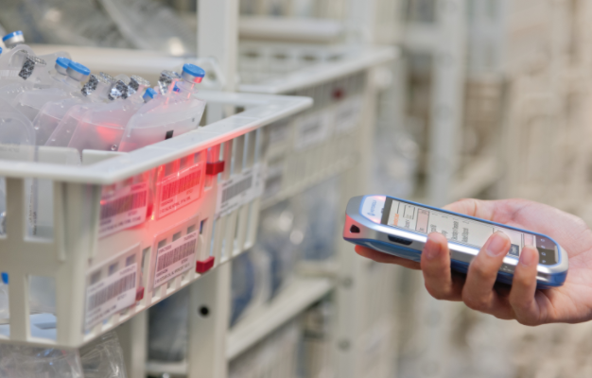
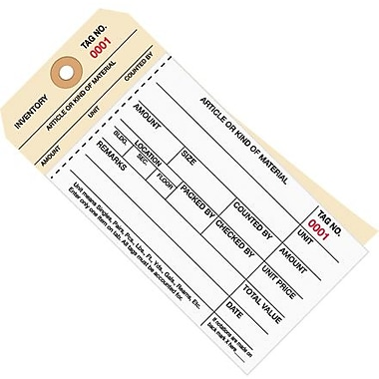


Slide 8
Physical inventory procedure
3 phases of a physical inventory:
Planning and preparation (date and time , counting team(s), method)
Execution of physical inventory (rules to achieve an accurate and effective count)
Analysis of results (shortages or overages)

Slide 9
General procedure involved in taking an inventory
deciding the method of taking inventory;
deciding a date and time for taking inventory;
closing a store’s sales floor for taking inventory;
alerting customers using signs about a store closure when a store is closed for taking inventory;
planning and determining a person as the inventory supervisor;
creating inventory worksheets for different departments in a store;
keeping the backroom stock area clean and organized; and
dealing with unsaleable products (damage or expired medications)

Slide 10
Steps involved in taking inventory are:
persons appointed to take inventory will be divided into a team of two members for each department of a pharmacy;
the inventory supervisor will allocate each team to a particular department with a worksheet;
one member from each team will count the goods kept in each department and the other person will record it on the worksheet;
each completed section will be marked with a piece of tape, a 3×5 card, or any other method to ensure that every thing is counted and counted only once;
an inventory supervisor will then take each team to their concerned department to ensure that everything is accounted;
the count in the inventory worksheets will be multiplied with the retail unit price by bookkeeper;
the average gross margin estimated for each section is subtracted from the retail price of total goods;
department managers will then assign margins to each worksheet;
the department worksheets are totaled together to obtain each department’s inventory; and
each department’s inventory is counted to get the total pharmacy’s inventory.

Slide 11
Possible sources of differences
Negligent managing
Misplacement of goods
Internal theft
Shoplifting
Administrative error
Vendor fraud
Excess inventory or surplus - revenue of a company
Shortage – employee reimburse to a company

Slide 12
Excess inventory or surplus ^{- revenue of a company}
Shortage (deficiencies ) – employee reimburse to a company

Slide 13
So, stocktaking:
is the basis of a precise inventory information, and purchasing strategy
is one of the best countermeasures for theft,
controls sales without invoice.

