Slide 1
Odessa National Medical University
Faculty of Pharmacy department of Organization and Economics of Pharmacy
State regulation of pharmaceutical activity. Licensing to pharmaceutical activity
Ass.prof., PhD in Pharmacy Oksana Bieliaieva

Slide 2
The lecture plan
Pharmacy as a health care institution and as a business entity
Classification of pharmacies
The main tasks and functions of the Pharmacy
Organizational structure of the Pharmacy, the main functions of its departments
Structural subdivisions of the Pharmacy, definition, characteristics
Premises, equipment of pharmacies
Sanitary requirements for pharmacies
The staff of the Pharmacy

Slide 3
Main International drug regulators
WHO (World Health Organization)
FDA, US (Food and Drug Administration)
MHRA,UK (Medicines and Healthcare Products Regulatory Agency)

Slide 4
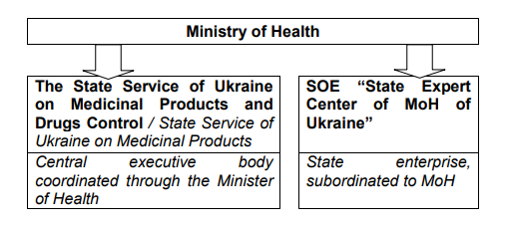
The Institutional Framework for Regulating the Ukrainian Pharmaceutical Market

Slide 5
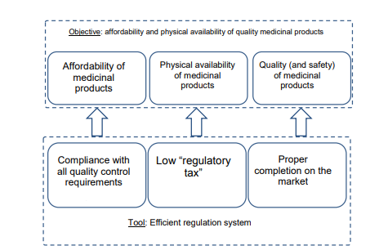
The Role of the Efficient Pharmaceutical Market Regulation System

Slide 6
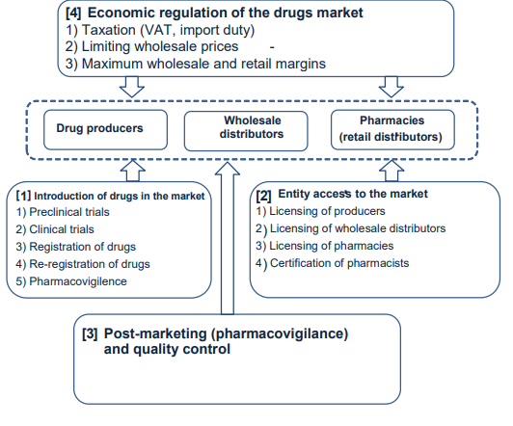
Elements of Regulator System in the Pharmaceutical Market

Slide 7
Definition
A license (American English) or licence (British English) is an official permission or permit to do, use, or own something (as well as the document of that permission or permit)
OR
License – document of a state standard, certifying the licensee’s right to conducting economic activity, specified in this document, within the established term under condition of fulfillment of terms of licensing

Slide 8
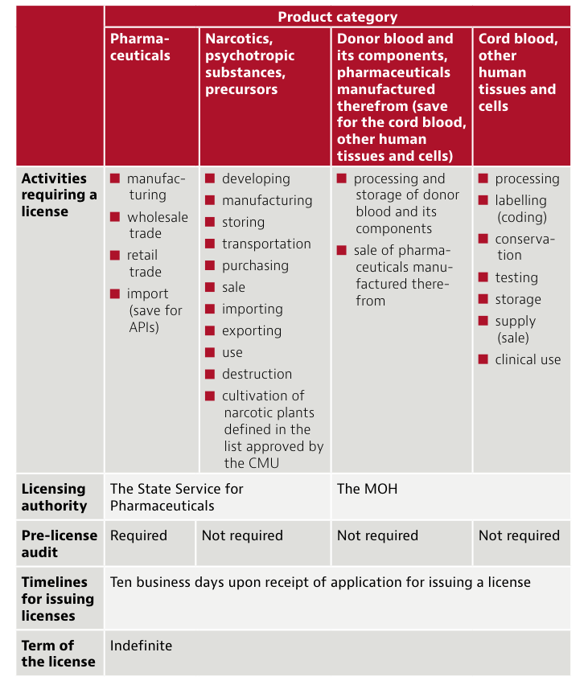

Slide 9
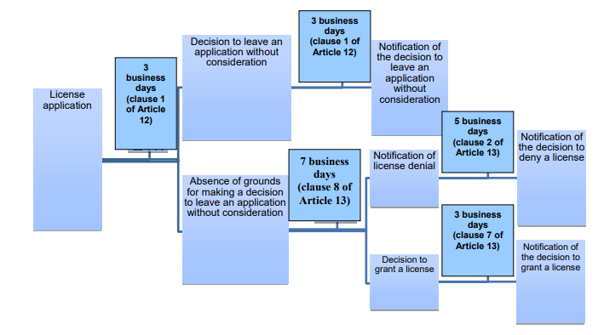
The Licensing Procedure for Manufacturing, Importing and Trading of Medicinal Products

Slide 10
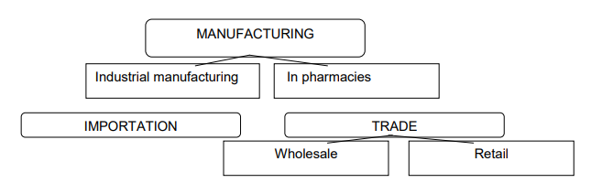
Pharmaceutical Market: Licensing Components

Slide 11
Pharmacy institutions include: pharmacy warehouses (wholesales), pharmacies and their structural subdivisions
Pharmacy - a health care institution whose main task is to provide the population, healthcare institutions, other enterprises, institutions and organizations with medicines.
Pharmacy Point (Satellite) - is a structural subdivision of the pharmacy, which is based at healthcare institutions, operates in conjunction with the pharmacy, the main task of which is to provide the population with medicines through retail trade.
Pharmacy warehouse (base)- is a healthcare institution supply with medicines and medical goods to medical institutions, wholesale or retail entities, manufacturers by the wholesale activity.
Drug retailers
Drug wholesaler

Slide 12
Definition of the Term
Pharmacy (also called "drugstore" in American English or "community pharmacy" or "chemist's" in Commonwealth English) is a retail shop which provides prescription drugs, among other products.
At the pharmacy, a pharmacist oversees the fulfillment of medical prescriptions and is available to give advice on their offerings of over-the-counter (OTC) drugs
Dispensing: the review of a prescription and the preparation, packaging, labeling, record keeping and transfer of the medicine, including counseling, to a patient, their agent, or another person who is responsible for the administration of the medicine to that patient.

Slide 13
Licensing to pharmaceutical activity in Ukraine
Resolution No. 929
approved the License Terms for the Production of Medicinal Products, Wholesale and Retail Trade in Medicinal Products and Import of Medicinal Products:
requirements for premises
requirements for personnel

Slide 14
Requirements for drugstore’s licensing
requirements for premises
requirements for personnel

Slide 15
Main requirements for premises of pharmacy
if pharmacy is located in city then its size must be not less than 50 square meters
if pharmacy is located in village then its size must be not less than 30 square meters
General requirements:
Adequate heating, lighting and ventilation/air conditioning should be provided to ensure the correct storage and safe dispensing of medicinal products within the pharmacy.

Slide 16
Premises Requirements
It is necessary to organize such areas (premises) in pharmacy:
              Commercial area (Medicine Dispensing Area / Dispensary)
              Manufacturing area
              Utility rooms

Slide 17
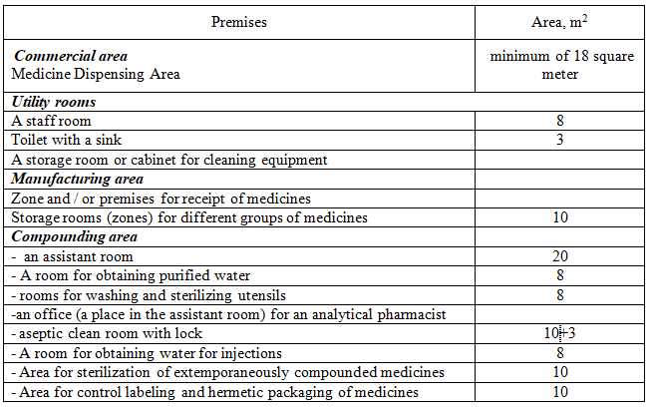
Minimum requirement for the number of premises and their area in pharmacies

Slide 18
TYPES OF PHARMACY
community pharmacy
hospital pharmacy
clinical pharmacy
industrial pharmacy
compounding pharmacy
consulting pharmacy
ambulatory care pharmacy
regulatory pharmacy
home care pharmacy

Slide 19
Specializations in Pharmacy
Geriatric pharmacy
Oncology pharmacy
Nuclear pharmacy
Psychopharmacotherapy
Personal pharmacy
Nutritional support pharmacy
Hospice pharmacy
Pediatric pharmacy
Pharmacy benefit manager
Poison control pharmacy

Slide 20
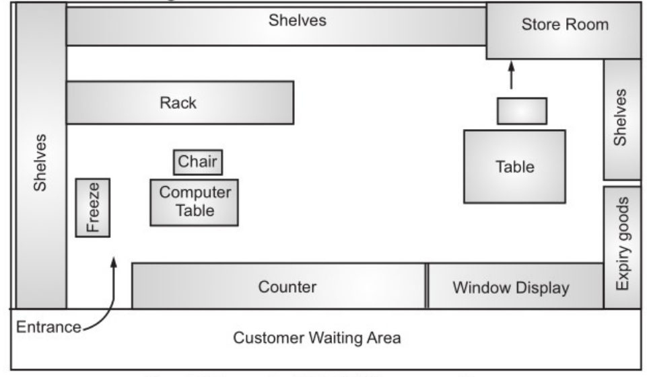

Slide 21
Functions of a Pharmacy
Social
1- Providing the first medical aid
2 -Free (or part of charge) dispensing of the prescribed medicines to certain populations
3- Free (or with a co-payment) dispensing of medicines (Affordable Medicines State Program)
Trading
1- Filling prescriptions medicines
2 -Selling OTC-medicines
Manufacture
Compounding individually prescribed medicines both for individual patients and health care institutions
Information
1 - Pharmaceutical care
2 - Providing pharmacists and other health professionals with necessary information on pharmaceutical products to achieve the optimal health outcomes for consumers

Slide 22
Pharmacy Departments and their functions
Store department
Quantity Control
Quality Control
Storage of medicines
Pricing
Dispense to other departments
Prescription-manufacturing department
Filling prescriptions, dispense medications, counsel patients on the use of prescription medications
Extemporaneous compounding and dispensing medicines
Quality control
Finished medicinal products department
Sale (dispensing) of medicinal products by prescriptions
Over-the-counter medications
(chemist’s department, non-prescriptions) department
Selling non-prescription (OTC)drugs, goods for medical care, nutritional supplements

Slide 23
Pharmacy Point: General information
Definition
is a structural subdivision of the pharmacy, which is based at healthcare institutions, operates in conjunction with the pharmacy, the main task of which is to provide the population with medicines through retail trade
Placement
is placed within the same administrative area with the pharmacy
occupy a separate room with (or without) its own separate entrance in permanent buildings of medical institutions
Area
The total area must be at least 18 square meters
Equipment
Cabinets, refrigerator, safe or metal cabinet for storage controlled medicines, place for sanitary treatment of hands, cabinet for separate storage the personal and work wear, cabinet for storage cleaning equipment
Permitted to sale
Sale (dispensing) of medicinal products to the public either subject to or without medical prescriptions

Slide 24
Pharmacy Point: General information
Pharmacy Opening Hours
set by the owner independently
in pharmacies both state or communal property it should be establish in agreement with the local executive body
Receiving of medicinal products
is carried out only through the pharmacy to which the pharmacy points are subordinated, or through the pharmacy warehouse (base) of this licensee
Requirements for personnel
The position of head may be occupied only by employees who have the appropriate diploma of educational institutions of III-IV accreditation levels

Slide 25
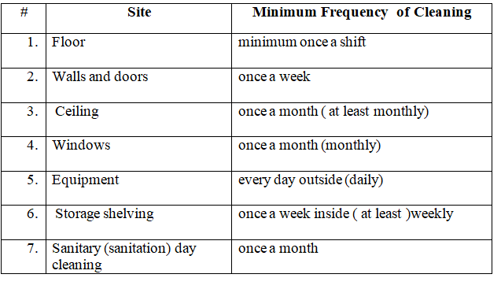
Sanitary requirements for the pharmacy premises

