Slide 2
SULFANILAMIDES.
ANTIMICROBIAL AGENTS
OF DIFFERENT ORIGIN

Slide 3
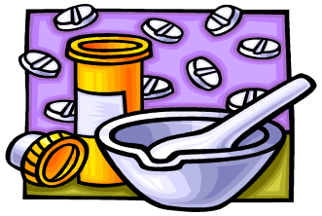
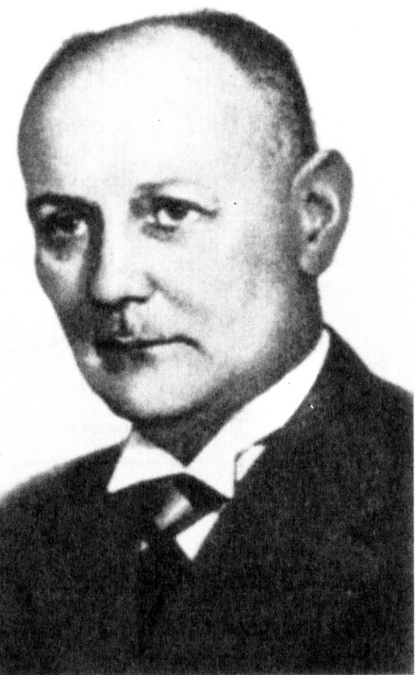
HISTORY
Klarer & Mietz
in 1932 year
in Germany it was synthesized and studied in vitro antibacterial activity of prontosile (red streptocidum)
G. Domagc
in 1935 year
at first it was shown in vivo its activity against hemolytic streptococcus and other bacteria

Slide 4


PRINCLES OF RATIONAL CHEMOTHERAPY
Rational choice of agent (depending on sensitivity of infectional agent, concomitant diseases, anamnesis etc);
Early onset of treatment;
Route of administration;
Choice of dose for achievement of therapeutic concentration (depending on weight, age, sex, concomitant diseases etc.);
Intervel of administration (depending on pharmacokinetic properties of agent);
Duration of therapy (principle of train);
Combined therapy;
Improvement of immunologic reactivity of organism (vitamins, immunostimulators).

Slide 5
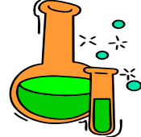
CHEMICAL STRUCTURE
Derivetive of sulfanyl acid (usually, white, has no smell, bitter, weak acids, badly dissolved in water)
H₂N
SO₂
NH₂
Modification of aminogroup leads to physical, chemical, pharmacological properties;
majority available as sodium salts
sulfanilamide (streptocide)
H₂N
СООН
para-aminobenzoic acid (PABA)

Slide 6
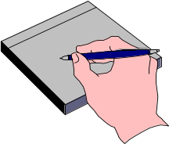
CLASSIFICATION OF SULFANILAMIDE AGENTS
Well-absorbed in gastro-intestinal tract for resorptive action:
short-acting (Т_{1/2} < 10 hrs) – streptocide, ethazole, norsulfazole, sulfadimezine;
long-acting (Т_{1/2}< 24-28 hrs) – sulfapyridazine, sulfadimethoxine
ultralong (Т_{1/2} < 65 hrs) – sulfalen
Badly absorbed in gastro-intestinal tract: phthalazole
Combined:
with salicylic acid – salazopyridazine, salazosulfapyridine;
with thimethaprim – co-trimoxazole (bactrim, biseptol), sulfatone
For local use – streptocide, sulfacyl sodium & other sodium salts

Slide 7
CLASSIFICATION OF SULFANILAMIDE AGENTS
According to the duration of action, systemic sulfonamides are divided into:
short-acting drugs - up to 8 hours. (sulfadimezin, etazol, etazol-sodium, urosulfan, sulfacyl-sodium);
drugs with an average duration of action — 8-16 hours. (sulfadiazine, sulfamethoxazole, sulfameterol);
long-acting drugs — 24-28 hours. (sulfadimethoxine, sulfameterol);
drugs of ultra-long action — more than 7 days (sulfalen).

Slide 8
CLASSIFICATION OF SULFANILAMIDE AGENTS
By the point of application of the action:
Sulfonamides that are enteric-soluble and act in the intestines: succinylsulfathiazole, phthalylsulfathiazole, and sulfaguanidine;
Systemic sulfonamides – N1-substituted sulfonamides (except sulfaguanidine and topically applied sulfonamides);
"Renal" sulfonamides - sulfisoxazole (sulfafurazole), sulfazomidine;
Sulfanilamides of local action: sulfamilon, silversulfadiazine;
Local sulfonamides with a selective effect on the eyes: sodium sulfacetamide.

Slide 9
MECHANISM OF ACTION
competitive antagonism of sulfonamide agents with paraaminobenzoic acid
The effect of sulfonamide agents and para-ammoniobenzoic acid on the vital activity of microorganisms is exactly the opposite:
Para-aminobenzoic acid is converted into dihydrofolic acid and then into tetrahydrofolic acid in living microorganisms.
tetrahydrofolic acid participates in the synthesis of purines, pyrimidines and nucleic acids, is necessary for the synthesis of proteins, enzymes, development and reproduction of microorganisms

Slide 10
RESISTANCE
Resistance to sulfonamides develops as a result of mutation of microbial cells:
manifested:
in the accumulation of a large amount of para-aminobenzoic acid
changes in the structure and properties of the corresponding bacterial enzymes
loss of permeability of pathogens' membranes to sulfonamide drugs.

Slide 11

PHARMACOKINETICS
Absorption (well-absorbed agents): mainly, in small intestine.
Binding with plasma proteins: 20-90 %.
Distribution: highest concentration – in liver, kidneys, lungs, skin; less – in fat tissues. Readily cross in liquid compartments of organism, including BBB, placenta.
Biotransformation: Acetylation, oxidation, glucuronidation or unchanged. Acetylated forms (especially in acidic medium!) precipitate in urine, leads to crystalluria.
Excretion: via kidneys, mainly, through glomerular filtration. Long-acting agents undergo reabsorption.
In children and aged people can be changed!

Slide 12

CONDITIONS, DETERMINING ANTIMICROBIAL ACTIVITY
The concentration of sulfonamides in 100-1000 times should overcome PABA concentration in substrate
Antibacterial activity drop at presence of pus, blood, products of tissue degradation, where PABA present in large amount

Slide 13
ANTIMICROBIAL SPECTRUM
Action is bacteriostatic
Highly susceptible microorganisms: cocci (pneumococci, gonococci, meningococci, streptococci), intestinal (E.coli, Salmonella, Vibrio cholera), large viruses (trachoma), Protozoal (Plasmodium, Toxoplasma gondii), Chlamydia, Cl. perfringens, Corynebacteria etc
Moderately susceptible: staphylococci, enterococci, Kl. pneumonia, Mycobacterium, Yersinia pestis, Actinomycets.
In combination with trimethaprim - bactericidic, antibacterial spectrum is more wide

Slide 14
RESISTANCE
Only those microorganisms are sensitive that essentially need PABA
In result of often and unwise use of drugs staphylococci, meningococci, streptococci, gonococci, Enterobacter became resistant to sulfonamides
There is cross-resistance among sulfonamides.

Slide 15
GENERAL PRINCIPLES OF
SULFONAMIDES THERAPY
Rational choice of sulfanilamide
Early beginning of treatment
Route of administration
Principle of loading dose
Intervals of administration
Duration of treatment
Combined therapy (sulfanilamides should not be combined with!), interaction with other agents (novocain, diphenin, NSAIDs, synthetic hypoglycemic agents, diuretics, anticoagulants etc.)
Increasing of immune resistance of organism (vitamins, immunomodulators).

Slide 16
THERAPEUTIC USES
Acute coccal infections (pneumonia, tonsillitis, bronchitis, sinusitis, otitis, cholecystitis, meningitis etc.) –resorptive long- and ultra-long-acting (sulfadimethoxine, sulfalen), co-trimoxazol;
Acute infections of bile & urinary ducts (cystitis, pyelonephritis etc.) – resorptive short acting (urosulfan), co-trimoxazol;
Acute intestinal infections (dysentery, enterocolitis, colitis etc.) – badly absorbed (phthalazol); nonspecific ulcerative colitis – salazosulfanilamides;
Ophthalmic infections (conjuctivitis) – sulfacyl-sodium;
For the treatment of trachoma, malaria, chlamydiasis, toxoplasmosis, actinomycosis, lepra etc.

Slide 17


ADVERSE EFFECTS
Renal damage : crystalluria, hematuria, urine retention
Inhibition of bone marrow: leucopenia, agranulocytosis, anemias
Hepatotoxicity: hepatitis, in children – jaundice (insufficiency of glucuronyl transferase)
Allergic reactions: dermatitis, синдром Stevens-Johnson syndrom etc
Dysbacteriosis (hypovitaminosis В, К).
Neurotoxicity (dizziness, headache, mental depression)

Slide 18
SULFONAMIDES
drugs that have a sulfonamide functional group in their chemical structure:
for the treatment of Crohn's disease, non-specific ulcerative colitis and rheumatoid arthritis (sulfasalazine),g
out (probenecid),
diabetes (glyburide, tolbutamide, etc.),
diuretics (for example, chlorothiazide, furosemide, hydrochlorothiazide),
selective anti-inflammatory drug (celecoxib)

Slide 19

CONDITIONS OF RATIONAL SULFANILAMIDE THERAPY
Rational choice of sulfonamide taking into account anamnesis of a patient! (whether administered before, sulfonamide resistance, diseases)
• Early onset of treatment
• Principle of loading dose!
• Interval of introduction
• Duration of treatment — 6–8 days
(with acute infections and especially in children and elderlies)

Slide 20
CONDITIONS OF RATIONAL SULFANILAMIDE THERAPY
• Combined treatment (sulfonamides do not combine with each other!), careful usage with other drugs (novocaine, diphenine, NSAIDs, synthetic
hypoglycemic drugs, diuretics, anticoagulants, etc.)
• Rise of immunological reactivity and
decline of therapy complications
(vitaminic drugs, immunomodulators)

Slide 21
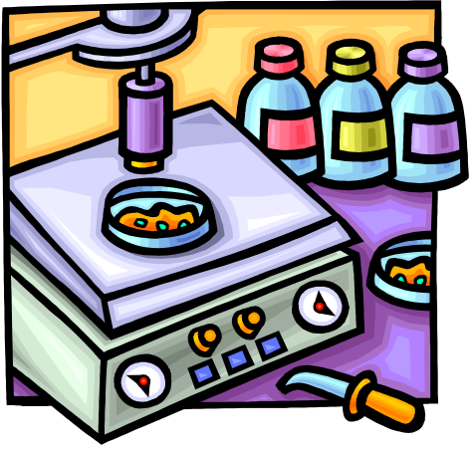
MISCELLENOUS CHEMOTHERAPEUTIC AGENTS
Fluoroquinolones
Naftiridine derivatives
8-oxyquinolines
Nitrofurane derivatives
Imidazole derivatives
Quinoxolone derivatives

Slide 22
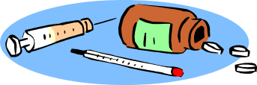
FLUOROQUINOLONES
Non-fluorinated quinolones: nalidixic acids (nevigramon, negram), oxolinic, pipemidic (palin)
• I generation — monofluoroquinolones: norfloxacin, ciprofloxacin, ofloxacin, pefloxacin
• II generation — difluoroquinolones: lomefloxacin, sparfloxacin
• III generation — trifluoroquinolones: fleroxacin, trovafloxacin, moxyfloxacin

Slide 23
FLUOROQUINOLONES
Mechanism of action:
• Inhibits DNA-gyrase (bactericidal)
• Also affect the RNA bacteria and bacterial proteins synthesis,
on stability of membranes and other vital processes
of bacterial cells
• They have a post-antibiotic effect (~2 hrs)
Antibacterial spectrum
They are highly active to aerobic Gr– bacteria (E. coli, Shigella,
Salmonella, Vibrio cholerae, Yersinia enlerocolytica, Legionella,
Brucella, Listeria monocytesgenes, Haemophilus, Neisseria
gonorrhoeae, N. meningitidis, P. aeruginosa, etc.), the Gr+ series:majority of staphylococci (Streptococci are more stable),
Chlamydia, Mycoplasmas, Ureaplasmas, and also Mycobacteria
tuberculosis, Rickettsia, Leishmania, Plazmodia, etc.
They are active to the bacteria which are resistant to other
antimicrobial drugs! Resistant stains appear

Slide 24
FLUOROQUINOLONES
Non-fluorinated (Nalidixic acid) As a rule Gr– microflora
(Enterobacteriaceae family)
quinolonesI — “gram negative” (Ciprofloxacin, Pefloxacin
Ofloxacin, Lomeflotxacin) Gr- microflora, S. aureus,
low activity against Streptococcus pneumoniae, Mycoplasma, Chlamydophila
Fluoroquinolones II — “respiratory” fluoroquinolones (Levofloxacin, Sparfloxacin) Gr- microflora, S. aureus + high
activity of Streptococcus pneumoniae, Mycoplasma pneumoniae, Chlamydophila pneumoniae
III — “respiratory” + “antian aerobial” fluoroquinolone (Moxyfloxacin ) The same + anaerobes, atypical
causative agents

Slide 25
FLUOROQUINOLONES
Pharmacokinetics
• Absorption: fluoroquinolones are well absorbed with
oral intake (Tmax = 1–3 hrs); meal, antacides slow up absorption
• Binding with proteins: no more than 30%
• Distribution: fluoroquinolones (unlike quinolones!) create high concentrations in organs and tissues (higher than in the blood!), penetrate into the cells. Ciprofloxacin, ofloxacin, pefloxacin penetrate through the BBB, placenta, breast milk
• Biotransformation: quinolone quickly metabolized,
fluoroquinolones with different degree, some metabolites
are active
• Excretion: by kidneys, with bile too;
T1/2 norfloxacin — 3–4 hrs, pefloxacin — 13 hrs

Slide 26
FLUOROQUINOLONES
Indications
Non-fluorinated quinolones and norfloxacin:
chronic infections of the urinary system and
intestinal infections
Fluoroquinolones:
• ENT-infections: malignant otitis and sinusitis
caused by polyresistent strains
• Infections of the lower respiratory tracts: chronic
bronchitis, nosocomial pneumonia, legionellosis
• Intestinal infections: shigellosis, typhoid fever,
generalized salmonellosis, plague, cholera
• Anthrax
• Intra-abdominal infections

Slide 27
FLUOROQUINOLONES
Indications
Fluorquinolones:
♦ Infections of pelvic organs, urinary system, prostatitis,
gonorrhoea
♦ Infection of the skin, soft tisues, bones and joints
♦ Infections of eyes
♦ Meningitis caused by gram-negative microflora (ciprofloxacin)
♦ Sepsis
♦ Infections in patients suffering from mucoviscidosis and
neutropenia (treatment and prophylaxis)
♦ Tuberculosis (ciprofloxacin, ofloxacin, lomefloxacin
as drugs of II series)

Slide 28
FLUOROQUINOLONES
Adverse effects
General for all quinolones:
GIT: heartburn, pains in the epigastral region, appetite disorders,
nausea, vomiting, diarrhea
CNS: ototoxicity, drowsiness, insomnia, headache, dizziness,
visual disorders, paresthesia, tremor, seizures
Allergic reactions: rash, itching, angioneurotic edema;
photosensitization
Typical for non-fluorinated quinolones:
Haematological reactions: thrombocytopenia, leukopenia; with deficit of glucoso-6-phosphate dehydrogenase — hemolytic anaemia
Liver: cholestatic icterus, hepatitis

Slide 29
FLUOROQUINOLONES
Adverse effects
Typical for quinolones:
Locomotor apparatus: arthropathies, arthralgias,
mialgias, tendinitis, tendovaginitis, raptures of
tendons (are not recommended
before 18 years old and pregnant women!)
Kidneys: crystalluria, transitory nephritis
Heart: the QT interval lengthening on ECG
Others: most often — candidiasis of the
mucous membrane of oral cavity and/or
vaginal candidiasis

Slide 30
DERIVATIVES OF IMIDASOLE
Metronidazole (metrogil, trichopol), tinidazole
Mechanism of action: bactericidal — a recovered nitro group of the drug disturbs replication and transcription
of the microbial cell’s DNA
Antimicrobial spectrum:
• Anaerobic bacteria
• Trichomonades
• Lamblia
• Amoebae
• Balantidia
• Helicobacter
• They are ineffective to fungi
and aerobes

Slide 31
DERIVATIVES OF IMIDASOLE
Adverse effects:
GIT: Anorexia, vomiting, glossitis, stomatitis, nausea, diarrhea, weight loss, abdominal pain, vomiting, headache, dizziness, and metallic taste in the mouth
CNS: headache, dizziness, paraesthesia
High doses and long-term treatment: leucopenia, neutropenia, increased risk of peripheral neuropathy, dark urin
Topical therapy: local redness, dryness and skin irritation; and eye watering (if applied near eyes)
Metronidazole has been associated with cancer in animal studies
Some evidence from studies in rats indicates the possibility it may contribute to serotonin syndrome
Disulfiram-like effect (incompatibility with alcohol)

Slide 32
8-OXYQUINOLINES DERIVATIVES
Nitroxoline (5-NОК), chlorquinaldol, intetrix, oxolinic acid
Nitroxoline
Mechanism of action: Bactericidic – inhibit protein synthesis, chelate-formation, induction of oxidative process in protoplasma.
Bacterial spectrum activity: Broad. Gr⁺ & Gr– bacteria (staphyloccoci, enterobacteria), Protozoal (amoeba, gardia), fungi.
Uses: pyelonephritis; urethritis; cystitis; epididymitis;
prostate infectious adenoma; prostate carcinoma;
The chelating activities of nitroxoline have also been used in an anticancer .
Adverse effects: allergic reactions, increased heart rate, headaches, abnormal liver function, paresthesia.

Slide 33
8-OXYQUINOLINES DERIVATIVES
chlorquinaldol
Mechanism of action: Bactericidic – inhibit protein synthesis, chelate-formation, induction of oxidative process in protoplasma.
Bacterial spectrum activity: Broad. It is active against most Gram-positive and Gram-negative bacteria, Shigella, Salmonella, Escherichia, Vibrio cholerae, some protozoa (amoeba, Giardia) and fungi. Chlorquinaldol resistance develops slowly,
Uses: Dysentery, salmonellosis, food poisoning, dysbiosis, infectious and inflammatory diseases of the vagina.
Adverse effects: Diarrheal phenomena (abdominal pain, nausea, vomiting, diarrhea), headache, peripheral neuropathy, myelopathy, damage to the optic nerve, allergic reactions (skin rashes, itching, fever); sensation of itching and burning in the vagina (disappears after cessation of treatment).

Slide 34
NITROFURANE DERIVATIVE
Furadonine, furazolidone, furagin; locally – furacillin.
Mechanism of action: Bacteriostatic & bacteriocidic(depending on concentration). Nitrogroup reduce to aminogroup, that inhibit synthesis of DNA, tissue respiration, Creb’s cycle. рН < 5,5 increases action!
Bacterial spectrum: Gr⁺ & Gr– bacteria, Protozoal (Amoeba, Gardia, trichomonada), large viruses, fungi.
Uses: Effective at resistance to antibiotics & sulfanilamides.
- intestinal infection (furazolidone);
- infection of urinary tract (furadonine, furagin).
Adverse effects: allergic reactions, neuritis, bleeding, methemoglobinemia, nephrotoxicity, dyspepsia, embryotoxicity.

Slide 35

QUINOXOLINES
Dioxydinum, chinoxydinum
Mechanism of action: Bactericidic – block of DNA synthesis
Bacterial spectrum: Gr⁺ & Gr– bacteria, Proteus vulgaris, Pseudomonas, anaerobs. Active against bacteria resistant to other chemotherapeutic agents
Uses: used to treat severe inflammatory processes of various nature, as an antiseptic for wound infections, infected burns; for the prevention and treatment of infectious complicationsarthritis, severe purulent-visceral processes, sepsis etc.
Dioxidine quickly cleans the wound surface, promotes tissue regeneration. When administered intravenously, it penetrates rapidly into tissues and organs. It is

Slide 36
QUINOXOLINES
Dioxydinum, chinoxydinum
Mutagens
Chemical agents that increase the rate of genetic mutation by interfering with the function of nucleic acids. A clastogen is a specific mutagen that causes breaks in chromosomes.
Adverse effects: mutagenic, teratogenic, embryotoxic, seizures, allergic reactions, hyperthermia
intracavitary and intravenous administration may cause headache, fever, nausea, diarrhea, allergic reactions, muscle cramps.
Only for adults under restrict doctor supervision !

