Slide 1

Principles
of clinical- pharmaceutical approach
to the selection of drugs
in rheumatology

Slide 2
RHEUMATOLOGY
Rheumatology –
section of medicine devoted to the study of rheumatic diseases and disorders of the function and/or structure of the musculoskeletal system

Slide 3
RHEUMATOLOGY
The term "rheumatic diseases" includes a variety of
the origin of the disease, with a persistent or transient articular syndrome. This is rheumatism and diffuse connective tissue diseases, such as systemic lupus erythematosus (SLE), systemic scleroderma (SSD), dermatopolymyositis and
other, multiple arthritis and arthrosis, diseases of the spine
inflammatory and degenerative nature, soft (extra-articular,
periarticular) tissues, such as periarthritis, bursitis, myositis.

Slide 4
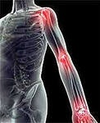
RHEUMATOLOGY
History –
In the I century AD. e. for the
first time in the literature
Appeared concept of rheuma (rheuma).
Rheuma refers to
a "substance that flows",
possibly derived from phlegm.
This "primary juice", by the definition of the ancients, which was formed in the brain and flowed into various parts of the body, causing ill health.

Slide 5
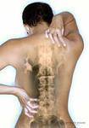
RHEUMATOLOGY
History –
In 1642 the term "rheumatism" was introduced into literature by
the French doctor Dr. Ballo (G. Baillou), who stressed that arthritis can be a manifestation of a systemic disease.
In 1940, Bernard Comroe proposed the term "rheumatologist".

Slide 6
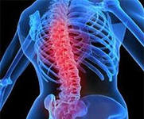
RHEUMATOLOGY
In 1946, Dr. Rich (Rich) proposed the term "collagen-vascular disease" on the basis that the primary damage is characterized by the involvement of the vascular endothelium.
In 1952, Dr. Eric (Ehnch) proposed the term "connective tissue disease," which gradually supplanted the term "collagen-vascular diseases."

Slide 7
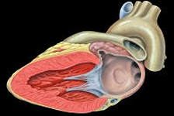
Classification of rheumatic diseases
Rheumatism (rheumatic fever)
1.0. Rheumatism in the active phase
1.1. Without heart involvement
1.1.1. Rheumatoid arthritis or polyarthritis
1.2. With the involvement of the heart
1.2.1. Primary rheumatic heart disease
1.2.2. Recurrent rheumatic carditis without cardiac defect
1.2.3. Recurrent rheumatic heart disease with a heart defect
1.3. Rheumatic chorea
2.0. Rheumatism in the inactive phase

Slide 8
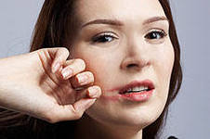
Classification of rheumatic diseases
II. Diffuse connective tissue diseases
1.0. Systemic lupus erythematosus
1.1. Drugs lupus-like syndrome
2.0. Systemic scleroderma
2.1. Induced (medicinal) scleroderma.
3.0. Diffuse fasciitis
4.0. Dermatomyositis (polymyositis) idiopathic
4.1. Paraneoplastic
4.2. Juvenile
5.0. Sjogren's disease
6.0. Mixed face. connect. fabrics
7.0. Rheumatic polymyalgia
8.0. Recurrent polychondritis, including Tietze disease
9.0. Recurrent panniculitis (Weber-Crischen disease)

Slide 9
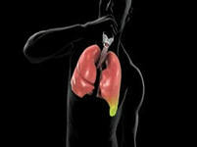
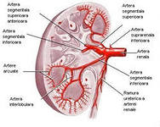
Classification of rheumatic
diseases
III. Systemic vasculitis (angiitis, arteritis)
1. Nodular periarteritis
2.0. Granulomatous arteritis:
2.1. Wegener's granulomatosis
2.2. Eosinophilic granulomatous vasculitis
2.3. Giant cell temporal arteritis
2.4. Nonspecific. aortoarteriitis (Takayasu's disease)
3.0. Hyperergic angiitis
3.1. Hemorrhagic vasculitis
(b-nd Shenlaine - Genocha)
3.2. Goodpasture Syndrome
3.3. Mixed cryoglobulinemia
4.0. Obliterating thromboangiitis (Buerger's disease)
5.0. Behcet's Syndrome
6.0. Kawasaki syndrome (mucocutaneous-glandular syndrome)

Slide 10
Classification of rheumatic diseases
IV. Rheumatoid arthritis
1.0. Polyarthritis
1.1. Polyarthritis (rheumatoid factor positive)
1.2. Polyarthritis (rheumatoid factor is negative)
2.0. Rheumatoid arthritis with systemic manifestations
3.0. Felty Syndrome
V. Juvenile arthritis
1.0. Juvenile arthritis
1.1. Still's syndrome
2.0. Juvenile chronic arthritis
VI. Ankylosing spondylitis (Bechterew's disease)

Slide 11
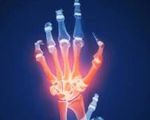
Classification of rheumatic diseases
VII. Arthritis combined with spondylitis
1.0. Psoriatic arthritis
2.0. Reiter's disease
3.0. Arthritis in chronic nonspecific bowel diseases
(nonspecific ulcerative colitis, regional ileitis Crohn's disease)
4.0. Arthritis and (or) sakroileitis, unspecified etiology

Slide 12
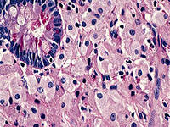
Classification of rheumatic diseases
VIII. Arthritis associated with infection
1.0. Infectious arthritis
1.1. Bacterial (staphylococcal, gonococcal, brucellosis,
syphilitic, tuberculosis, etc.)
1.1.1. Lyme disease
1.1.2. Whipple's disease
1.2. Viral
1.3. Fungal
1.4. Parasitic
2.0. Reactive arthritis
2.1. Post-enterocolitis (shigellosis,
yersiniosis, salmonellosis, klebsiella, etc.)
2.2. Urogenital (excluding Reiter's disease)
2.3. After a nasopharyngeal infection
2.4. After other infections
2.5. Post-vaccination

Slide 13
Classification of rheumatic diseases
IX. Microcrystalline arthritis
1.0. Gout primary
2.0. Gout secondary (drug, with kidney failure, etc.)
3.0. Chondrocalcinosis (pseudogout)
4.0. Hydroxyapatite arthropathy
X. Osteoarthritis
1.0. Primary
1.1. Polyostearthrosis, oligoarthrosis, monoarthrosis
1.2. Spondylosis, spondylarthrosis
1.3. Intervertebral osteochondrosis
1.4. Endemic osteoarthritis (Kashin-Bek's disease)
1.5. Diffuse idiopathic hyperostosis (Forestier's disease)
2.0. Secondary (in the case of dysplasia, arthritis, trauma, static disorders, hypermobility, etc.)

Slide 14
Classification of rheumatic diseases
XI. Other joint diseases
1.0. Palindromia rheumatism
2.0. Intermittent hydratrosis
3.0. Multiple reticulohystocytosis
4.0. Synovium
5.0. Chondromatosis of the joint
6.0. Villonodular synovitis
XII. Arthropathy in non-rheumatic diseases
1.0. Allergic diseases
1.1. Serum sickness
1.2. Medicinal disease
1.3. Other allergic conditions
2.0. Metabolic disorders
2.1. Amyloidosis
2.2. Ochronosis
2.3. Hyperlipidemia and other

Slide 15
Classification of rheumatic diseases
XIII. Diseases of extraarticular soft tissues
1. Diseases of the muscles
1.1. Myositis
1.2. Ossifying myositis
2. Diseases of the periarticular tissues
2.1. Enthesopathies (involvement of tendon attachment sites - stiloiditis, epicondylitis)
2.2. Tendinitis (including "snapping finger")
2.3. Tendovaginitis (including de Keurwen's disease)
2.4. The Tenosynovite
2.5. Bursites
2.6. Periarthritis
2.7. Carpal tunnel syndrome and other ligamentitis
3. Diseases of the fascia and aponeuroses
3.1. Aponeurosis - Dupuytren's contractures
4. Disease of subcutaneous fat
4.1. Nodal erythema
4.2. Painful lipomatosis (Derkum syndrome)

Slide 16
Classification of rheumatic diseases
XIV. Diseases of bones and osteochondropathies
1. Diseases of bones
1.1. Osteoporosis (osteopenia) generalized
1.2. Osteomalacia
1.3. Osteopathy is hypertrophic pulmonary (Marie-Bamberger syndrome)
1.4. Deforming osteitis (Paget's disease)
2. Osteochondropathies
2.1. Aseptic necrosis of the head of the femur (Perthes disease) and other localizations (Köhler's disease I and II, Kenbec disease, etc.)
2.2. Dissecting osteochondritis
2.3. Osteochondropathy of vertebral bodies (Sheyerman's disease)
2.4. Osteochondropathy tuberosity of
the tibia (Osgood – Schlatter disease)

Slide 17
Etiological factors of rheumatic diseases
Predisposing factors :
- hypothermia
- heredity
- unfavorable weather conditions (spring, autumn)
- periods of physiological restructuring of the organism (puberty, postpartum, climacteric periods)
- injuries
- stress
- age (for rheumatism - young age, for RA-45 years and older, for DOA-age over 40-60 years)
- gender: for RA and DOA-female, men suffer from gout 20 times more often

Slide 18
Etiological factors of rheumatic diseases
Infectious factors
In some cases, the infectious agent (microbe or virus) has etiological significance. For example, with rheumatism (Sokolsky-Buyo disease) - beta-hemolytic streptococcus gr. А, with RA - the Epstein-Barr virus.
Numerous infectious arthritis (tubercular, gonorrheal, syphilitic, septic, brucellosis, etc.) arise due to direct penetration of the pathogen into the joint tissue.
The reaction of the joint tissues can develop in response to a circulating agent in the blood or its antigen (reactive arthritis). Rheumatism, reactive arthritis.

Slide 19
Etiological factors of rheumatic diseases
The role of lysosomal enzymes
Lysosomal enzymes take participation in the damage of articular tissues already in the early stage of RA, when the synovial membrane is dominated by neutrophil infiltration.
During this period, local activation of phagocytes by immune complexes occurs.
The initial degradation of the cartilage matrix occurs with the participation of lysosomal proteases,
including a neutral serine protease of neutrophils, elastase and cathepsin C, or metal-dependent neutral proteases such as collagenase.
In chronicizing arthritis, the main source of these enzymes are accumulations of monocytes and tissue macrophages carrying on the surface receptors to the Fc fragment of IgG.

Slide 20
Etiological factors of rheumatic diseases
The role of reactive metabolites of oxygen of lysosomal enzymes
The radical of superoxide O2, hydrogen peroxide H2O2, hydroxyl radical OH - exert a cytotoxic effect, which is related to the following effects:
-destruction of prostaglandins and collagen cartilage;
-depolymerization of hyaluronic acid and a decrease in the viscosity of synovial fluid;
-formation of chemotactic factors, local activation of phagocytosis;
-increased cellular aggregation in the lesion focus;
-increased local tissue damage (due to in situ formation of chemotaxis and influx of new phagocytes).
The destruction of cartilage is also associated with the activity of interleukin-1

Slide 21
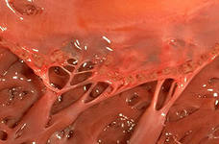

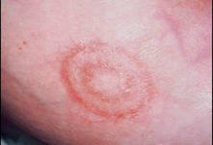
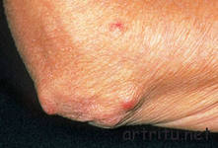
The main criteria for the diagnosis of rheumatism
LARGE CRITERIA :
1. Carditis
2. Chorea
3. Subcutaneous nodules
4 Polyarthritis
5. Annular erythema

Slide 22
The main criteria for the diagnosis of rheumatism
Small criteria:
1. Clinical data, arthralgia, fever
2. Laboratory data
Growth of acute phase reactants: ESR, CRP
3. Lengthening the interval PQ
SYMPTOMS OF PREVIOUS STREPTOСOCCAL INFECTION :
1. The growth of hemolytic streptococcus during bacteriological examination of the material from the pharynx
2. High titer or increase in the titer of anti-streptococcal antibodies

Slide 23
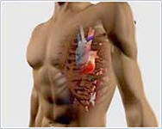
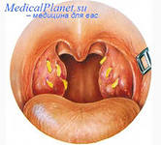
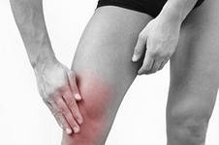
The main criteria for the diagnosis of rheumatism
Allows you to diagnose rheumatic fever:
-Presence of 2 large criteria and signs of the previous streptococcal infection
-The presence of 1 large, 2 small criteria and characteristics of the previous
streptococcal infection

Slide 24
Diagnostic criteria for rheumatoid arthritis
5. Rheumatoid nodules. Subcutaneous nodules on protruding sites of bones, extensor surfaces or near the joints, detected by a doctor
6. Rheumatoid factor in serum. Revealing an abnormal amount of rheumatoid factor in the serum by any method
7. Radiographic changes
On the X-ray of the hand and wrist in the anterior-posterior projection: narrowing of the joint gap, erosion, clear osteoporosis of the bones of the affected joint and the bones immediately adjacent to it. Characteristic subluxations in the metacarpophalangeal joints, lateral deviation of the fingers.
If there are 4 or more of 7 of the above criteria can be diagnosed with rheumatoid arthritis.

Slide 25
Diagnostic criteria for rheumatoid arthritis
8. Laboratory data:
increased ESR, determination of the rheumatoid factor (from 6 months of disease, diagnostic titer by the Voler-Rose reaction 1:32, latex test 1:20).
In the immunogram - a decrease in T-lymphocytes, anti-keratin antibodies (AT) of the blood.
9. Instrumental studies: synovial fluid: cloudy, low viscosity, with high protein content (40-60 g / l), glucose decrease to 0.5-3.5 mmol / l, LDH> 300 ED, cell count of 5000-25000 in 1 μl (normal up to 200).
8. Лабораторные данные:
повышение СОЭ, определение ревматоидного Фактора (с 6 мес. заболевания; диагностический титр по реакции Волера-Роуза 1:32, латекс–тест 1:20).
В иммуннограмме - снижение Т-лимфоцитов, антикератиновые антитела (АТ) крови.
9. Инструментальные исследования: синовиальная жидкость: мутная, низкой вязкости, с повышенным содержанием белка (40-60г/л), снижением глюкозы до 0.5-3.5 ммоль/л, ЛДГ >300 ЕД, количество клеток 5000-25000 в 1мкл (в норме до 200).

Slide 26
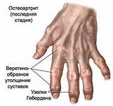
Diagnostic criteria for osteoarthrosis (osteoarthritis)
Arthrosis of wrists
1.Pain, stiffness or stiffness in the hands, most often during the day during the past month
2.Dense thickening of two or more
joints and less than 3 swollen
metacarpophalangeal joints,
or
1.Hardening of two or more distal interphalangeal joints
2.Incorrect position of one or more joints - II and III distal interphalangeal joints; II and III proximal interphalangeal joints; carpometacarpal joint on both hands

Slide 27
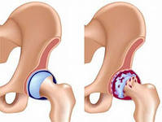
Diagnostic criteria for osteoarthrosis (osteoarthritis)
Coxarthrosis
Clinical symptoms:
Pain in the hip joint and
internal rotation less than 15 gr.
flexion of the hip joint
less than 115 degrees)
or
internal rotation less than 15 gr.
pain in internal rotation
morning stiffness less than 60 minutes
age over 50 years.
Clinical and radiological symptoms:
Pain in the hip joint and 2 of 3 following signs:
X-ray osteophytes (head or acetabulum)
X-ray narrowing of the joint space (top, lateral and / or medially)

Slide 28
Diagnostic criteria for osteoarthrosis (osteoarthritis)
Gonarthrosis
Clinical symptoms:
1. Pain in the knee joint
2. a) crepitation within
most days
previous month.
b) morning stiffness
with active movement
less than 30 minutes
c) age over 37 years or
3. a) crepitation and
b) morning stiffness for at least 30 minutes and
c) bone deformation (swelling).
4. a) lack of crepitation and
b) bone deformation.

Slide 29
Diagnostic criteria for osteoarthrosis (osteoarthritis)
Gonarthrosis
Laboratory, radiographical symptoms:
Radiographically, there are 3 stages of arthrosis:
1 stage - insignificant movement restrictions, slight narrowing of the joint gap, initial osteophytes.
2 stage - restriction of mobility in the joint, pronounced narrowing of the joint gap 2-3 times normal, significant osteophytes.
3 stage - joint deformation, restriction of its mobility, complete absence of an articulation gap, deformation and compaction of articular surfaces of the epiphyses, extensive osteophytes and subchondral cysts.
In the synovial fluid:
the number of cells in 1 ml is 500-5000,
neutrophils less than 50%,
fragments of cartilaginous tissue are found.

Slide 30
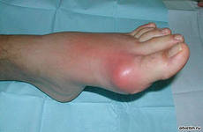
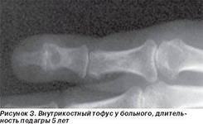
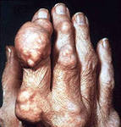
Diagnostic criteria for gouty arthritis
Presence in the anamnesis or observation of at least 2 attacks and swelling and / or redness and severe pain in the limb joint with remission after 1-2 weeks
Acute arthritis of metatarsus-phalanx
the joint of the big toe in history
or status
The symptom of the "piercer" or
large cysts on radiograph
Increased uric acid in the blood serum:
- in men> 0.42 mmol/l (7 mg%)
- in women> 0.36 mmol/l (6 mg%)
Tofusi
Urolithiasis disease

Slide 31
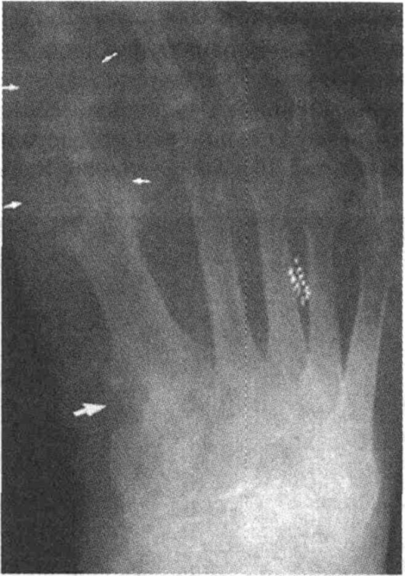
Diagnostic criteria for gouty arthritis
Laboratory data:
During the period of exacerbation in the blood analysis:
- neutrophilic leukocytosis with a leftward shift
- increased ESR
- an increase in serumucoid, fibrin, sialic acid, uric acid
(in the norm-0.12-0.24 mmol/L)
and urine (1.8-3.6 mmol/day)
Credible X-ray signs of gout appear
after 5 years from the onset of the disease:
against the background of osteoporosis are
detected "Stamped" foci of enlightenment
up to 2-3 cm in diameter -
symptom of "swelling of the bone edge"

Slide 32

Main tasks and purposes of complex treatment of rheumatic diseases
Elimination of the most painful subjective and severe objective clinical and laboratory indicators of rheumatic diseases by affecting the leading links in pathogenesis, in
first of all for inflammation and immunopathological mechanisms
Purposes of antirheumatic therapy:
- reduce or eliminate pain
- reduce or eliminate signs of general and local inflammatory activity
- to influence the violation of immunoregulatory processes
- to prevent an exacerbation of the disease
- help restore the affected joints and spine

Slide 33
Main tasks and purposes of complex treatment of rheumatic diseases
Among the urgent tasks in the first place is the elimination of pain
Mechanism of pain syndrome:
- stimulation of local pain receptors by mediators of inflammation, especially bradykinin and prostaglandins
- increased pain during fever, with the development of systemic manifestations
- psychogenic phenomena (depression, anxiety)
Consideration of the general mechanisms of the pathogenesis of inflammatory rheumatic diseases shows that the signs of inflammation with which the patient seeks to the doctor are preceded by deep disturbances in the activity of the immune system leading to the development of chronic persistent immune inflammation

Slide 34
Therapy of a first row of rheumatic diseases
Use of NSAIDs
Use of corticosteroids
Classification of NSAIDs on the effect on the processes of biosynthesis in the cartilaginous tissue
a) suppressing inflammation and neutral to arthrosis - Piroxicam, diclofenac, sulindac, solpaflex
b)suppressing inflammation and strengthening arthrosis - Acetylsalicylic acid, indomethacin, fenoprofen, phenylbutazone
c)suppressing inflammation and promote the normalization of metabolic processes in the cartilaginous tissue - Benoxaprofen, tiaprofenic acid (surgam), paracetamol

Slide 35
Therapy of a first row of rheumatic diseases
NSAIDs suppress predominantly the phase of exudation. The most potent drugs - indomethacin, diclofenac, phenylbutazone - also act on the proliferation phase (reducing the synthesis of collagen and the associated tissue sclerosis), but weaker than the exudative phase. At the phase of alteration, NSAIDs are practically not affected. For anti-inflammatory activity, all NSAIDs are inferior to glucocorticoids.
The most important mechanism of NSAIDs is associated with inhibition of the synthesis of cyclooxygenase (COX) and lipoxygenase (LOH), the key enzymes of arachidonic acid metabolism. Arachidonic acid is a part of membrane phospholipids and is released under the influence of the enzyme phospholipase A2. COX and LOG are catalyzed by further conversion of arachidonic acid. The products of their metabolism include cyclic endoperoxides, prostaglandins (PG), thromboxane (TXA2), leukotrienes (LT), etc. PG are produced by many cells and are among the most important paracrine and autocrine mediators.
Anti-inflammatory action can be associated with inhibition of lipid peroxidation, stabilization of lysosome membranes (both of these mechanisms prevent damage to cellular structures), decrease in ATP formation (decrease in energy supply of inflammatory reaction), inhibition of neutrophil aggregation (release of inflammatory mediators from them), inhibition of rheumatoid factor production in patients with rheumatoid arthritis. The analgesic effect is to a certain extent connected with the violation of pain impulses in the spinal cord (metamizole).
The antiproliferative effect of NSAIDs can also be mediated by various mechanisms: both by increasing the activity of natural killer cells in suppressing the synthesis of PG and COG-2 dependent regulation of apoptosis of cells. It was found that the production of COX-2 precedes the apoptosis of neuronal cells, therefore selective inhibitors of COX-2 have a certain neuroprotective activity. This therapy remains perennial in most patients with Bekhterev's disease and in a certain group of patients with seronegative rheumatoid arthritis.
The use of corticosteroids, which are
powerful anti-inflammatory drugs. Indications for systemic
the appointment of glucocorticosteroids (mainly prednisolone): active
SLE and dermatopolymiosis, rheumatoid arthritis with systemic manifestations,
vasculitis, organ-specific autoimmune syndromes. Remains unchanged
recommendation of individual suppressive therapy and slow gradual
cancellation to a maintenance dose. In recent years, the megado-
6-methylprednisolone (intravenously for 1 g / day-pulse therapy) for
suppression of crisis situations, as a measure of emergency therapy and in the development
resistance to traditional oral glucocorticoid therapy.
Pulse-therapy does not abolish the oral administration of corticosteroids, which
should continue with the same intensity as before the pulse-therapy.
Finally, with rheumatoid arthritis and other peripheral arthritis
glucocorticosteroids are administered intra-articular already in the early stages of development
disease during the appointment of the NTP.
In order to reduce the side-effects of the gluco-
corticosteroids prescribe a more active suppressive dose, including pulse-
therapy, but with a faster reduction to a maintenance dose, and
alternating route of admission, i.e., a single morning intake of the whole
the overwhelming dose of glucocorticosteroids.
If the anti-inflammatory therapy is ineffective, drugs are prescribed
second row. In the treatment of rheumatoid arthritis, SLE, recurrent rheumatism
4-aminoquinoline derivatives are classified as second-line drugs, however
because of their low toxicity, ease of use, the possibility of combination with
with any medications, delagil and plaquenil have found the widest application.
belongs to the first place among second-line drugs. Aminoquinolone
the remedies are effective on condition of early and long-term treatment.

Slide 36
Therapy of a first row of rheumatic diseases
NSAIDs suppress predominantly the phase of exudation. The most potent drugs - indomethacin, diclofenac, phenylbutazone - also act on the proliferation phase (reducing the synthesis of collagen and the associated tissue sclerosis), but weaker than the exudative phase. At the phase of alteration, NSAIDs are practically not affected. For anti-inflammatory activity, all NSAIDs are inferior to glucocorticoids.
The most important mechanism of NSAIDs is associated with inhibition of the synthesis of cyclooxygenase (COX) and lipoxygenase (LOH), the key enzymes of arachidonic acid metabolism. Arachidonic acid is a part of membrane phospholipids and is released under the influence of the enzyme phospholipase A2. COX and LOG are catalyzed by further conversion of arachidonic acid. The products of their metabolism include cyclic endoperoxides, prostaglandins (PG), thromboxane (TXA2), leukotrienes (LT), etc. PG are produced by many cells and are among the most important paracrine and autocrine mediators.
Anti-inflammatory action can be associated with inhibition of lipid peroxidation, stabilization of lysosome membranes (both of these mechanisms prevent damage to cellular structures), decrease in ATP formation (decrease in energy supply of inflammatory reaction), inhibition of neutrophil aggregation (release of inflammatory mediators from them), inhibition of rheumatoid factor production in patients with rheumatoid arthritis. The analgesic effect is to a certain extent connected with the violation of pain impulses in the spinal cord (metamizole).
The antiproliferative effect of NSAIDs can also be mediated by various mechanisms: both by increasing the activity of natural killer cells in suppressing the synthesis of PG and COG-2 dependent regulation of apoptosis of cells. It was found that the production of COX-2 precedes the apoptosis of neuronal cells, therefore selective inhibitors of COX-2 have a certain neuroprotective activity. This therapy remains perennial in most patients with Bekhterev's disease and in a certain group of patients with seronegative rheumatoid arthritis.
The use of corticosteroids, which are
powerful anti-inflammatory drugs. Indications for systemic
the appointment of glucocorticosteroids (mainly prednisolone): active
SLE and dermatopolymiosis, rheumatoid arthritis with systemic manifestations,
vasculitis, organ-specific autoimmune syndromes. Remains unchanged
recommendation of individual suppressive therapy and slow gradual
cancellation to a maintenance dose. In recent years, the megado-
6-methylprednisolone (intravenously for 1 g / day-pulse therapy) for
suppression of crisis situations, as a measure of emergency therapy and in the development
resistance to traditional oral glucocorticoid therapy.
Pulse-therapy does not abolish the oral administration of corticosteroids, which
should continue with the same intensity as before the pulse-therapy.
Finally, with rheumatoid arthritis and other peripheral arthritis
glucocorticosteroids are administered intra-articular already in the early stages of development
disease during the appointment of the NTP.
In order to reduce the side-effects of the gluco-
corticosteroids prescribe a more active suppressive dose, including pulse-
therapy, but with a faster reduction to a maintenance dose, and
alternating route of admission, i.e., a single morning intake of the whole
the overwhelming dose of glucocorticosteroids.
If the anti-inflammatory therapy is ineffective, drugs are prescribed
second row. In the treatment of rheumatoid arthritis, SLE, recurrent rheumatism
4-aminoquinoline derivatives are classified as second-line drugs, however
because of their low toxicity, ease of use, the possibility of combination with
with any medications, delagil and plaquenil have found the widest application.
belongs to the first place among second-line drugs. Aminoquinolone
the remedies are effective on condition of early and long-term treatment.

Slide 37
Therapy of rheumatic diseases (1st row)
NSAIDs -
suppress predominantly the phase of exudation
also act on the proliferation phase (decreasing the synthesis of collagen and associated sclerosis of tissues), but weaker than the exudative phase - indomethacin, phenylbutazone diclofenac
On the phase of ALPA alteration practically
do not affect
For anti-inflammatory activity, all NSAIDs are inferior to glucocorticoids

