Slide 1

Principles
clinico-pharmaceutical
approach to the selection of drugs
for the treatment of diseases
of pancreas

Slide 2

«As a gentle panther,
she laid her head in
twist of 12-finger
guts, flattened
thin body on the aorta,
lulling her
dimensional movements,
but slightly curved
tail blithely dismissed into the gates of the spleen - a hiding beautiful predator who unexpectedly in case of illness can inflict irreparable
harm: so does the pancreas - beautiful, like an angel of heaven, like a demon deceitful and evil»

Slide 3
Pancreas
is one of the most
mysterious organs of
gastrointestinal tract.
Still
there are many
unresolved issues,
which is explained:
- features of the location of the pancreas
- nonspecific manifestations of many of its diseases.
How the well-known pancreatologist G.F. Korotko, "the pancreas slowly and reluctantly reveals its secrets“.

Slide 4
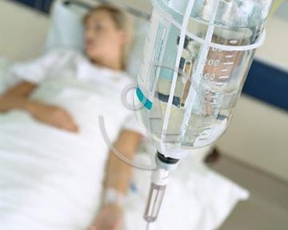
Acute pancreatitis

Slide 5
Acute pancreatitis
Acute pancreatitis is a destructive and inflammatory lesion of the pancreas, the basis of which is the processes of autoenzymatic necrobiosis and necrosis with possible endogenous infection and involvement in the pathological process of the tissues of the retroperitoneal space, abdominal cavity and systems of extraperitoneal localization.
The term "pancreatitis" combines several homogeneous pathogenesis, but different in pathomorphology clinical forms, reflecting the successive stages of the evolution of a single pathological process:
acute inflammatory
destructive conditions of the pancreas.

Slide 6
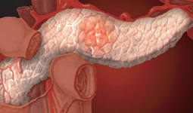
Epidemiology of acute pancreatitis
Acute pancreatitis is one
of the most common surgical
diseases averaging 3-10%
cases of acute organ diseases
abdominal cavity.
In industrialized countries,
the incidence of acute
pancreatitis has doubled over
the past two decades, which makes it possible to speak of this disease as a disease of civilization.
The objective forecast assumes a gradual increase in the number of such patients within the next 5 years.
The age of patients with pancreatonecrosis is 15-94 (more often - 47) years.

Slide 7
Etiology of acute pancreatitis
Acute pancreatitis is a polyetiological disease. The cause of its development can be clearly identified in 75-80% of patients, the rest it remains unidentified.
Among the reasons for the development of pancreatitis are three closely related groups of damaging factors:
- mechanical (violation of the evacuation of pancreatic secretion through the duct system of the pancreas);
- neurohumoral (violation of innervation, metabolic functions of the pancreas and liver of various etiologies);
- toxic (the presence of exogenous and endogenous toxic metabolites of different nature).

Slide 8
Etiology of acute pancreatitis
1. Alimentar factor
2. Genetically determined pancreatitis
3. Medicinal pancreatitis
Among the pancreatic-damaging factors are:
> Azathioprine;
> Estrogens;
> Glucocorticosteroids;
> Sulfonamides;
> Non-steroidal anti-inflammatory drugs (brufen);
> Furosemide;
> Thiazide diuretics;
> Tetracycline;
Indirect anticoagulants;
> Cimetidine;
> Metronidazole;
Cholinesterase inhibitors.
4. Viral infection
5. Dismetabolic pancreatitis
6. Idiopathic pancreatitis
The etiology remains uncorrected in 20-40% of patients. Distinguish early idiopathic pancreatitis, with onset at the age of 35 years, and late3.

Slide 9
Chronic pancreatitis
Chronic pancreatitis (CP) is a slowly progressing inflammatory disease of the pancreas, characterized by focal necrosis in combination with fibrosis, and leading to a progressive decrease in the exo- and endocrine function of the organ.
Conventionally, CP is said when the inflammatory process in the pancreas lasts more than 6 months.
CP usually occurs with episodes of exacerbations and remissions.
Acute and chronic pancreatitis - between them to draw a line is sometimes extremely difficult, because the exacerbation of chronic pancreatitis in its clinical picture is very similar to acute processes, and AP, in turn, may remain unrecognized (in 60% of cases!), flowing under the masks of other gastrointestinal diseases.
It is known that acute pancreatitis in 10% of cases is transformed into chronic (and considering unrecognized episodes of AP - much more often).

Slide 10
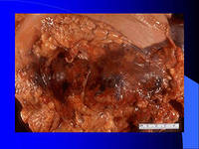

Chronic pancreatitis
Classification
Chronic panceatitis are divided into several features:
According to the morphological features:
1)interstitial-edematic;
2) parenchymal;
3)fibro-sclerotic (inductive);
4)hyperplastic (pseudotumorous);
5) cystic.
According to clinical manifestations:
- painful;
- hypoxecretory;
- astenoneurotic (hypochondriacal);
- latent;
- combined.

Slide 11
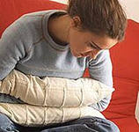
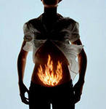
Chronic pancreatitis
Classification
Chronic pancreatitis are divided into several features:
By the nature of the clinical course:
- rarely recurrent;
- often recurrent;
- persistent.
On the etiology:
- alcoholic;
- biliary-dependent;
- dismetabolic;
- infectious;
- drug;
- idiopathic.

Slide 12
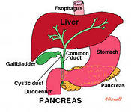
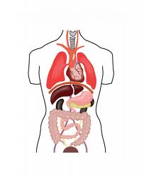
Chronic pancreatitis
Complications:
- disturbances of bile outflow;
- portal hypertension;
- infectious (cholangitis, abscesses);
inflammatory (abscess, cyst,
parapancreatitis, "fermentative cholecystitis", erosive esophagitis);
- gastro-duodenal bleeding;
- exudative pleurisy, pneumonia;
- acute respiratory distress syndrome, paranephritis, acute renal failure;
exocrine disorders (diabetes mellitus, hypoglycemic conditions).

Slide 13
PANCREATITIS
- inflammation of the pancreas, resulting from bile duct disease.
With inflammation of the pancreas, the enzymes released by the gland are not thrown into the duodenum, but are activated in the gland itself and start to destroy it (self-digestion). Enzymes and toxins that are secreted are often discharged into the bloodstream and can seriously damage other organs, such as the brain, lungs, heart, kidneys and liver.

Slide 14
CLASSIFICATION
The basis of clinical and morphological classification of acute pancreatitis is the form of the disease, intra-abdominal and systemic complications, taking into account the prevalence of necrotic pancreatic lesions and various departments of retroperitoneal tissue, the phase development of the inflammatory necrotic process from bacterial to infected.
FORMS OF DISEASE
1. Edematic (interstitial) pancreatitis;
2. Sterile pancreatic necrosis:
- the prevalence of the lesion: limited and widespread;
- by the nature of the lesion: fatty, hemorrhagic, mixed;
3. Infected pancreatic necrosis.

Slide 15
LOCAL COMPLICATIONS
Into the infectious phase:
1. Parapancreatic infiltrate (omentobursit, volumetric fluid formations of retroperitonealization);
2. Necrotizing (aseptic) phlegmon of retroperitoneal tissue (parapancrelic, paracolic, paranephric, pelvic, etc.);
3. Peritonitis: enzymatic (abacterial);
4. Pseudocyst (sterile);
5. Arrosive bleeding (intra-abdominal and gastrointestinal tract).
During the infection phase:
1. The septic phlegmon of retroperitoneal tissue: parapancreatic, paracolic, paranephric, pelvic;
2. Pancreatogenic abscess (retroperitoneal cell spaces or abdominal cavity);
3. Peritonitis fibrinous-purulent (local, common);
4. The pseudocyst is infected;
5. Internal and external pancreatic, gastric and intestinal fistulas;
6. Arrosive bleeding (intra-abdominal and gastrointestinal tract).

Slide 16
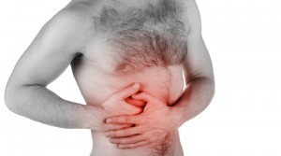
SYSTEM COMPLICATIONS
1. Pancreatogenic shock with sterile pancreatic necrosis and its intra-abdominal complications;
2. Septic (infectious-toxic) shock in infected pancreatic necrosis and its intra-abdominal complications;
3. Multiple organ failure in both sterile and infected pancreatic necrosis and their complications.

Slide 17
ETIOLOGY
Acute pancreatitis affects more than 25% of elderly people. The development of the disease contributes to the problems of the digestive system and, first of all, the biliary tract. Changes in the pancreas in elderly patients are often accompanied by hemorrhages or necrosis.
Acute pancreatitis can occur against the background of other diseases of the digestive system, for example, in the combination of acute pancreatitis of vascular origin with intestinal infarction. Therefore, such patients are treated only in the intensive care unit or intensive care units. The complex treatment necessarily includes cardiovascular and other necessary drugs.

Slide 18
25-30% of cases - in people with diseases of the biliary tract, including gallstones.
70% of cases are due to alcohol consumption.
4-9% of cases - among patients with acute surgical diseases of the abdominal cavity.
Also, the causes of pancreatitis can be poisoning, trauma, viral diseases, surgery and endoscopic manipulation. More often at the age of 30-60 years, and at women in 2 times more often, than at men.

Slide 19
Symptoms, course and complications
There is no clear clinical picture. In this regard, for an accurate diagnosis of acute pancreatitis requires a number of additional studies.
Complaints about acute pain in the abdomen, nausea, vomiting with duodenal contents, not bringing relief, bloating. As a rule, due to intoxication and vomiting there is a violation of water-electrolyte balance, dehydration, which plays an important role in the pathogenesis of the disease. There may be hemorrhagic bluish spots on the left side wall of the abdomen, sometimes with a yellowish tinge (Gray Turner symptom). Perhaps the appearance of spots at the navel (Cullen's symptom).
The emergence of acute pancreatitis is possible against a background of chronic pancreatitis. Acute pancreatitis differs from the concept of "exacerbation of chronic pancreatitis."

Slide 20
Often after acute pancreatitis, pancreatic pseudocysts are formed. Increasing in size and accumulating pathological fluid, the pseudocyst due to compression of surrounding organs can cause pain, disruption of food in the stomach and duodenum. Perhaps suppuration of pseudocysts.
Sometimes edema or sclerosis in the head of the pancreas leads to a clinical picture resembling the compression of the ducts of the bile ducts and the duct of the pancreas (the Virsungov duct). A similar picture is observed with tumors of the head of the pancreas, so this form of pancreatitis is called pseudotumorous. Violation of the outflow of bile in such cases can cause mechanical jaundice.
The most common cause of death of patients with acute pancreatitis in the first days of the disease is endogenous intoxication, accompanied by the development of circulatory hypovolemic shock, edema of the brain, acute renal failure.

Slide 21
Laboratory and instrumental diagnostics
Biochemical tests
For diagnostic purposes, indicator (amylase, transaminase) and pathogenetic (lipase, trypsin) biochemical tests are produced. Laboratory and instrumental diagnostics
The activity of amylase in urine and blood in acute pancreatitis sharply increases.
Based on the activity of phospholipase A2 in the blood serum, the degree of disease, in particular, violations in the lungs, is evaluated. By the level of serum ribonuclease (RNase), the phase of acute destructive pancreatitis is evaluated. The increase in alkaline phosphate, transaminase and bilirubin are diagnostic criteria for the obstruction of the biliary tree.

Slide 22
Ultrasound
With ultrasound, a decrease in the echogenicity of the parenchyma of the gland and the appearance of an absent in the normal lumen of the gland bag due to the accumulation of effusions in it in the form of an echo-transparent band between the posterior wall of the stomach and the anterior surface of the gland.
Radiography
X-ray study of the abdominal cavity is usually of little informative, but sometimes it can reveal both indirect signs of the inflammatory process in the pancreas (a symptom of the "watchtower") and a possible combined pathology (shadows of concrements in the gallbladder, etc.).
Computed Tomography (CT)
CT has an advantage over ultrasound, as it provides better specific visualization of pancreatic tissue and retroperitoneal formations.

Slide 23
Magnetic resonance imaging (MRI)
MRI allows you to assess the level of tissue metabolism, the presence of ischemia, necrosis of pancreatocytes. This is important in assessing the course of the disease before the development of severe conditions and complications.
Angiography
Angiography makes it possible to establish circulatory disorders in the pancreas and surrounding tissues and organs. These data allow you to determine the prognosis and tactics of surgical intervention.
However, due to the appearance and improvement of non-invasive techniques such as ultrasound, CT and MRI, the importance of angiography for the diagnosis of acute pancreatitis and other pancreatic lesions is largely lost.

Slide 24
Laparoscopy
Laparoscopy allows us to clarify the form and type of the disease, diagnose pancreatogenic peritonitis, parapancreatic infiltrate, destructive cholecystitis (as a concomitant disease) and find indications for laparotomy. Laparoscopy can reveal reliable and indirect signs of acute pancreatitis.
Indirect signs of edematous pancreatitis include: edema of the small omentum and hepatic duodenum ligament, bulging of the stomach anteriorly, mild hyperemia of the visceral peritoneum of the upper abdominal cavity, small serous effusion in the right parietal space. A reliable sign of fatty pancreatic necrosis are foci of fatty necrosis on the parietal and visceral peritoneum, small and large epiploon.
The main endoscopic symptom of hemorrhagic pancreatic necrosis is hemorrhagic imbibition of the large omentum and mesentery of the transverse colon, and the presence in the abdominal cavity of the effusion with a hemorrhagic tinge.

Slide 25
TREATMENT
Conservative treatment
Fasting is shown.
Therapy should be selected strictly individually, depending on the pathogenetic factors, this or that stage and form of destructive pancreatitis.
It is necessary to eliminate spasm of smooth muscles.
The decompression of the stomach is carried out by installing a nasogastric tube.
Cytostatic drugs that inhibit protein synthesis and, in particular, intracellular formation of enzymes (fluorouracil).
It inhibits the process of cell division by blocking the synthesis of DNA and the formation of a structurally deficient RNA.
The dosage regimen is set individually.
Contraindications: peptic ulcer of stomach and duodenum in the phase of exacerbation, bleeding of any location, high risk of gastrointestinal bleeding; anemia, leukopenia, thrombocytopenia.

Slide 26
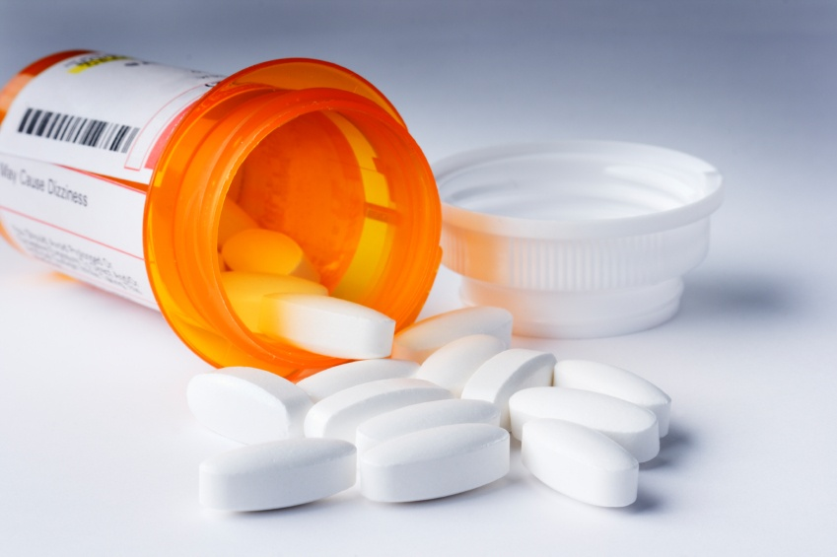
The use of somatostatin and its analogues have a good effect both on the process of the disease itself and on its outcome. These drugs reduce pancreatic secretion, eliminate the need for analgesic therapy, reduce the incidence of complications and lethality.
Somatostatin infusion improves the index of glomerular filtration and increases renal blood flow, which is important for the prevention of kidney complications in destructive forms of acute pancreatitis.

