Slide 1
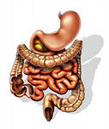

Principles of
clinico-pharmaceutical
approach to the selection of medicines
for the treatment of diseases
of intestines

Slide 2
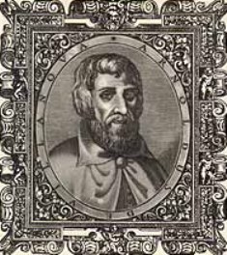
Semiotics of bowel diseases
Long urine do not hold, do not force
stools;
You will follow this, -
you will live long in the world.
If doctors are not enough, let
will be your doctors
Three: a cheerful character,
peace and moderation in food
Salerno health code "is written
in the fourteenth century philosopher
and the doctor Arnold of Villanova.
Salerno School is not just history
medicine; to a certain extent it
is modern and now.
The author is philosopher and doctor Arnold from Villanova

Slide 3
Semiotics of bowel diseases
Complaints with bowel disease:
pain, flatulence, constipation, diarrhea, intestinal bleeding
For intestinal pain characterized by the following:
are paroxysmal
start and end suddenly
localization - umbilical region
accompanied by flatulence
are facilitated after the gases escape
The nature of pain
spasmodic pains - convulsive
contraction of smooth muscles
Distression pains occur
from the expansion of the intestine with gases
Pain in the intestine occurs when:
intestinal obstruction
appendicular colic - initially localized around the navel and in the epigastric region, and then after a few hours they descend to the right iliac region, gradually increasing here
Tenesmus - a special type of intestinal colic
develop with irritation of the rectum
and adjacent bodies
observed - with dysentery, etc.

Slide 4

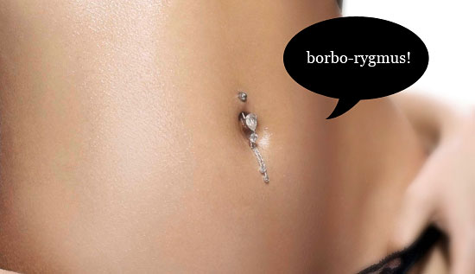
Semiotics of bowel diseases
Flatulence
In patients with bowel disease, bloating is often observed. The increase in the size of the abdomen is associated with the expansion of the intestinal loops with gases
Rumbling
Under the name rumbling is understood as noise in the abdomen, resulting from the collision of gases and fluids while passing through the bottleneck. Observed with abundant fermentation or abundant ingestion of air.

Slide 5

Semiotics of bowel diseases
Diarrhea - rapid (more than 2 times a day) allocation
liquid feces
accelerated content
intestinal tract due to increased peristalsis
with violation of water absorption in the large intestine and
the intestinal wall of a significant
the amount of inflammatory secretion or transudate
are a symptom of acute or chronic colitis, enteritis, etc.
Types of diarrhea
Infectious diarrhea - for dysentery, salmonellosis, food poisoning, viral diseases, amoebiasis, etc.
Alimentary diarrhea - with malnutrition or with allergies
Dyspeptic diarrhea - if there is a violation of digestion of food mass due to secretory deficiency of the stomach, pancreas of the liver or insufficient isolation of the small intestine enzymes.
Toxic diarrhea - with uremia, mercury poisoning, arsenic.
Medicamentous diarrhea - a consequence of suppression of the physiological flora of the intestine, the development of dysbiosis
Neurogenic diarrhea - in violation of nervous regulation of motor activity of the intestine (under the influence of excitement, fear)

Slide 6

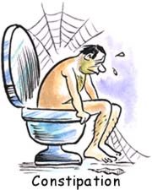
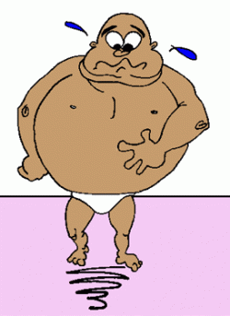
Semiotics of bowel diseases
Constipation (obstipatio)
This term is usually understood as the long-term stool retention in the intestine (more than 48 hours)
Constipation may be:
-organic
-functional
Organic can be caused by narrowing of the bowel
Functional may be due to:
-weakness of the abdominal
-when eating high-calorie food
-hypodynamia
-intoxication
-CNS damage

Slide 7

Methods of intestinal examination
Inspection (visual) of the oral cavity
Determine the presence of odor (putrefactive ammonia, apples,
alcohol, etc.). Determine the condition of the mucosa of
oral cavity, gums, palate, tonsils, tongue, teeth.
Inspection (visual) of the abdomen
determine the shape of the abdomen in a standing position,
determine the shape of the abdomen in the lying position on the back
(drawn, stuck out)
to determine the presence or absence of asymmetry in the abdomen
identify the involvement of the abdomen in the act of breathing
assess the condition of the skin
assess the condition of the navel and the presence of a venous vascular pattern.
Superficial palpation of the abdomen
determine the presence of a common or limited soreness of the abdominal wall
to reveal the tension of the abdominal wall, the presence of hernial protrusions
to reveal superficially located tumors and enlarged organs (liver, spleen)

Slide 8
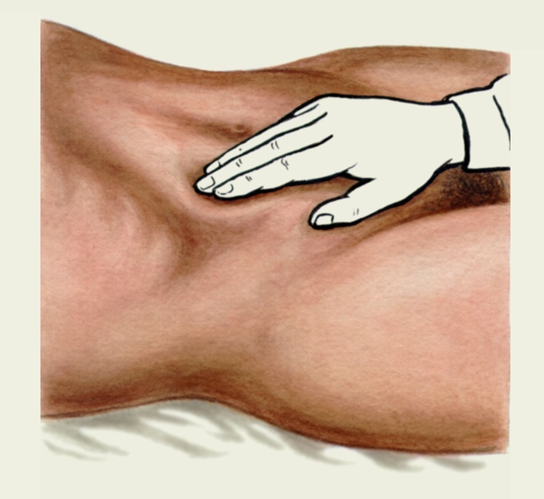
Methods of intestinal examination
Conditions when performing superficial palpation
Patient's situation:
the patient lies on his back in bed with a low headboard
arms stretched along the trunk
muscles relaxed
The position of the doctor: the doctor sits on a chair on the right side of the patient's bed
Course of the study: palpation begins with the left ileal region. The right hand is laid flat on the left ileal region and weakly pressed with fingers on the abdominal wall.
Then the hand is transferred to the symmetrical section of the opposite side and the pressure is applied with the same force. After that the doctor passes to the palpation of the suprapubic region.
The middle section of the abdomen is palpated with the left, then the right lateral area, finally in the umbilical region.
The upper abdomen is palpated from the left hypochondrium, then the right hypochondrium and the actual epigastric region.
Surface palpation ends with the definition of hernial protrusions along the white line of the abdomen, in the navel, the inguinal regions.

Slide 9
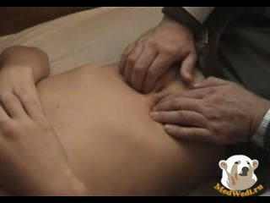
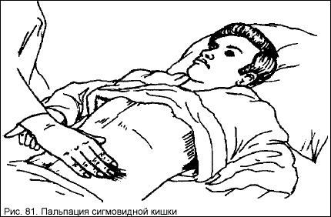
Methods of GIT research
Methodical, deep, sliding palpation of the abdomen according to the method of Obraztsov-Strazhesko
Rules of deep, palpation:
1. Slightly bent fingers of the right hand are installed parallel to the length of the palpable organ
3. Gradually immerse the fingers of the right hand during the exhalation of the patient deep into the abdominal cavity to the back wall
4. Sliding movements do not produce on the skin, but with it
Sequence of deep palpation:
sigmoid colon
cecum
transverse colon
ascending and descending parts of the colon
great curvature of the stomach and pylorus
liver, spleen

Slide 10
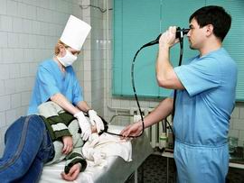
Instrumental methods
of GIT research
Endoscopic examination of the gastrointestinal tract.
Endoscopy is a direct examination of the internal surface of the cavity or tubular organs (esophagus, stomach, duodenum, large intestine) with the help of special instruments - endoscopes
Endoscopy is used for:
research of the esophagus (esophagoscopy)
stomach (gastroscopy)
12 duodenal ulcer (duodenoscopy)
direct and sigmoid intestines (sigmoidoscopy)
the entire colon (colonoscopy)
Investigation of the upper sections of the gastrointestinal tract - esophagus, stomach, duodenum (esophagogastroduodenoscopy, FGDS) - is usually carried out simultaneously

Slide 11
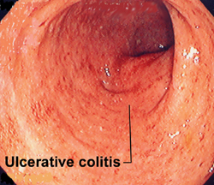

Instrumental methods
of intestinal examination
Colonoscopy -
endoscopic examination, during which visually,
that is under the control of vision, the condition of the entire colon is assessed
The study is performed by flexible endoscopes.
The illuminator is on a halogen or xenon lamp, that is, the so-called "cold" light is used, which eliminates the burn of the mucosa.
- It allows to reveal the bulk of diseases of the large intestine
- It allows performing biopsy of the intestinal wall and performing small operations (removal of polyps, villous tumors, etc.)
The method of dynamic observation after removal of polyps, small tumors and surgical interventions on the large intestine

Slide 12
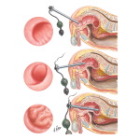

Instrumental methods
of intestinal examination
Rectoromanoscopy (rectoscopy) -
method of endoscopic examination of the rectum and the lower part of the sigmoid colon to a depth of 30-35 cm from the anus.
The use of special tools makes it possible to perform various endoscopic operations in benign or malignant tumors (polypectomy, stopping bleeding, conducting probes, recanalizing stenoses, etc.).
Indications for conducting:
- pain in the anus,
- the allocation of blood, mucus or pus,
- disorders of stool (constipation, diarrhea),
- suspicion of rectum and sigmoid disease
- prophylaxis of malignant neoplasms of the rectum, people after 40 years are recommended to perform a sigmoidoscopy once a year

Slide 13
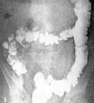
Instrumental methods
of GIT research
X-ray examination of
esophagus, stomach and intestines -
allows to specify:
- form of these organs
- their position
- tone
- peristalsis
- condition of mucosal relief.
This method plays an important role in the diagnosis:
- peptic ulcer disease
- tumors of the gastrointestinal tract
- anomalies in the development of cholelithiasis
- complications (stenosis of the stomach, penetration of the ulcer, varicose veins of the esophagus, dolichosigma, megacolon, etc.)
- also assess the nature of functional (motor-evacuation) disorders.

Slide 14
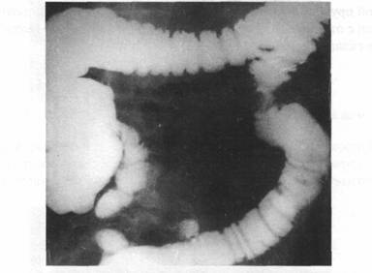
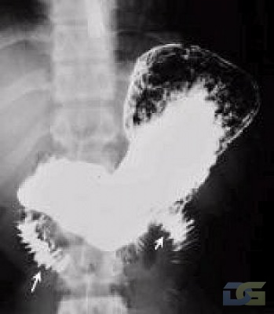
Instrumental methods
of GIT research
X-ray examination of the gastrointestinal tract is usually carried out using a contrast agent - an aqueous suspension of chemically pure barium sulphate.
Strongly absorbing X-rays, barium sulfate as it moves makes all parts of the digestive tube visible.
X-ray of the stomach and duodenum
with the use of both gas and contrast medium - is called research under conditions of double contrasting
Irrigoscopy - X-ray examination
the colon with filling it with radiopaque suspension through the anus after a preliminary cleansing of the intestine (barium enema)

Slide 15
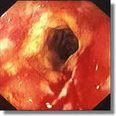
INFLAMMATORY DISEASES
of the intestines
Inflammatory bowel disease -
this is the common name of two diseases -
- nonspecific ulcerative colitis (NUC)
- Crohn's disease
The incidence of NUC is 25-50 people per 100 thousand of the population
The incidence of Crohn's disease is 5-15 people per 100 thousand of the population

Slide 16
INFLAMMATORY DISEASES
of the intestines
Nonspecific ulcerative colitis (NUC) - is a chronic relapsing disease in which all organs and systems can be affected, but the greatest changes occur in the colon.
It is established that the primary lesion is localized in the rectum and sigmoid colon with the subsequent spread of the process up the intestine
NUC - is a recurrent disease of unclear etiology, characterized by hemorrhagic-purulent inflammation of the large intestine with the development of local and systemic inflammation. The mucous and submucous membranes of the intestinal wall are affected, and the involvement of the muscular and serous membranes is also characteristic for acute forms of the disease.
The disease occurs in people of both sexes aged 20-50 years. It is registered ubiquitously, but more often in cities

Slide 17
DISEASES OF THE INTESTINE
Crohn's disease -
chronic nonspecific inflammation of any part of the gastrointestinal tract, characterized by granulomatous changes, ulceration, thickening of the wall and narrowing of the lumen of the affected area, the formation of infiltrates and fistula
In the vast majority of cases, the small intestine is affected, especially the terminal ileum (terminal ileitis), somewhat less often at the same time the small and large intestine; there is also an isolated lesion of the large intestine; very rarely the process is localized in the esophagus, stomach. Lesions of various parts of the gastrointestinal tract in Cron’s disease are also called granulomatous enteritis, granulomatous colitis, granulomatous esophagitis, granulomatous gastritis

Slide 18
SYMPTOMS OF INFLAMMATORY
DiSEASES OF THE INTESTINES
Nonspecific ulcerative colitis and Crohn's disease have many common symptoms that can develop gradually or suddenly:
Chronic diarrhea
Inflammation affects the cells of the intestine, which causes the secretion of large amounts of salt and water. Since normal intestinal absorption is impaired, the large intestine can not absorb the releasing fluid - diarrhea develops
Abdominal pain and spasms.
The walls of the intestine become inflamed, over time, as a result of the formation of scars thicken, which blocks the movement of intestinal contents in the digestive tract and can be accompanied by pain, spasms and vomiting.

Slide 19
SYMPTOMS OF INFLAMMATORY
DiSEASES OF THE INTESTINES
Blood in the stool.
A food moving along the digestive tract can cause the inflamed cells to begin to bleed.
Decreased appetite.
Sometimes abdominal pain, spasms and an inflammatory reaction in the walls of the intestines can be the cause of loss of appetite.
Decreased body weight.
Due to the inflammation of the intestinal cells, not all useful substances taken with food can be absorbed, which causes a reduction in body weight.
Increased body temperature.
This symptom is characteristic for some cases of inflammatory bowel disease.

Slide 20
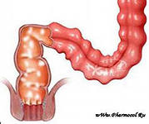
SYMPTOMS OF INFLAMMATORY
DiSEASES OF THE INTESTINES
NUC and Crohn's disease also have a number of key differences:
NUK affects the mucosa of the colon and rectum;
Crohn's disease - the wall of the intestine at full thickness in any part of the digestive tract, but most often the ileum or large intestine.

Slide 21
ETIOLOGY AND PATHOGENESIS OF INFLAMMATORY
DISEASES OF THE INTESTINES
The etiology is unknown
It is assumed a hereditary predisposition in which viruses, bacteria, eating habits and immune responses trigger an inflammatory process.
As in the case of Crohn's disease, there is a family predisposition.
As a risk factor: oral contraceptives, nutrition and psychosocial problems
The autoimmune nature of the disease is confirmed by:
- frequent combination of NUC and Crohn's disease with autoimmune diseases, such as autoimmune thyroiditis, diabetes mellitus, autoimmune gastritis
- detection in the mucosa of the colon of IgG antibodies to epithelial cells

Slide 22
TREATMENT OF INFLAMMATORY
DISEASES OF THE INTESTINES
The purpose of treating of inflammatory bowel diseases is to eliminate inflammation, which is the cause of symptoms
Apply several groups of drugs that control inflammation by various mechanisms
Anti-inflammatory drugs (sulfasalasin, mesalazine, mesalamine, balsalazide, corticosteroids).
Suppressors of the immune system (azathioprine, mercaptopurine, infliximab, methotrexate, cyclosporine).
Antibacterial drugs (metronidazole, ciprofloxacin).
Other drugs (antidiarrheal, laxatives, painkillers, iron and vitamin B12).

Slide 23
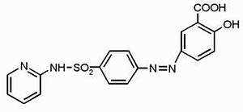
TREATMENT OF INFLAMMATORY
DISEASES OF THE INTESTINES
Sulfasalazine is a drug
with antimicrobial and
anti-inflammatory properties.
By chemical structure -
combination of sulfapyridine
and 5-aminosalicylic acid.
The molecule of the active substance decomposes into the constituent components: sulfapyridine and 5-aminosalicylic acid.
Anti-inflammatory action of
5-aminosalicylic acid due to its low capacity for absorption is mainly determined in the walls of the large intestine.
Metabolism of sulfapyridine occurs in the liver, the rate of metabolic transformations largely depends on the rate of acetylation.
Способ применения:
Сульфасалазин принимают перед приемом пищи – 3-4 раза в сутки по 1 гр

Slide 24
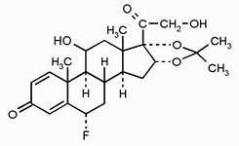
TREATMENT OF INFLAMMATORY
DISEASES OF THE INTESTINES
Corticosteroids
an alternative to the development of side effects against systemic corticosteroids are topical (local) corticosteroids, which include budesonide
Budesonide
is a corticosteroid, which has an anti-inflammatory effect by suction and passage through the mucosa of the gastrointestinal tract and rapidly degrades in the liver, which reduces the severity and number of side effects

Slide 25
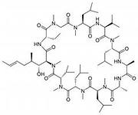
TREATMENT OF INFLAMMATORY
DISEASES OF THE INTESTINES
Cyclosporine is a unique drug that makes it possible to achieve remission in the most severe patients, whose therapy with high doses of systemic corticosteroids does not give the desired result. However, long-term use of this drug is impossible due to a significant number of side effects
Pharmacological action - immunosuppressive.
It inhibits the development of cellular-type immune responses, delayed-type hypersensitivity, the production of antibodies dependent on T-helpers. Has the ability to block the activation of lymphocytes in G0 or G1 phases of the cell cycle, the synthesis and release of cytokines, the growth of T-lymphocytes (interleukin-2). It has a selective effect and does not have a depressing effect on the hematopoiesis and phagocytic link of immunity.

Slide 26
TREATMENT OF INFLAMMATORY
DISEASES OF THE INTESTINES
Cyclosporine - 1 caps. for 25, 50 or 100 mg
Side effects:
CNS: headache, paresthesia, seizures, tremor, myopathy, encephalopathy, visual impairment, consciousness, movement coordination disorder.
Gastrointestinal tract: intestinal hyperplasia, loss of appetite, nausea, vomiting, diarrhea, abdominal pain, pancreatitis; liver dysfunction.
Urinary tract: renal dysfunction, interstitial fibrosis.
Other: increased blood pressure, anemia, leuko-, thrombopenia, gynecomastia, dysmenorrhea, hirsutism, acne, gingival hypertrophy, edema, increased body weight; hyperkalemia, hypomagnesemia, increased uric acid, lipid levels in the blood development of infectious, malignant and lymphoproliferative diseases.

Slide 27
TREATMENT OF INFLAMMATORY
DISEASES OF THE INTESTINES
Azathioprine and 6-mercaptopurine
Azathioprine after cleavage of the imidazole ring is rapidly converted to 6-mercaptopurine.
Then, 6-mercaptopurine can be involved in three metabolic pathways.
Azathioprine (imurane)
is a synthetic imidazole derivative of 6-mercaptopurine. The introduction of the imidazole ring into the mercaptopurine structure led to an increase in the specificity of the immunosuppressive effect of the drug. Azathioprine has a large immunosuppressive effect and a smaller cytotoxic effect.

Slide 28
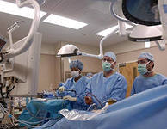
TREATMENT OF INFLAMMATORY
DISEASES OF THE INTESTINES
Azathioprine and 6-mercaptopurine
Azathioprine - is an antimetabolite for which the target is actively dividing cells
Side effects:
- leukopenia
- thrombocytopenia
- anemia
- nausea
- vomiting
- diarrhea
- loss of appetite
- toxic hepatitis
- alopecia
- immunosuppression
- nephrotoxicity

Slide 29
TREATMENT OF INFLAMMATORY
DISEASES OF THE INTESTINES
Infliximab is a blocker of tumor necrosis factor-a
However, following publications on the successful and effective use of this drug, a whole series of articles appeared on side effects and cases of resistance
Side effects:
- leukopenia, thrombocytopenia, anemia
- fever, flu-like reaction
- toxic hepatitis, loss of appetite, nausea
- cardiopulmonary reactions, including a feeling of pressure in the chest, changes in blood pressure
- reactivation of tuberculosis and sepsis
- immunosuppression
- allergic reactions

Slide 30
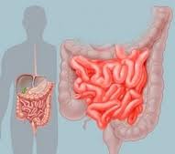
INTESTINAL INFECTIONS
Acute enteritis -
infectious diseases, most often developing as a result of food poisoning ("dirty hand" disease) and taking place in the form of gastroenteritis with common intoxication, fever and severe diarrhea.
As the causative agents of such gastroenteritis, microbial agents appear in most cases: salmonella, microparathyphoid group, vibrio cholera, etc.
Chronic enteritis -
are a composite group of diseases with a far ambiguous pathogenesis, many of which remain unclear at the present time. Is manifested in the form of dystrophy, inflammation or atrophy of the mucosa.

Slide 31
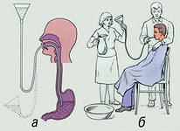
TREATMENT OF INTESTINAL INFECTIONS
Diet
Diet 4
Then -
diet 2
Washing
stomach
Required!
pathogenic
microorganisms
for a long time
persist
in folds
mucous
shells

Slide 32
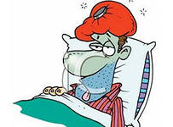
TREATMENT OF INTESTINAL INFECTIONS
Detoxification
and rehydration therapy:
- oral
- intravenous
For intravenous rehydration
use:
"Trisol", "Quartasol", "Khlosol"
The volume of injected fluid depends on the degree of dehydration and the body weight of the patient:
when the disease is severe, 60-120 ml / kg
at the average - 55-75 ml / kg
There are two stages of intravenous rehydration:
1) primary rehydration with the aim of arresting signs of dehydration and intoxication
2) maintenance therapy to stop the continued loss of fluid

Slide 33
TREATMENT OF INTESTINAL INFECTIONS
Detoxification and rehydration therapy
Oral rehydration therapy (ORT) is also carried out in two stages.
To this end, solutions of oral rehydration salts (ORS) of two generations are used:
I generation (glucosalan, citroglucosalan, regidron)
II generation (on a cereal basis)
The volume of injected solutions depends on:
degree of dehydration
body weight of the patient
The rate of administration is 1-1.5 l / h
In cases of prevalence of intoxication syndrome over dehydration, the use of colloidal solutions is shown:
haemodez, reopoliglyukin and others.

Slide 34
TREATMENT OF INTESTINAL INFECTIONS
Treatment of diarrheal syndrome
I. Antidiarrheal drugs SORBENTS
Carboline (activated carbon) in tablets of 0.25 g and 0.5 g. Carbolen take 2-3 tablets 3-4 times a day.
Activated charcoal in powder is taken 1-2 g (in water) 3-4 times a day.
"KM" (composition: activated carbon - 0.2 g, white clay - 0.0455 g, sodium salt of carboxymethyl cellulose - 0.0045 g).
This drug has a higher adsorption capacity. It is taken orally for 4-6 tablets 2-4 times a day, washed down with water
"SKN" - a large sorption capacity - 10 g (the contents of one package) 3 times a day.
Carbolong - powder from activated stone drenches - 5-10 g per reception 3 times a day

Slide 35
TREATMENT OF INTESTINAL INFECTIONS
Treatment of diarrheal syndrome
Polyphepan - is obtained by processing lignin - a product of hydrolysis of carbohydrate components of wood.
Produced in the form of granules (contains 40% polyphepan) or paste (50% polyphepan).
Assign inside 1 tablespoon 3-4 times a day; Before use, the drug is thoroughly stirred for 2 minutes in a glass of water.
Diosmectite - in the form of a powder in packages of 3 grams
the most effective sorbent,
has a significant enveloping ability
Protects the epithelium of intestinal villi from destruction
Dissolve the contents of the package in 100 ml of water 3-4 packs (9-12 g) per day

Slide 36
TREATMENT OF INTESTINAL INFECTIONS
Treatment of diarrheal syndrome
Antidiarrheal drugs with opioid effect
loperamide and trimebutane -
The action of loperamide is rapid and lasts 4-6 hours.
He is appointed adult with acute diarrhea, first 2 capsules, and then 1 capsule after each act of bowel movement, but not more than 6 capsules per day.
It is not recommended to use the drug together with atropine-containing agents
Atropine-containing antidiarrheal drugs:
lispaspen
reamer
trimebutin maleate
reduce the tone of smooth muscles and motor activity of the stomach and intestines

Slide 37
TREATMENT OF INTESTINAL INFECTIONS
Treatment of diarrheal syndrome
Antidiarrheal drugs with enveloping and astringent properties
Powder of the Cashier
Desmole
Antidiarrheal powder (composition: Bismuti subnitrici 0.5, Dermatoli 0.3, Calcii carbonici I 0, Ac. Ascorbinici 0.3, Ac. Nicotinici 0.01) - 1 powder 3-4 times a day
bismuth nitrate - 2 g 3 times a day
bismuth subsalicylate - 2 tablets 3-4 p / d
Octreotide - a new hormonal agent for the treatment of diarrhea, which has a pathogenetic effect on the absorption and secretion in the intestine
increases the rate of absorption of water and electrolytes in the small intestine,
reduces the concentration of vasoactive peptides in the blood,
reduces the frequency of acts of defecation and stool mass
Subcutaneously - 0.05, 0.1 and 0.5 mg. 1-2 times a day

Slide 38
TREATMENT OF INTESTINAL INFECTIONS
Etiotropic treatment
Antibiotics and other antiseptics:
b-lactam antibiotics:
penicillins natural, semi-synthetic penicillins, inhibitors of b-lactamases
cephalosporins of I-IV generations
carbapenems, monobactams
2) antibiotics of other classes:
aminoglycosides,
tetracyclines, macrolides,
rifampicins, lincosamines, chloramphenicol, polymyxins, glycopeptides;
3) synthetic antibacterial agents:
sulfonamides, quinolones, fluoroquinolones,
nitrofurans, quinoxaline derivatives,
derivatives of 8-hydroxyquinoline.

Slide 39
TREATMENT OF INTESTINAL INFECTIONS
Etiotropic treatment
Intestinal antiseptics
Intetrix is a preparation with antibacterial, antiprotozoal and antifungal action, a derivative of 8-hydroxyquinoline
Nifuroxazid, furazolidon - act primarily in the lumen of the intestine are active against campylobacteria, escherichia (enterotoxigenic, enteropathogenic and enteroinvasive), salmonella, shigella, cholera vibrio and yersinia (J. enterocolitica)
Dependal-M is a combined chemotherapeutic agent used to treat intestinal infections of bacterial, protozoal and mixed nature. It is based on well-known components - furazolidone and metronidazole

Slide 40
TREATMENT OF INTESTINAL INFECTIONS
Etiotropic treatment
Intestinal antiseptics
Enterosediv - has antimicrobial and antiparasitic action.
It consists of highly active and nonabsorbable antibiotics in the gastrointestinal tract dihydrostreptomycin and bacitracin, sulfanilamide sulgin, oxyquinoline preparation diiodohin. In addition, the preparation contains adsorbents (pectin and kaolin, which bind many toxins), vitamin K and pantothenic acid (which have a protective effect on the mucous membrane). Is issued in tablets, in packing 20,100 and 500 pieces. In bacterial diarrhea, adults take a dose of 1 tab. 3 times / day on average for 7 days (no more than 4 weeks). At an amebiasis it is accepted in a dose 2 tab. 3 times / day for 7-10 days with two courses with a weekly interval

Slide 41
Dysbacteriosis
Dysbacteriosis - a change in the composition and properties of the intestinal microflora
- leading syndrome in pathological conditions of the small and large intestine;
- characterized by an increase in the number of microbial bodies in the small intestine with the prevalence of Escherichia, Klebsiella, enterococci, lactobacilli;
- in the large intestine, in feces decreases the number or complete disappear of lactoflora, bifidobacteria; the number of Escherichia, strepto- and staphylococcus, yeast fungi, Klebsiella, Protea increases relatively.

Slide 42
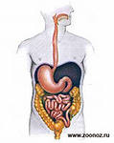
Dysbacteriosis
  Classification of dysbiosis
  1. Dysbacteriosis can be primary, when the microflora first changes, and then the inflammatory process in the mucosa.
  2. Secondary dysbacteriosis can occur in all diseases of the digestive tract.
  Often found drug, iatrogenic dysbiosis

Slide 43
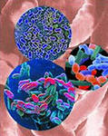
Dysbacteriosis
  Classification of dysbiosis
  I degree - the latent phase is manifested only in a decrease by 1-2 orders of the amount of protective lactic acid flora - bifidobacteria, lactobacilli, and full-bodied E. coli up to 80% of the total.
  In this phase, it is possible to vegetate in the intestine of some representatives of conditionally pathogenic flora in the amount of 103.
  The initial phase does not cause intestinal dysfunction.

Slide 44
Dysbacteriosis
  Classification of dysbiosis
  II degree - starting phase
  Characterized by a marked deficit of bifidobacteria against a background of a normal or reduced number of lactobacilli
  or their reduced acid-forming activity,
  imbalance in the number and quality of E. coli.
  At the same time, the number of full-fledged Escherichia decreases.
  Against the backdrop of a deficit of protective components of the intestinal microbiocenosis, the multiplication of either the proteas up to 105 and higher than CFU / g or the fungi of the genus Candida occurs.
  Functional digestive disorders are expressed indistinctly.

Slide 45
Dysbacteriosis
  Classification of dysbiosis
  At the third degree of severity (phase of aggression) dysbiosis
  there is a significant suppression of the anaerobic microbial component, primarily bifidobacteria (105.6) and lactobacilli.
  This is accompanied by excessive multiplication of different kinds of conditionally pathogenic microorganisms and pathogenic gas-forming microflora,
  a decrease in the number of full-fledged Escherichia,
  proliferation of proteases, Staphylococcus aureus.
  Such advanced forms of dysbiosis characterize the clinical symptoms of intestinal dyspepsia: decreased appetite, constipation, diarrhea, flatulence, and pain.

Slide 46
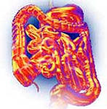
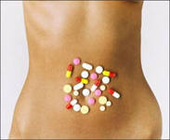
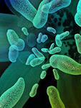
Dysbacteriosis
  Classification of dysbiosis
  IV degree of dysbiosis (phase associated dysbiosis) - with the absence of bifidobacteria.
  It occurs with prolonged intake of antibiotics against the background of cytostatics or hormonal therapy, x-ray irradiation of the abdominal cavity organs, small pelvis with cancer, or chemotherapeutic treatment of patients with this profile.
  This phase is accompanied by functional disorders of the digestive system and nutritional status disorders.

Slide 47
Functions of intestinal microflora
  Protective, due to the antagonistic activity of normal microflora to pathogenic or opportunistic;
  Enzymatic, providing cleavage of plant fiber, starch, residues of food proteins and fats with the formation of absorbable substances, organic acids, and also relaxing the irritating effect of intestinal contents on the mucous membrane;
  Synthetic - 70% of the body's need for vitamins is provided by their formation by a normal microflora (vitamins B, K, nicotinic and ascorbic acid); with the participation of eubiotic microflora, amino acids, cholesterol and other compounds are synthesized;
  Immune - under the influence of normal microflora, components of the immunocompetent system providing immunoglobulin synthesis, phagocytosis and other mechanisms of immune defense are formed and preserved.

Slide 48
Composition of microflora
of various parts of the gastrointestinal tract
  The microbe spectrum of the stomach is represented by acid-resistant gram-positive aerobic and facultative anaerobic bacteria and genera of Lactobacillus, Streptococcus, Staphylococcus, Micrococcus, Helicobacter pylori and acid resistant yeast-like fungi.
  In the duodenum, jejunum and proximal part of the ileum, streptococci and lactobacilli predominate; characteristic is the complete absence of obligate anaerobic bacteria and numerous representatives of the Enterobacteriaceac family.

Slide 49
Composition of microflora
of various parts of the gastrointestinal tract
  In the distal ileum, the total number of bacteria increases; the number of aerobic and anaerobic bacteria is approximately equal (enterococci, Escherichia coli, bacteroides, veylonelli, bifidobacteria).
  A biotope with a high degree of microbial contamination (more than 400 species) is the large intestine. Basically, it is obligate anaerobic bacillus (bifidobacteria and bacteroides) - 90%; aerobic and facultative anaerobic bacteria (Escherichia coli, lactobacilli, enterobacteria, streptococci, spore-bearing anaerobes) are 10%.

Slide 50
Correction of microbiocenosis
of intestines
  To correct the violation of the microbiocenosis of the intestine, representatives of normal human microflora
  Classification:
  Probiotics - drugs consisting of living microorganisms;
  Prebiotics are components that promote reproduction, selective increase in the population of own beneficial microbes;
  Symbiotics - a combination of several types of microorganisms;
  Synbiotics - preparations including pre- and probiotics.

Slide 51
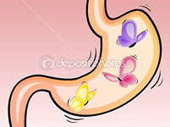
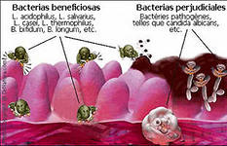
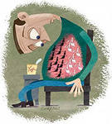
Correction of microbiocenosis
of intestines
  The phenomenon of probiosis:
  - is defined as "the association of two organisms that stimulate the life processes of each of them"
  - discovered by I. Mechnikov in the beginning of XX century from the reception of sour milk with live lactobacilli
  PROBIOTICS - living microorganisms, which, when administered in sufficient quantities, have a positive effect on health

Slide 52
Criteria for inclusion in the group
probiotics - microorganisms
  Must:
  - survive passaging through the gastrointestinal tract, which suggests their resistance to acid and bile;
  - adhere to epithelial cells of the intestine followed by colonization;
  - stabilize the intestinal microflora;
  - preserve vitality both in food products and in the process of obtaining pharmacopoeial lyophilized preparations;
  - multiply rapidly, colonizing the intestine;
  - persist with the manifestation of the generic properties of probiotics.
  Should not:
  - to show signs of pathogenicity

Slide 53
Types of probiotic
microorganisms
  Domestic probiotics
  В. bifidum
  В. longum
  В. adolescentis
  В. infantis
  В. breve
  L. acidophilus
  L. delbrueckii subsp. bulgaricus
  L. fermentum
  L. planfarum
  L. lactis
  L. cremioris
  В. subtilis
  Foreigh probiotics
  В. animalis (lactis)
  В. longum
  В. bifidum
  В. infantis
  L. casei
  L. rhamnosus
  L. lactis
  L. brevis
  L. salivarius
  L. gasseri
  В. cereus

Slide 54
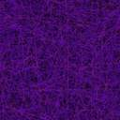
Most bacteria that have probiotic properties are representatives of the families of Lactobacillus and Bifidobacterium, and sporobiogenic bacteria from the genus Bacillus have increasingly become such a quality.
To date, the world has created more than 50 drugs that are fully or partially composed of spore-forming bacteria (baktisubtil, flonivin, biosporin, bactisporin, vitosporin, etc.).

Slide 55
Bacillus clausii
-Non-pathogenic bacteria that make up the normal transit intestinal microflora;
-Habitat - soil, water, air;
-Independently eliminated from the gastrointestinal tract;
-The genome of the Bacillus clausii strain has been fully studied;
-They form multiresistant spores capable of surviving during transit through the acidic environment of the stomach;
-Disputes, after exposure in the acidic environment of the stomach, enter the intestine and are transformed into a vegetative form;
-Vegetative forms can exist and develop at pH> 4.5, grow in the presence of bile and conditions of insufficient oxygen, while retaining all of their probiotic properties;
-Bactericidal activity against most gram + pathogenic bacteria (Staphylococcus aureus, Clostridium difficile, Enterococcus feacium, etc.) and rotaviruses;
-They have a wide range of antibiotic resistance (cephalosporins, macrolides, penicillins, tetracyclines, aminoglycosides, chloramphenicol, lincosamides, isoniazid, rifampicin).

Slide 56

Mechanisms of treatment-and-prophylactic
effects of spore-forming probiotics
Stages of translocations of bacilli | The actions of bacilli and their metabolites |  | Effects for macroorganism
 | Adaptive | Antagonistic
Passage of the stomach and intestines with partial fixation on their mucous membranes | Activation and germination of a part of the spore with the survival of vegetative forms in the intestine. Participation in digestion due to the production of proteases, amylases, lipases, cellulases, as well as the synthesis of amino acids and vitamins. | Inhibition of pathogenic microorganisms due to dipicolinic acid spores, production by vegetative catalase, lysozyme, antibiotic, bacteriocins and other metabolites. | Improve digestion, prevent accumulation of metabolic products of pathogenic microbes.
Permanent translocation into the blood, lymph and internal organs |  |  | Protection and strengthening of microbiocenosis, induction of interferon synthesis, immunoglobulins, stimulation of immunocompetent cells.
Excretion from the body |  |  | Cleavage of allergens, purification of inflammatory foci, removal of toxins, heavy metals.

Slide 57
Indications for use
of probiotics
  Acute and protracted intestinal infections;
  Inflammatory bowel disease
  Antibiotic-induced diarrhea;
  Gastroenterological diseases (gastritis, ulcer
  disease, irritable bowel syndrome);
  5. Fermentopathy (disaccharidase insufficiency)
  6. Syndrome of chronic constipation;
  7. Allergic diseases, including food, respiratory and dermato-intestinal polyvalent allergy, bronchial asthma;
  8. Chronic diseases of the nasopharynx and oropharynx;
  9. Dysmetabolic nephropathies (hyperoxaluria);
  10. Hematopoietic diseases (leukemia);
  11. Stress;
  12. Hypertonic disease;
  13. Urogenital diseases (vaginosis, colpitis, urethritis, endocervicitis);
  14. Helminthiases.

Slide 58
Classification of probiotics
  Monoprobiotics
  1. Bifid-containing (B. Bifidum):
  Bifidumbacterin
  Bifidumbacterin forte
  Probiere
  Bifidogen
  Eugalan
  2. Lactose-containing:
  Lactobacterin (L. Plantarum or L. fermentum)
  Biobactone (L. Acidophilus)
  Gastroparm (L. bulgaricum)
  3. Coli containing:
  Colibacterin (E. coli M-17)
  II. Polyprobiotics
  Bifid-containing:
  Bifilong V. bifidum, V. longum
  Lactose-containing:
  Acylactate (3 strains of L. Acidophilus)
  Bifido and lactose-containing:
  Bifacid (B. bifidum, L. Acidophilus)
  Bifido- and coli-containing:
  Bifikol (V. bifidum, E. Coli M 17)
  Lineks (Lactobacillus, Streptococcus faecium, B.infantis)
  Omniflora

Slide 59
Classification of probiotics
  III. Probiotics are self-eliminating antagonists:
  - bacillary
  - Saccharomyces containing
  Sporobacterin
  Bactisporin
  Biosporin
  Bactisubtil
  Flonivin In
  Enterol
  IV. Combined probiotics (synbiotics)
  Bifidobesoderzhaschie: Bifiliz, Bifiform
  Lactose-containing: Acipot in tab.
  Yogulact (Lactobacillus acidophilus, Lactobacillus rhamnosus, Streptococcus thermophilus, Lactobacillus delbrueckii, ssp. Bulgaricus)
  Coli-containing:
  Bioflora

Slide 60
Correction of dysbiosis
Bioenteroseptics - drugs, whose action is based on the antagonism of non-pathogenic and pathogenic bacteria.
ENEROZHERMINA - probiotic-bio-enteroserptic
Bacillus clausii, which are part of this drug:
1. possess:
the natural ability to suppress the growth of microorganisms alien to the human intestine
2. exhibit:
antibacterial activity against most pathogenic microorganisms,
3. provide optimal conditions for the existence of the main intestinal microflora;
4. facilitate the splitting and absorption of food components;
5. have a positive effect on local and systemic immunity.

Slide 61
Correction of dysbiosis
ENTEROZHERMINA - MODERN PROBIOTIC-BIOENEROSEPTIC
(CONTAINS 2 BILLION DISPOSAL OF POLYRE-RESISTANT STAMP BACILLUS CLAUSII IN EACH VARIETY)
The antibiotic resistance of Bacillus clausii allows the use of Enteroburnum
for prevention of changes in intestinal microflora during antibiotic therapy (especially a broad spectrum of action)
In the digestive tract Bacilius ciausii live no more than 30 days, after which they are eliminated naturally, therefore they are called self-eliminating antagonists

Slide 62
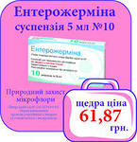
Correction of dysbiosis
ENTEROZHERMINA therapy is highly physiological, since it has a regulating effect on the symbiontic relations of the host and its microflora and practically minimizes the possibility of side effects from the treatment.
Contraindications regarding the use of the drug during pregnancy and lactation are not!
ENTEROZHERMINA - Suspension for oral administration
Dosage and Administration:
Children - 1 bottle 1-2 times a day
Adults - 1 bottle 2-3 times a day

Slide 63
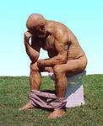
Constipation
Blessed is he who is early in the morning
Has a feces without coercion,
That and food on the inside,
And all the pleasures are available ...
Definition of constipation - as an increase in the intervals between bowel movements by more than 48 hours,
and at the same time straining takes more than 25% of the time of defecation.
With chronic constipation, this condition is noted for more than three months.
With constipation often occurs:
irregular bowel movement,
too hard consistency of stool,
feeling of incomplete emptying or
a small amount of feces (less than 35 g, in the norm of 100-150 g)

Slide 64

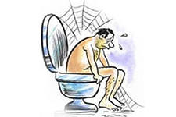
Constipation
Constipation - an urgent problem of modern medicine and pharmacy
Constipation is diagnosed:
in 12% of the adult population of the Earth,
in 50% of the UK population,
30% of Germany's population,
in 20% of the population of France.
in 10% only among school-age children
And this is only the tip of the iceberg, given that people who suffer from constipation often do not consult a doctor, but engage in self-medication.
According to foreign authors,
about 75% of the elderly
engaged in self-healing constipation.
Given the above,
It is not difficult to understand that the true
the prevalence of constipation,
obviously, much higher,
than it follows from epidemiological
research.

Slide 65
The main causes of constipation
Endocrine and metabolic diseases: diabetes mellitus, hypothyroidism, hypercalcemia, obesity, porphyria.
Neurogenic factors: vegetative vascular dystonia.
Neurological diseases (peripheral level of neuropathology): Parkinson's disease, multiple sclerosis, sacroiliitis, Hirschsprung's disease.
Diseases of the rectoanal zone: strictures (benign and malignant), proctitis.
Iatrogenic diseases: adhesions after surgical operations, radiotherapy, taking medications: atropine, sympathomimetics, diphenine, calcium bicarbonate, tranquilizers, antidepressants, almagel, iron preparations, NSAIDs, psychotropic drugs, some diuretics, anti-Parkinsonian.
Insufficient physical activity.
Nutritional factors: low content of plant fiber.

Slide 66
Complications of constipation
Chronic constipation can cause various complications:
- secondary colitis
- proctosigmoiditis (inflammation of the sigmoid and rectum)
- enteritis (reflux enteritis)
- bile duct disease
- hepatitis
- rectum disease
- hemorrhoids
- rectal fissures
- inflammation of the rectum (paraproctitis)
Long constipation sometimes causes enlargement and lengthening of the large intestine (acquired megacolon), which makes them even more stubborn.
The most formidable complication of prolonged constipation is cancer of the rectum and large intestine.

Slide 67
Classification of laxatives
І. Drugs that inhibit fluid absorption and stimulate secretion (irritation of the intestinal wall).
1. Antraglykosides (Senna, buckthorn, rhubarb)
2. Derivatives of diphenylmethane (isafenin, bisacodyl)
3. Castor oil
4. Surfactants (sodium and calcium dioctyl succinate)
ІІ. Drugs that increase the amount of intestinal contents
1. Saline laxatives (Glauber's salt, Karlovy Vary salt, etc.)
2. Macrogels (macrogol)
3. Vegetative laxatives (sea kale, bran, agar-agar, flaxseed, psyllium husk)
4. Sugars and their derivatives (sorbitol, lactiol)
5. Lactulose (dufalac)

Slide 68
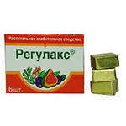
Classification of laxatives
III. Drugs that lubricate the intestinal mucosa: vaseline, almond oil, etc.
ІV. Combined drugs
1. Guttalax (sodium picosulphate + sorbitol)
2. Regulax
3. Laxative Teas
V. Other drugs
1. Rectal (glycerin suppositories, docusate sodium, etc.)
2. Probiotics, prebiotics
3. Prokinetics: cholinergic agonists (betanecol), prostaglandin agonists (misoprostol), 5-HT4 agonists (tegaserod)

Slide 69
Classification by mechanism of action
Group name | Mechanism of action | Efficiency | Drugs
1-st group - chemical laxatives (surfactants) | Chemical irritation of the receptor apparatus of the colon and, thus, stimulate its peristalsis. | Act in a colon, cause a single defecation after 6-10 h | Derivatives of anthraquinones (preparations of senna, buckthorn, rhubarb), diphenylmethane (bisacodyl *), castor oil.
2-nd group - osmotic | Do not suck, hold a large amount of water in the lumen of the intestine, increasing the volume of its contents. | Act in both the thin and large intestine and cause watery diarrhea after 3-6 hours after ingestion. | Sodium and magnesium sulfate, citrate, magnesium hydroxide, Carlsbad salt, nonadsorbed polysaccharide lactulose ** (dufalac)
3-rd group -volumetric or excipients | Increase the volume of intestinal contents. | The onset of a laxative effect of 8-10 h. | Bran, agar-agar, methyl cellulose, sea cabbage, etc.
4-th group - laxative oils - detergents | They soften hard feces and facilitate their sliding. | Act in a small intestine, so the laxative effect - after 4-5 hours. | Vaseline, almond, fennel oil, liquid paraffin.

Slide 70
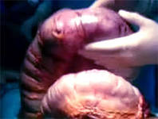
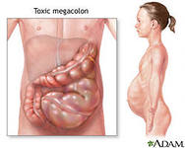
Classification of laxatives
To regulators of motor activity carry:
Spasmolytics - new drugs: pinaverium bromide (dicetel) and otilonium bromide (smazmomen).
Prokinetics - 5-HT4-agonists of serotonin receptors: tegaserod and cisapride.
Serotonin, released by enterochromachine cells of the intestine, stimulates vagal and enteral afferent nerve fibers, increases the release of acetylcholine, increases the contraction of smooth muscles and, thus, normalizes the passage.

