Slide 1

Clinical and pharmaceutical
aspects
use of medicines
in infectious
diseases

Slide 2
Infectious process
this is a typical pathological process that underlies the development of infectious diseases.
Represents a set of reactions (biochemical, cellular, immunological, functional) in response to the damaging effect of pathogens.

Slide 3
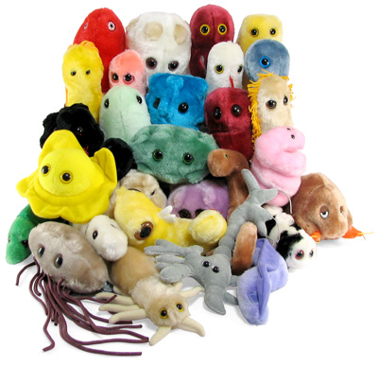
Microorganisms
Bacteria
Protozoa
Viruses
Rickettsia
Spirochetes
Lower mushrooms

Slide 4
What determines the pathogenicity of microorganisms
Mechanisms of spread and penetration
The ability to inhibit the immunity of a macroorganism
Toxins (endotoxins - are released during life, exotoxins - are released when the microorganism is killed)

Slide 5

Factors determining the nature of the infectious process
Type and properties of the pathogen
The number of microbes that have entered the body
Reactivity of the macroorganism

Slide 6
Types of relationships between the pathogen and the macroorganism (host)
- Commensalism - a condition in which the preservation of the microbe in the host does not result in damage to the host, but activation of systems of specific and non-specific resistance is noted;
- Symbiosis (mutualism) - a condition in which both the microbe and the host receive adaptive advantages;
- Infectious disease - clinical manifestations of damage to the macroorganism resulting from host-parasite interactions;
- Persistence - a condition in which the host resistance factors do not ensure the elimination of the microorganism, accompanied by a prolonged but insignificant damage, depending on the balance of interaction the host-parasite can evolve into an infectious disease;
- Colonization - a state that develops after the master acquires a new microorganism, is characterized by the dynamic and unstable relationship between the host and the parasite, evolving into other forms of relationships.

Slide 7
Conditions of infection
are determined:
- entrance gate of infection;
- ways of its spread in the body;
- mechanisms of anti-infective resistance

Slide 8
Entrance gates
The entrance gate of the infection is the place where microbes penetrate into the macroorganism. Such gates can be:
• skin integuments (for example, for malignant pathogens, typhus, skin leishmaniasis),
• mucous membranes of the respiratory tract (for pathogens of influenza, measles, scarlet fever, etc.)
• mucous membranes of the gastrointestinal tract (for example, for pathogens of dysentery, typhoid fever),
• the mucous membrane of the urino-genital organs (for the causative agents of gonorrhea, syphilis, etc.)
• the walls of the blood and / or lymph vessels through which the agent enters the blood or lymph (for example, with the bites of arthropods and animals, injections and surgical interventions).

Slide 9
Ways of the spread of bacteria
The following ways of spreading bacteria in the body are known:
• on the intercellular space (due to bacterial hyaluronidase or epithelial defects),
• on the lymphatic capillaries - lymphogenically,
• on blood vessels - hematogenous,
• on the liquid of serous cavities and spinal canal.
Most pathogens have tropism for certain tissues of the macroorganism. This is determined by the presence of adhesion molecules in microbes and specific receptors in macroorganism cells, which leads to the attachment of bacteria to the receptors of target cells.

Slide 10
Mechanisms of anti-infective resistance
There are effective protective systems that prevent the penetration of pathogens into the body, their reproduction and the realization of their pathogenic effects. Particularly great is the role of factors that inhibit the penetration of pathogenic or conditionally pathogenic bacteria.

Slide 11
Cyclicity of infectious diseases
The incubation period - from the moment of penetration of the pathogen into the body before the appearance of the first clinical symptoms.
The prodromal period - begins with the manifestation of nonspecific signs of malaise (headaches, muscle, joint pain, weakness, decreased appetite, fatigue, fever). On the site of the "entrance gate" develops a local inflammatory reaction.

Slide 12
Cyclicity of infectious diseases
3. The period of the main manifestations is the appearance of typical for this infectious disease symptoms. The protective forces of the organism are actively involved, which also predetermines the course of the disease. In some organs and systems there is an increase in function, in others - oppression. Each infection causes typical for her morphofunctional changes.

Slide 13
Cyclicity of infectious diseases
The period of extinction of the disease (early convalescence period) is the gradual disappearance of the main symptoms.
The period of recovery (in a favorable course) is convalescence - the complete disappearance of the symptoms of the disease or the preservation of residual events, bacteriovirus or chronic disease (dysentery, viral hepatitis).

Slide 14
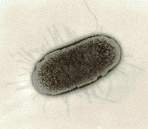
E. coli

Slide 15
Immune deficiency in the infectious process
Immunodeficiency - primary and secondary
Allergic reactions
Autoimmune reactions

Slide 16
Protective - adaptive mechanisms in the infectious process
-Specific
-Non-specific

Slide 17
Nonspecific mechanisms
- act as the first and early barrier:
1.Protective functions of the skin and mucous membranes: barrier function, bactericidal action (sweat, acidic skin reaction)
2.Lymphonoduses and clusters of lymphoid tissue
3.Humoral mechanisms of nonspecific resistance (phagocytosis, factors - properdin, lysozyme, complement, lysozyme, betta-lysines, leukins, interferons)

Slide 18
Nonspecific mechanisms
4. Cellular mechanisms - granulocytes and macrophages
5. Reflex reactions - coughing, vomiting, etc. , contributing to the mechanical removal of the pathogen
6. Nonspecific adaptive response of various organs and systems (redistribution of blood flow, enhancement of the function of excretory organs, activation of antitoxic liver function

Slide 19
Specific protection mechanisms
- assume the connection of the work of the immune system.
On microorganisms that parasitize intracellularly formed cellular immunity
On microorganisms parasitizing extracellularly develops humoral immunity

Slide 20
Principles of therapy of the infectious process
Etiotropic treatment
Etiotropic therapy is the effect on the pathogen. To do this, use:
• antibacterial agents (for example, antibiotics, sulfonamides, quinolones, diaminopyrimidines, nitroimidazole and nitrofuran derivatives, bacteriophages, Ig),
• antiviral drugs (eg, Ig, adamantane derivatives, protease inhibitors, reverse transcriptase and DNA polymerases, IFN, nucleotide analogues).
• antifungal agents (eg, azoles, fluorocytosine, amorolfine, allylamines, griseofulvin).
• antiprotozoal drugs (for example, sulfonamides, sulfones, chloroquine, sulfadoxine, quinine, artemisin, metronidazole).

Slide 21
Principles of therapy of the infectious process
Pathogenetic therapy
Pathogenetic treatment is designed to block the mechanism of development of the infectious process. This is achieved with the help of:
• detoxification therapy (for example, using antitoxic sera, hemodilution, hemodialysis, plasmapheresis);
• anti-inflammatory treatment;
• Immunotherapy and immunocorrection (for example, using specific sera, vaccines, adaptogens, immunomodulators, desensitizing effects);
• normalization of the functions of organs, tissues and their systems (for example, SSS, respiratory, digestive, nervous), disturbed due to the development of inf.
• correction of the main parameters of body homeostasis (KChR, ion content, mass and rheological properties of circulating blood, pO2, pCO2, etc.).

Slide 22
Principles of therapy of the infectious process
Symptomatic therapy
Symptomatic treatment is aimed at alleviating the patient's condition and eliminating painful, painful sensations that aggravate the course of the infection process. For this purpose, for example, drugs that eliminate headaches, feelings of emotional stress or fear, hypnotic and analgesic drugs are used.

Slide 23
INTRODUCTION
Infectious diseases are known to mankind since antiquity.
Epidemics covered vast territories, including entire states and peoples. Not without reason infectious diseases have received the name of "morbid diseases".

Slide 24
INTRODUCTION
The prevention of infectious diseases, the fight against them at all times and among all peoples represented the most serious public problem.

Slide 25
INTRODUCTION
Euphoria 50-70-ies of the XX century on the successful fight against infections and the complete elimination of part of them was premature.

Slide 26


INTRODUCTION
Only one infectious disease - a smallpox - can be considered conditionally liquidated on the planet.

Slide 27
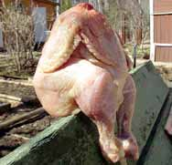
INTRODUCTION
On the other hand, the number of new, previously unknown to science infections.

Slide 28
INTRODUCTION
Suffice it to recall that if in the 1950s there were about a thousand infectious diseases, now there are more than 1200 of them, hence the emergence of new problems (AIDS, Lyme disease, legionellosis, etc.) both for professionals and for society as a whole.

Slide 29
INTRODUCTION
Of particular importance is medical ignorance, sometimes medical illiteracy of the population.

Slide 30
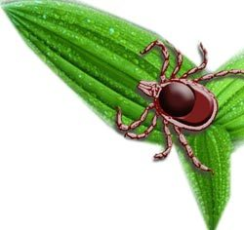
Before health care, there are serious tasks in the prevention and control of infectious diseases.
Hence the late application to the doctor and the late hospitalization of infectious patients (diphtheria, borreliosis - Lyme disease, etc.).

Slide 31
What do you need to know about the characteristics of infectious diseases?
Infectious diseases have a number of characteristic distinctive features, knowledge of which will help the teacher to prevent them among schoolchildren, and, if necessary, to provide first aid.

Slide 32
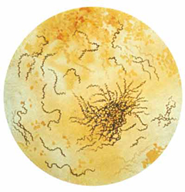
What do you need to know about the characteristics of infectious diseases?
An infectious disease is a disease that is not only caused, but also supported by the presence in the body of a living damaging foreign agent (pathogen).

Slide 33
Distinctive features of infectious diseases:
contagiousness and danger of rapid spread among the population;
the source of the infection is usually a sick person;
cause of occurrence - a living pathogen;

Slide 34
Distinctive features of infectious diseases:
- the development of persistent immunity after some infectious diseases;
- alternation of certain periods (incubation, initial, the height of the disease and the period of recovery).

Slide 35
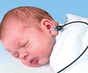
In pre-school and junior school age
the so-called children's infections (measles, chickenpox, scarlet fever, whooping cough, diphtheria), as well as ARVI, including influenza, are most often encountered.

Slide 36
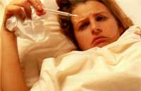
At children of the senior school age
Infections of adults: intestinal infections (dysentery, salmonellosis, etc.), various forms of viral hepatitis, sexually transmitted diseases, influenza, etc.

Slide 37
What does epidemiology study?
Epidemiology is the science of the patterns of development and spread of infectious diseases in human society, measures for their prevention and elimination.

Slide 38
What is the epidemic process, what are its links?
The epidemic process is the process of spreading infectious diseases in the team.

Slide 39
includes three interrelated links:
-- source of infection, excretory pathogens;
-- mechanism of transmission of pathogens;
-- susceptibility of the population.

Slide 40
Who can be the source of the infection?
The source of the infection can be a sick person, a carrier or sick animal.
From the body, the pathogen is excreted into the environment with feces (feces), urine, vomit, etc.

Slide 41

All the infections that are infected and sick people, it is common to divide into two groups:
1. Anthroponoses - diseases peculiar only to man and transmitted from person to person (from the Greek words: anthropos - man, nosos - disease).

Slide 42
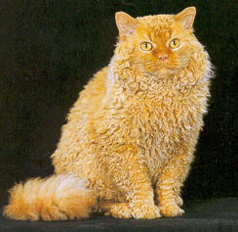
All the infections that are infected and sick people, it is common to divide into two groups:
2. Zoonoses (from the Greek word zoon - animals) - the diseases inherent in animals and humans and transmitted from the animal to man, are not transmitted from person to person.

Slide 43
What is bacteriocarrierism and what are its variants?
A person who has had an infectious disease sometimes remains a source of infection for a long time. Such people are called bacterial carriers,
and the phenomenon itself - bacteriocarrier.

Slide 44
What is bacteriocarrierism and what are its variants?
In addition, there is a group of healthy bacterial carriers - these are people who themselves did not get sick or suffered the disease in a very light, unrecognized form.

Slide 45
CAUSES OF INFECTIOUS DISEASE
The causative factor of infectious diseases is the pathogen (microorganism).
He enters into a complex biological interaction with the human body, which leads to an infectious process, then an infectious disease.

Slide 46
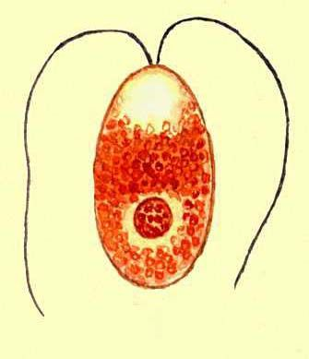
CAUSES OF INFECTIOUS DISEASE
The simplest are unicellular creatures capable of carrying out various functions peculiar to individual tissues and organs of more highly developed organisms.

Slide 47
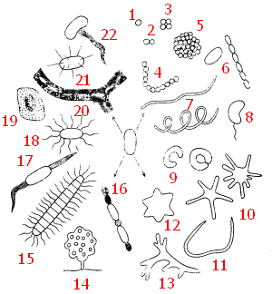
CAUSES OF INFECTIOUS DISEASE
Bacteria are unicellular microorganisms of a spherical (cocci), cylindrical (rod) or spiral (spirilla) form

Slide 48
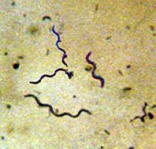
CAUSES OF INFECTIOUS DISEASE
Spirochetes are mobile microorganisms characterized by a filamentary, spiral form.

Slide 49
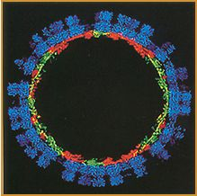
CAUSES OF INFECTIOUS DISEASE
Rickettsia, chlamydia are parasitic intracellular microorganisms occupying an intermediate position between bacteria and viruses.

Slide 50
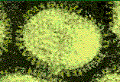
CAUSES OF INFECTIOUS DISEASE
Mycoplasmas are microorganisms that do not have a cell wall, but parasitize outside cells.

Slide 51
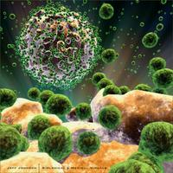
CAUSES OF INFECTIOUS DISEASE
Viruses are microscopic non-cellular forms of life, capable of penetrating into certain living cells and multiplying in them.

Slide 52
What is an epidemic focus?
An epidemic focus is the location of the source of the infection in the surrounding area, to the extent that it can transmit the pathogen to others.

Slide 53
What is sporadic incidence, epidemic, pandemic?
Sporadia - the emergence of single infectious diseases, between which there is no visible epidemiological connection.

Slide 54
What is sporadic incidence, epidemic, pandemic?
Epidemic - mass distribution
among the population in the locality
specific infectious disease.
Can cover the whole city
region, country.

Slide 55
What is sporadic incidence, epidemic, pandemic?
A pandemic is a big epidemic,
extending to many
countries, continents.

Slide 56
How are infectious diseases classified?
The classification of infectious diseases is based on:
localization of the pathogen and
mechanism of transmission of infection.

Slide 57
In this regard, distinguish 4 groups of infectious diseases:
Intestinal infections (typhoid fever, dysentery, salmonellosis, etc.):
the pathogen is localized in the intestine;
transmission mechanism - fecal-oral.

Slide 58

Infections of the respiratory tract (influenza, measles, scarlet fever, etc.):
the pathogen is in the airways;
transmission mechanism – airborne.

Slide 59
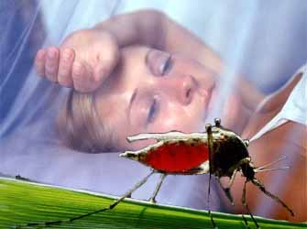
Blood infections (rash and recurrent malaria, etc.)
the pathogen is in the blood;
the transmission mechanism is transmissive, i.e.
blood sucking insects
(lice, fleas, mosquitoes, etc.).

Slide 60
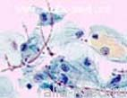
Infections of the outer layers and mucous membranes
syphilis, gonorrhea, rabies, tetanus, and others.
the causative agent is in the semen and vaginal secret of persons infected with sexually transmitted diseases, the saliva of animals infected with rabies, etc.

Slide 61
The third link in the epidemic process
is a person (man) susceptible to infectious diseases.
The degree of susceptibility depends on the presence and intensity of natural or artificial immunity in humans.

Slide 62
DEVELOPMENT OF INFECTIOUS DISEASE IN TIME (PERIODS OF DISEASE)
A feature of the infectious disease is its cyclicity.
This means that in the development of an infectious disease, several consecutive periods are singled out: incubation, initial, midsection and recovery.

Slide 63
DEVELOPMENT OF INFECTIOUS DISEASE IN TIME (PERIODS OF DISEASE)
The period of time from the moment of infection and to the first clinical manifestations of the disease is called incubation (latent).
Various infectious diseases have different duration of this period (from several hours to months and even years).

Slide 64
DEVELOPMENT OF INFECTIOUS DISEASE IN TIME (PERIODS OF DISEASE)
At this time, there are usually no visible health problems.
For some diseases (measles, malaria, angina, chicken pox, etc.), the duration of the incubation period is so strictly defined that it is one of the most characteristic signs of this disease.

Slide 65
DEVELOPMENT OF INFECTIOUS DISEASE IN TIME (PERIODS OF DISEASE)
The initial period is the time from the appearance of the first signs of the disease to its height.
In the initial period there are no characteristic signs inherent in a particular disease.
The general symptoms of the disease predominate (fever, malaise, general weakness, decreased efficiency, etc.).

Slide 66
DEVELOPMENT OF INFECTIOUS DISEASE IN TIME (PERIODS OF DISEASE)
As the development of an infectious disease, the symptoms characteristic of the disease appear.
This moment also means the beginning of the period of the height of the illness. In the future, many signs can reach their maximum severity.

Slide 67
DEVELOPMENT OF INFECTIOUS DISEASE IN TIME (PERIODS OF DISEASE)
Since the decrease in the severity of manifestations of the infectious disease, the recovery period (reconvalescence) begins, the duration of which depends on many factors:

Slide 68
DEVELOPMENT OF INFECTIOUS DISEASE IN TIME (PERIODS OF DISEASE)
the severity of the disease;
associated diseases;
characteristics of the body, as well as from quality of treatment and the volume of rehabilitation activities performed).

Slide 69
DEVELOPMENT OF INFECTIOUS DISEASE IN TIME (PERIODS OF DISEASE)
Sometimes after the infectious disease that has been left, there are residual events that occurred during the height of the swell, but last for many months, years and even the whole life (for poliomyelitis, encephalitis, diphtheria, etc.).

Slide 70
DEVELOPMENT OF INFECTIOUS DISEASE IN TIME (PERIODS OF DISEASE)
With most infectious diseases a person becomes dangerous to others at the end of the incubation period.
Only in the period of recovery the degree of danger of infection from the patient is significantly reduced. In the same period comes the complete cleansing of the organism from the pathogenic agent.

Slide 71
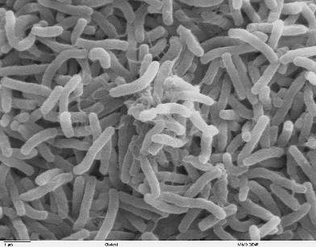
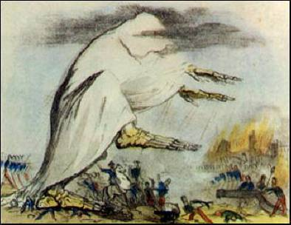
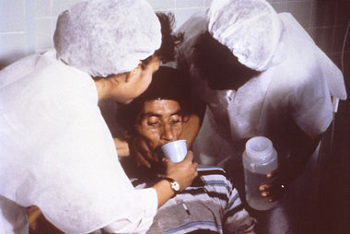
Cholera (Latin cholera) is an acute intestinal infection. Characterized by the fecal-oral mechanism of infection, small intestine lesions, watery diarrhea, vomiting, fastest loss of body fluids
It spreads, as a rule, in the form of epidemics. Endemic foci are located in Africa, Latin America, India (Southeast Asia).

Slide 72

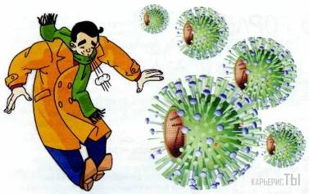
Influenza is an acute infectious disease of the respiratory tract caused by the influenza virus. He is a member of the group of acute respiratory viral infections (ARVI). Periodically spreads in the form of epidemics and pandemics. Currently, more than 2,000 variants of the influenza virus have been identified, which differ in antigenic spectrum.
Often, the word "flu" in everyday use is also called any acute respiratory disease (ARVI), which is erroneous, since in addition to influenza, more than 200 other types of respiratory viruses (adenoviruses, rhinoviruses, respiratory essential viruses, etc.) that cause flu-like disease in man. Presumably, the name of the disease comes from the Russian word "wheeze" - sounds produced by patients.

Slide 73
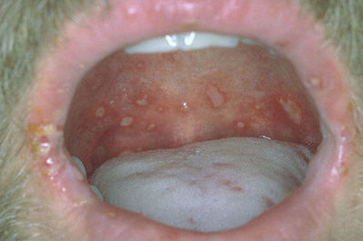
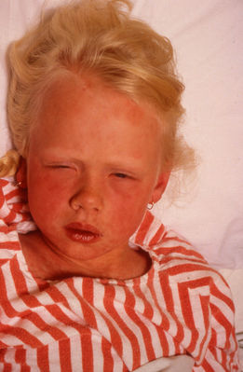
Measles is an acute infectious virus disease with a high level of susceptibility, which is characterized by high fever (up to 40.5 ° C), inflammation of the mucous membranes of the oral cavity and upper respiratory tract, conjunctivitis and a characteristic patchy-papular rash of skin, general intoxication.

Slide 74
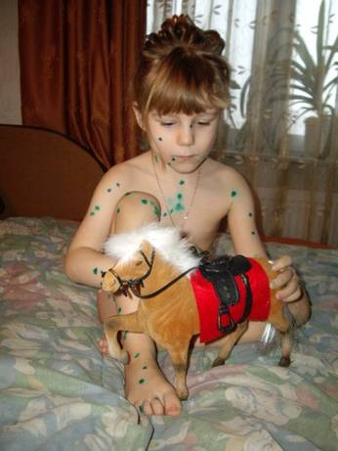
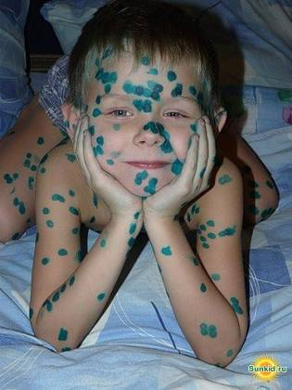

Varicella, chicken pox - an acute infectious disease with airborne droplets. Usually characterized by fever, papulovezikuleznoy rash with benign flow.

Slide 75
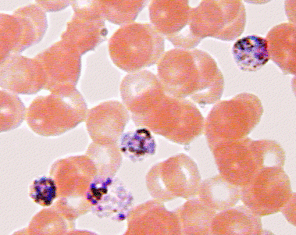
Malaria – ("bad air", formerly known as "swamp fever") is a group of infectious diseases transmitted to humans by mosquito bites of "malarial mosquitoes") and accompanied by fever, chills, spleen enlargement, increased liver size, anemia, characterized by a chronic recurrent course .

Slide 76
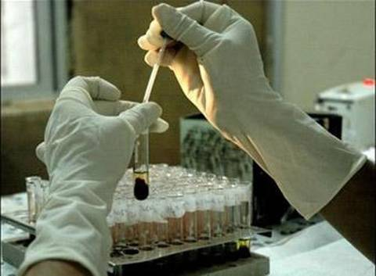
HIV is the human immunodeficiency virus that causes the disease - HIV infection, the last stage of which is known as the acquired immune deficiency syndrome (AIDS) - in contrast to congenital immunodeficiency.

Slide 77
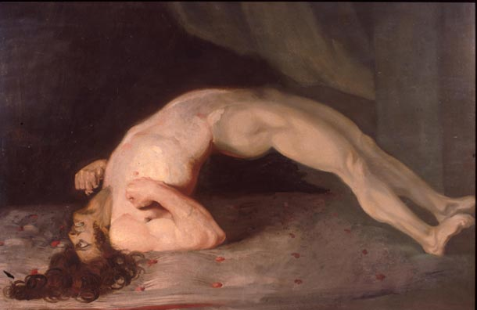
Tetanus is a bacterial acute infectious disease with a contact mechanism for the transmission of the pathogen, characterized by damage to the nervous system and manifested by tonic stress of skeletal muscles and cramps.

Slide 78
MEASURES FOR PREVENTION OF INFECTIOUS DISEASES
Activities should be planned and conducted in three areas:
1) exposure to the source of infection - neutralization of it;
2) rupture of transmission routes;
3) increase of people's immunity to infectious diseases.

Slide 79
MEASURES FOR PREVENTION OF INFECTIOUS DISEASES
The most important timely detection of infectious patients, their early isolation and
hospitalization.
To break the transmission routes of infection, it is necessary to monitor compliance with the rules of personal and public hygiene.

Slide 80
MEASURES FOR PREVENTION OF INFECTIOUS DISEASES
Quarantine is a system of anti-epidemic and regime measures aimed at the complete isolation of the outbreak from the surrounding population and the elimination of infectious diseases in it.

Slide 81
Quarantine measures
Armed protection is established around the hearth, entry and exit, as well as the removal of property are prohibited.
The supply is made through special points under strict medical supervision.

Slide 82
Duration of quarantine for different infections (day)
Hepatitis A 35 Anthrax 13
Typhus rash 25 Meningococcal infection 10 Abdominal typhus and paratyphoid 21 Dysentery 7
Chicken pox 21 Diphtheria 7
Rubella 21
Scarlet fever 7 Epidemic parotitis 21 Plague 6
Measles 17
Cholera 5 Whooping cough 14 Influenza 3

Slide 83
MEASURES FOR PREVENTION OF INFECTIOUS DISEASES
Observation is a system of isolation-restrictive measures aimed at restricting the entry, exit and communication of people on the territory declared dangerous, strengthening medical surveillance, preventing the spread and eliminating infectious diseases.

Slide 84
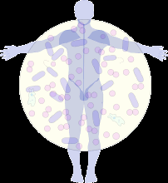
Observational activities
Observation is introduced when infectious agents are identified that do not belong to the group that are particularly dangerous, as well as in areas directly in contact with the quarantine zone.

Slide 85
MEASURES FOR PREVENTION OF INFECTIOUS DISEASES
Disinfection is a complex of special measures aimed at destroying pathogens of infectious diseases in the external environment and interrupting the transmission routes of infectious origin.

Slide 86
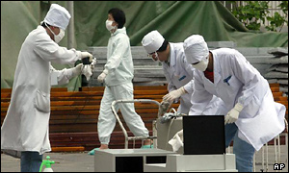
Disinfection
Disinfection is divided into preventive and focal.

Slide 87
MEASURES FOR PREVENTION OF INFECTIOUS DISEASES
In the conduct of preventive disinfection, a special service is involved to work at water supply facilities, sewerage, at enterprises procuring raw materials of animal origin, in places of constant concentration of people, etc.

Slide 88
MEASURES FOR PREVENTION OF INFECTIOUS DISEASES
Focal disinfection is carried out in the foci of infections, i.e. at the place of residence or work of the sick person. Employees of out-patient polyclinic institutions are involved in its implementation.

Slide 89
MEASURES FOR PREVENTION OF INFECTIOUS DISEASES
Focal disinfection may be ongoing, which is carried out in the environment of the patient, and the final, carried out in the hearth after his recovery, hospitalization or death.

Slide 90
MEASURES FOR PREVENTION OF INFECTIOUS DISEASES
The current disinfection provides for permanent disinfection of the patient's discharge (bowel movements, vomit, sputum, urine, etc.), household items, personal belongings, etc.

Slide 91
Classical antimicrobial therapy suggests:
- etiotropic treatment: the choice and appointment of antibiotics in accordance with the properties of the identified
microorganism - the causative agent of infection;
- determination of optimal doses of antibiotic and "method of its administration on the basis of pharmacological properties and features of pharmacokinetics in the body" of the patient;
- timely initiation of treatment and conduction of courses of antibiotic therapy of the necessary duration;
- rapid change of antibiotics and correction of the regimens-treatment when obtaining new data on the pathogen;
- selection of combinations of antimicrobial agents for empirical therapy (until bacteriological diagnosis is established), switching to monotherapy after identification of the pathogen.

Slide 92
Choosing an effective and safe antibacterial drug remains difficult medical task.
Causes (why?):
I. Change of pathogens:
- in patients with various immunodeficiencies;
- in elderly people with chronic pathology;
- in patients after traumatic diagnostic and medical manipulations.
II. Complexity of identification of the pathogen:
- lack of substrate for research;
- lack of a laboratory base;
- the objective complexity of identification of the causative agent due to its properties, the cost of research, etc.).
III. Development of resistance of bacterial flora to antimicrobial drugs.
("Doctors barely have time to remember the name of new antibiotics,
and the microbes have already come up with measures to combat them ").

Slide 93
Which conditional constant is used for
evaluation of antimicrobial activity of drugs?
IPC - minimal overwhelming
Concentration;
MIC - minimal inhibitory
Concentration;
IPC50, IPC9O, MBK.
Methods of diagnostics of pathogens
The dilution method is the lowest concentration of antibiotic (In vitro),
introduced into agar or nutrient broth, which can cause suppression of visible growth of a microorganism
Disco-diffusion method - measurement of the suppression zone
growth of the microorganism on a Petri dish with agar around the disc containing a certain amount of antibiotic.
By the size of the growth zone suppression, all strains
subdivided into sensitive,
Moderately resistant, resistant to this antibiotic.

Slide 94
Methods of bacteriological control:
- bacterioscopy of native material;
- Bacterioscopy of the stained smear according to Gram;
bacteriological investigation (seeding on "solid and liquid
media with the determination of the amount of contamination
and sensitivity" of the pathogen to antimicrobial drugs).
In the presence of a substrate for research, the collection
of material for bacteriological research should, if possible,
be carried out before the start of treatment with antimicrobials,
which significantly increases the information content and reliability
research.
The reliability of research depends also on
Correct selection and transportation
material for the study.
In the process of antibiotic therapy should be conducted
constant microbiological monitoring.

Slide 95
Methods of immunological control:
RNIF - reactions of indirect immunofluorescence;
RCC - complement fixation reaction;
(For all pathogens is absolutely conclusive
4-fold increase in antibody titres in paired blood sera,
taken at an interval of 2 weeks - retrospective diagnosis).
ELISA-Immuno-enzyme method for determination in serum,
sputum specific antibodies to Mycoplasma pneumoniae,
chlamydia classes IgM and IgG;
(Elevated concentrations of IgM antibodies
testify to the acute phase of the infectious process,
then concentrations of IgG antibodies that increase
can last a long time).
PIF - direct immunofluorescence
(for diagnostics of urogenital chlamydiosis);
PCR is a polymerase chain reaction.

Slide 96
Types of resistance of microorganisms:
natural -, acquired -
stability results from the mutation of individual
strains of bacteria and
selection of resistant clones of microorganisms or as a result of
extrachromosomal (plasmid) exchange of genetic information
between individual bacterial cells.
There are two types of acquired bacterial resistance:
Primary resistance - resistance of bacteria to
beginning of treatment;
(eg, primary resistance of some strains of pneumococcus
or Staphylococcus aureus
to benzylpenicillin).

Slide 97
Secondary resistance of bacteria-
occurs or increases during treatment
antibacterial drugs and requires a review of treatment tactics.
Associated Resistance
one chemical class simultaneously, for example,
to p-lactams, aminoglycosides and fluoroquinolones simultaneously.
Cross-resistance:
Resistance of the microorganism to antimicrobial agents
one chemical class
(for example, to several representatives of aminoglycosides,
several fluoroquinolones, etc.).
Penicillin-resistant S. pneumoniae.
Strains S. pneumoniae, having a reduced sensitivity to
penicillin.
PSSP - sensitive to penicillin,
PISP - moderately resistant
(MPC of penicillin 0.12-1.0 mg / L)
PRSP-resistant (MIC> 2 mg / l).
Antibiotic-resistant S. pneumoniae
Strains of pneumococcus,
resistant to antibacterial drugs of three or more classes,
for example, to penicillin, co-trimoxazole and macrolides.

Slide 98
Post-antibiotic effect.
The temporary cessation of reproduction
microorganisms (in comparison with the control
a population containing the same number of microorganisms) after a limited period
exposure to the antibiotic. Measured in units of? Time - minutes or hours

Slide 99
Mechanisms of development of bacterial
resistance to antimicrobial agents:
- active removal of antibacterial drugs from
a microbial cell (efflux);
- change in permeability of the cell wall
bacteria for drugs;
- modification of target cell structures for "antibiotics,
for example, penicillin-binding proteins (PSBs) –
enzymes of microorganisms" (transpeptidases and
carboxypeptidases) responsible for the synthesis of
peptidoglycans of the bacterial cell wall
((3- lactam antibiotics, by binding to PSB, block them
action, disrupting the synthesis of the cell wall - bacteria);
-the production of specific enzymes by bacteria,
destroying the molecule of antibiotics.

Slide 100
The most common β-lactamases and their
properties (Enzymes / characteristics).
Plasmid beta-lactamases of staphylococci class A /
- Hydrolyse natural and semi-synthetic penicillins (except penicillin-resistant "penicillins, for example, oxacillin).
Sensitive to inhibitors (3-lactamases.
Plasmid β-lactamases of class A
a wide range of gram-negative bacteria /
Hydrolyse natural and. "Olusynthetic" penicillins, cephalosporins of the first generation. "- Sensitive to inhibitors of β-lactamases.
Plasmid β-lactamases of class A
extended spectrum of Gram-negative bacteria /
- Hydrolysis of natural and semi-synthetic penicillins, cephalosporins of I-IV generation.
- Sensitive to inhibitors of β-lactamases.

Slide 101
Chromosomal β-lactamases
class A gram-negative bacteria:
Hydrolyses natural and semi-synthetic penicillins,
cephalosporins of the I-II generation.
Sensitive to inhibitors of β-lactamases.
Chromosomal β-lactamases
Class B Gram-negative bacteria:
Almost all β-lactam antibiotics, including carbapenems, hydrolyse.
Not sensitive to β-lactamase inhibitors.
Chromosomal β-lactamases
Class C Gram-negative bacteria:
Hydrolyzed natural and semi-synthetic penicillins, cephalosporins I-III generation.
- Not sensitive to β-lactamase inhibitors.

Slide 102
Modern problems of resistance of the most frequent pathogens of community-acquired infections
respiratory tract.
The modern problems of treatment
Streptococcus pneumoniae
Decreased sensitivity to beta-lactams;? Resistance to penicillin in Russia does not exceed 2%.? Beta-lactams are clinically effective against? Penicillin-resistant pneumococci.
Low natural activity of oral? Cephalosporins of the third generation.
Growth of resistance to macrolides: in Europe from 8 to 35%, in Russia about 12%; resistance is associated with? clinical failure of therapy;
■
High frequency of resistance in Russia to co-trimoxazole and tetracyclines (> 50%).
Low natural activity of early fluoroquinolones - in recent years there has been an increase in the frequency of resistant strains; high activity of new fluoroquinolones - there is no resistance.

Slide 103
Modern problems of resistance of the most frequent pathogens of community-acquired respiratory infections (continued)
Streptococcus pyogenes
Increasing resistance to macrolides:
in Europe to 50%, in Russia 10-20%.
The increase in resistance is directly related to an increase in the frequency of macrolide consumption, mainly of the long-acting drugs (azithromycin, clarithromycin).
High resistance to tetracyclines (> 50%).
Low natural activity of early fluoroquinolones. Resistance to penicillin and other beta-lactams is not described.
Haemophilus influenzae
Production of beta-lactamases -
in the world 1-40%; in Russia does not exceed 10%.
There is no resistance to
tsmoksitsillin / clavulanate, cephalosporins
II-IV generation, fluoroquinolones.
Cephalosporins of the first generation are not active.
The natural activity of macrolides is low, the risk of bacteriological failure is high.
Resistance to co-trimoxazole in Russia is about 20%.

Slide 104
Principles of the selection and dosing of antimicrobial drugs
1. Pharmacodynamics of the drug:
a) antimicrobial activity,
b) the effect of the action (bactericidal or bacteriostatic).
2. Pharmacokinetics of the drug.
3. Predicted adverse reactions. (Side effects)
4. Cost of treatment
From the standpoint of pharmacotherapy and clinical pharmacology
important is the definition:
- performance monitoring programs
and the duration of antibiotic therapy;
- control programs for projected
undesirable reactions.

Slide 105
A targeted selection of antimicrobial drugs (or combination of C) is carried out in accordance with the type of pathogen isolated from the pathological material.
The basis for a selective choice of antimicrobial drugs is the identification of microorganisms that caused an infectious disease, the sensitivity of microbes to drugs (competent bacteriological diagnostics), especially in the isolation of "problem pathogens" -staphylococcus, Escherichia coli, Klebsiella, enterococcus, Proteus, Synaemic bacillus, Mycobacterium tuberculosis.
If the clinical picture of the disease is characteristic of a specific pathogen and is atypical for it, the development of resistance, therapy can be carried out without determining the sensitivity of the microorganism to antibiotics. For example, the causative agents of erysipelas, inflammation, scarlet fever are always streptococci, and epidemic meningitis - meningococci.

Slide 106
Nature of the type of action
(bacteriostatic or bactericidal effect).
The choice of bacteriolytic drugs is preferable:
- in the treatment of severe infections;
- in patients with impaired immunity? (AIDS patients, persons receiving "immunosuppressive drugs");
- in the case where the site of localization of the infection is devoid of blood vessels (infectious endocarditis).

Slide 107
Pharmacokinetics.
From the pharmacokinetic point of view, the goal of "antimicrobial chemotherapy" is to create and maintain, during the entire period of treatment in the focus of bacterial infection, the concentration of active drugs that provide bactericidal (for bacteriostytic) or bacteriostatic (for bacteriostatics) effect against the putative or established pathogen (pathogens) .

Slide 108
What are the optimal pharmacokinetic properties of an antimicrobial drug in the localization of bacterial inflammation in the intestine:
- have a low percentage of absorption;
- have a high percentage of excretion with bile ("cyclic process" or recycling).
What are the optimal pharmacokinetic properties of an antimicrobial drug in the localization of the focus of bacterial infection in other organs:
- high percentage of suction;
- a stable percentage of suction;
- high suction speed.

Slide 109
Effects of acidity of urine on the activity of antibiotics.
With an acidic urine reaction (pH 5.0-6.5), penicillins, tetracyclines, novobietsin, 8-hydroxyquinolines,
quinolines, rifampicin, furadonin, furazoline.
When alkaline urine reaction (pH 7.5-8.5) are effective:
macrolides, lincomycin, aminoglycosides.
The effectiveness of the following antimicrobial drugs does not depend on the pH of the urine:
chloramphenicol, polymyxins, cephalosporins, vancomycin, cycloserine.
To acidify urine use:
ascorbic acid, calcium chloride;
For alkalizing - soda drink, alkaline mineral water.

Slide 110
Interaction.
Fluoroquinolones affect cytochrome
P1 A2, carrying out dealkylation
theophylline, reducing its clearance.
According to the effect on the pharmacokinetics of theophylline, fluoroquinolones can be divided into 3 groups:
Group 1 - drugs with a pronounced effect on the pharmacokinetics of theophylline and a high risk of side effects - enoxacin 50-65%;
2-nd group, causing a moderate increase in the content of theophylline in the plasma (up to 40%) -
ciprofloxacin, pefloxacin;
3rd group - drugs that do not interact with theophylline -
ofloxacin, lomefloxacin, sparfloxacin).
Caffeine is widely used in beverages, theobromine is the main component of cocoa and a small part of coffee and tea, theophylline is found in large quantities in tea and is widely used in medicine as a bronchodilator.

Slide 111
Clinical and laboratory criteria for the adequacy of antibiotic therapy (after which the drug can be canceled):
- 2-3 days of normal temperature:
- absence of intoxication;
- stable hemodynamics (absence
arterial hypotension, tachycardia);
- respiration rate not exceeding 20 per minute;
- a positive dynamics of the main symptoms of the disease (cough, sputum, wheezing in the lungs, abdominal tenderness, draining and absence of purulent sputum (with bronchopulmonary infections), pyuria and leukocyturia in urinary infections, condition of a purulent wound, etc.) ;
- positive radiographic dynamics;
- the number of leukocytes in the blood <9 x 109 / l;
- the number of n / nuclear neutrophils is less than 7%.
- ESR, fibrinogen, C-reactive protein, etc.) can not serve as criteria for the adequacy of antibiotic therapy.

Slide 112
By the time of discontinuation of antibiotic therapy, some symptoms of the disease may persist (for example, coughing, sputum separation, wheezing in the lungs, infiltration on radiographs, etc.)> which is not always an occasion to prolong the use of the antibiotic;
The abolition of the antimicrobial drug does not mean the cessation of the patient's treatment (physiotherapy, immunotherapy, etc.);
This provision does not apply to conditions such as staphylococcal infections (especially in the case of methicillin-resistant staphylococci), atypical pneumonia caused by chlamydia, mycoplasma or legionella, meningitis, endocarditis, febrile neutropenia, which, due to specific conditions of occurrence and course of infections, require longer courses of antibiotic therapy, even with the rapid achievement of clinical improvement in the patient.
If the patient has severe concomitant diseases, a decrease in immunity, the duration of antibiotic therapy increases individually.

Slide 113
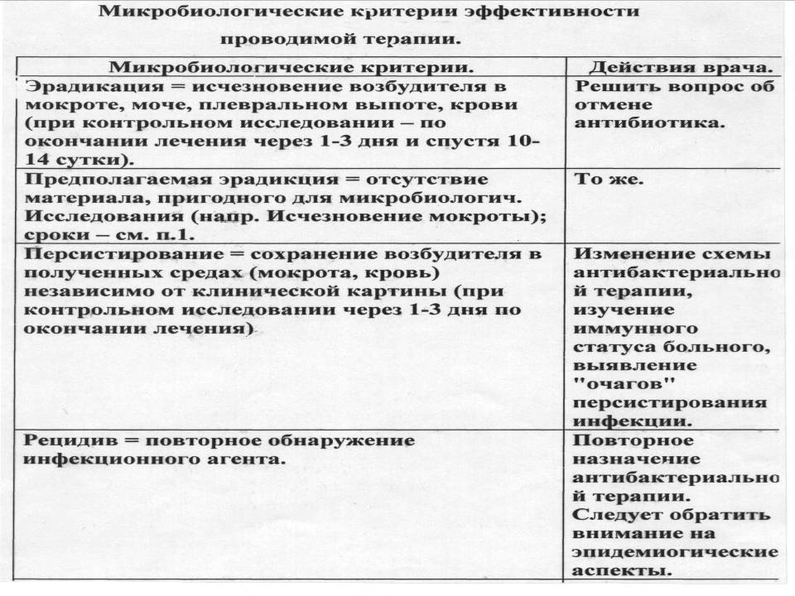

Slide 114
Cost of treatment.
According to statistics 25-35% of financial costs
hospitals account for antimicrobial drugs
(abroad up to 50-60%).
It is necessary to distinguish concepts
"Cost of antibiotic" and "cost of antibacterial
therapy ".
The cost of antibiotic therapy:
includes several indicators.
Direct costs:
-the cost of the antibacterial drugs themselves,
Indirect costs:
- the cost of its introduction,
the cost of additional antibiotic "therapy with its ineffectiveness
and / or development" of unwanted reactions,
- cost of stay of the patient in a hospital.

Slide 115
Approaches to reducing costs.
(while maintaining high clinical efficacy):
- an adequate choice of an antibacterial agent for initial therapy (based on the form of "treating a bacterial infection");
- monotherapy;
- step antibiotic therapy;
- oral antibiotic therapy (with drugs with high bioavailability);
- the optimal duration of antibiotic therapy.
Stepwise therapy can not be used for meningitis, infective endocarditis, multiresistance of the pathogen to antibiotics, impaired absorption in the gastrointestinal tract.

