Slide 1
Pulmonary and extrapulmonary tuberculosis: etiology, pathogenesis, methods of treatment and prevention; clinical pharmacy of anti-tuberculosis drugs
Odesa National Medical University
Department of General and Clinical Pharmacology
and Pharmacognosy
Odesa-2025

Slide 2
10.8 million!
As of 2023

Slide 3
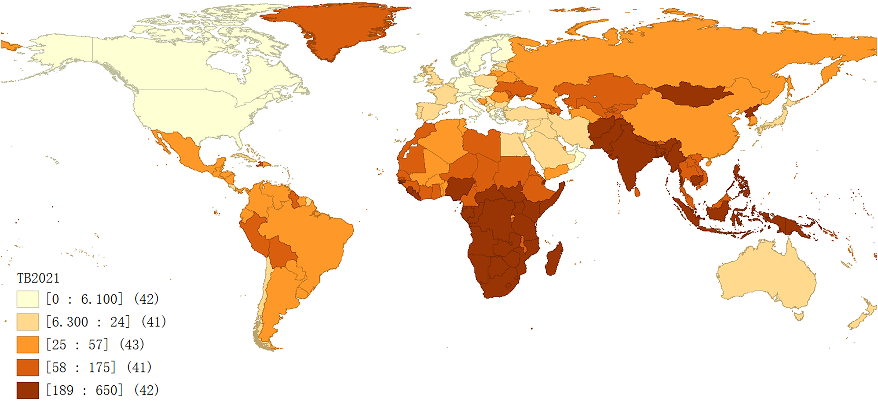

Slide 4
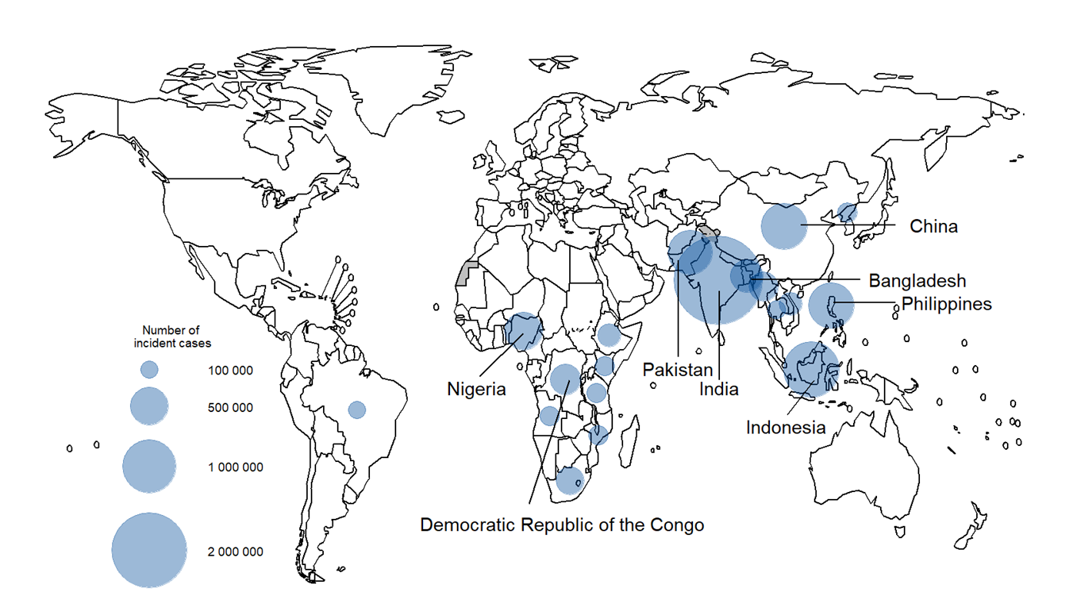
Estimated number of incident TB cases in 2023,
for countries with at least 100,000 incident cases

Slide 5
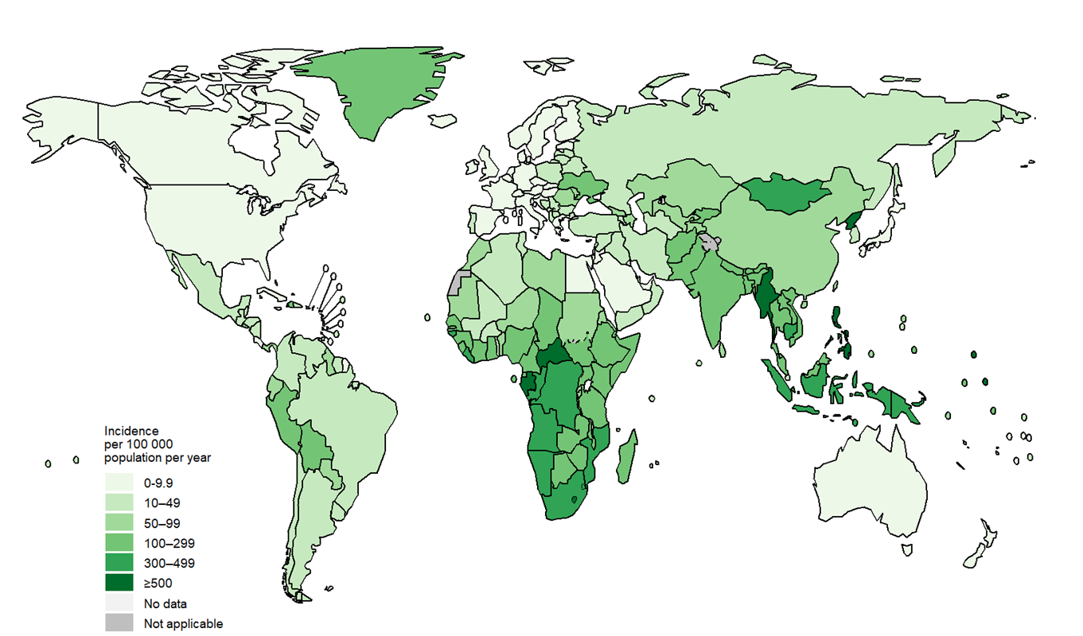
Estimated TB incidence rates, 2023

Slide 6
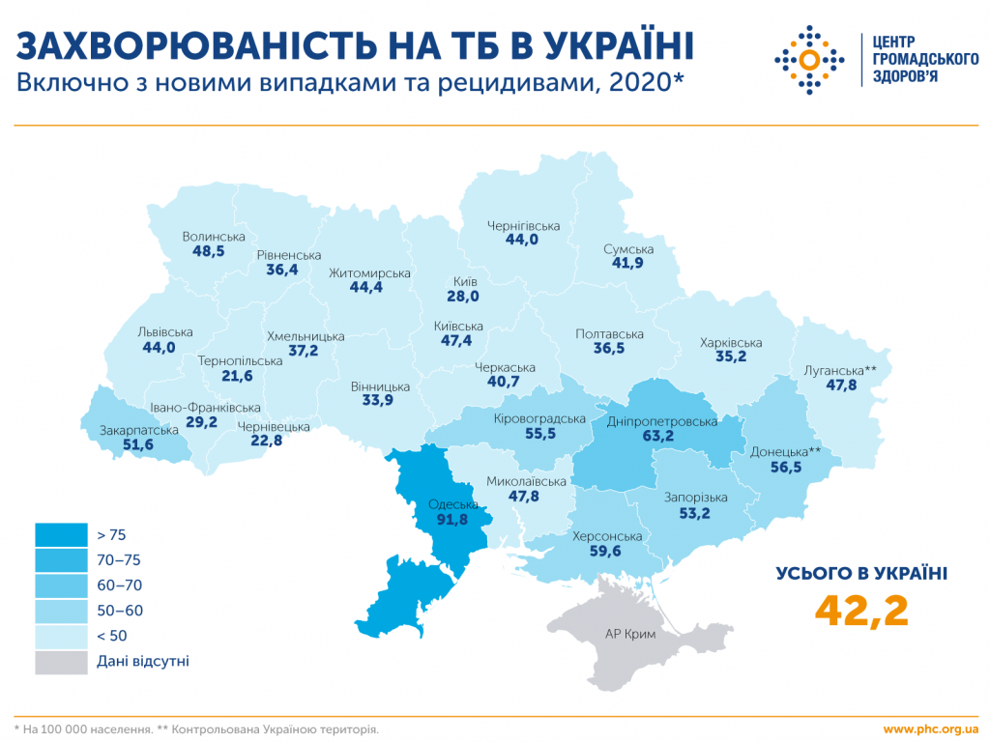

Slide 7
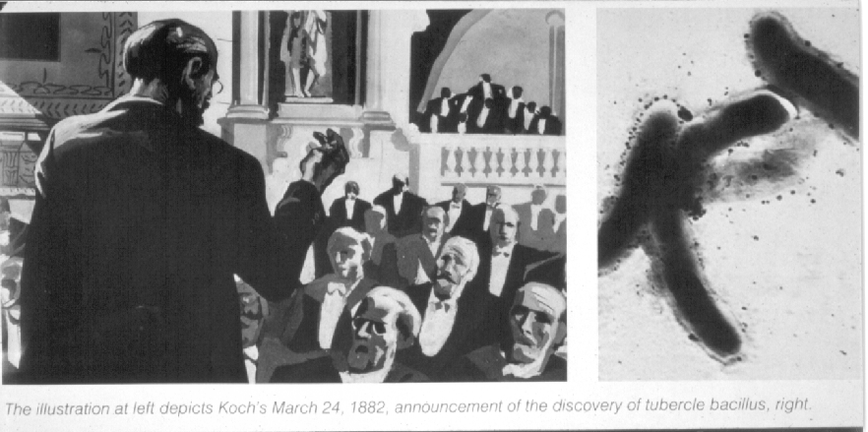
On March 24, 1882, Robert Koch reported at a meeting of the Berlin Physiological Society about tuberculosis pathogen – Mycobacterium tuberculosis (Mycobacterium tuberculosis)

Slide 8

History of struggle
1895 – the discovery of X-rays by V.K. Roentgen, which made it possible to conduct objective diagnostics of tuberculosis of the lungs, internal organs, bones and joints.
1919 – Calmette and Guérin developed a weakened strain of mycobacteria for vaccination (BCG vaccine).
1944 – discovery of streptomycin by Solomon Waksman, a Ukrainian bacteriologist from Vinnytsia region.
Since 1954, PASK, isoniazid, and tibon have been widely used, and since 1967, the most effective anti-tuberculosis drug, rifampicin, has been used.

Slide 9

Etiology of tuberculosis
Tuberculosis is an infectious disease, the causative agent of which in almost 95% of cases is Mycobacterium tuberculosis.
(from the Latin word tuberculum – “tubercle”, tuberculosis is characterized by the presence of tubercles in organs and tissues).

Slide 10
Etiology of tuberculosis
Mycobacteria belong to the family of radiant fungi, widely distributed in nature.
Mycobacterium bovis and Mycobacterium africanum are also pathogenic for humans.
Mycobacterium tuberculosis (MBT) have the appearance of thin, slightly curved rods 0.8-5 microns long and 0.3-0.5 microns thick.
MBT do not form spores and capsules.

Slide 11
Etiology of tuberculosis
During microscopic examination of sputum, tuberculosis pathogens are visible as red rod-shaped formations (they retain the dye after washing the stained preparations with acid or alcohol).
Tuberculosis mycobacteria can remain in tissues in an inactive state, remaining viable for many years.
Their most important feature is acid, alcohol, and alkali resistance.
MBT are aerobes, they require oxygen for their normal development.
The reproduction of MBT occurs by simple division, less often by budding. The cycle of simple division lasts 20-24 hours.

Slide 12
Stability of MBT in the external environment
MBT sensitive
to the sunlight,
UV radiation,
exposure to high temperatures
solutions containing chlorine

Slide 13
Stability of MBT in the external environment
In the absence of sunlight, MBTs remain viable for several months (on the pages of books – up to 3 months);
can be stored in street dust for up to 10 days.
Under the influence of direct sunlight, MBTs die after 1-1.5 hours .
under ultraviolet irradiation – after 2-3 minutes .
Diffuse sunlight kills MBT in 40-80 days

Slide 14
Stability of MBT in the external environment-2
When heated
up to 60C, MBTs die within 30-50 minutes,
up to 80C – for 5 minutes,
Boiling kills MBT within minutes.
Dry heat (100C) kills MBT after only 1 hour
MBT tolerates drying, rotting, and low temperatures well. At a temperature of -23C, they can be stored for up to 7 years.
The most effective disinfectants are preparations containing chlorine.

Slide 15
Epidemiology
The main source of infection is
patients with pulmonary tuberculosis,
in whose sputum MBT is detected

Slide 16
Ways of transmission of TB
aerogenic route - more than 95%:
- airborne
- airborne dust
RARELY:
alimentary (when consuming unpasteurized milk from sick cows);
contact (through damaged skin or mucous membranes).

Slide 17
Mechanism of infection
When coughing, small droplets are formed (infectious particles of respiratory secretions less than 5 microns in diameter, which contain TB pathogens).
Up to 3,000 of these droplets can be produced during a single cough. The droplets can remain in the air for a long time.
Infection usually occurs indoors. The droplets are so small that they penetrate the alveoli of the lungs, where the mycobacteria begin to multiply.

Slide 18
TB is not transmitted
through food and water,
sexually,
through blood transfusion,
due to mosquito bites.

Slide 19
The risk of infection causes
MBT quantity and virulence
duration of contact with a patient who is shedding bacteria
immune properties of the body
The risk of infection in a susceptible person who has prolonged close indoor contact with a bacillary TB patient is quite high.
The risk of infection from an abacillary pulmonary TB patient is low, and from a patient with extrapulmonary TB is even lower.
Up to 30% of the world's population is infected with tuberculosis, but only 5-10% of them develop tuberculosis during their lifetime.

Slide 20
the world's population is infected with tuberculosis , but only 5-10% of them develop tuberculosis during their lifetime.

Slide 21
Pathogenesis
When a large number of MBT enter the respiratory tract, an interaction between the pathogen and the human immune system begins. In the alveoli, MBT are absorbed by macrophages, inside which the pathogen begins to multiply rapidly.
After destroying macrophages, MBTs enter the intercellular space, from where they enter the lymphatic vessels, then the bloodstream. With the bloodstream, MBTs spread to all organs.
Usually, the immune system stops the reproduction and further spread of MBT within 2 to 6 weeks.
A person becomes infected, but does not suffer from tuberculosis: he does not complain, there are no changes in his lungs on X-ray, and the person does not pose an epidemiological risk.

Slide 22


Model of tuberculosis pathogenesis
Risk of chronicity
Inadequate treatment
Risk of infection
Number of infectious patients
Duration of contagiousness
Nature of contact
Patients with MBT+
Subclinical infection
(90% infected)
Cure
chronology
death
Exposition
Patients with MBT-
Risk of death
Late detection
Process localization
Inadequate treatment
Disease risk
Decreased immunity
( for Urban and Vogel, 1995)

Slide 23
Tuberculosis –
This is a condition in which there are clinical symptoms or signs of damage to one or more organs.
This happens because MTB begin to multiply and there are so many of them that the immune system is unable to cope with them.

Slide 24
Clinical picture of the disease
Depends on localization
Pulmonary tuberculosis
Extrapulmonary tuberculosis
  TB of the lymph nodes;
  TB of the kidneys;
  TB of the spine and bones;
  Tuberculous meningitis;
  Abdominal TB.
Miliary TB (children, patients with exhaustion, HIV-infected)

Slide 25
Primary tuberculosis
As a result of the first encounter with M. tuberculosis, primary tuberculosis is formed.
It occurs with obligatory damage to the lymphatic system, is characterized by an imperfect immune response, a tendency to generalization, and after the development of immunity, the possibility of self-healing.
It occurs mainly in childhood and in HIV-infected individuals in the stage of severe immunosuppression.
The most common clinical form is tuberculosis of the intrathoracic lymph nodes.

Slide 26
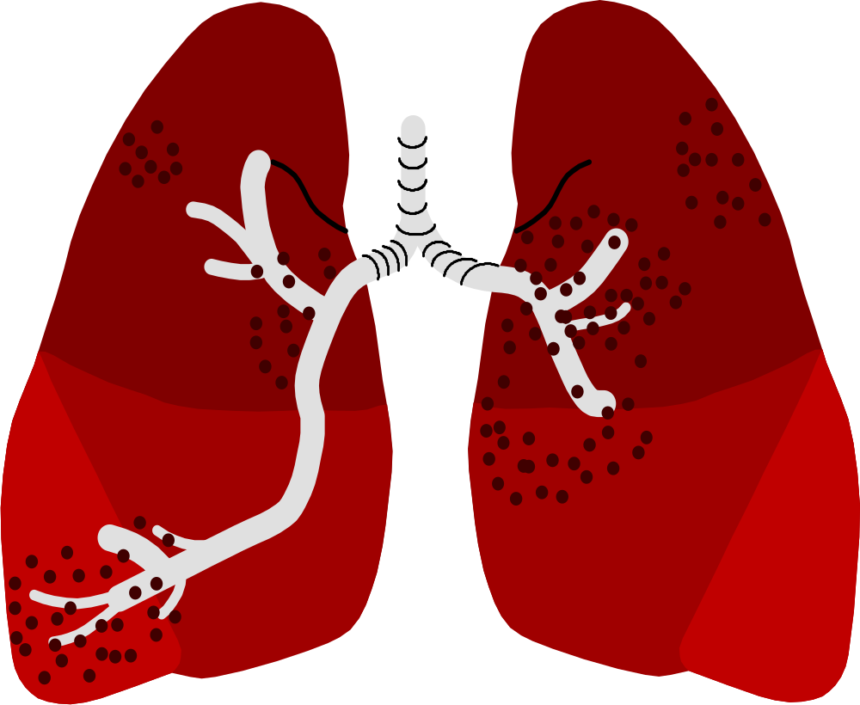
Primary foci and primary TB

Slide 27
Dissemination through the bloodstream

Slide 28
Miliary TB

Slide 29
Pulmonary TB with cavities

Slide 30
Tuberculous pleurisy

Slide 31
Secondary tuberculosis
It develops against the background of acquired immunity after a primary infection.
May develop as a result of reactivation of an old tuberculosis focus or reinfection
Reactivation – mycobacteria that have been in the body for some time have begun to multiply.
Reactivation can occur as a response to a weakened immune system (HIV infection, exhaustion, stress)
Concurrent diseases, hypothermia, treatment with immunosuppressants, physical and mental trauma contribute

Slide 32
Secondary tuberculosis
Reinfection is the re-infection of a person who has previously had a primary infection.
Signs of secondary TB are extensive lung involvement, formation of cavities; presence of Mycobacterium tuberculosis in sputum; involvement of the upper lobes of the lungs; usual absence of enlargement of intrathoracic lymph nodes.

Slide 33
Detection and diagnosis of tuberculosis
Detection is a complex of organizational and epidemiological measures to select people who may have tuberculosis (screening).
Tuberculosis diagnostics are clinical measures to establish or refute the diagnosis of tuberculosis in selected individuals.

Slide 34
Tuberculosis Detection
Active Method
A general survey of a contingent
In Ukraine, according to official statistics, 50-60% of TB patients are detected during preventive examinations.
1) X-ray examination is the main method in penal institutions.
- there are conditions for 100% examination of the contingent to be examined,
- high risk of tuberculosis,
- a large percentage of detected patients compared to the examined contingent,
- detects diseases in the early stages of development.
2). Survey for symptoms of the disease .
3). Tuberculin diagnostics using Mantoux tests with 2 TO.

Slide 35
Tuberculosis detection-2
"By request"
1) Collection of complaints and anamnesis, objective examination of the patient .
2) 3-fold microscopic examination of sputum smears for CBC .
ASF are acid-fast bacteria, which include Mycobacterium tuberculosis. In an epidemic, ASF found in the sputum of a patient with suspected TB are considered to be Mycobacterium tuberculosis – MBT.
3) X-ray examination of the chest organs .

Slide 36
Tuberculosis diagnostic methods
1. Objective examination of the patient
There are no specific clinical signs for tuberculosis.
The basis for diagnosing and verifying the diagnosis of tuberculosis is sputum examination.
2. Sputum microscopy – a quick, simple and inexpensive method for identifying TB patients and diagnosing this disease.
Patients with CSB+ in the smear are the most contagious, they are the ones who need to be identified first.
Culture-positive patients pose a much lower risk to others and should be identified by culture and radiographic findings.
3. X-ray examination of the chest organs

Slide 37
Strategies to combat tuberculosis
At the initiative of the WHO, a tuberculosis control strategy was developed that guarantees the best existing method of using anti-tuberculosis drugs - short-term treatment under direct observation - DOTS (Directly Observed Treatment Short-course).

Slide 38
5 components of the DOTS strategy
Continued support for the tuberculosis control program from the government and regional health authorities.
Detection of tuberculosis cases through microscopic examination of sputum from all patients who presented to a medical facility with suspected tuberculosis.

Slide 39
5 components of the DOTS-2 strategy
Conduct a standard treatment regimen for 6 to 8 months in all patients with a positive sputum smear under the direct supervision of medical professionals.
Regular, continuous provision of all necessary anti-tuberculosis drugs.
A standard recording and reporting system for evaluating both treatment outcomes and the overall TB control program.

Slide 40
The goal of the DOTS strategy
detection of 70% of bacillary forms of tuberculosis (among all forms of tuberculosis)
and
achieving cessation of bacterial excretion in 85% of patients.

Slide 41
STOP-TB Strategy
(since 2006)
Components of the STOP-TB strategy:
Improving the quality of DOTS strategy implementation.
Addressing challenges in the fight against HIV-associated TB, multidrug-resistant TB, and other special problems.
Strengthening the healthcare system.
Involvement of all medical institutions in the fight against tuberculosis.
Patient support and public engagement.
Conducting and encouraging research.

Slide 42
The goal of the STOP-TB strategy
reducing global TB prevalence rates by 2050 to 1 case per 1 million population per year and TB mortality rates by 50% by 2015 compared to 1990;
Diagnose 75% of the predicted number of tuberculosis patients and cure 85% of such patients.

Slide 43
The adapted DOTS strategy in Ukraine provides for
Political and financial support for the TB control program should be provided at the level of the Government and administrative territories of the country .
2. Identification of patients with active forms of tuberculosis should be carried out:
upon referral to medical and preventive institutions (LPU) using smear microscopy and X-ray fluorography;
by conducting tuberculin diagnostics among risk groups in children;
by conducting screening fluorography or smear microscopy among at-risk groups in adults;

Slide 44
The adapted DOTS strategy in Ukraine provides for-2
3. Diagnosis of tuberculosis should be carried out by:
performing smear microscopy;
sputum culture and determination of the sensitivity of mycobacteria of tuberculosis to antimycobacterial drugs;
X-ray diagnostics;
use of other laboratory and instrumental research methods (by indicators).

Slide 45
The adapted DOTS strategy in Ukraine provides for-3
4. Treatment of tuberculosis patients should be provided by:
- conducting a standardized controlled short-term regimen under the direct supervision of a medical professional;
- prescribing a five-component standardized controlled regimen of antimycobacterial therapy to patients with severe forms of tuberculosis;
- implementation of a standardized five- or six-component regimen of antimycobacterial therapy for patients with multidrug-resistant tuberculosis
- prescribing surgical treatment of tuberculosis according to indications;

Slide 46
The adapted DOTS strategy in Ukraine provides for-4
- monitoring the effectiveness of treatment using cohort analysis;
- treatment in the intensive phase is mainly carried out in a hospital, in the continuation phase - mainly on an outpatient basis under the supervision of a medical professional;
- granting permission to prescribe second-line drugs by decision of the council of regional anti-tuberculosis dispensaries;
- palliative treatment for patients with extended drug resistance in cases where it is impossible to prescribe four first- and second-line antimycobacterial drugs.

Slide 47
The adapted DOTS strategy in Ukraine provides for-5
5. Provision of anti-tuberculosis institutions with antimycobacterial drugs should be carried out at the expense of the State Budget of Ukraine and the involvement of extra-budgetary funds.
6. Monitoring for tuberculosis should be carried out by :
- creation of a national and regional computer registry of tuberculosis patients;
- creation of a system for monitoring the effectiveness of the tuberculosis control program;
- monitoring of diagnostic and therapeutic measures;
- approval and implementation of WHO recommended accounting and reporting statistical forms.

Slide 48
The adapted DOTS strategy in Ukraine provides for-6
7. Tuberculosis prevention should be carried out by :
- prescribing chemoprophylaxis to children in contact with tuberculosis mycobacteria, persons at risk of tuberculosis and HIV-infected persons;
- vaccination and revaccination with BCG vaccine.
8. Measures to prevent the spread of HIV-associated tuberculosis should be implemented through coordination of national tuberculosis and HIV/AIDS programs.

Slide 49
Treatment of tuberculosis patients
Timely and correctly initiated treatment of the patient allows :
prevent disability,
possible complications,
fatal outcome.
reduce the spread of the disease.
The goal of anti-tuberculosis chemotherapy:
- treatment of tuberculosis cases and prevention of the development of drug resistance (resistance) of MBT.

Slide 50
Basic principles of tuberculosis treatment:
Treatment is comprehensive (prescription of 3 - 4 - 5 anti-tuberculosis drugs) in order to prevent the development of drug resistance (DR) of TB to the used antituberculosis drugs, is carried out according to standard schemes.
Monotherapy in the treatment of tuberculosis is unacceptable, because it contributes to the development of drug resistance.
Tuberculosis treatment is carried out for at least 6 months (the goal is to prevent relapse).

Slide 51
Basic principles of tuberculosis treatment-2:
The course of treatment consists of two phases: intensive and maintenance.
The goal of IF is to stop the secretion of MBT (sputum smear conversion). In this phase, at least 4 PTPs are prescribed.
In the maintenance phase (MP) of treatment, fewer PTPs are required, but for a longer period of time.
In order to influence persistent forms of MBT, a maintenance phase of treatment is necessary.
If treatment is not completed on time, the remaining mycobacteria can cause a new episode of tuberculosis (relapse) and become resistant to drugs.

Slide 52
First-line anti-tuberculosis drugs
Isoniazid (H) | Ethambutol (E)
Rifampicin (R) | Streptomycin (S)
Pyrazinamide (Z) | Thiacetazone (T)

Slide 53
Anti-tuberculosis drugs
second row
Aminoglycosides: Kanamycin Amikacin Capreomycin | Quinolones: Ofloxacin Ciprofloxacin Lomeflaxocin Levofloxacin Sparfloxacin
Thiomides: Prothionamide Ethionamide | Others: Cycloserine PASK Rifabutin

Slide 54
Ensuring adherence to treatment regimen
Direct monitoring of medication intake in both the intensive and maintenance phases.
Cooperation from the patient is a key factor in achieving treatment success.
The healthcare professional must be responsible for monitoring treatment

Slide 55
Adherence to treatment
The patient adheres to the recommended course of treatment, takes all prescribed medications for the entire required time.
Tuberculosis is almost always curable if the patient cooperates with TB treatment.
Treatment nonadherence – the inability or refusal of a patient to accept prescribed treatment.

Slide 56
Consequences of poor adherence to treatment
the patient remains ill for a long time or may develop an even more severe form of TB;
the patient continues to infect others;
contributes to the development and spread of multidrug-resistant TB;
can lead to the death of the patient as a result of frequent interruptions in treatment .

Slide 57
Factors affecting treatment regimen adherence
Low level of patient knowledge
Personal beliefs
Low level of sanitary culture
Lack of skills and ability to take care of yourself
Poor relationships with healthcare professionals
Weak motivation for treatment (lack of housing, money for travel, etc.)
Receiving secondary benefits from the disease (establishing disability and receiving a disability pension)

