Slide 1

Factors affecting
clinical efficacy
of medicines.
Age features of
clinical pharmacology

Slide 2

FACTORS AFFECTING
THE EFFECTIVENESS OF DRUGS
1. Pharmacokinetic factors inherent in each drug:
- suction or absorption rate;
- distribution;
- bioavailability;
Biotransformation;
excretion of drugs.

Slide 3
FACTORS AFFECTING
THE EFFECTIVENESS OF DRUGS
2. The second group of factors is physiological:
a) Age.
Indeed, everyone is well aware of the fact that the patient's sensitivity to medicines changes with age. Even stood out in connection with this:
- perinatal pharmacology;
- pediatric pharmacology;
- geriatric pharmacology;
- reproductive pharmacology;
b) Weight of the patient.
It is known that the more mass, the higher the dose. Therefore, the drugs are dosed in (mg / kg).

Slide 4
ВЗАИМОДЕЙСТВИЕ ЛЕКАРСТВЕННЫХ СРЕДСТВ
FACTORS AFFECTING
THE EFFECTIVENESS OF DRUGS
c) Sex.
There is a different sensitivity in men and women to certain substances, for example, nicotine, alcohol, etc., which is explained by the difference in metabolism, the difference in the specific weight of the fat layer, etc.
d) The state of the body.
The effect of drugs on the body after significant physical exertion will be different than without it.
e) Biological rhythms (diurnal, monthly, seasonal, annual, and now even populational) have the most serious effect on the effect of drugs in the body.

Slide 5
ВЗАИМОДЕЙСТВИЕ ЛЕКАРСТВЕННЫХ СРЕДСТВ
FACTORS AFFECTING
THE EFFECTIVENESS OF DRUGS
3. Pathological factors:
(for example, the level of hormonal activity).
So, in case of Graves' disease, toxic doses of morphine are easier to tolerate, but the sensitivity of the myocardium to adrenaline rises.
The effect of cardiac glycosides on blood circulation is manifested only on the background of heart failure.
The effect of drugs changes significantly:
with hypo- and hyperthermia,
with infectious diseases,
when the functional state of the central nervous system changes, etc.).

Slide 6
ВЗАИМОДЕЙСТВИЕ ЛЕКАРСТВЕННЫХ СРЕДСТВ
FACTORS AFFECTING
THE EFFECTIVENESS OF DRUGS
4. Genetic factors:
It is known that the absence of the enzyme glucose-6-phosphate dehydrogenase (G-6-FDH) in thalassenia, makes it impossible to prescribe antimalarial drugs like primaquine.
Insufficiency of the butyrylcholinesterase enzyme in the blood, occurring in one of 2500 people, is the cause of prolonged muscle relaxation for the administration of dithiline.
5. An intractable patient or placebo effect:
In this regard, the antianginal effect of placebo drugs, for example, reaches 40% and up to 81% of the placebo effect arises from the injection route of administration of the drugs. Probably, therefore, the use of vitamin preparations, tonic, tranquilizers is largely due to this effect.

Slide 7
ВЗАИМОДЕЙСТВИЕ ЛЕКАРСТВЕННЫХ СРЕДСТВ
FACTORS AFFECTING
THE EFFECTIVENESS OF DRUGS
6. Dose of the medicine (drug):
The effect of drugs is determined to a very large extent by their dose.
The dose is the amount of drug intended for one dose (usually referred to as a single dose).
From the dose of the drug depends not only the effectiveness of treatment, but also the safety of the patient.
As early as the end of the century, William Withering wrote: "Poison in small doses is the best medicine, a useful medicine in too large a dose is poison."
This is all the more true in our time, when extremely active medicines are introduced into medical practice, the dosages of which are measured in fractions of a milligram.

Slide 8
ВЗАИМОДЕЙСТВИЕ ЛЕКАРСТВЕННЫХ СРЕДСТВ
FACTORS AFFECTING
THE EFFECTIVENESS OF DRUGS
Indicate the dose in grams or in fractions of a gram. For more accurate dosage of drugs, calculate their quantity per 1 kg of body weight (or per 1 sq. m. of body area), for example, 1 mg / kg; 1 mkg/ kg, etc. The doctor needs to be oriented not only in a dose intended for a single dose (pro dosi), but also in a daily dose (pro die). Approximately, you can calculate the dose by the following simple formula:
1/20 dose x the number of years of the baby.
The minimum doses in which drugs cause an initial biological (therapeutic) effect are called threshold, or minimally effective (therapeutic) doses.
Average therapeutic doses, in which the drugs provide the necessary optimal pharmacotherapeutic effect.

Slide 9
ВЗАИМОДЕЙСТВИЕ ЛЕКАРСТВЕННЫХ СРЕДСТВ
FACTORS AFFECTING
THE EFFECTIVENESS OF DRUGS
If the effect is not sufficiently pronounced for the patient, the dose is raised to the highest therapeutic dose.
Higher therapeutic doses may be:
one time
daily
The highest single dose is the maximum amount of a drug that can be administered once without harm to the patient.
These doses are rarely used, in extreme cases (in an urgent, urgent situation).
Average therapeutic doses
are usually 1 / 3-1 / 2 of the highest single dose

Slide 10
ВЗАИМОДЕЙСТВИЕ ЛЕКАРСТВЕННЫХ СРЕДСТВ
FACTORS AFFECTING
THE EFFECTIVENESS OF DRUGS
In some cases, for example, when using chemotherapeutic agents, the dose of the drug for the course of treatment (the course dose) is indicated.
If it becomes necessary to quickly create a high concentration of the drug in the body (sepsis, cardiovascular failure), then use the first dose, the so-called shock dose, which exceeds all subsequent.
There are also toxic (hazardous effects) and lethal doses.
By the breadth of the therapeutic action is meant the distance, the range from the minimally therapeutic to the minimally toxic dose.
Naturally, the more this distance, the more safe this drug is.

Slide 11
ВЗАИМОДЕЙСТВИЕ ЛЕКАРСТВЕННЫХ СРЕДСТВ
FACTORS AFFECTING
THE EFFECTIVENESS OF DRUGS
To quantify and evaluate the effectiveness of a new pharmacological agent, there are usually two standard comparisons - either with a placebo or with a drug of a similar type of action, which is one of the most effective in this group.
Placebo (dummy) is an indifferent substance in a dosage form simulating a certain pharmacological or medicinal product.
Use of a placebo is necessary if:
a) the effect of presumption, the impact of the individual, the expectation and prejudice of the patient or the researcher;
b) spontaneous changes in the course of the disease, symptoms, as well as phenomena not related to treatment.

Slide 12
ВЗАИМОДЕЙСТВИЕ ЛЕКАРСТВЕННЫХ СРЕДСТВ
FACTORS AFFECTING
THE EFFECTIVENESS OF DRUGS
Placebo is a Latin term meaning "I can give you pleasure."
The placebo effect is an effect caused not by the specific pharmacodynamic properties of the drug in this pathology, but by the FACT of APPLICATION of drugs that works psychologically.
Placebo drugs are usually pharmacologically inert, they contain inactive substances like starch or lactose. Placebo is used in clinical studies to establish the effect of suggestion on the part of both the patient and the physician, especially if funds are to be studied for the treatment of bronchial asthma, hypertension, angina, coronary artery disease.

Slide 13
ВЗАИМОДЕЙСТВИЕ ЛЕКАРСТВЕННЫХ СРЕДСТВ
FACTORS AFFECTING
THE EFFECTIVENESS OF DRUGS
Placebo should not differ in color and other physical properties (odor, taste, form) from the active drug.
Placebo is more effective when both the doctor and the patient are poorly informed about it.
EXAMPLE. In ischemic heart disease (IHD), if one group of patients with IHD is prescribed an active drug and the other is a placebo, then in 40% of patients in the second group, angina attacks stop.
The most pronounced placebo effect is observed:
at the injection route of administration (up to 81%)
The medicines and pills are less effective

Slide 14
GERIATRIC PHARMACOLOGY
Enough sharp changes in the demographic structure of society in recent years, due to the aging of the population, cause a legitimate interest in the social and medical problems of older people.
The United Nations Principles for Older Persons "Make the full life of the elderly people" define the role and place of the elderly in society, including independence, care, participation in social development, the possibility of realizing their internal potential (UN General Assembly Resolution 40/91) .

Slide 15
GERIATRIC PHARMACOLOGY
Demographic aging of the population - an increase in the proportion of elderly and old people in the total population, which was regarded two decades ago as a phenomenon that belongs exclusively to developed countries, now covers almost the whole world.
According to the literature, in 2000
the number of this part of the population reached 590 million people,
and by 2025 the number of elderly people on the planet will reach 1 billion people

Slide 16
PECULIARITIES OF THE DEVELOPMENT OF DISEASES IN AGRICULTURAL AND SENIOR AGE
The aging of the population makes it an urgent problem of providing medical and social assistance to persons of elderly and senile age, about 80% of whom suffer from multiple chronic pathologies
The course of many diseases in elderly and senile patients has its own characteristic features. So, in the morbidity structure of elderly people, the main place is occupied by coronary heart disease, hypertension, diabetes, respiratory diseases, diseases of the musculoskeletal system. At the same time, only one disease is rarely detected in patients - a combination of three, four, and sometimes more diseases is found much more often, which creates additional difficulties in treatment and worsens the prognosis for recovery.

Slide 17
PECULIARITIES OF THE DEVELOPMENT OF DISEASES IN AGRICULTURAL AND SENIOR AGE
Many common diseases can occur in elderly patients hidden, without clear clinical symptoms, while being accompanied by a tendency to develop serious complications.
Thus, infectious and inflammatory diseases in elderly patients are often not accompanied by an increase in body temperature, which is due to reduced body reactivity. One of the frequent concomitant manifestations of disease in people of old and old age is pain, the value of which is often underestimated, not diagnosed in a timely manner and, as a result, is not treated. Clinical symptoms of acute surgical diseases are also sometimes erased, which leads to a delayed start of treatment. These difficulties are sometimes also connected with the fact that the elderly patient himself sometimes cannot clearly draw the line between health and illness, explaining the resulting discomfort for purely “age-related” reasons. The combination of several diseases in the same elderly person that make his condition heavier makes it often impossible to conduct a full-fledged examination.

Slide 18
Pneumonia in the elderly patients
S.P. Botkin wrote: "In old cases, pneumonia in some cases gives an insignificant reaction to such an extent that it does not strike at all. In such cases, pneumonia must be sought ... Despite the severity of the condition, the patient sometimes has no active complaints.
More than 100 years ago, Osler said: "pneumonia is a friend of old people".

Slide 19
Pneumonia in the elderly patients
For 1000 elderly people living at home, the incidence of pneumonia is 25-45 per year, among those in geriatric institutions - 60-115 cases, and the frequency of hospital pneumonia reaches 250 per 1000. Approximately 50% of cases of pneumonia in the elderly are fatal and ranked fourth among the causes of death in patients older than 65 years.

Slide 20
Pneumonia in the elderly patients
Factors contributing to the development of pneumonia in the elderly patients:
− heart failure;
− chronic obstructive pulmonary disease;
− CNS diseases (vascular, atrophic);
− cancer diseases;
− diabetes, urinary tract infections (source of infection);
− recent surgery treatment;
− stay in hospital, intensive care wards;

Slide 21
Pneumonia in the elderly patients
Factors contributing to the development of pneumonia in the elderly patients:
−  drug therapy (antibacterial drugs, glucocorticosteroids, cytostatics, antacids, H2-blockers, etc.), reducing the immune response;
− acute respiratory viral infections (influenza, respiratory syncytial infection);
− hypodynamia (especially after surgery treatment), creating "local conditions" for the development of infection.

Slide 22
Clinical features of pneumonia in elderly patients
− - minor physical symptoms, frequent lack of local clinical and radiological signs of pulmonary inflammation, especially in dehydrated elderly patients (violation of exudation processes);
- ambiguous interpretation of detectable wheezing (can be heard in the lower sections of the elderly and without the presence of pneumonia as a manifestation of the phenomenon of closure of the respiratory tract), areas of blunting (it is difficult to distinguish pneumonia from atelectasis);
- frequent absence of acute onset, pain;

Slide 23
Clinical features of pneumonia in elderly patients

- frequent disorders of the central nervous system (confusion, lethargy, disorientation), occurring acutely and not correlating with the degree of hypoxia (may be the first clinical manifestations of pneumonia and are often regarded as acute disorders of cerebral circulation);
- shortness of breath as the main symptom of the disease, not explained by other causes (heart failure, anemia, etc.);
- isolated fever without signs of local pulmonary inflammation (in 75% of patients the temperature is above 37.5 ° C);

Slide 24
Clinical features of pneumonia in elderly patients
− - deterioration of general condition, decrease in physical activity, sudden and not always explainable loss of self-service skills;
- unexplained falls, often preceding the appearance of signs of pneumonia (it is not always clear whether a fall is one of the symptoms of pneumonia or the latter develop after a fall);

Slide 25
Clinical features of pneumonia in elderly patients

- exacerbation and decompensation of concomitant diseases (strengthening or appearance of signs of heart failure, heart rhythm disturbance, decompensation of diabetes, signs of respiratory failure, etc.). Often, these symptoms appear in the clinical picture to the fore;
- long-term resorption of pulmonary infiltrate (up to several months).

Slide 26
Pneumonia (lung inflammation caused by bacterial or viral infection, in which the air sacs fill with pus and may become solid. Inflammation may affect both lungs ( double pneumonia ), one lung ( single pneumonia ), or only certain lobes ( lobar pneumonia ).:
1. Over 60 years of age, the ARI on the background of COPD, pneumosclerosis, emphysema, CHD, CHF, DM, tumors, that is, secondary.
2. Etiology - the importance of Gr-flora (klebsiella, enterobacteria, legionella), mycoplasma increases.
3. The clinic is atypical - it can be ARI without temperature, intoxication syndrome, it can be - wet whezzers on the background of CHF is difficult to interpret, delayed regression and prolonged course.

Slide 27
Pneumonia:
4. Radiological changes are very important:
- but remember the background,
- reverse development is delayed by 1.5 months.
5. If more than 1.5-2 months - search for oncology, with the exception of cr and TBS and the preservation of the clinic - focal pneumovirus.
6. Change of respiratory function (mixed type).
7. There are ECG changes up to> P pulm., tachycardia, extrasystole, ECG signs of deterioration of the coronary circulation.
8. biochemical changes, a shift of up to 3-4 weeks or more is maintained.

Slide 28
Antibacterial therapy
The most significant point is the choice of the initial antibiotic - it must proceed from the clinical situation in which pneumonia occurred in an elderly patient. The initial choice of antibiotics is not only the efficacy and further success or not of the success of treatment, it implies quite obvious economic aspects, which is of particular importance for the treatment of the geriatric contingent of patients with pneumonia.

Slide 29
Antibacterial therapy
Treatment of community-acquired pneumonia, the choice of AB drugs
Clinical situation | Probable pathogen | Antibiotic
Pneumonia in persons about 60 years without comorbidities | Pneumococcus Mycoplasma Chlamydia | Macrolides (any of a class of antibiotics containing a lactone ring, of which the first and best known is erythromycin.)
Pneumonia in persons older than 60 years or against the background of associated diseases | Pneumococcus Hemophilius influenza | Aminopenicillins Amoxicillin / clavulanate and macrolides, Ampicillin / sulbactam, Cephalosporines of III generation

Slide 30
Antibacterial therapy
Treatment of community-acquired pneumonia, the choice of AB drugs
Clinical situation | Probable pathogen | Аntibiotic
Severe pneumonia | Pneumococcus Hemophilius influenza Microbial association | Amoxicillin / clavulanate, Ampicillin / sulbactam, Macrolides Cephalosporines of III generation
Severe pneumonia + risk factors for increased mortality | Pneumococcus Legionella Gram-negative sticks | Cephalosporines of III generation, Macrolides, Fluoroquinolones, Carbapenems

Slide 31
Antibacterial therapy
The appointment of combinations of AB drugs is justified in the treatment of severe pneumonia or with factors increasing mortality.
Combinations of penicillins and cephalosporins with aminoglycosides are effective. Metronidazole is combined with antibiotics for anaerobic infections. Combinations of cephalosporins with macrolides and aminoglycosides with ciprofloxacin are widely used abroad.

Slide 32
Antibacterial therapy
Antibacterial agents, the purpose of which should be avoided in elderly patients
Antibacterial agents | The reasons for the undesirability of appointment
Аminoglycosides | Nephrotoxicity, hearing loss, deafness, vestibular disorders
Carbopenicillins: carbenicillin, tycarcillin | Platelet dysfunction (bleeding), hypernatremia (progression of heart failure), hypokalemia (heart rhythm disorders)

Slide 33
Antibacterial therapy
Antibacterial agents, the purpose of which should be avoided in elderly patients
Antibacterial agents | The reasons for the undesirability of appointment
Nitrofurans | High toxicity with reduced kidney function
Penicillins in high doses | Toxic effects of the central nervous system (convulsions)

Slide 34
Antibacterial therapy
Antibacterial agents, the purpose of which should be avoided in elderly patients
Antibacterial agents | The reasons for the undesirability of appointment
Polymixines | Nephrotoxicity, neurotoxicity
Tetracyclines | Nephrotoxicity with kidney disease, hepatotoxicity

Slide 35
Antibacterial therapy
Antibacterial agents, the purpose of which should be avoided in elderly patients
Аntibacterial agents | The reasons for the undesirability of appointment
Chloramfenicol | Inhibition of bone marrow function (neutropenia / agranulocytosis, aplastic anemia)
Cephalosporins with a N-methyl-thiotetrazole structure (cefemandole, cefotetan, cefmetazole, cefaperasone) | Impaired intestinal absorption of vitamin K, bleeding

Slide 36
Treatment
Antibiotics are cautious in view of acute vascular insufficiency during the period of critical decrease in temperature, and vascular insufficiency may manifest as chronic, cerebrovascular, coronary or renal failure.

Slide 37
Treatment
Evaluation of the effectiveness of antibiotics:
- 48-72 hours efficiency
- more often toxic effects of antibiotics - control of renal, hepatic parameters, complete blood count, urinalysis

Slide 38
Treatment
- mucolytics,
- bronchodilatory (atrovent),
- detoxification therapy (not transfuse),
- oxygen therapy, painkillers, for CHF - glycosides, an ACE inhibitor, diuretic, respiratory analeptics.

Slide 39
COPD in the elderly
- progressive nature of COPD → irreversible changes
(emphysema, pneumosclerosis, LI, RI),
- erasing the nosological faces (diagnosis of COPD: BA + COPD),
- erasing the faces of exacerbations and remission,
- contribution to the symptoms of COPD (cough, shortness of breath) of other CVDs,
- diagnostics (clinical + additional emphasis on cardiovascular system (ECG, ultrasound)),
differential diagnosis with cancer

Slide 40
COPD in the elderly
treatment (training, especially in old age):
- refusal of smoking (provat. A),
- bronchodilators (<β2 agonists,> anticholinergics, β-blockers are prohibited (even with CHD PICS)),
- aspirin (carefully), aspirin asthma (polinoz),
- mucoregulators in full,
- GCS (caution → inhalation),
- AB for strict infectious indications,
- RI correction - obligatory (oxygen therapy, breathing exercises),
- ERT (electrotherapy in the absence of contraindications - CHD, AG, TsVB).

Slide 41
International Recommendations for Asthma and COPD
 | The optimal route of administration | Basic therapy | Situational therapy
Asthma | Inhalation Nebulizer | Antiinflammatory | Bronchodilators: 1. Cholinolytics 2. Beta agonists 3. Theophylline
COPD | Inhalation Nebulizer | Bronchodilators: 1. Cholinolytics 2. Beta agonists 3. Theophylline | Аntibacterial therapy

Slide 42
Tactics of treatment of COPD
Patient education
Smoking cessation
Bronchodilator therapy
Mucoregulatory therapy
Glucocorticosteroid therapy
Correction of respiratory failure
Antibacterial therapy
Rehabilitation therapy

Slide 43
Algorithm of basic therapy of COPD
IPRATHROPIUM
OPTIMAL
ACTION
CONTINUED
TREATMENTS
SMALL ACTION
NO EFFECT
ADD OF
BETA -AGONISTS
OPTIMAL
ACTION
SMALL ACTION
CONTINUED
TREATMENTS
CANCEL OF
BETA -AGONISTS
ADD OF
PROLONGED
THEOFILLINS

Slide 44
Advantages of an inhalation route of administration
Creating a high concentration of the drug in the airways
The speed of the effect
Minimum side effects

Slide 45
Spacer advantages
Easier coordination with breathing
Prevention of oropharyngeal aerosol deposition
Prevent cold irritation

Slide 46
Benefits of nebulizer inhalation
The possibility of introducing a high dose of the drug
Creating an aerosol with optimal particle size
Coordination of inhalation with inhalation is not required.
Inhalation technology is easily doable for children, elderly and severely ill
The possibility of inclusion in the circuit of oxygen supply and circuit ventilation
Lack of freon and other propellants

Slide 47
Osteoarthrosis –
a group of diseases of various etiologies, but with similar biological, morphological and clinical outcomes, in which the pathological process involves not only articular cartilage, but the entire joint, including the subchondral bone, ligaments, capsule, synovial membrane and periarticular muscles, leading to degeneration of the cartilage
Keuttner&Goldberg, 1995

Slide 48
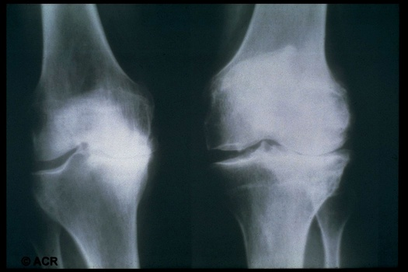
Radiographic signs of gonarthrosis
Constriction of the joint space
Regional osteophytes
Subchondral cysts
Bone sclerosis

Slide 49
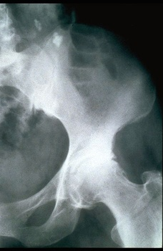
Hip joint injury
Ostephitis, subchondral sclerosis, complete disappearance of the joint space
Pain in the groin, radiating to the inner thigh

Slide 51
Osteoarthrosis :
DOA = osteoarthritis (1 place among diseases of the musculoskeletal system) often cox- and gonarthrosis, as more loaded joints.
- Late appealability, the process which has come far, self-treatment (herbs)
- pain and dysfunction of the joint, quality of life.
Diagnostics:
1. X-ray stage IV according to Laurence Kellgren, “O” stage and inconsistency maybe
2. objectification of pain.
3. depression - сoncomitant pathology (biography).

Slide 52
Purposes of osteoarthrosis pharmacotherapy
Slow down the progression of the disease
Prevent the development of deformities and disabilities
Reduce pain
Suppress inflammation
Reduce the risk of exacerbations and damage to new joints
Improve the quality of life

Slide 53
Treatment of osteoarthrosis
Analgesics (paracetamol, tramadol)
NSAIDs
Glucocorticoids (intra-joint)
Chondroitin sulfate
Glucosamine Sulfate
Hyaluronic acid (intra-joint)
Zinaxin
Hydroxychloroquine
Surgical (joint replacement, osteotomy, lavage, arthroscopy)

Slide 54
Treatment of osteoarthrosis
Period of exacerbation:
1. Reducing physical activity.
2. Exercise therapy, massage.
3. Intra-articular administration cautiously for a year 1-2 injections.
4. NSAIDs and means modifying the structure of cartilage.
5. Physical therapy (ozokerite, paraffin, UHF, helium-neon laser, mud therapy).
6. Sanatorium treatment.
7. Surgical intervention – arthroplasty, joint replacement.
8. School for patients with osteoarthrosis.

Slide 55
Involutional osteoporosis
Osteoporosis - <content of bone mass per unit volume of bone tissue:
− postmenopausal - 51-65 years old - deficiency of sex hormones;
− involutional (senile) type II <absorption in the intestine, in women in 80 years, approximately 100% of patients.

Slide 56
Definition-2000
A skeletal disease characterized by a decrease in bone strength, predisposing to an increased risk of fractures.
Bone strength reflects bone density and quality.
- Bone density: grams of mineral / cm2 or cm3
- Bone quality: architecture, exchange, damage accumulation, mineralization
NIH Consensus Development Conference on osteoporosis, 2000

Slide 57
Norm
Severe osteoporosis
Osteopenia
Оsteoporosis
Cortical
bone
Trabecular
bone

Slide 58
Basic forms
Оsteoporosis
Primary
- Postmenopausal (women)
- Involutional (senile) (women and men)
Secondary
- Various diseases
- Drug therapy

Slide 59
Involutional (senile) osteoporosis
Osteoporosis is a metabolic skeletal disease that occurs for a long time, affecting a significant part of the elderly population, characterized by a decrease in bone mass per unit volume, a violation of microarchitecture, which leads to a high risk of fractures;
- economic losses are very huge.
Geriatric aspects of the pathology of the musculoskeletal system> life expectancy and> number of such patients
- <immunological reactivity, microcirculation, blood circulation, bone demineralization, age-related changes in cartilage (cells do not regenerate).

Slide 60
Involutional (senile) osteoporosis
Clinic is pain (diagnosis is clinically difficult!)
X-ray <bone tissue, changes in the trabecular pattern and shape of the vertebrae (wedge-shaped deformation or compression deformity).
densitometry (norm, osteopenia and osteoporosis),
treatment and prevention
diet calcium supplements
active metabolite of vitamin D3 (alpha D3 Teva) or calcium D3 nycomed improves absorption in the intestine
tissue absorption - calcitonin
active lifestyle, exercise therapy, massage, moderate exercise
fluoride drugs (sodium fluoride),
estrogens are the "gold standard".

Slide 61
The modern definition of gout
Gout - definition used for a heterogeneous group
diseases found mainly in men.
With the full development of the disease is complex
the following symptoms:
attacks of characteristic arthritis, in which urate crystals
may be exhibited in leukocytes in synovial fluid
increased serum uric acid
aggregation of urates into deposits (tophi) found inside
and around the joints
pathology of the kidneys, including the defeat of the glomeruli, tubules,
interstitial tissue, blood vessels
Urolithiasis
Wyngaarden & Kelley 1976

Slide 62
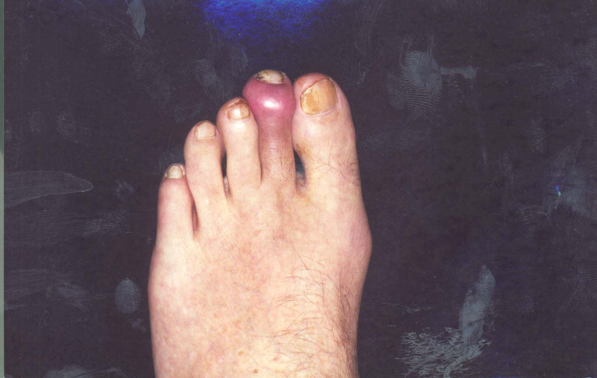
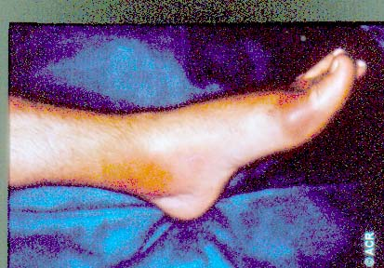
Clinical manifestations
      Attack of acute arthritis
      - sharply painful, monoarticular, completely passing
      onset arthritis PPS 1 finger - 85-90% of cases
      - oligo or polyarticular beginning - 3-14% of cases
      - increase of inflammatory parameters - rarely
      ATTENTION: ANY joint may be affected, large
      more often than small
      time - night

Slide 63
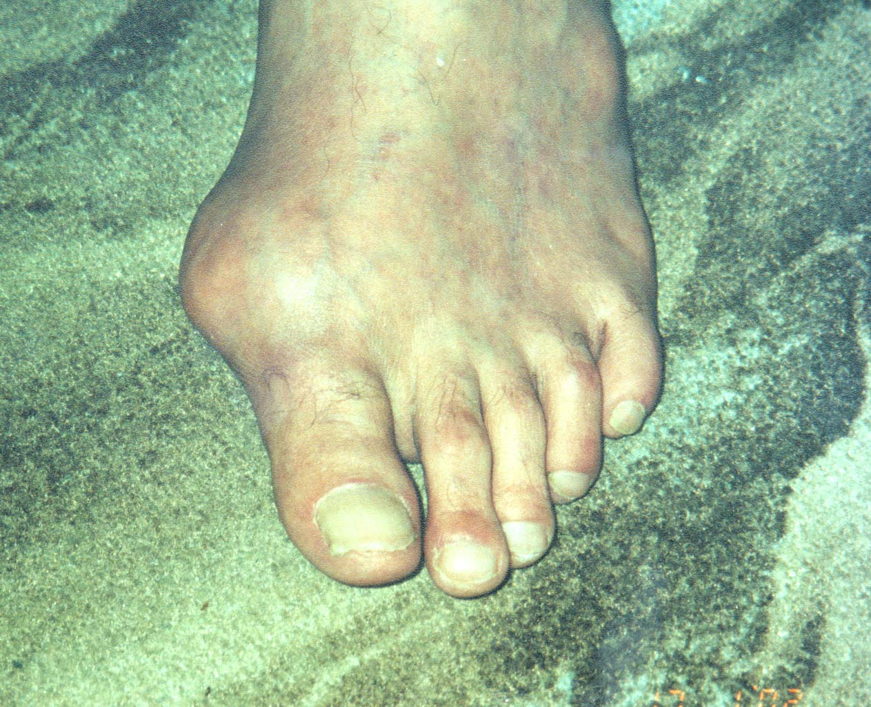

Slide 64
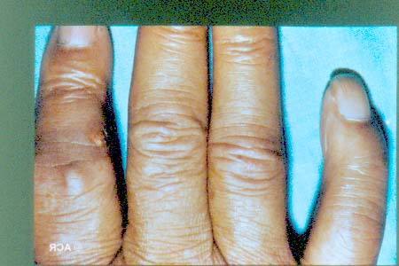
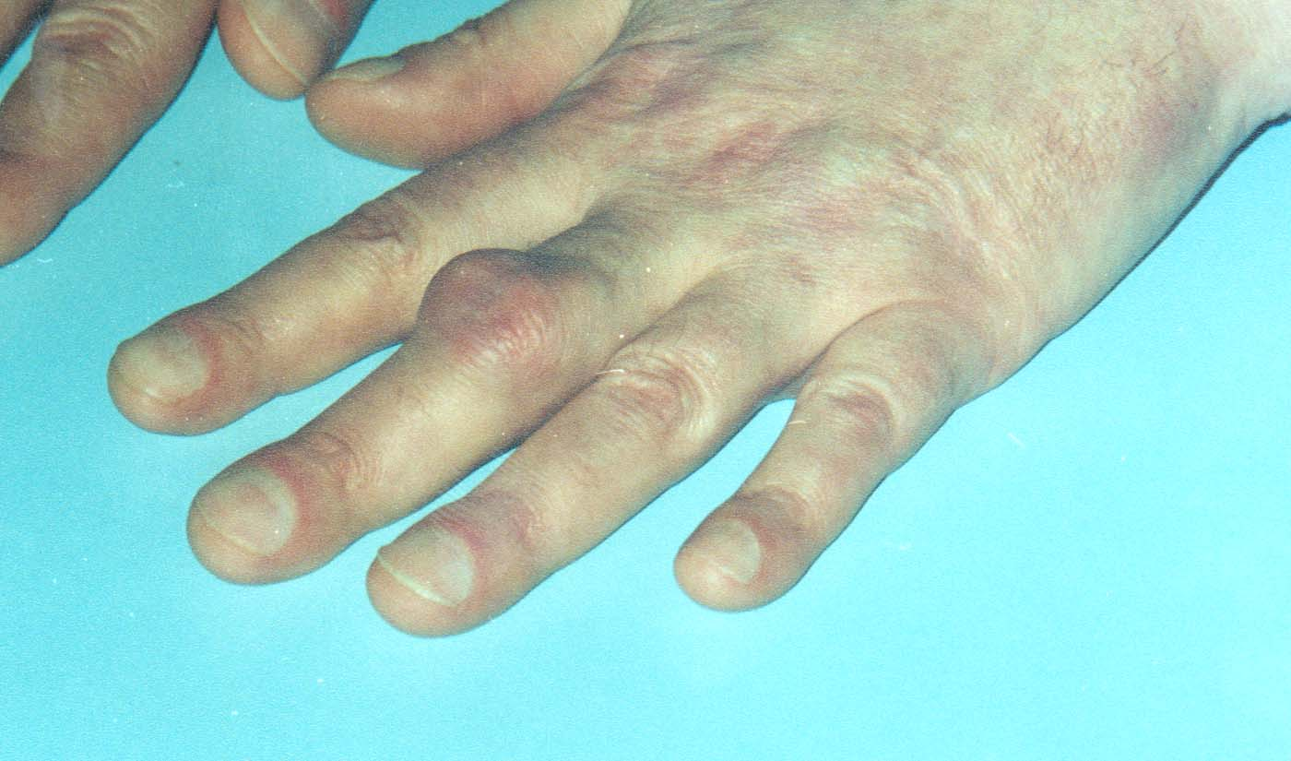

Slide 65
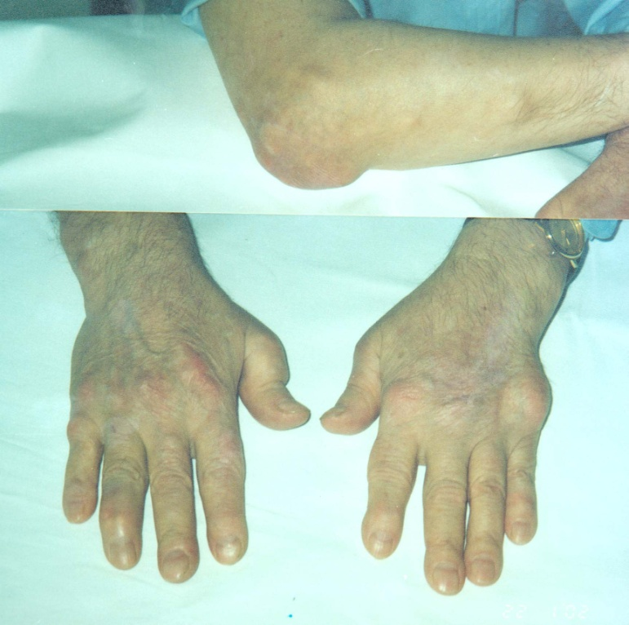
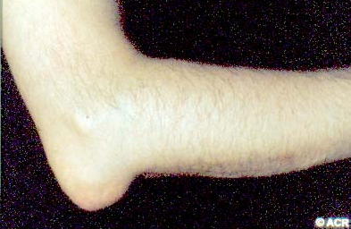
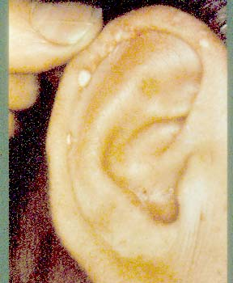

Slide 67
Anti-gout therapy proper
The basic principles of allopurinol therapy
1. It is not recommended to start therapy during an acute attack,
You must try to completely arrest the articular syndrome.
2. If an attack of arthritis developed while taking allopurinol
(usually in the first 3-6 months of initiation of therapy), it is possible
only reduce the dose.
3. For the prevention of acute attacks and severe adverse events.
reactions, it is recommended to begin therapy with a small dose (100,
less than 300 mg)
4. The reflection of the correct selection of the dose is
the rate of reduction of the level of hyperuricemia - not more than 0.6-0.8 mg%,
or 0.1-0.6 mg / dl, or 10% of the original figures within 1 month
therapy "the slower the better"

Slide 68
Anti-gout therapy proper
Uricosuric drugs
Probenecid
increased kidney urate sweating
significantly reduced in size tophi, even for a long time
existing
reduces inflammation in the joints
Dose: 0.25 g every 12 hours for 2-3 days, then 0.5 twice a day
Adapt the dose of the drug according to the level of MK
The risk of crystalluria and urate crisis is an abundant drinking regime,
especially at night

Slide 69
FEATURES OF COURSE OF DISEASES IN THE PERSONS OF ELDERLY AND OLD AGE
The aging of the population makes it an urgent problem of providing medical and social assistance to people of elderly and senile age, about 80% of whom suffer from multiple chronic pathologies.
The course of many diseases in patients of elderly and senile age has its own characteristic features. So, in the morbidity structure of elderly people, the main place is occupied by coronary heart disease, hypertension, diabetes, respiratory diseases, diseases of the musculoskeletal system. At the same time, only one disease is rarely detected in patients - a combination of three, four, and sometimes more diseases is much more common, which creates additional difficulties in treatment and worsens the prognosis for recovery.

Slide 70
Pneumonia in the elderly patients
S.P. Botkin wrote: "In old cases, pneumonia in some cases gives an insignificant reaction to such an extent that it does not strike at all. In such cases, pneumonia must be sought ... Despite the severity of the condition, the patient sometimes has no active complaints."
Over 100 years ago, Osler said: "pneumonia is a friend of old people".

Slide 71
Pneumonia in the elderly patients
For 1000 elderly people living at home, the incidence of pneumonia is 25-45 per year, among those in geriatric institutions - 60-115 cases, and the incidence of hospital pneumonia reaches 250 per 1000. Approximately 50% of cases of pneumonia in the elderly are fatal. and ranked fourth among the causes of death in patients older than 65 years.

Slide 72
Pneumonia in the elderly patients
Factors predisposing to the development of pneumonia in the elderly patients:
− heart failure;
− chronic obstructive pulmonary disease;
− CNS diseases (vascular, atrophic);
− cancer;
− diabetes, urinary tract infections (place of infection);
− recent surgery;
− hospital stay, intensive care wards;

Slide 73
Pneumonia in the elderly patients
Factors predisposing to the development of pneumonia in the elderly:
−  drug therapy (antibacterial drugs, corticosteroids, cytotoxic drugs, antacids, H2-blockers, etc.), reducing the immune response;
− acute respiratory viral infections (influenza, respiratory syncytial infection);
− hypodynamia (especially after surgery), creating "local conditions" for the development of infection.

Slide 74
Clinical features of pneumonia in elderly patients
− minor physical symptoms, frequent lack of local clinical and radiological signs of pulmonary inflammation, especially in dehydrated elderly patients (violation of exudation processes);
− ambiguous interpretation of detectable wheezing (can be heard in the lower sections of the elderly and without pneumonia as a manifestation of the phenomenon of closing of the respiratory tract), areas of dulling (it is difficult to distinguish pneumonia from atelectasis);
− frequent absence of acute onset, pain;

Slide 75
Clinical features of pneumonia in elderly patients
 frequent disorders of the central nervous system (confusion, inhibition, disorientation), occurring acutely and not correlating with the degree of hypoxia (may be the first clinical manifestations of pneumonia and are often regarded as acute disorders of cerebral circulation);
− shortness of breath as the main symptom of the disease, not explained by other causes (heart failure, anemia, etc.);
− isolated fever without signs of local pulmonary inflammation (in 75% of patients the temperature is above 37.5 ° C);

Slide 76
Clinical features of pneumonia in elderly patients
 deterioration of general condition, decrease in physical activity, sudden and not always explainable loss of self-service skills;
− unexplained falls, often preceding the appearance of signs of pneumonia (it is not always clear if a fall is one of the symptoms of pneumonia or the latter develop after a fall);

Slide 77
Clinical features of pneumonia in elderly patients
 exacerbation and decompensation of concomitant diseases (intensification or appearance of signs of heart failure, cardiac arrhythmia, decompensation of diabetes mellitus, signs of respiratory failure, etc.). Often, these symptoms appear in the clinical picture to the fore;
Long-term resorption of pulmonary infiltrate (up to several months).

Slide 78
Pneumonia:
1. Over 60 years of age, acute renal failure in the background of COPD, pneumosclerosis, emphysema, ischemic heart disease, CHF, diabetes, tumors, that is, secondary.
2. Etiology - the importance of Gr-flora (Klebsiella, enterobacteria, legionella), mycoplasma increases.
3. The clinic is atypical - there can be ONE without temperature, intoxication syndrome, it can be - wet rales on the background of CHF is difficult to interpret, delayed regression and prolonged course.

Slide 79
Pneumonia:
4. Radiological changes are very important:
- but remember the background,
- reverse development is delayed by 1.5 months.
5. If more than 1.5-2 months - search for oncology, with the exception of cancer and tuberculosis and the preservation of the clinic - focal pneumofibrosis.
6. Change of respiratory function (mixed type).
7. There are ECG changes up to> P pulmonale, tachycardia, extrasystoles, ECG signs of deterioration of the coronary circulation.
8. Biochemical changes, the shift is maintained up to 3-4 weeks or more.

Slide 80
Antibacterial therapy
The most significant point is the choice of the initial antibiotic - must proceed from the clinical situation in which pneumonia occurred in an elderly patient. The initial choice of antibiotics is not only efficacy and further success or not success of treatment, it implies quite obvious economic aspects, which is of particular importance for the treatment of the geriatric contingent of patients with pneumonia.

Slide 81
Antibacterial therapy
Treatment of community-acquired pneumonia, the choice of antibiotics
Clinical situation | Probable pathogen | Antibiotic
Pneumonia in persons about 60 years without comorbidities | Pneumococcus Mycoplasma Chlamidia | Macrolides
Pneumonia in persons over 60 years or in person with concomitant diseases | Pneumococcus Hemophilius influenza | Aminopenicillins Amoxicillin|clavulanat, macrolides Ampicillin|sulbactam Cephalosporines III generation

Slide 82
Antibacterial therapy
Treatment of community-acquired pneumonia, the choice of antibiotics
Clinical situation | Probable pathogen | Antibiotic
Severe pneumonia | Pneumococcus Hemophilius influenza Microbial association | Аmoxicillin|clavulanat Аmpicillin|sulbactam Macrolides Cephalosporines III generation
Severe pneumonia + risk factors for increased mortality | Pneumococcus Legionella Gram (-) bacillus | Cephalosporines III generation Macrolides Fluoroquinolones Karbapenems

Slide 83
Antibacterial therapy
The appointment of combinations of antibiotics is justified in the treatment of severe pneumonia or with factors increasing mortality.
Effective combinations of penicillins and cephalosporins with aminoglycosides. Metronidazole is combined with antibiotics for anaerobic infections. Abroad widely used combination of cephalosporins with macrolides and aminoglycosides with ciprofloxacin.

Slide 84
Antibacterial therapy
Antibacterial agents, the appointment of which should be avoided in elderly patients
Аntibacterial agents | The reasons for the undesirability of appointment
Aminoglycosides | Nephrotoxicity, hearing loss, deafness, vestibular disorders
Carbopenicillins: carbenicillin, ticarcillin | Platelet dysfunction (bleeding), hypernatremia (progression of heart failure), hypokalemia (cardiac arrhythmia)

Slide 85
Antibacterial therapy
Antibacterial agents, the appointment of which should be avoided in elderly patients
Antibacterial agents | The reasons for the undesirability of appointment
Nitrofurans | High toxicity with reduced kidney function
Penicillins in large doses | Toxic effects of the central nervous system (convulsions)

Slide 86
Antibacterial therapy
Antibacterial agents, the appointment of which should be avoided in elderly patients
Antibacterial agents | The reasons for the undesirability of appointment
Polymixines | Nephrotoxicity, neurotoxicity
Tetracyclines | Nephrotoxicity with kidney disease, hepatotoxicity

Slide 87
Antibacterial therapy
Antibacterial agents, the appointment of which should be avoided in elderly patients
Antibacterial agents | The reasons for the undesirability of appointmen
Chloramphenicol | Inhibition of bone marrow function (neutropenia / agranulocytosis, aplastic anemia)
Cephalosporins with a N-methyl-thiotetrazole structure (cefemandole, cefotetan, cefmetazole, cefoperazon, latamoxfef) | Impaired intestinal absorption of vitamin K, bleeding

Slide 88
TREATMENT
Antibiotics are cautious in view of acute vascular insufficiency during the period of critical temperature reduction, and vascular insufficiency may manifest as chronic, cerebrovascular, coronary or renal failure.

Slide 89
TREATMENT
Evaluation of the effectiveness of antibiotics:
- 48-72 hours efficiency;
- more often toxic effects of antibiotics - control of renal, hepatic parameters, complete blood count, urinalysis.

Slide 90
TREATMENT
– mucolytics;
- bronchodilatory (atrovent);
- detoxification therapy (not transfuse);
- oxygen therapy, painkillers, for CHF - glycosides, an ACE inhibitors, diuretics, respiratory analeptics.

Slide 91
COPD in elderly patients
- progressive nature of COPD → irreversible changes
(emphysema, pneumosclerosis, RI),
- erasing the nosological faces (diagnosis of COPD: BA + COPD),
- erasing the faces of exacerbations and remission,
- contribution to the symptoms of COPD (cough, shortness of breath) of other CVDs,
- diagnostics (clinical + additional emphasis on cardiovascular system (ECG, ultrasound)),
differential diagnosis with cancer,

Slide 92
COPD in elderly patients
treatment (training - 1, especially in old age):
- refusal of smoking ,
- bronchodilators (<β2 agonists,> anticholinergics, β-blockers are prohibited (even with CHD PICS)),
- aspirin (carefully), aspirin asthma (polinoz),
- mucoregulators in full,
- GCS (caution → inhalation),
- antibiotics for strict infectious indications,
- RI correction - obligatory (oxygen therapy, breathing exercises),
- ERT (electrotherapy in the absence of contraindications - CHD, AG).

Slide 93
International Recommendations for Asthma and COPD
 | The optimal route of administration | Basic therapy | Situational therapy
Аsthma | Inhalation Nebulizer | Antiinflammatory | Bronchodilators: 1. Beta agonists 2. Cholinilitics 3. Theophyllines
COPD | Inhalation Nebulizer | Bronchodilators: 1. Beta agonists 2. Cholinilitics 3. Theophyllines | Antibacterial therapy

Slide 94
Tactics of treatment of COPD
Patient education
Smoking cessation
Bronchodilator therapy
Mucoregulatory therapy
Glucocorticosteroid therapy
Correction of respiratory failure
Anti-infective therapy
Rehabilitation therapy

Slide 95
Algorithm of basic therapy of COPD
Iprathropium
Оptimal action
Continuation of
treatment
Small action
No effect
Addition of
beta agonists
Оptimal action
Continuation of treatment
Small action
Abolition of
beta agonists
Addition of prolonged
theophylline

Slide 96
Advantages of an inhalation route of administration
Creating a high concentration of the drug in the airways
The speed of the effect
Minimum side effects

Slide 97
Spacer advantages
Easier coordination with breathing
Prevention of oropharyngeal aerosol deposition
Prevent cold irritation

Slide 98
Benefits of Nebulizer inhalation
The possibility of introducing a high dose of the drug
Creating an aerosol with optimal particle size
Coordination of inhalation with inhalation is not required.
Inhalation technology is easily doable for children, elderly and severely ill
The possibility of inclusion in the circuit of oxygen supply and circuit ventilation
Lack of freon and other propellants

