Slide 1
A Review of Pulpotomy Techniques
in Primary Molars

Slide 2
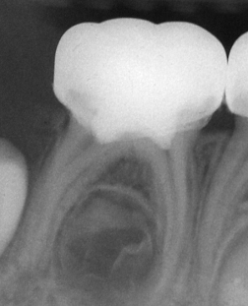
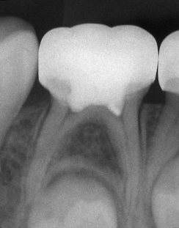
A review of pulpotomy techniques in primary molars
Pulpotomy of primary teeth is a technique that has been used to treat teeth of which only the coronal pulp has been affected or infected by caries or has been traumatized, while the radicular pulp remains healthy. Signs and symptoms that indicate extensive inflammation or necrosis of the radicular pulp are against the use of this procedure.
Fuks & Eidelman 1994
6 mo
36 mo

Slide 3
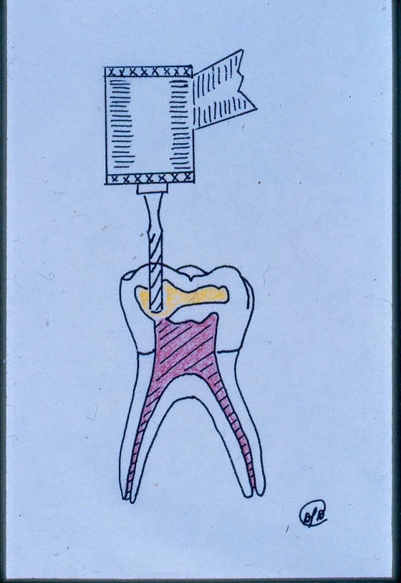
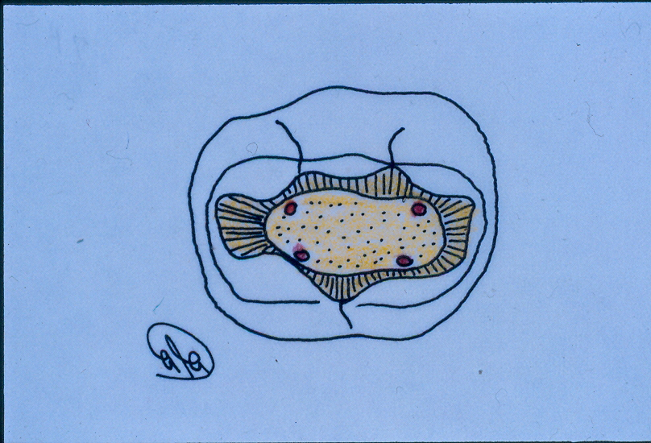
Exposure of pulp horns

Slide 4
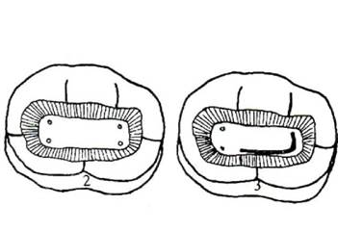
Connection of pulp horns

Slide 5
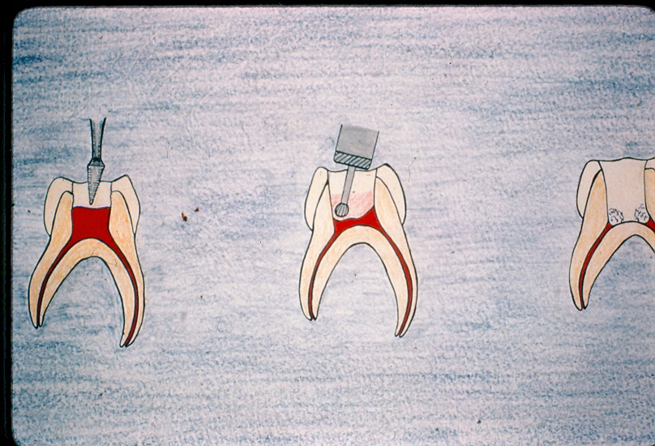
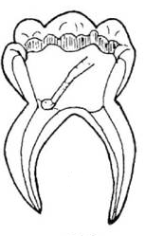
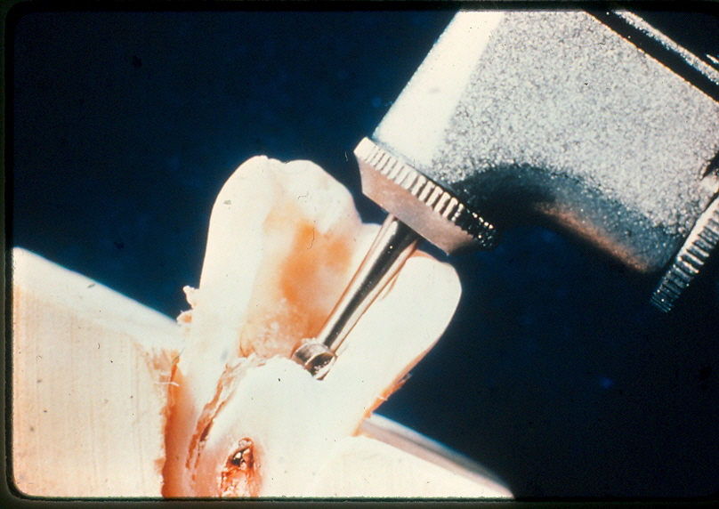
Removal of the crown pulp

Slide 6
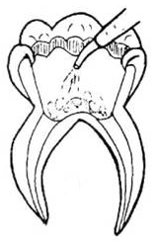
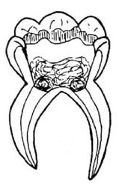
Tooth rinsing
Haemostasis with cotton pellets

Slide 7
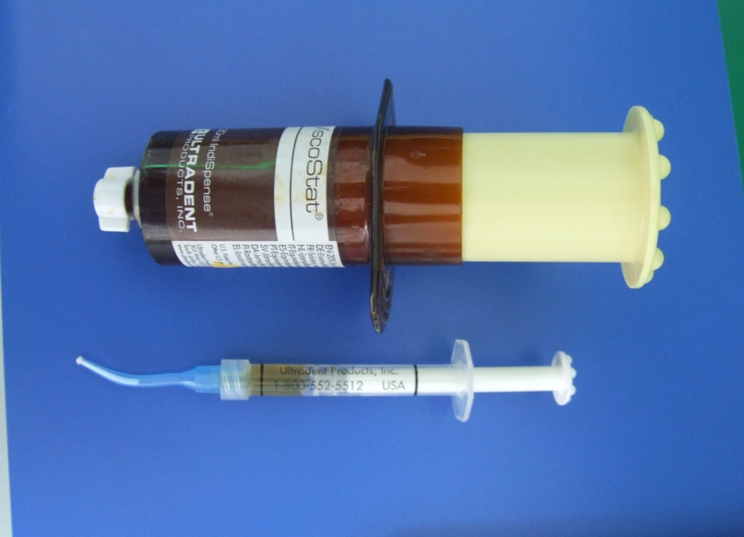
Ferric Sulphate = Haemostatic Factor

Slide 8
A review of pulpotomy techniques in primary molars
Pulpotomy techniques:
Devitalization
Formocresol - Electrosurgery
Preservation
Glutaraldehyde - Ferric sulphate - Nd:YAG lazer
Regeneration
Ca(OH)₂ - MTA - BMP
Modified by Ranly, Pediatr. Dent. 1994
Notes:
Pulpotomy therapy for primary teeth has been developed along three lines: Devitalization with the use of formocresol (FC) and electrosurgery where the intent is to destroy the radicular pulp,
Preservation of the remaining radicular pulp with the use of glutaraldehyde and ferric sulphate (FS)
Regeneration of the radicular pulp by stimulation of the dentinal bridge which in humans has been done with the use of calcium hydroxide and mineral trioxide aggregate and in animal studies with morphogenetic protein (BMP).
From the above treatments, formocresol technique, that first was introduced by Sweet in 1904, is considered, for a 100 years now, the most universally taught and preferred pulp therapy for primary teeth .

Slide 9
A review of pulpotomy techniques in primary molars
Formocresol pulpotomies
Clinical studies: High success rate (70%-98%)
Histological findings: Chronic inflammation and necrosis of the
radicular pulp
Animal studies: Systemic distribution of the formocresol and
allergic and mutagenic properties
Human studies: No direct evidence of adverse effects
Notes:
Formocresol pulpotomies have, in clinical trials, an overall success rate of 55% to 98%. The success rate is mainly depending on sample size and the length of the observation period of each study.
However, histological studies on formocresol pulpotomies have shown chronic inflammation and necrosis of the radicular pulp, while other studies have shown systemic distribution of formocresol from the pulpotomy site and allergic or mutagenic properties of formaldehyde in animal models. Formocreasol (FC) is no longer used in Canada and the Netherlands due to safety concerns. However in humans there is no direct evidence of adverse effects due to FC pulpotomies so far, but the potential remains that further research may provide evidence justifying caution in the use of aldehydes in pulp therapy techniques.

Slide 10
A review of pulpotomy techniques in primary molars
Electrosurgery pulpotomies
Comparison of electrosurgical and formocresol pulpotomy procedures in children.
Dean JA, Mack RB, Fulkerson BT, Sanders BJ. Int. J Paediatr. Dent 2002
This article is inconclusive, since the follow-up period was up to 5
months post-operative.
Notes:
From all the other medicaments that have been used so far, electrosurgery has been also used but the data that where obtained from the literature were inconclusive since even in the very well designed study by Dean et al. the observation period was only 5 months postoperative period which is a very short time for one to draw conclusions.

Slide 11
A review of pulpotomy techniques in primary molars
Laser pulpotomies
Nd:YAG laser pulpotomy of human primary teeth.
Liu J. International Congress Series 2003
This article shows that Nd:YAG laser is superior to formocresol,
without statistical analysis of the results.
Notes:
The same applies for the use of lasers since there is only one study in the literature. This study by Liu, showing 6-48 months follow up, shows very good results in teeth that were treated with Nd:YAG laser. The control group consisted of teeth treated with formocresol. There was no statistical analysis of the data and also the follow up was not the same for both treatments.

Slide 12
A review of pulpotomy techniques in primary molars
Ferric sulphate
Ferric sulphate is a hemostatic agent that causes
agglutination of blood proteins forming plugs that occlude the
capillary orifices.
FS is proposed as a promising alternative to formocresol
pulpotomies from recent clinical studies.
Notes:
Ferric sulphate has been used as a hemostatic agent for crown and bridge impressions. Even though the mechanism of the haemostatic action of ferric sulphate is still debated, it seems that agglutination of blood proteins results from the reaction of blood with ferric and sulphate ions with the acidic pH of the solution. The agglutinated proteins form plugs that occlude the capillary orifices. The use of ferric sulphate was recommended on the grounds that it may prevent problems arising from clot formation after the removal of the coronal pulp and minimizes the chances for inflammation and internal resorption that, according to Schroder, was an important factor for the failure of pulpotomies with calcium hydroxide. Ferric sulphate (FS) seems to be a promising alternative to formocresol since, in clinical trials, has given similar to it success rates.

Slide 13
A review of pulpotomy techniques in primary molars
Mineral Trioxide Aggregate (MTA)
Stimulates cytocine production in human osteoblasts
Produces bone healing in cases of pulp capping, apexification,
root perforation and root-end filling
Produces dentinal bridge in pulpotomized human teeth
Excellent results as a pulpotomy dressing in clinical studies
Notes:
MTA is a relatively novel material that appears to stimulate cytokine production in human osteoblasts and allow good adherence to the cells of the materials, as proved by Koh et al. in 1996. Since 1998 MTA has been approved by the US Food and Drug Administration, as a therapeutic endodontic material for humans. MTA has been proved to allow bone healing and elimination of clinical symptoms in cases of pulp caping, apexifications, root perforation repairs and root-end fillings. There are two studies by Eidelman et al. and Agamy et al. in which MTA has been used as the dressing material after pulpotomy of primary molars. From those two studies MTA seems a promising material for the pulpotomy of primary teeth.

Slide 14
A review of pulpotomy techniques in primary molars
Purpose
To review prospective and retrospective clinical studies in
which Ferric sulphate (FS) and Mineral Trioxide Aggregate
(MTA) have been compared to formocresol as a pulpotomy
medicament.
To determine which of the above medicaments is the most
appropriate for the pulpotomy of primary molars.

Slide 15
Clinical studies on ferric sulphate
as a pulpotomy medicament in primary teeth
Materials & Methods
Notes:
The Methods and Materials that have been used are similar in all these studies so we can easily compare them.

Slide 16
Methods & Materials
Subject selection:
Symptomless exposure of vital pulp by caries
No clinical or radiographic evidence of pulp degeneration
Possibility of proper restoration of the teeth
Notes:
The sample used consisted of primary molars of healthy children that were selected on the basis of symptomless exposure of vital pulp by caries, absence of clinical or radiographic evidence of pulp degeneration and possibility of proper restoration.

Slide 17
Methods & Materials
Pulpotomy technique:
Isolation with rubber dam
Caries removal
Removal of pulp chamber roof (#330 bur)
Coronal amputation with a slow speed round bur and a spoon excavator
Hemostasis with cotton pellets
Notes:
The teeth were treated under local anaesthesia and isolation with rubber dam. Following caries removal the pulp chamber was removed and coronal amputation was performed with a slow speed round bur and/or with a spoon excavator. Haemostasis was obtained with cotton pellets.

Slide 19
Methods & Materials
Pulp covering:
Zink Oxide Eugenol Paste (ZOE) + Reinforced ZOE (IRM)
Restoration:
Stainless steel crown
Composite resin
Notes:
Pulp covering - Restoration. After rinsing, the pulpal stumps were covered by a layer of Zinc oxide eugenol cement (ZOE) and a second layer of reinforced ZOE cement. Then the teeth were restored, in all published studies, by a stainless steel crown with the exception of our study where a composite resin was also used.

Slide 20
Methods & Materials
Recall examination: every 3 – 6 – 12 months
• Clinical
• Radiographic
Notes:
Recall examination . The recall examination period varied among the studies from 3 to 6 months after the pulpotomy for the first recall and 6 to 12 months for the following ones.

Slide 22
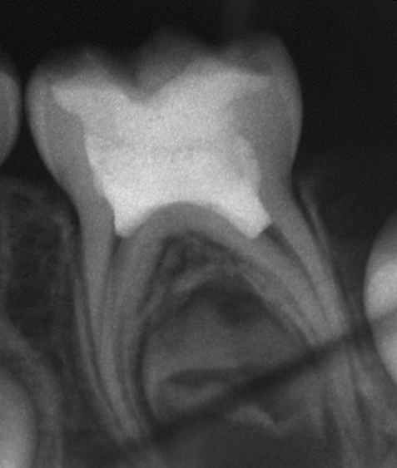
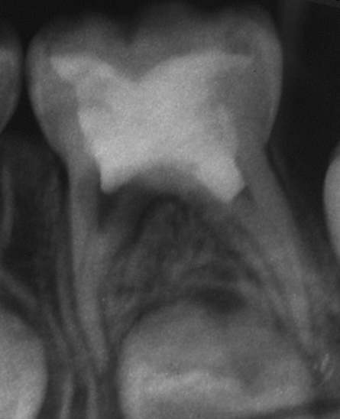
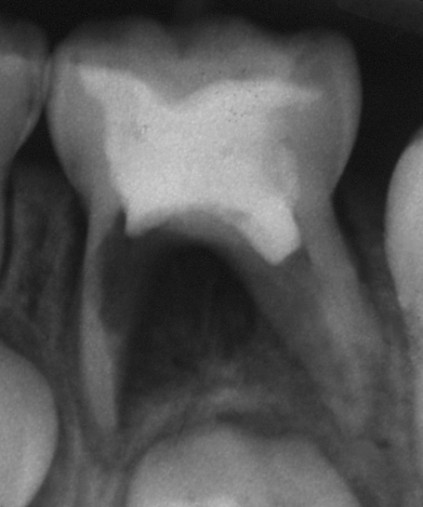
A three-year comparative study in pulpotomized primary teeth: FS vs FC
Excessive internal resorption
6 mo
12 mo
24 mo
Notes:
Radiographs on mandibular second primary molar with excessive internal resorption at the 12th month and interradicular and periapical lession at the 24th month.

Slide 23
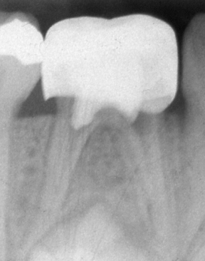
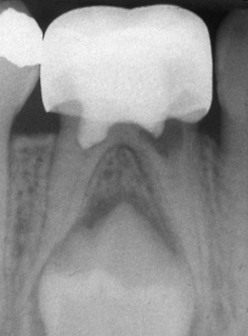
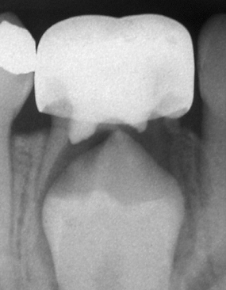
A three-year comparative study in pulpotomized primary teeth: FS vs FC
Internal resorption progressing with time
12 mo
24 mo
36 mo
Notes:
Radiographs of mandibular primary molar with internal resorption progressing with time

Slide 24
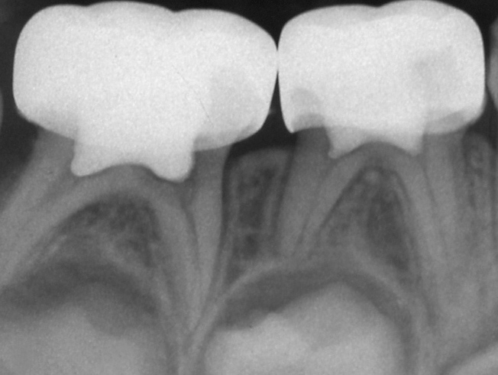
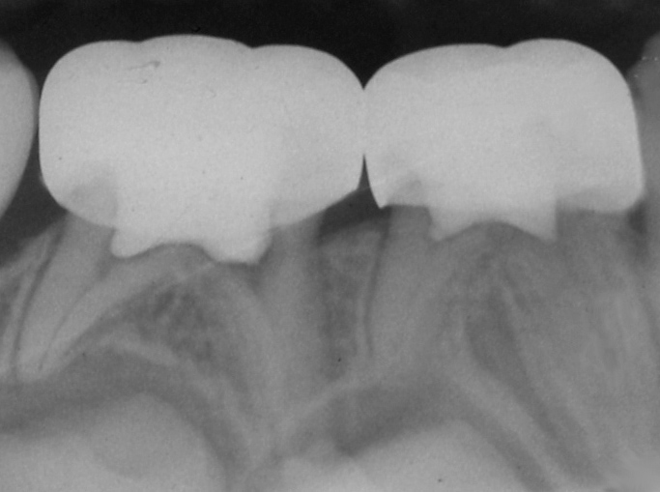
A three-year comparative study in pulpotomized primary teeth: FS vs FC
Internal resorption unchanged by time
12 mo
36 mo

Slide 25
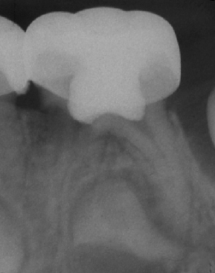
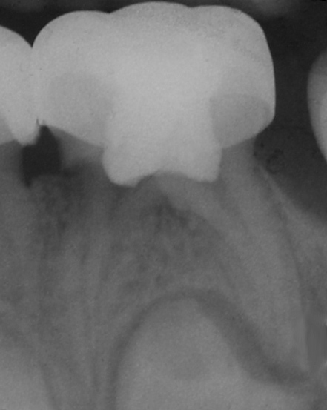
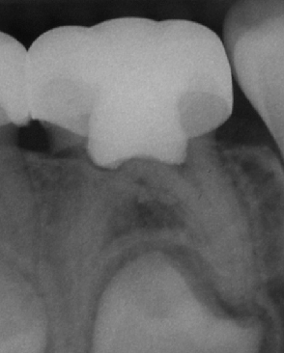
A three-year comparative study in pulpotomized primary teeth: FS vs FC
Internal resorption repaired by hard tissue
12 mo
24 mo
36 mo
Notes:
In this molar the area with resorption was filled with reparative hard tissue as you can see in this radiographs.

Slide 26
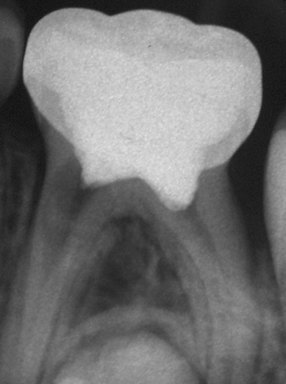
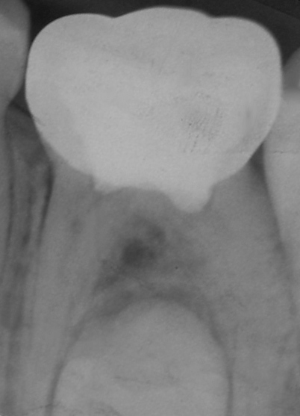
A three-year comparative study in pulpotomized primary teeth: FS vs FC
Internal resorption repaired by hard tissue
12 mo
24 mo
Notes:
Another case of a molar filled with hard tissue from the 12th to 24th month.

Slide 27
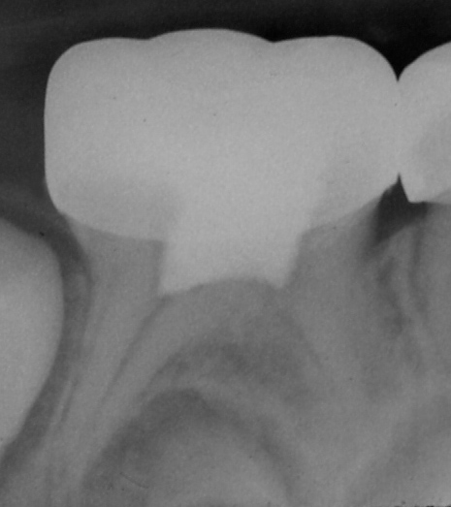
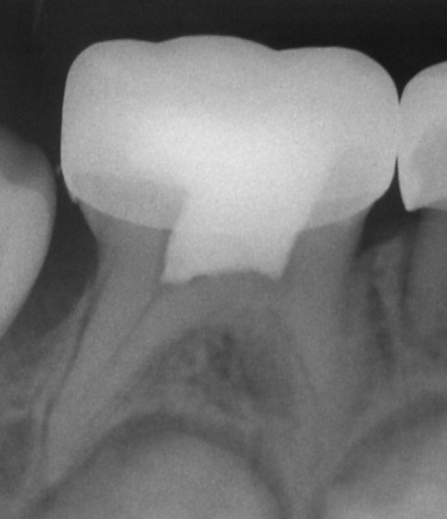
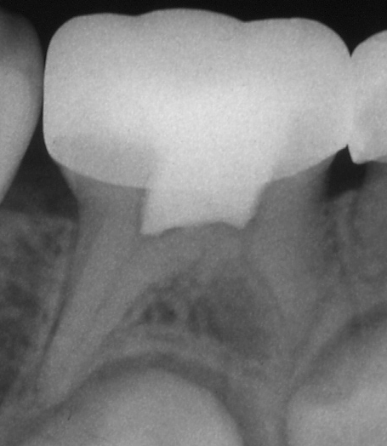
A three-year comparative study in pulpotomized primary teeth: FS vs FC
Calcific metamorphosis
6 mo
24 mo
36 mo
Notes:
Calcific metamorphosis was the most common finding for both treatments. Calcicfic metamorphosis was not consider a failure.

Slide 28
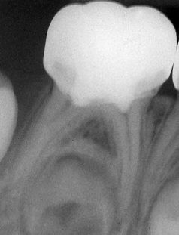
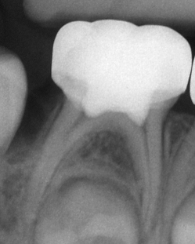
A three-year comparative study in pulpotomized primary teeth: FS vs FC
6 mo
12 mo
24 mo
36 mo
Notes:
One case of a mandibular molar treated successfully with FS in 6, 12, 24 and 36 months after pulpotomy.

