Slide 1

Disconnect your mobile phones!

Slide 2
Theme: “Prosthodontics. Definition, stages of development, problems, structure. Teeth. Dental arches. Bite. Clinical examination of prosthodontics patient. Case report.”

Slide 3
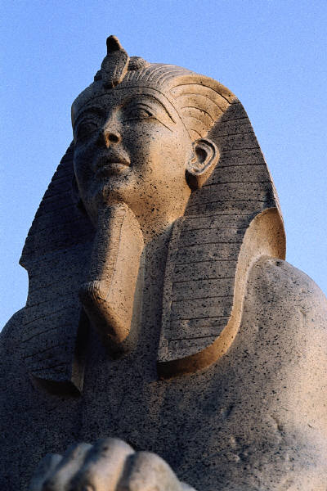
2500 B.C.
Egypt
In 1807 y. it was find the wooden prosthesis in Hephrem pyramid

Slide 4
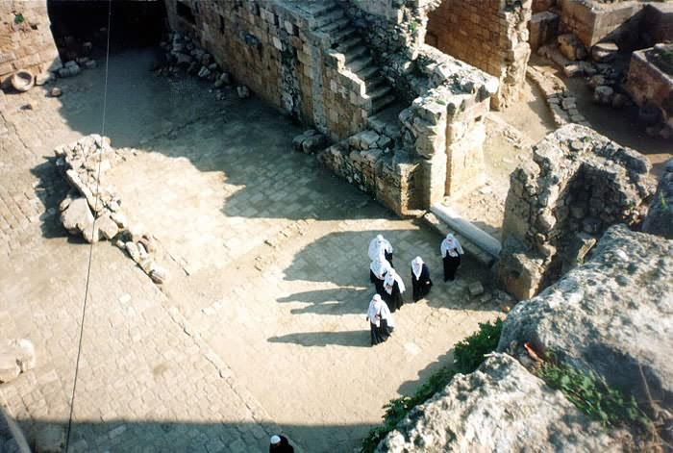
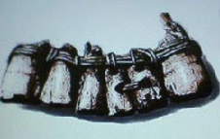
12 century B.C.
Phinikia SIDON
Wooden prothesis, fixed to teeth with gold wire

Slide 5
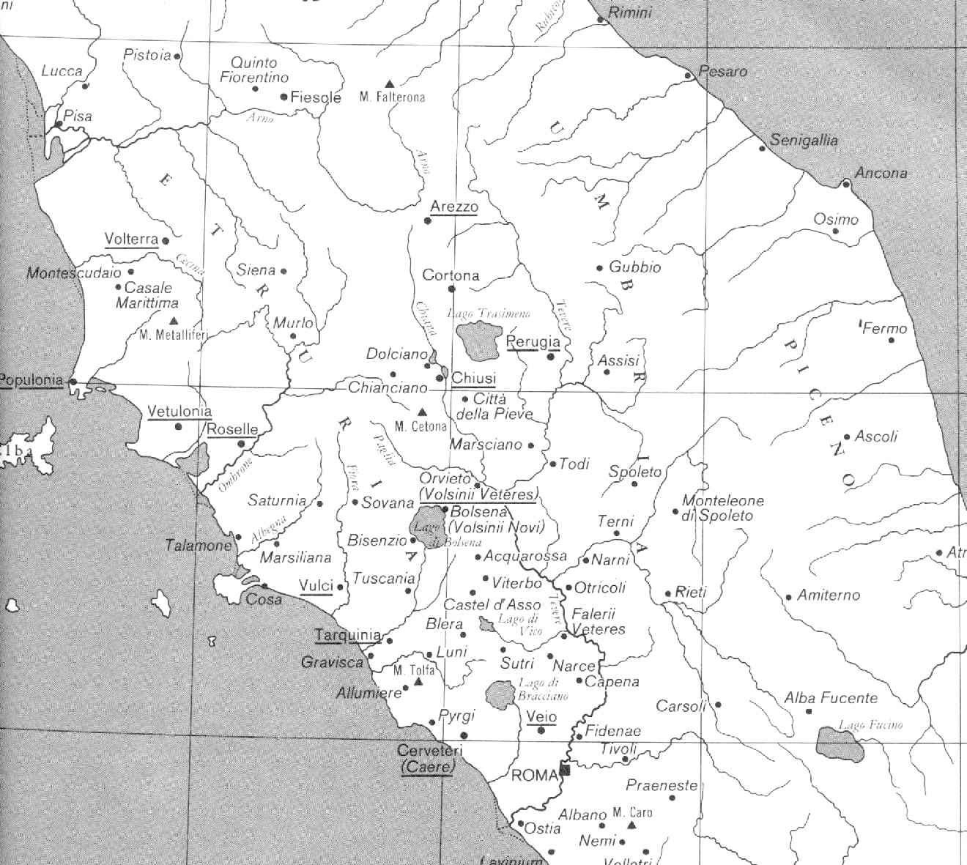
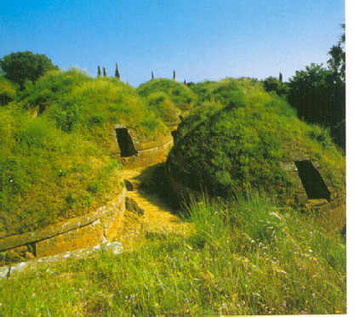
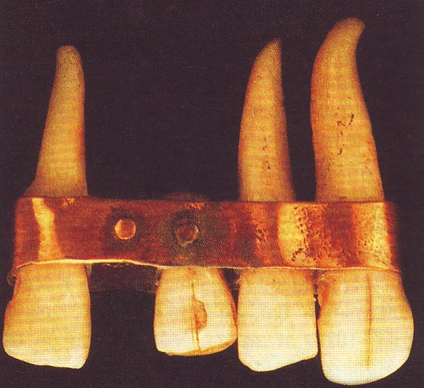
7 century B.C.
Apennines tombs of Ethrusks
There are finded gold dental prostheses, like modern removed bridge. Artificial teeth fixed to nature support teeth with rings.

Slide 6
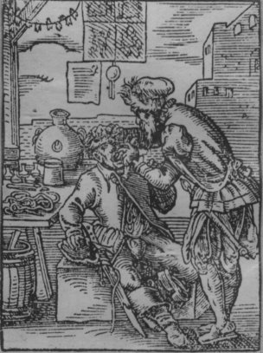
MIDDLE AGES
Dental prosthetics hand of artisans (jewellers, etchers, barbers). For artificial teeth used elephant ivory, nature teeth from corpses.
Decadence of science and art
TOOTHEXTRACOR
engraving XIV C.

Slide 7
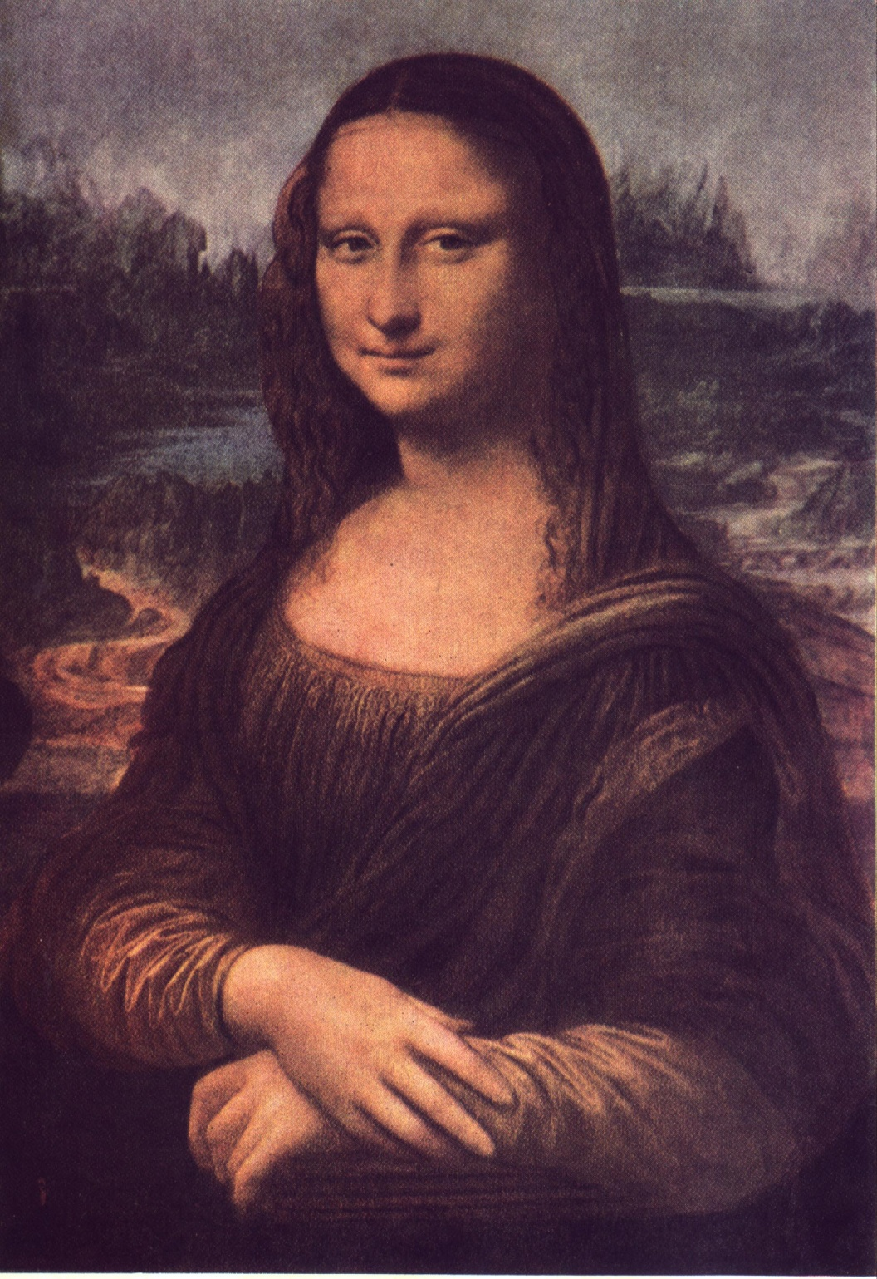
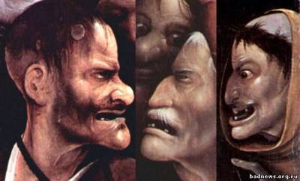
Renaissance
In 18 century it was improvement of dental prosthetics. A prosthesis didn’t satisfactory for cosmetic and functional requirements
Dental practice and dental prostheses is medical discipline now.

Slide 8
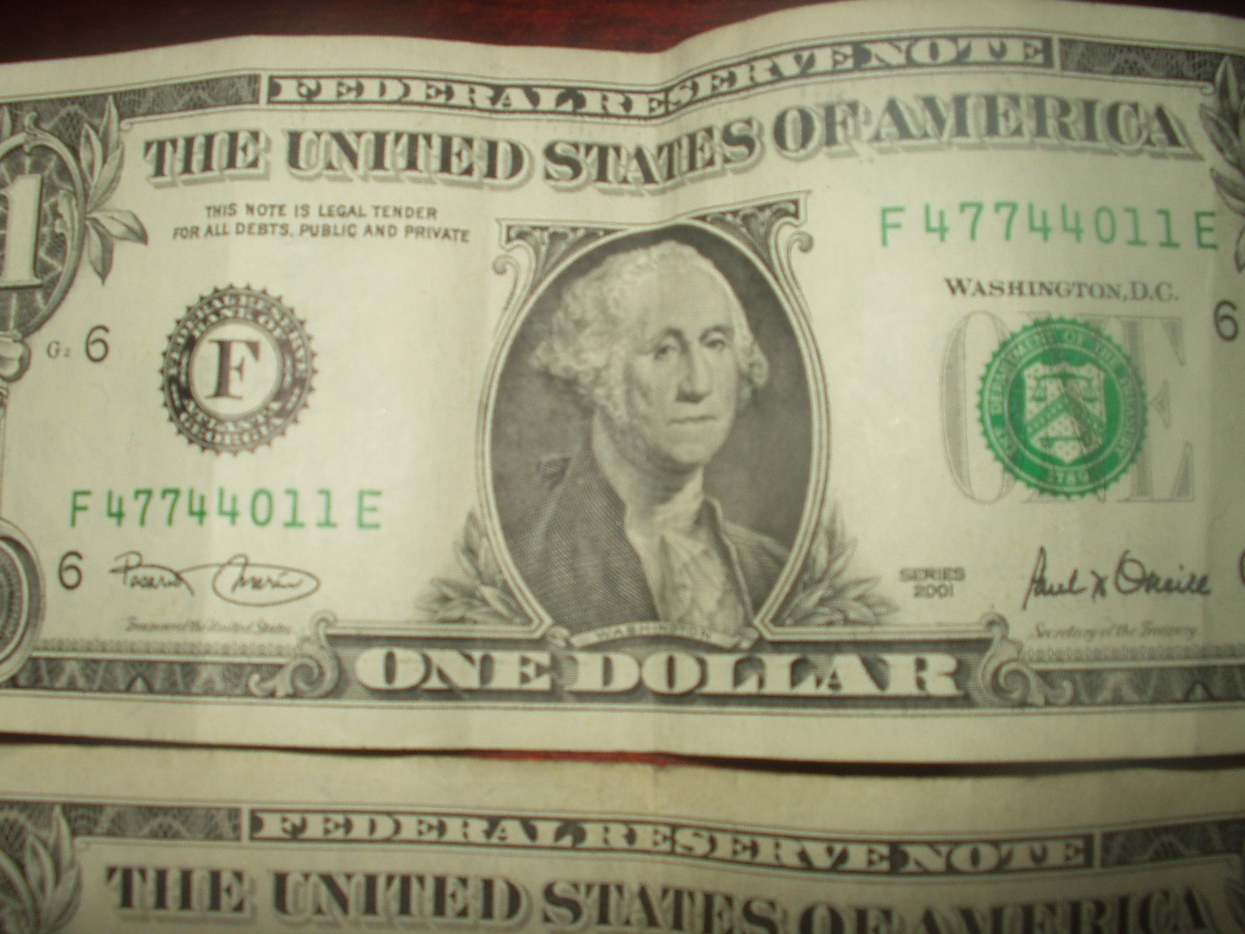
Jorge Washington

Slide 9
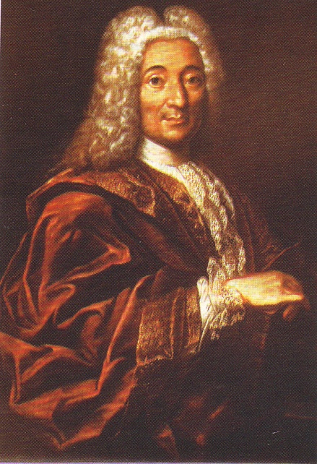
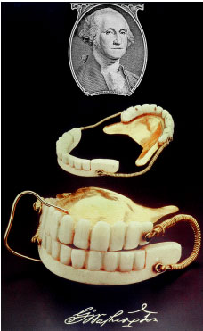
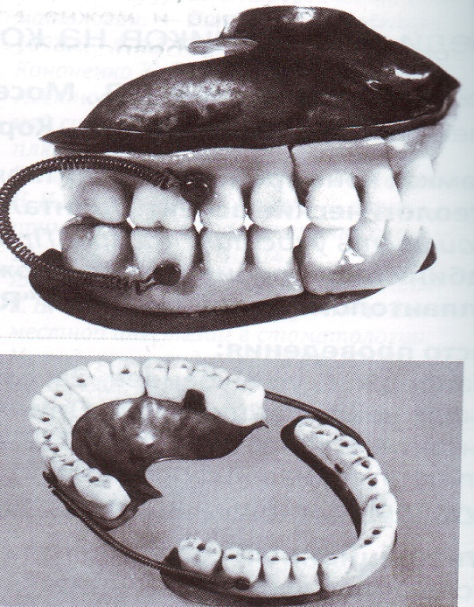

Slide 10
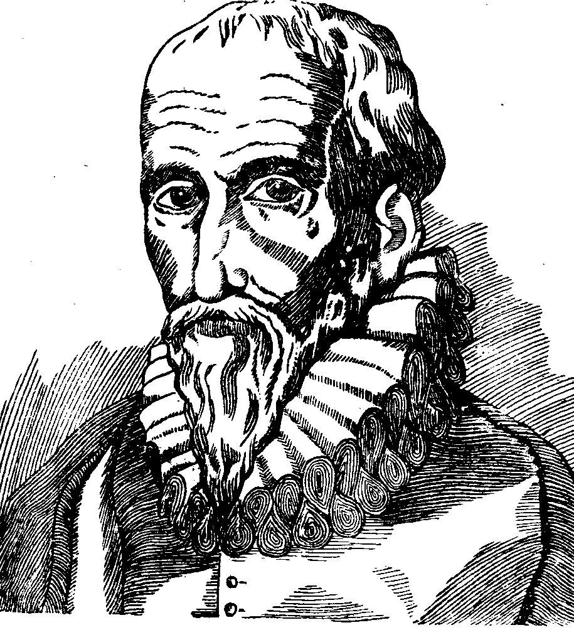
Main advances
1590 y.
Ambruas Pare
He is the first, who describe apparatus for cover defects of palate up
OBTURATOR

Slide 11
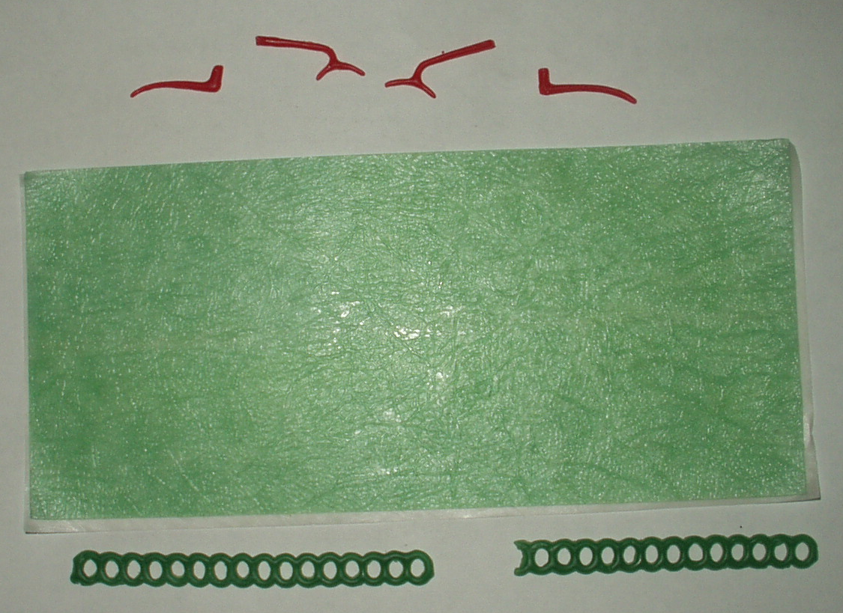
Main advances
1721 y.
Gotfreed Purman
To use WAX
for obtained impressions

Slide 12
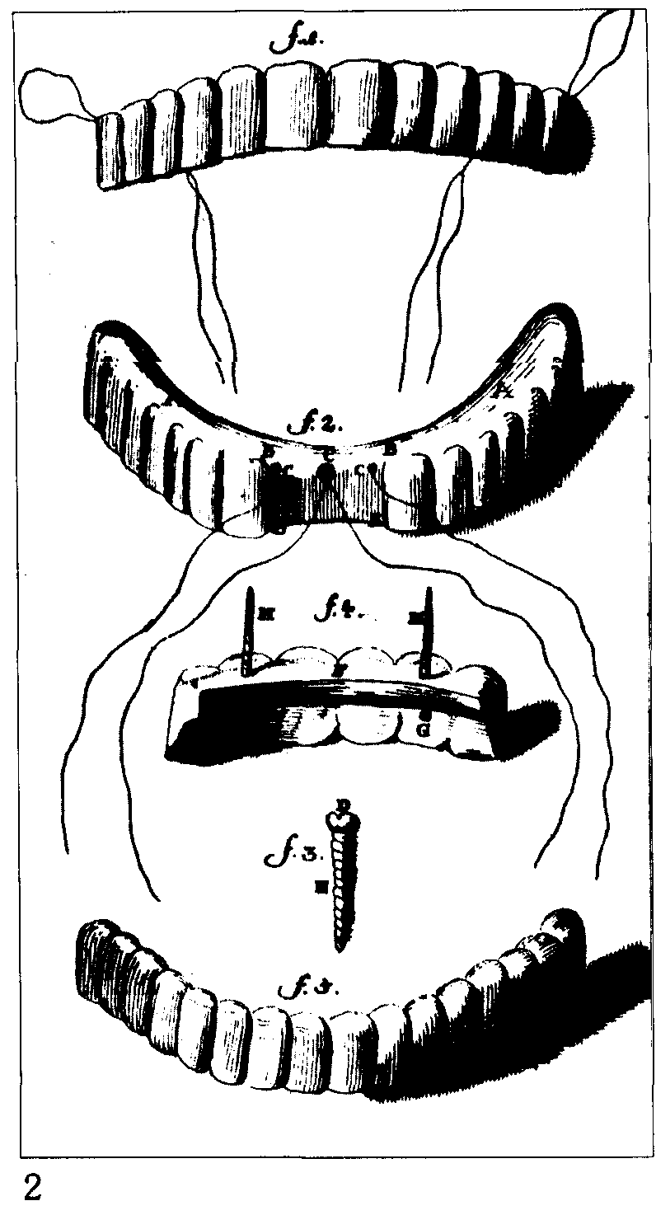
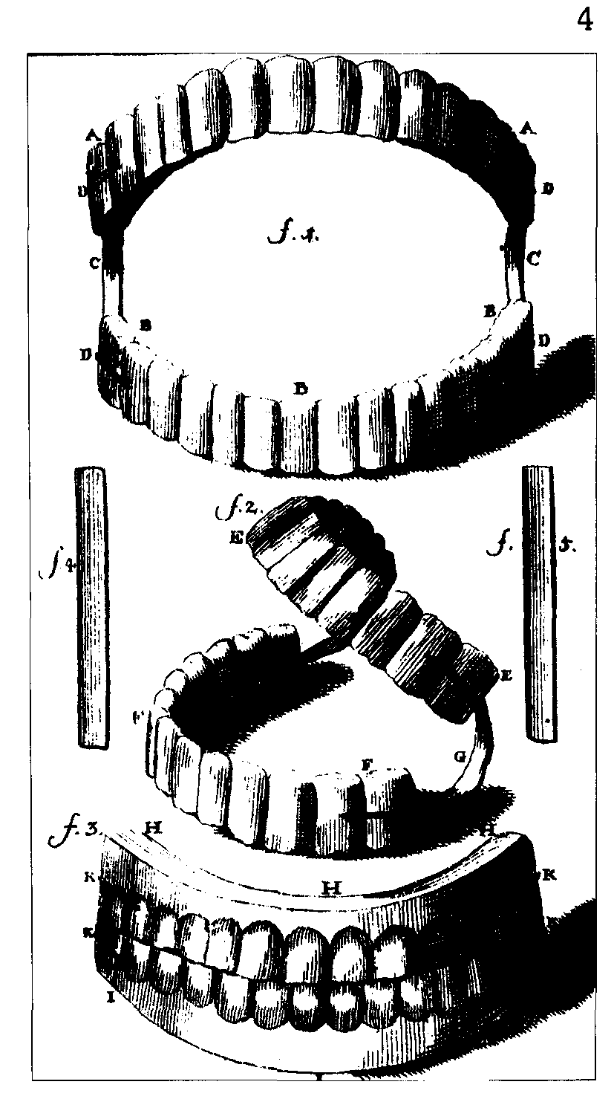
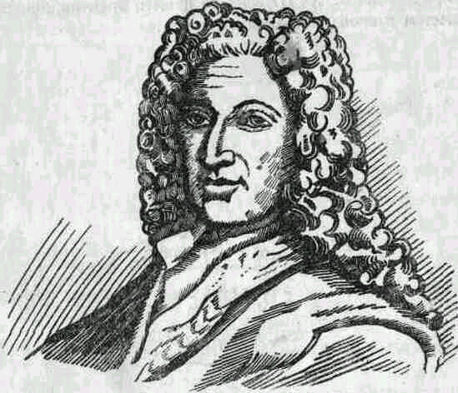
P’er Foshar (1670—1762) в 1728 г.
Fixing complete denture with gold springs;
To use nature teeth for pin construction;
To cover artificial teeth with enamel
Improvement the obturator for hard palate, invented Ambruase Pare, 18 centure

Slide 13
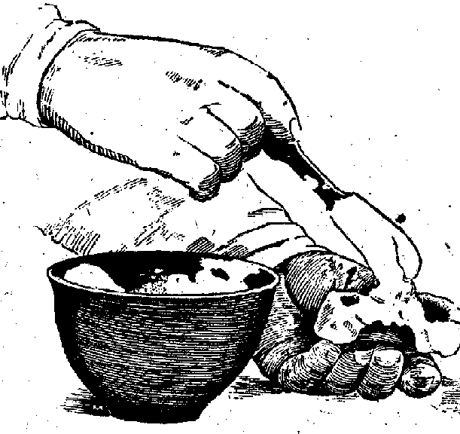
Main advances
1756 y.
Pfaf
To use
gipsum
For making casts

Slide 14
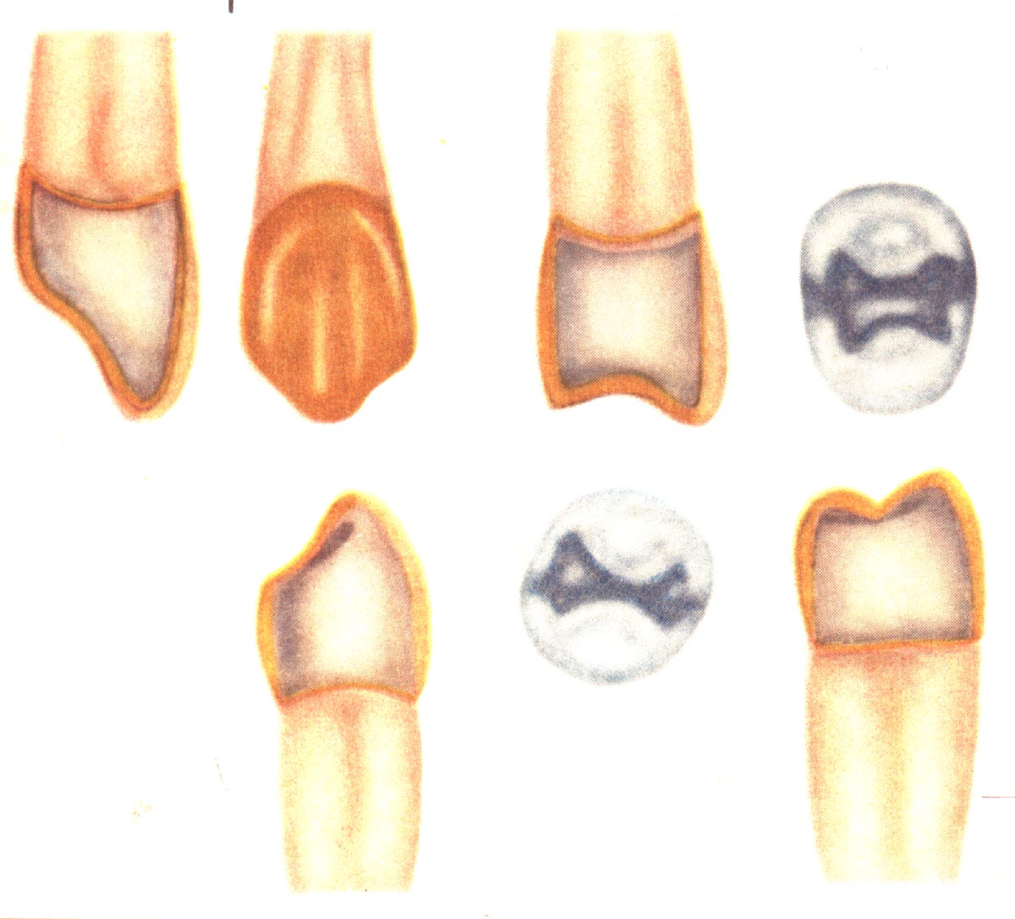
Main advances
1756 y.
Muton
To make gold crown
and
clamps

Slide 15
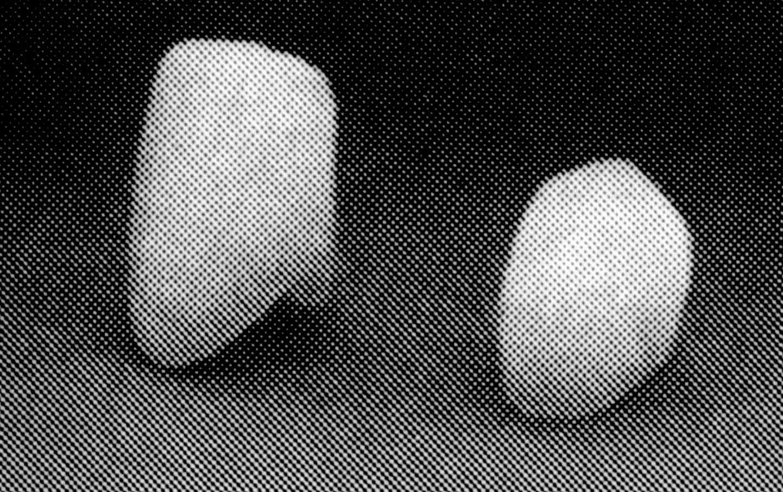
Main advances
1776 y.
Dushato
Dubua-Shaman
invent and improvement of porcelane teeth

Slide 16
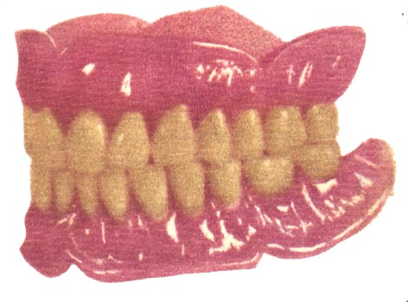
Main advances
1800 y.
Herbst
Make complete denture, which fixed by difference between atmosphere pressure
over and under prothese.

Slide 17
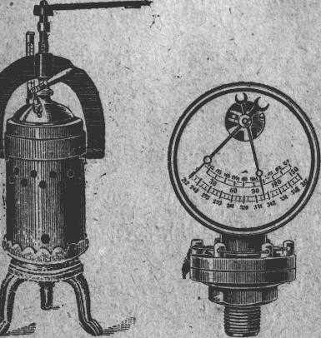
Main advances
1856 y.
Petmen
Invent
apparatus for rubber vulcanization,
use rubber for making basis of dentures

Slide 18
To end of 19 century
Dental prosthesis included whole tissue of oral cavity, not only teeth.
It was appeared new title-
“prothesis dentistry"
Prosthodontics (app. In XX century)
occupied recognizing, prevention, detecting and treatment of defects of dental arches by its compensation, and correction of deformations of maxillofacial area.

Slide 19
The structure of prosthodontics
Science of materials;
Laboratory and prosthesis techniques;
Dental prostheses;
Maxillofacial orthopedic;
Orthodontic;
Implantology.

Slide 20
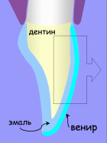
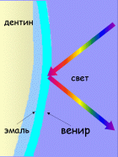
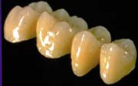
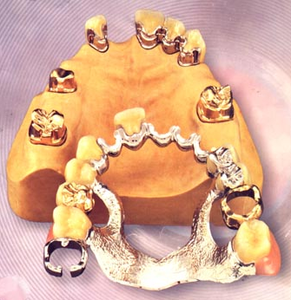
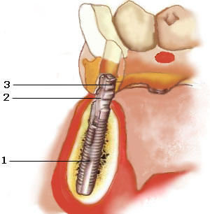
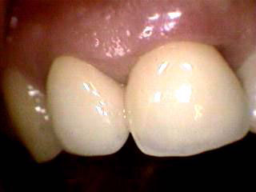
Modern kids of prostheses
Veeners
Metalloceramic
Ceramic without metal
Bugel denture with attachments
Implantation

Slide 21
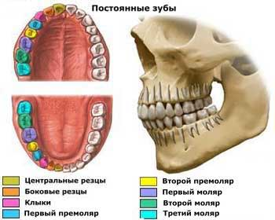

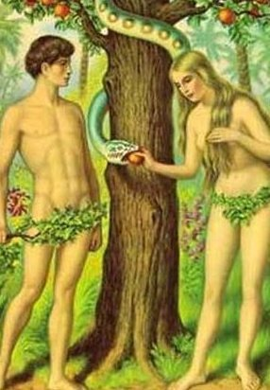
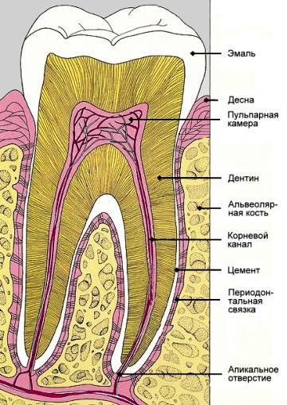
Teeth. Dentition, bite.
According to legend, the Buddha in his mouth had 40 teeth.
And the first man - Adam had 30 teeth.
What was the woman making from?

Slide 22
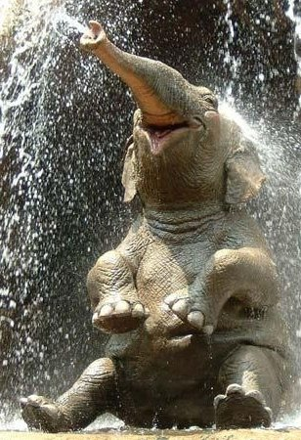
Teeth. Dentition, bite.
Ordinary people for life has 2 generations of teeth: 20 deciduous teeth, and then 32 permanent teeth.
But the new teeth can grow up to 6 times in elephants.

Slide 23
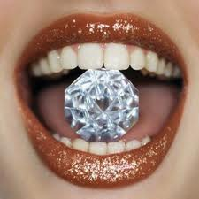
Teeth. Dentition, bite.
Tooth enamel is the hardest tissue in the human body.
The tooth is the only part of the human body, which is unable to repair itself.

Slide 24
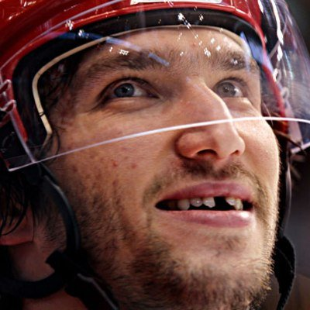

Teeth. Dentition, bite.
The most dangerous sports for teeth is hockey:
68 % of professional players on the field have lost at least one tooth.

Slide 25

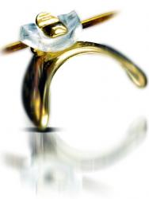
Teeth. Dentition, bite.
Самым дорогим зубом в мире считался зуб британского ученого сэра Исаака Ньютона, проданный на лондонском аукционе 1816 года за 3,300£, что примерно равняется 38 535 долларам по текущему курсу.
Купивший его аристократ вставил этот зуб в свой перстень.

Slide 26
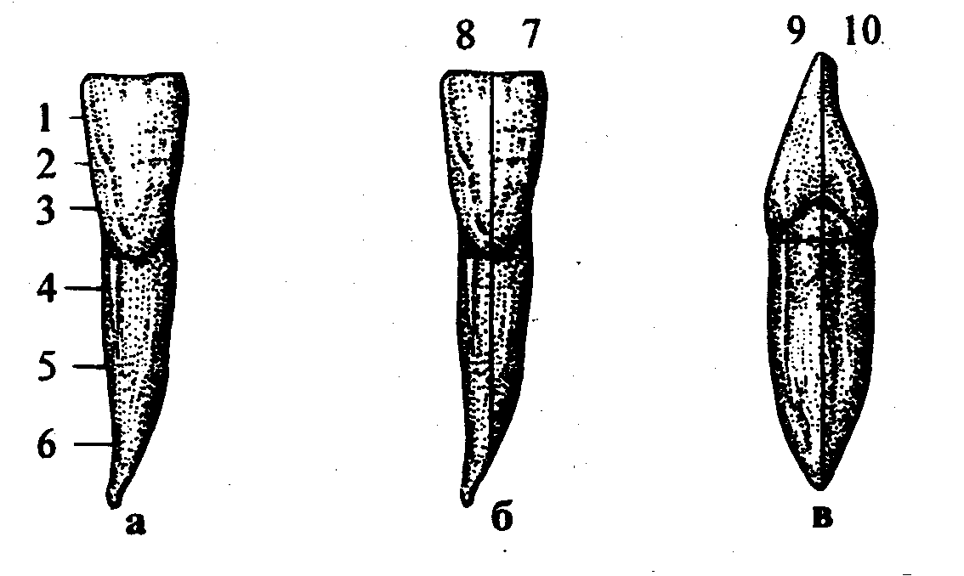
Parts of tooth

Slide 27
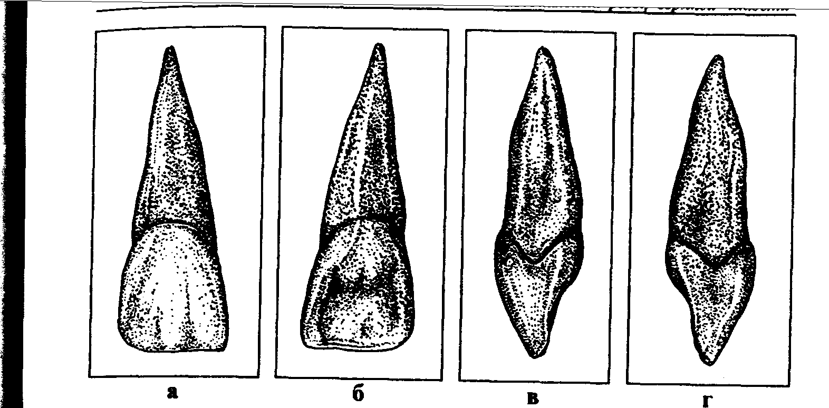
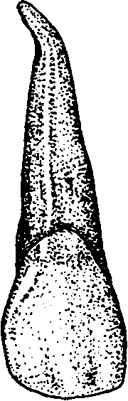
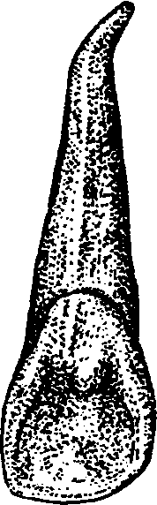
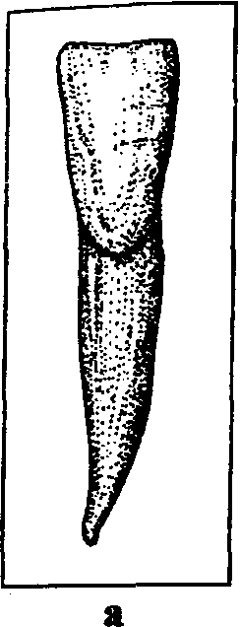
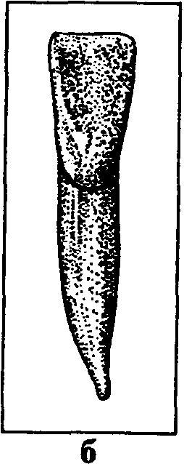
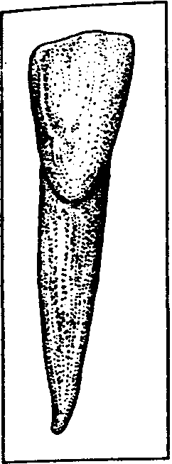
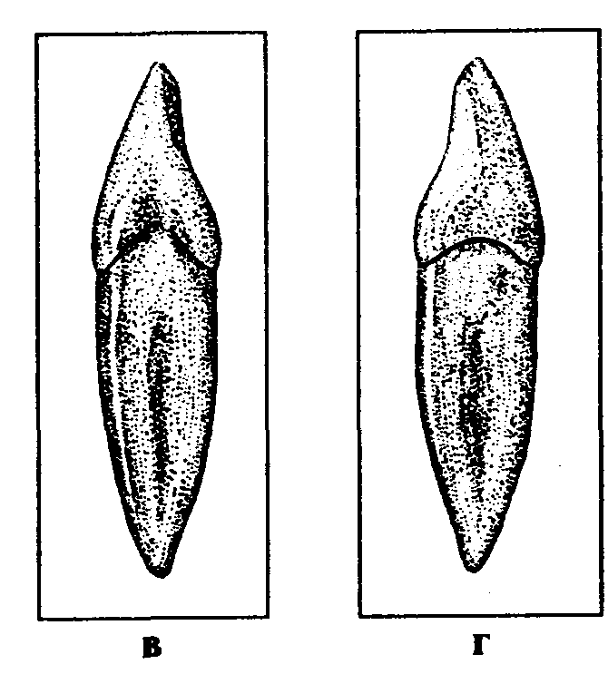
Incisors

Slide 28
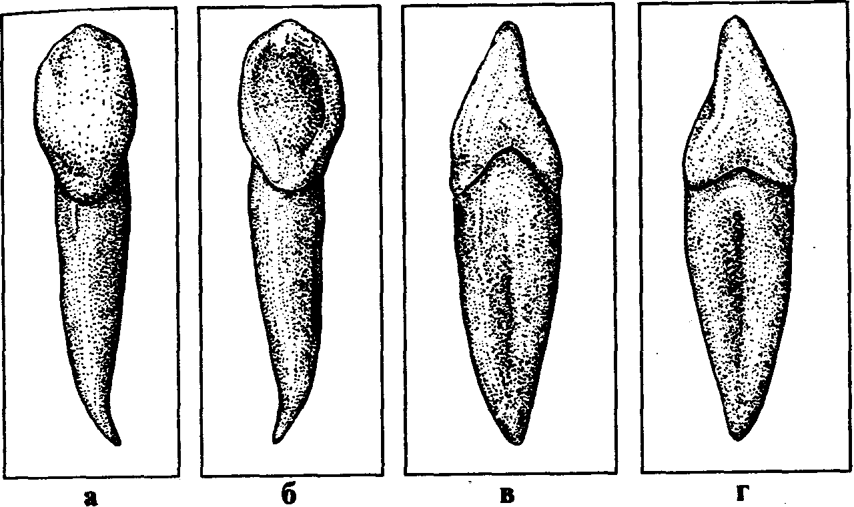
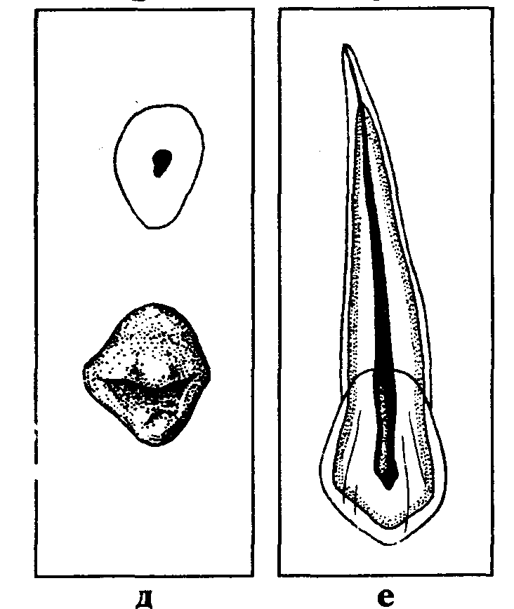
Canina

Slide 29
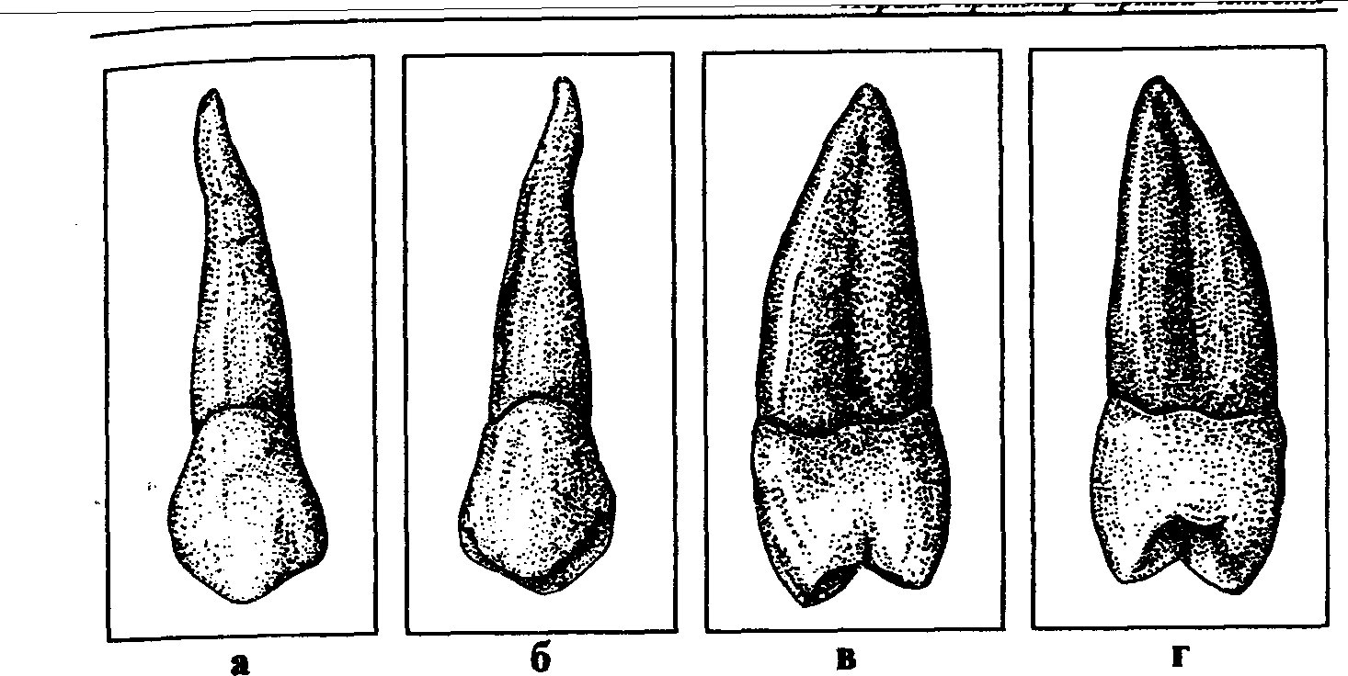
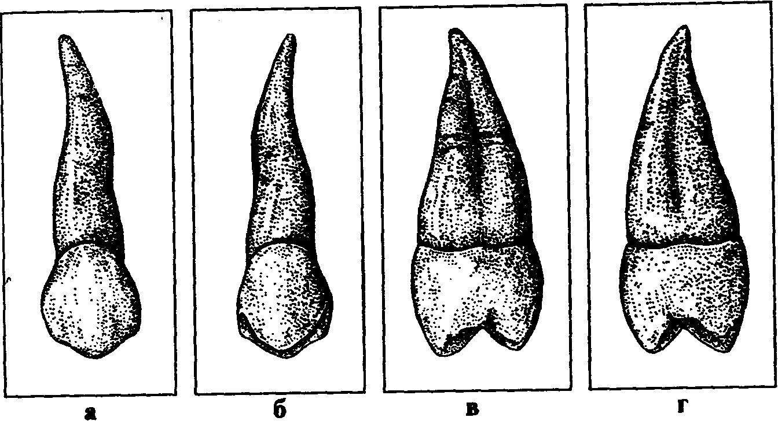
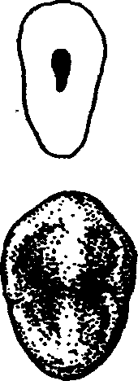
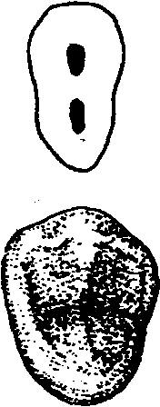
Upper premolars

Slide 30




Lower premolars

Slide 31



Upper molars

Slide 32


Lower molars

Slide 33

Thank you
for your time!

